Slide 1
An Introduction to Unconscious Bias
[Insert speaker’s names]
DD/MM/YYYY

Slide 2
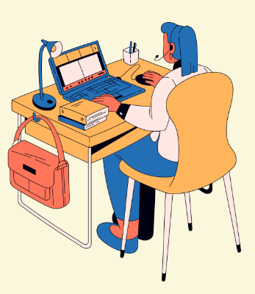
Learning objectives
To introduce the different types of bias and learn how to spot your own
To understand the importance of being aware of your unconscious biases
To learn how to apply good practice around unconscious bias in both social and professional environments
Notes:
The learning objectives for this session are as follows:
To introduce the different types of bias and learn how to spot your own
To understand the importance of being aware of your unconscious biases
To learn how to apply good practice around unconscious bias in both social and professional environments
ONLINE DELIVERY: If you have any questions you can raise your hand or use the chat function.
You will need something to write with (and on) for some of the tasks during this 50-minute session.

Slide 3
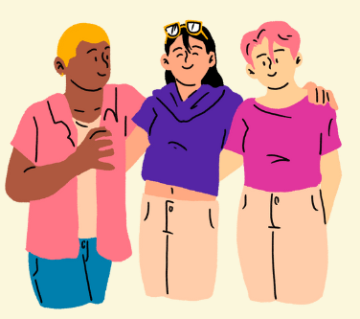
What is Unconscious Bias?
Notes:
[Ask students ‘What is unconscious bias?” and discuss answers]
Throughout our lives, every conversation we’ve had, film we’ve watched, and article we’ve read has influenced how we make decisions. Based on our own individual experiences, we will have formed impressions or stereotypes about people from certain cultures, educational backgrounds, gender or age. We may have found ourselves in situations that only reinforce the stereotypes that we have formed, whether we have wanted to or not.
A lot of this stereotyping happens subconsciously without us even knowing – and this is known as unconscious bias.

Slide 4
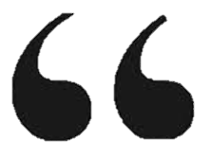
Unconscious bias is when we make judgments or decisions on the basis of our prior experiences, our own personal deep-rooted thought patterns, assumptions or interpretations, and we are not aware that we are doing it.
- The Royal Society
Notes:
The definition of unconscious bias by the Royal Society is this: "Unconscious bias is when we make judgments or decisions on the basis of our prior experiences, our own personal deep-rooted thought patterns, assumptions or interpretations, and we are not aware that we are doing it". (https://royalsociety.org/~/media/policy/publications/2015/unconscious-bias-briefing-2015.pdf)
Everyone has at one point or another experienced unconscious bias, whether as the victim of the perpetrator, and that is what we are going to talk about today

Slide 5
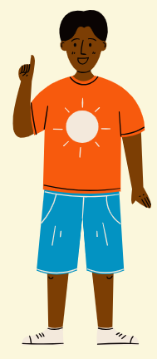
Can you think of a time when you made a snap judgement about someone that you later found to be correct?
Can you think of a time when you made a snap judgement about someone that you later found to be incorrect?
How did this make you/them feel?
Notes:
To put this into perspective:
Can you think of a time when you have made a snap judgement about someone that you later found to be correct?
[CLICK] On the flip side, can you think of a time when you have made a snap judgement about someone that you later found to be incorrect?
[CLICK] How did this make you or them feel?
These snap judgements are based upon our experiences of the world so far, and can change over time depending on our experiences.

Slide 6

Notes:
Unconscious Bias video – The Royal Society
https://royalsociety.org/topics-policy/publications/2015/unconscious-bias/

Slide 7
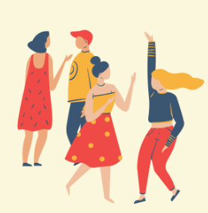
Unconscious or Implicit Bias?
Unconscious bias refers to a bias that we are unaware of, and which happens outside of our control. It is a bias that happens automatically and is triggered by our brain making quick judgments and assessments of people and situations, influenced by our background, cultural environment and personal experiences.
Notes:
There are two main categories of bias – unconscious bias and implicit bias.
Unconscious bias refers to a bias that we are unaware of, and which happens outside of our control. It is a bias that happens automatically and is triggered by our brain making quick judgments and assessments of people and situations, influenced by our background, cultural environment and personal experiences.
An example of this is making the unconscious assumption that when you go to see a doctor they are going to be male. Or being surprised when you hear a female voice announce that they are the captain of the flight you are on.

Slide 8
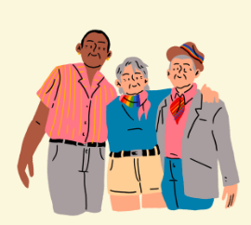
Unconscious or Implicit Bias?
Implicit bias refers to the same area, but questions the level to which these biases are unconscious, especially as we are being made increasingly aware of them. Once we know that biases are not always explicit, we are responsible for them. We need to recognise and acknowledge our biases and find ways to mitigate their impact on our behaviour and decisions.
Notes:
Implicit bias refers to the same area, but questions the level to which these biases are unconscious, especially as we are being made increasingly aware of them.
Once we know that biases are not always explicit, we are responsible for them. We need to recognise and acknowledge our biases and find ways to mitigate their impact on our behaviour and decisions.

Slide 9
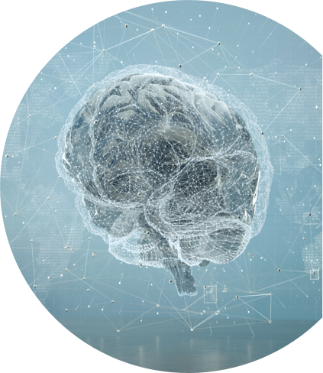
Unconscious bias is what helped our species to survive…
Without the brain's ability to subconsciously process thousands of pieces of information in an instant, our ancestors would have ended up as food.
35,000
choices made per day by the average person
Notes:
Unconscious bias isn’t all bad. It’s what’s helped our species to survive for so long. That gut feeling we get as to whether something is dangerous for us, where is safest to walk at night, whether we should be wary of that person who comes up to us on a night out, our unconscious bias is the thing that kicks in first.
We rely on our subconscious to make decisions quickly. [CLICK] If you do any google search you will find that on average we humans make 35,000 decisions per day. We need our subconscious or our unconscious to make a lot of these decisions on our behalf, otherwise we would never get anything done!
https://www.psychologytoday.com/gb/blog/stretching-theory/201809/how-many-decisions-do-we-make-each-day

Slide 10
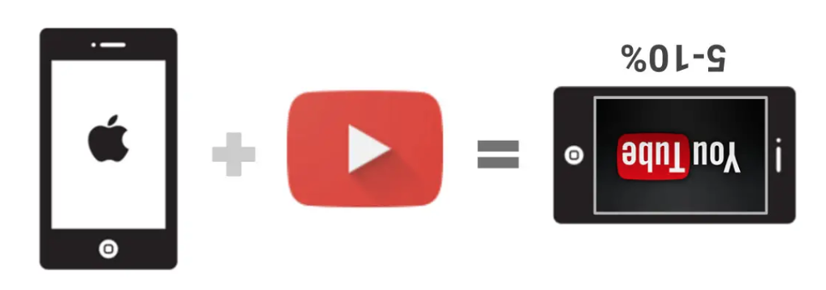
Unconscious bias is often manifested in non-malicious ways
Example: When YouTube launched its first app for Apple's iOS, 5-10% of videos appeared upside-down because the engineers had unconsciously optimised the app for right-handed users [1].
[1] N. Serra, "Unconscious Bias Agile Indy," 17 July 2017. [Online]. Available: https://www.slideshare.net/slideshow/unconscious-bias-agile-indy/77815328#13. [Accessed 15 July 2024].
Notes:
Not all unconscious bias happens as a result of malicious behavior. Sometimes biases happen by accident or come from a place of ignorance. When YouTube launched its first app for Apple's iOS, for example, 5-10% of videos appeared upside-down because the engineers had unconsciously optimised the app for right-handed users.
This is why it is important that your team is diverse when developing any new product. What this tells us about the developers of that app is that all of them were right-handed, when in fact around 10% of the population worldwide is lefthanded.

Slide 11
Non-malicious, Still Fatal
Women are 47% more likely to be seriously injured in a car crash
Women are 17% more likely to die in a car crash
69% of single person pedestrian injuries (in Sweden) were women
Invisible women : exposing data bias in a world designed for men: Caroline Criando-Perez, 2019

Slide 12
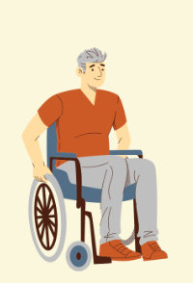
Data continued…
Soap for light skin only: https://reporter.rit.edu/tech/bigotry-encoded-racial-bias-technology
Facial recognition:
https://sitn.hms.harvard.edu/flash/2020/racial-discrimination-in-face-recognition-technology/
https://www.wired.com/story/can-apples-iphone-x-beat-facial-recognitions-bias-problem/

Slide 13
[Insert your department/course] Examples
Who is the secretary?
Who is the project leader?
Who gets heard and trusted?...

Slide 14

Activity 1
Write a list of 10 people who you really trust (not including family)
Most Trusted | Gender | Age | Ethnicity | Level of Education | Sexual Orientation | Disability?
Jennifer
Omar
Marianna
14
Notes:
I’m now going to give you a minute or two to write a list of 10 people who you really trust that are not members of your family. This could be friends, your doctor, a teacher, someone who works at the supermarket that you chat with every day, etc. People who you trust. You won’t have to share the names with anyone but the next part of the task relies on you having written something down.
[CLICK] Now I want you to complete the rest of these columns. I will give you a minute or so to do that.

Slide 15

Activity 1
Do you notice any trends?
Are the people on your list all the same gender?
Are they all of the same ethnicity?
Or educational background?
15
Notes:
Do you notice any trends – any similarities or differences?
Some of you might have noticed that everyone on your list is of the same gender? Or they’re all the same ethnicity?
You may find that you are unconsciously bias or implicitly biased to certain ages, ethnicities, educational backgrounds, etc.
[Give students opportunity/time to feed back OR pair together to discuss OR use embedded Microsoft forms on Panopto if pre-recording session]
It’s not uncommon for us to want to be around people who look and act like ourselves…

Slide 16
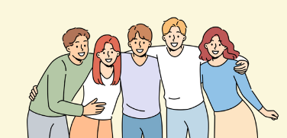
Ingroup and Outgroup
We have a positive bias towards our ingroup, and negative bias towards our outgroup.
We are familiar with members of our ingroup and feel on firm ground when judging their excellence and trustworthiness.
16
Notes:
What you've discovered from your lists is known as having an ingroup and an outgroup.
We have a positive bias towards our in-group, and negative bias towards our outgroup.
We can have an automatic dislike towards people who are not in our ingroup. This is important to be mindful of when you are sitting on an interview panel, for example. A lot of you will go on to work in industry or develop your own companies and what you want to make sure of is that you are not being biased to people who are like you – for example graduates who have studied at Imperial, went to the same school as you, grew up in your home town, like the same interests, have the same accents or family background – all of this means that you will be more favourable towards them and you might not end up making the right choice on who to hire, because you have let your biases influence your decision.

Slide 17
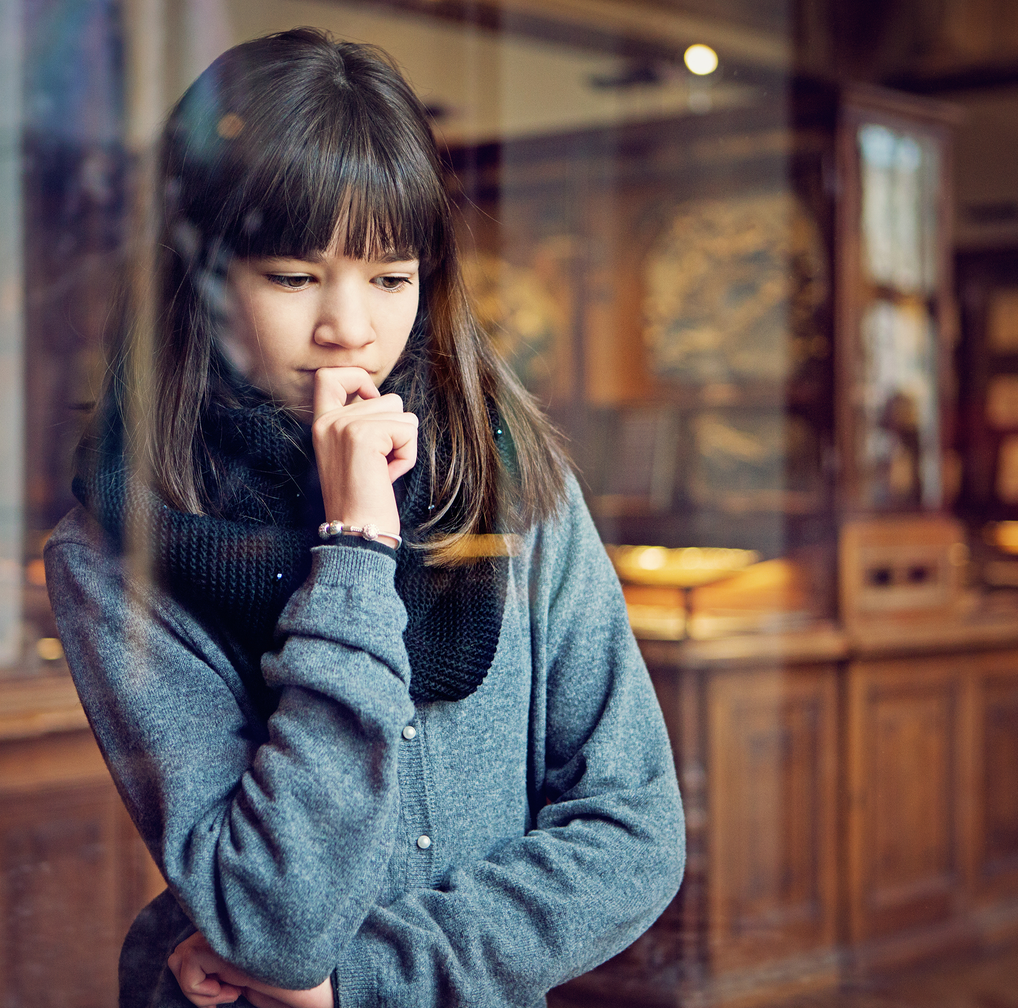
Bias is dynamic; it can be generated by exposure to new experiences, situations, images and narratives.
Stereotypes can also impact on our behaviour, even if we don’t believe in them…
17
Notes:
Our biases can however change over time, depending on new experiences.
When we travel to new places and come into contact with other cultures we can develop or dispel biases depending on how those experiences went.
Stereotypes are also quite interesting.
We see them everywhere – in films, books, popular culture.
They can be drilled into us so much that even if we personally don’t believe in them they can still heavily affect our judgement.

Slide 18
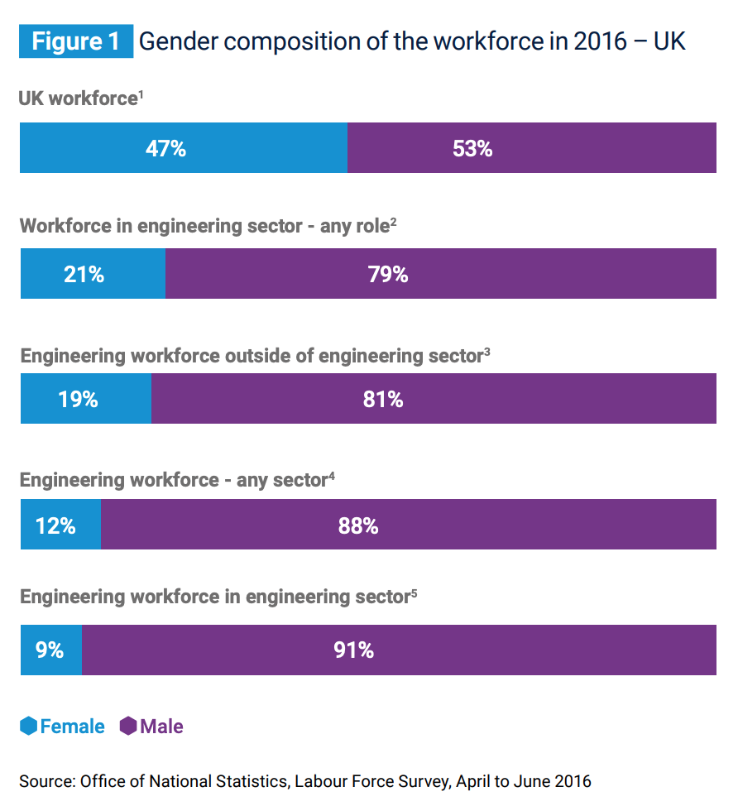


Just 12% of those working in engineering occupations were women compared with 47% of the overall UK workforce [2].
[2] EngineeringUK, "Gender disparity in engineering," 2018.
18
Notes:
These unconscious biases can create gender imbalances and cause lack of diversity - which is something we see in engineering and in the tech industry as a whole.
Only 12% of the UK’s engineering workforce are women. There can be many causes for this, but we cannot downplay the negative effect that stereotyping has on our field.
Stereotyping [subject, e.g. computing] as a male subject and developing an unconscious bias that men are better at [subject, e.g. computing] than women can steer girls away from choosing the subject at school. Of course for us here, we know that this is only a stereotype, and that men and women are equally as good at [subject, e.g. computing].
But what we see around us (i.e. more men than women, especially in leadership roles within engineering) can heavily reinforce that view.

Slide 19
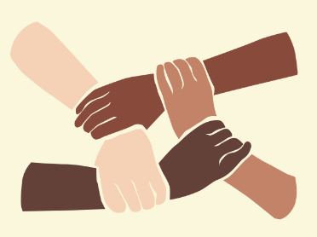
Diversity isn’t just ‘nice to have’…
Increasing the diversity of leadership teams leads to more and better innovation
Notes:
Diversity in any field is extremely important.
Research has proven that Increasing the diversity in leadership teams leads to more and better innovation.
Tech companies with mixed management boards are more successful, and those companies make more money overall.

Slide 20

Diversity is a competitive advantage
Complex problems are best approached by teams with a variety of perspectives
Notes:
Having a diverse team gives you a competitive advantage.
[Add subject/course specific example here]
Later on in the year when you are working in teams, carrying out your group projects remember this when you’re choosing who to work with.
It is hardly ever the strongest strategy to go for a team of people who all act and think like you, complex problems are best approached by teams with a variety of perspectives.

Slide 21

There are multiple ways that unconscious bias can creep into our decision-making processes…
21
Notes:
There are many different forms that bias can take

Slide 22
Confirmatory / Confirmation Bias
1.
A form of cognitive bias, based on expectations and experience [3]
[23 K. Straub, "Chainsawsuit," 16 September 2014. [Online]. Available: https://chainsawsuit.krisstraub.com/20140916.shtml. [Accessed 14 July 2024].
Notes:
Confirmation bias. Many of you will have come across confirmation bias before.
This is a form of cognitive bias, based on expectations and experience.
For example, you believe that the earth is flat. You google flat earth and the first thing you see is a blog by another flat-earther that completely agrees with your viewpoint and strengthens the argument that the earth must be flat. Because you have had your view confirmed you don’t bother looking for other information that gives evidence for why the earth is round. Your mind is made up, the evidence you found confirms it and no one can persuade you otherwise. Now you might think that having an ever-increasing number of flat-earthers may not seem very damaging to society, but if we think about confirmation bias throughout our history we know it can lead to mass genocide and a hatred of certain people and cultures. We need to be extremely careful. The more we educate ourselves on this and other types of bias the better.

Slide 23
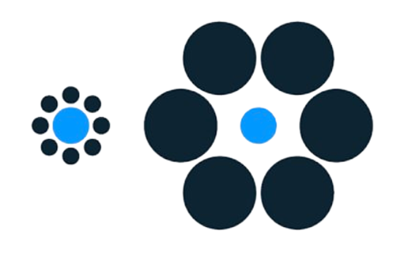
Activity 2
Which light blue dot is bigger?
23
Notes:
If you were to make a split second judgement, which light blue dot would you say was bigger? [CLICK]
Some of you may have seen this before. If we let our unconscious decide for us it might say that the dot on the left is bigger, when in fact [CLICK] they are both the same size.

Slide 24

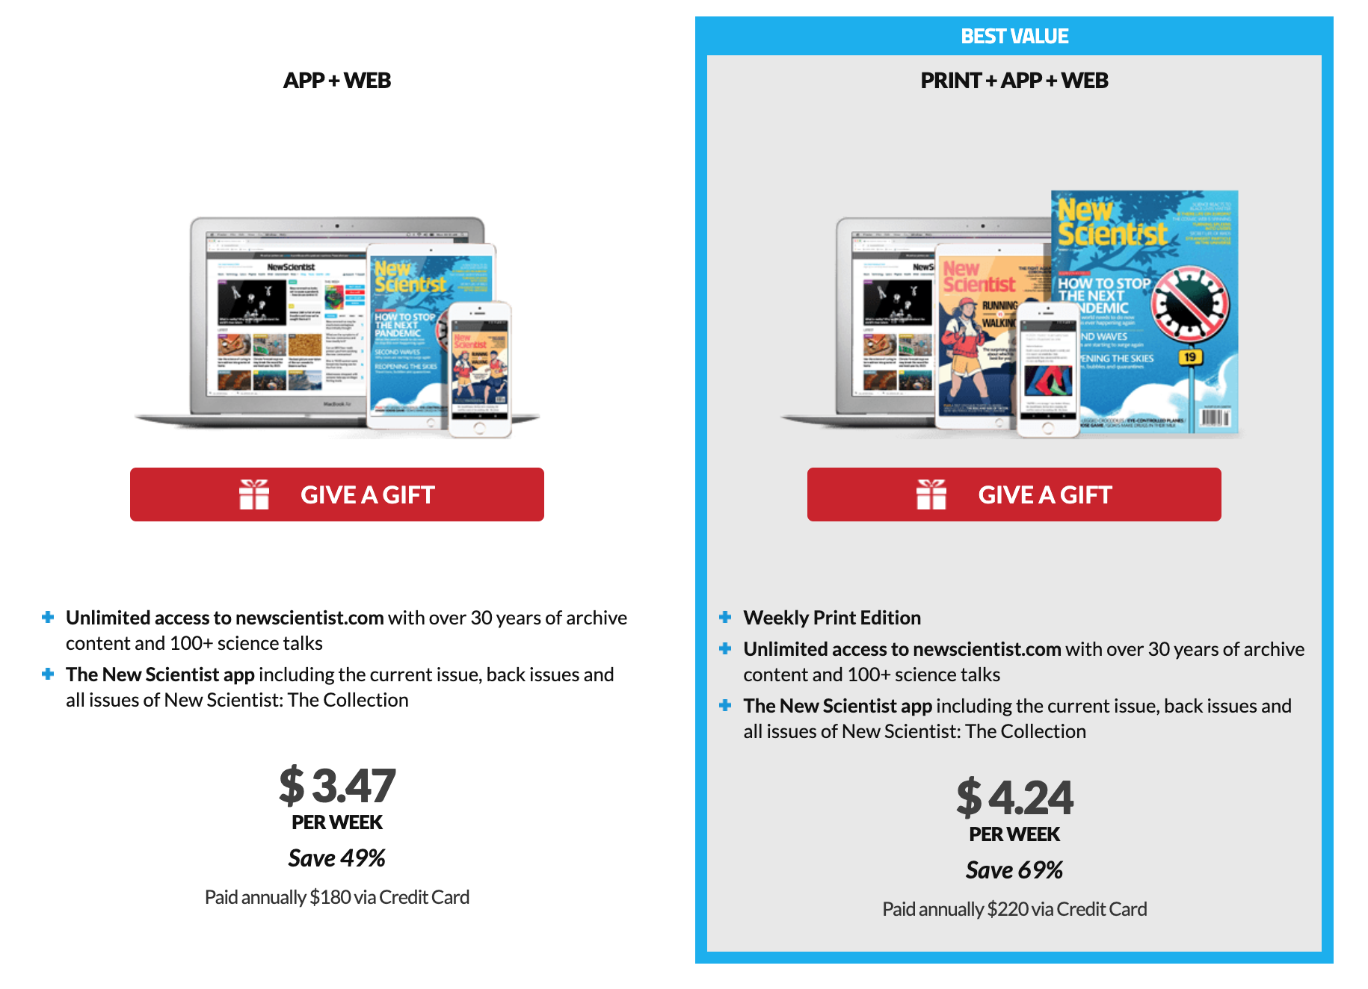
2.
Contrast Bias (The Contrast Effect)
[4] NewScientist, "Begin your journey of discovery," 2024. [Online]. Available: https://subscription.newscientist.com/packages/summer2024?promCode=21457,21488&packageCodes=TAP&offerCodes=51I,6M&skipTerms=51I,6M&gad_source=1&gclid=EAIaIQobChMI3JG0lLKmhwMVTJRQBh3p4AaWEAAYASAAEgJrQfD_BwE. [Accessed 14 July 2024].
Notes:
This is known as contract bias or the contrast effect and is a technique typically used in sales.
Sales people will often use the contrast effect by showing you a poor quality product alongside the one that they want you to buy.
They might also show you a wonderful product that is way beyond your reach. When you compare your ideal purchase with this, you are then likely to re-evaluate it upwards.
Sometimes this happens to you and you don’t even realise.
For example [CLICK] (example adapted from Dan Ariely‘s book, Predictably Irrational) take a look at this advert for a New Scientist magazine subscription. Almost all of us will agree that the best value deal is the one where you get print, app and web versions of the magazine for just a fraction of the cost more. We don’t have an inbuilt system of what constitutes as value, “we focus on the relative advantage of one thing over another, and estimate value accordingly.” (Dan Ariely)

Slide 25
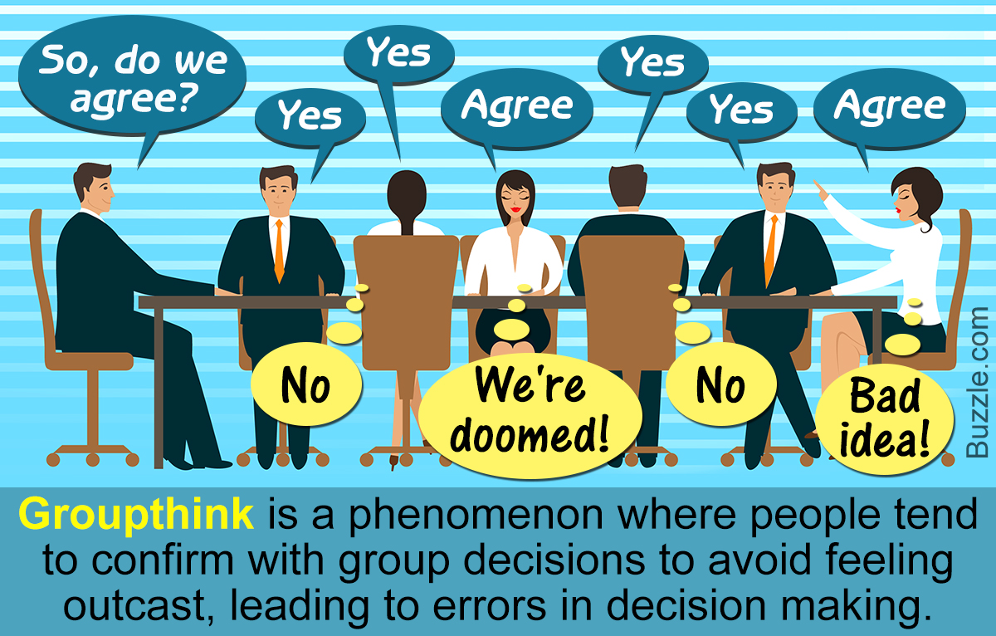
Groupthink
3.
Social pressure
for the consensus
[5] R. Kilmann, "Break the Vicious Cycle of Groupthink Using Assumptional Analysis," [Online]. Available: https://kilmanndiagnostics.com/break-groupthink-with-assumptional-analysis/. [Accessed 14 July 2024].
25
Notes:
A very common type of bias is groupthink, and we see this all the time.
This is when everyone is in a meeting for example and one person says they agree. Now, you're thinking that you don’t agree at all, but by the time it gets to you to share your thoughts the four people before you have agreed that they agree and now you’re questioning your decision.
Groupthink is the social pressure for the consensus and can cause massive problems.
When working in groups throughout your degree please consider this and try not to let groupthink affect your work. This is honestly how so many people go along with something they don’t agree with for so long and it never ends well. Good practice would be to each write down your thoughts or share them using an anonymous platform and then have the discussion.

Slide 26
Activity 3
26
Notes:
Read out loud the words in order on this slide [Click]
Easy right? Now do the exact same thing with the next slide but this time reading out the colours rather than the words. Ready? [Next slide]

Slide 27
Activity 3
27
Notes:
Go! [Read along with students (out loud)]
For this one you should have felt that a different level of effort was required.
Even if it was only small, more effort was needed to stop your brain being distracted by the redundant information.
We call this selective attention.

Slide 28
Selective Attention
Attentional bias involves the tendency to pay attention to some things while simultaneously ignoring others.
[6] P. Muth, 9 March 2015. [Online]. Available: https://www.linkedin.com/pulse/dresses-confirmation-bias-education-parke-muth. [Accessed 14 July 2024].
28
Notes:
Even though you might have found the last task effortless, your brain had to switch a gear to really pay attention to what was happening.
Attentional bias involves the tendency to pay attention to some things while simultaneously ignoring others.
So this could be as innocent as not hearing your parents call you down for dinner when you’re playing on your games console to as damaging as only considering the opinions of your male colleagues - or your white colleagues - and not paying attention or selecting not to pay attention to your black or female peers.

Slide 29
How does unconscious bias manifest itself?
Our attitudes are shaped by cultural values, listening to conversations, reading stories, the media, etc.
Our unconscious brain is constantly looking for patterns.
When the unconscious brain experiences two things occurring together, it begins to expect them to be seen together. As a result, other patterns or combinations feel less ‘normal’ and become more challenging to process.
If ignored, this can lead to lazy stereotypes and discriminatory behaviour.
Notes:
I’ve mentioned before that our attitudes are shaped by cultural values, listening to conversations, reading stories, the media, etc.
Our unconscious brain is constantly looking for patterns because it wants to speed up decision making for us – which is great!
When the unconscious brain experiences two things occurring together (e.g. many male senior managers or many female nurses), it begins to expect them to be seen together all the time. As a result, other patterns or combinations feel less ‘normal’ and become more challenging to process.
If we ignore this and we don’t acknowledge our unconscious biases it can lead to lazy stereotypes and discriminatory behaviour.

Slide 30
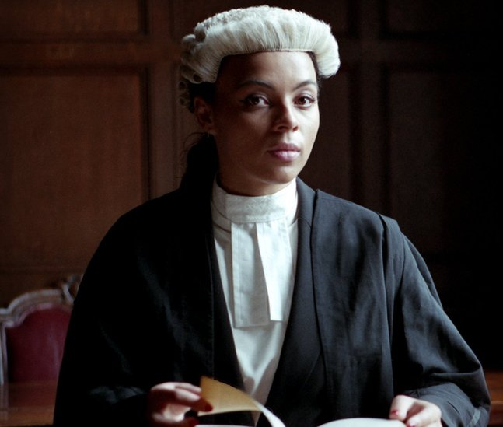
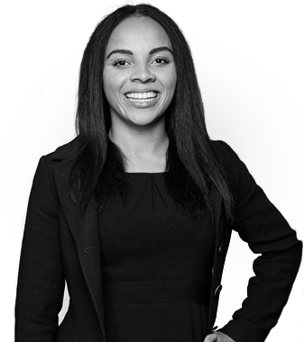
30
Notes:
This is Alexandra Wilson. Last year while she was trying to do her job she got stopped on three separate occasions while trying to walk into a courtroom.
Upon arrival, a security officer asked for her name and then searched for it on a list of defendants.
After meeting her client, she tried to enter a courtroom to discuss the case with the prosecutor, and another barrister sitting at the back of the court told her to go outside and wait and to sign in with the usher for her case.
She was then stopped and questioned a third time when trying to enter the room again.
This is a classic example of a lazy stereotype. Assuming that because she is a Black woman she cannot possibly be the lawyer.
(link to article: https://www.theguardian.com/law/2020/sep/24/investigation-launched-after-black-barrister-mistaken-for-defendant-three-times-in-a-day)

Slide 31
First impressions and stereotypes
Have you ever experienced someone making an assumption about you?
What do you think the assumption was based on?
Was it accurate?
Can you think of any examples of stereotyping you have encountered, either professionally or personally?
Is there such as thing as a positive stereotype?
Notes:
First impressions and stereotypes can be extremely unhelpful and exhausting for the people who are continuously targeted
Just a few things for you to think about:
[CLICK EACH ONE INDIVIDUALLY AND DESCRIBE]
Have you ever experienced someone making an assumption about you?
What do you think the assumption was based on? Your accent, the colour of your skin, the way you dress?
Can you think of any examples of stereotyping you have encountered, either professionally or personally? If you haven't you’re either very lucky or you are using your attention bias to ignore what is happening around you, in other words you’re not tuned in.
Is there such as thing as a positive stereotype? No, although there is positive role modelling or positive action to encourage more people from underrepresented groups to pursue certain careers for example, by seeing someone like them.

Slide 32
We are all affected by unconscious bias
The ability to quickly and automatically categorise people according to social and other characteristics is a fundamental quality of the human mind.
Although we all like to think we are openminded and objective, we are heavily influenced in ways that are completely hidden from our conscious mind in how we view and evaluate both others and ourselves.
32
Notes:
You might think that you are the most unbiased person in the world, that this session is not for you and that you are a perfect little angel. Unfortunately everyone is affected by unconscious bias.
As humans, we like to categorise things, and this includes people. Putting them into boxes that make sense to us.
With your age, gender, ethnicity, and this goes all the way back to the times of Sir Frances Galton, the brother of Charles Darwin, who came up with the concept of eugenics and looked for a way to categorise us all.
The ability to quickly and automatically categorise people according to social and other characteristics is a fundamental quality of the human mind. Although we all like to think we are openminded and objective, we are heavily influenced in ways that are completely hidden from our conscious mind in how we view and evaluate both others and ourselves.

Slide 33
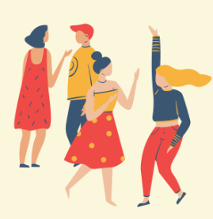
Practical steps you can take to reduce the impact of bias
33
Notes:
So we’ve heard about the different types of bias and how these impact our decisions and opinions of ourselves and others, and hopefully you’ll leave this lecture with a motivation to explore your own biases in more depth, but having done that, what are the practical steps that we can take to reduce the impact of our biases and the biases of others?

Slide 34
Bias and our actions
Perception – how we see people and perceive reality.
Attitude – how we react towards certain people.
Behaviors – how receptive/friendly we are towards certain people.
Attention – which aspects of a person we pay most attention to.
Listening Skills – how much we actively listen to what certain people say.
Micro-affirmations – how much we comfort certain people in certain situations.
34
Notes:
We can take action to change our behaviours:
how we see people and perceive reality.
how we react towards certain people.
how receptive/friendly we are towards certain people. (the different reactions we have to our ingroup and our outgroup) – this we might not even know we are doing and sometimes we need to hear this from a friend or peer to realize our behaviour is different.
which aspects of a person we pay most attention to.
how much we actively listen to what certain people say.
how much we comfort certain people in certain situations. (If your female friend is upset for example you might put an arm around them to comfort them, or give them a hug, but would you automatically do the same for your male friend? Or would your reaction be different? Why is this?)

Slide 35
Conditions under which bias has most impact:
1
Under pressure
4
Need to reach closure
2
High cognitive load
5
Overall impressions
3
Drugs and alcohol
6
Tiredness
Notes:
Sometimes we become overworked, tired, under a lot of pressure, and the more we try to multitask and cram things in the more our unconscious tries to help us and it can lead to bias.
The need to reach a decision very quickly, especially when it is coming up to lunch or dinner time can make your bias kick in.
These conditions are when your biases are most likely to kick in so if we are aware of that we can compensate and make sure we get enough sleep, food or time to make those important decisions.

Slide 36
You can reduce the chance you will act on bias by:
Taking your time to make decisions
Avoid multitasking when trying to make a decision about someone/something
Avoid acting on your gut instinct when making a decision about someone
Spend a bit more time getting to know people before you judge them
Avoid making important decisions when you’re tired
Question cultural stereotypes that seem truthful. Be open to seeing what is new and unfamiliar and increase your knowledge of other groups.
You can detect unconscious bias more easily in others than in yourself so be prepared to call out bias when you see it
Notes:
You can reduce the chance you will act on bias by:
Taking your time to make decisions
Avoid multitasking when trying to make a decision about someone/something
Avoid acting on your gut instinct when making a decision about someone
Spend a bit more time getting to know people before you judge them
Avoid making important decisions when you’re tired
Question cultural stereotypes that seem truthful. Don’t take things at face value. Be open to seeing what is new and unfamiliar and increase your knowledge of other groups. Have open conversations to help understand.
You can detect unconscious bias more easily in others than in yourself so be prepared to call out bias when you see it

Slide 37

“But I’m not biased!”
Yes you are…
… We all are!
37
Notes:
The point of this lecture is not to agree to whether you think you are biased or not, or to feel like a bad person, [CLICK] it is to acknowledge your biases and act on them to reduce any impact they might have on your life, both personal and professional.

Slide 38
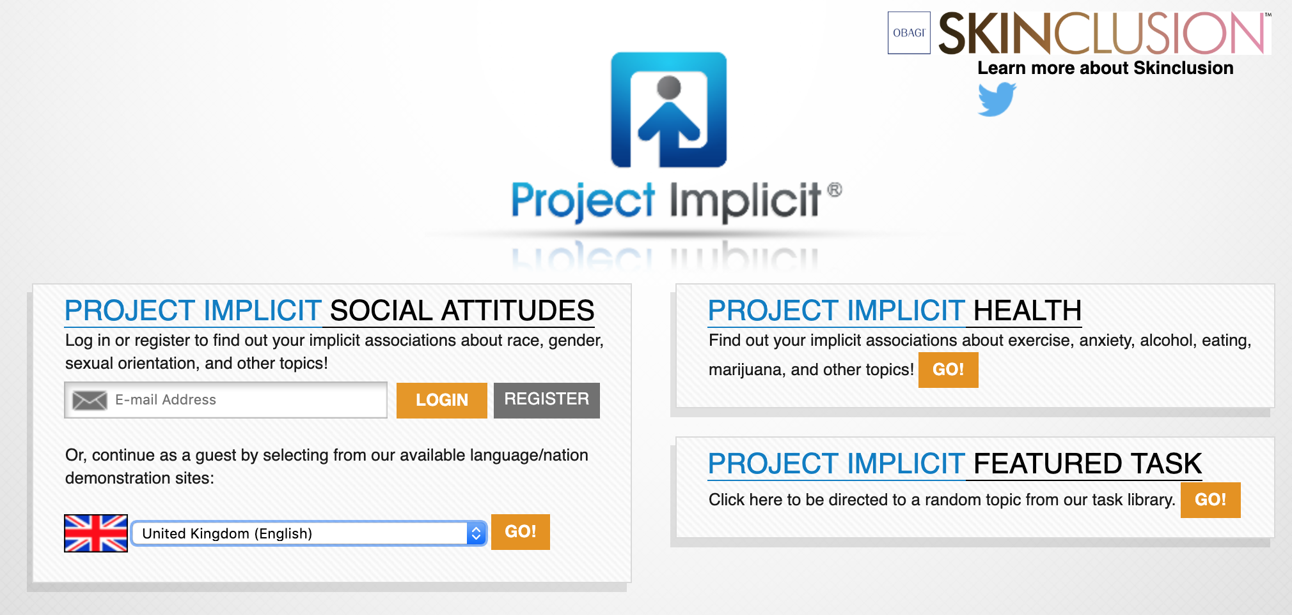
Get to know your biases: take an Implicit Association Test
38
Notes:
You can get to know your biases by taking an implicit association test, and there are many of these about. And it might be that you find you only have a slight bias towards young people for example, and a huge bias against people who are carrying a bit of extra weight.
[If running online, pause video and take test(s) – report back using MS Forms whether anything surprised you]
(link to test: https://implicit.harvard.edu/implicit/takeatest.html)

Slide 39
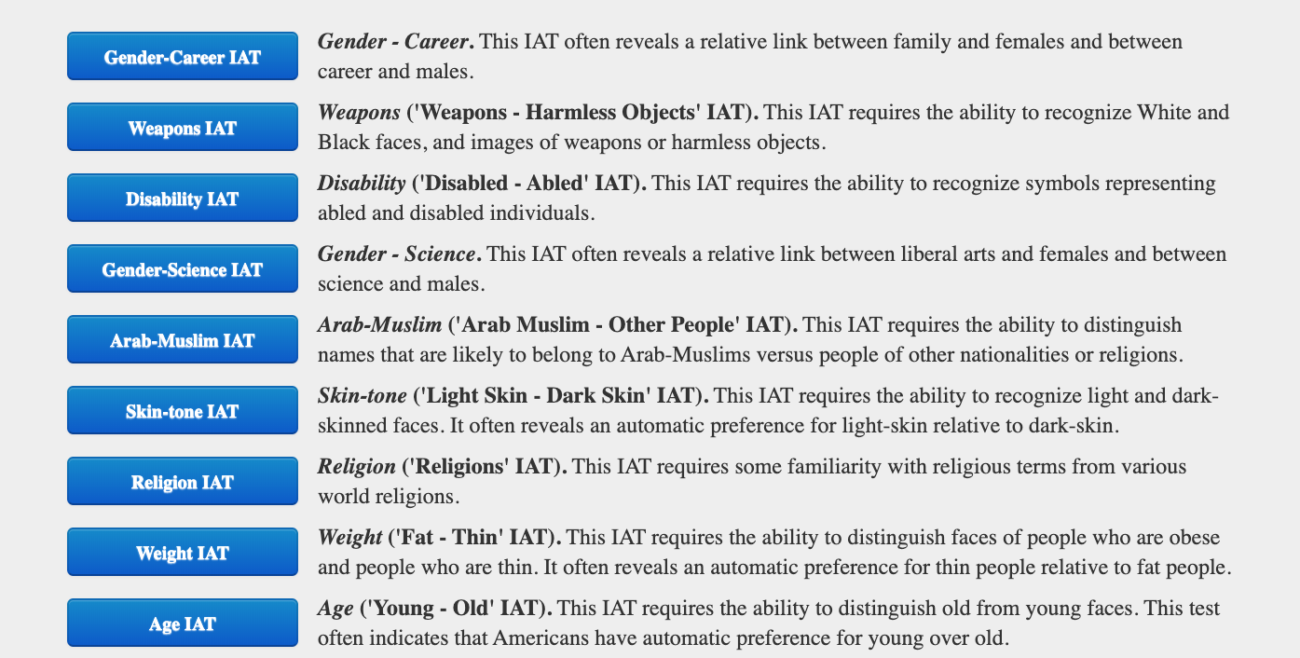
39
Notes:
These tests will help you determine where your areas for improvement lie.
It’s quite interesting to check really so I would definitely advise to have a look
(link to test: https://implicit.harvard.edu/implicit/takeatest.html)

Slide 40
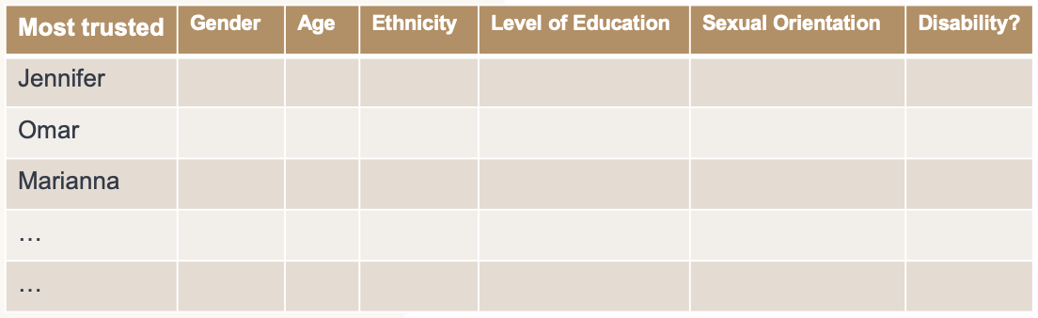
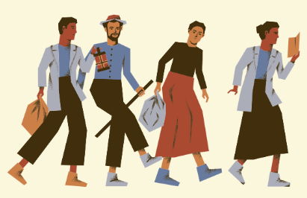
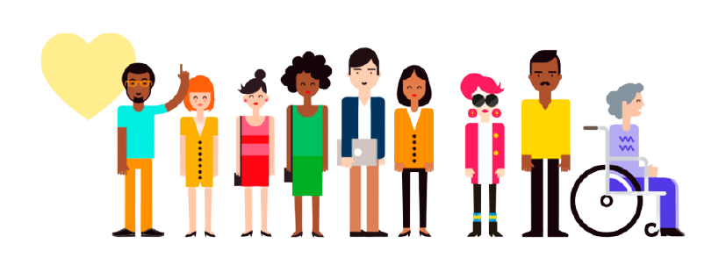
Develop a diverse personal network and avoid simply talking to the same people all the time
Notes:
If you found from the task earlier that you have a very narrow diversity of trusted friends, perhaps you can try developing a diverse personal network and avoid simply talking to the same people all the time.
This is something you can improve by joining different societies, clubs, trying something new and out of your comfort zone, meeting people from other cultures and when choosing who to work with on joint assignments perhaps go for someone you haven’t worked with before, who is a little different from yourself.

Slide 41
Hold yourself accountable
Bias is UNAVOIDABLE
Question first impressions
Justify your decisions
Ask for feedback
Hold others accountable
Make others justify decisions
Make decisions collectively
Create a culture of calling out bias – become an ‘active bystander’
Notes:
In summary, bias is unavoidable.
HOWEVER, as we’ve discussed you can make an effort to acknowledge your unconscious biases and transform these into implicit ones - then you can work towards fixing these using some of the techniques we have discussed and will develop further throughout the year.
A first step is to hold yourself accountable: Question first impressions, justify your decisions and ask for feedback from friends and peers.
At the same time, hold others accountable for their biases and actions too. You might be the one to bring an unconscious bias to their attention.
Make others justify decisions so both you and they know they haven’t been made on the basis of bias.
Make decisions collectively (remembering best practice to acknowledge and eliminate group think where possible)
Create a culture of calling out unconscious bias – become an ‘active bystander’ – if you see something uncomfortable you have a duty to step in and do something about it. However not everyone feels comfortable doing this and there are a range of techniques that you can use - this is something that we will meet again to discuss later in the year.

Slide 42
Activity 4
Write down three things you have taken from today’s lecture
Write down three things you are going to do as a result of today’s learning
(E.g., read more about …, change my behaviour by …)
42
Notes:
[If pre-recording, can also use an embedded MS form to collect results – then follow up in Spring Term to see if any action has been taken]]

Slide 43

Learning objectives
To introduce the different types of bias and learn how to spot your own
To understand the importance of being aware of your unconscious biases
To learn how to apply good practice around unconscious bias in both social and professional environments
Notes:
Today we covered the following learning objectives:
To introduce the different types of bias and learn how to spot your own
To understand the importance of being aware of your unconscious biases
To learn how to apply good practice around unconscious bias in both social and professional environments
Hopefully, you have found that this session has provided an introduction to each of these objectives.

Slide 44
Thanks for listening!
[Insert speaker’s names]
[Insert email address and contact information]
Notes:
Thank you for listening. If you have any questions please do not hesitate to reach out to me on the contact details displayed.

Slide 45
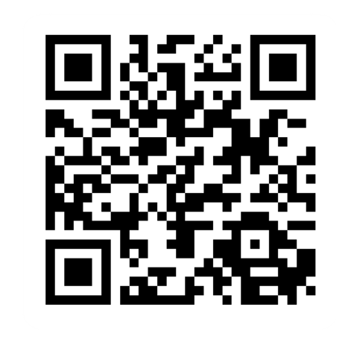
Provide feedback!
https://forms.office.com/e/pHBZpniFvB
If you used this resource, please take the time to fill out this form to provide your feedback.
If you have any questions or require more information about the REET (Resources for Embedding EDI in Teaching) project, please contact the Project Lead using the following contact details:
Chloe Agg c.agg@imperial.ac.uk

