Slide 1
Managing your project, and your wellbeing, in diverse ways
[insert speaker’s name]

Slide 2
[insert speaker name and contact details]
[insert background to speaker]

Slide 3
Student Mental Health
21.5% of student have a mental health diagnosis
64% of “failing” students cite mental health as the primary reason
52% say mental health has deteriorated since COVID
The Insight Network and Dig-In, 2019
Changing Futures, Andrews, J. & Clark, R. 2017
NUS survey in December 2020

Slide 4
Student Disability
STEM UGs with a known disability was 15.5% in 2018/19
(this has approximately doubled since 2007/8)
Students with a known disability are less likely to achieve first or upper second-class honours compared to STEM qualifiers with no known disability.
Male STEM UGs reporting a social communication/autistic spectrum disorder are least likely to achieve a 1st / 2.1 (in 2018/19)
Of students who did not complete their undergraduate degree in 2017/18, only 7.5% had no known disability
https://royalsociety.org/-/media/policy/topics/diversity-in-science/210118-disability-STEM-data-for-students-and-staff-in-higher-education.pdf

Slide 5

Managing your project:
What, What and How?
Image credit: Aleks Dorohovich from Unsplash

Slide 6
Managing your Project
What are you managing in your projects?
Budget
Risk
Time
Tasks
How are you managing your projects?
Logbooks
Gantt charts
Kanban / Trello / etc.
Notes:
DONE

Slide 7
Engineering Council
Chartered Engineers shall:
“Plan the work and resources needed to enable effective implementation of a significant engineering task or project”
“Manage (organise, direct and control), programme or schedule, budget and resource elements of a significant engineering task or project”

Slide 8

Risk Management –
Mind What Gap?
Image credit: Miquel Parera from Unsplash

Slide 9
Journalling = Logbooks?
Student centred
Own environment / own voice
Recognised wellbeing methodology
Tillapaugh, D. and Haber-Curran, P., 2013. At the intersection of leadership and learning: a self-study of using student-centered pedagogies in the classroom. Educational Action Research, 21(4), pp.519-531.

Slide 10
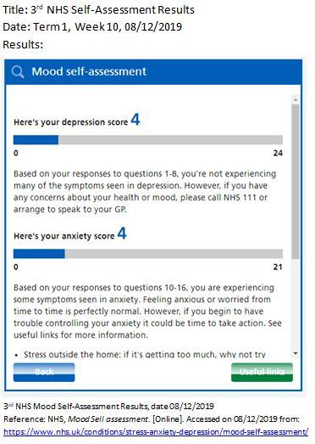
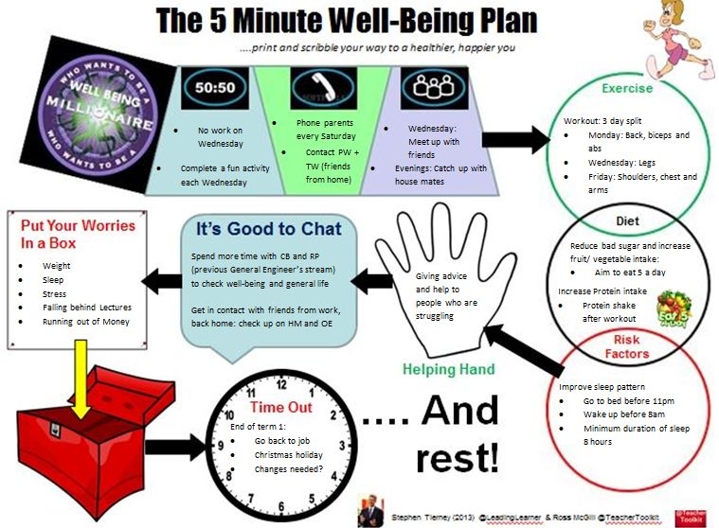
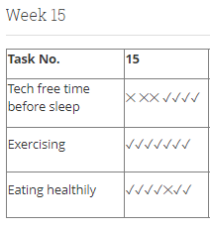
Wellbeing Management
Examples of methods used in Warwick projects

Slide 11
Wellbeing
Deming Cycle:
Plan
Do
Check
Act
Notes:
DONE

Slide 12


Beyond wellbeing and mental health
Diverse project management
Writing
Notes:
DONE

Slide 13
Meetings
Structure
Ground rules / expectations
Preparatory Emails
Location
Online / In Person
Agendas / Minutes
Territory
Noise
Access
People
Group or 1-1
Learning Mentors
Study Buddy
2nd Supervisor
Format
Notes:
DONE

Slide 14
Notetaking / Writing
Meeting Recording
Follow up emails / notes
Notetaking pauses
Templates / Exemplars
Organisation / Procrastination
Regular Meetings
Pre/Post meeting prep slots
Calendar scheduling
Pomodoro
Task lists / apps
Notes:
DONE

Slide 15
Tools
Organisation and time management
Outlook
OneNote
Writing, planning and proofreading
MindView
Grammarly
Reading
ClaroRead
AT Bar
Strict Workflow
Notion
XMind 8
Microsoft Lens
Spellex
Global Autocorrect
Dictation.io
MyScript Maths Sample
Photomath
EquatIO
Post-it app
Microsoft Immersive Reader
Colour Veil
Notetaking
Audio Notetaker
OneNote
Notability
Research and Referencing
Zotero
ClaroCapture
Weava
Procrastination and stress management
Mind Shift
Habitica
Stay Focused
Catch It
Workrave
Mynoise.net
Focusmate
Forest
Notes:
DONE

Slide 16
Find Your Way
Experiment & Refine
Give
(& Get) Feedback
Use Your Network
Communicate Your Needs
Notes:
DONE

Slide 17
Ensuring Project Diversity
Datasets
Journals
Cited Authors
Surveys
Standards
…?

Slide 18
Call to action…
…make a change!
[insert speaker’s contact details]
Notes:
DONE

Slide 19
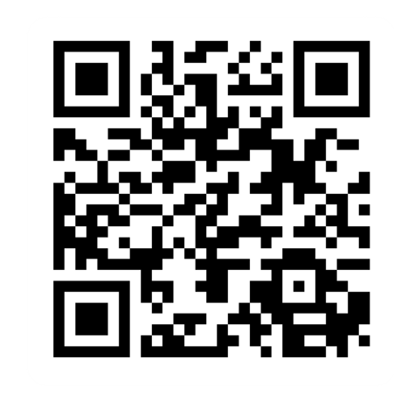
Provide feedback!
https://forms.office.com/e/pHBZpniFvB
If you used this resource, please take the time to fill out this form to provide your feedback.
If you have any questions or require more information about the REET (Resources for Embedding EDI in Teaching) project, please contact the Project Lead using the following contact details:
Chloe Agg c.agg@imperial.ac.uk

