Slide 1
Teamwork and Leadership with MCQ
[Insert speaker’s names]

Slide 2
Recap / Position Update
Teamwork and Leadership with MCQ
Overview
Intro
CPD & CVs
EDI
EDI + Ethics
EDI + Test
Teamwork
Teams + Leaders
Teams + Test
Decisions
Decisions + Quality
Decisions + Test
Support
Essay Planning
Wrap Up
Notes:
Last lecture:
Recognise the importance of teamworking skills
Identify and appraise attributes of successful teams
Develop a plan to improve you own teamworking skills
Select diverse teamworking methodologies
Define leadership and types of leader

Slide 3
Session Learning Outcomes
Teamwork and Leadership with MCQ
Application and evaluation of techniques learnt earlier in the module
  Reflection
  Professional Development
  Teamwork
Compare and summarise team formation methodologies

Slide 4
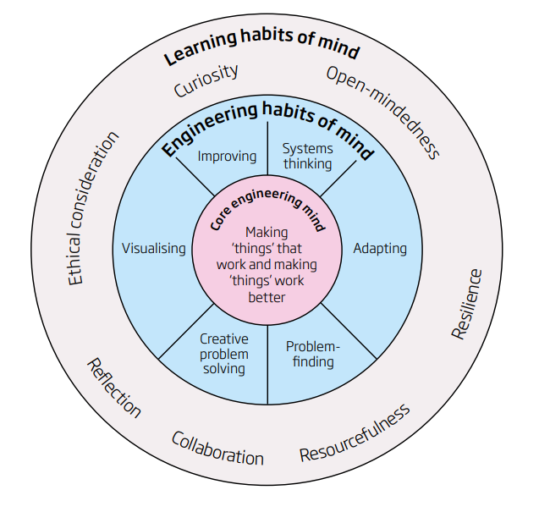
Skills
Teamwork and Leadership with MCQ
Example of thinking like an engineer
Royal Academy of Engineering
May 2014
Lucas, B., Claxton, G. and Hanson, J. (2014). Thinking Like an Engineer: Implications for the education system.
Notes:
Have you used skills/habits which are shown on the diagram? Do you think that your skill levels in any of these have developed? Some are fairly likely that everyone will have used, such as "creative problem solving" and hopefully also "collaboration", others though may not have been used by all team members, or perhaps even no-one in your team used them?
Can you think of any skills/habits from the diagram which you didn't use?
It is likely that few of you thought about ethics last week. How could you have brought ethics into your work?
What about reflection? Again, I imagine that not everyone has used reflective practice over the last couple of weeks. Did you write/say that after a coursework submission was a good time to reflect? Did you stick to this? If not, did you use your logbook?

Slide 5
Teamwork
Teamwork and Leadership with MCQ
Forming
Storming
Norming
Performing
Tuckman’s model of team development, 1965

Slide 6
Teamworking Methodologies - Ideation
Teamwork and Leadership with MCQ
Round Robin:
Fishbowl:
Discussion Group
Observers / Note Takers
Idea
Idea + 1
Idea + 2
Idea + 3
Idea + 4
Notes:
Thinking about the start of the week, how did you come up with ideas for solutions? Did you find that everyone contributed? Did you use the methodologies shared last lecture?:
If you did use them, did they change the group dynamic or the number of ideas created
For those of you who didn't use them, did you find that you had "enough" ideas and that you were able to generate these quickly? Did you find everyone participated in ideation? Did everyone then have a sense of ownership over the final idea?
What will have happened for some of you is that you may have done some of these things informally without recognising it; did you find some group members came up with ideas whilst others made notes? This is the beginnings of fishbowl. Did you find that some people came up with initial ideas and others built on/added to these? This is the beginnings of round robin.

Slide 7
Skill levels in teamwork
Teamwork and Leadership with MCQ
Contribution
Working independently
Aligned individual goals / someone else’s goal
Cooperation
Working together
Aligned individual goals / someone else’s goal
Collaboration
Working together
Shared ownership / goals
Notes:
Thinking now about the end of the week, how were your team working together? What skill levels had been developed and were now being shown?
Did you manage to reach collaborative working practices, honestly? Were the goals shared and did everyone have ownership of these or were you working together on goals set by Idris, your design tutor or 1 member of your team? Many teams were perhaps cooperating rather than truly collaborating. This is hard to achieve in only a week though
Were you even working together, or were tasks delegated and progressed independently? Some teams, particularly those with unresolved conflict, may have remained at a "contribution" level; how could you have improved on this if this was how your team worked?

Slide 8
Teamworking key concept reminders
Teamwork and Leadership with MCQ
Team vs Task Work
Rotating Roles
Management / Leadership
Inclusive Practices
Document Control

Slide 9
Reflection – 5 R’s
Teamwork and Leadership with MCQ
Reporting
Relating
Reasoning
Reconstructing
Responding
What happened? What was the context?
How does this link to your current knowledge and skills?
Why did this happen? What significant factors or theories were at play?
How can you change your practice for the future?
What did you observe? How did you feel? What do you think about this?
University of Edinburgh (2018). Reflecting on experience. [online] The University of Edinburgh. Available at: https://www.ed.ac.uk/reflection/reflectors-toolkit/reflecting-on-experience.
‌
Notes:
To think about our leadership, but also all of the teamworking skills we used (or ought to have used) last week, we can go back to the reflection frameworks we learnt about in lecture 2. I've included the 5 R's, but you may want to revisit other methods if you preferred them
Talk about the 5 R’s

Slide 10
Activity 1
Teamwork and Leadership with MCQ
In your head, think of an incident or outcome you would like to improve on;
    What happened?
    Why did this happen / how does this relate to theory?
    What have you learnt?
In the forum:
    What will you do differently in the future?
[insert QR code to a forum / menti for students to share their thoughts]

Slide 11
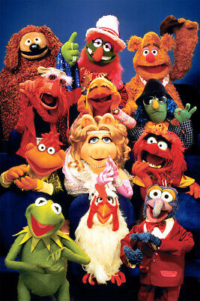
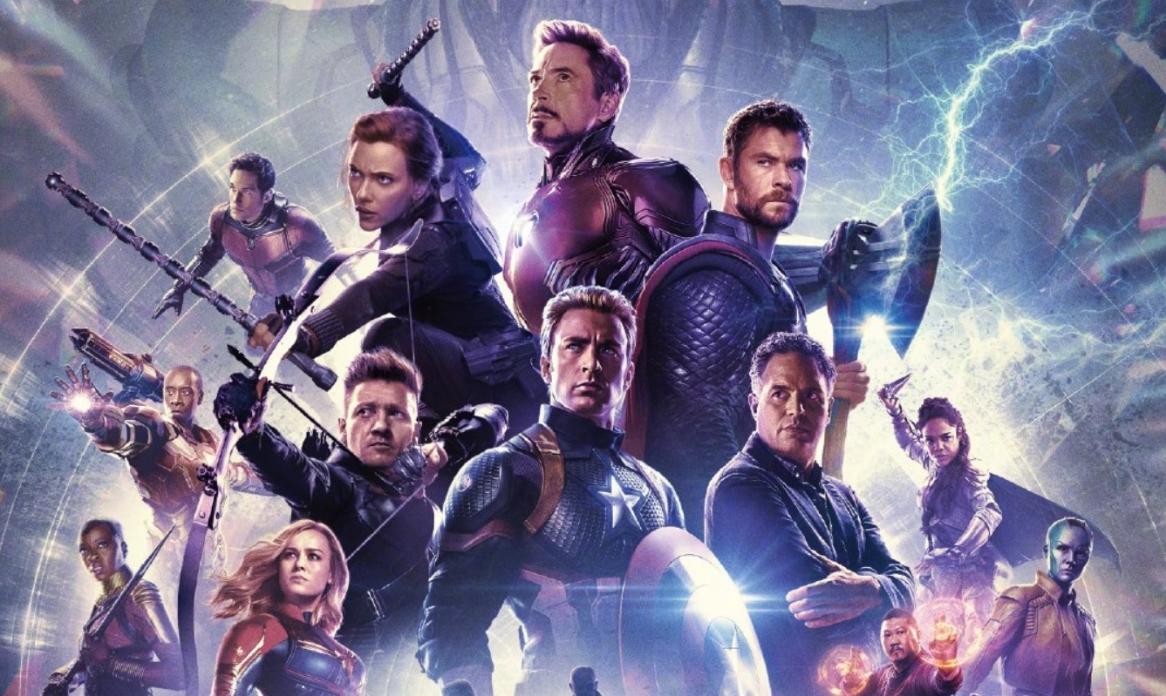
Team Make Up
Teamwork and Leadership with MCQ
eBay. (n.d.). The Muppet Show Art Wall Indoor Room Outdoor - POSTER 20x30. [online] Available at: https://www.ebay.co.uk/itm/133946554436 [Accessed 16 Jul. 2024].
‌
Smith, C. (2019). The Avengers team might be totally different by the time ‘Avengers 5’ premieres. [online] BGR. Available at: https://bgr.com/entertainment/avengers-5-release-date-heroes-still-in-the-team-and-new-additions/ [Accessed 16 Jul. 2024].
‌
Notes:
In the previous slide I asked about what YOU would do differently in the future, so I have asked you to reflect on your influence over the outcome. How many of you though, think that the team you were assigned to impacted your success?

Slide 12
Activity 2
Teamwork and Leadership with MCQ
Should students or staff choose teams?
Why?
[insert QR code to a forum / menti for students to share their thoughts]

Slide 13
Example Methods
Teamwork and Leadership with MCQ
Self Selection
Paired Selection
Random
Interest Basis
Representative
Prevent Isolation
Notes:
What are the ethical issues of any of these methods?

Slide 14
Activity 3
Teamwork and Leadership with MCQ
What should we take into account when forming teams?
[insert QR code to a forum / menti for students to share their thoughts]

Slide 15
Example Factors
Teamwork and Leadership with MCQ
Skills
Interest
Experience
Diversity
Personality
Availability

Slide 16



Personality Profiling Methods - Belbin
Teamwork and Leadership with MCQ
Developed 1970’s
Dr. Meredith Belbin
Academic & Psychologist
Observations of management teams
Henley Management College, UK
9 year research project
Multi-disciplinary research team
Questionnaire based
9 personality type outcomes
Shaper
Coordinator
Monitor Evaluator
Completer Finisher
Implementer
Teamworker
Resource Investigator
Specialist
Plant
Belbin, M. (2019). Belbin. [online] Belbin.com. Available at: https://www.belbin.com/.
‌

Slide 17
Personality Profiling Methods - MBTI
Teamwork and Leadership with MCQ
Extrovert
Introvert
Sensation
Intuition
Thinking
Feeling
Judging
Perception
Created in 1943
Katharine Cook Briggs & Isabel Briggs Myers (mother & daughter)
Based on Carl Jung’s work
Tested on acquaintances then medical students
Questionnaire based
Most ‘popular’ test in the world (over 2 million people/year)
eu.themyersbriggs.com. (n.d.). Home. [online] Available at: https://eu.themyersbriggs.com/en.
‌

Slide 18
Personality Profiling - Critiques
Teamwork and Leadership with MCQ
Evidence basis / validation
Context
Judgement / selection
Pre-determination
Self-reporting
Worker allocation
Controversy…

Slide 19
Personality Profiling – Recognised Uses
Teamwork and Leadership with MCQ
Identification and understanding of team diversity
Identification of team strengths / weaknesses
Predictor of job / academic performance
Worker allocation

Slide 20
Recap
Teamwork and Leadership with MCQ
Application and evaluation of techniques learnt earlier in the module
  Reflection
  Professional Development
  Teamwork
Compare and summarise team formation methodologies
Overview
Intro
CPD & CVs
EDI
EDI + Ethics
EDI + Test
Teamwork
Teams + Leaders
Teams + Test
Decisions
Decisions + Quality
Decisions + Test
Support
Essay Planning
Wrap Up

Slide 21
MCQ Time
Teamwork and Leadership with MCQ
[insert path to the MCQ]
Starts at 15:35
15 minutes allowed
In lecture theatre or elsewhere
No disruptions please!
[insert QR code to a forum / menti for students to share their thoughts]

Slide 22
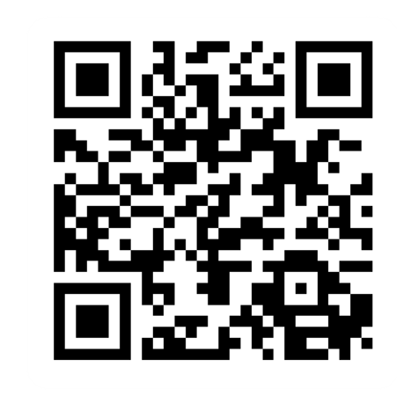
Provide feedback!
https://forms.office.com/e/pHBZpniFvB
If you used this resource, please take the time to fill out this form to provide your feedback.
If you have any questions or require more information about the REET (Resources for Embedding EDI in Teaching) project, please contact the Project Lead using the following contact details:
Chloe Agg c.agg@imperial.ac.uk

