Slide 1
Teamwork and Leadership
[Insert speaker’s names]

Slide 2
Recap / Position Update
Teamwork and Leadership
Overview
Intro
CPD & CVs
EDI
EDI + Ethics
EDI + Test
Teamwork
Teams + Leaders
Teams + Test
Decisions
Decisions + Quality
Decisions + Test
Support
Essay Planning
Wrap Up
Notes:
Last Lecture:
Make a business case for EDI
Financial impacts
Engineering impacts
Academic impacts
Identify issues and barriers and consider mitigations
List measures for EDI

Slide 3
Session Learning Outcomes
Teamwork and Leadership
Recognise the importance of teamworking skills
Identify and appraise attributes of successful teams
Develop a plan to improve you own teamworking skills
Select diverse teamworking methodologies
Define leadership and types of leader

Slide 4

Teamwork and Leadership

Slide 5
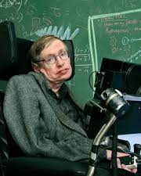
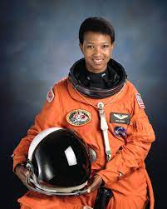
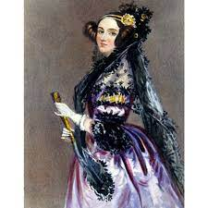

STEM Role Models
Teamwork and Leadership
Notes:
Can you name them?
Hands up if you admire them.
Reflect on the fame and popularity of the individual.

Slide 6

Group Achievements
Teamwork and Leadership
Neste in North America. (2018). Neste in North America. [online] Available at: https://www.neste.com/.
‌
Notes:
So hands up who knows who Neste is? One of the biggest engineering companies in the world (~5000 employees, revenue of ~15million EURpa).
Less known about group achievements. Relate this to UKRI recognition that the “lone genius” stereotype is unhelpful. QEP Prize group awards etc.

Slide 7
Defining Teamwork
Teamwork and Leadership
Teamwork – Combined action of a group / group of people working together / people collaborating to achieve a common goal
Taskwork - The completion of activities performed by an individual in order to deliver group results
Notes:
Project management
Team organisation
Deliverables management
All important parts of successful teams, but not key features of team work itself. Teamwork is the interactions between you, the facilitation of shared activity. Rather than ensuring specific things are completed by specific times.

Slide 8
Activity 1
Teamwork and Leadership
Roughly what percentage of your pre-university qualifications (A-Level, IB, etc.) were assessed on group work?
Roughly what percentage of your university degree is assessed on group work?
Roughly what percentage of the average job you would get from this degree is team based?
[insert QR code to a forum / menti for students to share their thoughts]

Slide 9
Assessed group work in degree
Teamwork and Leadership
[insert statistics for the amount of group work in specific modules / whole year]

Slide 10
Where do we need to demonstrate teamwork?
Teamwork and Leadership
Job interviews
Assessed group work
Chartership applications
Funding bids

Slide 11
Activity 2
Teamwork and Leadership
Discuss the most successful team you’ve participated in
What behaviours, rules, processes or environmental factors made it successful?
Share these success factors on the forum
[insert QR code to a forum / menti for students to share their thoughts]

Slide 12
Good teamwork
Teamwork and Leadership
Ground rules
Planned modes of communication
Agreed deadlines and deliverables
Clear standards (work and behaviour)
Accepting different expectations and aspirations
Valuing and building on different strengths
Opportunities to learn, grow & change
Reflection and appraisal (constructive criticism)
Honesty (to others and SELF)

Slide 13
Teamworking Methodologies - Ideation
Teamwork and Leadership
Round Robin:
Fishbowl:
Discussion Group
Observers / Note Takers
Idea
Idea + 1
Idea + 2
Idea + 3
Idea + 4

Slide 14
Teamworking Methodologies - Deliverables
Teamwork and Leadership
Live editing documents
Teams files & associated tagging
Track changes
Use of comments
File sharing / naming / revision conventions

Slide 15
Teamworking Methodologies - Meetings
Teamwork and Leadership
Recorded Teams meetings (even in person) – records, captions/transcripts
Meeting purpose (agenda)
Minute taking & post meeting additions (or simplify to action tracker)
Record risks (& controls), unknowns, queries, alternatives
Actions (with deadlines and persons accountable)
Appoint a chair:
Ensures all voices are heard, time is kept and purpose is achieved
Ensures everyone has an action
Checks previous actions, have they all been met
Rotate roles

Slide 16
Good Teamwork – Supportive Environments
Teamwork and Leadership
Spark
Outcome
Impact
Resolution
Forming
Storming
Norming
Performing
Notes:
Emotional responses to tense situations common in teamwork. Give an example:
These phases of managing conflict relate to the 1965 “Tuckman” model of team development which tell us we must pass through some conflict together in order to become a high performing team. So where we are struggling with the behaviour of others we should raise and face this rather than tolerate in silence.

Slide 17

The [insert department i.e. Mech Eng] Environment?
Teamwork and Leadership
Is [insert department] always supportive?
Impact on teams…

Slide 18
Improving the Team Environment
Teamwork and Leadership
Spark
Outcome
Impact
Resolution
Consider Language
Observe Behaviours
Support Affected
Address Cause
Notes:
Based on previous slide we can see that banter is an issue, and one which exists in [insert department]
Stops groups from being successful as it is very difficult to collaborate with trusting those around you, feeling respected and safe
Examples of banter
Impact on teams
Ways to counter these – allyship & speaking up, setting ground rules

Slide 19
Skill levels in teamwork
Teamwork and Leadership
Contribution
Working independently
Aligned individual goals / someone else’s goal
Cooperation
Working together
Aligned individual goals / someone else’s goal
Collaboration
Working together
Shared ownership / goals

Slide 20
Not teamwork
Teamwork and Leadership
Collusion – “secret / illegal cooperation” “deceitful/deceptive” (e.g. excessive support on individual coursework)
Competition – “establish supremacy/superiority” “striving to win/gain by defeating others”

Slide 21
Activity 3
Teamwork and Leadership
Have you experienced or seen good leadership?
Within your own teams? In school/uni? Sport? Companies? Governance?
What makes a good leader?
[insert QR code to a forum / menti for students to share their thoughts]

Slide 22
Good Leadership
Teamwork and Leadership
Forbes:
Sincere enthusiasm
Integrity
Communication skills
Loyalty
Decisiveness
Managerial competence
Empowerment
Charisma
Fries, K. (n.d.). 8 Essential Qualities That Define Great Leadership. [online] Forbes. Available at: https://www.forbes.com/sites/kimberlyfries/2018/02/08/8-essential-qualities-that-define-great-leadership/?sh=1cbbdb543b63.
‌
Centre for Creative Leadership:
Vision
Management
Empowerment
Diplomacy
Feedback
Entrepreneurialism
Personal Style
Personal Energy
Multicultural Awareness
Campbell, David P. In Focus : Leadership Characteristics - Nine Keys to Good Leadership. Greensboro, North Carolina: Center for Creative Leadership, 2002. Print.
Notes:
Good leaders ensure ethical conduct, and create a sense of belonging. They nurture cultures which reward good team work and continuous development, etc. Tie leadership back into all other topics covered.

Slide 23
Defining leadership
Teamwork and Leadership
Leading; use of influence, creating shared ideas, encouraging progress / innovation
Managing; use of authority, task / process focused, aiming for aligned end goal(s)
Coaching; developing, motivating and supporting others in shared goals (short term / specific)
Mentoring; developing, motivating and supporting others in their goals (long term / experiential)
Notes:
Mention
Project management
Team organisation
Deliverables management

Slide 24
Take me to your leader…
Teamwork and Leadership
Head of Department
Prime Minister
Conductor
Group Leader
Notes:
Different contexts, different leaders (“take me to your leader”), therefore different types of leader (group, thought, organisational…).

Slide 25
Student Team Leadership
Teamwork and Leadership
Leadership vs Management
Management roles
Role rotation
Group experiential gain
Shared responsibility / accountability
Increased innovation through reduced repetition/predictability
Refer back to “Teamworking Methodologies – Meetings”

Slide 26
Activity 4
Teamwork and Leadership
Which of your behaviours have been least conducive to successful team outcomes?
How will you action a change in this area?
[insert QR code to a forum / menti for students to share their thoughts]
Notes:
Students to reflect on how their own actions / attributes may have differed from the consensus on positive behaviours and select one thing to work on
Students to anonymously share something they plan to try on the forum to help them to be inspired and feel accountable.

Slide 27
Recap
Teamwork and Leadership
Recognise the importance of teamworking skills
Identify and appraise attributes of successful teams
Develop a plan to improve you own teamworking skills
Select diverse teamworking methodologies
Define leadership and types of leader
Overview
Intro
CPD & CVs
EDI
EDI + Ethics
EDI + Test
Teamwork
Teams + Leaders
Teams + Test
Decisions
Decisions + Quality
Decisions + Test
Support
Essay Planning
Wrap Up

Slide 28
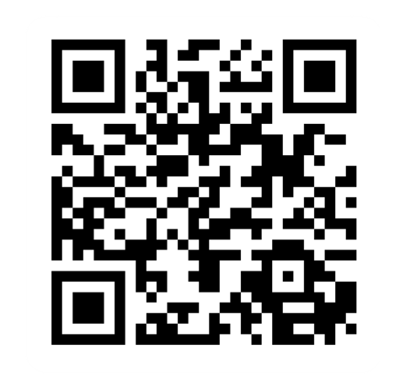
Provide feedback!
https://forms.office.com/e/pHBZpniFvB
If you used this resource, please take the time to fill out this form to provide your feedback.
If you have any questions or require more information about the REET (Resources for Embedding EDI in Teaching) project, please contact the Project Lead using the following contact details:
Chloe Agg c.agg@imperial.ac.uk

