Slide 1
Equality, Diversity, Inclusion and MCQ Test
[Insert speaker’s names]

Slide 2
Recap / Position Update
Equality, Diversity, Inclusion and MCQ Test
Overview
Intro
CPD & CVs
EDI
EDI + Ethics
EDI + Test
Teamwork
Teams + Leaders
Teams + Test
Decisions
Decisions + Quality
Decisions + Test
Support
Essay Planning
Wrap Up
Notes:
Last Lecture:
Define key terms in EDI & Ethics
Summarise the Equality Act 2010
Give examples of different EDI approaches from industry & academia
Identify your own ethical code

Slide 3
Session Learning Outcomes
Equality, Diversity, Inclusion and MCQ Test
Make a business case for EDI
Financial impacts
Engineering impacts
Academic impacts
Identify issues and barriers and consider mitigations
List measures for EDI

Slide 4


EDI – To care or not to care, that is the question
Equality, Diversity, Inclusion and MCQ Test
Adobe Stock. (n.d.). %22I Don%27T Care%22 Images – Browse 409 Stock Photos, Vectors, and Video. [online] Available at: https://stock.adobe.com/uk/search?k=%22i+don%27t+care%22&asset_id=148073033 [Accessed 15 Jul. 2024].
‌
Notes:
Some of you will have read those learning outcomes and be interested or even excited. Some of you will already be activists or advocates, or at least angry at discrimination. Some of you though probably just don’t care. Whether that’s because it doesn’t impact you, or you are resigned to it, or because you don’t see its place in your degree. So why should you care?

Slide 5
Equality, Diversity, Inclusion and MCQ Test
“Companies in the top quartile for racial and ethnic diversity are 35 percent more likely to have financial returns above their respective national industry medians”
“Companies in the top quartile for gender diversity are 15 percent more likely to have financial returns above their respective national industry medians”
Hunt, V., Layton, D. and Prince, S., 2015. Why Diversity Matters. [online] https://www.mckinsey.com/ Available at: https://www.mckinsey.com/~/media/mckinsey/business%20functions/organization/our%20insights/why%20diversity%20matters/why%20diversity%20matters.pdf
Notes:
Because diversity can make you more money. Make your business more successful.

Slide 6
Equality, Diversity, Inclusion and MCQ Test
“In the United Kingdom, for every 10 percent increase in gender diversity on the senior-executive team, EBIT (earnings before interest and taxes) rose by 3.5 percent.”
“Bridging the gender gap in Europe could add USD 2 trillion to the GDP by 2025 and contribute to greater gender equality in leadership positions.”
Hunt, V., Layton, D. and Prince, S., 2015. Why Diversity Matters. [online] https://www.mckinsey.com/ Available at: https://www.mckinsey.com/~/media/mckinsey/business%20functions/organization/our%20insights/why%20diversity%20matters/why%20diversity%20matters.pdf
Devillard S., et al, 2016. Women Matter 2016: Reinventing the workplace to unlock the potential of gender diversity. [online] Available at: https://www.mckinsey.com/~/media/mckinsey/featured%20insights/women%20matter/reinventing%20the%20workplace%20for%20greater%20gender%20diversity/women-matter-2016-reinventing-the-workplace-to-unlock-the-potential-of-gender-diversity.pdf
Notes:
This is a lot of money!

Slide 7
Against EDI – A Chat GPT argument…
Equality, Diversity, Inclusion and MCQ Test
One argument against Equality, Diversity and Inclusion (EDI) is that it could lead to reverse discrimination, where individuals from majority groups may feel that they are being treated unfairly because of their background.
Another argument is that it could lead to a decrease in meritocracy, where the best candidate for a job or opportunity is not chosen based on their qualifications but rather on their diversity.
Moreover, some may argue that implementing EDI initiatives could be costly and time-consuming for organizations and could divert resources away from more important business objectives.

Slide 8
Against EDI – A Chat GPT argument…
Equality, Diversity, Inclusion and MCQ Test
“it could lead to reverse discrimination, where individuals from majority groups may feel that they are being treated unfairly”
Prejudice vs Discrimination
Systemic barriers
Positive discrimination vs positive action

Slide 9
Against EDI – A Chat GPT argument…
Equality, Diversity, Inclusion and MCQ Test
“it could lead to a decrease in meritocracy, where the best candidate for a job or opportunity is not chosen based on their qualifications but rather on their diversity”
Who defines merit?
Tokenistic EDI
(Positive discrimination vs positive action)

Slide 10
Against EDI – A Chat GPT argument…
Equality, Diversity, Inclusion and MCQ Test
“implementing EDI initiatives could be costly and time-consuming for organizations and could divert resources away from more important business objectives.”
Evidence of increased profitability!

Slide 11

Who Are [insert department, i.e. Engineers] ?
To consider; accuracy of data…
[Engineers] are…:
[insert statistics about your department, i.e. number of females, ethnicities]
UK Population:
51% Female
93% Heterosexual
82% White
82% Without Disability
(2021 census data)
Office for National Statistics (2021). Census - Office for National Statistics. [online] Ons.gov.uk. Available at: https://www.ons.gov.uk/census.
‌
Notes:
So when we talk about diversity in [insert your department], what do we mean? Who is already working in [your department]? Who *could* be?

Slide 12
So What?
We approach problems from our own perspective
We all have unconscious bias
(Some people also have conscious bias!)
As [engineers], we need to address these and design from the perspective of all end users

Slide 13

Why So Important? - Gender
Women are 47% more likely to be seriously injured in a car crash
Women are 17% more likely to die in a car crash
This is without taking pregnancy statistics into account
69% of single person pedestrian injuries (in Sweden) were women
Invisible women : exposing data bias in a world designed for men
Caroline Criando-Perez, 2019

Slide 14
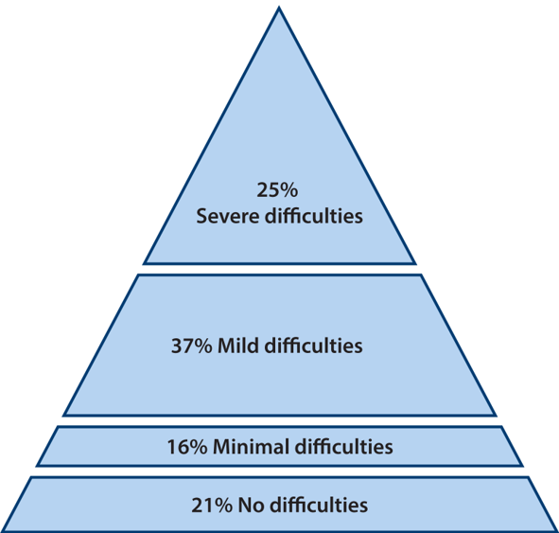
Why So Important? - Disabilities
The Wide Range of Abilities… (Microsoft, 2003)

Slide 15
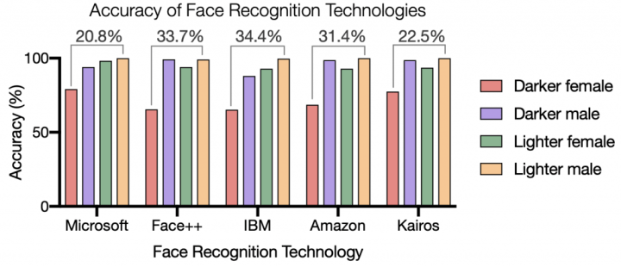
Why So Important? - Ethnicity
Najibi, A. (2020). Racial Discrimination in Face Recognition Technology. [online] Science in the News. Available at: https://sitn.hms.harvard.edu/flash/2020/racial-discrimination-in-face-recognition-technology/.
‌

Slide 16
Why So Important? - Ethnicity continued…
Soap for light skin only: https://reporter.rit.edu/tech/bigotry-encoded-racial-bias-technology
Facial recognition:
https://sitn.hms.harvard.edu/flash/2020/racial-discrimination-in-face-recognition-technology/
https://www.wired.com/story/can-apples-iphone-x-beat-facial-recognitions-bias-problem/

Slide 17

Inclusive Design
Wheelchairs & ramps…?
Height
Grip
Colour vision
Left-handed
…?
Sinead Burke’s TED Talk on Inclusive Design
https://youtu.be/RD_SLJG7oi8
Notes:
Hopefully that will have made you think a bit more about how details you might not consider important, can be hugely important to someone you may not have thought about.

Slide 18
Inclusive Design is…
“a comprehensive, integrated design which encompasses all aspects of a product used by consumers of diverse age and capability in a wide range of contexts, throughout the product’s lifecycle from conception to final disposal”
Managing Inclusive Design (BS 7000-6:2005)
Notes:
We need to be thinking about inclusive design.

Slide 19
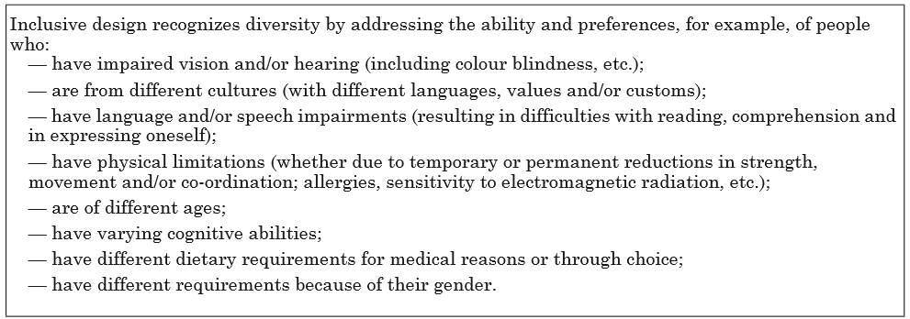
Inclusive Design…
Managing Inclusive Design (BS 7000-6:2005)
Notes:
We need to be thinking about inclusive design.

Slide 20
Inclusive Design…
The ultimate goal of inclusive design is to meet the needs of all such consumers and is based on the principle that appropriate access to information, products and facilities is a fundamental human right.
Managing Inclusive Design (BS 7000-6:2005)

Slide 21
Academic Impact
Is there any?
Guesses / examples?

Slide 22
Academic Impact
[Insert images / statistics of the academic impact within your department]

Slide 23
Academic Impact
Share your experiences of EDI issues in academia
[insert QR code to a forum / menti for students to share their thoughts]

Slide 24
Privilege For Sale
Holding hands with your partner w/o judgement
Always being able to afford food & heating
Feeling safe walking alone in the dark
Seeing yourself represented in/by authority
Suitable hair / skin products & services readily available
Being a fluent / native English speaker
More ideas: https://www.eiu.edu/eiu1111/Privilege%20Walk%20Exercise-%20Transfer%20Leadership%20Institute-%20Week%204.pdf

Slide 25
Academic Action
What could we change to improve those experiences?
[insert QR code to a forum / menti for students to share their thoughts]

Slide 26
Models of EDI
Deficit (Medical model / Individual level “blame”)
Structural (Systems and processes)
Socio-psychological (Society and belief)

Slide 27
Measures and Benchmarks
Equality Impact Assessment
Stonewall
Athena Swan
Racial Equality Charter
Disability Confident
Inclusive Design Standards

Slide 28
Equality Impact Assessment (EIA)
PSED – Public Sector Equality Duty
Requires public bodies to consider all individuals when shaping policy.
It also requires that public bodies have due regard to the need to:
eliminate discrimination
advance equality of opportunity
foster good relations between different people when carrying out their activities
EIAs are a tool for public bodies to prompt considerations of impact on different protected groups and provide evidence of these considerations.

Slide 29
Recap
Make a business case for EDI
Financial impacts
Engineering impacts
Academic impacts
Identify issues and barriers and consider mitigations
List measures for EDI
Overview
Intro
CPD & CVs
EDI
EDI + Ethics
EDI + Test
Teamwork
Teams + Leaders
Teams + Test
Decisions
Decisions + Quality
Decisions + Test
Support
Essay Planning
Wrap Up

Slide 30
MCQ Time
[insert path to the QR code]
15 minutes allowed
In lecture theatre or elsewhere
No disruptions please!
[insert QR code to a forum / menti for the MCQ Test]

Slide 31
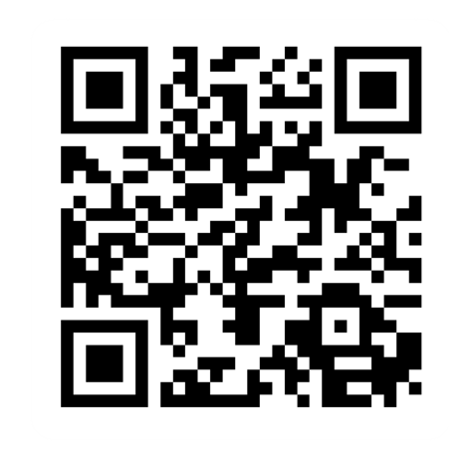
Provide feedback!
https://forms.office.com/e/pHBZpniFvB
If you used this resource, please take the time to fill out this form to provide your feedback.
If you have any questions or require more information about the REET (Resources for Embedding EDI in Teaching) project, please contact the Project Lead using the following contact details:
Chloe Agg c.agg@imperial.ac.uk

