Slide 1
Equality, Diversity, Inclusion and Ethics
[Insert speaker’s names]

Slide 2
Recap / Position Update
Equality, Diversity, Inclusion and Ethics
Overview
Intro
CPD & CVs
EDI
EDI + Ethics
EDI + Test
Teamwork
Teams + Leaders
Teams + Test
Decisions
Decisions + Quality
Decisions + Test
Support
Essay Planning
Wrap Up
2
Notes:
Last Lecture:
Define what reflection is in a professional context
Select a method for carrying out reflection
Give examples of reasons for CPD record keeping
Identify skill sets which it would be relevant to develop
Apply improvements to CVs based on the above
Identify reasons and methods for managing wellbeing

Slide 3
Session Learning Outcomes
Equality, Diversity, Inclusion and Ethics
Define key terms in EDI & Ethics
Summarise the Equality Act 2010
Give examples of different EDI approaches from industry & academia
Identify your own ethical code
3

Slide 4
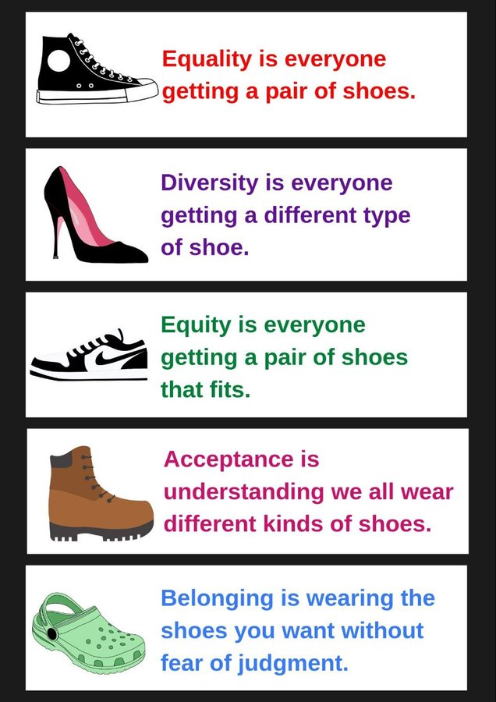
Equality, Diversity, Inclusion and Ethics
https://www.linkedin.com/in/shieldsjamie/
4
Notes:
Inclusion: ensuring the people who weren’t in the room when we gave out shoes are able to collect shoes later
Justice: removing the need for shoes

Slide 5

Equality, Diversity, Inclusion and Ethics
[1]
[1] J.-W. Seo et al., “Equality, equity, and reality of open access on scholarly information,” Science Editing, vol. 4, no. 2, pp. 58–69, Aug. 2017, doi: https://doi.org/10.6087/kcse.97.
‌
5
Notes:
So in equality everyone gets the same benefits/support
In equity they get the support they need to achieve the same end goal
Or, the social justice approach, we could just remove the systemic barriers which result in the need for support!

Slide 6

Defining Equality – Discussion Point
Equality, Diversity, Inclusion and Ethics
Everyone has the same opportunities
The same support is provided, irrespective of circumstance.
6
Notes:
Is this how you would define equality? How does this differ from your own terms for this?

Slide 7

Diversity
Equality, Diversity, Inclusion and Ethics
Is your group ‘diverse’?
Why? Why not?
7
Notes:
Discuss amongst the people sat around you. Do you perceive your group to be diverse? Why? Or why not?

Slide 8

Defining Diversity
Equality, Diversity, Inclusion and Ethics
Involving / containing people from a range of different backgrounds or who have different characteristics
8
Notes:
How does this change (or not) your group’s decision on its diversity?
Discuss.

Slide 9
Protected Characteristics
Equality, Diversity, Inclusion and Ethics
Gender Reassignment (Trans/nonbinary)
Marriage and civil partnership
Age
Pregnancy and maternity leave
Disability
Race
Sexual orientation (LGBTQ+)
Religion or belief
Sex (gender)
9
Notes:
Can you list the protected characteristics? Feel free to call them out
These are the characteristics legally defined in the Equality Act 2010. Some terms have been up for consultations, such as gender reassignment. This is not a term that people from the trans and nonbinary community feel the most comfortable with.
There are also other groups not covered by protected characteristics. For example class. Though class is not included, it is something we think about when delivering EDI strategies and initiatives.

Slide 10
Equality Act 2010
Equality, Diversity, Inclusion and Ethics
“The Act provides a legal framework to protect the rights of individuals and advance equality of opportunity for all.
It provides Britain with a discrimination law which protects individuals from unfair treatment and promotes a fair and more equal society.” [2]
[2] Equality and Human Rights Commission, “What is the Equality Act? | EHRC,” www.equalityhumanrights.com, Mar. 15, 2016. https://www.equalityhumanrights.com/equality/equality-act-2010/what-equality-act
‌
10

Slide 11
Investigating Inclusion
Equality, Diversity, Inclusion and Ethics
[insert QR code to a forum / menti for students to share their thoughts]
Who is missing?
i.e. which communities are not (well) represented?
Why are they missing?
11

Slide 12

Defining Inclusion
Equality, Diversity, Inclusion and Ethics
Providing access to marginalised or excluded groups
12

Slide 13
Professional EDI
Equality, Diversity, Inclusion and Ethics
[insert QR code to a forum / menti for students to share their thoughts]
EDI statements / policies of employers and institutions of interest…
13

Slide 14
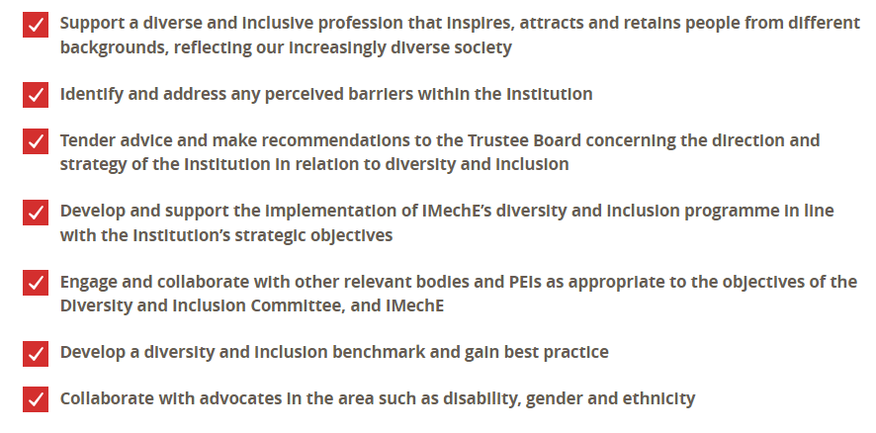
IMechE – EDI Objectives
Equality, Diversity, Inclusion and Ethics
[3] “Diversity and Inclusion (D&I) - IMechE,” www.imeche.org. https://www.imeche.org/about-us/governance/council/committees-and-boards/diversity-and-inclusion-committee/ (accessed Jul. 15, 2024).
‌
14

Slide 15
Rolls-Royce – Staff Requirements
Equality, Diversity, Inclusion and Ethics
Being open to new perspectives and letting go of previously-held assumptions
Having the courage to accept that you can’t know everything and asking for help when you need it.
Actively listening to a diverse range of opinions as often as possible to shape the best decisions
Willingly doing things differently if it means a faster and more efficient solution or delivery.
Showing an interest in the people around you and in their wellbeing.
[4] “Inclusion and diversity,” careers.rolls-royce.com. https://careers.rolls-royce.com/united-kingdom/what-we-offer/inclusion-and-diversity
‌
15

Slide 16
Cundall - Ethos
Equality, Diversity, Inclusion and Ethics
Whatever your background or identity, you are welcome at Cundall. We are proud to be an inclusive employer that recognises the value of diversity; where anyone can find joy in what they do.
At Cundall, we are not only committed to a culture of inclusivity internally, but also to influencing change in the industry for the benefit of all.
Whether through the work we do on ourselves to identify and remove structural barriers to equality, or our involvement with local communities to widen participation in engineering, we are active in our pursuit of a fairer future.
[5] Cundall, “Diversity and Inclusion - About,” Cundall. https://www.cundall.com/about/diversity-and-inclusion
‌
16

Slide 17
Engineering Council – Ethical Principles
Equality, Diversity, Inclusion and Ethics
“The Engineering Council and the Royal Academy of Engineering (RAEng) believe that all persons engaged in engineering at any level, from the youngest apprentice and student, should be educated and encouraged to think and work in accordance with these ethical principles.”
Honesty and Integrity
Respect for life, law, the environment and public good
Accuracy and rigour
Leadership and communication
- promote equality, diversity and inclusion
[6] Engineering Council, “Statement of Ethical Principles,” Engc.org.uk, 2017. https://www.engc.org.uk/standards-guidance/guidance/statement-of-ethical-principles/
‌
17
Notes:
BREAK?

Slide 18
Defining Ethics
Equality, Diversity, Inclusion and Ethics
[insert QR code to a forum / menti for students to share their thoughts]
What does it mean to be ethical?
18

Slide 19
Ethics vs Morals
Equality, Diversity, Inclusion and Ethics
Ethics:
Rules based
Actions / outcomes
Analytical
Morals:
Community based
Values
Interpersonal
Adultery: Illegal? Immoral? Unethical?
19

Slide 20
Factors in Morality / Ethics
Equality, Diversity, Inclusion and Ethics
Culture
Religion
Tradition
Family
Education
Geography
…?
20

Slide 21
Ethical Approaches
Equality, Diversity, Inclusion and Ethics
Deontological
Kantian
Is an action morally right or wrong?
Utilitarian
Consequential
What are the consequences of the action?
Virtue Ethics
Eudaimonism
Was the decision about the action based on virtue?
21

Slide 22
Finding Your Moral Compass
Equality, Diversity, Inclusion and Ethics
https://neal.fun/absurd-trolley-problems/
Did we agree?
Did we need to?
What is the impact of that?
Were our decisions deontological, utilitarian or eudaimonic
22

Slide 23
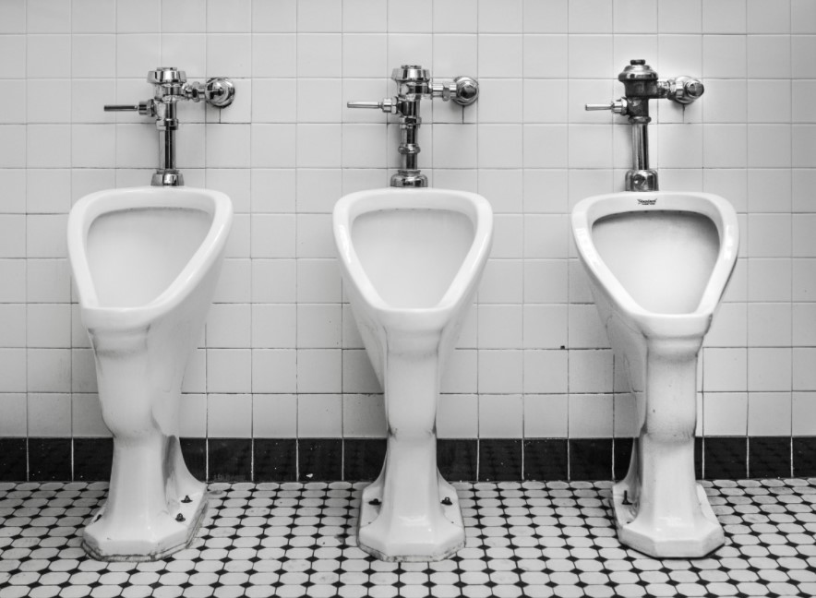
Case studies – ethics in engineering design
Equality, Diversity, Inclusion and Ethics
Middlemist, Knowles & Matter 1976
Personal Space Invasions in the Lavatory
Findings: delay between unzipping the fly & a urine stream hitting the urinal increases with proximity of other urinal users
[7] “Urinal,” www.designingbuildings.co.uk. https://www.designingbuildings.co.uk/wiki/Urinal
‌
23

Slide 24
Ethics in Design – The Urinal
Equality, Diversity, Inclusion and Ethics
Pilot
Observer pretending to ‘groom’ themselves in the mirror, using a stopwatch to time delay
Study
Observer concealed in a cubicle, watching urination via a periscope concealed in a stack of books
Control
Out of Order Signs + Water Buckets
24

Slide 25
Question
Equality, Diversity, Inclusion and Ethics
Was this ethical?
The four general moral principles that apply to scientific research;
weighing risks against benefits
acting responsibly and with integrity
seeking justice
respecting people’s rights and dignity
Was this ethical?
25

Slide 26
Questioning the ethics…
Equality, Diversity, Inclusion and Ethics
Gerald P Koocher, Harvard Medical School
Bathroom Behaviour and Human Dignity
Journal of Personality and Social Psychology, 1977, Vol 35, Pages 120-121
Spying vs Research
Dignity of Subjects
Subjects not Informed
No Discussion of Ethics
Was this ethical?
26

Slide 27
Questioning the ethics…
Equality, Diversity, Inclusion and Ethics
Middlemist et al. responded
What to Do and What to Report: A Reply to Koocher
Journal of Personality and Social Psychology, 1977, Vol 35, Pages 122-124
Info is available to all
Subjects were unaware
Subjects “were not bothered”
University setting legitimises behaviours
Was this ethical?
27

Slide 28
Ethical Approaches
Equality, Diversity, Inclusion and Ethics
Deontological
Kantian
Is an action morally right or wrong?
Utilitarian
Consequential
What are the consequences of the action?
Virtue Ethics
Eudaimonism
Was the decision about the action based on virtue?
28

Slide 29
Which ethical framework?
Equality, Diversity, Inclusion and Ethics
Middlemist (author)
Koocher (response)
Participants
Deontological
Utilitarian
Virtue
Do you agree? What is your ethical code?
29

Slide 30
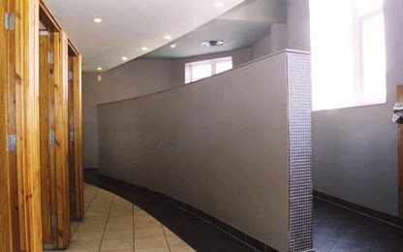
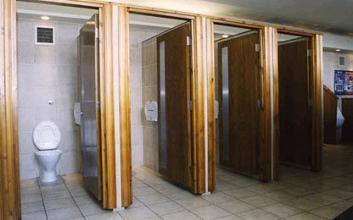
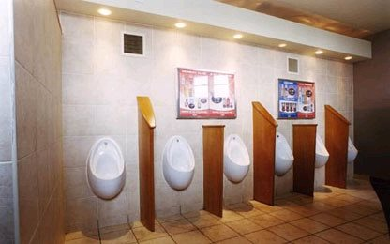
Is it ethical now?
Equality, Diversity, Inclusion and Ethics
Information from the study is used to design public toilets [6]:
Size
Spacing
Means of separation, etc.
[6] “Public Toilet Design Guidelines,” UKPT - United Kingdom Paruresis Trust - Shy Bladder Syndrome Support. https://www.ukpt.org.uk/paruresis-information-for-professionals/public-toilets/public-toilet-design-guidelines
‌
30

Slide 31
The Difficult Question - At What Cost?
Equality, Diversity, Inclusion and Ethics
Public Toilet Users’ Comfort
Study Participants Dignity
31

Slide 32
Question for Reflection
Equality, Diversity, Inclusion and Ethics
IF the study data was obtained unethically, is it ethical to use it for design?
IF the study data was obtained unethically, is it ethical not to use it for design, or does this make the unethical treatment of participants even worse?
32

Slide 33
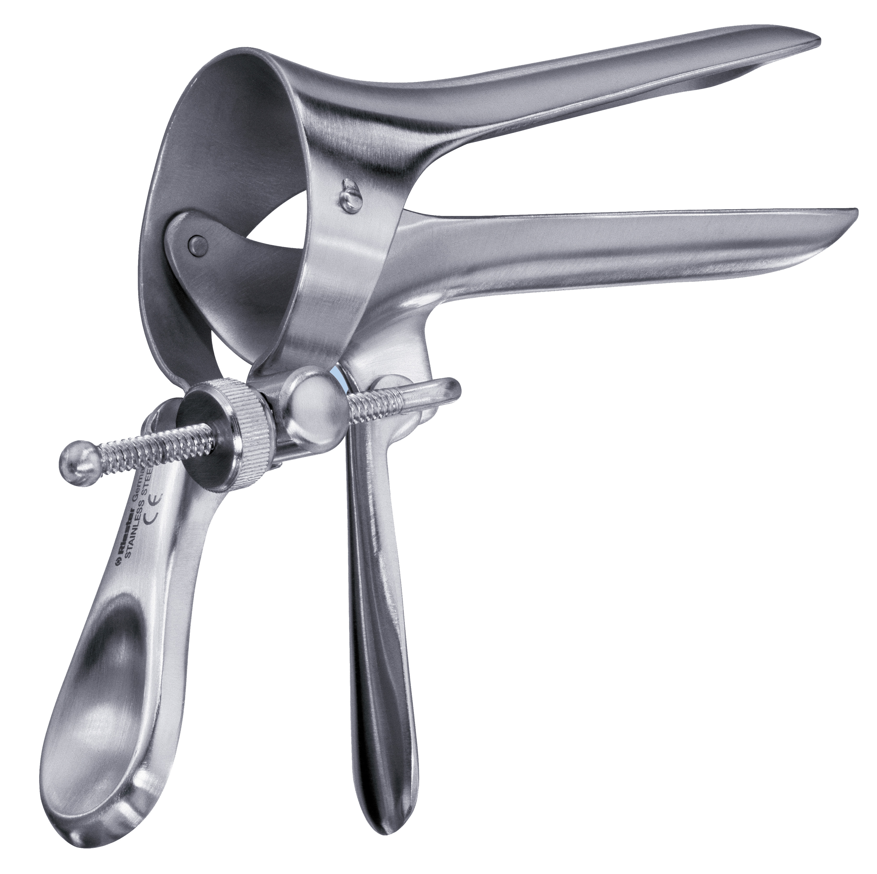
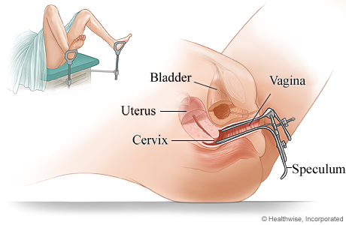
Ethics in Design – The Speculum
Equality, Diversity, Inclusion and Ethics
[9]‌
[10]‌
[9] “cusco vaginal speculum,” Ecomed. https://www.ecomed.com.au/shop/our-brands/cusco-vaginal-speculum/ (accessed Jul. 15, 2024).
[10] “Pelvic Examination With Speculum,” myhealth.alberta.ca. https://myhealth.alberta.ca/Health/Pages/conditions.aspx?hwid=zm2209
‌
33

Slide 34
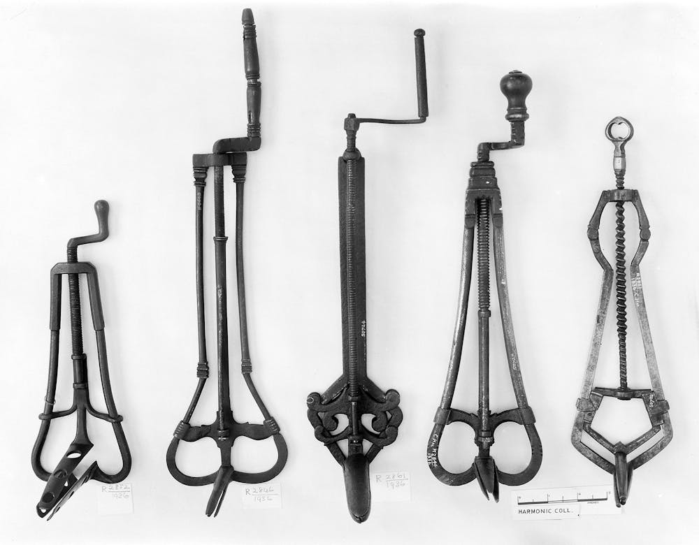
Ethics in Design – The Speculum
Equality, Diversity, Inclusion and Ethics
Evidence of devices for the purpose of examining cervix, uterus etc. from 130 A.D.
The ‘modern’ speculum was invented in 1840’s
James Marion Sims
During medical experimentation on black slave women
With no anaesthetic
[11] H. King, “Speculum: the creepy history of this ancient gynaecological device and why it’s still feared today,” The Conversation, Jan. 11, 2023. https://theconversation.com/speculum-the-creepy-history-of-this-ancient-gynaecological-device-and-why-its-still-feared-today-196977
‌
34

Slide 35
The Difficult Question
Equality, Diversity, Inclusion and Ethics
Ability to diagnose & treat a range of conditions
Pain & suffering of initial subjects
35

Slide 36
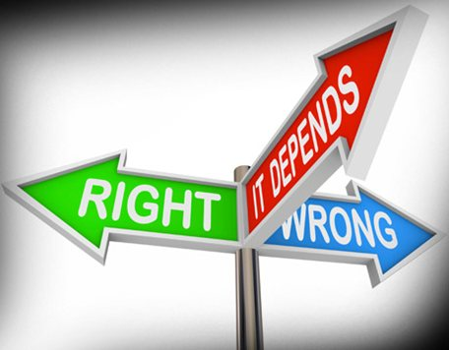
Ethics in Design – The Speculum
Equality, Diversity, Inclusion and Ethics
Clearly the development of the original speculum was not ethical
But what about the design of the speculum now?...
36

Slide 37
Gynaecological Examination
Equality, Diversity, Inclusion and Ethics
Need to be tested
Enter clinical environment
Strip from the waist down
Lie on a bed, legs apart
Put your feet in stirrups
Have cold device inserted into your body
Listen to the sound of the ratchet as it opens
Feel the speculum hold the vaginal walls apart
Sample Taken (scrape of cervix)
37

Slide 38
Gynaecological Examination - Success
Equality, Diversity, Inclusion and Ethics
A check-up using a speculum is not a pleasant experience
- Painful, scary, uncomfortable, embarrassing [difficult to get data from non-attendance]
Women avoid routine check-ups (& more serious examinations)
This can lead to treatable conditions such as cervical cancer progressing beyond the point ‘easy’ treatment [12]
In fact, when the speculum was first developed, it was predominantly used for pelvic examination of prostitutes by the police, and as such was used as a threat
[12] A. D. Domar, “Psychological Aspects of the Pelvic Exam,” Women & Health, vol. 10, no. 4, pp. 75–90, Jan. 1986, doi: https://doi.org/10.1300/j013v10n04_07.
‌
38

Slide 39
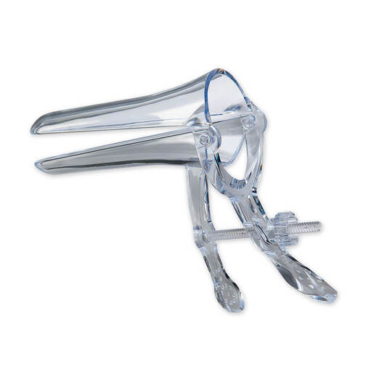
1840 – 2018 : Any Change?
Equality, Diversity, Inclusion and Ethics
Minor changes to main design
~50% are plastic
Multiple sizes are available (but are the correct sizes used?)
Still predominantly the same
Why?
[13]
[13] “PELIspec Vaginal Specula (with lock) Clear Extra Small (previously known as Virgin) x25 | Disposable Vaginal Specula | Vaginal Speculum | Gynaecology & Family Planning | Williams Medical Supplies,” www.wms.co.uk. https://www.wms.co.uk/Gynaecology-%26-Family-Planning/Vaginal-Speculum/Disposable-Vaginal-Specula/Pelispec-Speculum-with-lock/p/400091 (accessed Jul. 15, 2024).
‌
39

Slide 40
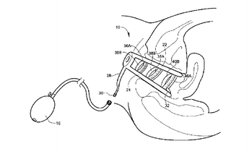
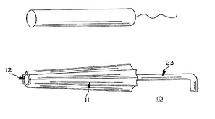
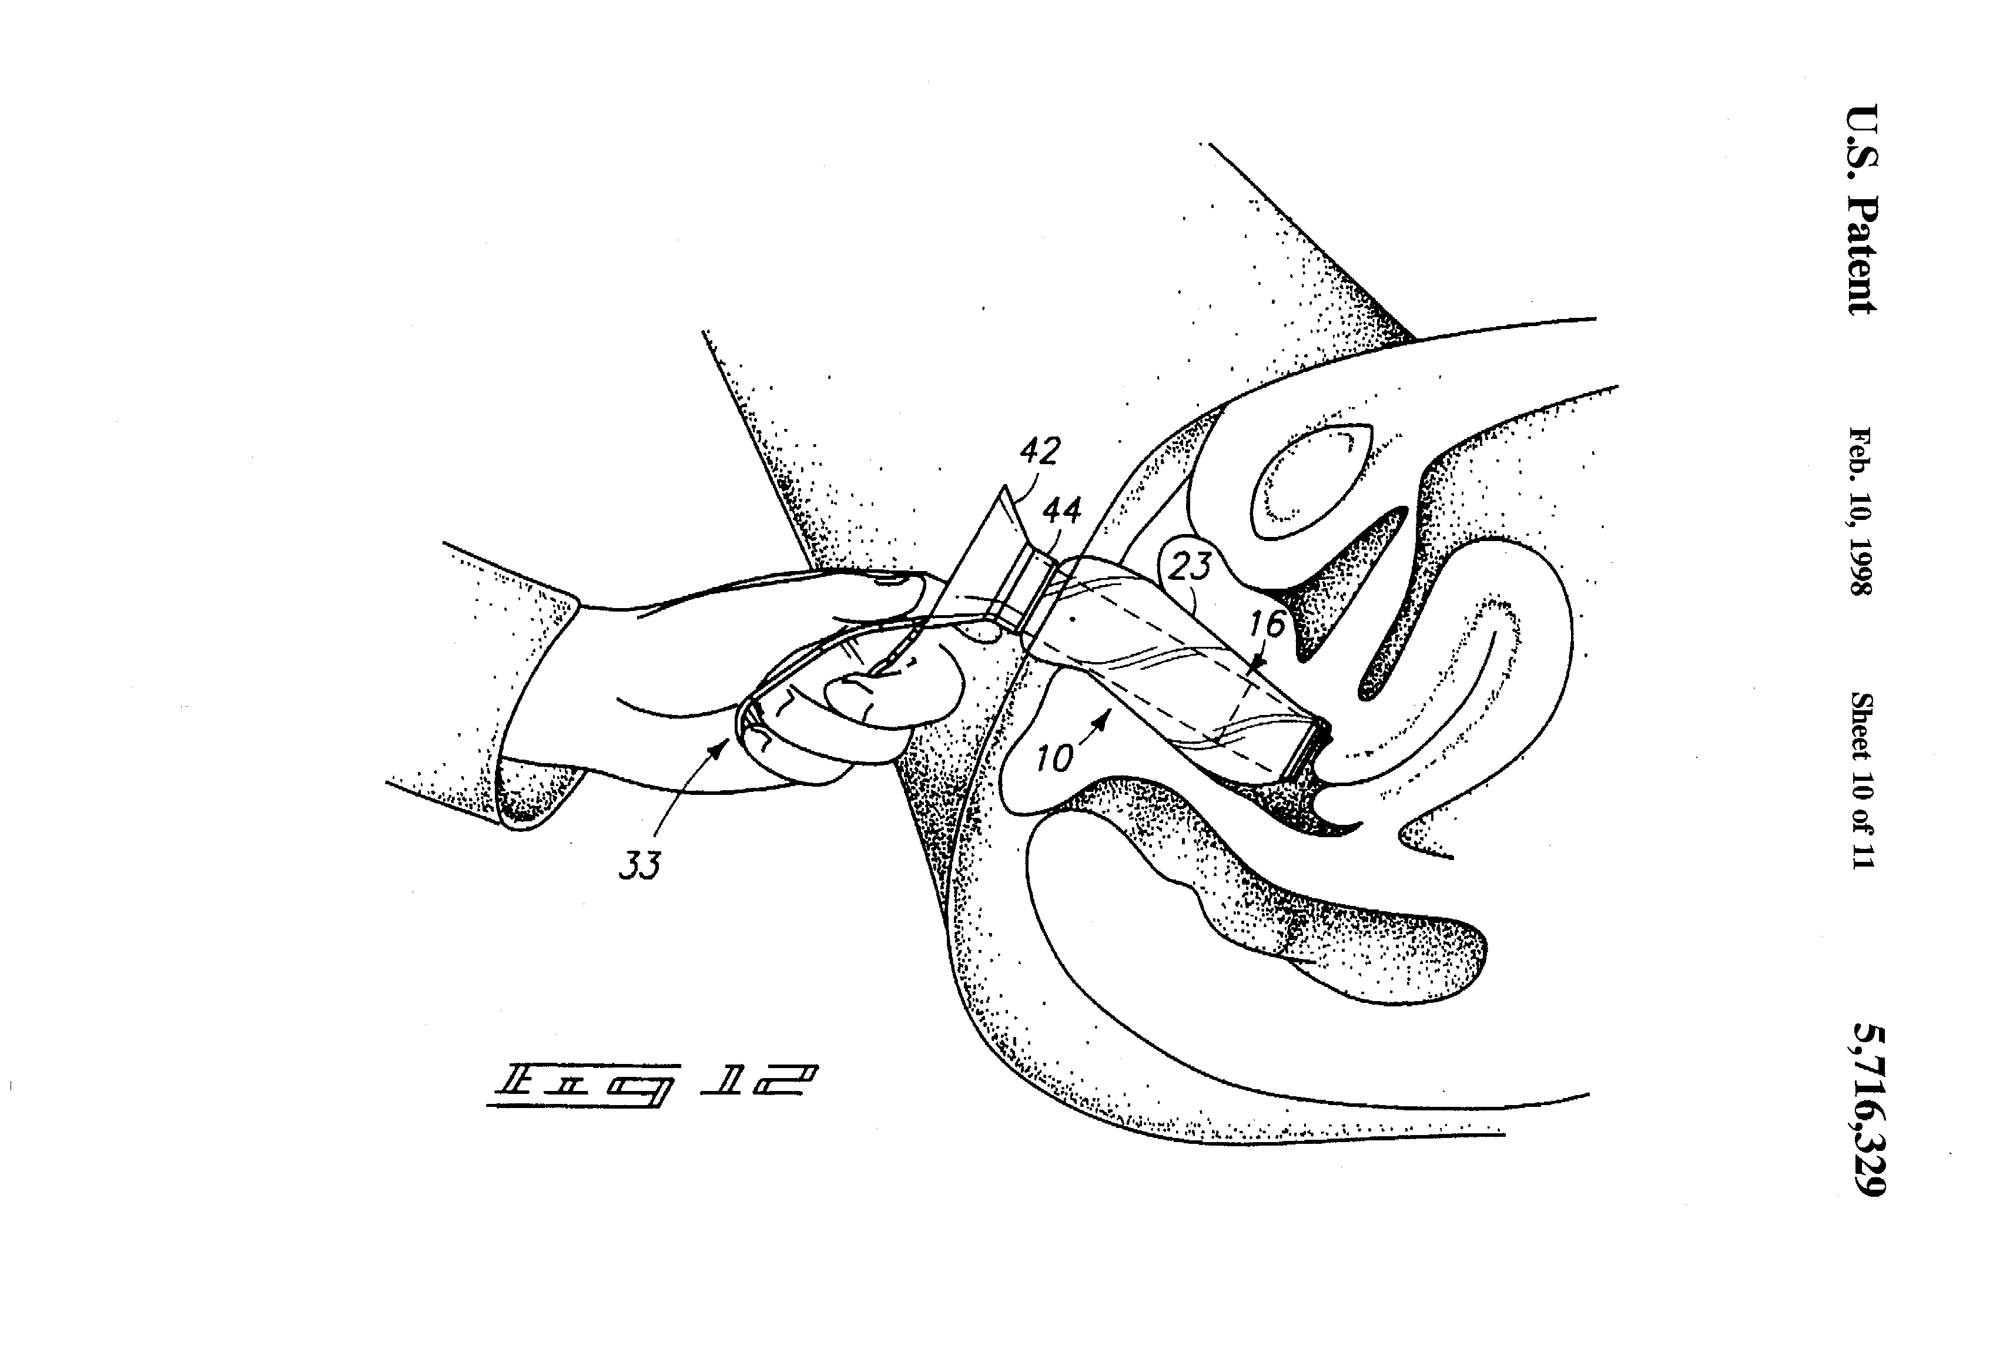
Resistance to Change
Equality, Diversity, Inclusion and Ethics
Improved speculum designs took into account the experience of the patient
Smoother insertion
Inflatable walls
Did not consider the experience of the medical expert / physician using it
No time for training to adopt a new technique
[14] R. Eveleth, “What Makes the Speculum Awful,” The Atlantic, Nov. 17, 2014. https://www.theatlantic.com/health/archive/2014/11/why-no-one-can-design-a-better-speculum/382534/
‌
40

Slide 41
The Difficult Question
Equality, Diversity, Inclusion and Ethics
“No time for training to adopt a new technique”
Is this ethical?
At what cost…
…time out for training means less treatment / diagnosis slots available
…but new device might mean more women are willing to go for treatment
Perhaps the existing design is the best possible? https://www.theatlantic.com/health/archive/2014/11/why-no-one-can-design-a-better-speculum/382534/
41

Slide 42
Ethical Approaches
Equality, Diversity, Inclusion and Ethics
Deontological
Kantian
Is an action morally right or wrong?
Utilitarian
Consequential
What are the consequences of the action?
Virtue Ethics
Eudaimonism
Was the decision about the action based on virtue?
42

Slide 43
Which ethical framework?
Equality, Diversity, Inclusion and Ethics
J. Sims (inventor)
Further developers
Medical professionals
Deontological
Utilitarian
Virtue
Do you agree? What is your ethical code?
43

Slide 44
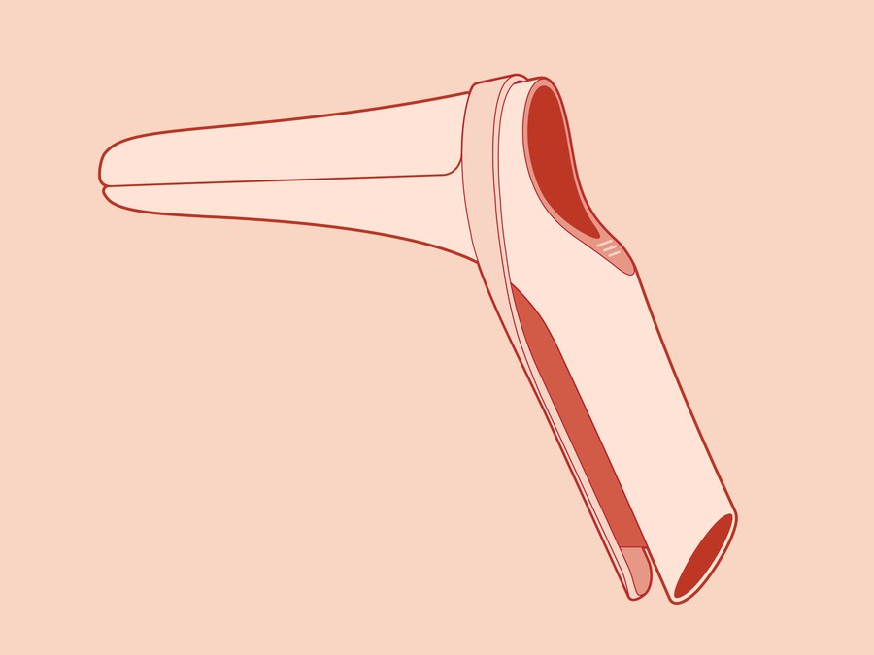
Current Design Status
Equality, Diversity, Inclusion and Ethics
New design being undertaken by Frog
Women involved in the design
Physicians involved in the design
App being created to aid both physicians and patients in education
Some design technology from the vibrator industry
Prototype tested on consenting volunteers
[15] A. Pardes, “The Speculum Finally Gets a Modern Redesign,” Wired. https://www.wired.com/story/the-speculum-finally-gets-a-modern-redesign/
‌
44

Slide 45
Recap
Equality, Diversity, Inclusion and Ethics
Overview
Intro
CPD & CVs
EDI
EDI + Ethics
EDI + Test
Teamwork
Teams + Leaders
Teams + Test
Decisions
Decisions + Quality
Decisions + Test
Support
Essay Planning
Wrap Up
Define key terms in EDI & Ethics
Summarise the Equality Act 2010
Give examples of different EDI approaches from industry & academia
Identify your own ethical code
45

Slide 46
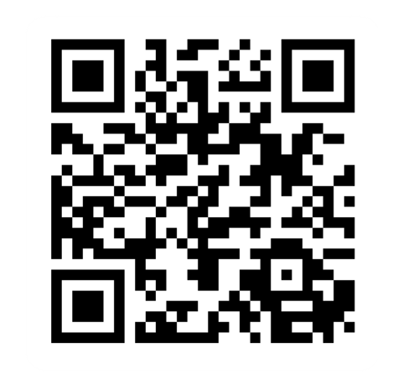
Provide feedback!
https://forms.office.com/e/pHBZpniFvB
If you used this resource, please take the time to fill out this form to provide your feedback.
If you have any questions or require more information about the REET (Resources for Embedding EDI in Teaching) project, please contact the Project Lead using the following contact details:
Chloe Agg c.agg@imperial.ac.uk

