Slide 1
Summary and Assessments
EDI in Engineering Module
[insert speaker’s names]

Slide 2
Overview of session
Summary of legislation and EDI frameworks
Summary of lecture content
Examples of student led initiatives
Assessment and rubric overview

Slide 3
Legislation and Frameworks
Equality Act 2010
Wheel of Power and Privilege
Equity Compass
Equality Impact Assessments (EIA)
Intersectionality
Notes:
Equality Act 2010 is the legislation that underpins EDI action in the UK. EIAs are part of this legal framework.
Useful to think about our speakers and how/if they fit these frameworks. Consider each of the speakers’ positionality, useful for reflection
There are strengths and limitations to legislation and frameworks. Not all groups are covered by the Equality Act but are still important, for example, socioeconomic background. Additionally, legislation isn’t fixed, it can change.
When designing initiatives, it is useful to consider intersectionality and how you can’t think of protected characteristics in isolation
Just a reminder that these frameworks are these to help you think of your initiatives critically

Slide 4
Gender Reassignment (Trans/nonbinary)
Marriage and civil partnership
Age
What protected characteristics were covered by our guest lecturers? Was any group missing?
Pregnancy and maternity leave
Race
Religion or belief
Sexual orientation (LGBTQ+)
Sex (gender)
Disability
Notes:
Do you think some topics were covered in greater depth than others?

Slide 5
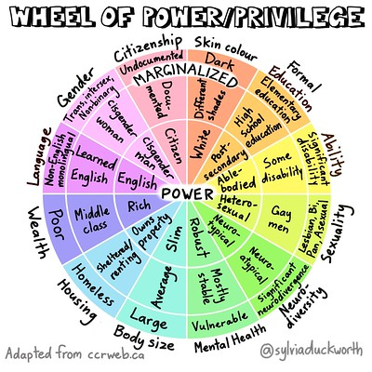
Wheel of power and privilege
Think of the positionality of our guest speakers. Does that influence your perceptions of their content?
[1]
[1] Lydia, “Privilege Wheel,” York Disability Rights Forum, Sep. 19, 2021. https://ydrf.org.uk/2021/09/19/privilege-wheel/
‌

Slide 6




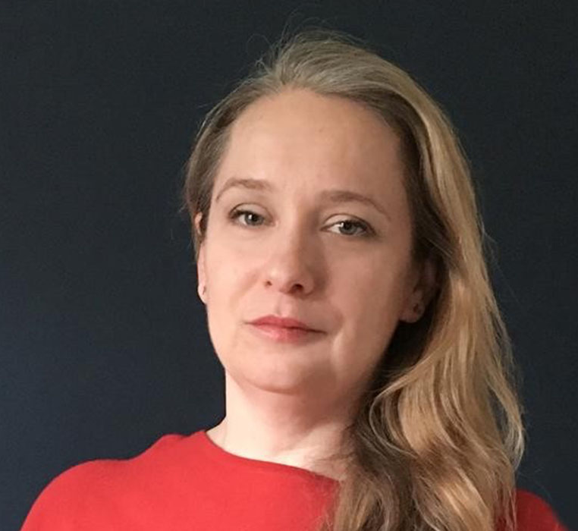
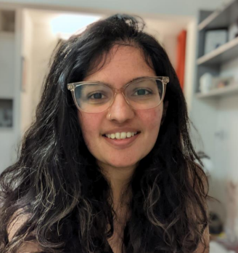



Guest speaker summary
What do you think are the common themes/links from the talks by our guest speakers?

Slide 7
Group Exercise 1
Think about initiatives you are aware of:
        Who is the target audience?
        How well is it communicated?
        What’s the purpose, does it effectively achieve this?
        What resources does it need?
        How is it evaluated? If at all...? [How should it be evaluated?!]
Examples:
        WIME, ND revision sessions, Scholarships/Bursaries, Mentoring

Slide 8
EDI Seed Fund – up to £2,000 per project
https://www.imperial.ac.uk/equality/activities/seed-fund/
Julia Anderson Training Programme - secondary school outreach
Ann-Sophie Pieters and Nicolette Davies, from the institute of Global Health Innovation, will develop a secondary school outreach initiative to raise awareness and encourage applications to the Julia Anderson Training Programme - a scheme that offers paid work experience to people who have no, or limited, prior work experience.
LGBTQ+ students of Imperial
Avani (Avi) Ela Kaura, LGBTQ+ Officer 2023-24, and third year medical student, will produce a video exploring students experiences and to raise awareness of support available, for LGBTQ+ History Month 2024.
Notes:
Find blank copy of application form to explain the remit/conditions of the funding

Slide 9
EDI Seed Fund – up to £2,000 per project
Women & Non-Binary in Physics: UG to PhD Mentoring Scheme
Isabel Rabey and the Society for Women & Non-Binary Individuals in Physics will establish a mentoring scheme that will support and encourage women and non- binary students to pursue postgraduate research in physics.
Meet the author book club sessions
Wayne Mitchell, Department of Immunology and Inflammation, and Sharon Datt, alumni, will host a monthly book cub event to highlight a minority writer and to raise awareness and provided greater insight in the intersectionality of the lived experience and how this is visible in their books.
Notes:
Not an exhaustive list, just a sample of the types of projects funded

Slide 10
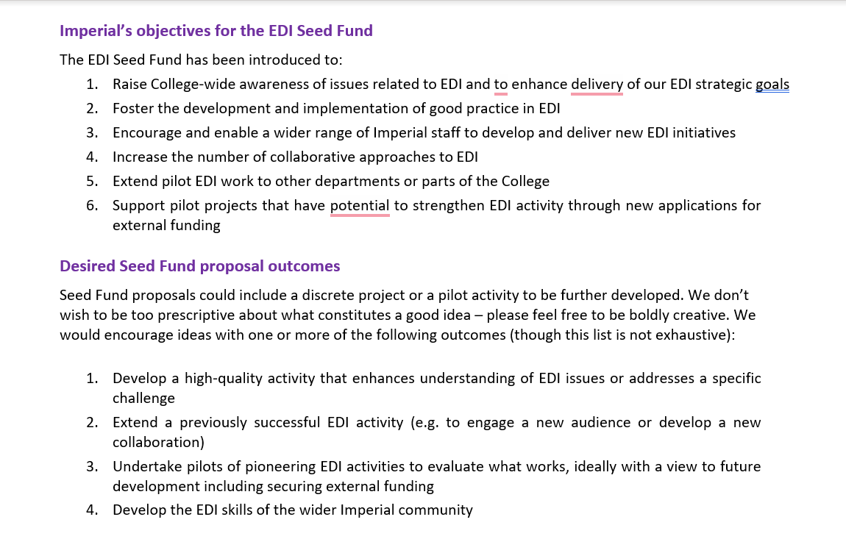
EDI Seed Fund
Notes:
Share the document on the screen

Slide 11
EDI Seed Fund at MechEng
Mental health awareness explainer videos at Mechanical Engineering
Dr Antonis Sergis and Sophia Quazi (Department of Mechanical Engineering) will develop short video clips about frequently encountered mental health topics.
Type of evidence we gathered
People we consulted
Goals and what we hoped to achieve
Communication and deliverables
Evaluation
Notes:
Share screen and show the application form

Slide 12
More examples of initiatives
Outreach event in Nigeria
Two day coding camp for a girls’ school in Nigeria
Initiative as part of International Day of Women and Girls in Science
Funding/activity as part of departmental Athena SWAN action plan
Latin American Symposium
Two day conference to connect and spread awareness of the Latin American community at Imperial
Science communication – showcasing work from Latin American colleagues
BBSTEM
A non-profit organisation campaigning for balance and representation of Black individuals in STEM
Includes a job posting board
Mentorship scheme
Outreach events in school
Notes:
Examples funded outside of the EDI seed fund

Slide 13
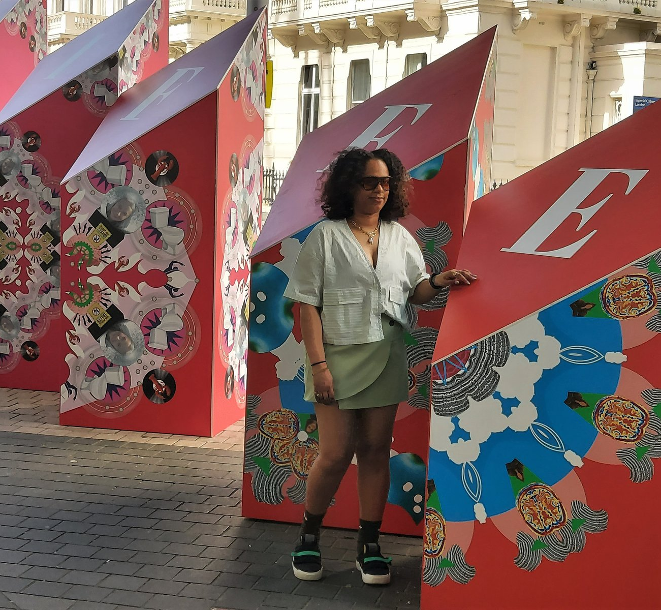
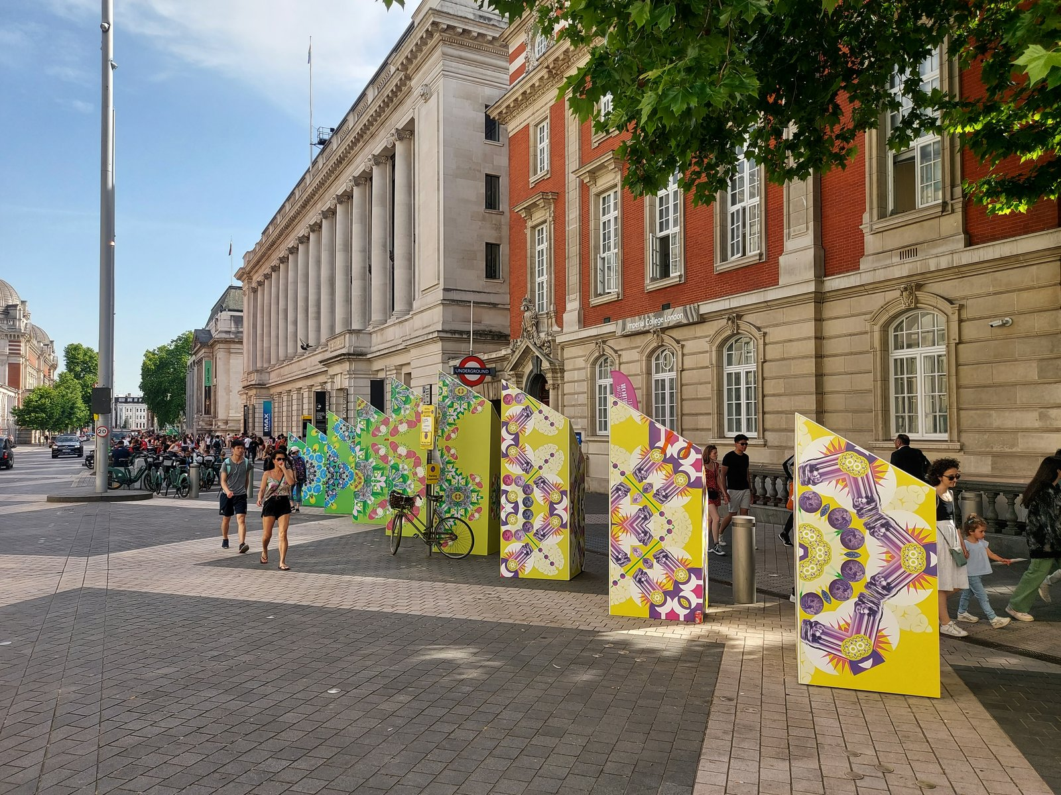
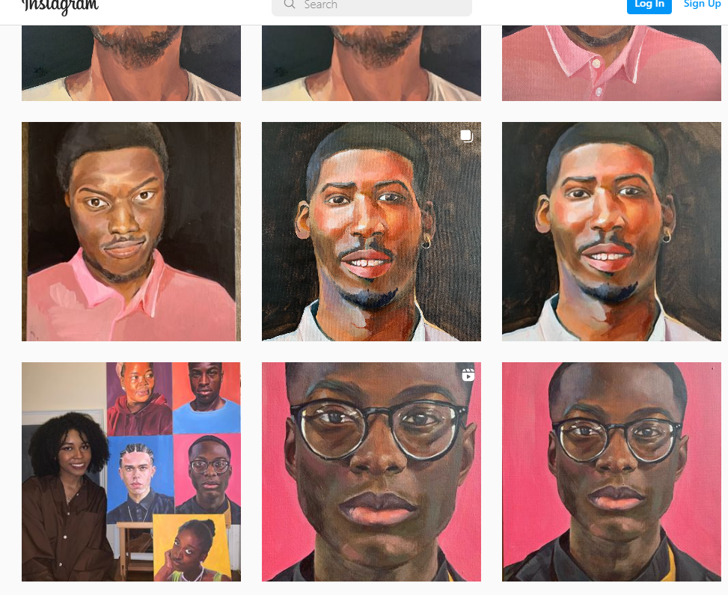
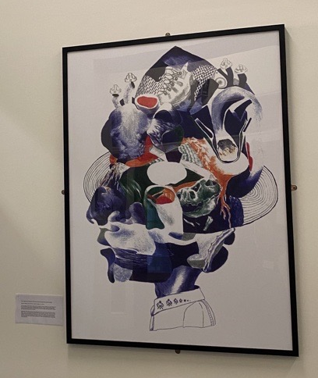
Further examples of initiatives
UROP project that created this module
UROP project on the experience of neurodiverse/neurodivergent students at MechEng
Black People of Imperial
Kaleidoscope Minds – Thinking differently
Watson Forum – Promoting Women in STEM
Artwork created by student at ESE – outcome of History Group Report
Student Networks – Women at MechEng
Staff Networks
Notes:
There are a couple of staff initiatives listed here too. These initiatives are all Imperial based. Some of these might inspire the communication strategy for your initiative. I’ve included networks as that can be an initiative as well. You might enter a workplace that doesn’t have a network that represents a group you belong to and decide to create one. One of our guest lecturers mentioned staff starting a neurodiverse staff network.

Slide 14
Optional group exercise 2
Reflecting on these initiatives think of the following:
        The group the initiative is aimed towards
        Sector or area the initiative is targeting
        Who is the participant of this group? Students, staff, general public etc
        With the 3 points in mind, How would you evaluate these initiatives?

Slide 15
EDI in Engineering
Assessment and Rubrics

Slide 16
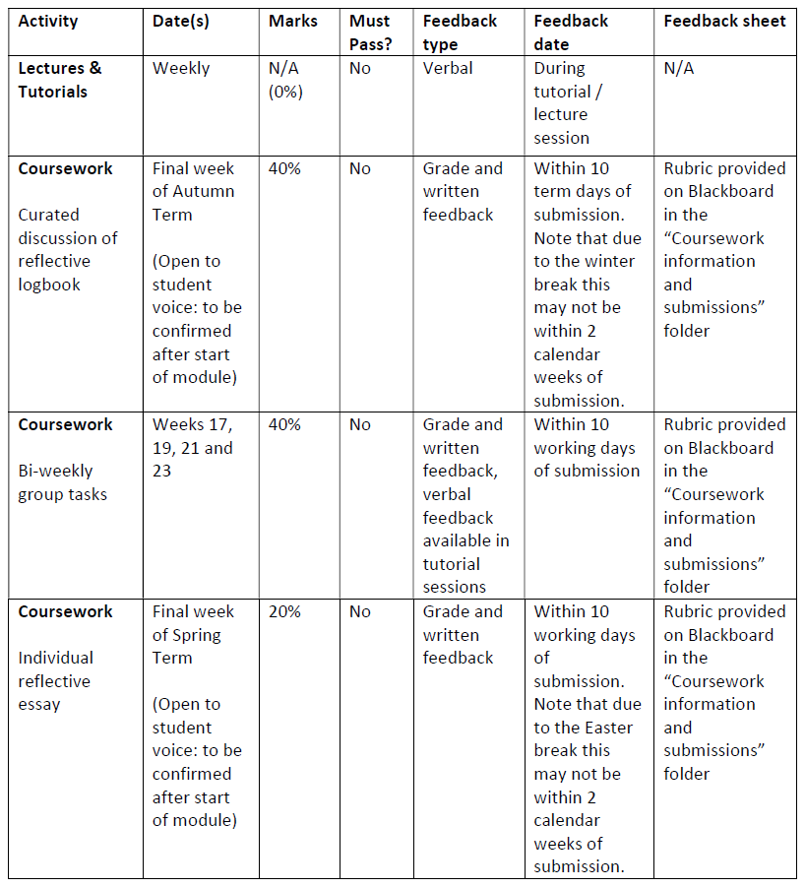
Logbook: 9th January
Bi-weekly:
Justify – 24th Jan
Design – 7th Feb
Plan – 21st Feb
Comms – 7th March
Formative Peer Assessment: 8th March
Individual Essay: 28th March

Slide 17
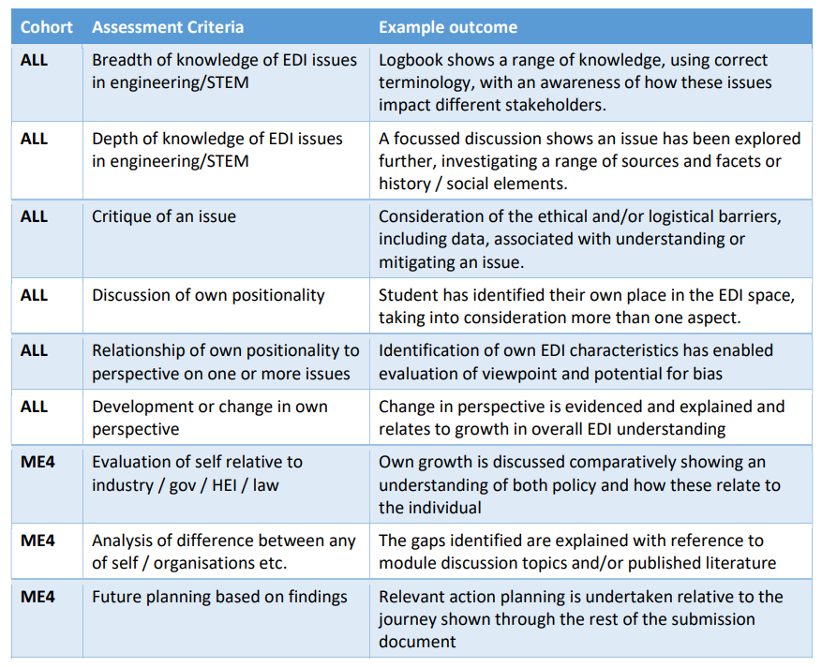
Curated Logbook

Slide 18
Curated Logbook
Created from logbook entries
500-750 words of new work to explain the curation
Demonstrate growth in EDI
Identify and evaluate key issues
Evaluate one’s own positionality and development

Slide 19
Curated Logbook - ME4
"ME4 students will be required to relate their own positionality and reflective growth to that of the EDI policy, strategy or report of at least two organisations (e.g. the university and a company they have an interest in) or a change in legal requirements"

Slide 20
Curated Logbook - Tips
Show clear difference between original logbook and new curation
Use curation to show a developmental journey
Use these questions to kick start your planning:
        What are ~three key points you have learnt during this term?
        What was the most surprising or “eye opening” thing you have learnt (and why was this surprising)?
        How has or will this learning affect your behaviour?

Slide 21
Bi-weekly Group Tasks - Initiative
Justify your chosen area of initiative (25% Max 2 sides A4)
Design the initiative (25% Max 5 min presentation)
Plan the evaluation (25% Exemplar plus max 500 words)
Develop communications strategy and materials (25% Poster/video plus max 500 words)

Slide 22
Bi-weekly Group Tasks - Initiative
[inset link to rubric]
[inset QR to rubric]

Slide 23
Individual Essay Rubric
Students will carry out a formative peer assessment based on their input and behaviours on the biweekly group tasks, using a structured template. Based on their formative peer assessment feedback, students will write an essay reflecting on;
their peer feedback, including whether they perceive it to be fair and accurate
their own positionality and how this will have impacted their interactions with the team
their teammates’ perceived positionality and how this will have affected their perceptions
what they could do, with respect to EDI, to ensure a team had balanced peer assessment marks / distribution of workload in the future
Learning Outcomes
The individual essay is intended to specifically address the following learning outcome:
Evaluate one’s own positionality and personal development as well as changes to thinking through reflective practice

Slide 24
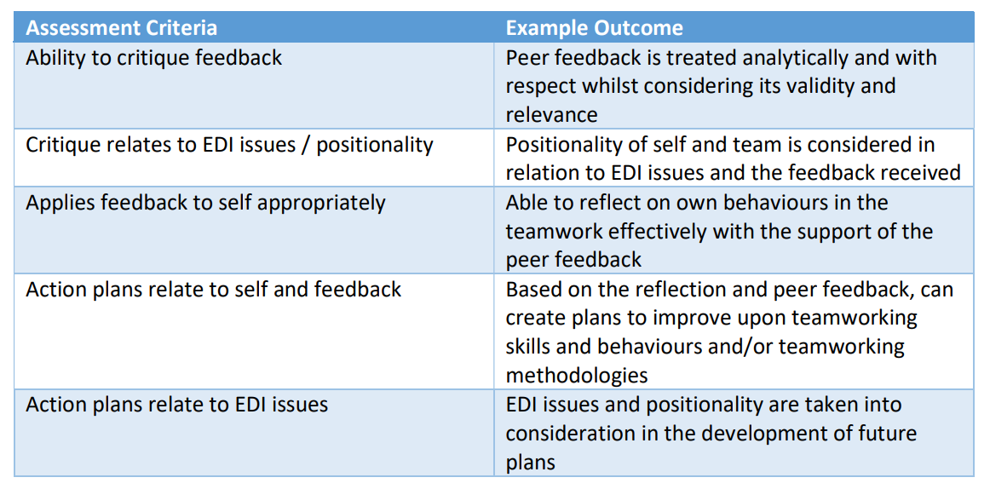
Individual Essay Rubric

