Slide 1
Equality, Diversity and Inclusion in [insert department (i.e. Engineering)]
Positionality
[insert speaker’s names]

Slide 2
Today’s Learning Outcomes
Gain an awareness of EDI tools and their limitations
Gain an awareness of the 3 primary models of EDI and how these relate to positions of power and perspectives
Practice criticality in an EDI context
Develop reflexive practice skills and consider how reflection mode relates to perspective

Slide 3
Session Plan
[9.00-9.10]
Intro
[9.10-9.30]
[9.30-9.40]
P v D
Models
[9.40-9.50]
Discuss
WPP
WPP Activity
[10.00-10.20]
Refle(ct)
[9.50-10.00]
Break
[10.20-10.45]
EIA
[10.45-10.50]
Notes /
Discuss
Activity
Queries
Notes:
[Change timings]

Slide 4
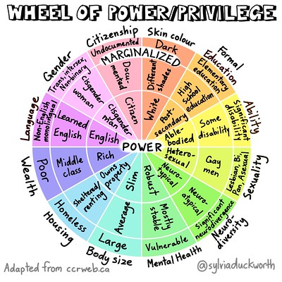
Wheel of Power and Privilege
Sylvia Duckworth
Kimberlé Crenshaw
Intersectionality continued…
[1]
[1] Lydia, “Privilege Wheel,” York Disability Rights Forum, Sep. 19, 2021. https://ydrf.org.uk/2021/09/19/privilege-wheel/
‌

Slide 5
Wheel of Power and Privilege - Activity
Draw
Self
Aspire
Discuss
Spread
Critique
Position affects perspective
Reflect
Admire
F/F
Impact
Agree?
Constant?
Missing?

Slide 6

Positions of Power
Prejudice vs Discrimination
Race
Sexuality
Parenthood
Age…

Slide 7
Models of EDI
Deficit / Medical Model (Individual level “blame”)
Structural (Systems and processes)
Socio-psychological (Society and belief)

Slide 8

Discussion - Whose responsibility is it?

Slide 9

Break + Attendance Register
[insert QR for link to menti to register students]
Menti code: [insert menti code]

Slide 10


Reflective vs Reflexive Practice
Self: Mirror: Post Event
Context: Action: During Event

Slide 11
Why be reflexive
Mark Scheme
Positions of Power

Slide 12
Activity – Developing Logbooks
Review previous entry, with a peer or alone
Reflective or reflexive…how could you improve your practice?
[insert speaker’s names] to support

Slide 13
Equality Impact Assessment (EIA)
PSED – Public Sector Equality Duty
      Requires public bodies to consider all individuals when shaping policy.
It also requires that public bodies have due regard to the need to:
      Eliminate discrimination
      Advance equality of opportunity
      Foster good relations between different people when carrying out their activities
EIAs are a tool for public bodies to prompt considerations of impact on different protected groups and provide evidence of these considerations.

Slide 14
What does an EIA look like?
Many template styles, but most follow similar steps/themes:
      Space to define what the policy, procedure, initiative, etc is
      What type of evidence are you using?
      Who have you consulted with? What types of consultation has taken place?
      Consideration for each of the protected characteristics
      Monitor and review – How do you plan to monitor the change/policy/initiative? How often will you review this?

Slide 15
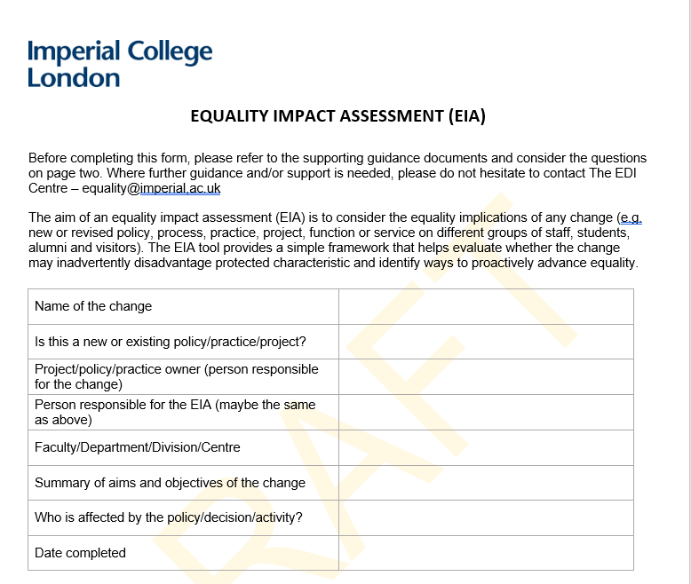
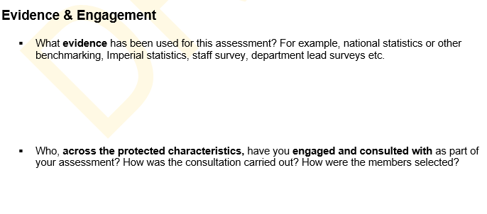
What does an EIA look like?

Slide 16
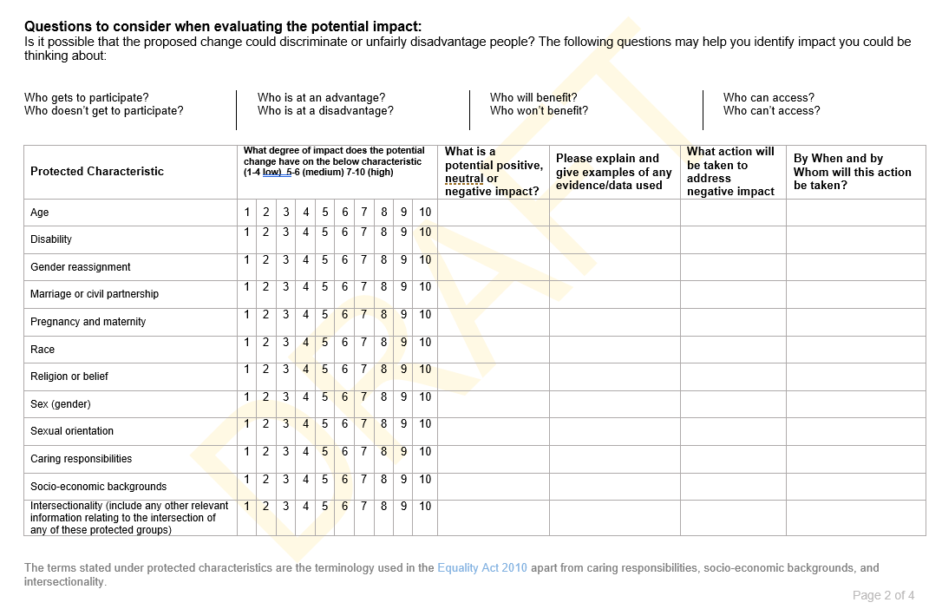
What does an EIA look like?

Slide 17
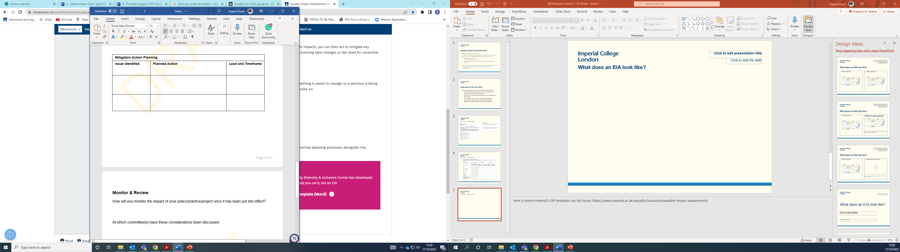
What does an EIA look like?

Slide 18
Examples
Event planning –
      Are there diverse speakers?
      Is the venue where the event is taking place accessible?
      Are there prayer facilities in the building or nearby?
      Does the event clash with a religious holiday?
      Is the session being recorded for people who cannot attend in person?
      Is the event taking place at a time suitable for individuals with caring responsibilities?
      So many more considerations

Slide 19
Questions?

Slide 20
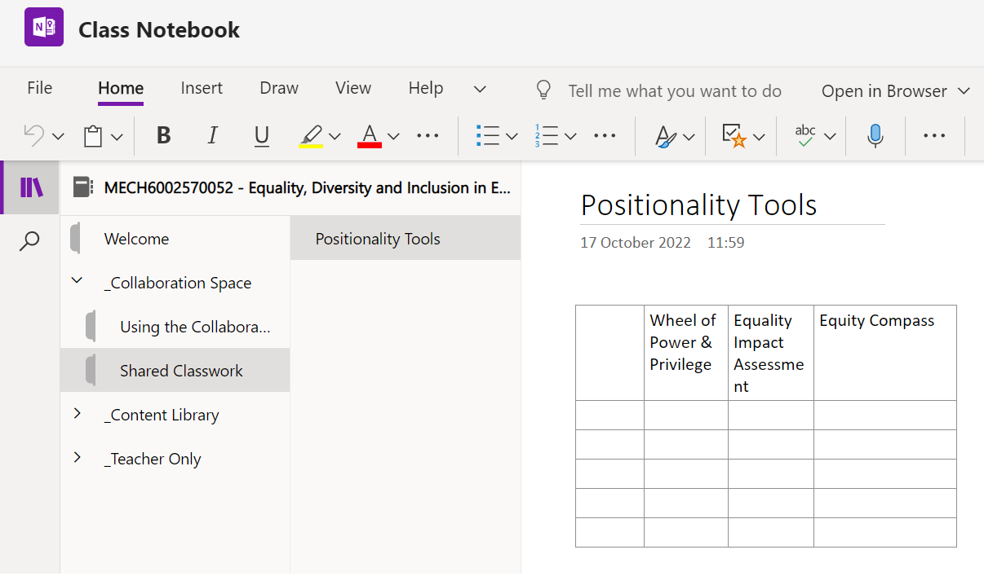
Comparisons - Discussion
Teams / Class Notebook / Shared Classwork / Positionality Tools

Slide 21
Comparisons - Discussion
Equity Compass (learnt from core reading)
Equality Impact Assessment (learnt from Sophia’s section)
WPP (learn via this morning’s first activity)
What are the key differences
Where might you use each of these?
What are the issues with these tools?

Slide 22
Critique
As per previous: What are the issues with these tools individually?
What are the issues with these tools collectively/cumulatively?
What are the limitations of your own analysis?
What are the limitations of the reading?
What are the limitations of our teaching?

Slide 23
Today’s Learning Outcomes
Gain an awareness of EDI tools and their limitations
Gain an awareness of the 3 primary models of EDI and how these relate to positions of power and perspectives
Practice criticality in an EDI context
Develop reflexive practice skills and consider how reflection mode relates to perspective

Slide 24
Attendance Register:
[insert QR code for student registration]
Menti code: [insert menti code]

Slide 25
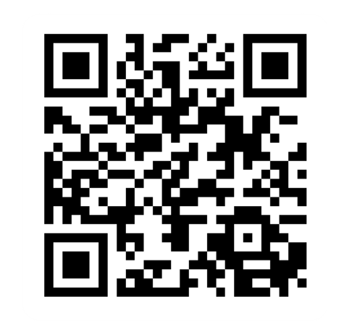
Provide feedback!
https://forms.office.com/e/pHBZpniFvB
If you used this resource, please take the time to fill out this form to provide your feedback.
If you have any questions or require more information about the REET (Resources for Embedding EDI in Teaching) project, please contact the Project Lead using the following contact details:
Chloe Agg c.agg@imperial.ac.uk

