Slide 1
Equality, Diversity and Inclusion in [insert department (i.e. Engineering)]
Introductions
[insert speaker’s names]

Slide 2
Purpose of Today
Introduce the module
Explain teaching patterns and assessment methods
Discuss and define Equality, Diversity and Inclusion
Set the scene for EDI in the department and the University
Discuss, record and reflect

Slide 3
Session Plan
[9.00-9.10]
Intro
[9.10-9.15]
Video
UROP
[9.15-9.30]
Module
[9.30-9.50]
EDI Activity
10.00-10.20
Define
9.50-10.00
Break
10.20-10.30
Discuss
10.30-10.50
Note taking
Reflect
Data
Notes:
[Change session timings}

Slide 4
Module Leaders
[insert image of module leader]
[insert image of module leader]
[insert image of module leader]
[insert name for module leader]
[insert name for module leader]
[insert name for module leader]

Slide 5
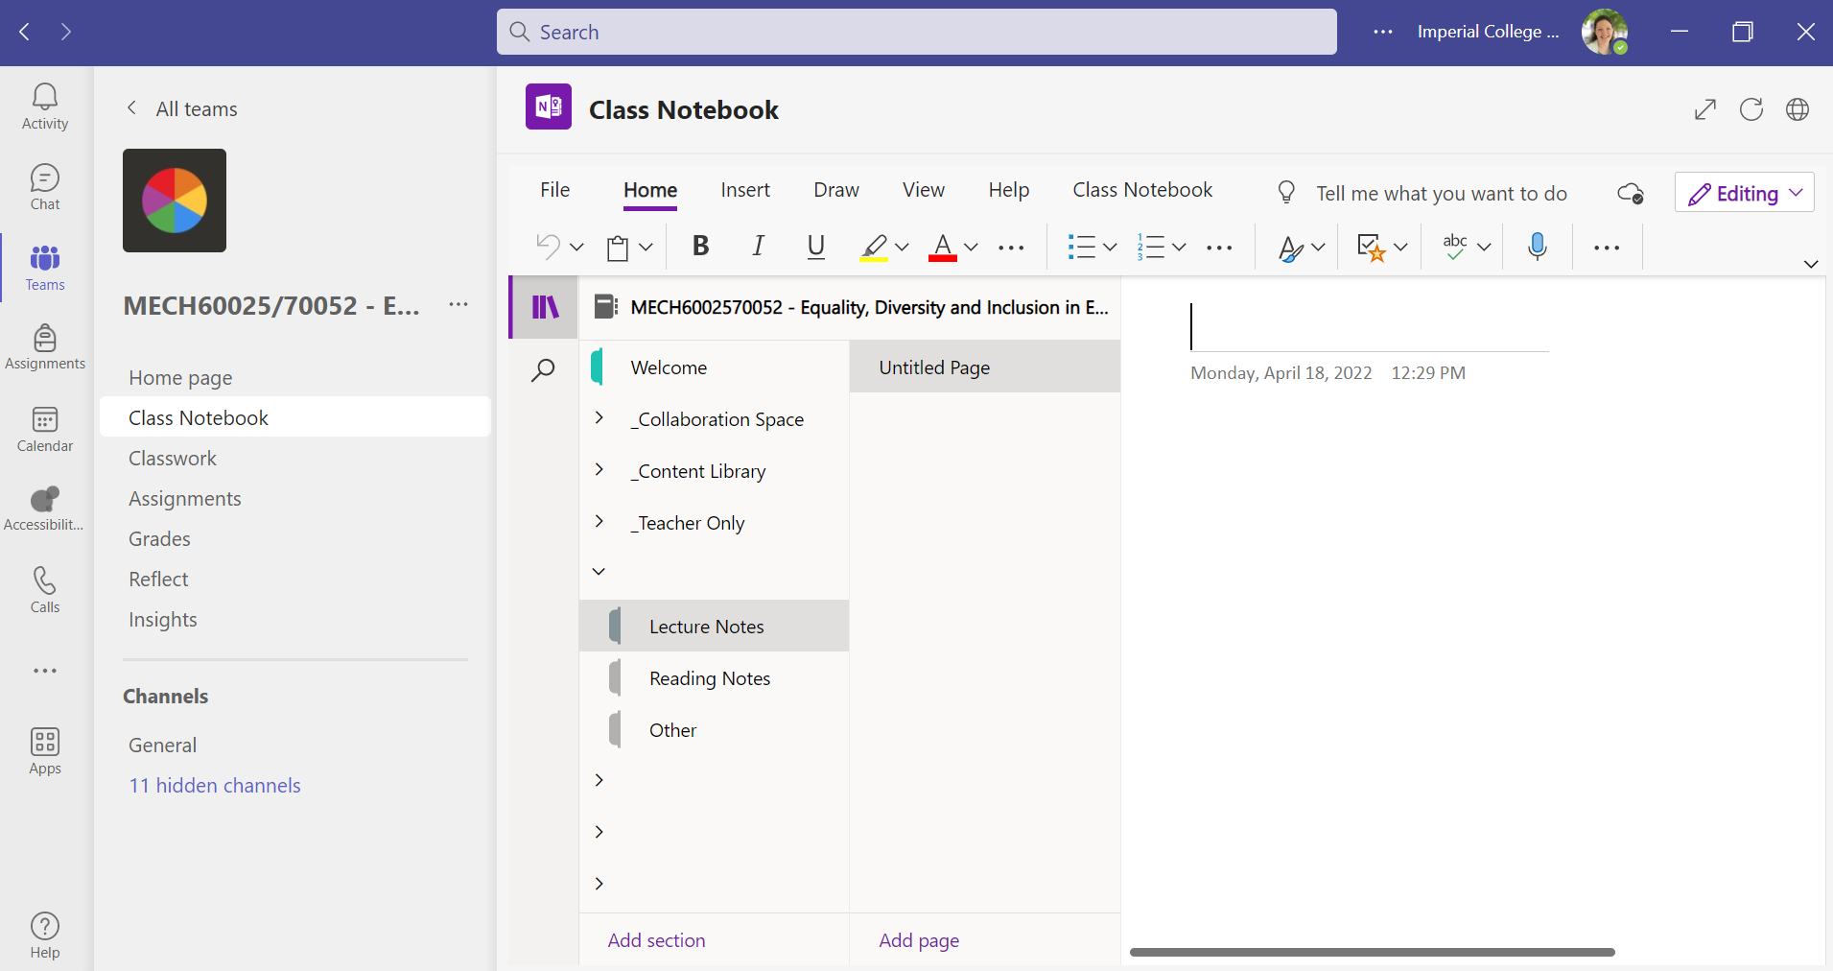
VLE – Imperial Mechanical Engineering EDI Blackboard and Teams
Student Name

Slide 6
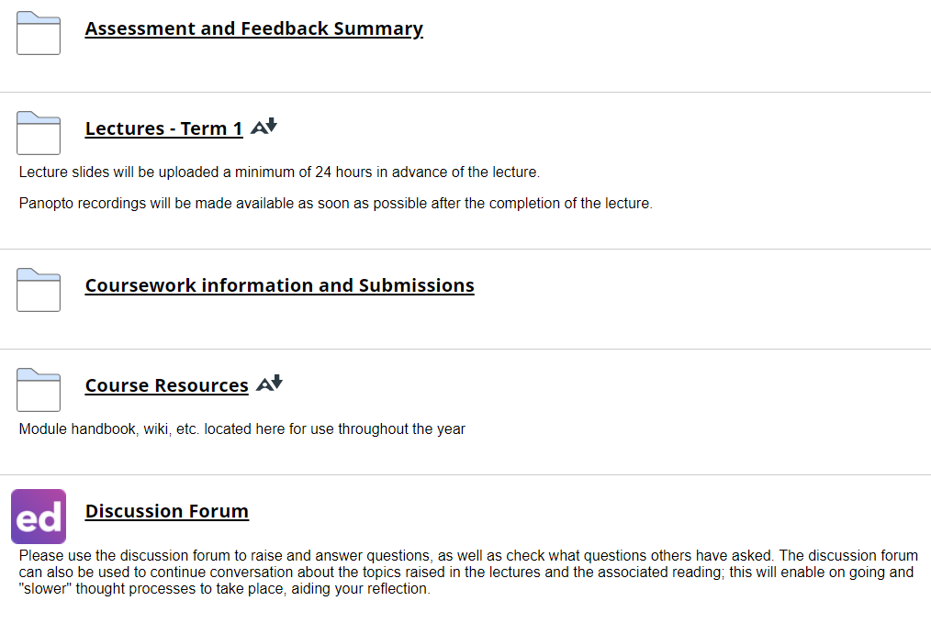
VLE – Imperial Mechanical Engineering EDI Blackboard and Teams

Slide 7
Teaching Pattern – Autumn Term - Weekly
Pre-Read
1-2 sources
2 hours
Lecture
2 hours
Reflect
Logbook
30 mins
Learn & Discuss
Depth
More sources
2 hours
Depth
More sources
2 hours

Slide 8
Guest Speakers
Own Voice
Topic Experts
Limitations!
Diverse Demographic
Variety of Perspectives

Slide 9
Teaching Pattern – Spring Term - Weekly
Group
Cwk
3 hours
Tutorial
1 hour
Reflect
Essay
Activities
Assess
Biweekly
Cwk
15 mins

Slide 10
Expectations
Facilitation
Live Feedback
Scheduled Availability
Group to Group
Structured Sessions
Compulsory Attendance

Slide 11
Assessment
Logbook
40%
Individual
Initiative
40%
Group
Essay
20%
2x A4 pages
Curated
Yr 3 ≠ Yr 4
4x A4 pages
4 Tasks
Bi weekly
Format Varies
Individual
Peer Feedback
Positionality

Slide 12
Have your say…
Assignment deadlines
[add link to mentimeter for students to suggest deadlines]
[add QR code to mentimeter for students to suggest deadlines]

Slide 13
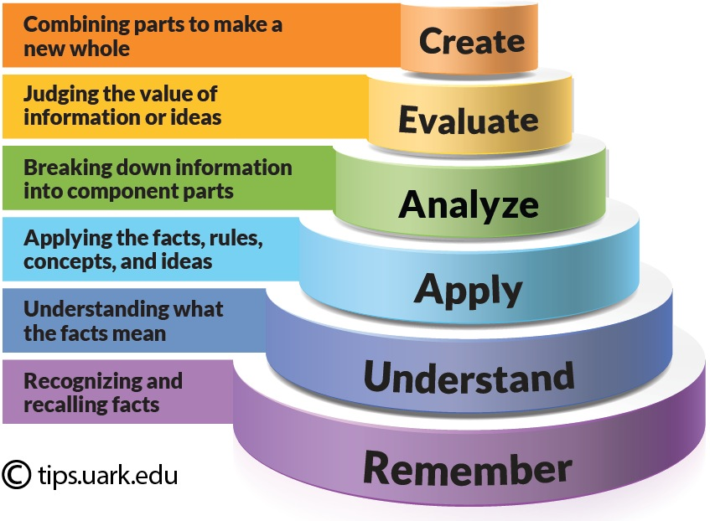
Academic and Technical Rigor
Critical Analysis
Citation
Comparison and benchmarking
Systematic review
Engineering processes
[1]
[1] amoore9, “Curriculum Corner: Bloom’s Taxonomy: Create | Tennessee 4-H Youth Development,” Jan. 06, 2017. https://4h.tennessee.edu/curriculum-corner-blooms-taxonomy-create/ (accessed Jul. 23, 2024).
‌

Slide 14
Group Activity
Groups 1 & 2 – What is Equality
Groups 3 & 4 – What is Diversity
Groups 5 & 6 – What is Inclusion
~7 minutes to discuss in small groups
~7 minutes (1 minute per team) to share

Slide 15
Critique
Considering definition activity and outcomes;
What are the limitations?
How has the context informed the outcome?
What is the evidence basis?
How could this evidence be improved upon?
What else should we question…?

Slide 16

Break + Register
[Add QR code to menti meter to register student attendance ]
[Add link to menti meter to register students]
CODE: [Add code to menti meter]

Slide 17
Introduction to EDI
Equality Act
PSED – Public Sector Equality Duty
Gender and Ethnicity Pay Gap
Protected characteristics

Slide 18
Introduction to EDI
Equality Act 2010 – protects people from discrimination in the workplace and wider society
PSED – Public Sector Equality Duty – requires public bodies to consider all individuals when shaping policy. It also requires public bodies to publish compliance information to the Equality Duty. Imperial publishes a PSED report annually.
Gender pay gap – employers with a headcount of 250 or more must report gender pay gap data. This was established in 2017. Reporting on the ethnicity pay gap is currently not a legal requirement.
Protected characteristics are part of the Equality Act– How many are there? Can you name them all?

Slide 19
Protected characteristics activity
Gender Reassignment (Trans/nonbinary)
Marriage and civil partnership
Age
Pregnancy and maternity leave
Disability
Race
Sexual orientation (LGBTQ+)
Religion or belief
Sex (gender)
Notes:
Can you list the protected characteristics? Feel free to call them out
These are the characteristics legally defined in the Equality Act 2010. Some terms have been up for consultations, such as gender reassignment. This is not a term that people from the trans and nonbinary community feel the most comfortable with.
There are also other groups not covered by protected characteristics. For example class. Though class is not included, it is something we think about when delivering EDI strategies and initiatives.

Slide 20
Intersectionality
Gender Reassignment (Trans/nonbinary)
Marriage and civil partnership
Age
Pregnancy and maternity leave
Disability
Race
Sexual orientation (LGBTQ+)
Religion or belief
Sex (gender)
Notes:
It’s important not to think of protected characteristics in isolation. Intersectionality exists. People can have more than one protected characteristic and that can impact how they navigate the world differently. The term intersectionality was coined by American lawyer and scholar Kimberle Crenshaw.

Slide 21

Notes:
Video with Kimberlé Crenshaw explaining how intersectionality can be used as a tool or framework for understanding different types of identity

Slide 22
Data – Prompts for further investigation
Female students - UG
Department | Year 1 | Year 2 | Year 3 | Year 4 | Total
Mechanical Engineering | 44 | 39 | 36 | 35 | 154
Full- and part-time combined | Declared Disability
Department | Learning difficulty | Mental health | No disability | Other disability | Grand Total
Mechanical Engineering | 54 | 35 | 830 | 96 | 1015
Notes:
Data is important in terms of understanding what areas initiatives/interventions should target. Demographic data is useful but it is also important to consult with people to understand their needs before planning any type of EDI initiative.
*some categories were deleted as numbers were too low but still included in the grand total
The main focus, ethnicity and gender for UG students
The other stat is the overall College number of students who have disclosed a disability. Disability and sexual orientation tend to have low disclosure rates. It is usually due to societal stigma.
Student records webpage: https://www.imperial.ac.uk/student-records-and-data/for-staff/student-statistics/2022-2023/
PSED Data: https://www.imperial.ac.uk/equality/governance/

Slide 23
EDI @ Imperial
Imperial publishes a PSED report annually. The bottom of the webpage includes a spreadsheet of staff and student data. Granularity is limited so staff and students are not identifiable
Gender and Ethnicity Pay Gap – Imperial has started publishing both.
EDI Strategy
Committees and working groups – There are central College groups and local departmental EDI Committees
Charter marks/ Accreditations – Higher Education (HE) and non-HE specific
Staff Networks
Student Societies

Slide 24

Discussion

Slide 25

Record and Reflect

Slide 26
Have your say…
Assignment deadlines
[add link to mentimeter for students to suggest deadlines]
[add QR code to mentimeter for students to suggest deadlines]

Slide 27
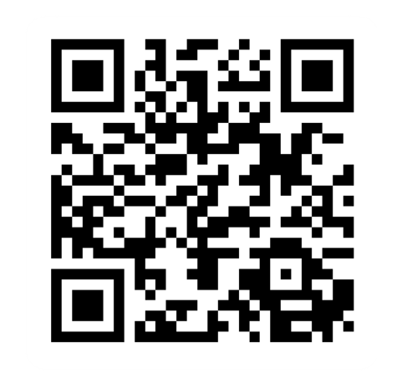
Provide feedback!
https://forms.office.com/e/pHBZpniFvB
If you used this resource, please take the time to fill out this form to provide your feedback.
If you have any questions or require more information about the REET (Resources for Embedding EDI in Teaching) project, please contact the Project Lead using the following contact details:
Chloe Agg c.agg@imperial.ac.uk

