Slide 1
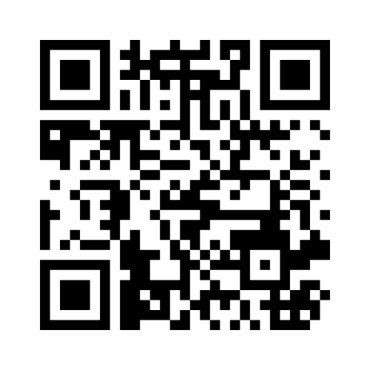
Sustainable models for academic integrity:
A cross-disciplinary exploration (panel discussion)
menti.com code
1592 2155
Natasha Croome, School of Public Health
Anita Hall, Department of Life Sciences
Elizabeth Killeen, Library Services
Thomas Lancaster, Department of Computing
Coco Nijhoff, Library Services (Moderator)
Imperial Festival of Learning and Teaching: Day 2
25/03/2025
Notes:
Welcome
we

Slide 2
Academic integrity
Six fundamental values
Honesty the quality of being free from fraud or deception
Trust the assured reliance on the character, ability, strength or truth of someone or something
Fairness the quality or state of being fair and impartial, with a lack of favouritism
Respect high or special regard, the quality or state of being esteemed
Responsibility the quality or state of being responsible, with moral, legal, mental accountability
Courage the mental or moral strength to venture, persevere, or withstand fear or difficulty
Source: International Centre for Academic Integrity

Slide 3
Prompt #1
Academic integrity, broadly
What are your most pressing concerns about academic integrity in your context?
Please share some successful methods or practices your department has implemented to promote academic integrity (or based on your experience).
menti.com code
1592 2155

Slide 4
Prompt #2
Academic integrity and sustainability
What does sustainability in academic integrity look like, and how can it be achieved?
What strategies can be implemented to foster a culture of academic integrity?
menti.com code
1592 2155

Slide 6
Thank you
Presentation Title
DD/MM/YYYY

