Slide 1
Mapping the curriculum:
Are we developing students’ sustainability competencies?
Nigel Forrest
24/03/2025

Slide 2
Competency?
Knowledge
Skills
Attitudes
Successful Task Completion

Slide 3
What are the main tasks?
→ Sustainability problem-solving framework
create future scenarios
current state analysis
craft sustainable visions
develop transformation strategies

Slide 4
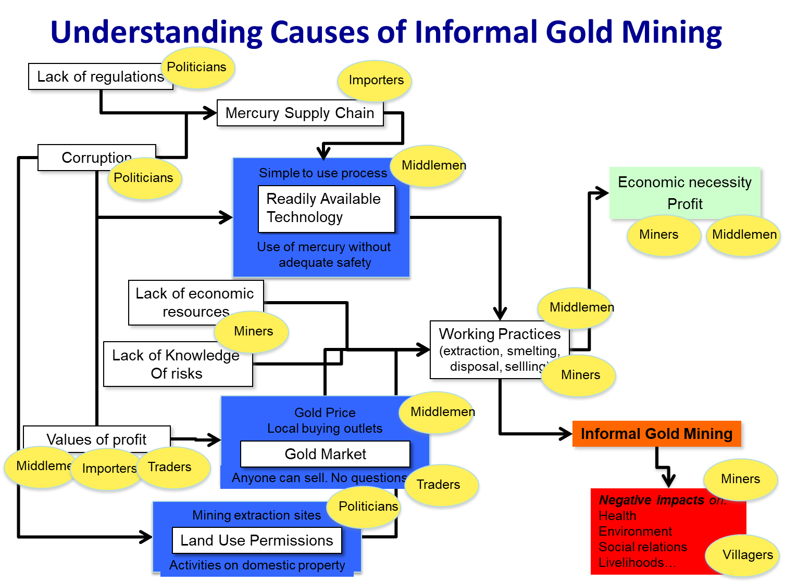
Current state analysis
Notes:
Objective: obtain sufficient understanding of the problem
Make sure it is a sustainability problem!
Use systems analysis methods and models to understand the current state of the problem system, including sustainability assessment
May include historical analysis (how did it get there?)
Identify forces of inertia/resistance, stakeholders and their interests, path dependencies, and leverage points
Informs solution-oriented research

Slide 5
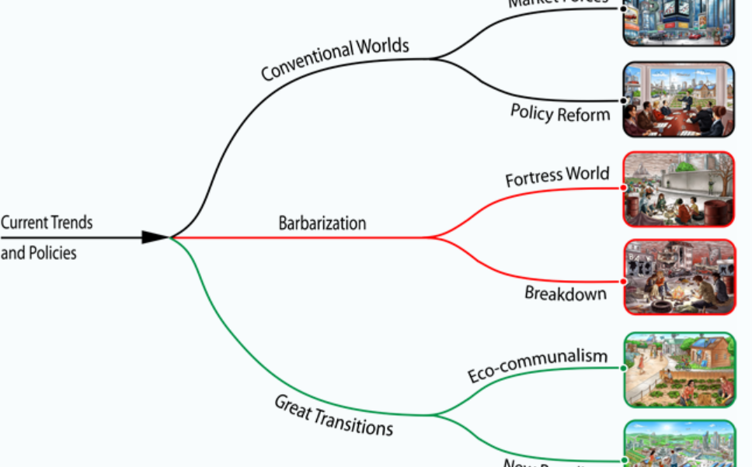
Create future scenarios
https://www.greattransition.org/explore/scenarios
Notes:
Objective: obtain a sufficient understanding of the of problem and possible futures
Optional step
Use scenario construction methods (qualitative + quantitative) to creatively and rigorously scan the future
Identify critical trends and possible futures
Communicate creatively (narratives, visual, experiential, …)
Use to inspire, motivate, inform, explore

Slide 6
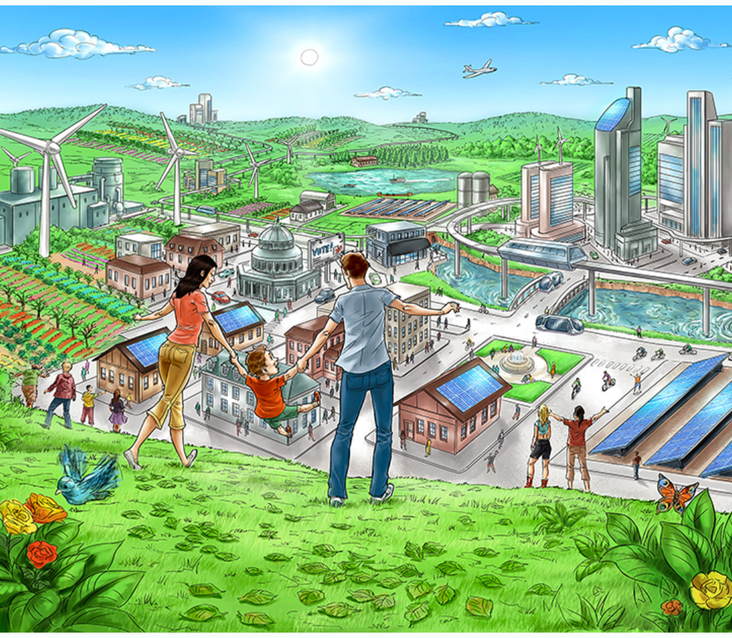
Craft sustainable visions
https://www.greattransition.org/explore/scenarios
Notes:
Objective: create a coherent, sustainable vision of the future
Use visioning method to creatively and rigorously develop a vision
Adhere to rigorous quality criteria
Can be used for a wide variety of entities
Creatively communicate in multiple modes and media
Is one half of the solution: defines the goals to be achieved by strategy building
Engages, inspires, motivates, educates

Slide 7
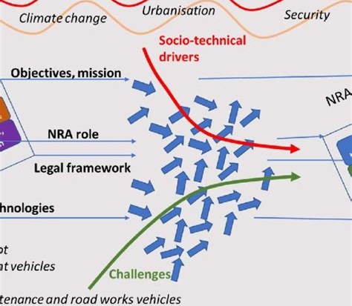
Develop transformation strategies
Notes:
Objective: a dynamic plan to realise the sustainability vision
Is the other half of the ‘solution’ (the means to the solution vision)
Uses tools and methods for innovating, designing, and adapting new or existing solutions
Supported by evidence and ex-ante assessment
Exploits ‘leverage points’ in the problem system as intervention points

Slide 8
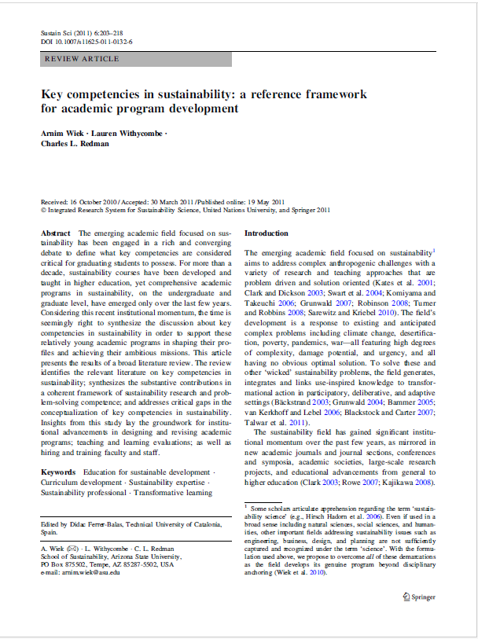
Key competencies for sustainability
Systems Thinking
Futures Thinking
Values Thinking
Strategic Thinking
Interpersonal
Integrated Problem-solving

Slide 9

Systems Thinking
Soft system analysis
Quantitative modelling
Institutional analysis
Causal analysis
Social network analysis
Notes:
Ability to…
analyze complex systems in current and historical context, across domains scales
considering cascading effects, inertia, feedback loops and other systemic features

Slide 10

Futures Thinking (Anticipatory)
Scenario construction / analysis
statistical and simulation modeling
Visioning
Participatory approaches
Notes:
Ability to…
analyze, evaluate, and craft rich “pictures’’ of the future that are plausible
-

Slide 11

Values Thinking (Normative)
Sustainability assessment
Multi-criteria decision analysis
Impact assessment
Risk analysis
Notes:
Ability to…
map, specify, apply, reconcile, evaluate and negotiate sustainability values, principles, goals, and targets

Slide 12

Strategic Thinking
Intervention design
Evaluation research
Change management
Behavioural change
Transition management
Notes:
Ability to…
design and implement interventions, transitions, and transformative governance strategies toward sustainability

Slide 13

Interpersonal / Collaborative
effective communication, listening, inquiry
trust building, non-judgmental interactions
Empathy and inclusivity
Negotiation, conflict resolution
Stakeholder workshops, facilitation
Peer & self-evaluation and reflection
Notes:
Ability to…
motivate, enable, and facilitate collaborative and participatory sustainability projects and problem solving

Slide 14

Integrated problem-solving
Transition management
Organisational change
Intervention design
Integrated foresight & backcasting
Transformational planning
(Wiek et al. 2016)
Notes:
Ability to…
integrate the five key competencies within different problem-solving frameworks to complex sustainability problems and develop viable solution options

Slide 15
Integrated problem-solving
Systems Thinking
Interpersonal
Futures Thinking
create future scenarios
current state analysis
craft sustainable visions
develop transformation strategies
Strategic Thinking
Values Thinking

Slide 16
MSc Environmental Technology
Identify teaching and learning activities
Map to competencies
Are we developing graduates to be sustainability problem solvers?

Slide 17
Unconscious bias and active bystander training
Communication (SGS Video & Poster)
Coping with Eco-anxiety
Concept Mapping
Modelling (human populations)
Measuring biodiversity
Modelling (fish populations)
Risk Perception and communication
Concept maps & SGS policy recommendations
Frameworks for people & nature
Debating
Argument Mapping
Visioning
Six Hats (deliberative techniques)
Transformation / strategies exercise
Team dynamics
Teamwork in practice
Peer Assessment of Groupwork (PAG) in practice
Systems Thinking
Sustainability Problem Solving Framework
Critical analysis (reading, essay writing)

Slide 18
Integrated Problem-Solving
Sustainability problem solving framework;
Systems Thinking
Concept Mapping;
systems thinking;
Modelling (human pop.); Modelling (fish pop.);
Frameworks for people & nature;
Measuring biodiversity;
Critical analysis
Interpersonal
Unc. Bias & Act. Bystander;
Eco-anxiety;
Team Dynamics;
Teamwork in Practice;
Peer Assessment of Groupwork in Practice;
Communications (SGS video & poster);
Futures Thinking
Modelling (human pop.);
Modelling (fish pop.);
Visioning;
Risk Perception & Communication
create future scenarios
current state analysis
craft sustainable visions
develop transformation strategies
Strategic Thinking
Concept map & SGS policy recs;
Transformation / strategies exercise;
Critical analysis
Values Thinking
Measuring Biodiversity;
Risk Perception & Communication;
Six Thinking Hats;
Argument Mapping;
Debating;
Frameworks for people & nature;
critical analysis

Slide 19
Are we developing graduates to be sustainability problem solvers?
YES
Integration?
Awareness?
Weak spots?

Slide 20
Mapping sustainability competencies
Competency analysis
ILO mapping
Assessment mapping
Different disciplines

Slide 21
References
Brundiers, K., Barth, M., Cebrián, G., Cohen, M., Diaz, L., Doucette-Remington, S., Dripps, W., Habron, G., Harré, N., Jarchow, M. and Losch, K., 2021. Key competencies in sustainability in higher education—toward an agreed-upon reference framework. Sustainability science, 16, pp.13-29.
Keeler, L.W., 2015. Arnim Wiek, Michael J. Bernstein, Rider W. Foley, Matthew Cohen, Nigel Forrest, Christopher Kuzdas, Braden Kay and. Routledge Handbook of Higher Education for Sustainable Development, p.241.
Wiek, A., Withycombe, L. and Redman, C.L., 2011. Key competencies in sustainability: a reference framework for academic program development. Sustainability science, 6, pp.203-218.

