Slide 1

Sustainable Learning in Economics
Group Work for Engagement, Collaboration, and Inclusion
Dr Maria Psyllou, Economics and Public Policy
25/03/2025

Slide 2
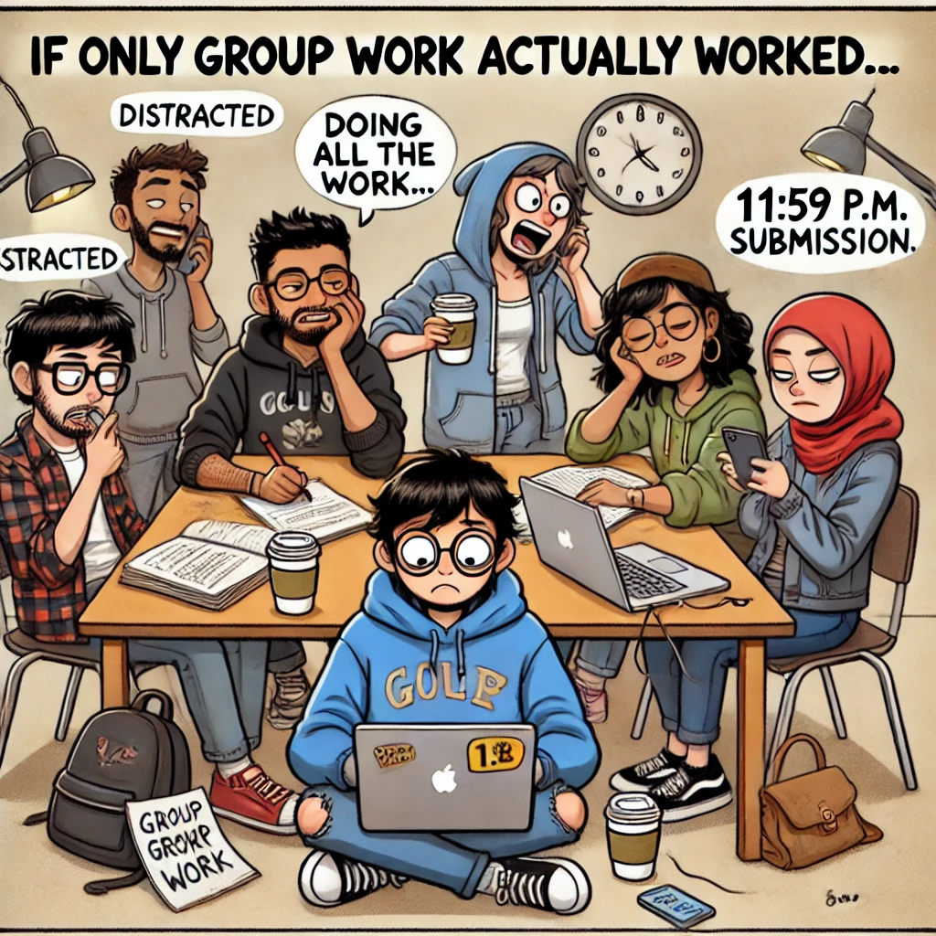
Group Work or Chaos?

Slide 3

Building a Sustainable Future

Slide 4

Setting the Scene
Applied Economics & Statistics, UG Year 1
Small Class Size
Diverse Backgrounds

Slide 5
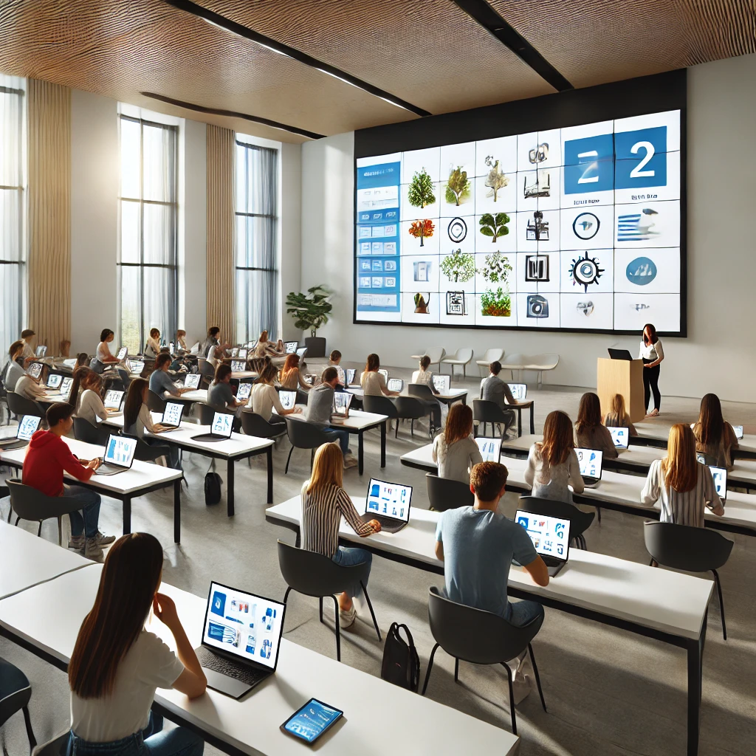
Multimedia Activity

Slide 6
Multimedia Activity
Watch Video
Group Research
Group Presentation
Class Discussion

Slide 7
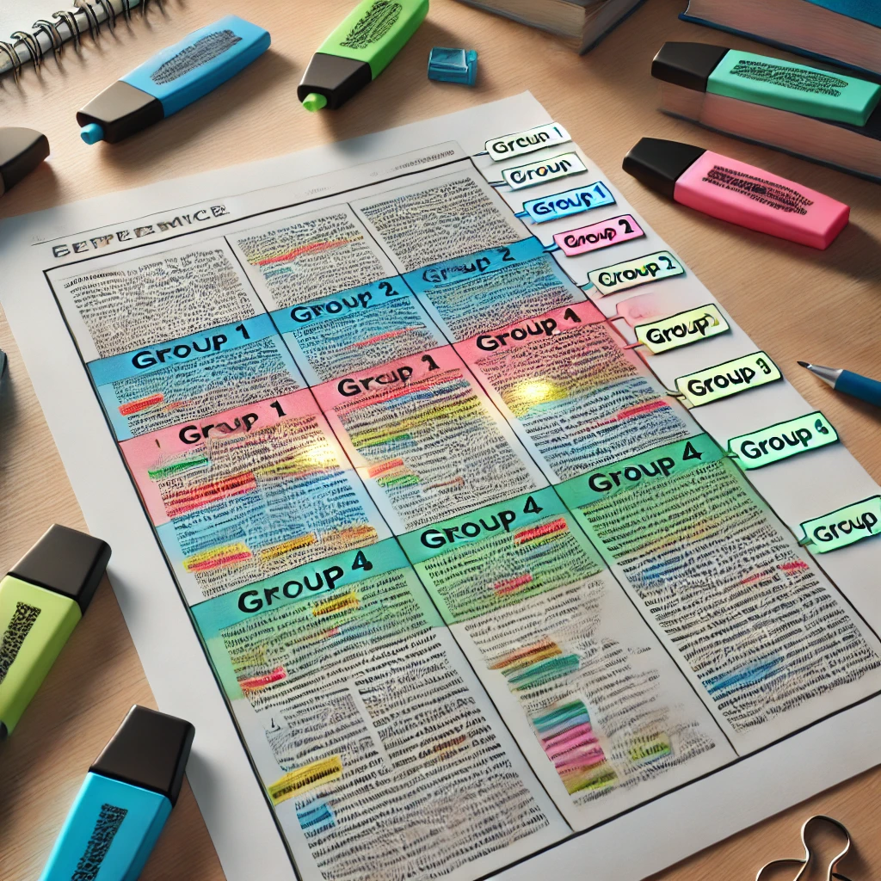
Segmented Article Activity

Slide 8
Segmented Article Activity
Analyse and Summarise One Section
Group Presentations
Peer Evaluation
Class Discussion

Slide 9

Connecting the Dots

Slide 10
What Students Said
Informative, helped improve presentation skills
Enjoyable activity that allowed us to better connect with our group, improve time management
It was great because it was different speaking in front of the class
A group analysis offers several perspectives on the same topic, which is rather eye opening
Very fun and interactive
I believe the activity was very engaging and it was a fun way to enhance our learning.
It was a good bonding experience and I learnt a lot by communicating with my peers
It was great that we cooperate together as a group

Slide 11
What the Numbers Tell Us
 | Strongly Disagree | Disagree | Neither | Agree | Strongly Agree
Communication with classmates improved |  |  | 8% | 52% | 40%
Learned from each other |  |  | 12% | 52% | 36%
Worked well within my group |  |  | 8% | 36% | 56%
More fun learning with each other |  |  | 12% | 36% | 52%
Improved my presentation skills |  | 8% | 16% | 44% | 32%
Improved my confidence on discussing opinions on the topic |  | 12% | 8% | 48% | 32%
Felt more involved |  | 4% | 4% | 60% | 32%
I enjoyed added all the pieces of the article together with my classmates |  |  | 20% | 36% | 44%
Added value on a different aspect of the topics |  | 8% | 16% | 24% | 52%

Slide 12
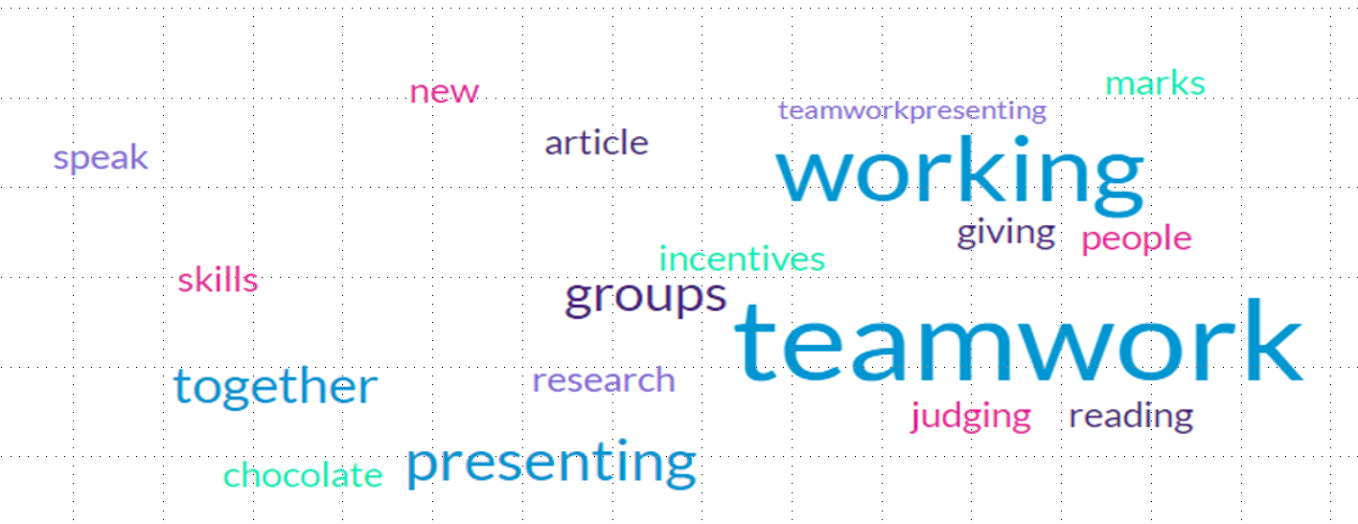
What Did you Enjoy the Most?

Slide 13
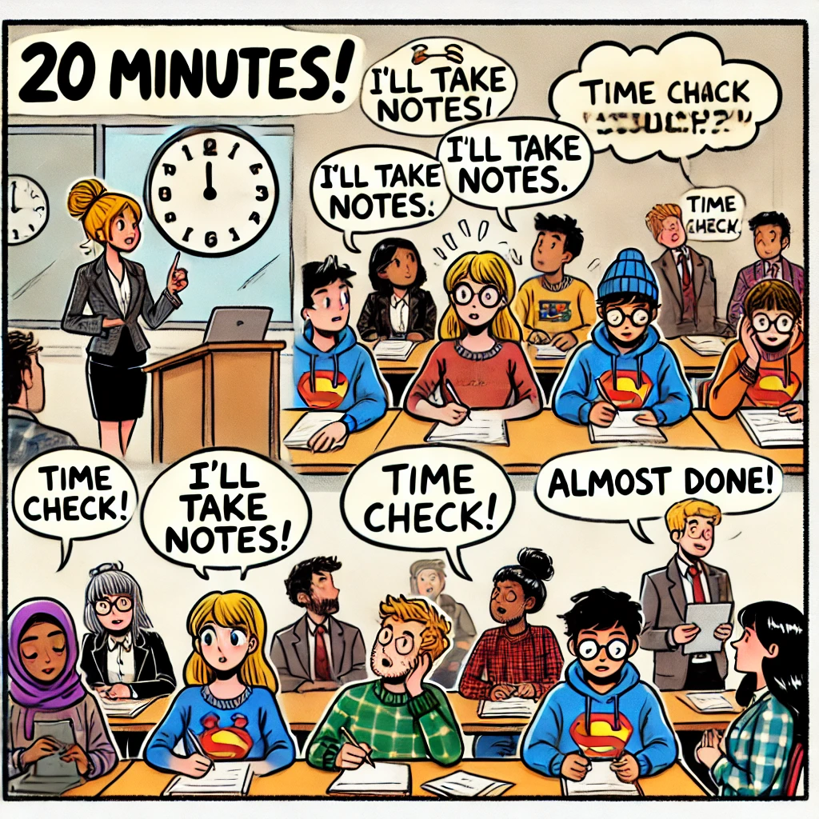
Challenges

Slide 14

A Collaborative Path Forward

Slide 15

Thank you!

