Slide 1
An adaptive, real-world-data-enabled, 2-randomisation, controlled, UK-wide trial to determine the effect of pasteurised human donor milk, preterm formula, and cow-milk derived fortifier, on severe necrotising enterocolitis, mortality, and cognitive impairment in extremely preterm babies
Funded by the National Institute for Health Research
V 08-06-25

Slide 2
Study hypotheses
Randomised trial hypotheses
In babies born <29 weeks gestation, when there is insufficient Own Mother's Milk (P), pasteurised human donor milk (pHDM) (I), when compared with Preterm Formula (C), improves survival rate to 34 weeks postmenstrual age (PMA) without surgical NEC (PO)
In babies born <29 weeks gestation (P), routine macronutrient fortification of human milk (Own Mother’s Milk and pHDM) with cow milk fortifier (I), when compared with no routine fortification (C), improves survival rate to 34 weeks PMA without surgical NEC (PO)
Mechanistic hypothesis (sub-study led by Professor James Boardman, University of Edinburgh)
In babies born <29 weeks gestation, when there is insufficient Own Mother's Milk (P), pHDM (I), when compared with Preterm Formula (C), differs in effect on the maturation of cerebral white matter tracts (PO) that subserve cognitive function, assessed at full-term
NHS value hypothesis (led by Professor Ramon Luengo-Fernandez, University of Oxford)
In babies born <29 weeks gestation, when there is insufficient Own Mother's Milk (P), the additional cost of pHDM (I), when compared with Preterm Formula (C), generates savings through improved survival to 34 weeks PMA without surgical NEC (PO)

Slide 3
Study design: key points
Eligibility: Birth <29 w gestation; no condition precluding enteral feeding; maternal intention to breast-feed
Randomisation 1: When the attending clinician feels a top-up is required because there is insufficient Own Mother’s Milk; if a mother is lactating well, babies will receive minimal supplemental feed
Randomisation 2: When the baby is receiving 60-120 ml/kg/day of human milk feeds (Own Mother’s Milk and/or pHDM)
Participation: Babies may participate in either or both randomisations
Sample size: This is an adaptive trial; this means that the sample sizes shown are the maximum that will be recruited; the true number will likely be less
Primary outcome: Survival to 34 weeks postmenstrual age without NEC surgery
Secondary outcomes: All core neonatal outcomes and cognitive and language development at age 2-years, assessed using an electronic version of the PARCA-R
Trial data: Primarily obtained from the National Neonatal Research Database, hence low-burden

Slide 4

Randomisation 1
Own mother’s milk is best for babies, but often the volume available is insufficient so a top-up feed is needed
Should pasteurised human donor milk (pHDM) or preterm formula be used if there is insufficient Own Mother’s Milk?

Slide 5
Variation in current UK practice
Enteral feeds for babies born<29 weeks gestation in the first 4 days after birth in the UK
Own Mother’s Milk Pasteurised Human Donor Milk (pHDM) Preterm Formula
Day 1 26.8% 6.8% 9.0%
Day 2 42.0% 15.9% 10.6%
Day 3 52.4% 21.5 % 10.8%
Day 4 60.1% 21.8% 11.0%
Data from the National Neonatal Research Database from all neonatal units in England, Wales, and Scotland over the 2-year period 2022-2023

Slide 6
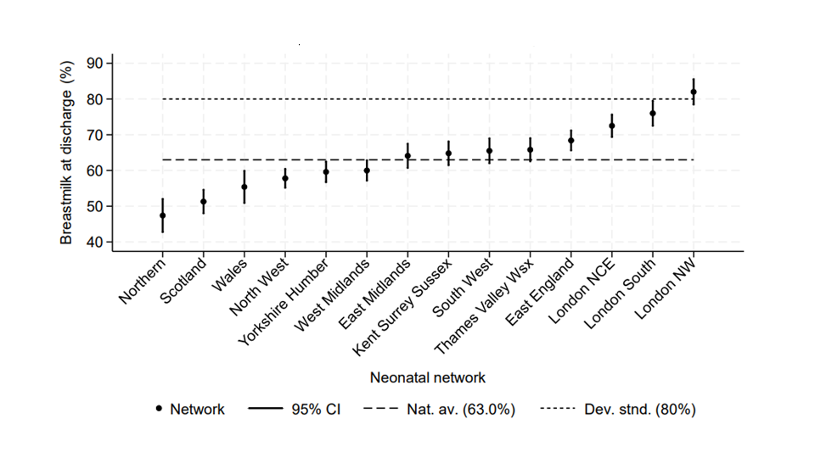
National Neonatal Audit Programme
Breastmilk at neonatal unit discharge for babies born <34 weeks gestation in the UK, by neonatal network (2023)

Slide 7
Evidence of possible harm from use of preterm formula as top-up if the volume of own mother’s milk is insufficient to meet her baby’s needs

Slide 8

Cochrane review
Quigley, Embleton, Meader, McGuire, 2024
https://doi.org/10.1002/14651858.CD002971.pub6
12 RCT (2296 infants) compared pasteurised Human Donor Milk (pHDM) and formula as either sole diet or supplement to Own Mother’s Milk
Meta-analysis of data from the 11 RCT assessing NEC (medical and surgical), in which the comparison combined trials of sole and supplementary diets, show lower risk with pHDM (Risk Ratio) 0.53, 95% CI 0.37 to 0.76)

Slide 9
This evidence is not definitive
Neither sole nor supplementary comparisons show significant differences in important functional outcomes that would be important corroboration of benefit from pHDM (mortality, invasive infection and neurodevelopment)
Medically managed NEC was included in the meta-analysis outcome which is an imprecise diagnosis highly liable to ascertainment bias
No data have been provided showing benefit for surgical NEC
Five of the Cochrane review trials took place more than 40 years ago, when the patient population differed substantially from that of today
Sample sizes were inadequate
Methodological quality was not high; 8 of the 11 trials had high or uncertain risk of bias

Slide 10
The Milk Trial (Colaizy et al JAMA 2024)
The Milk Trial (n=483) conducted in the US, compared pHDM with Preterm Formula in extremely preterm infants receiving no or minimal Own Mother’s Milk
Failed to complete planned recruitment
The trial showed no significant differences in 2-year neurodevelopment (primary outcome), mortality or bloodstream infection
Secondary outcome analysis found lower medical NEC in the pHDM arm
Details of surgical NEC were not provided

Slide 11
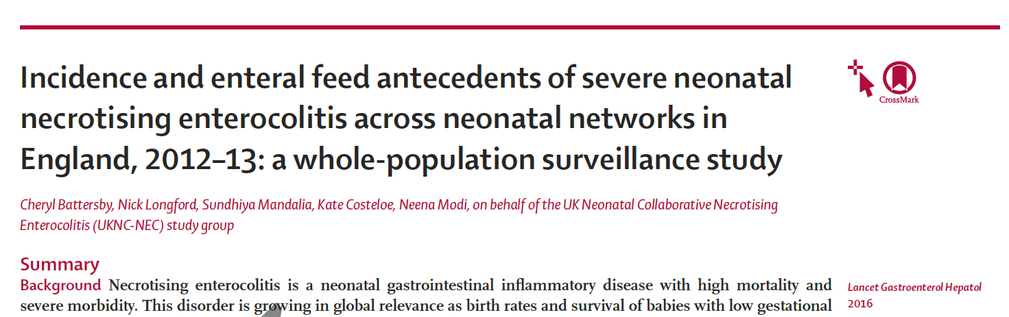
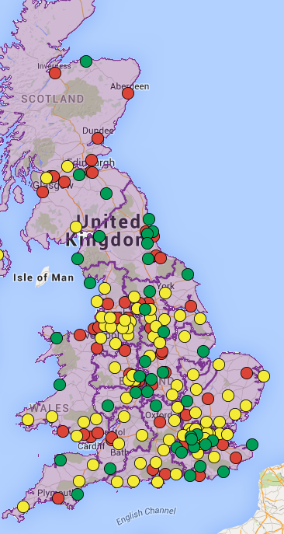
What feeds did babies with severe necrotising enterocolitis receive before disease onset?
Neonatal Intensive Care Unit
Local Neonatal Unit
Special Care Baby Unit
Two-year, whole population propensity score matched analysis of necrotising enterocolitis surgery and/or death
Of 14,678 babies <32w GA, 3·2% required surgery for necrotising enterocolitis and/or died
50% of babies with necrotising enterocolitis leading to surgery and/or death received only human milk prior to disease onset

Slide 12
Early enteral feeding of very preterm infants with exclusive formula was not associated with increased risk of morbidities, including necrotising enterocolitis
Shlomai et al, Nutrients 2022

Slide 13
Evidence of possible harm from use of pasteurised donor milk as top-up if the volume of own mother’s milk is insufficient to meet her baby’s needs

Slide 14

Pasteurised human donor milk is not the same as fresh own mother’s milk
Pasteurisation destroys or substantially reduces non-nutritional bioactive components (e.g., growth, anti-inflammatory and immune factors)
Pasteurisation eliminates probiotic species
Maternal genotype, health, disease, environmental exposures, and diet affect composition (e.g. long chain polyunsaturated fatty acids, environmental pollutants, toxins)
Bioactive components are unique to each mother
Nutrient content of pHDM is usually lower than milk from mothers delivering preterm

Slide 15
Cochrane review
Quigley, Embleton, Meader, McGuire, 2024
https://doi.org/10.1002/14651858.CD002971.pub6
12 RCT (2296 infants) compared pasteurised Human Donor Milk (pHDM) and formula as either sole diet or supplement to Own Mother’s Milk
Slower weight gain and head circumference growth with pHDM
Five trials reported neurodevelopmental outcomes or assessment scores in children aged at least 12 months, measured using validated assessment tools (Gross 1983; Lucas 1984a; Lucas 1984b; O'Connor 2016; Colaizy 2022)
Four found no significant differences in any neurodevelopmental measures; one found evidence of harm

Slide 16
The Domino Trial
O’Connor et al JAMA 2016
RCT comparing supplemental feeds of pHDM and formula
More children in the pHDM had cognitive composite scores indicative of neuro-impairment (<85) (donor: 27.2%; formula 16.2%; adjusted risk difference 10.6%; 95% CI 1.5% to 19.6%; P = 0.02)
All scores lower in the pHDM group
Worse mortality and morbidity index in pHDM group (43% vs 40%)

Slide 17
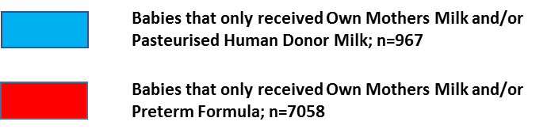
Outcomes in babies that received Own Mother’s Milk supplemented with either pHDM or formula
(Chehrazi et al Earl Hum Dev 2023)
Pasteurised donor milk group had:
Lower survival to 34w PMA without surgical NEC (71.6% vs. 97.4%) with difference most marked in the most immature infants
Higher all-cause mortality (29.4% vs 1.9%), NEC-deaths (4.2% vs. 0.5%) surgical NEC (3.5% vs 1.7%) and bloodstream infection (8.1% vs 3.0%)
Lower treated retinopathy of prematurity (0.8% vs. 2.3%) and bronchopulmonary dysplasia (13.5% vs. 19.9%)
Chance of survival to 34 weeks postmenstrual age without NEC surgery in babies by gestational age at birth (adjusted for GA, Bwt Z-score, multiple birth, sex, antenatal steroids)

Slide 18
Association of enteral feed type with neonatal and neurodevelopmental outcomes in preterm infants
Bando N et al, Canadian Neonatal Network; J Pediatr March 2025
Retrospective study of infants born <29 weeks’ gestation in relation to time they received Own Mother’s Milk, pHDM, mixed feeds of Own Mother’s Milk and pHDM, or were nil by mouth, over the first 28 postnatal days
Babies receiving any formula were excluded
Each one-day reallocation from Own Mother’s milk to pHDM was associated with statistically significant and highly clinically relevant greater odds of cognitive and language impairment

Slide 19
Impact of pasteurised human milk on maternal lactation and breast-feeding

Slide 20
Systematic literature review of studies that assessed maternal breastfeeding rates before and after the introduction of pasteurised Human Donor Milk (pHDM)
Introduction of pHDM had a positive impact on any breastfeeding on discharge (RR 1.19; 95% CI 1.06-1.35
No significant impact on exclusive breastfeeding on discharge (RR 1.12; 95% CI, 0.91-1.40)
No significant impact on exclusive administration of own mother’s milk over days 1 to 28 (RR 1.08; 95% CI, 0.78-1.49)
One study showed a significant decrease in the percentage receiving Own Mother’s Milk feeds after the introduction of pHDM
Available data are equivocal in respect of the impact of pHDM on maternal breastfeeding

Slide 21
The commercialisation of human milk

Slide 22
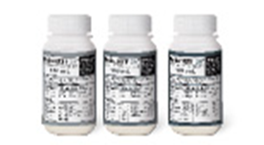
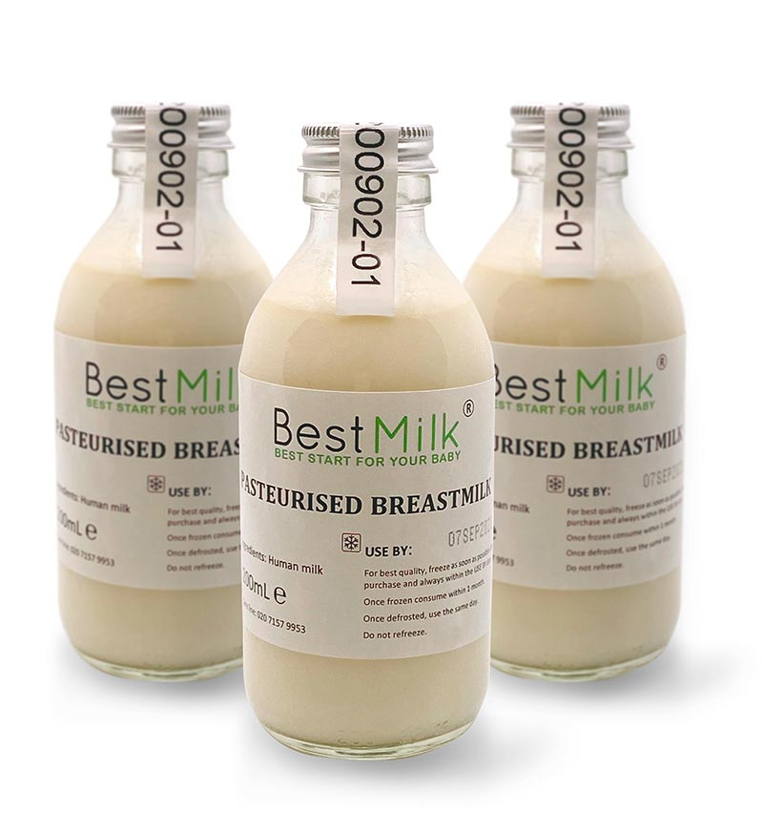
Human milk as a commodity
Unsubstantiated claims of benefit
Ethical concerns re exploitation of women
Highly lucrative industry
Human Donor Milk (not-for-profit UK Human Milk Bank)
~ £90-£175/litre
Commercial Human Donor Milk
~ £100-£2200/litre
Commercial Preterm Formula
~ £5/litre
Donors paid £1-£3
per 30ml

Slide 23
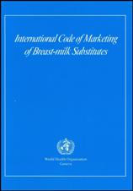
Aggressive marketing of formula is harmful
The international World Health Organisation Code of Marketing of Breast-milk substitutes
The Code has been implemented through legislation, due in large part to protests against the harms resulting from the commercialisation of infant feeding and aggressive marketing of formula
The Code prohibits promotion of formula, gifts to mothers or health workers, and false claims

Slide 24
The growing aggressive commercial human milk industry is likely to be as harmful to babies as the aggressive marketing of formula
In the US $495M and $60M lawsuit awards have been made on the grounds that formula causes NEC, with several hundred more cases pending
As a consequence, companies are divesting from neonatal research and development pipelines

Slide 25

Randomisation 1
Justification
Possible risk of NEC with formula
Possible risk of impaired neurodevelopment with pHDM
High cost of pHDM with no conclusive evidence of benefit
Possible adverse effect on maternal lactation if pHDM is perceived as equivalent to Own Mother’s Milk
Adverse effects of a growing commercial human milk industry
If pHDM is beneficial and safe, it should be available to every extremely preterm baby

Slide 26
Randomisation 2
Another major uncertainty
Should human milk have routine protein-carbohydrate fortification?

Slide 27
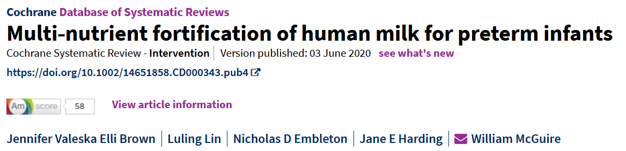
Total of 18 small, methodologically weak trials with 1456 participating infants
Necrotising enterocolitis (n=1110): risk ratio 1.37 (95%CI 0.72, 2.63)
Only a single trial (n= 245) carried out in 1996 assessed neurodevelopment at 18 months (mental development index: mean difference 2.20, [95%CI -3.35, 7.75]; psychomotor development index: 2.40 [-1.90, 6.70]
“Evidence is insufficient to show whether multi‐nutrient fortification has any effect on long‐term growth or neurodevelopment”

Slide 28
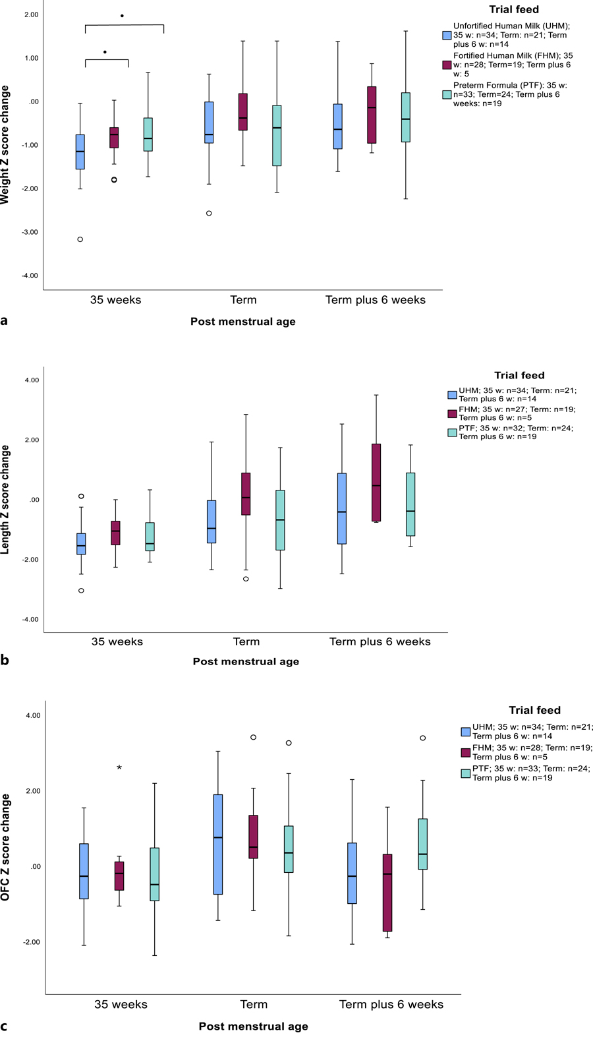
The PREMFOOD Study
Mills et al, Neonatology 2023
Babies born <32w gestation
Randomisation to i) unfortified Own Mother’s Milk supplemented with unfortified pHDM; ii) fortified Own Mother’s Milk supplemented with fortified pHDM; iii) unfortified Own Mother’s Milk supplemented with Preterm Formula
No significant differences in weight, length, head circumference, or body composition at term or term plus 6 weeks; i.e., babies self-regulated back to previous growth trajectory
NEC occurred in 2 infants, both in the unfortified human milk arm
Box plots for (a) weight, (b) length, and (c) occipital frontal circumference (OFC) Z score change from birth to 35 weeks post menstrual age, term, and term plus 6 weeks for randomised feed groups
Date of Download: 4/30/2025
Copyright © 2025 Karger Publishers. All rights reserved.
Notes:
Figure Legend: Box plots for (a) weight, (b) length, and (c) occipital frontal circumference (OFC) Z score change from birth to 35 weeks post menstrual age, term, and term plus 6 weeks age for randomised feed groups. Solid line is median, box is interquartile range (IQR), whiskers are 1.5 × IQR; <sup>●</sup>p < 0.05; *Outlier (>1.5 × IQR) <sup>○</sup> Outlier (>3 × IQR).

Slide 29
Postnatal weight gain in very preterm babies without major morbidity Greenbury et al, Modi, Lancet Child Adolescent Health, 2021
Despite substantial variation in nutritional practice, weight velocity in all gestational age groups stabilises around 32-34 weeks postmenstrual age at 16-25 g/day along parallel centile lines
Weight at term in babies without major morbidities is consistently below birthweight centile (around -1.6 z-score)
A similar pattern has been observed in other cohorts worldwide
This suggests that forcing a baby to attain birth centile may be detrimental by promoting accelerated weight gain
(N=52952 infants)

Slide 30
Possibility of harm from routine macronutrient fortification

Slide 31


Human milk macronutrient content is variable, within and between mother’s and across time
Preterm milk protein is high in the first month (average around 1.5g/100ml; range around 0.7 to 2.4 g/100ml)
Preterm milk energy content in the first month ranges from 50 to 80 kcal/100ml with an average of around 70kcal/100ml

Slide 32
The consequences of routine protein: carbohydrate fortification of human milk
A preterm baby receiving 200 ml/kg/day of unfortified own mother’s milk will have an average protein intake of 3g/kg/day with a range of 1.4 to 4.8 g/kg/day
Commercial breast milk fortifiers provide from 1.1 to 2.4g protein/100 ml milk
Routine fortification will mean some babies receiving a protein intake exceeding 5g/kg/day
Very high protein intakes are dangerous

Slide 33
Dangers of higher protein intakes
Increased risk of later non-communicable diseases (Wells 2016)
Obesity and abdominal adiposity (Weber et al 2014)
Sepsis (Moltu et al 2013; Fivez et al 2016)
Longer ventilation; bronchopulmonary dysplasia (Fivez et al 2016; Webbe et al 2022; Uthaya et al (2024)
Renal impairment (Kamper and Strandgaard 2017)
Impaired neurodevelopment (Blanco et al 2012: Jacobs et 2020; Bloomfield et al 2022; Das et al 2025)

Slide 34
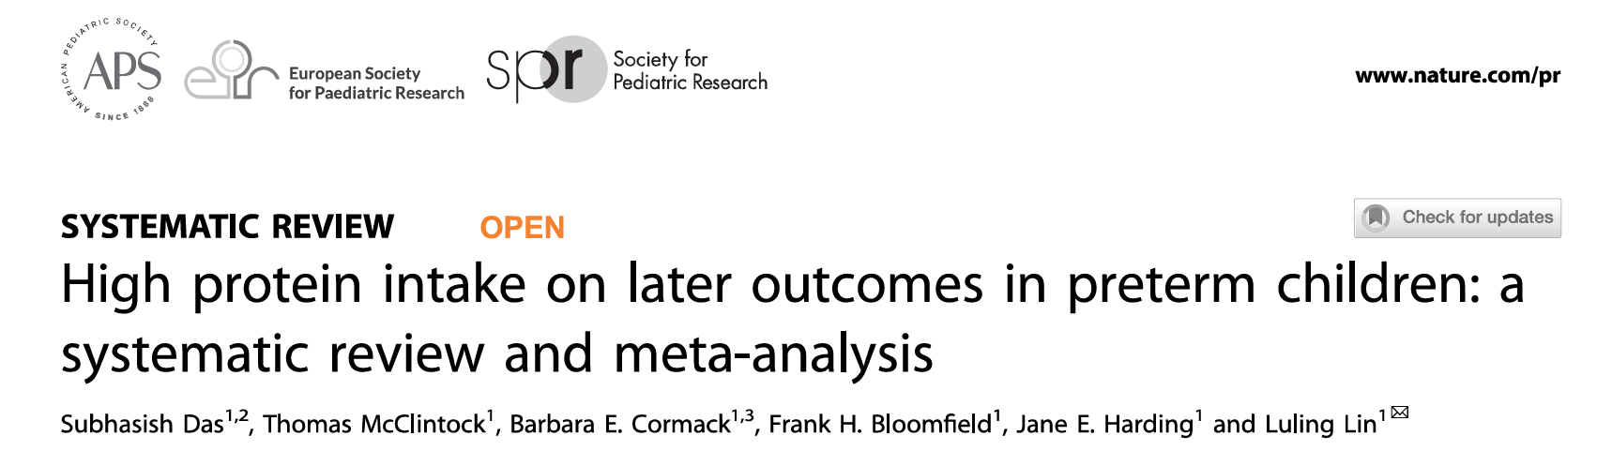
Meta-analysis of protein intakes ≥3.5g/kg/day versus <3.5g/k/day Paediatric Research 2025
“In 44 studies involving 5338 infants there was no evidence of benefit from protein intakes ≥3.5g/kg/day to growth beyond the neonatal period and possible harmful effects on survival, neurodisability and biochemical abnormalities”

Slide 35
Randomisation 2
Justification
No benefit for routine fortification shown to-date
No benefit to long-term growth
Risk of neurodevelopmental and other harms from routine fortification through excessive protein intake
NOTE
Fortification is not prohibited but can be introduced at clinician discretion if other causes of growth faltering are ruled out (guidance will be provided)

Slide 36
A research priority we should respect
All UK neonatal priority-setting partnership exercises in the last decade, the most recent in 2023, each with wide stakeholder input including from parents and people born preterm, rank these uncertainties within the top 10 most important in preterm care
Extensive engagement with parents shows they want to see the uncertainties associated with pHDM, preterm formula and fortifier resolved without further delay
British Association of Perinatal Medicine highlighted the urgent need for this research in 2023
The UK National Institute of Health and Care Excellence guidance published in 2010 (reviewed in 2018 and not changed) acknowledges limited evidence of benefit from pHDM and recommends research to evaluate efficacy
The current European Society of Paediatrics Gastroenterology and Nutrition recommendation to use fortified pHDM over formula if a supplement to Own Mother’s Milk is required is conditional and highlights the lack of strong evidence and the need for high-quality research, especially to assess longer-term functional outcomes

Slide 37
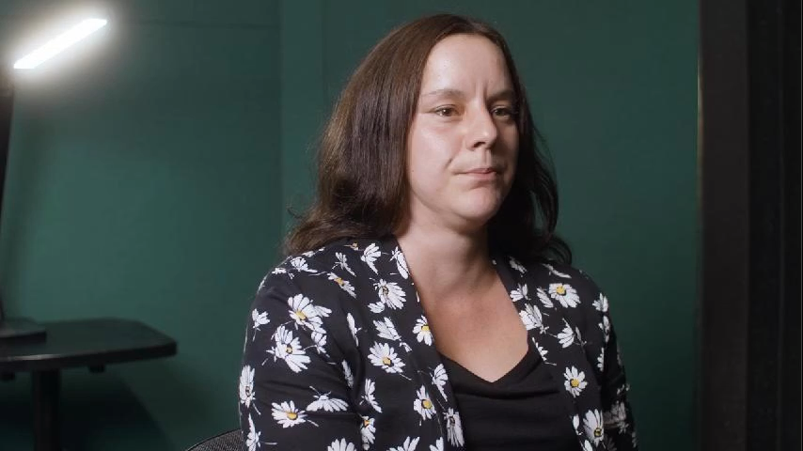
Research gives patients hope ….

Slide 38
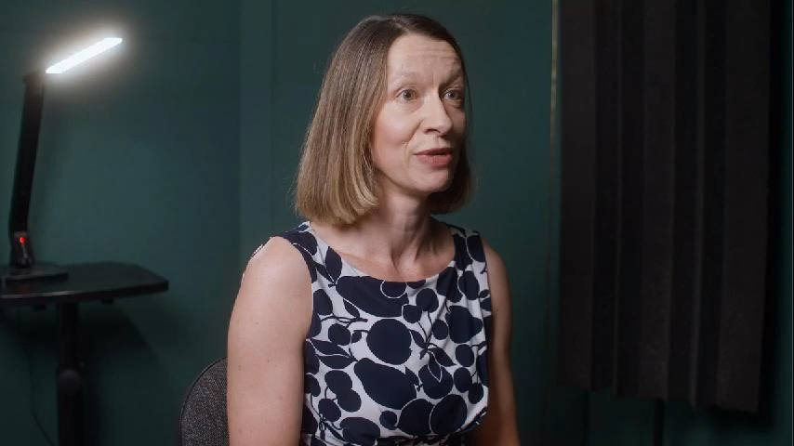
“This research is desperately needed….”

Slide 39
Why participate?
The uncertainties are important for the babies we care for, and their parents
Current practice is a patient safety concern
Inclusion benefit for participants (patients in randomised trials do better than those not participating regardless of the arm to which they are randomised)
NIHR portfolio study
Quality-assurance of routine clinical data
Free use of the electronic PARCA-R
Opportunity for trainees to gain research experience
Principal investigators from each site will be included in authorship
Opportunity to incorporate your own embedded sub-study
Be part of a national COLLABORATIVE effort to improve care globally

Slide 40
Investigators
Victoria Cornelius, Professor of Clinical Trials and Medical Statistics, Neena Modi, Professor of Neonatal Medicine, Dr Annemarie Lodder, PPIE Lead, Dr Sabita Uthaya, Imperial College London; Professor James Boardman, Dr David Quine, University of Edinburgh, Professor Shalini Ojha, University of Nottingham; Dr Hilary Wong, University of Cambridge; Professor Ramon Luengo-Fernandez, University of Oxford; Professor John Norrie, University of Belfast; Professor James Wason, University of Newcastle, Peter Bradley, Bliss, Lauren Ingledow, Adult Preemie Advocacy Network; Professor Andrew Morris, Health Data Research UK
Supported by
NEC UK, Bliss, Adult Preemie Advocacy Network, British Association for Neonatal Neurodevelopmental Follow-Up, Neonatal Nurses Association, British Association of Paediatric Surgeons, and The George Institute for Global Health

Slide 41

COLLABORATE: An efficient, UK-wide, real-world-data-enabled, digital technology-facilitated, multicentre, 2-randomisation, group-sequential, open-label, randomised, controlled trial to determine clinical efficacy, effect-size, and safety of widely used enteral feeds in reducing necrotising enterocolitis, mortality and cognitive impairment in extremely preterm babies
Randomisation 1:
When the attending clinician decides a supplementary feed is necessary (~ in first week)
Randomisation 2:
When receiving 60-120ml/kg/day human milk
(~ age 2 weeks)
Interims
Outcome assessments
Pasteurised human donor milk as supplement to own mother’s milk
n=1084
Routine fortification with cow milk-based product
Treatment as usual
Eligibility: Birth <29 weeks gestation; no condition precluding enteral feeding; maternal intention to breast-feed
Interim 1 when 50% of primary outcomes available
Interim 2 when 75% of primary outcomes available
Primary outcome (assessed at 34 weeks gestational age):
Rate of survival without surgical NEC
Secondary outcome (assessed at age 2-years corrected for prematurity): Rate of survival without moderate-severe cognitive or language impairment
Secondary outcomes (assessed at neonatal unit discharge):
Composite components; items from NEC and neonatal core outcomes sets
Preterm cow milk-based formula as supplement to own mother’s milk
n=1084
Routine fortification with cow milk-based product
Treatment as usual
NOTE: This is not a factorial trial; infants may participate in either, or both randomisations, indicated by the red (randomisation 1), white (randomisation 2), and dotted lines (both). We require 2168 participants (1084 per arm) for each of randomisations 1 and 2. If 50% participate in both randomisations, 3252 unique babies in total are required. Overall timeline is 60 months including an internal pilot from months 6-15.

