Slide 1
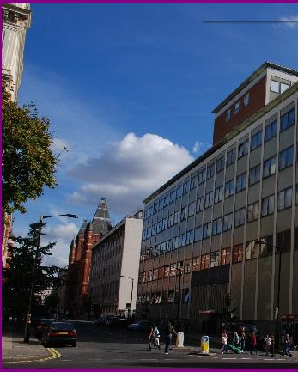




Welcome to the Blackett Laboratory
Linda Cremonesi
Director of Postgraduate Studies

Slide 2
Being a postgraduate
You are professionally qualified!
You have standing in the physics community
You are students in that you are still studying
so
You should expect to be treated with professional respect
You should treat others with professional respect

Slide 3
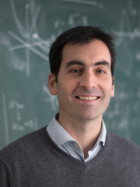
Department of Physics
Light
Matter
Particles
High Energy Physics
Space, Plasma and Climate
Space and Atmospheric Physics
Plasma Physics
Universe
Astrophysics
Theoretical Physics
Professor Stefan Söldner-Rembold Head of Department
Professor Carlo Contaldi
Deputy Head of Education
Staff
100 Academic Staff
150 Research Staff
Students
900 Undergraduates
200 Taught PG (masters students)
330 Research PG

Slide 4
Now meet some more wonderful people
Horacio Septien-Gonzalez & Zihan Wang (Dep Reps)
Jerry Chittenden (PGR Tutor)
Lesley Cohen (Physics careers)
Amaya Calvo Sanchez (Women and Non-binary individuals in Physics)
Shana Winston (Women’s PhD Network)
Maureen O’Brien (DAS)
Jake Durrant (ICAH)
Paul Seldon (MARS)

Slide 5
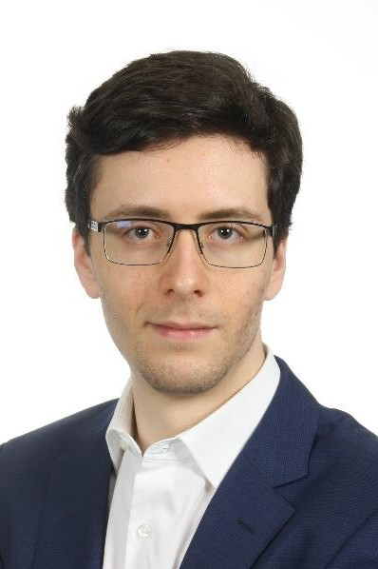
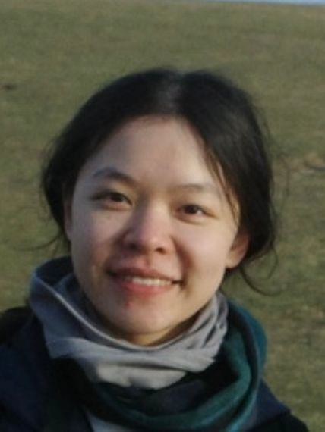
POSTGRADUATE STUDENT REPRESENTATIVE
Welcome to the Physics Department
The role of the Physics Postgraduate Representatives is to support the postgraduate student body on a community and departmental level. As a postgraduate student, you may discuss any issues you have with your Community or the department with either your Community Representatives or the Head Representatives in confidence. The Representatives will ensure that this feedback is passed on to the relevant members of staff in regular meetings throughout the year. Alongside liaising with academics, the Postgraduate Representative Committee organises numerous events for postgrad students throughout the year, such as specialised training courses, the postgraduate research symposium, meetings and tours within academia and industry, nights in and out, BBQs, the 3 Minute Thesis competition, and more.
Please feel free to contact us at:
physics-pg-student-representative@imperial.ac.uk or individually at:
Horacio: horacio.septien-gonzalez22@imperial.ac.uk
Zihan: zihan.wang18@imperial.ac.uk

Slide 6


Slide 7


Slide 8

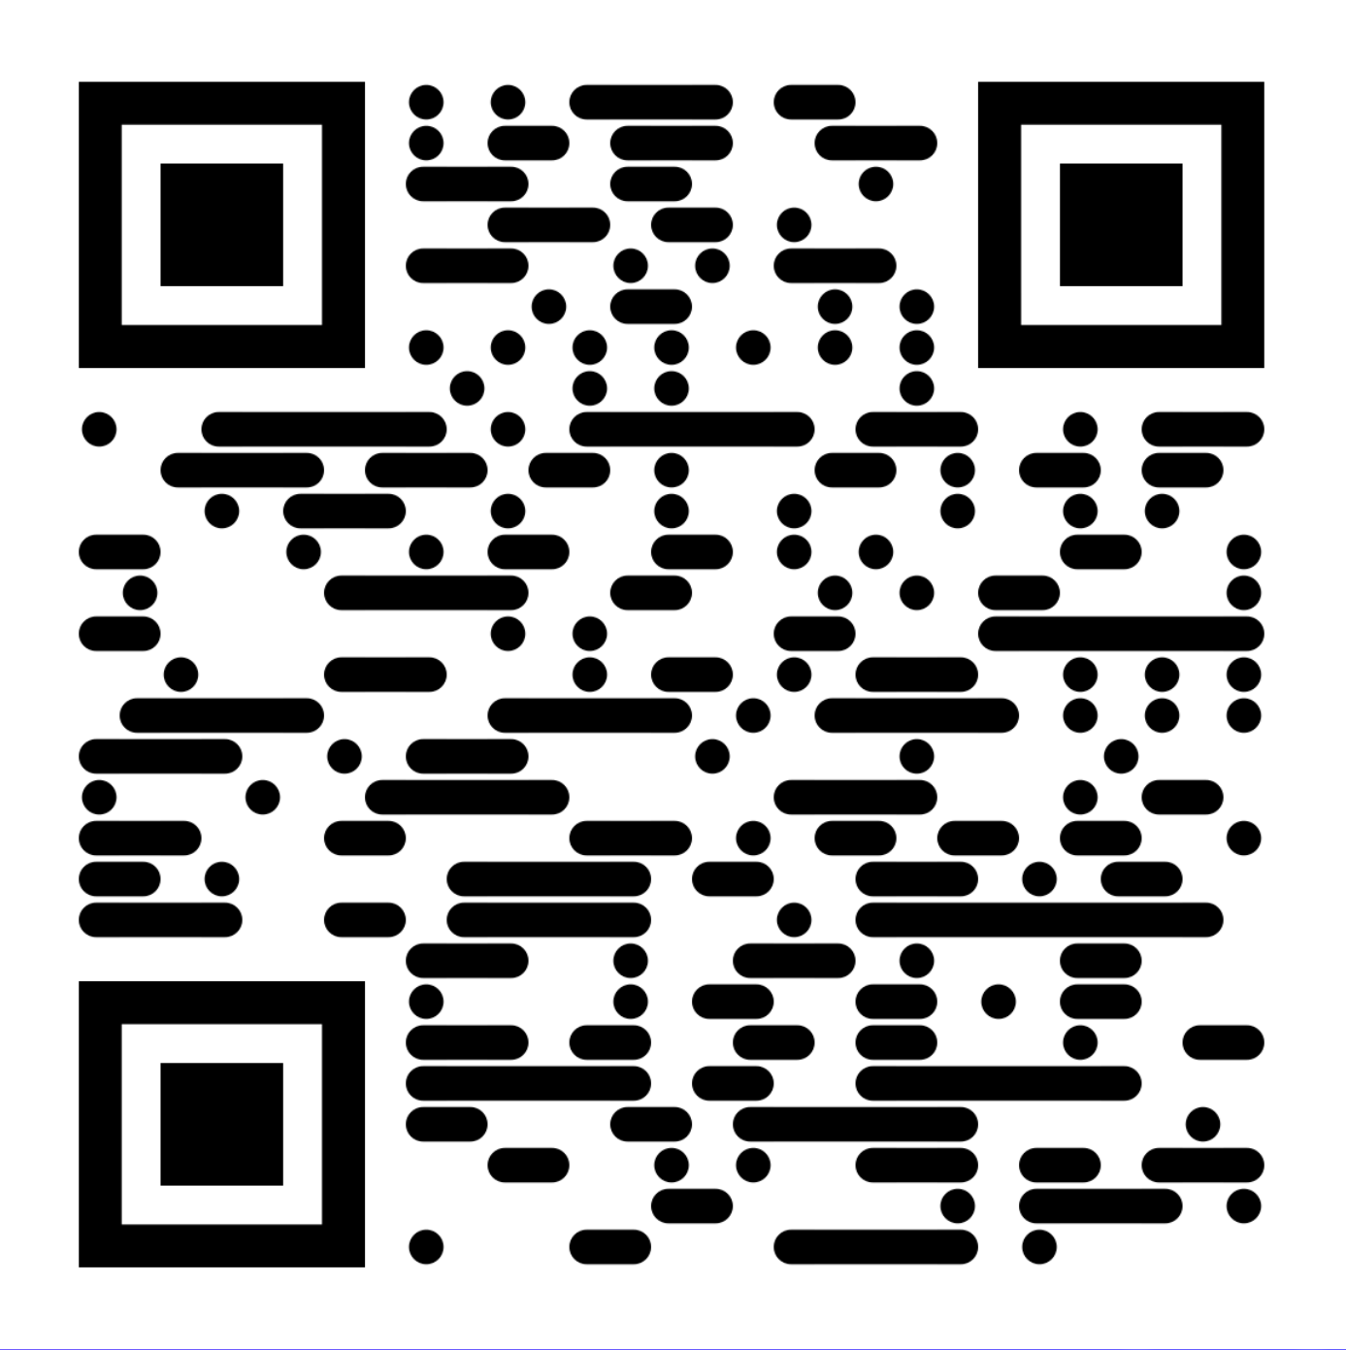
www.imperialhackspace.com
Turn your ideas into reality using the latest prototyping equipment and support
Digital Workshop
3d printing
Oscilloscopes
Soldering
Laser cutting
Wet lab
Cell culture lab
Microscope
Bioreactor
Autoclave
Mechanical Workshop
CNC machining
Milling & Turning
Water jet cutting
Welding
Based at Imperial’s White City Campus
Notes:
What is the Hackspace?
Imperial’s Prototyping Hub!
Accessible workshop and lab space for all students and staff of the College across all departments and levels.
One giant community of hackers, inventors and makers
The place to be for rapid development and prototyping of innovative projects.
It is a community hub for all backgrounds, disciplines and levels of expertise fostering collaboration, experimentation and innovation
Supported by team who’ve been there and done it!

Slide 9

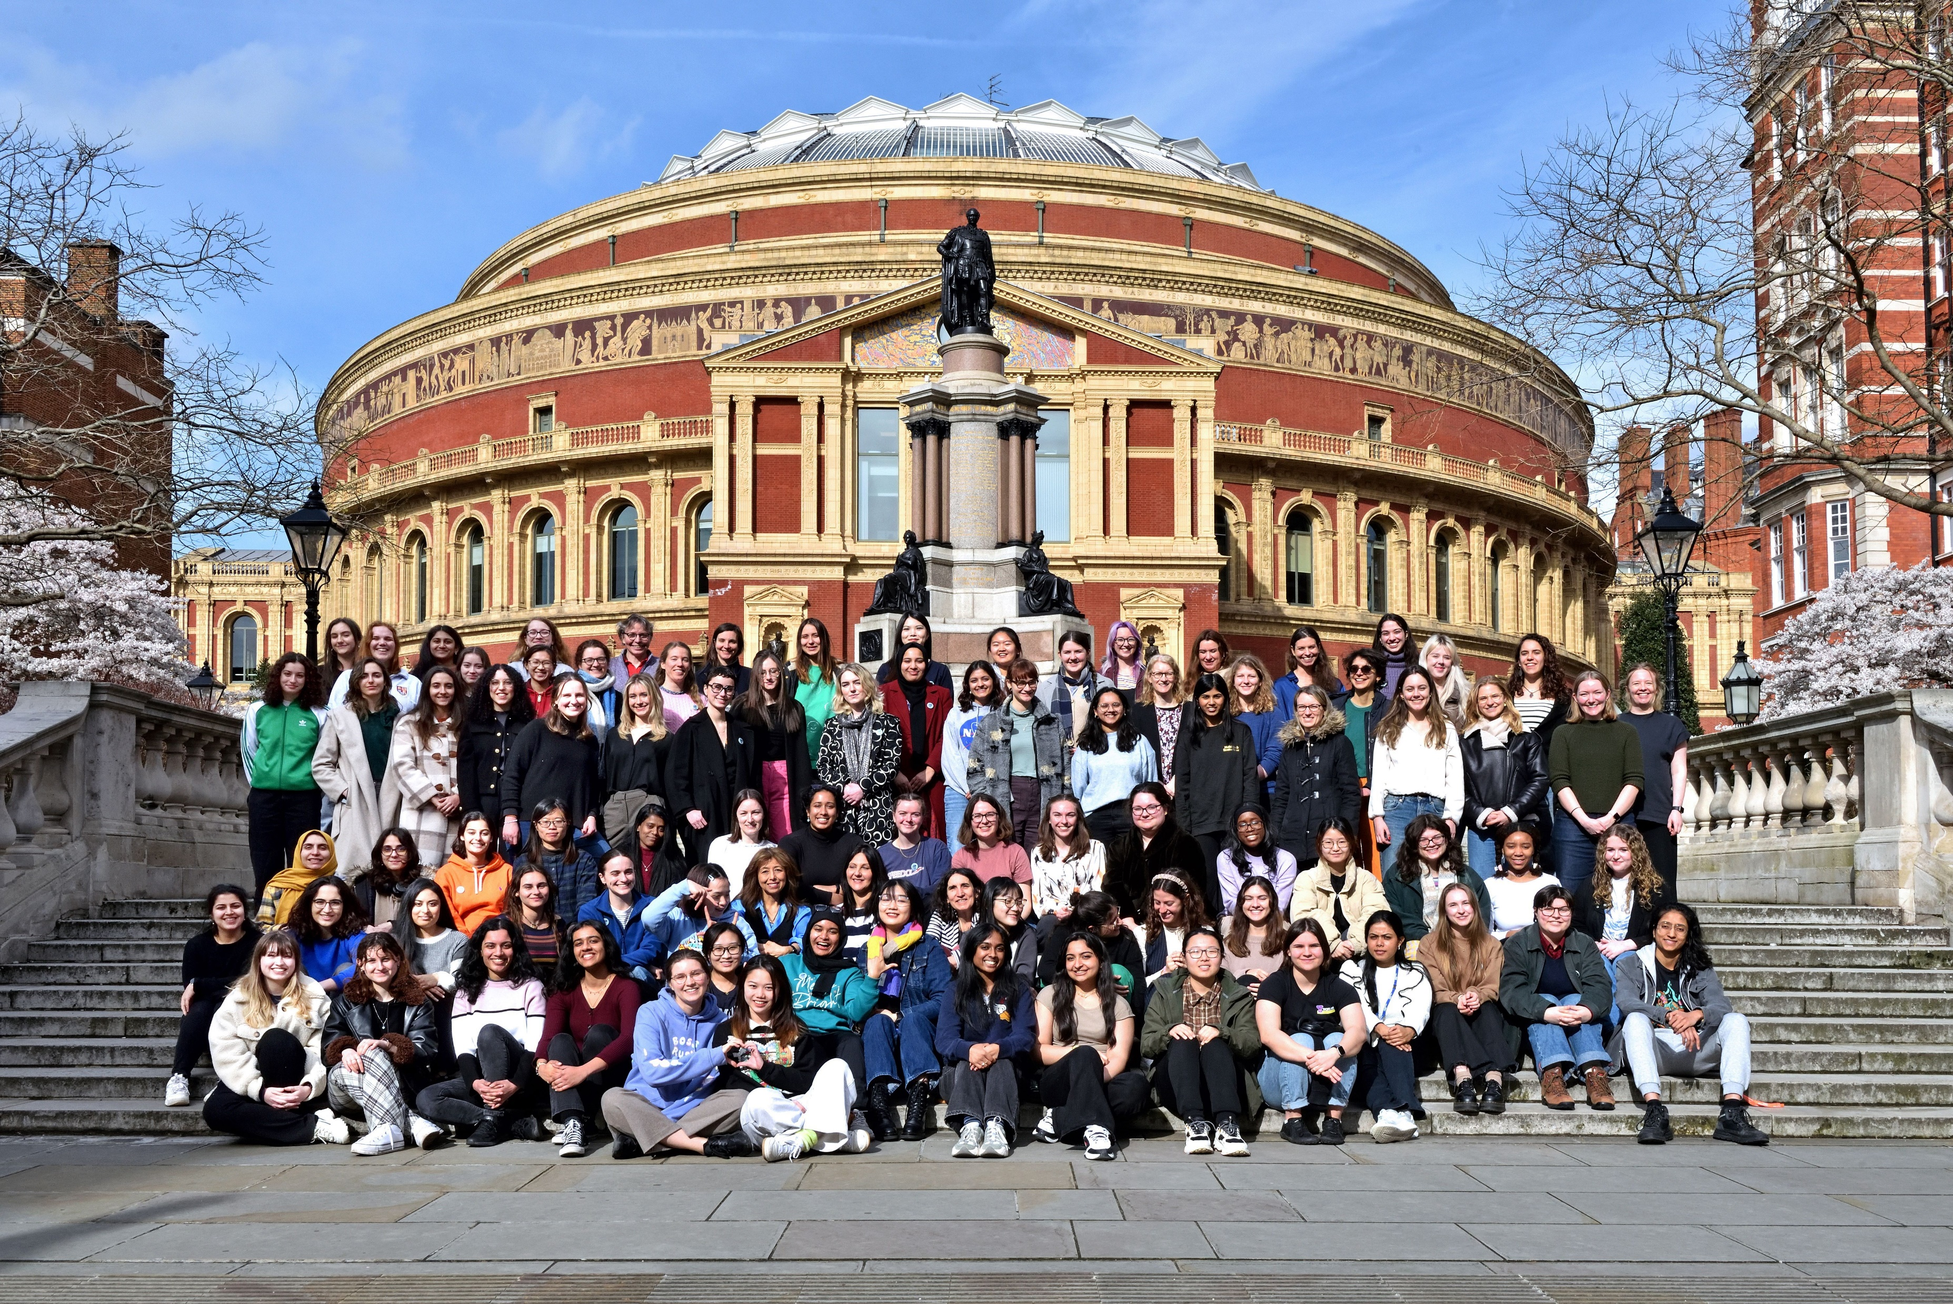
Imperial College Women and Non-Binary Individuals in Physics
We run social and academic events aiming to create a welcoming, inclusive, and supportive network for women and non-binary people working and studying in physics!
International Women’s Day 2024

Slide 10
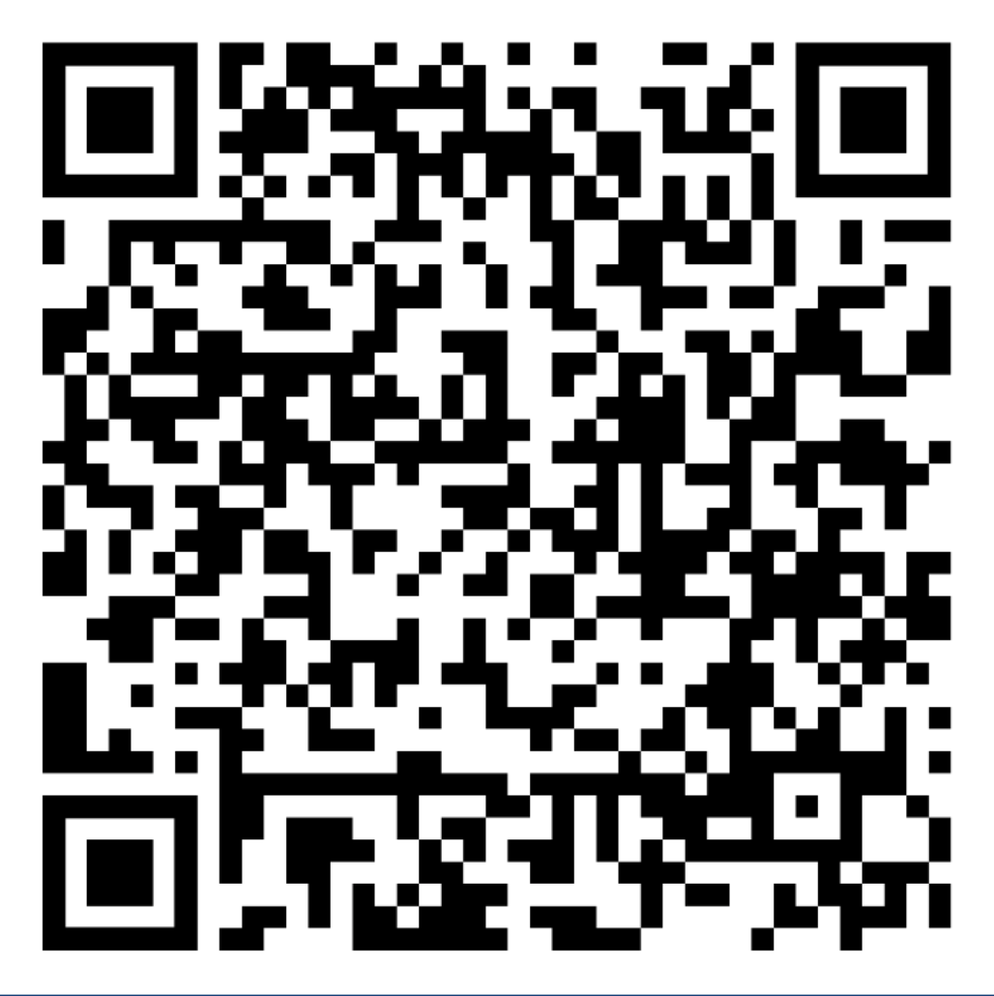
We’re looking for more committee members too! Please get in touch if you’re interested!
womeninphysics@imperial.ac.uk
@ic_wnbip
Becoming a member is free! Just sign up to the mailing list
International Women’s Day 2024

Slide 11
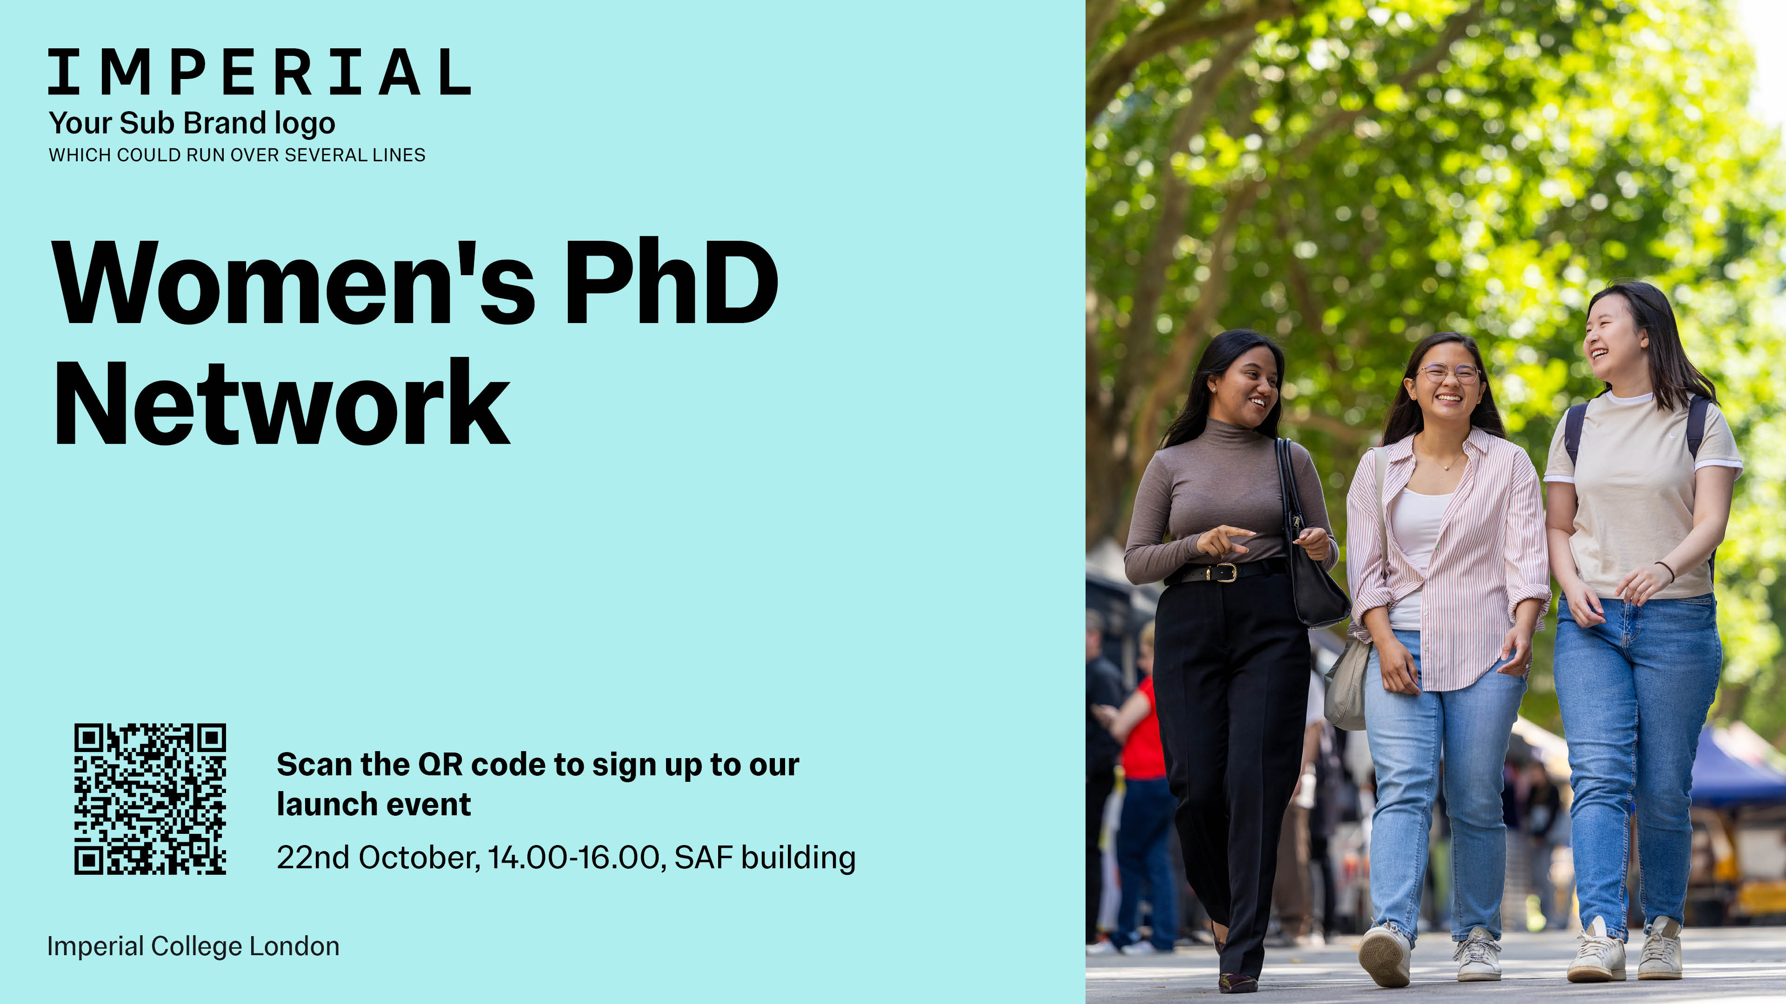

Supporting women doctoral students by fostering peer support, creating inclusive spaces, and providing opportunities to help accelerate academic and professional progress

Slide 12
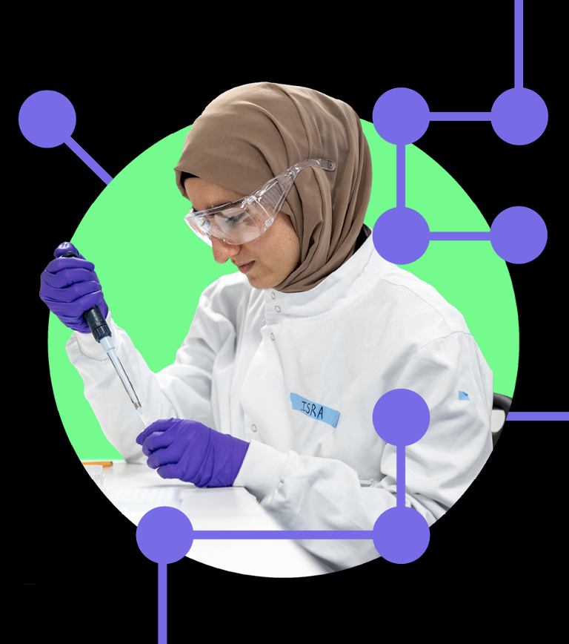

Graduate school and Postdoc and Fellows Development Centre merged into ECRI to provide outstanding learning and development opportunities, events, support and resources to early career researchers.
Focus on
Doctoral students
Postdocs & Fellows
Doctoral supervisors
Other related research staff
Master’s who are moving into research
www.imperial.ac.uk/ecri ecri@imperial.ac.uk
Notes:
We work with all Early Career Researchers from Postgraduate Researchers to Fellows and all staff supporting researchers, including Supervisors

Slide 13






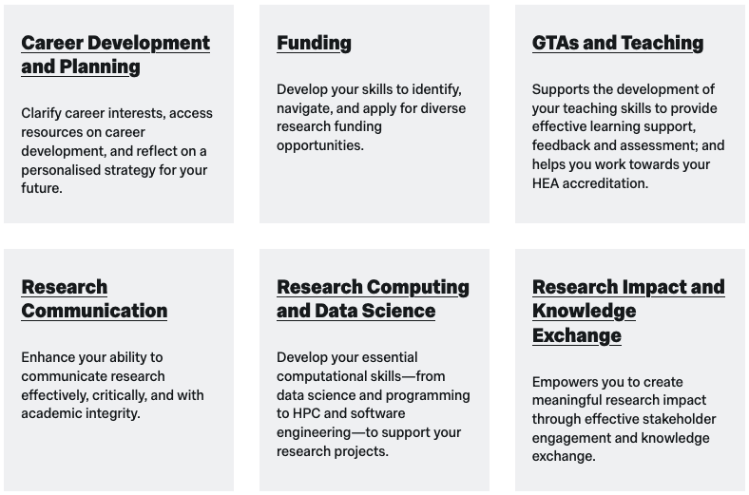
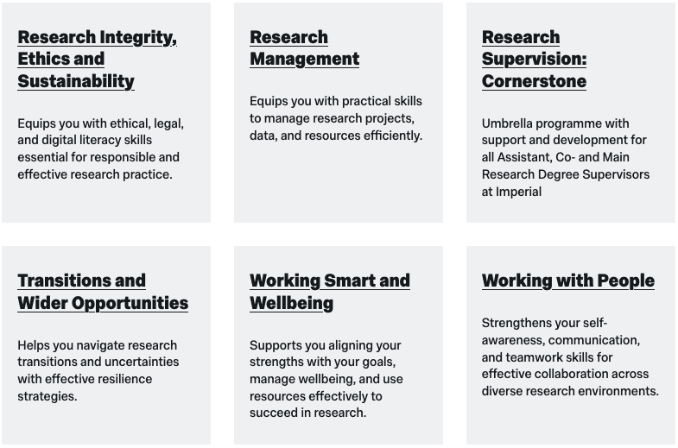

ECRI provision for Doctoral Students 2025 - 26
Skills development
Wellbeing & support
Online resources
Events & Networks
Funds
150+ courses to develop the skills you need to successfully complete your degree and prepare for your future career
Attendance requirement:
Plagiarism Awareness
4 ECRI credits (2 by ESA – 2 by LSR)

Slide 14

ECRI provision for Doctoral Students 2025 - 26
Skills development
Wellbeing & support
Online resources
Events & Networks
Funds
Postgraduate Coaching
Activate Mentoring Programme for under-represented PGRs: black and ethnic minorities & disabled
One-to-ones
Research degree mediation
Doctoral Success Guide
Supervision support site
ECRI tip sheets
www.imperial.ac.uk/ecri

Slide 15
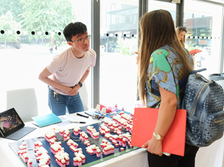
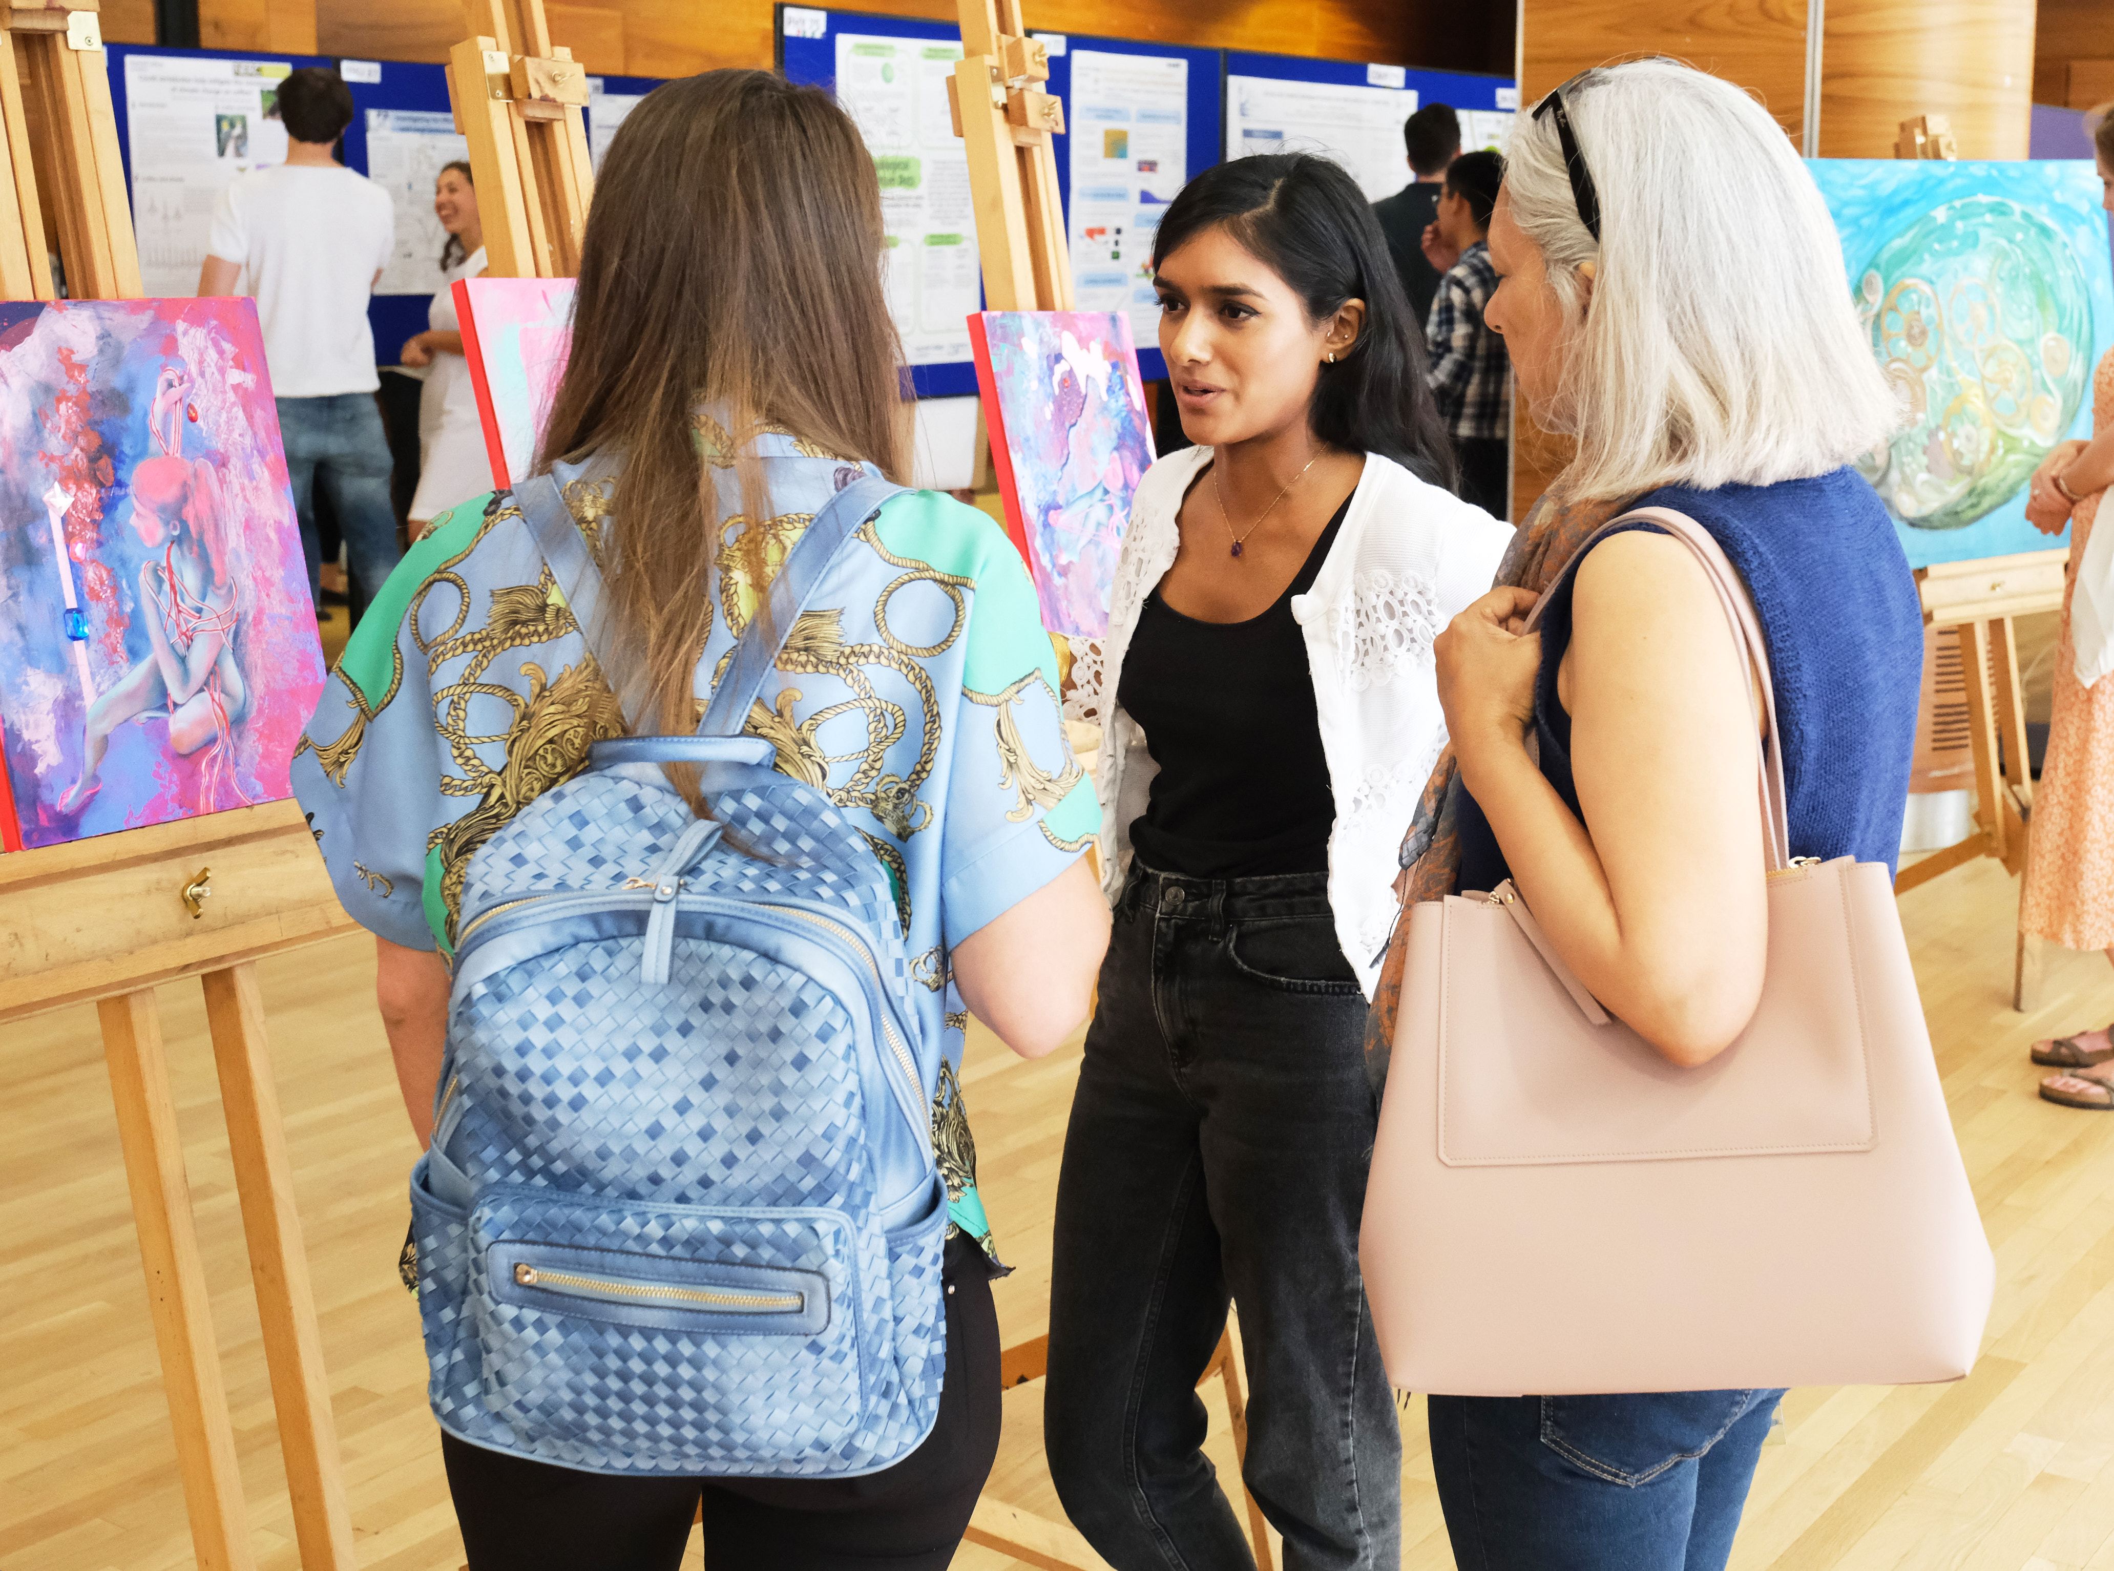
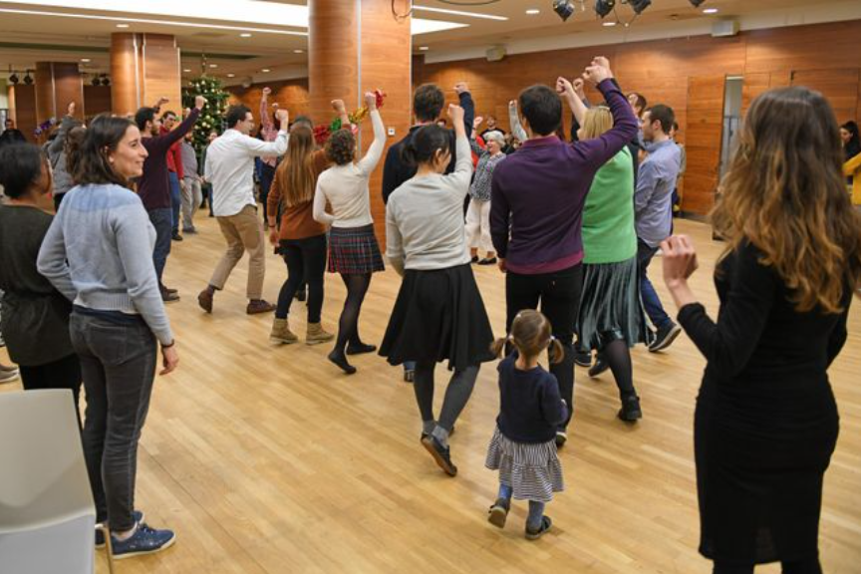
ECRI provision for Doctoral Students 2025 - 26
Skills development
Wellbeing & support
Online resources
Events & Networks
Funds
Welcome events PGR Welcome Wed 15 October
ECR Showcase
ECRI Winter Celebration
Support networks
ECRI Community Fund To designed to support researcher led cohort building activities. ECRI Blog.
ECRI Noticeboard
Regular newsletters & bulletins
ecri@imperial.ac.uk

Slide 16



16
Think it’s just about English?
Think again.
If you want to stand out in a world of
AI and automation, our personalised academic communication training will get you there.
Find out more
Imperial College London
imperial.ac.uk
Notes:
Intro to CfAE Good afternoon. I’m [Your Name], and I’m here to introduce the Centre for Academic English, better known as CfAE. Despite our name, we’re not here to police grammar. As you can see from the slide, we exist to help you communicate your brilliant STEMM ideas clearly, confidently, and effectively so that you can stand out.
Why communication matters at Imperial
Communication isn’t an optional extra at Imperial; it’s built into every assessment criterion.
You must express your ideas clearly, logically and persuasively.
You need to communicate your findings in ways that suit your audience.
Strong communication ensures your research is understood, valued, and acted upon. It’s the bridge between your knowledge and its impact, both in academia and beyond. Why communication matters beyond Imperial
The job market and global challenges keep changing,but the core skills employers seek remain stable:
Leading and collaborating with others
Adopting new tools and technologies
Managing projects and people
Demonstrating creativity and problem solving
What binds these skills together? Your ability to communicate effectively. Rather than a “soft skill,” communication is the bedrock that allows every other competency to shine.
How CfAE supports you We partner with you to help you develop your academic voice. There are pitfalls in communication that we all face: translating our specialist knowledge to a wider audience, not falling back on vague language or packing information into long, dense sentences that make our reader switch off.
While AI tools can assist, CfAE offers the human expertise you need to think critically, craft your academic voice, and present your originality with impact.
Our training is flexible, available to fit around your busy schedule, both online and in-person. Browse our website to access our self-study resources, register for our live sessions and book a 1:1 with a coach.
Thank you for listening. We look forward to helping you unlock your potential at Imperial and beyond.

Slide 17
Disability Advisory Service
Introduction to the service
02/09/2025

Slide 18
What we offer
How can DAS help you
Advisors – provide information, advice and guidance
Most common reasonable adjustments (extra time and computer use in exams), other
adjustments may also include ergonomic equipment, and lab assistant.
SpLD tutors - study skill tutorials and study efficiency sessions.
Study mentors – problem-solving, strategies, life/study balance.
And finally, we also offer screenings for autism and SpLDs (specific learning differences/difficulties).

Slide 19
Screenings and assessments
Specific learning difficulties (SpLDs) and autism
We can screen for autism – if you are finding it difficult to communicate in social situations, develop friendships, cope with unexpected changes to routine…. then come for a screening.
We can screen for SpLDs (dyslexia, dyspraxia – DCD, ADHD as an SpLD) – if you are
finding it difficult to retain what you’ve read, concentrate and stay focused, time
management.… then come for a screening.
If indicators are present, we refer you for a full diagnostic assessment.

Slide 20
Support at Imperial via DAS
How can DAS help you
Long and short-term support
Knowledgeable team members and a wealth of experience and expertise
Efficient service and in-house support
Multiple services are ready to support disabled students: careers, library, mental health mentors, student union - we all work in unison to provide support

Slide 21
Visit our website to find out how to get support from DAS.

Slide 22
We look forward to meeting you
02/09/2025

Slide 23
Library introduction
Physics PhDs
Ann Brew, Physics librarian ann.brew@imperial.ac.uk

Slide 24
Library Services
Subject support page:
https://www.imperial.ac.uk/admin-services/library/subject-support/physics/
Abdus Salam library, South Kensington
Support with searching for information, finding material, referencing, genAI tools and (avoiding) plagiarism
Specialist research support: https://www.imperial.ac.uk/admin-services/library/research-support/

Slide 25

Departmental Career Support
I have office hours usually on Wednesdays 12-2pm. To make an appointment (virtually or in person) please email PH CAREERS <ph.careers@imperial.ac.uk>
Please check the Physics Career Website for info on internships and international research placements (for Undergraduates)
https://www.imperial.ac.uk/physics/students/current-students/careers-information/
For all students - please sign up to jobslive for regular College Career Event updates
https://www.imperial.ac.uk/careers/services/jobslive/
Prof Lesley Cohen
Member of Matter Community
Research interests:
-Superconductivity
-Magnetism
-Functional Materials
-Energy Efficient ICT
-Caloric cooling

Slide 26

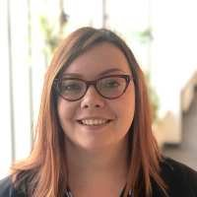
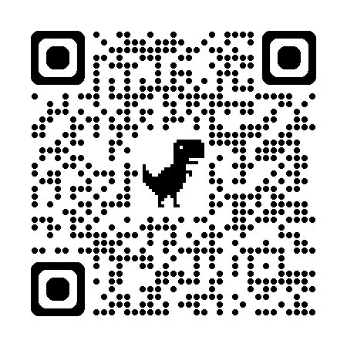
Your Careers Consultant: Jess Popplewell
j.popplewell@imperial.ac.uk
1-1 appointments available in-person and online​
Careers fairs and employer events​
Workshops throughout the year
Check over application documents​
Practice presentations​
Mock interview support​
Sign up to JobsLive
Ask an Alum >>>
Imperial.ac.uk/careers/about/jobslive/
Notes:
Ask an Alum is open to all Imperial students – use the QR code here to access. It allows students to register to a system called Vygo, where they can ask questions to alumni working in an area of their interest, for example to find out what skills are valued or what time of year internships are advertised.

Slide 27

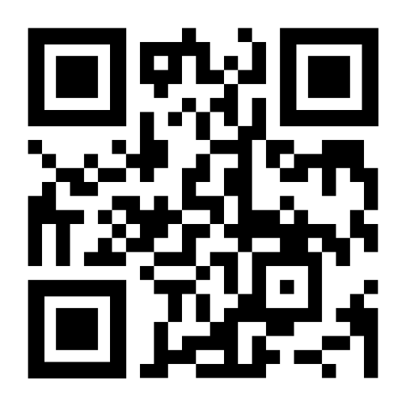

The Career Companion:
A new set of tools (in beta) designed to help you make career decisions and improve your skills in writing CVs, interviewing successfully and beating assessment centres.
Access via Blackboard (use the QR code) and once enrolled, use the tools as and when you are ready.
Contact Jess Popplewell or Becky Guppy with questions or feedback.
Career Companion​
Notes:
Practical, hands-on activities relating to:
Figuring out a career that might suit you
Working out what skills you already have
Planning to build new skills
Talking about your skills to an employer
Preparing for networking
Writing application documents effectively
Preparing for interviews
Practicing psychometric tests
Preparing for assessment centres
…and more!

Slide 29

MARS Membership Accreditation & Recognition Scheme
Registered & Chartered status are highly regarded peer-reviewed assessment that provides independent validation of your achievements, skills, knowledge, integrity and expertise.
Doctoral researchers can register on MARS to:
Become Registered Scientist (RSci)
Progressing towards Chartered status (Cphys)
Benefits of joining this scheme
Your development at Early Careers Research Institute is recognised by the IOP
You can apply for Chartered status earlier in your career
Full details at https://www.imperial.ac.uk/early-career-researcher-institute/learning-and-development/mars-membership/ - Contacts p.seldon@ic.ac.uk or ph.careers@imperial.ac.uk
Attend MARS Q&A session – see Inkpath to book.
MS Teams: 22nd October (12.00 - 13.00); 2nd February (13.00-14.00)
In Person: 4th November (10.00-11.00) & 22nd January (13.00-14.00)

Slide 30
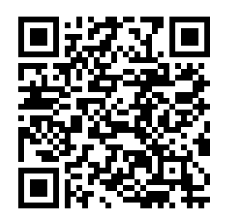

Attributes & Aspirations:
Online course to help you:
Adapt to your studies at Imperial
Get better grades through reflection and understanding assessment
Plan for your future
Pick and choose units as you need them
Attributes and Aspirations​
Notes:
AA is designed to help you adapt to your study, become a better student and plan for your future. There are bespoke AA versions for UG, Masters and PhD. AA will help you:​
Develop skills to help you be a better student like working in teams, time management, self-reflection and decision making​
is fully online with completion certificates for each module​
is available at any time while you are a student at Imperial​
supports career planning, job/PhD hunting, networking and more​
​

Slide 31
ICT
https://www.imperial.ac.uk/admin-services/ict/new-to-imperial/students/
Information Communication Technologies

Slide 32
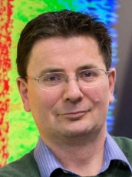
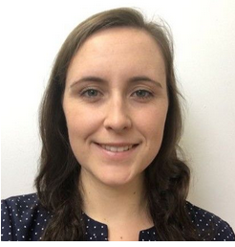
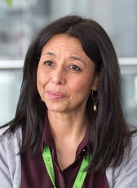
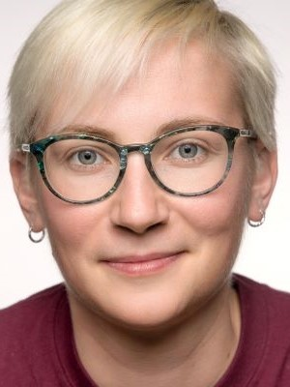
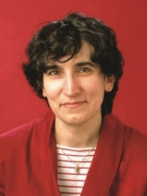

PGR welfare in Physics: PhD
Community PG Mentors | https://www.imperial.ac.uk/physics/students/current-students/postgraduate-research/contacts-and-mentors/academic-staff-contacts/ |  | Safety, academic and personal issues
Research community PG committee representatives | https://www.imperial.ac.uk/physics/students/current-students/postgraduate-research/contacts-and-mentors/research-group-committee-reps-and-coordinators/ |  | PG feedback to department, common issues, social events.
PGR Senior Tutor | Jerry Chittenden j.chittenden@imperial.ac.uk Blackett 744 |  | Pastoral care of students, supervisor/student issues, mental health issues
Student Wellbeing Adviser | Ella Robson fonsstudentwellbeing@imperial.ac.uk |  | Confidential one-to-one guidance to discuss your concerns and agree next steps, helping you to manage your wellbeing during your time at Imperial
Disabilities Officer | Mery Fajardo m.fajardo@imperial.ac.uk Blackett 306 |  | Disabilities
Director of PG studies | Linda Cremonesi ph.dps@imperial.ac.uk Blackett 522 |  | Administrative aspects, progression, issues related to the wider college.
PGR Administrator | Loli Sanchez Rey l.sanchez@imperial.ac.uk Huxley 903a, |  | Postgraduate liaison and administration; progression, deadlines, etc.
PGR Education Manager | Roxane Ray roxane.ray@imperial.ac.uk Blackett 901b |  | Oversees the postgraduate administration
Physics PG Helpdesk For both MSc and PhD students |  | First Wednesday of each month (12-1pm, advertised by email regularly)
(Prof Lesley Cohen or Dr Yvonne Unruh if you’d prefer to talk to a female member of staff)

Slide 33

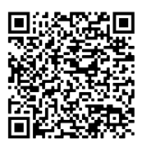
Student Wellbeing Adviser
Ella Robson, Department of Physics
The Student Wellbeing Adviser (SWA), provides confidential, one-to-one wellbeing support and guidance, either in-person or online via Microsoft Teams.
What can you expect from SWA support?
A safe space to discuss concerns or issues, such as feeling overwhelmed, mental health, personal challenges, settling into university life (and more)
Support with setting wellbeing-related goals
General guidance on managing your wellbeing and tools to support this
Discuss any wellbeing-related concerns in relation to your studies
Support is tailored to individual circumstances, if you’re not sure who to talk to, then we can discuss your initial concerns and agree next steps
Depending on your circumstances, the SWA will signpost you to/ or liaise with further support services within the Department, University, or externally
To find out more about support and/or to arrange a chat, scan the QR code, or email: fonsstudentwellbeing@imperial.ac.uk

Slide 34
Highlights
Jerry Chittenden - PGR Senior Tutor
Student-supervisor agreement: https://www.imperial.ac.uk/physics/students/current-students/postgraduate-research/postgraduate-student-handbook/guidance-for-students/
Student well being advice team (SWAT) & Student mental health intervention officers (concernedaboutastudent@imperial.ac.uk)

Slide 35
Welfare
Be honest with yourself & your supervisor.
And act:
1st port of call is/are your supervisor(s)
PGR mentor
Contact PGR Senior Tutor: Jerry Chittenden (j.chittenden@imperial.ac.uk)
Contact PGR Office: Roxane Ray and Loli Sanchez
Contact Director Post-Grad Studies: Linda Cremonesi (dps@imperial.ac.uk)
IN EMERGENCY - ANY ONE OF THE ABOVE or MENTAL HEALTH FIRST AIDER

Slide 36
Postgraduate Milestones
We will discuss the milestones in our meeting on Dec. 3
3M- you write one page about your research topic, identify safety training, bottlenecks, etc.
12M (early stage assessment) – you write a substantial literature review and have a viva to demonstrate familiarity with the area and a thesis strategy.
24M (late stage review) – you a substantial report on your research results and have a viva to demonstrate that you are on track for your PhD

Slide 37
Important starting information
1. You are in the Dept of Physics (which community?)
2. Who is/are your supervisor(s)?
3. Who is your community PGR mentor?
4. Who is your community administrator?
5. Who is funding you?
6. How long is the funding for?
These are the six most important things you need to know / find out – soon…….

Slide 38

Keep up to date:
Check your e-mail Visit the website for general activities/ information including welcome information: https://www.imperial.ac.uk/physics/students/current-students/postgraduate-research/

Slide 39


PGR Welcome Social Event
PGR Social welcome event with Refreshments
Date: 8th October 2025
Place: Level 2 Foyer, Blackett Lab
Time: 3:00 – 4:30
PGR 2nd Induction event
Date: 3rd December 2025
Place: LT2, Blackett Lab
Time: 2:00 – 3:00

