Slide 1
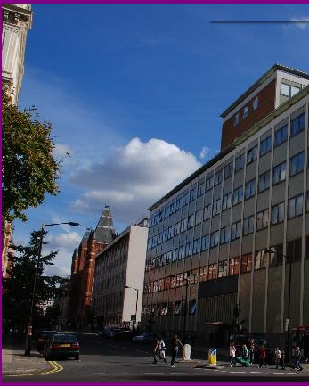




(a second) Welcome to
the Blackett Laboratory
Linda Cremonesi
Director of Postgraduate Studies

Slide 2
Structure of Physics Department
Head of Department – Professor Stefan Söldner-Rembold
Deputy Heads:
Research
Riccardo Sapienza
Education
Carlo Contaldi
People
Mary Matthews
Industry
Rupert Oulton
Infrastructure
Stuart Mangles
Director of Undergraduate
Studies
Derek Lee
Director of Postgraduate
Studies - Taught
Toby Wiseman
Director of Postgraduate
Studies - Research
Linda Cremonesi

Slide 3
Communities
Light
Matter
Particles
SPC
Universe
Head of community
Community mentor(s)
Community administration
PGR Senior Tutor
Supervisor(s)

Slide 4
PhD Milestones: What you need to do
Mutual expectations – document and discussion
Research Proposal Confirmation: by three months
Early stage assessment: by twelve months
Demonstrate knowledge of field, not research output
Late Stage Review: by 24 months
Summary of research to date, and plan for PhD thesis
Thesis progress review: by month 34

Slide 5

Departmental Career Support
I have office hours usually on Wednesdays 12-2pm. To make an appointment (virtually or in person) please email PH CAREERS <ph.careers@imperial.ac.uk>
Please check the Physics Career Website for info on internships and international research placements (for Undergraduates)
https://www.imperial.ac.uk/physics/students/current-students/careers-information/
For all students - please sign up to jobslive for regular College Career Event updates
https://www.imperial.ac.uk/careers/services/jobslive/
Prof Lesley Cohen
Member of Matter Community
Research interests:
-Superconductivity
-Magnetism
-Functional Materials
-Energy Efficient ICT
-Caloric cooling

Slide 6
Disability Advisory Service
Introduction to the service
02/09/2025

Slide 7
What we offer
How can DAS help you
Advisors – provide information, advice and guidance
Most common reasonable adjustments (extra time and computer use in exams), other
adjustments may also include ergonomic equipment, and lab assistant.
SpLD tutors - study skill tutorials and study efficiency sessions.
Study mentors – problem-solving, strategies, life/study balance.
And finally, we also offer screenings for autism and SpLDs (specific learning differences/difficulties).

Slide 8
Screenings and assessments
Specific learning difficulties (SpLDs) and autism
We can screen for autism – if you are finding it difficult to communicate in social situations, develop friendships, cope with unexpected changes to routine…. then come for a screening.
We can screen for SpLDs (dyslexia, dyspraxia – DCD, ADHD as an SpLD) – if you are
finding it difficult to retain what you’ve read, concentrate and stay focused, time
management.… then come for a screening.
If indicators are present, we refer you for a full diagnostic assessment.

Slide 9
Support at Imperial via DAS
How can DAS help you
Long and short-term support
Knowledgeable team members and a wealth of experience and expertise
Efficient service and in-house support
Multiple services are ready to support disabled students: careers, library, mental health mentors, student union - we all work in unison to provide support

Slide 10
Visit our website to find out how to get support from DAS.

Slide 11
We look forward to meeting you
02/09/2025

Slide 12
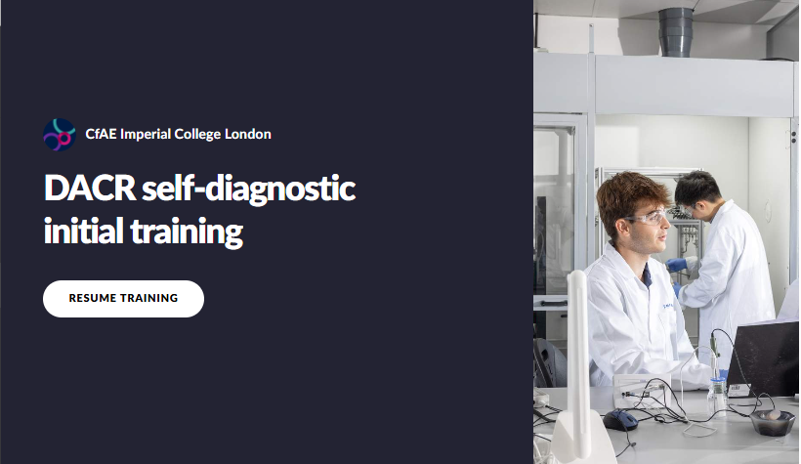
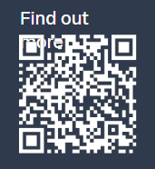

Slide 13
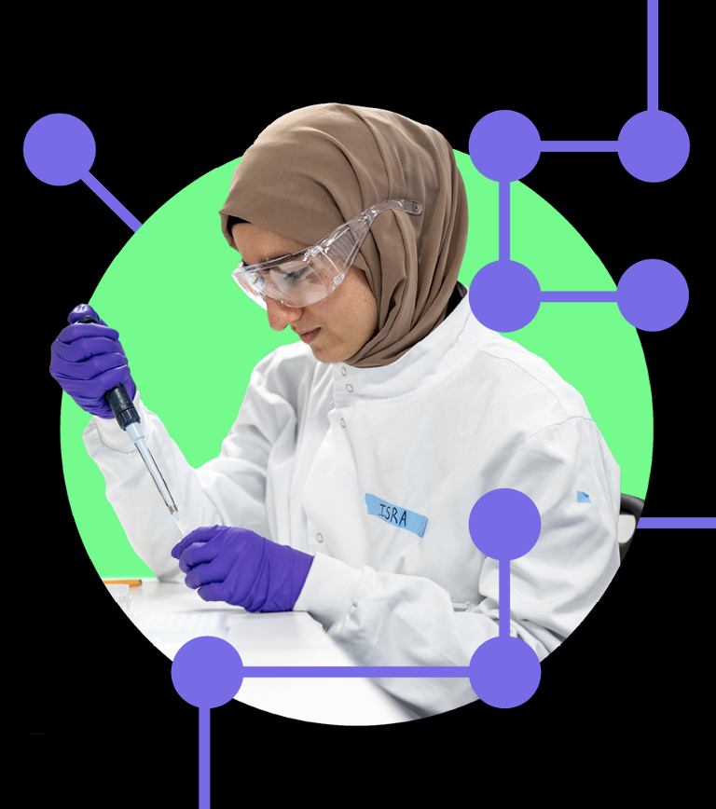

Graduate school and Postdoc and Fellows Development Centre merged into ECRI to provide outstanding learning and development opportunities, events, support and resources to early career researchers.
Focus on
Doctoral students
Postdocs & Fellows
Doctoral supervisors
Other related research staff
Master’s who are moving into research
www.imperial.ac.uk/ecri ecri@imperial.ac.uk
Notes:
We work with all Early Career Researchers from Postgraduate Researchers to Fellows and all staff supporting researchers, including Supervisors

Slide 14






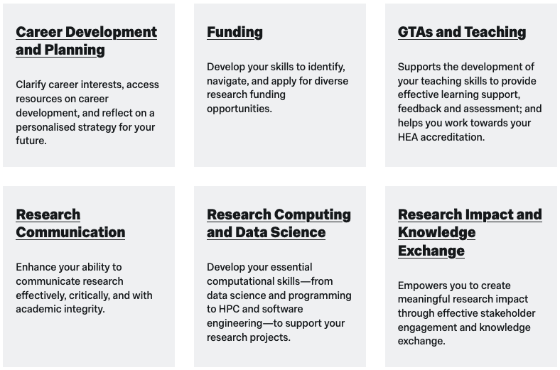
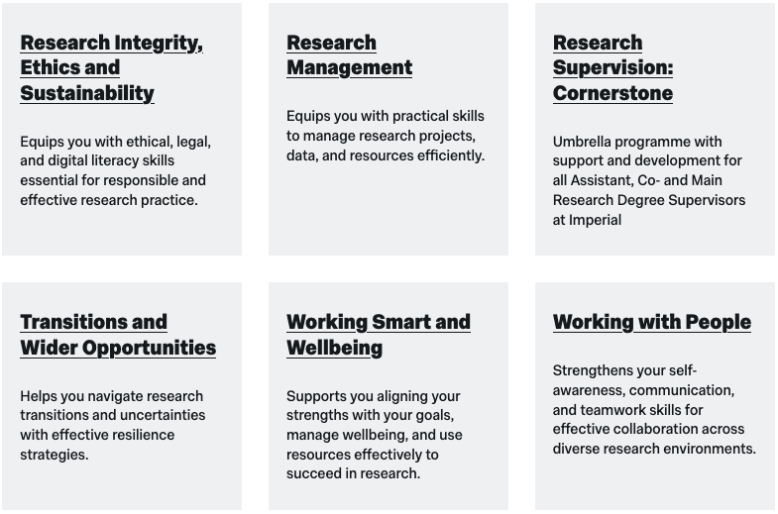

ECRI provision for Doctoral Students 2025 - 26
Skills development
Wellbeing & support
Online resources
Events & Networks
Funds
150+ courses to develop the skills you need
to successfully complete your degree and prepare for your future career
Attendance requirement:
Plagiarism Awareness
4 ECRI credits
(2 by ESA – 2 by LSR)

Slide 15

ECRI provision for Doctoral Students 2025 - 26
Skills development
Wellbeing & support
Online resources
Events & Networks
Funds
Postgraduate Coaching
Activate Mentoring Programme
for under-represented PGRs:
black and ethnic minorities & disabled
One-to-ones
Research degree mediation
Doctoral Success Guide
Supervision support site
ECRI tip sheets
www.imperial.ac.uk/ecri

Slide 16
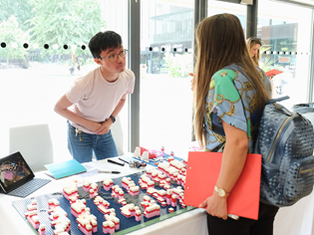
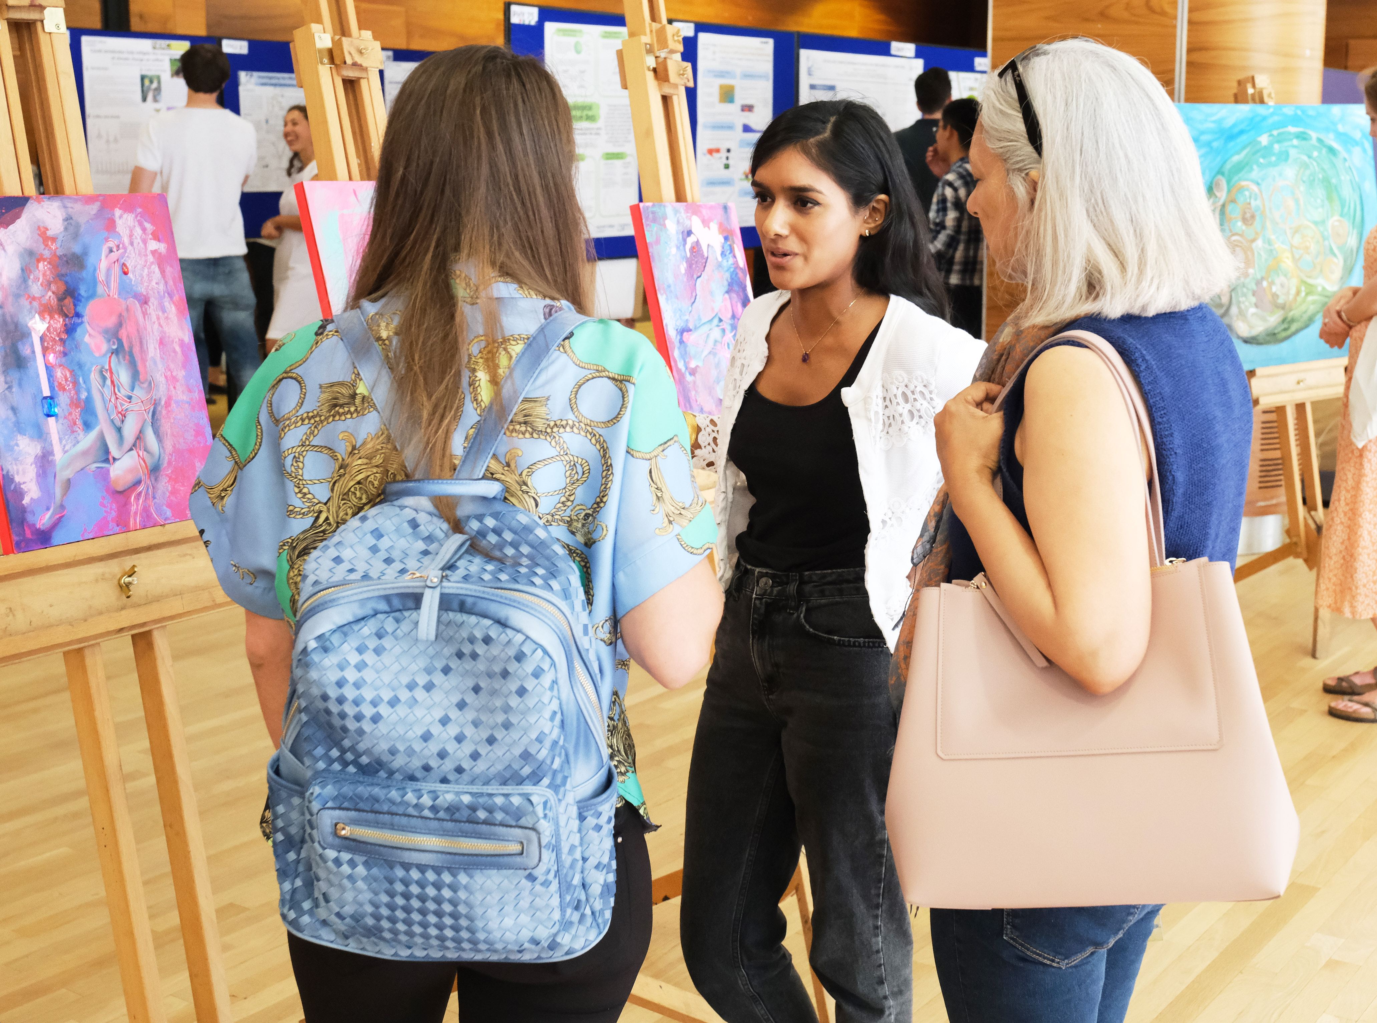
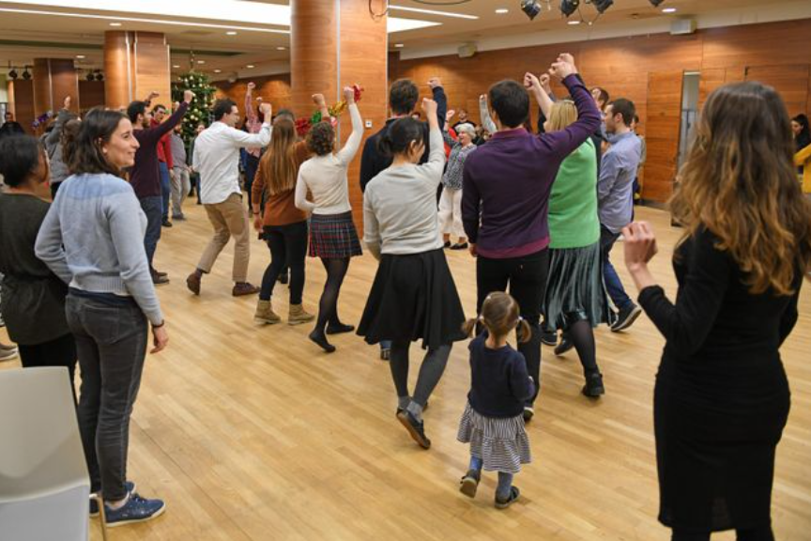
ECRI provision for Doctoral Students 2025 - 26
Skills development
Wellbeing & support
Online resources
Events & Networks
Funds
Welcome events
PGR Welcome Wed 15 October
ECR Showcase
ECRI Winter Celebration
Support networks
ECRI Community Fund
To designed to support researcher led cohort building activities. ECRI Blog.
ECRI Noticeboard
Regular newsletters & bulletins
ecri@imperial.ac.uk

Slide 17


Slide 18


Physoc
Physics society
imperial college london

Slide 19
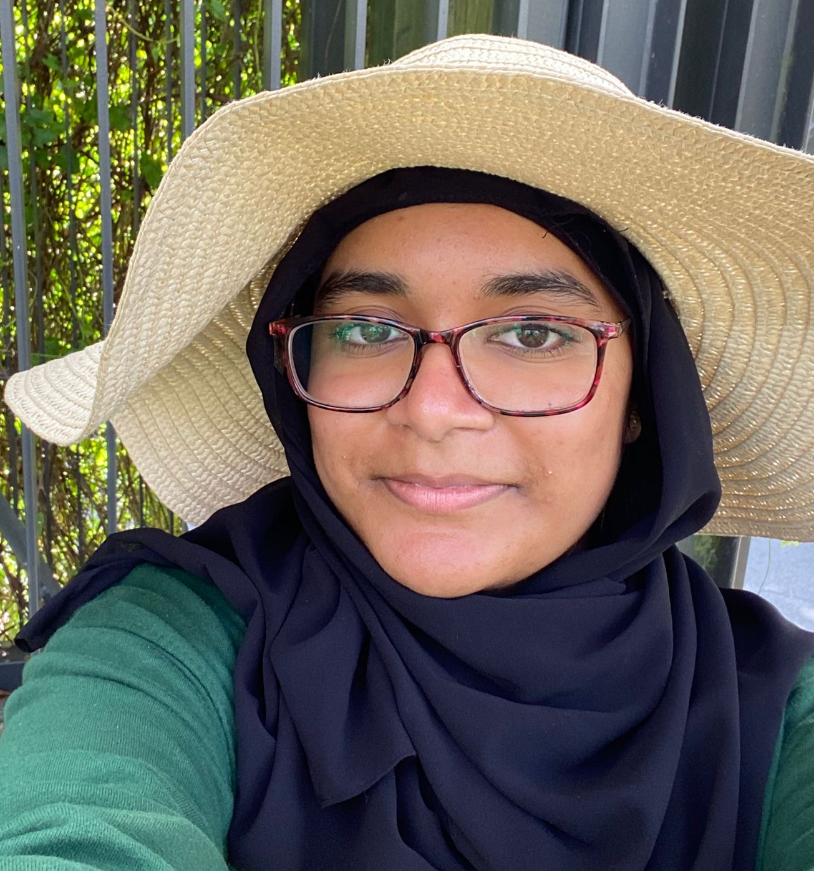
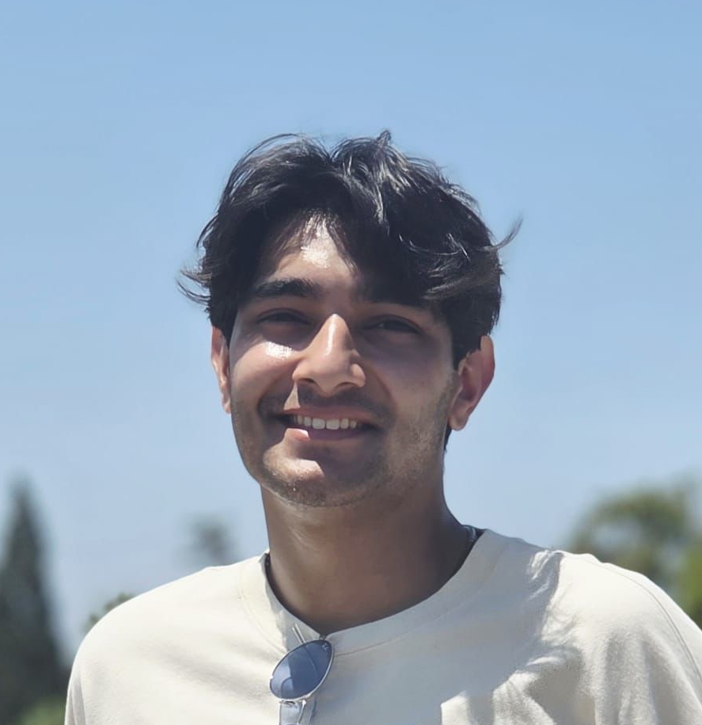
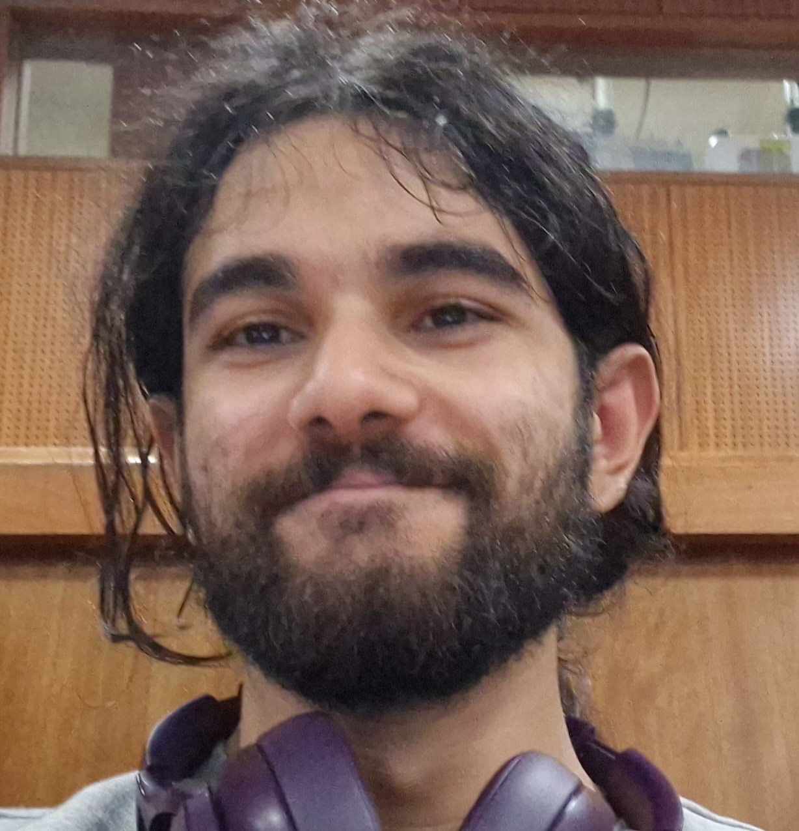
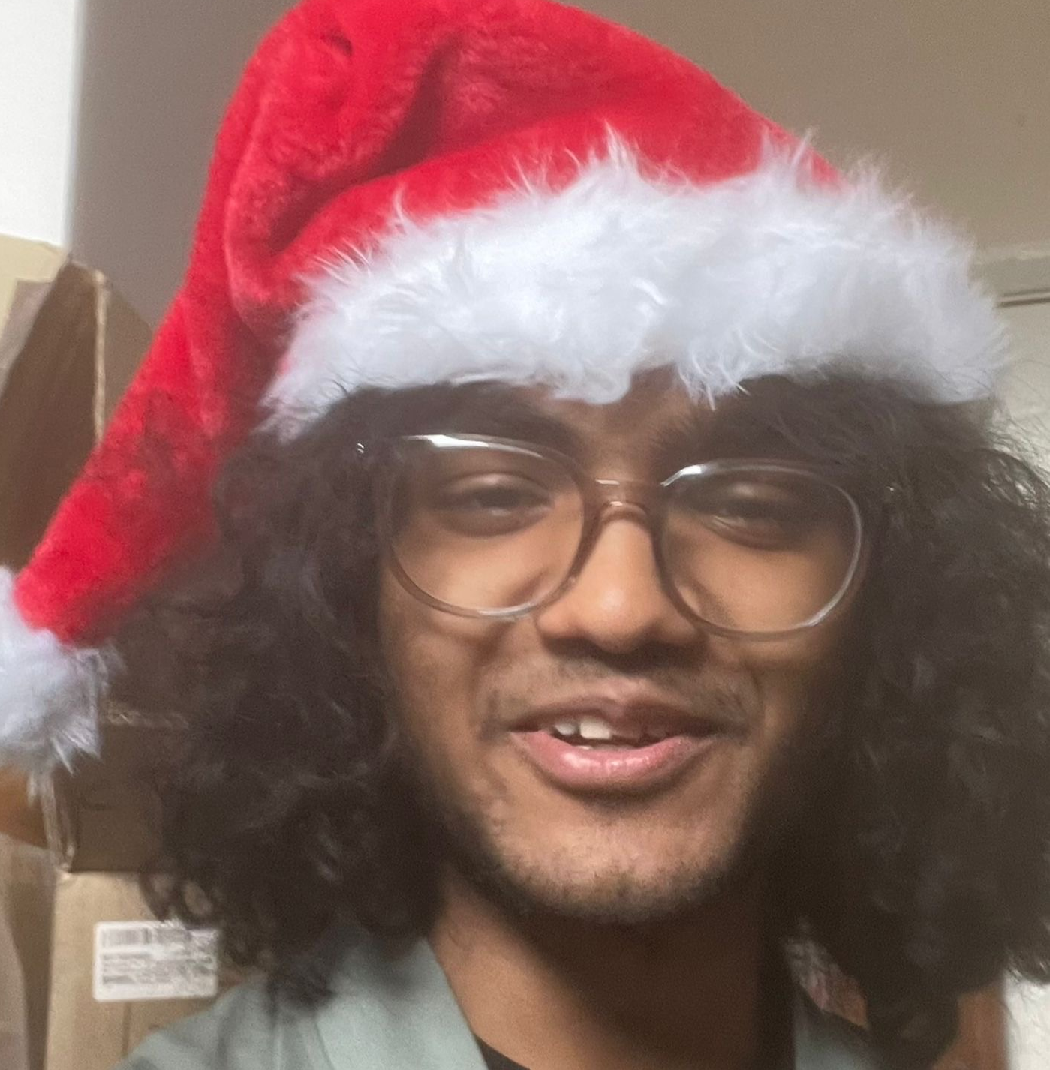
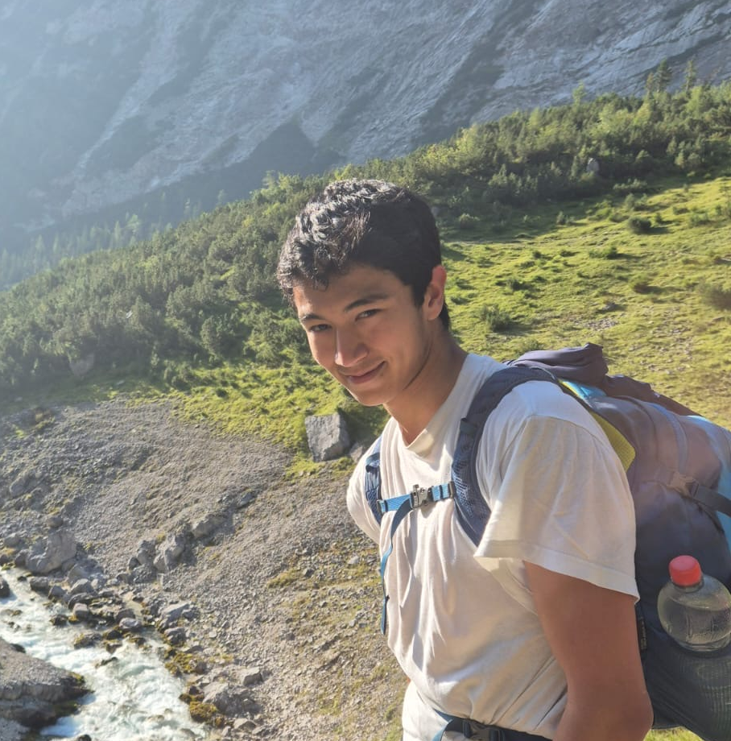
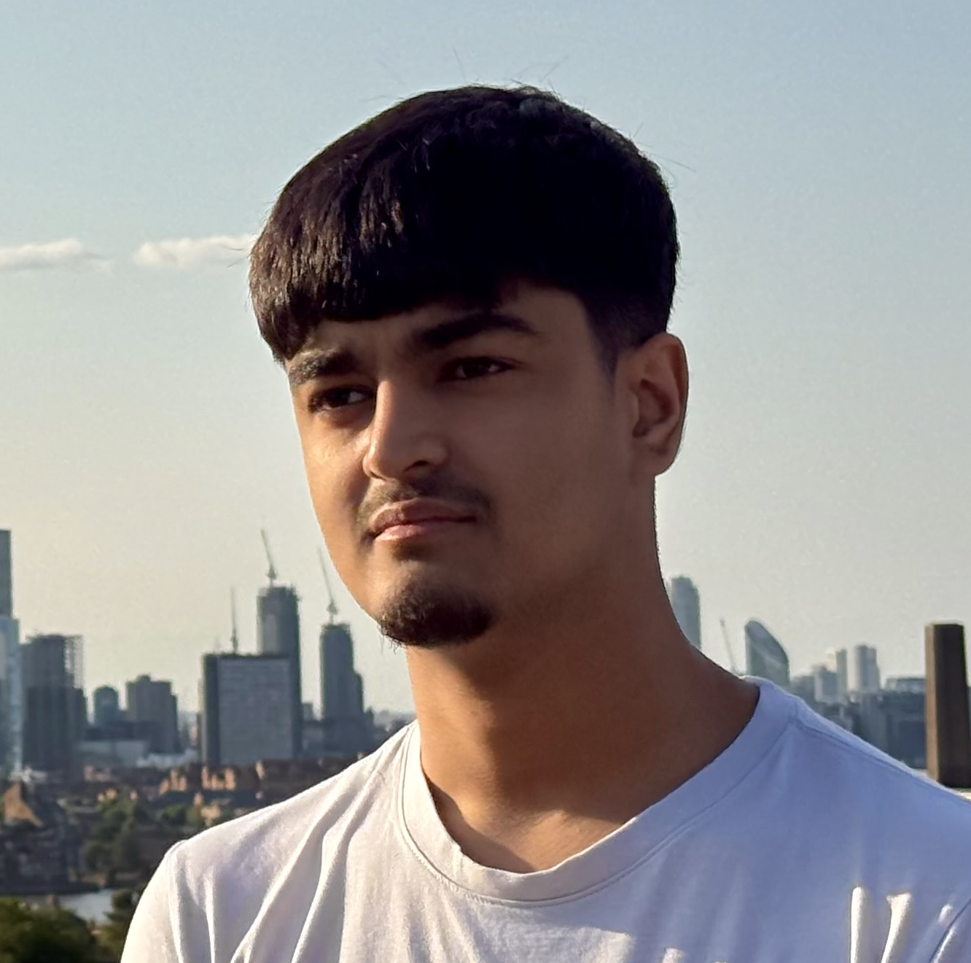
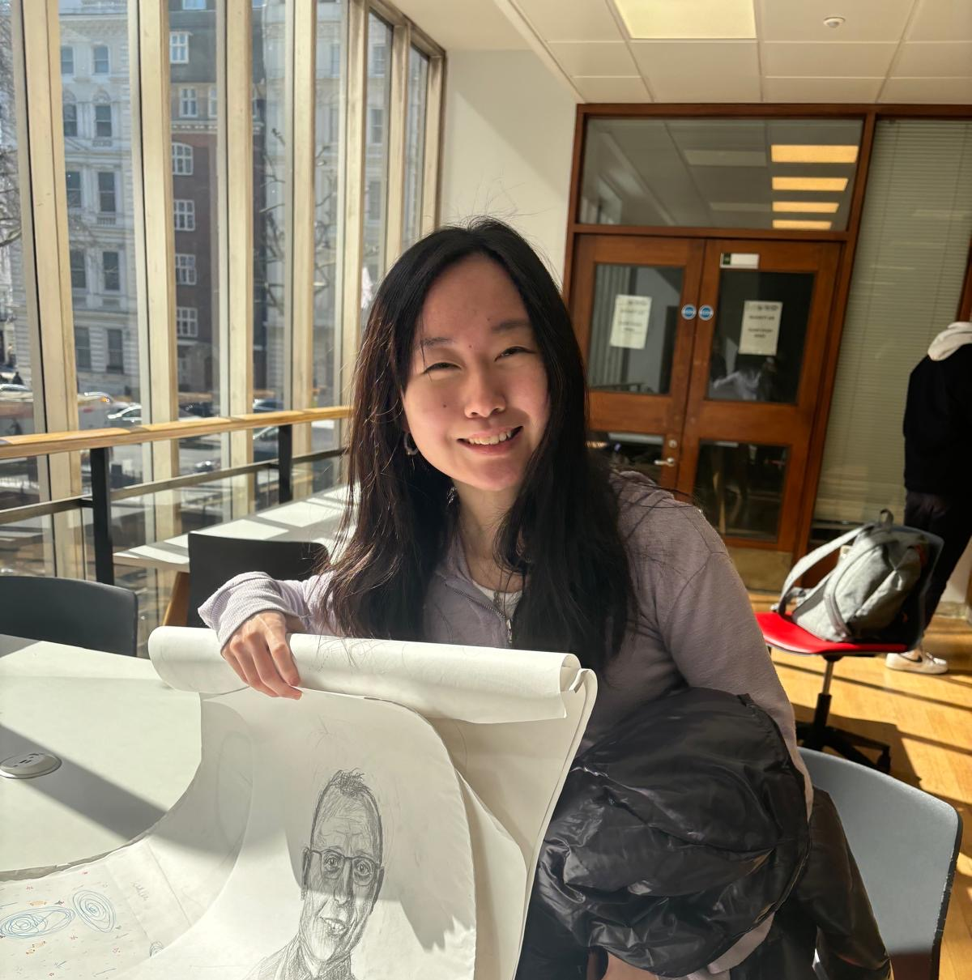
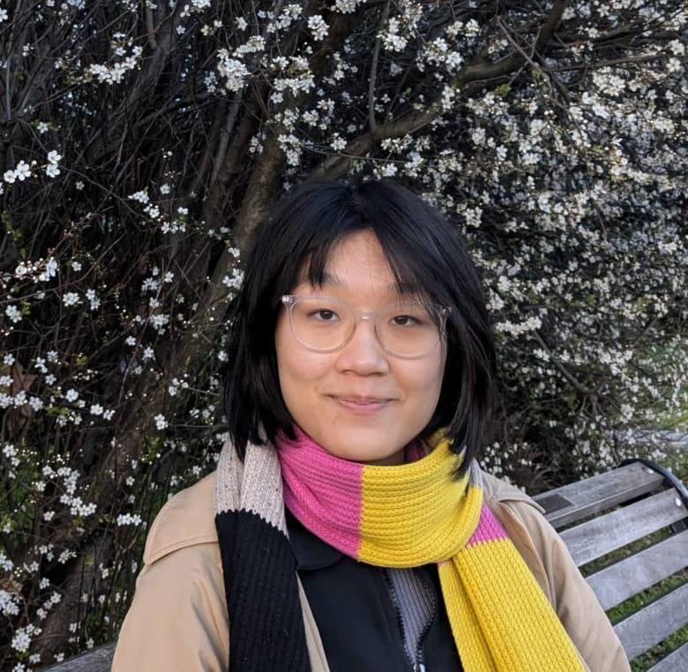
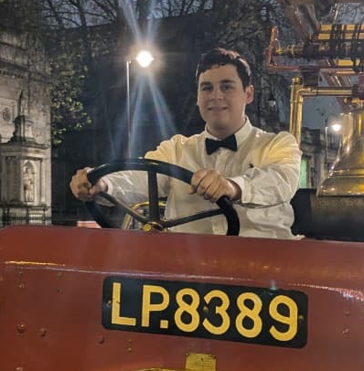
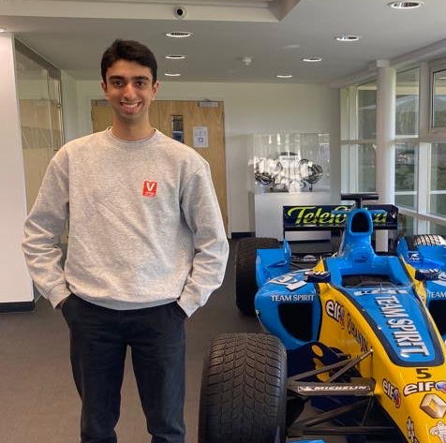
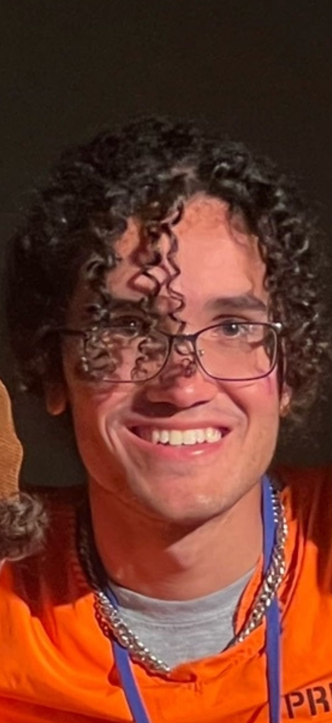
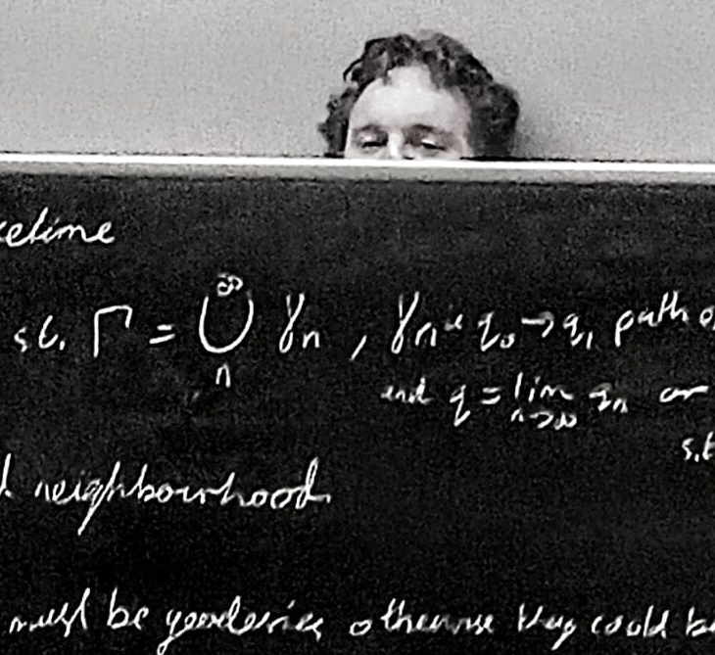
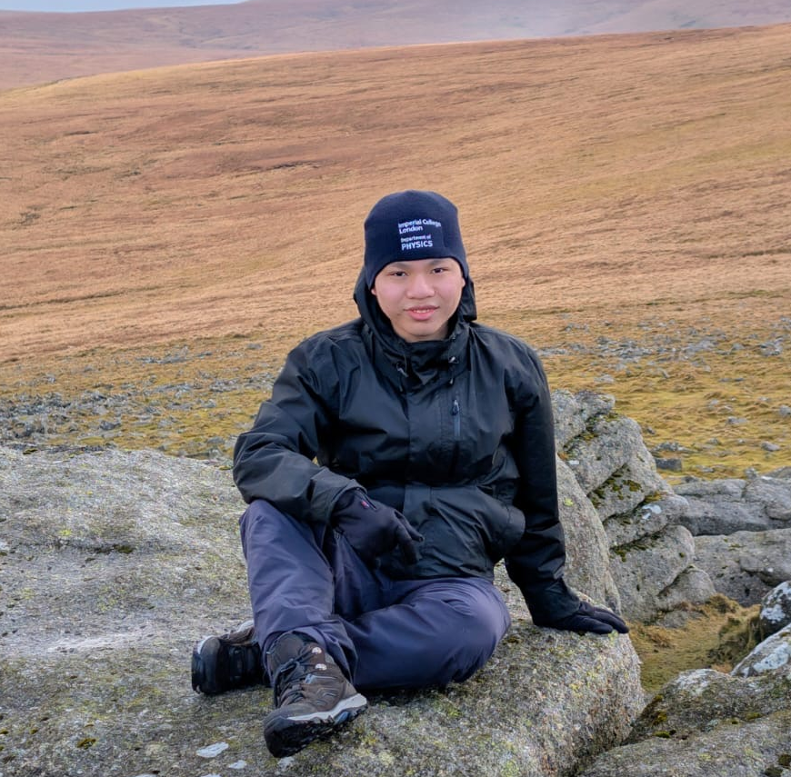
Who Are we?
Student-run
Departmental Society for all Physics Students (UG and PG)

Slide 20
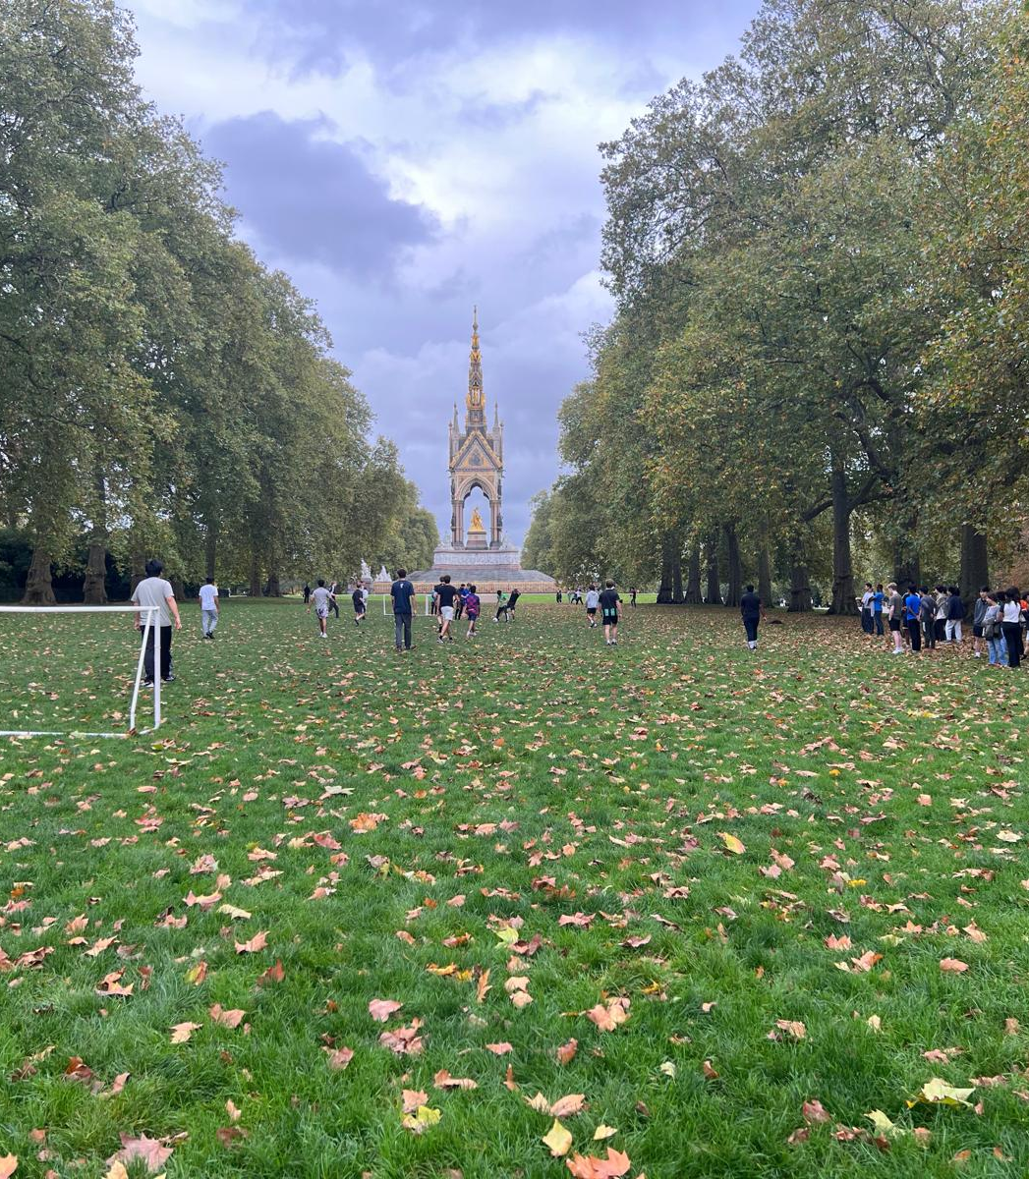
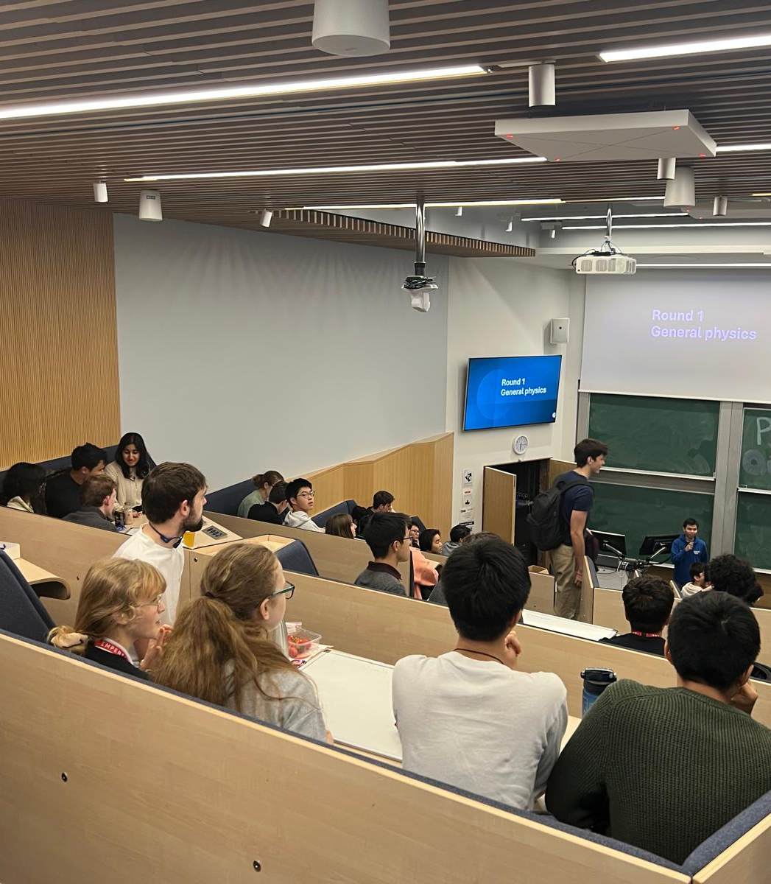
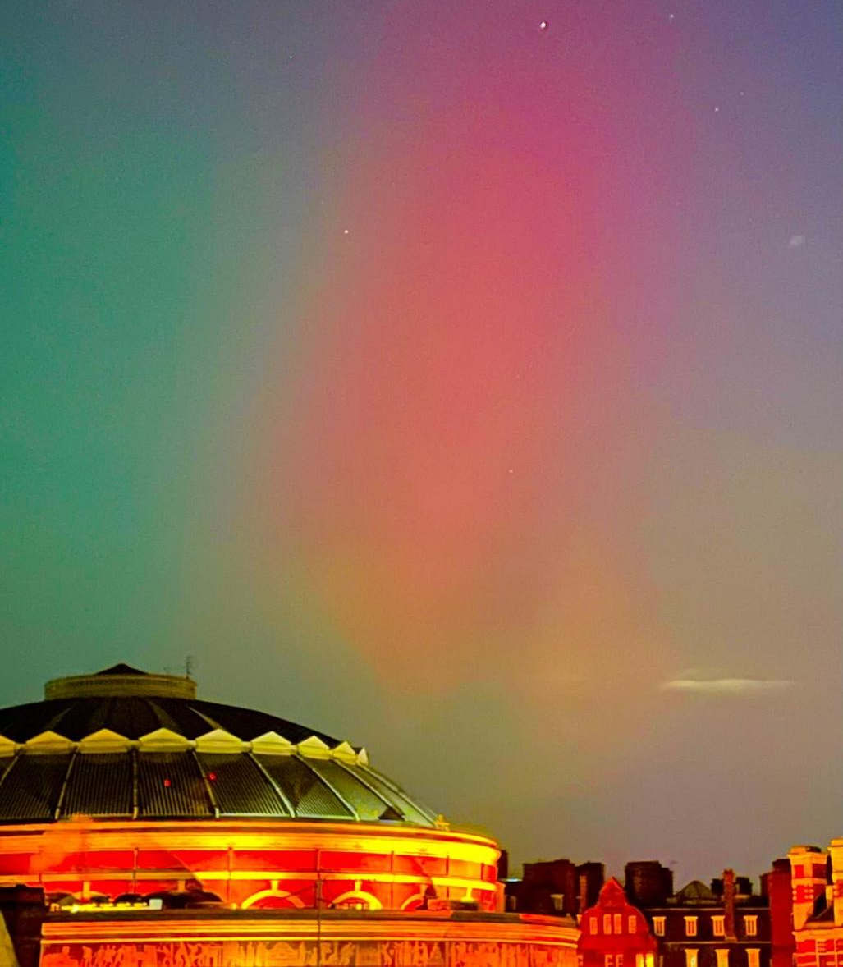
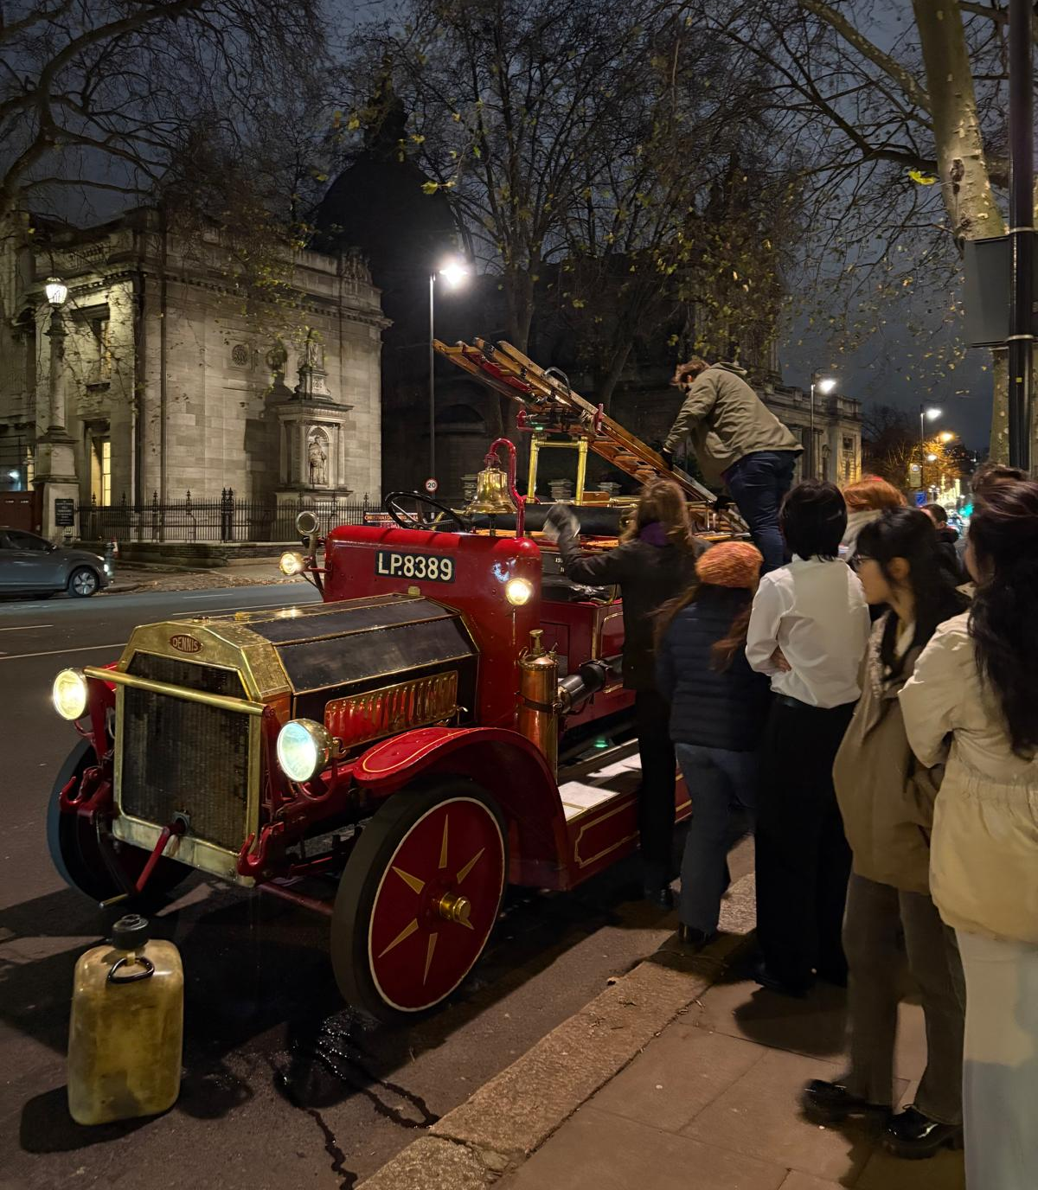
What we do:
Physoc Families
Flagship Events:
  QUIRK – Physics Conference with other universities
  Researchathon – Hackathon for Research
  UG Colloquia
  Annual Christmas Dinner
  Boat Party
Socials:
  Hyde Park Games – Football, Frisbee, …
  Movie Nights (with snacks)
  Collab with other societies
    Astronomy
    Debate
Careers Fairs
PhD and Masters students Panels for UG
PG Socials

Slide 21
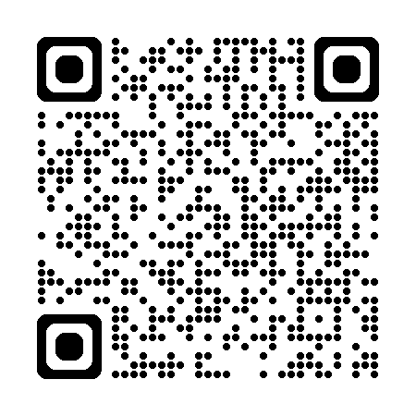
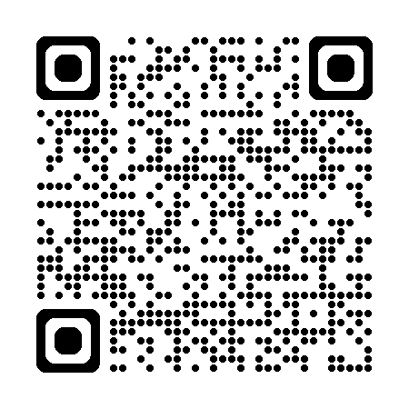
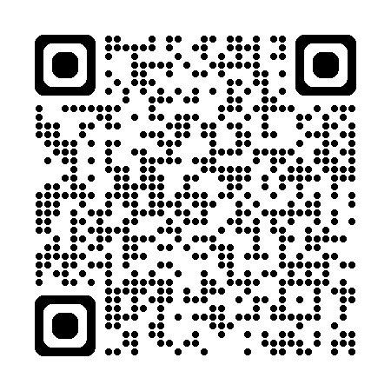
Thanks for Listening!
Website
Linkedin
Instagram
Follow our socials

Slide 22
Library introduction
Physics PhDs
Ann Brew, Physics librarian ann.brew@imperial.ac.uk

Slide 23
Library Services
Subject support page:
https://www.imperial.ac.uk/admin-services/library/subject-support/physics/
Abdus Salam library, South Kensington
Support with searching for information, finding material, referencing, genAI tools and (avoiding) plagiarism
Specialist research support: https://www.imperial.ac.uk/admin-services/library/research-support/

Slide 24
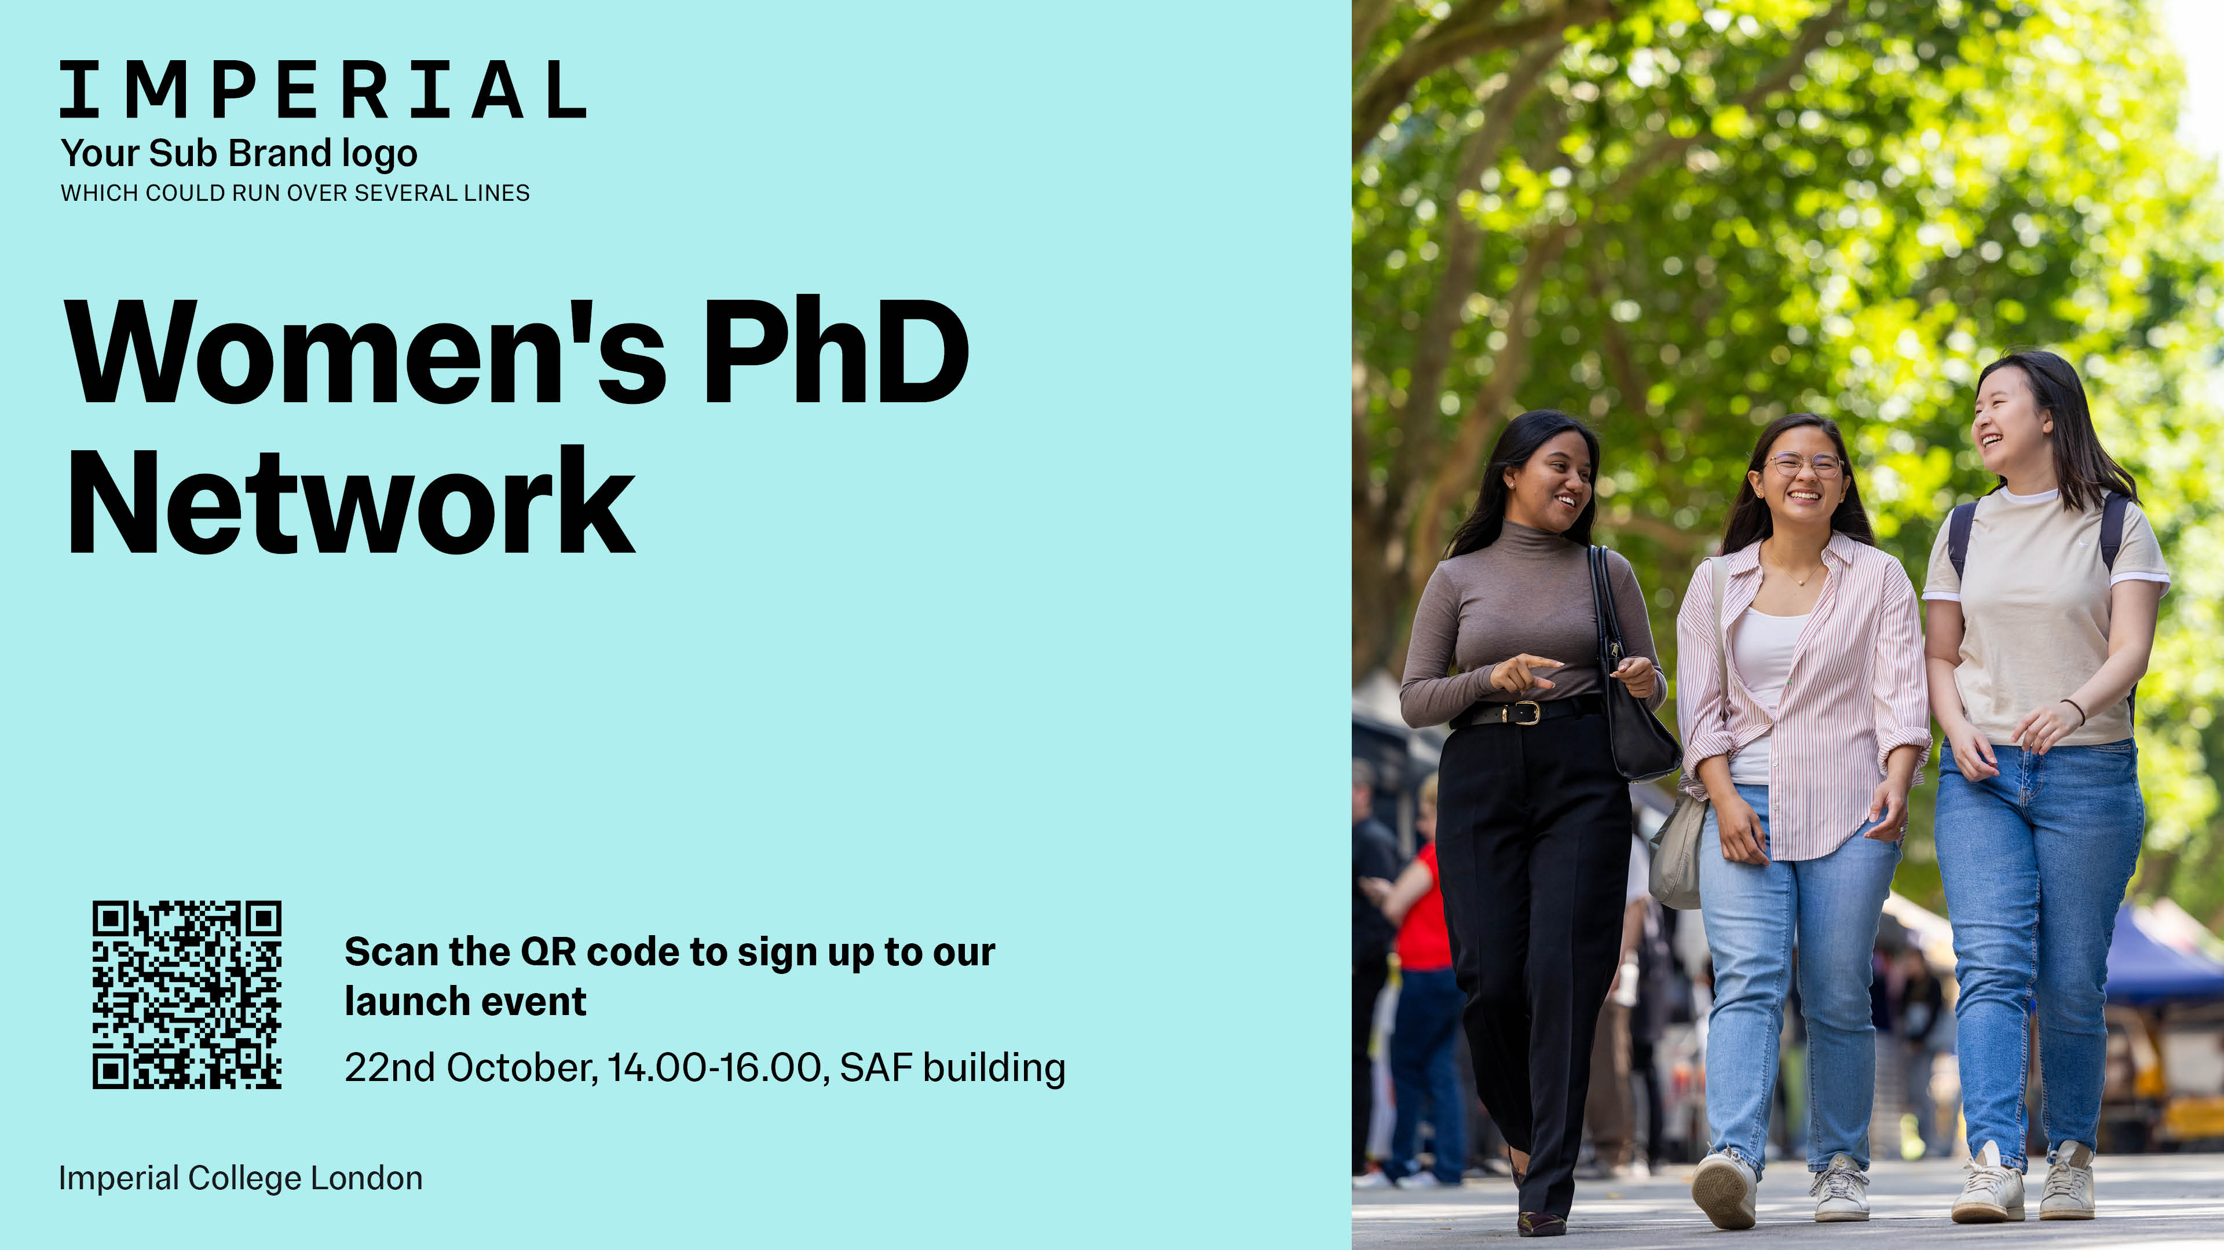

Supporting women doctoral students by fostering peer support, creating inclusive spaces, and providing opportunities to help accelerate academic and professional progress

Slide 25

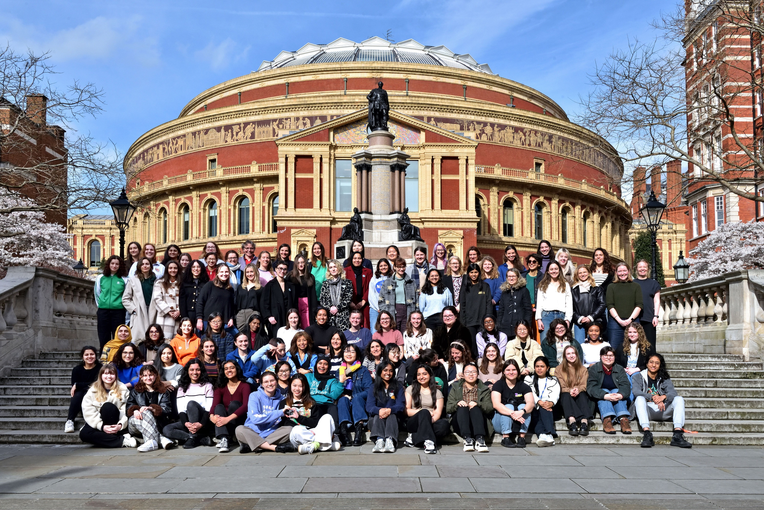
Imperial College Women and Non-Binary Individuals in Physics
We run social and academic events aiming to create a welcoming, inclusive, and supportive network for women and non-binary people working and studying in physics!
International Women’s Day 2024

Slide 26
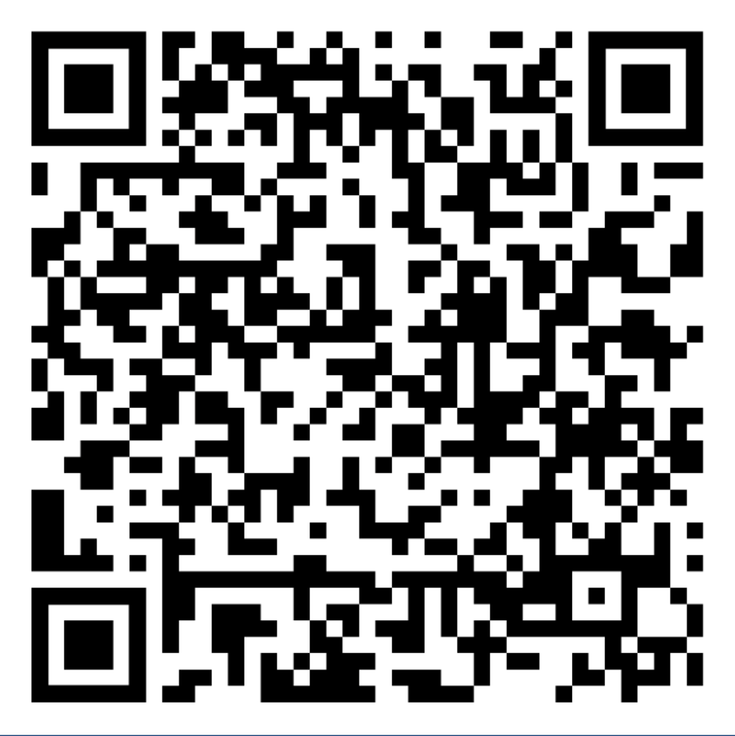
We’re looking for more committee members too! Please get in touch if you’re interested!
womeninphysics@imperial.ac.uk
@ic_wnbip
Becoming a member is free! Just sign up to the mailing list
International Women’s Day 2024

Slide 27



A dedicated community that brings together
women doctoral students across disciplines to:
  Share experiences
  Foster collaboration
  Build peer support
  Highlight students’ research and achievements

Slide 28
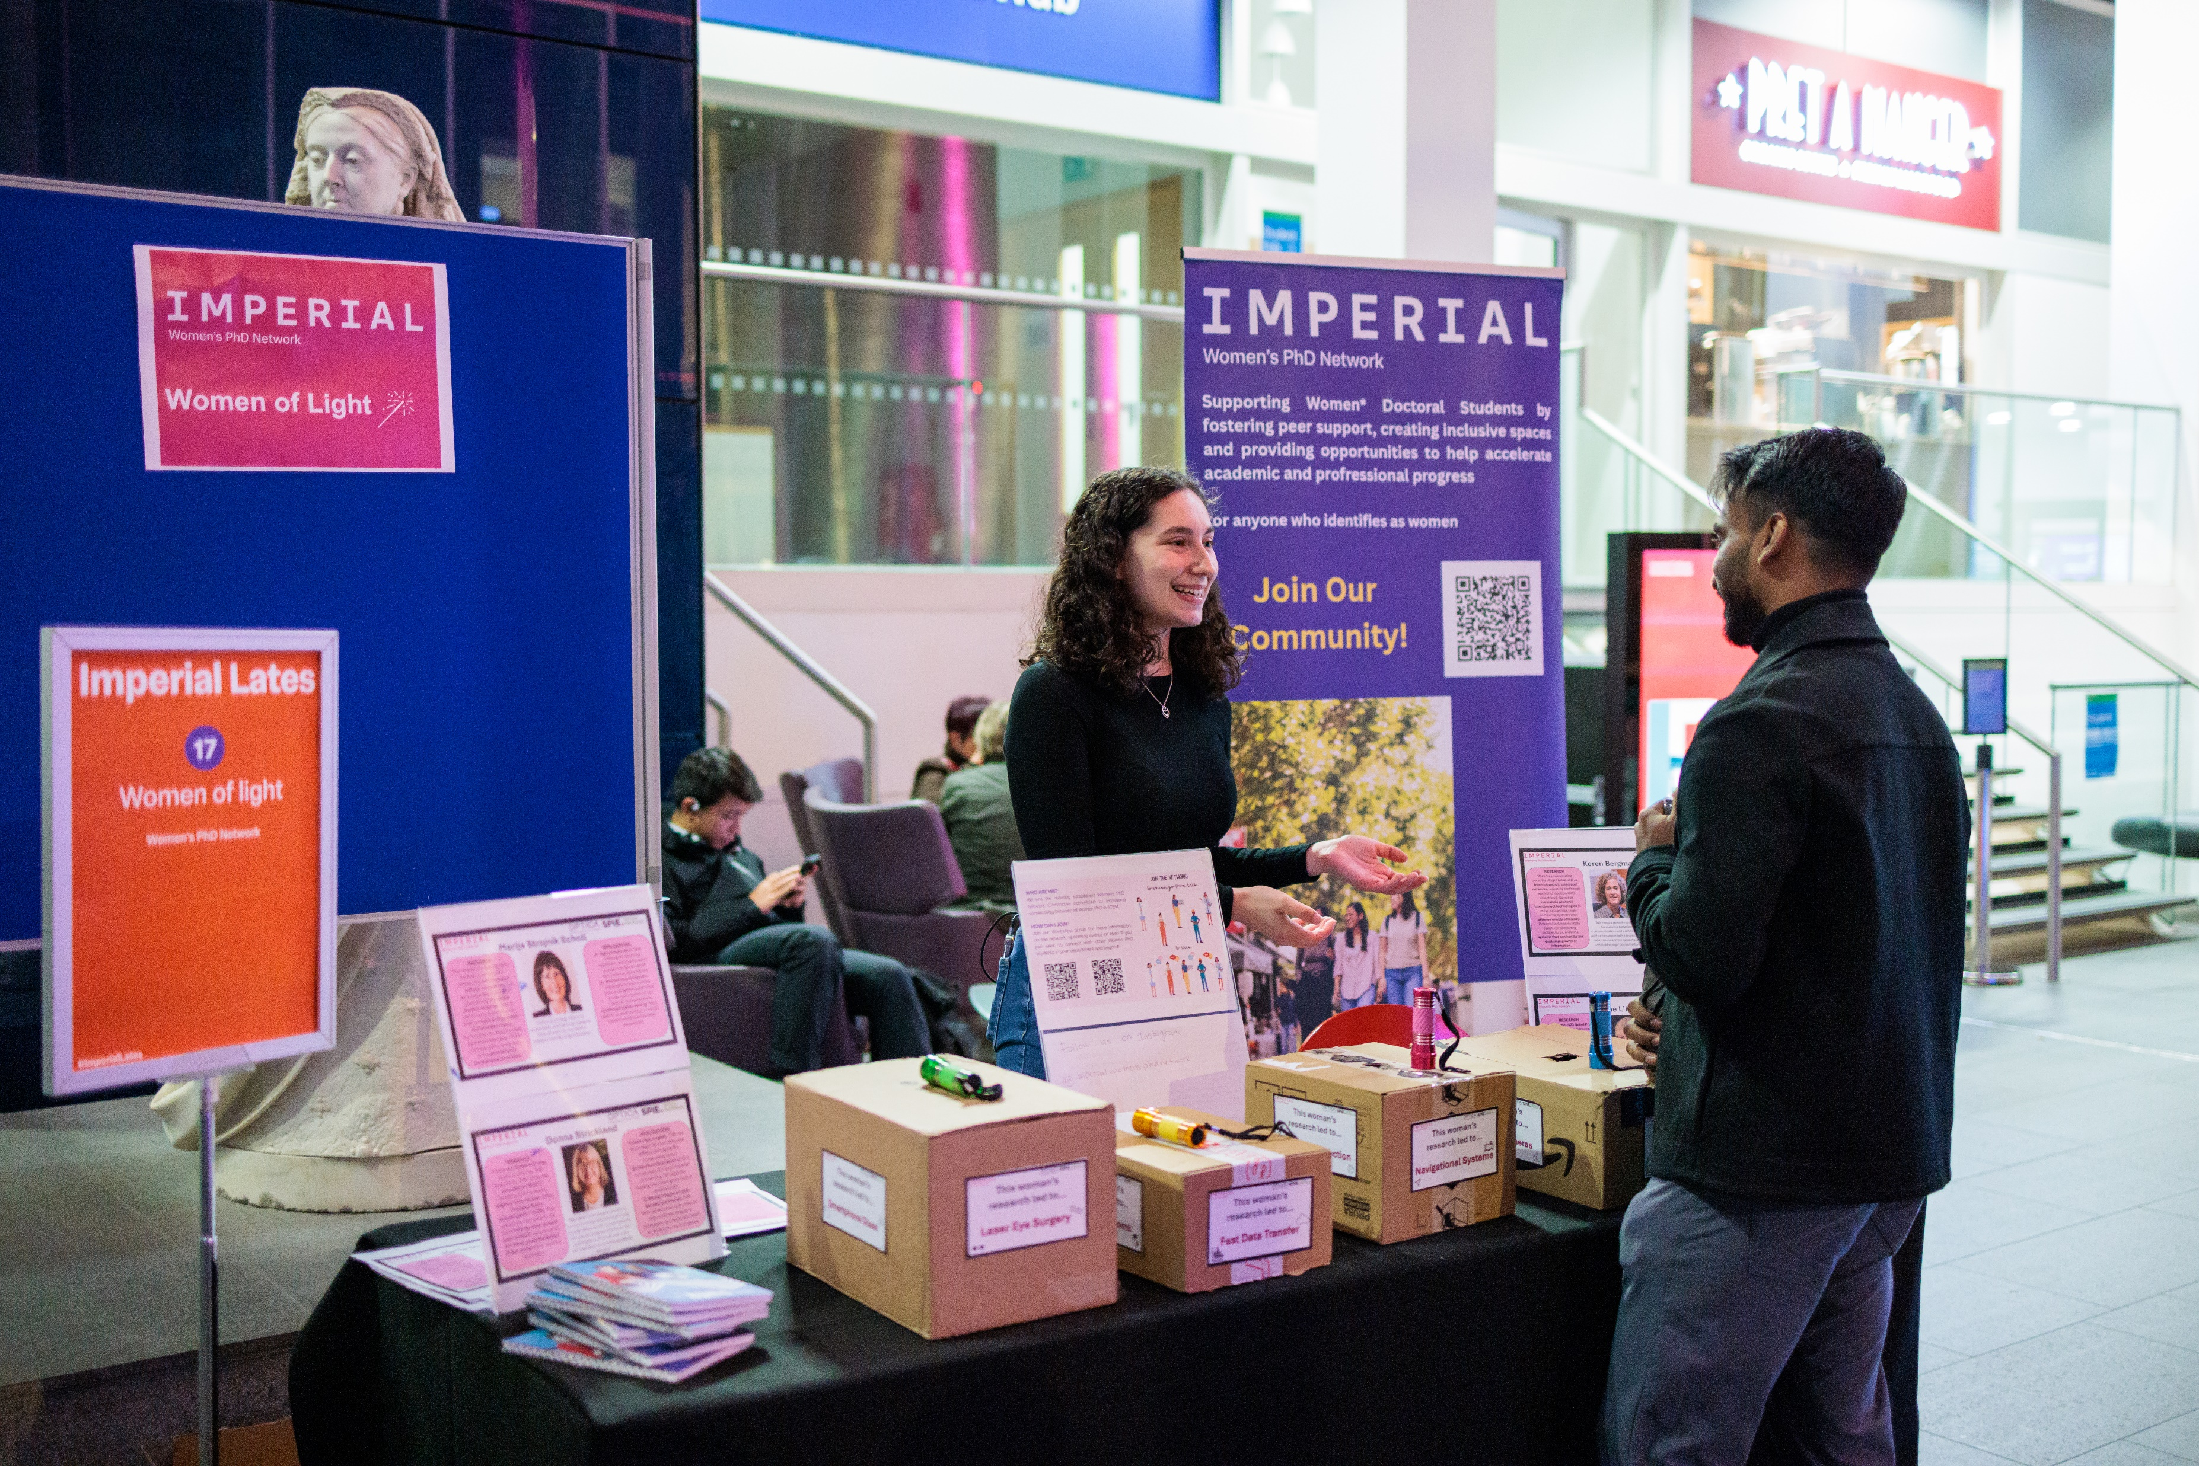
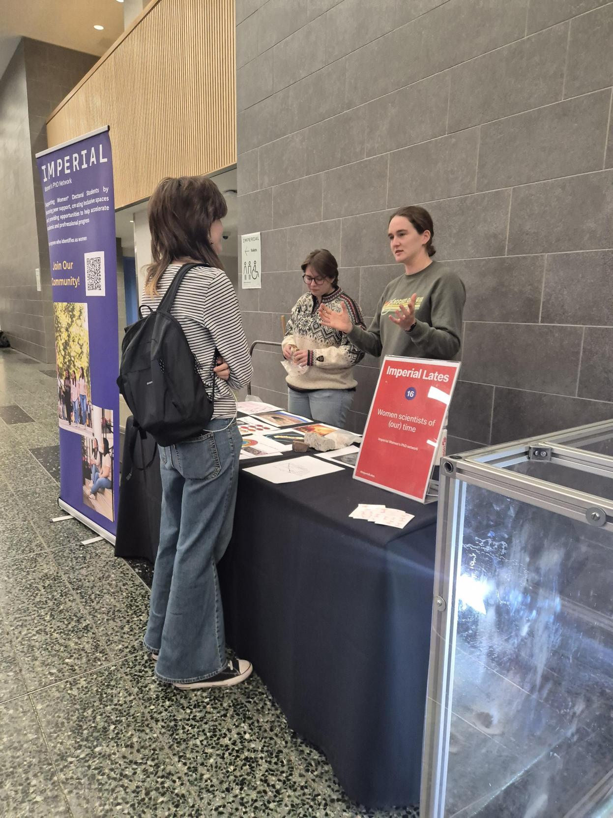
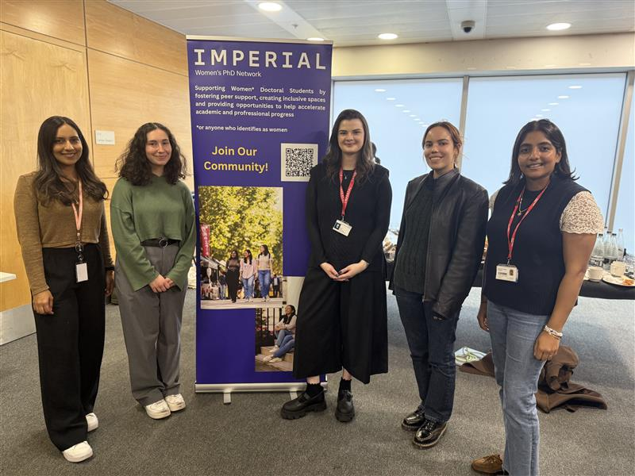
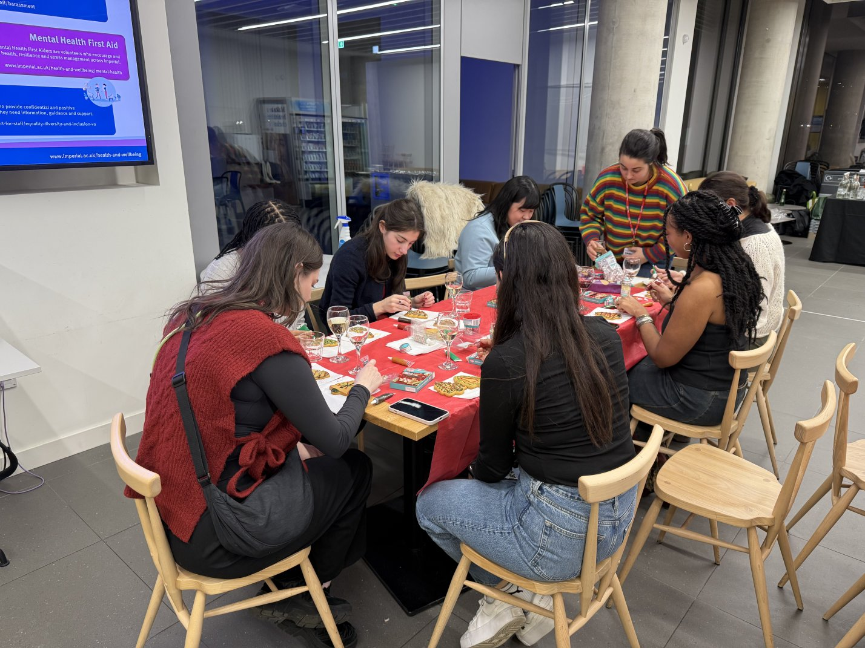

Slide 29
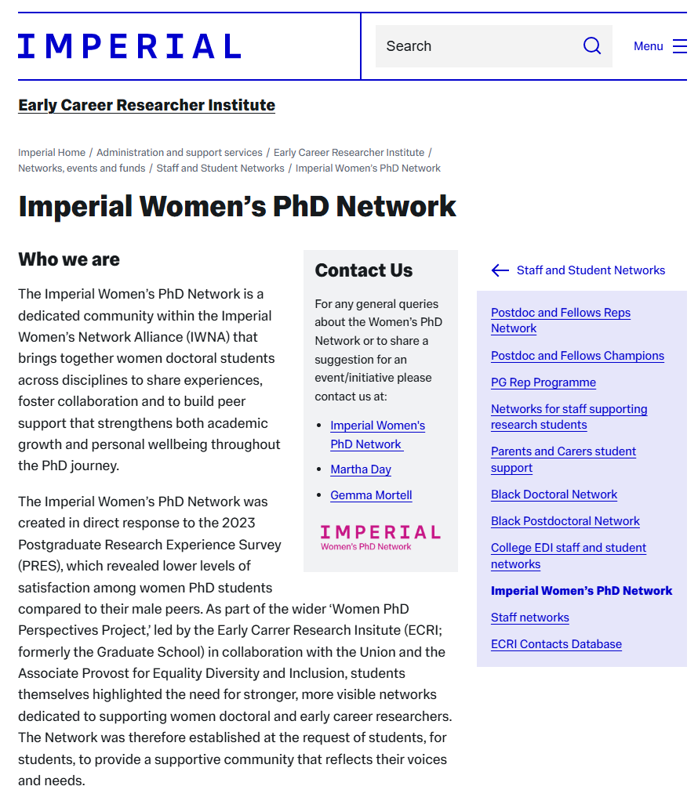
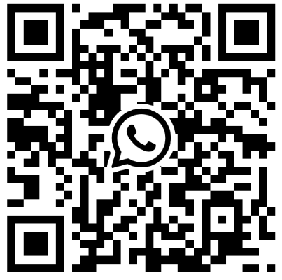


Join Us!
@ImperialWomensPhDNetwork
ImperialWomensPhDNetwork@imperial.ac.uk

Slide 30
Understanding the student-supervisor working relationship
Physics department specific material on understanding the student-supervisor relationship:
both from the student’s perspective
  https://www.imperial.ac.uk/physics/students/current-students/postgraduate-research/postgraduate-student-handbook/guidance-for-students/
and from the supervisors perspective
  https://www.imperial.ac.uk/physics/students/current-students/postgraduate-research/postgraduate-student-handbook/guidance-for-supervisors/
College wide information on what Research Students and their Main Supervisor Might Mutually Expect from Each Other:
both from the student’s perspective
https://www.imperial.ac.uk/students/success-guide/pgr/progressing-through-your-phd-/working-with-your-supervisor/
and from the supervisors perspective
https://www.imperial.ac.uk/media/imperial-college/education-office/What-Research-Students-and-their-Research-Degree-Main-Supervisor-Might-Mutually.pdf

Slide 31
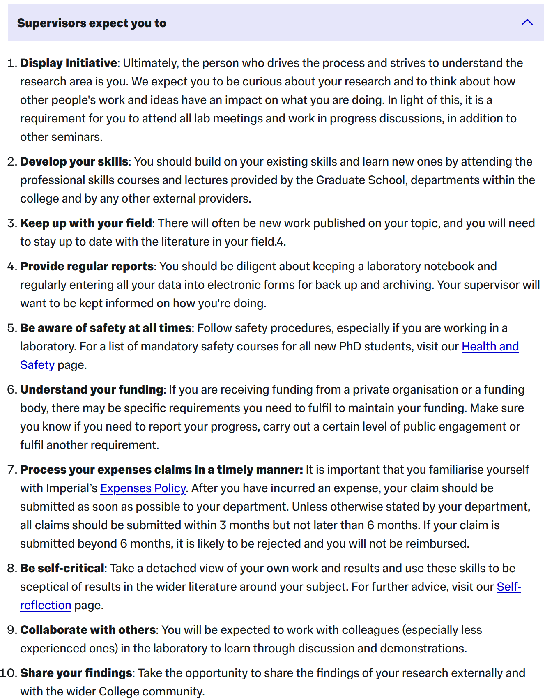
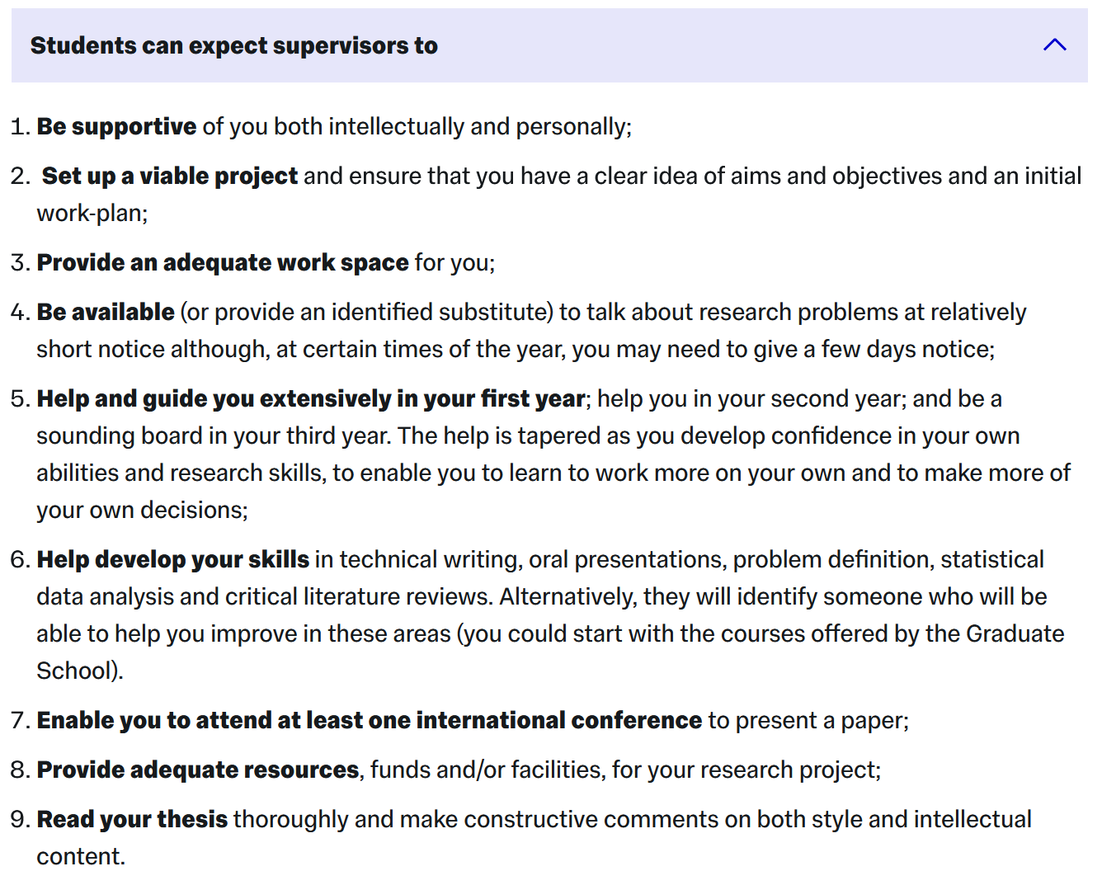
Understanding the student-supervisor working relationship
https://www.imperial.ac.uk/students/success-guide/pgr/progressing-through-your-phd-/working-with-your-supervisor/

Slide 32
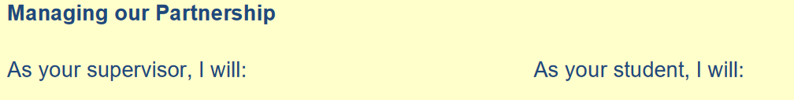
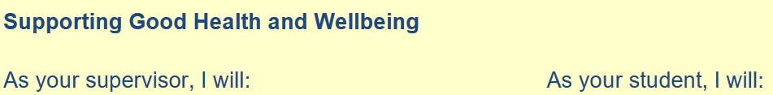
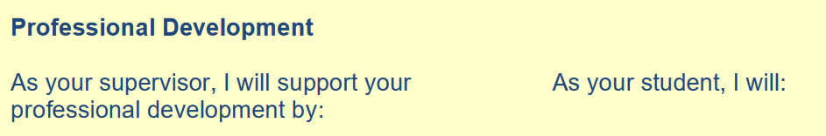
Understanding the student-supervisor working relationship
https://www.imperial.ac.uk/media/imperial-college/education-office/What-Research-Students-and-their-Research-Degree-Main-Supervisor-Might-Mutually.pdf

Slide 33
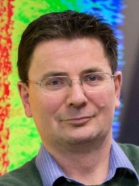
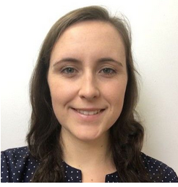
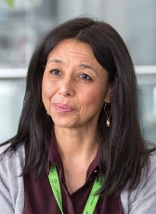
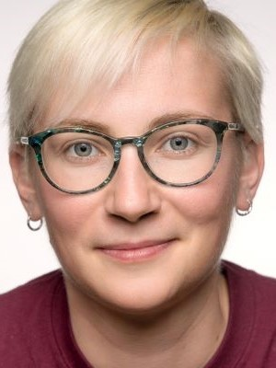
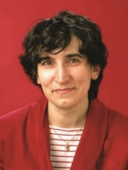

PGR welfare in Physics: PhD
Community PG Mentors | https://www.imperial.ac.uk/physics/students/current-students/postgraduate-research/contacts-and-mentors/academic-staff-contacts/ |  | Safety, academic and personal issues
Research community PG committee representatives | https://www.imperial.ac.uk/physics/students/current-students/postgraduate-research/contacts-and-mentors/research-group-committee-reps-and-coordinators/ |  | PG feedback to department, common issues, social events.
PGR Senior Tutor | Jerry Chittenden j.chittenden@imperial.ac.uk Blackett 744 |  | Pastoral care of students, supervisor/student issues, mental health issues
Student Wellbeing Adviser | Ella Robson fonsstudentwellbeing@imperial.ac.uk |  | Confidential one-to-one guidance to discuss your concerns and agree next steps, helping you to manage your wellbeing during your time at Imperial
Disabilities Officer | Mery Fajardo m.fajardo@imperial.ac.uk Blackett 306 |  | Disabilities
Director of PG studies | Linda Cremonesi ph.dps@imperial.ac.uk Blackett 522 |  | Administrative aspects, progression, issues related to the wider college.
PGR Administrator | Loli Sanchez Rey l.sanchez@imperial.ac.uk Huxley 903a, |  | Postgraduate liaison and administration; progression, deadlines, etc.
PGR Education Manager | Roxane Ray roxane.ray@imperial.ac.uk Blackett 901b |  | Oversees the postgraduate administration
Physics PG Helpdesk For both MSc and PhD students |  | First Wednesday of each month (12-1pm, advertised by email regularly)
(Prof Lesley Cohen or Dr Yvonne Unruh if you’d prefer to talk to a female member of staff)

Slide 34
Other useful resources
List of useful student support contacts in physics: https://www.imperial.ac.uk/physics/students/current-students/postgraduate-research/ and select Quick contacts
Helpdesk: co-run with Jerry Chittenden (PGR Tutor), Bob Forsyth (PGT tutor), Jess Popplewell from careers office and current RAs.
First Wednesday of every month 12-1pm by email invitation .
For general support regarding wellbeing and mental health I would recommend the Faculty Student Wellbeing Advice Team as a first point of call. There's a quick link to the form to book an appointment, https://www.imperial.ac.uk/natural-sciences/education-and-teaching/wellbeing-support/resources-for-students/advice-team/
There are also other links to the sorts of support at the Faculty and College level https://www.imperial.ac.uk/natural-sciences/education-and-teaching/wellbeing-support/
Plus there are other links to support services through the union and externally https://www.imperial.ac.uk/student-support-zone/
There is also the College’s Counselling service (https://www.imperial.ac.uk/counselling/self-directed-support/)
the Mental Health Intervention Team https://www.imperial.ac.uk/counselling/student-mental-health-intervention-officers/
as well as links to other types of support such as counselling external to the College
https://www.imperial.ac.uk/counselling/other-sources-of-help/ .

