Slide 1
Department of Electrical and Electronic Engineering
Day One Safety Induction
Zia Rahman
23/09/2025

Slide 2

Postgraduate Safety Video

Slide 3
Emergency Contact Numbers
In the event of an emergency anywhere on campus
Please dial 4444 from any internal phone
Store and dial 0207 589 1000 from your mobile phone
Both numbers will direct you to our 24 hour Security Office based in Sherfield Building
Do NOT dial 999 or 111 as Emergency Services will not be able to gain access in secured areas

Slide 4
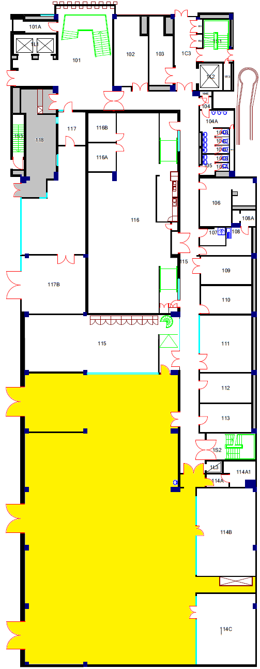
Level 1 floor plan
EE Stores [118]
Yr 1&2
Electronics
Lab
[114]

Slide 5
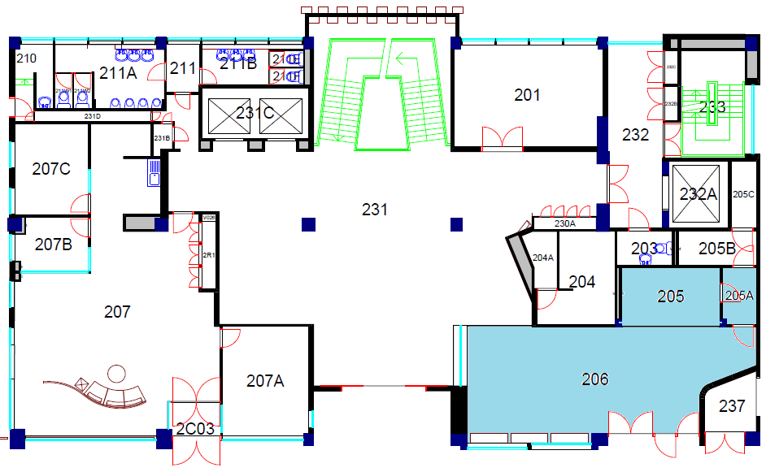
Level 2 Floor Plan
EE Cafe

Slide 6
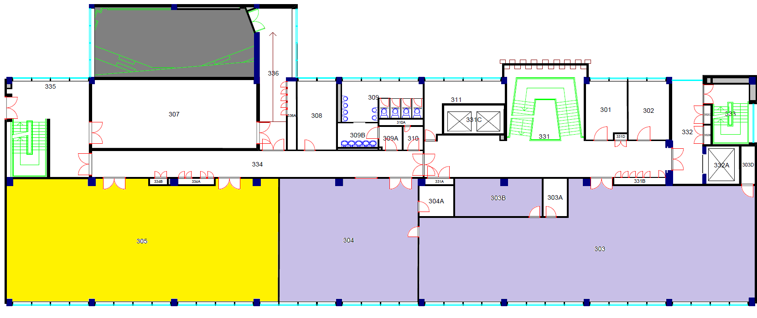
Level 3 Floor Plan
MSc Lab [303B]
Teaching Space
[305]
Post Graduate
Breakout Space
[305]
MSc
Computer Lab
[303]
MSc
Study Space
[303]

Slide 7
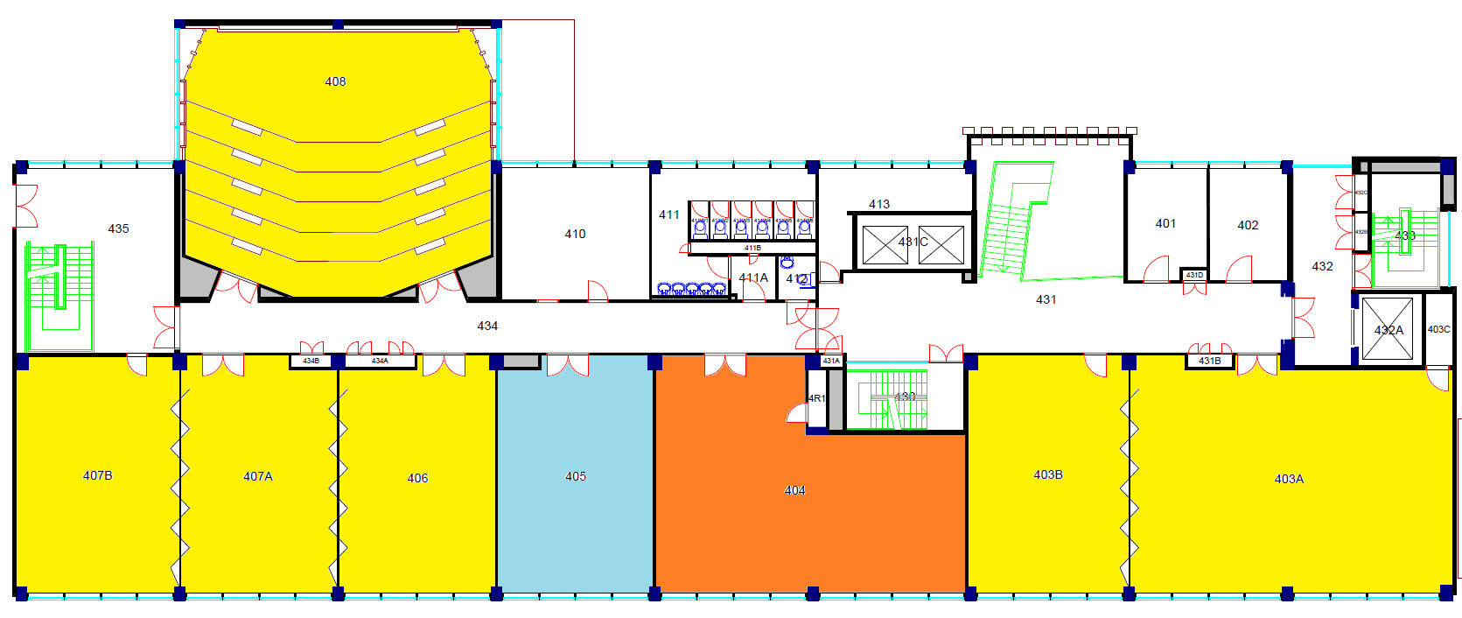
Level 4 Floor Plan
Lecture Theatre
[408]
Teaching Space
[406 / 407A / 407B]
Teaching Space
[403A / 403B]
Yr 1&2 Breakout Space
[405]
Yr 1&2
Study Lab
[404]

Slide 8
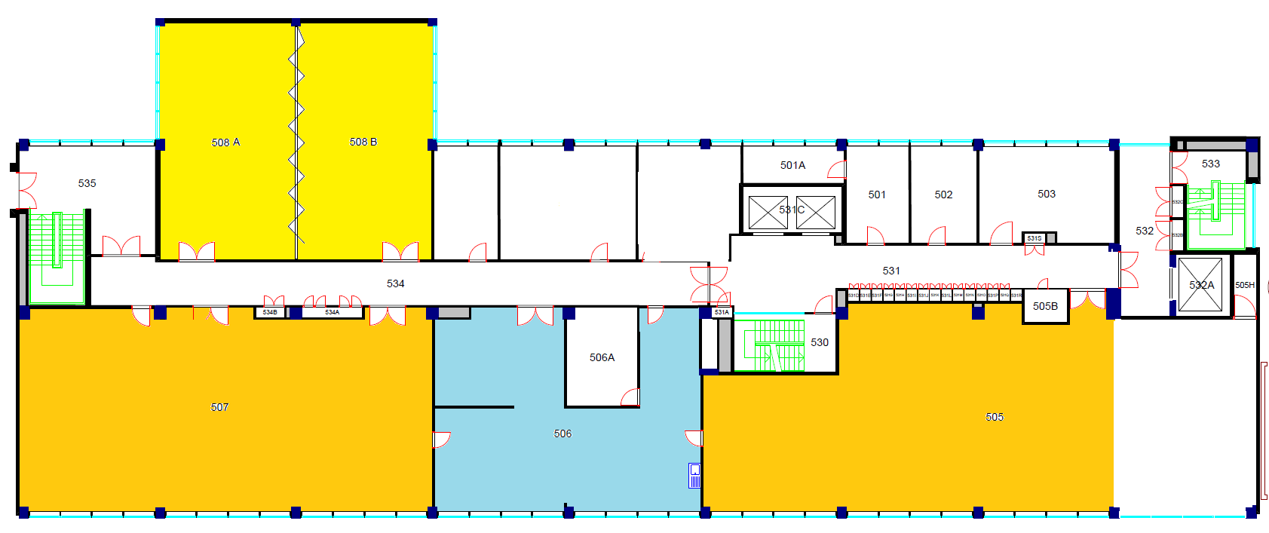
Level 5 Floor Plan
Teaching Space
[508A / 508B]
Yr 3&4
Computer Lab and Teaching Room
[507]
Imperial
College
Robotics
Society
Yr 3&4
Projects Lab
[505]
Yr 3&4 Breakout Space

Slide 9
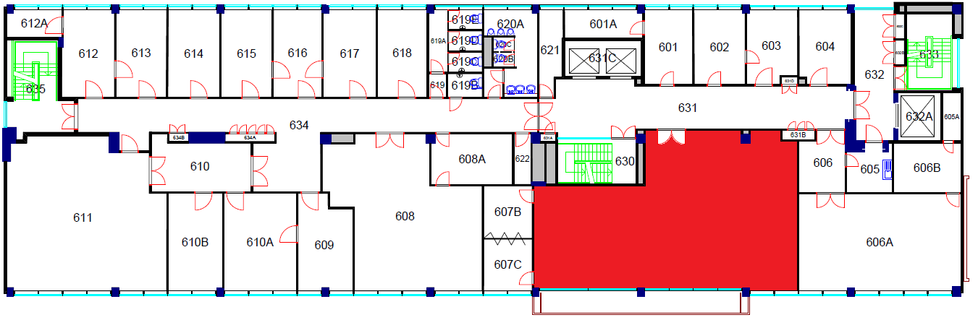
Level 6 Floor Plan
EE Education Support
Office

Slide 10

Electrical Engineering Building Plan
Level 11 > Control & Power (CAP) Research Group
Level 10 > Intelligent systems & networks (ISN) Research Group
Level 9 > Circuits & Systems (CAS) Research Group
Level 8 > Comm & Signal Processing (CSP) Research Group
Level 7 > Optical & Semiconductor Devices (OSD) Research Group
Level 6 > Education Support Office / Student Wellbeing Office
Level 5 > Teaching Rooms / Yr 3 & 4 Project and Computer Lab
Level 4 > Teaching Rooms / Yr 1& 2 Comp lab & Breakout room
Level 3 > Teaching Room / MSc Breakout room & Comp Lab
Level 2 > Lumen Cafe
Level 1 > Yr 1 & 2 Electronics Lab and EE Stores

Slide 11
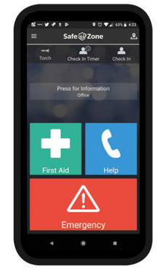

SafeZone App
SafeZone has been designed to contact the Security Team and locate you anywhere on campus. Download the app

Slide 12
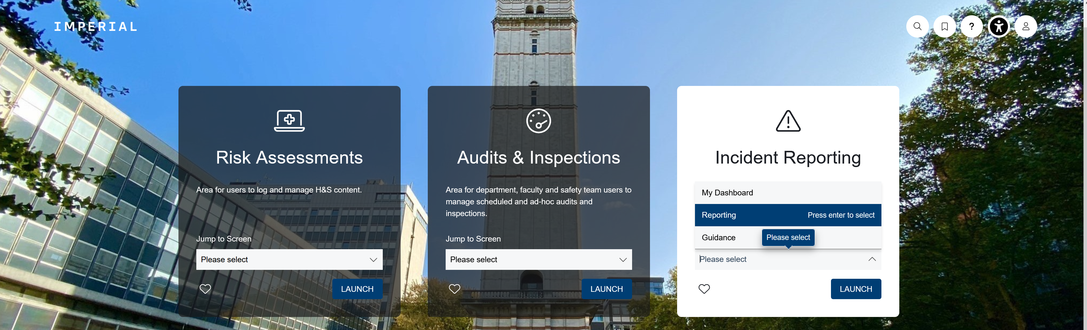
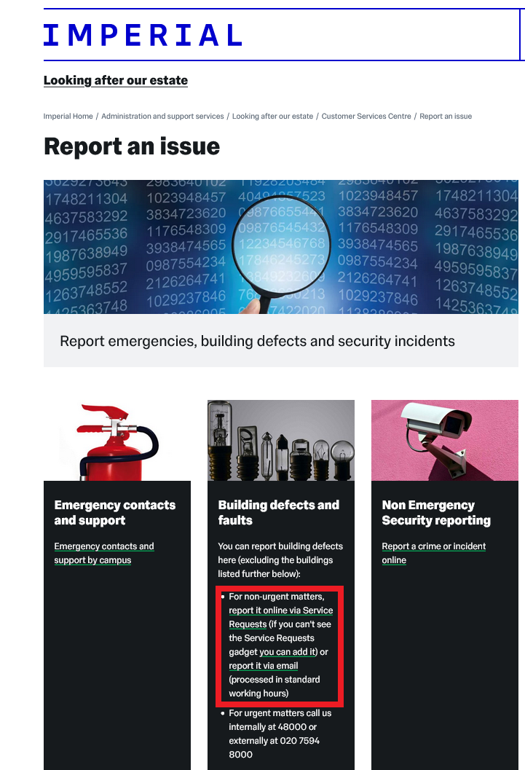
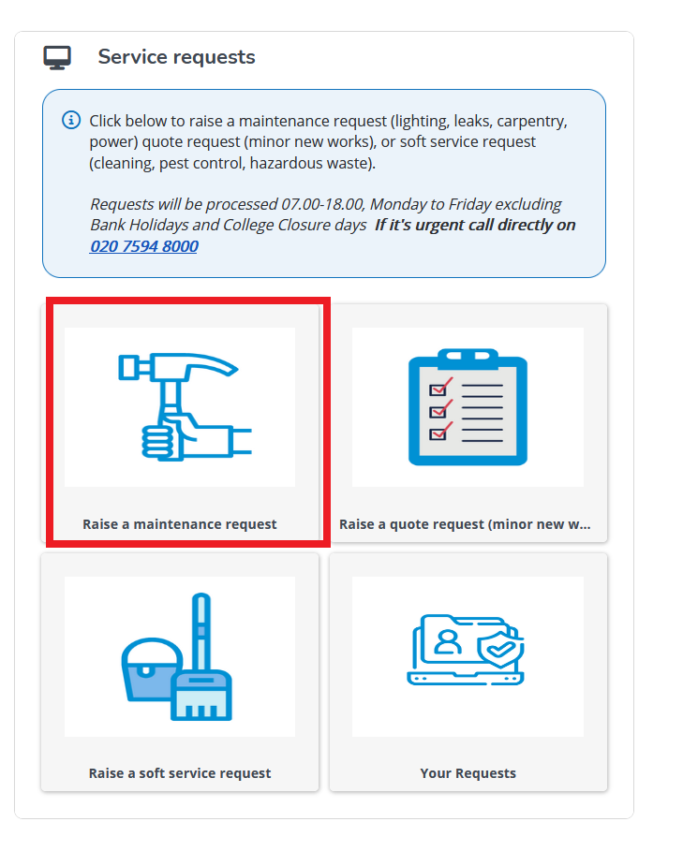
CORESTREAM and Building Defects
Please report all accidents and incidents using the online
CORESTREAM form
Please report all building defects via the online Customer Service Centre

Slide 13
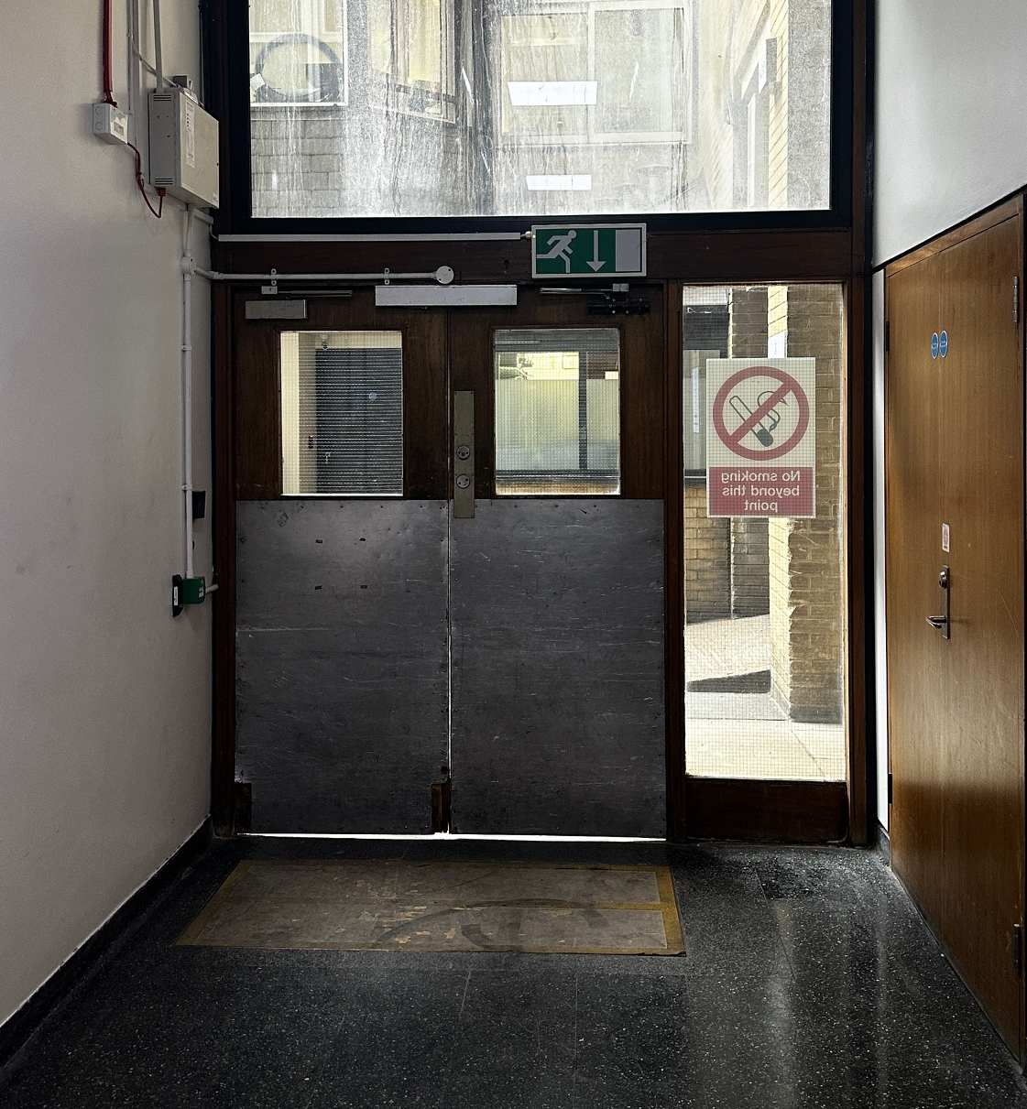
FIRE EXIT ROUTE VIA NORTH STAIRCASE
Level 1 Loading Bay exit

Slide 14
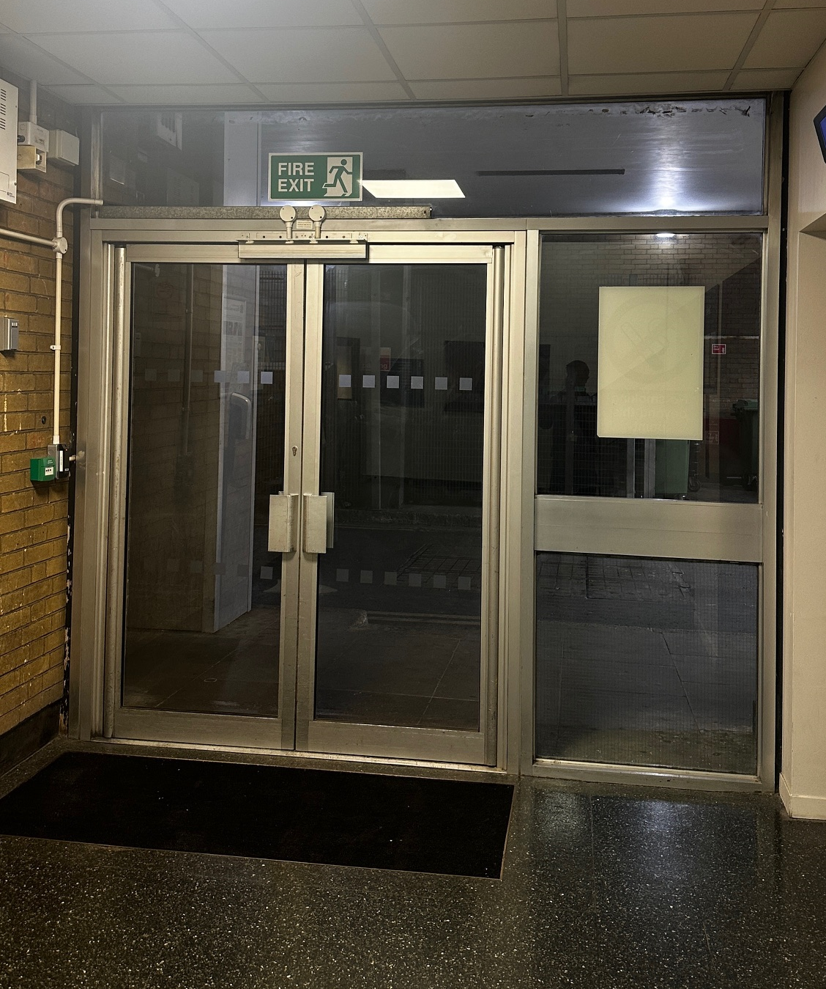
FIRE EXIT ROUTE NEAR CENTRAL STAIRCASE
Level 1 Passenger Lift / Ayrton Road

Slide 15
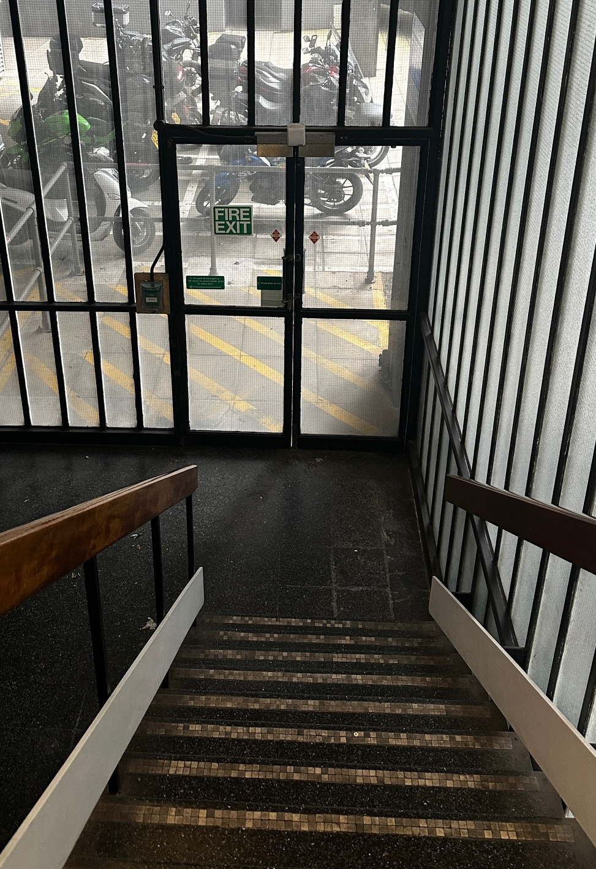
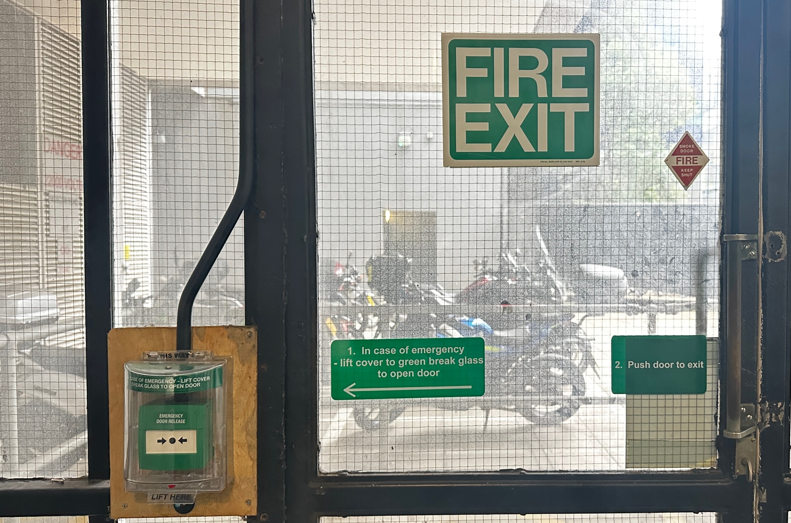
FIRE EXIT VIA SOUTH STAIRCASE
Level 1 Motorcycle Bays / Assembly Point (F)

Slide 16
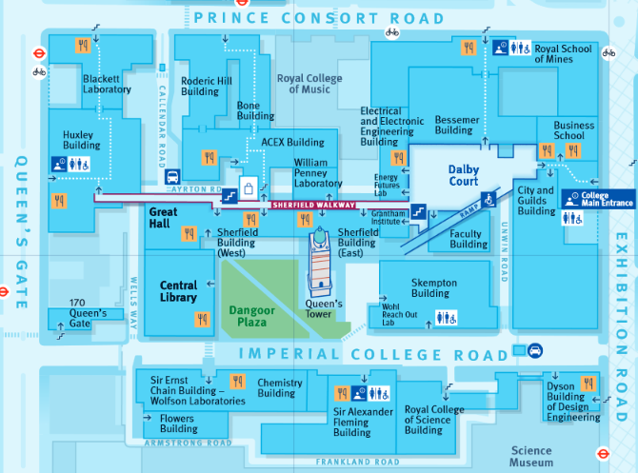
Fire Assembly Point
Follow Fire Exit route from the building to Assembly Point F (Queen’s Lawn Car Park)

Slide 17
Introduction to Fire Safety Video
(11 mins)

Slide 18
First Aid
Please call 4444 (from internal phone) or dial 0207 589 1000 (from mobile phone) to call Security Officers who are all first aid trained

Slide 19

Personal Emergency Evacuation Plan (PEEP)
Should you have a temporary or permanent disability at any time when on site, please contact Zia Rahman to arrange an evacuation plan specific to your needs.
Mr Zia Rahman
Department Safety Officer
Office: 302
Mob: 07852 850 186
Email: z.rahman@imperial.ac.uk

Slide 20
Hazardous Areas / Procedures
Use of laboratory or workshop equipment is prohibited without permission and UG students must be supervised
Department Safety Officer
Zia Rahman : z.Rahman@imperial.ac.uk
Departmental Chemical Safety
Dr Zahid Durrani : z.durrani@imperial.ac.uk
Departmental Laser Safety
Prof. Andrew Holmes : a.holmes@imperial.ac.uk

Slide 21
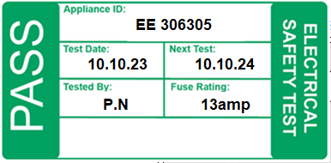
Dept. policy on electrical equipment
ALL mains-powered electrical equipment you bring into the building should have a valid Portable Appliance Test (PAT) label
If there is no label, or the test period has expired, you MUST NOT use the equipment or adaptors
Please contact Laboratory Manager Paul Norman (p.norman@imperial.ac.uk) throughout October to arrange a PAT for all equipment likely to be used on site

Slide 22
Dept. Notices and Safety Committee
Department Safety Notice board is located on the level 1 corridor
Departmental Safety Committee meet three times throughout the academic year. If you have anything you wish to raise, please contact your Undergraduate representative
Further guidance and information can be found on the EEE Department safety page

