Slide 1
Salt Precipitation Dynamics in Carbon Dioxide Storage: A Pore-Network Modelling Study
Yuxi Liang
Department of Earth Science & Engineering
Supervisors: Prof. Martin Blunt, Dr. Branko Bijeljic
14/01/2026

Slide 2
Outline
1 | Introduction & Motivation
2 | Methodology Overview
3 | Case Study
4 | Suggestions & Future Work
5 | Acknowledgments

Slide 3
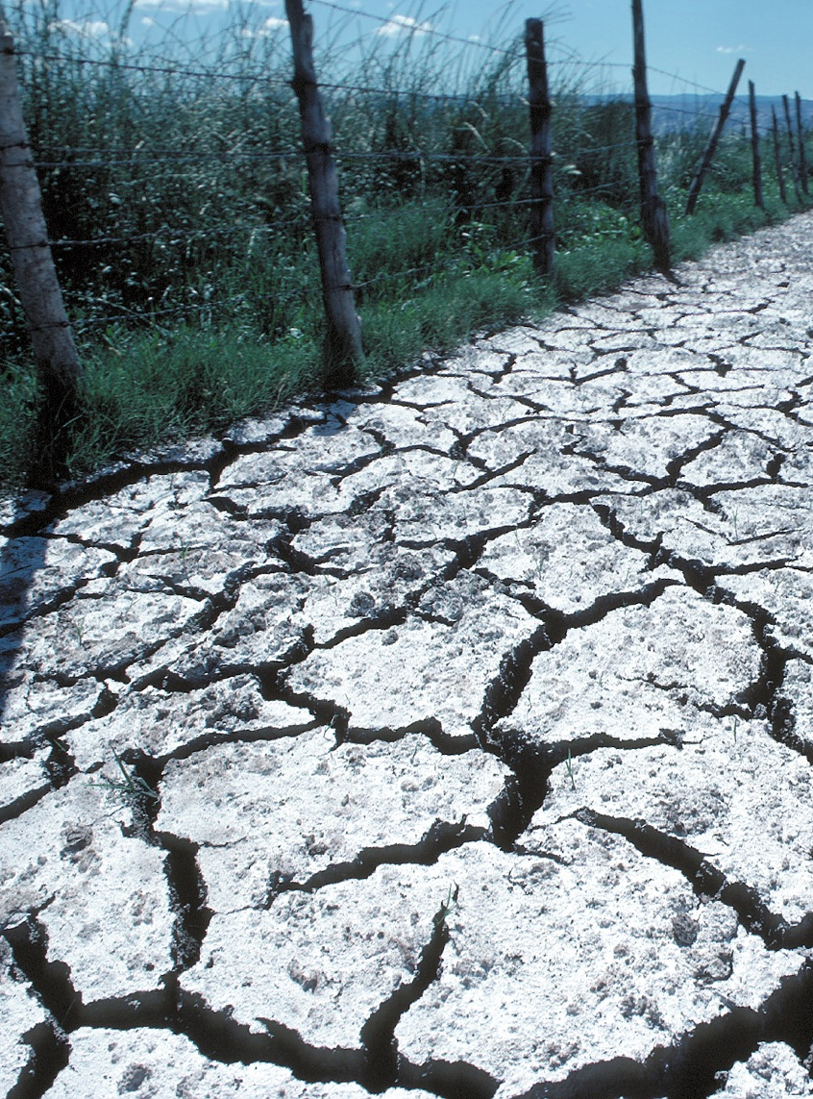
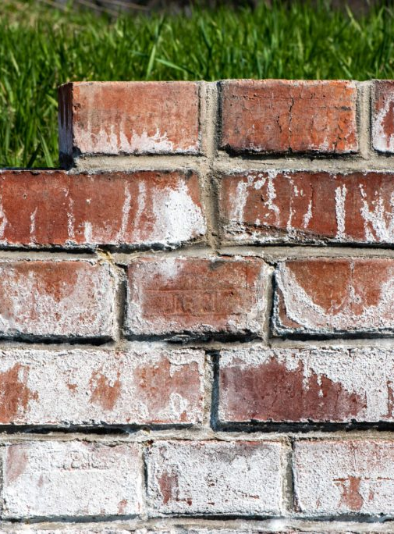
1. Introduction & Motivation
Motivation: Salt Precipitation, A Widespread Challenge
Salt Precipitation at the Surface
Agriculture
Civil Engineering
Similar Salt Issues in Subsurface CO₂ Storage
CO₂ injection → water evaporation
Increasing brine salinity → precipitation
Salt blocks pore throats → reduced flow & injectivity
Why It Matters
Predicting storage performance
Ensuring long-term injectivity
Designing better storage strategies
3

Slide 4
1. Introduction & Motivation
Background & Research Significance
Background
CCS is vital for CO₂ emission reduction.
Salt precipitation can cause severe injectivity decline (Birkholzer et al., 2009; Ott et al., 2011)
Existing models use empirical permeability loss only.
Need for a pore-scale understanding to:
Predict where/when salt forms
Quantify flow blockage
Capture feedback effects
Research Significance
Develop a pore-network model for salt precipitation
Simulate CO₂-induced drying and salt dynamics
Investigate roles of:
Fluid intermittency
Drainage
Imbibition

Slide 5
1. Introduction & Motivation
Phases, Components, and Process Evolution in the Pore-Network Model
 | CO₂ | H₂O | NaCl
Gas
Liquid | ?
Solid
Dry CO₂

Slide 6
1. Introduction & Motivation
Phases, Components, and Process Evolution in the Pore-Network Model
Brine
Dry CO₂
Water Vapor
CO₂
Salt (NaCl)
(a) Initial State
(b) Drainage
Dry CO₂
Dry CO₂
(c) Drainage continue
(d) Salt Precipitation

Slide 7
2. Methodology Overview
Methodology Overview
1 | Transport of Water in CO₂
2 | Evaporation of Water
3 | Salt Precipitation
4 | Transport of Salt in Water
5 | Permeability & Flow Field Update

Slide 8
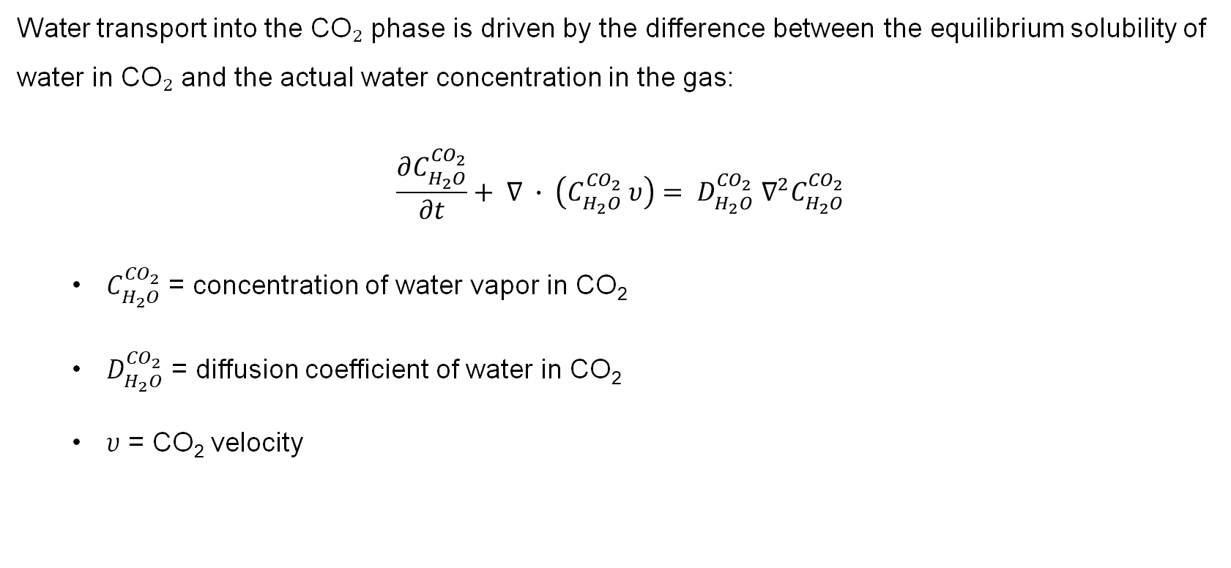
2. Methodology Overview
Step 1: Transport of Water in CO₂
Water transport into the CO₂ phase is driven by the difference between the equilibrium solubility of water in CO₂ and the actual water concentration in the gas:
$$\frac{∂C_{H_{2}O}^{{CO}_{2}}}{∂t}+ ∇ ∙ \left(C_{H_{2}O}^{{CO}_{2}} υ\right)= D_{H_{2}O}^{{CO}_{2}} ∇^{2}C_{H_{2}O}^{{CO}_{2}}$$
$C_{H_{2}O}^{{CO}_{2}}$ = concentration of water vapor in CO₂
$D_{H_{2}O}^{{CO}_{2}}$ = diffusion coefficient of water in CO₂
$υ$ = CO₂ velocity
Dry CO₂

Slide 9
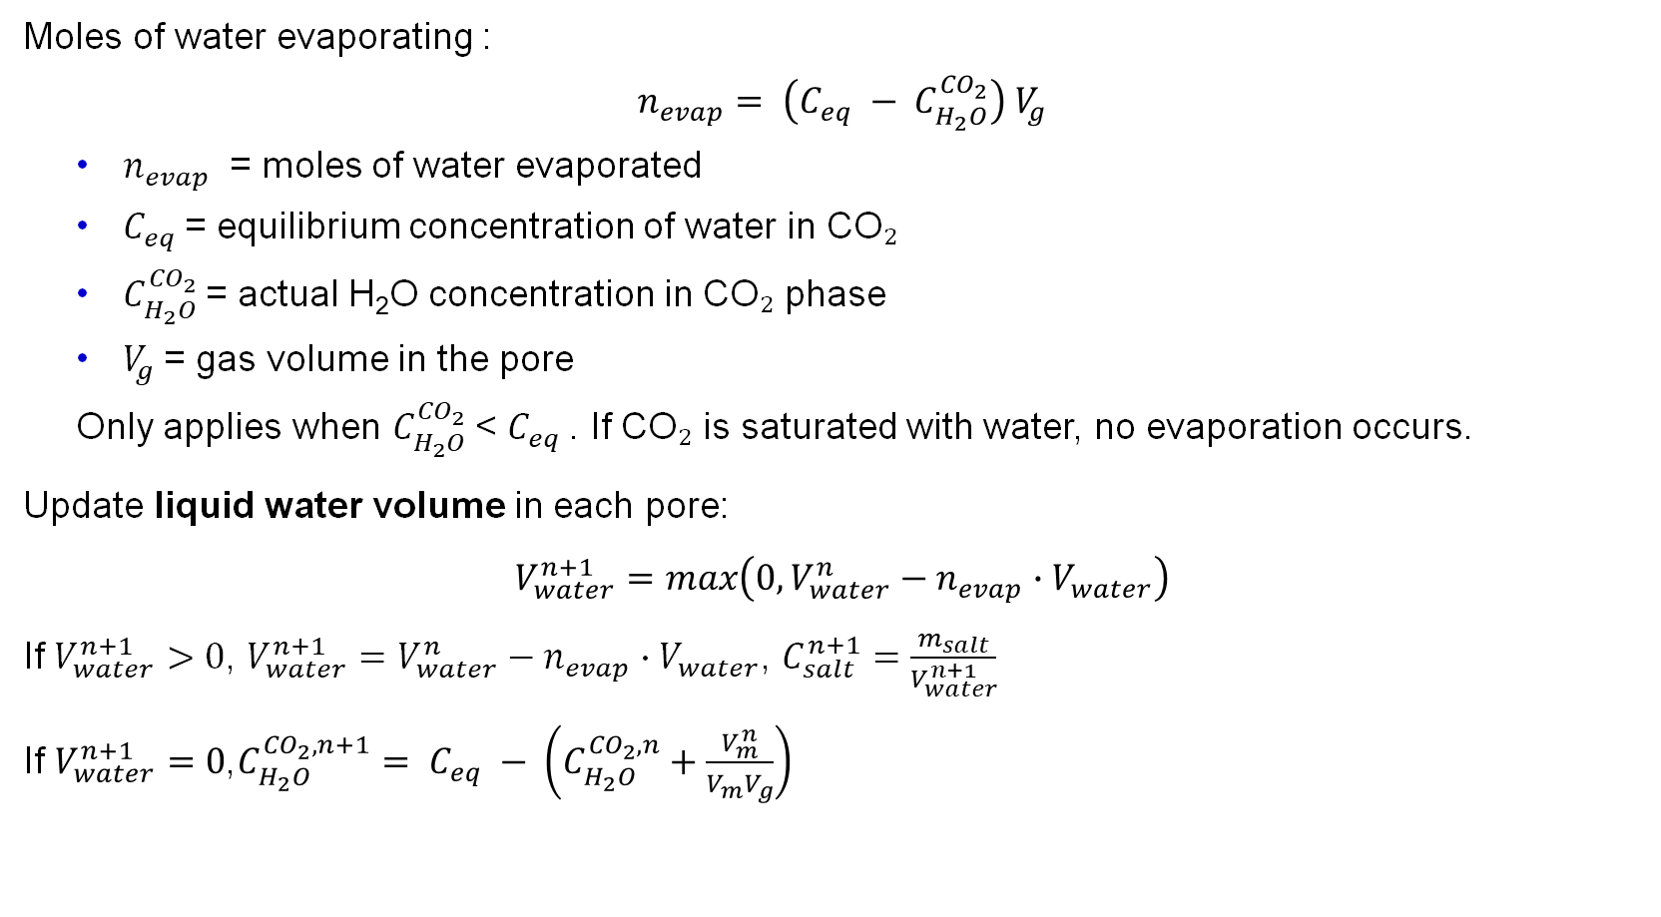
2. Methodology Overview
Step 2: Evaporation of Water
Dry CO₂
Moles of water evaporating :
$$n_{evap}= \left(C_{eq} − C_{H_{2}O}^{{CO}_{2}}\right) V_{g}$$
$n_{evap}$​ = moles of water evaporated
$C_{eq}$= equilibrium concentration of water in CO₂
$C_{H_{2}O}^{{CO}_{2}}$= actual H₂O concentration in CO₂ phase
$V_{g}$= gas volume in the pore
Only applies when $C_{H_{2}O}^{{CO}_{2}}$< $C_{eq}$. If CO₂ is saturated with water, no evaporation occurs.
Update liquid water volume in each pore:
$$V_{water}^{n+1}=max\left(0, V_{water}^{n}−n_{evap}∙V_{water}\right)$$
If $V_{water}^{n+1}>0$, $V_{water}^{n+1}=V_{water}^{n}−n_{evap}∙V_{water}$, $C_{salt}^{n+1}=\frac{m_{salt}}{V_{water}^{n+1}}$
If $V_{water}^{n+1}=0$,$C_{H_{2}O}^{{CO}_{2},n+1}= C_{eq} − \left(C_{H_{2}O}^{{CO}_{2},n}+\frac{V_{m}^{n}}{V_{m}V_{g}}\right)$

Slide 10
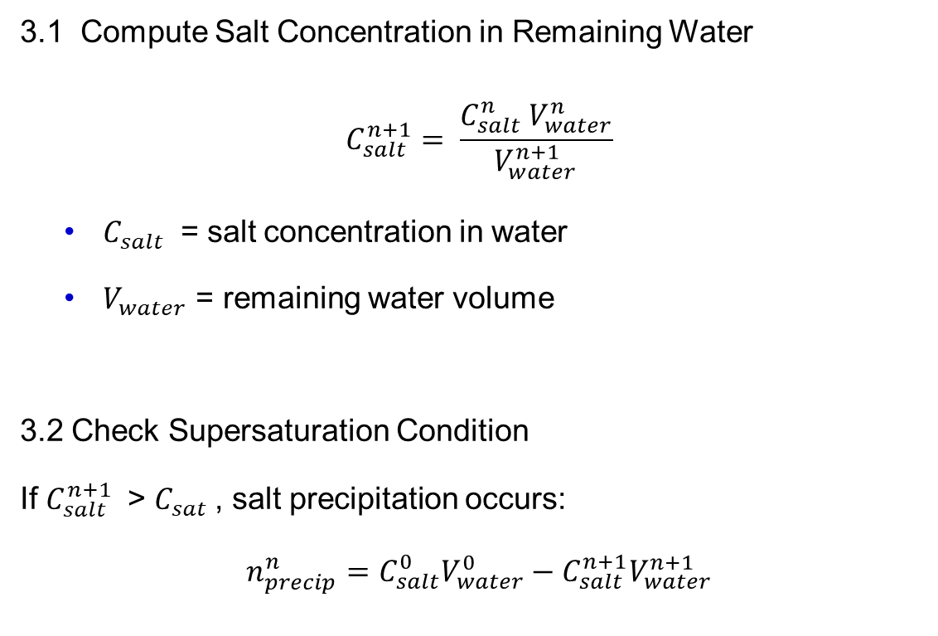
2. Methodology Overview
Step 3: Salt Precipitation
3.1 Compute Salt Concentration in Remaining Water
$$C_{salt}^{n+1}= \frac{C_{salt}^{n} V_{water}^{n}}{V_{water}^{n+1}}$$
$C_{salt}$​ = salt concentration in water
$V_{water}$ = remaining water volume
3.2 Check Supersaturation Condition
If $C_{salt}^{n+1}$​ > $C_{sat}$, salt precipitation occurs:
$$n_{precip}^{n}=C_{salt}^{0}V_{water}^{0}−C_{salt}^{n+1}V_{water}^{n+1}$$
Dry CO₂

Slide 11
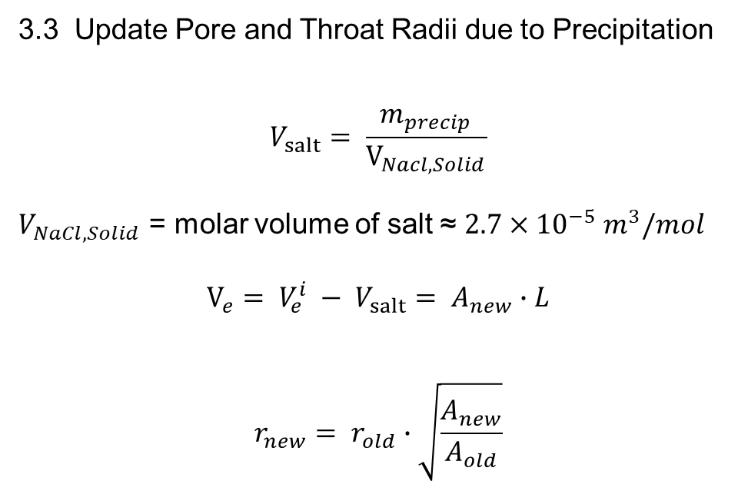
2. Methodology Overview
Step 3: Salt Precipitation
3.3 Update Pore and Throat Radii due to Precipitation
$$V_{salt}= \frac{m_{precip}}{V_{Nacl, Solid}}$$
$V_{NaCl, Solid}$ = molar volume of salt ≈ $2.7×{10}^{−5} m^{3}/mol$
$$V_{e}= V_{e}^{i} − V_{salt}= A_{new}∙L$$
$$r_{new}= r_{old}∙\sqrt{\frac{A_{new}}{A_{old}}}$$
Dry CO₂

Slide 12
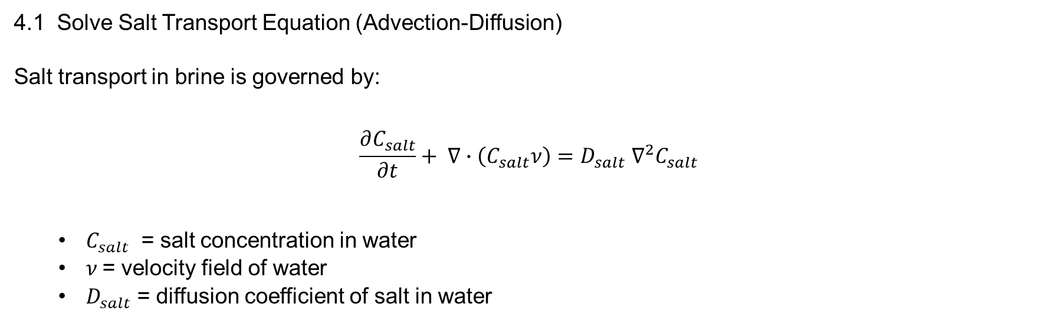
2. Methodology Overview
Step 4: Transport of Salt in Water
4.1 Solve Salt Transport Equation (Advection-Diffusion)
Salt transport in brine is governed by:
$$\frac{∂C_{salt}}{∂t}+ ∇∙\left(C_{salt}ν\right)=D_{salt} ∇^{2}C_{salt}$$
$C_{salt}$​ = salt concentration in water
$ν$= velocity field of water
$D_{salt}$= diffusion coefficient of salt in water
Dry CO₂
4.2 Capillary Transfer & Imbibition
Work in progress

Slide 13

2. Methodology Overview
Step 5: Permeability & Flow Field Update
5.1 Recompute Local Permeability
$$k= k_{0} {\left(\frac{r_{new}}{r_{old}}\right)}^{2}$$
Adjust flow pathways based on pore-throat constrictions.
5.2 Iterate Until Convergence
Repeat Steps 1-5 for each time step until steady-state or predefined simulation time is reached.

Slide 14






1-D network
3. Results
1 2 3 4 5 6 7 8 9 10 11 12 13 14 15 16 17 18 19 20
Gas-phase removal of water (moles)
Liquid water removed
Water initially stored in the porous medium
Definition of dry front
Mass balance
$$N_{evap}\left(t\right)=Q C_{eq} t$$
$$V_{w, evap}= \frac{N_{evap}}{m}$$
$$V_{w,0}\left(x\right)= A_{w}x$$
$$V_{w,0}\left(x_{f}\right)=V_{w, evap}\left(t\right)$$
$$A_{w}x_{f}= \frac{Q C_{eq} t }{m}$$
$$\frac{x_{f}}{t}= V_{f}= \frac{Q C_{eq}}{m A_{w}}$$

Slide 15
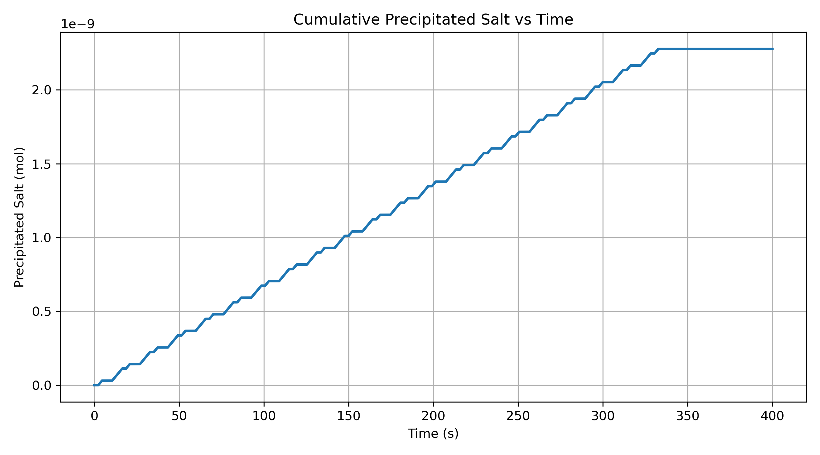
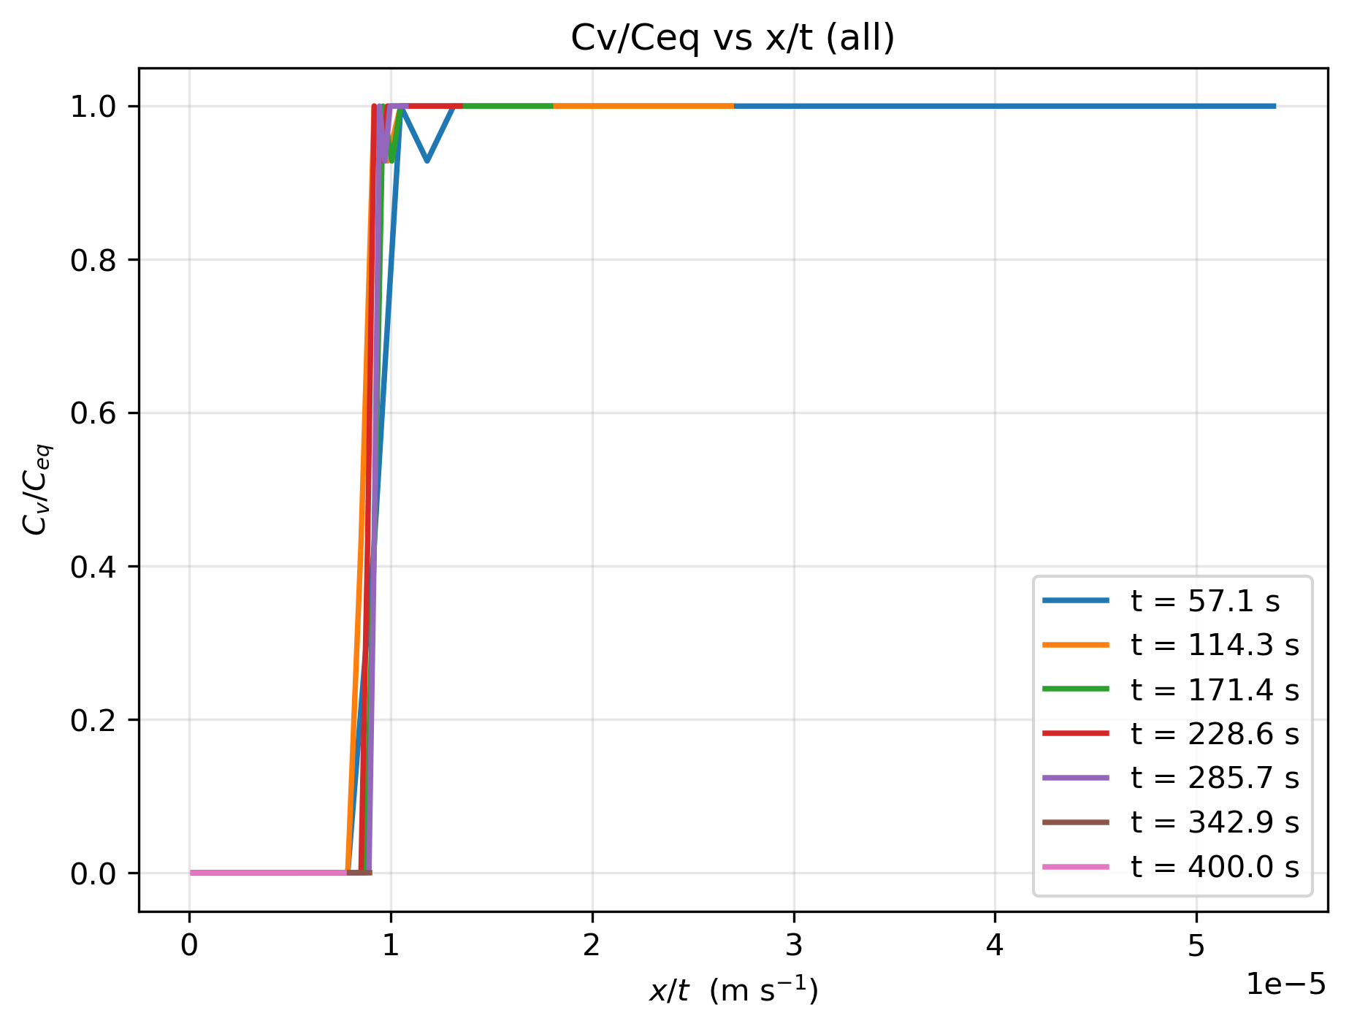
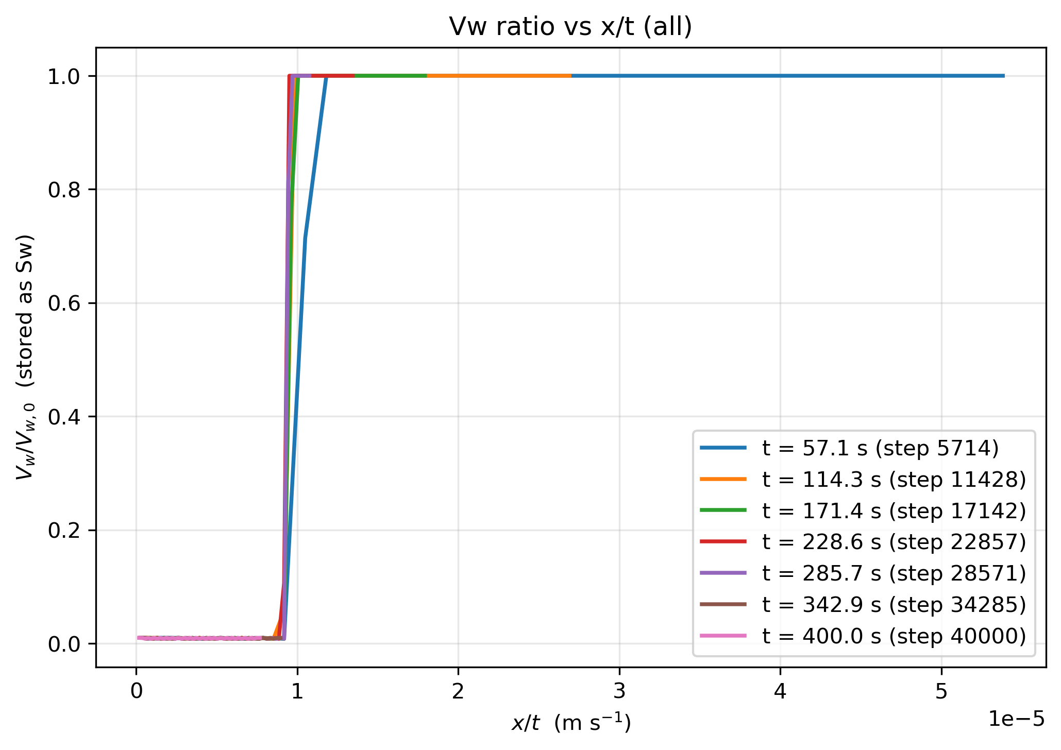
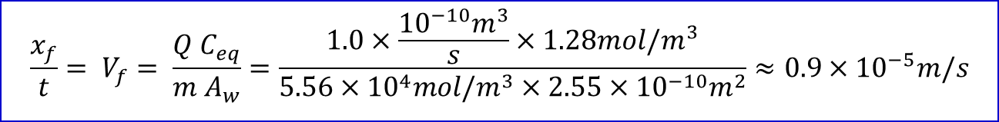

3. Results
1-D network
Numerical solution
Analytical solution
$$x/t≈0.95 × {10}^{−5} m/s$$
$$\frac{x_{f}}{t}= V_{f}= \frac{Q C_{eq}}{m A_{w}}=\frac{1.0×\frac{{10}^{−10}m^{3}}{s}×1.28mol/m^{3}}{5.56×{10}^{4}mol/m^{3}×2.55×{10}^{−10}m^{2}}≈0.9×{10}^{−5}m/s$$

Slide 16
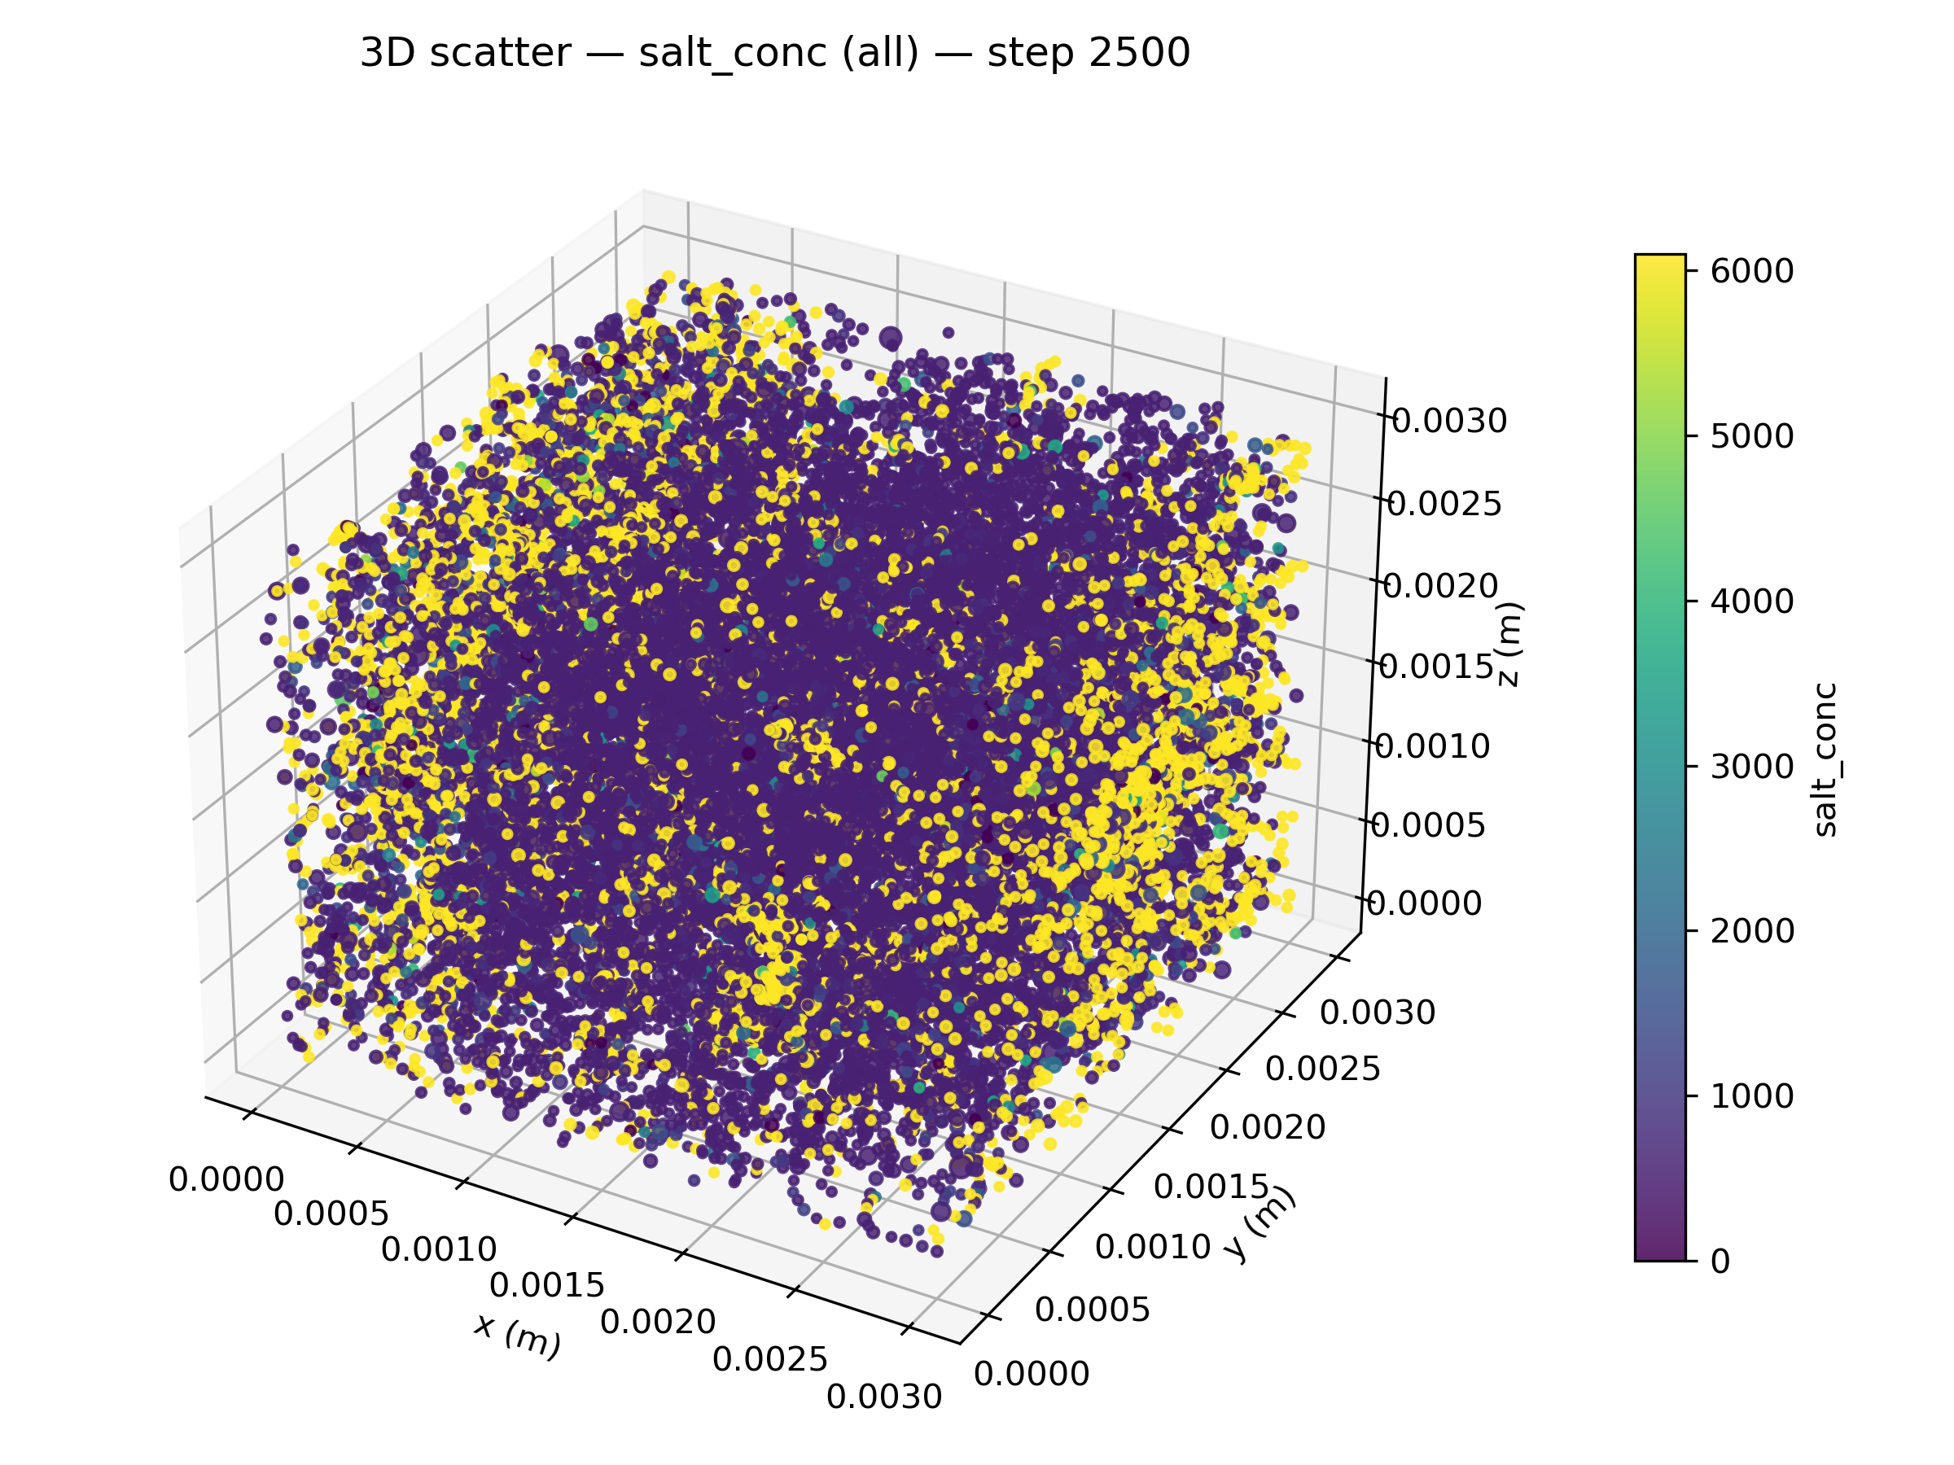
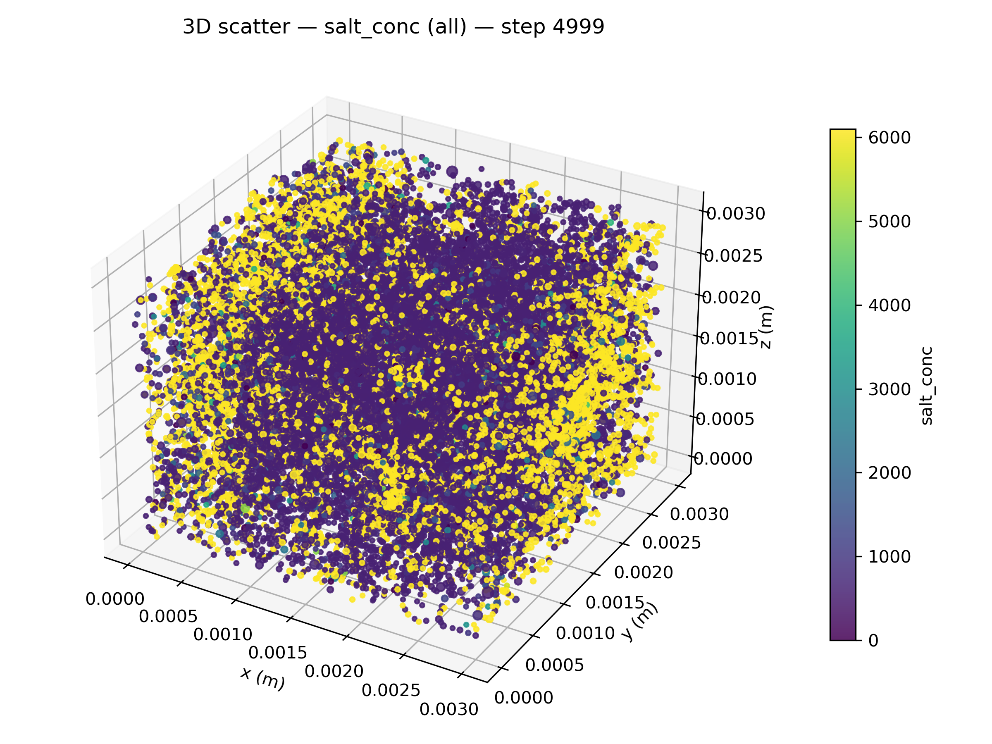
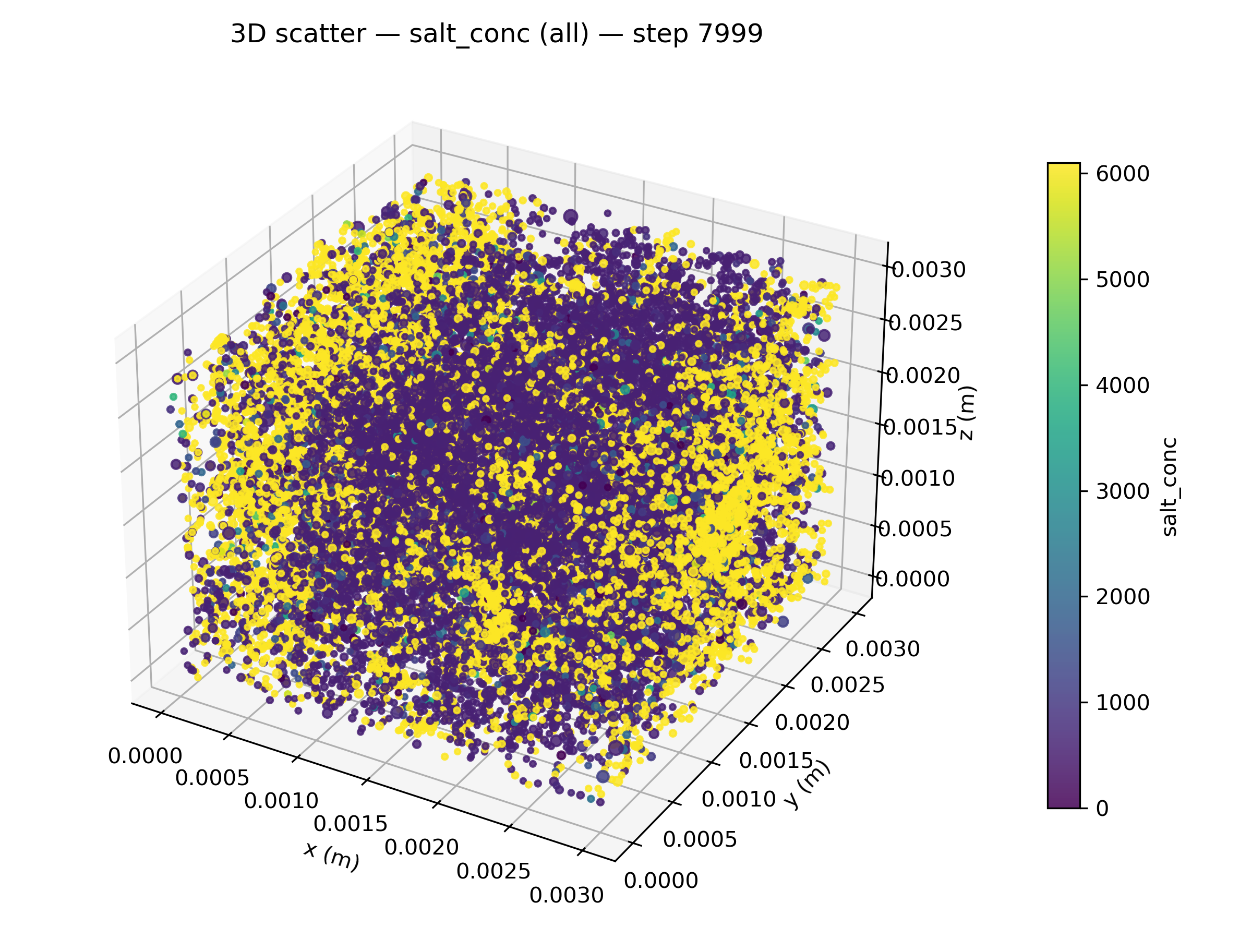
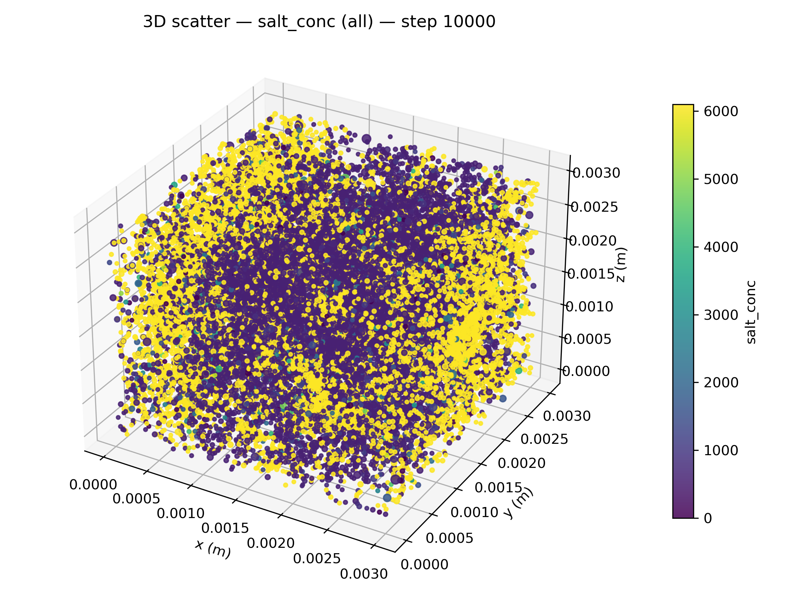
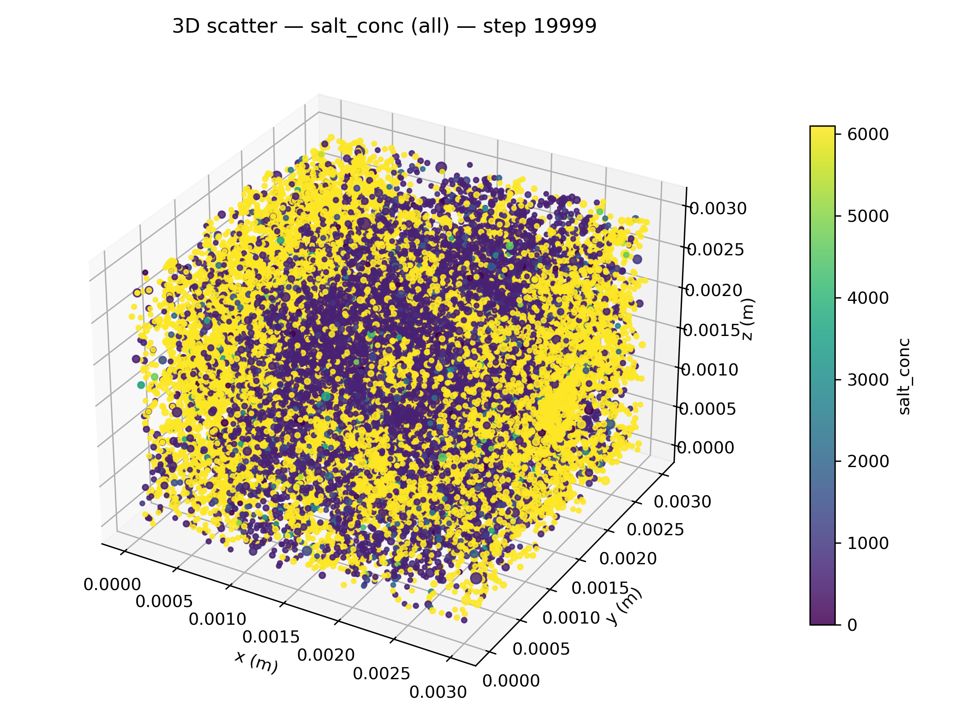
3. Results
3D Network – Salt Precipitation

Slide 17
4. Suggestions & Future Work
Future Work: include capillary imbibition
Dry CO₂
Capillary-driven Backflow
Brine
Water Vapor
CO₂
Salt (NaCl)

Slide 18
Thank you
Salt Precipitation Dynamics in Carbon Dioxide Storage: A Pore-Network Modelling Study 14/01/2026

