Slide 1




Underground Hydrogen Storage
The combined effects of displacement, exsolution and pressure decline
Waleed Dokhon
Martin J. Blunt
Branko Bijeljic

Slide 2
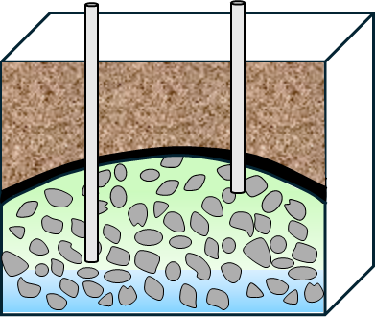
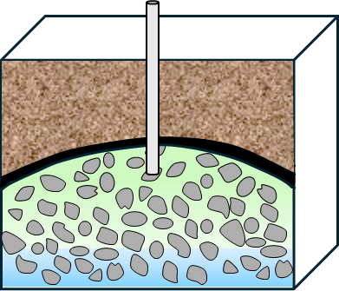
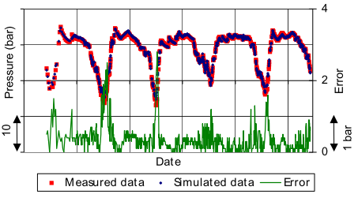


Why pressure decline in UHS is different
Rapid hydrogen withdrawal required to meet intermittent renewable power demand.
UHS operates fast pressure cycles (months), unlike decades-long oil and gas production.
UHS may experience significant pressure decline.
Rates of pressure decline can differ depending on aquifer strength (Alobaidan et al., 2025).
Oil & Gas
CO₂ Sequestration
Continuous production/injection
Pressure is mostly maintained
Mostly injection only
Pressure increases
Monthly energy demand in France
Figure: Depressurisation in an UGS reservoir
(Egermann et al., 2010)
UHS
High demand
(withdrawal)
Low demand
(storage)
Injection during excess energy => Pressure increases
Withdrawal during high demand (typically for 90 days) => Pressure declines, likely at a high rate
Source: EuroStat

Slide 3
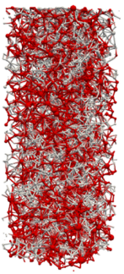
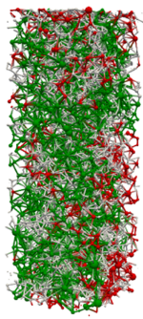
Has pressure decline been studied elsewhere?
Extensively studied in oil reservoirs via solution-gas drive and depressurisation.
Focus on gas exsolution and measuring the critical gas saturation.
Pressure decline rate has weak influence on the critical gas saturation (Bagudu et al., 2018).
Measuring S_{gc} at S_{gi} or S_{gr} shows different results (Egermann & Vizika, 2000).
Figure: Experimentally measured S_{gc} from previous studies and their PD rates
Figure: Stepwise pressure decline in CO₂-brine system (Moghadasi et al., 2025)
8 MPa
6 MPa
Trapped gas
Spanning gas
Swi
Swir
Sg = 0.58
Sg = 0.62

Slide 4
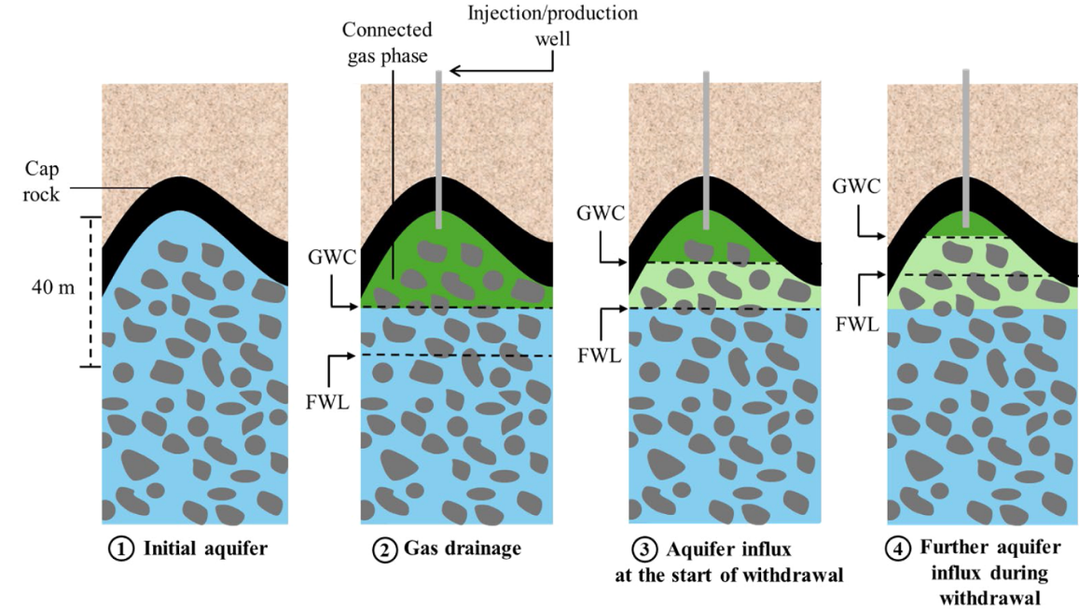
Pressure decline in UHS
Most studies examine solution-gas drive, not the expansion of pre-existing trapped gas.
Pressure decline is usually studied without simultaneous water injection to simulate withdrawal.
Most studies ignore testing the impact of different initial conditions (S_{gr} vs S_{gi}).
CO₂ and oil systems involve much higher gas solubility.
Figure: Schematic of UHS in an aquifer showing the sequence of displacement events (Dokhon et al., 2025)
Connected gas phase
(Above GWC)
Produced by expansion
Trapped gas (below GWC)
Gas expansion
Pressure
decline
Water
Connected gas
Trapped gas
S_{g}
S_{g} > S_{gr}

Slide 5
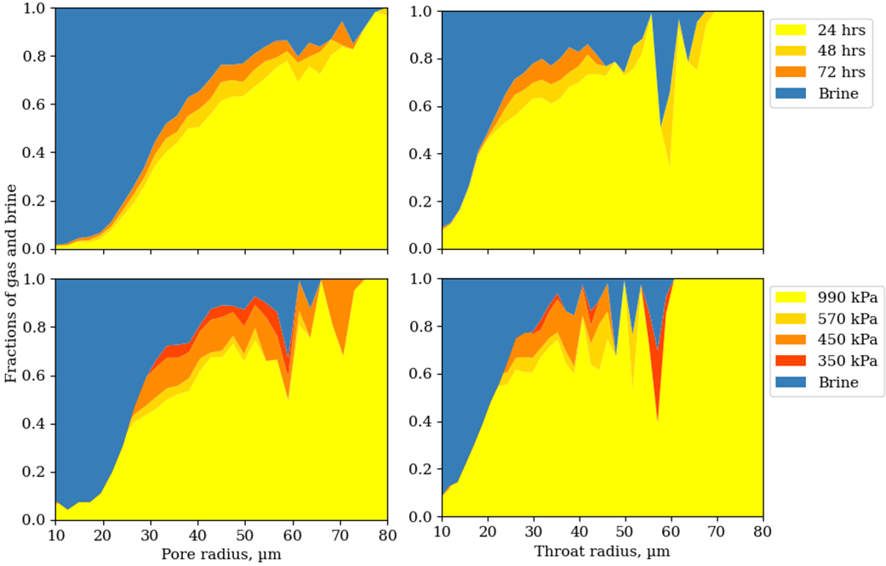
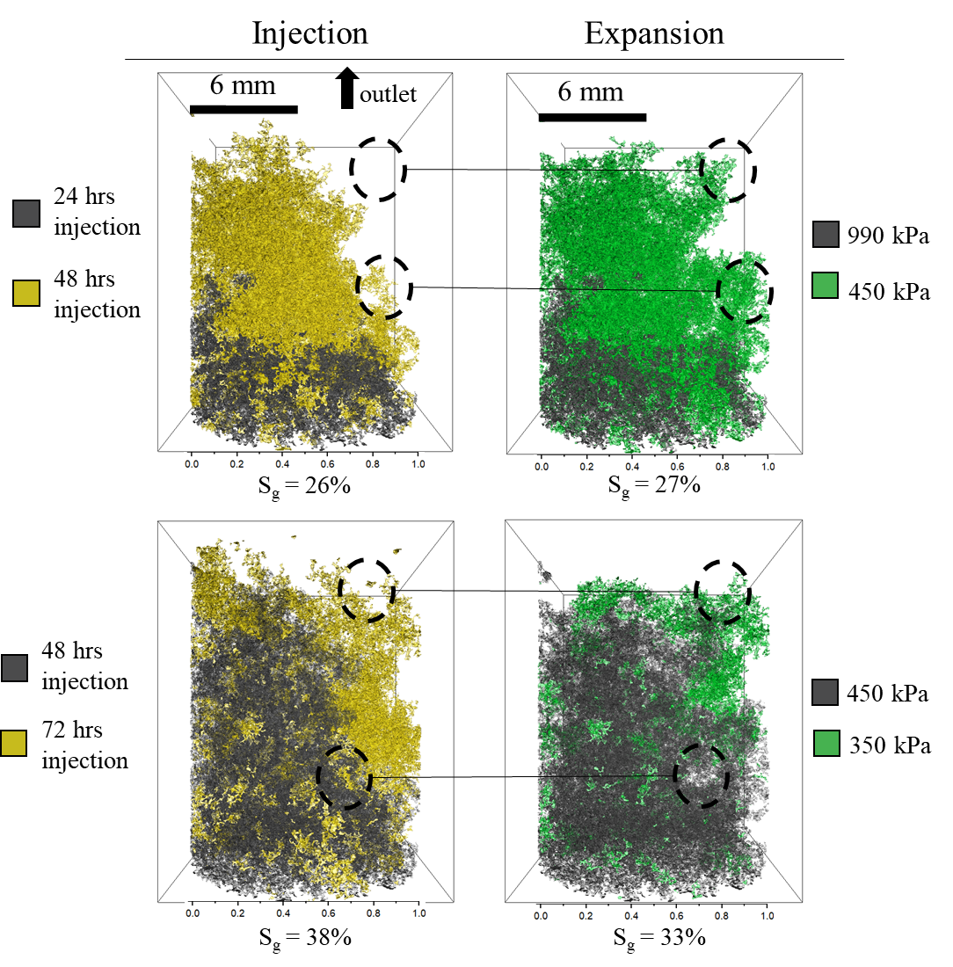
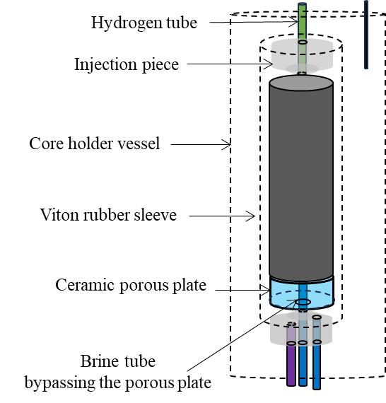
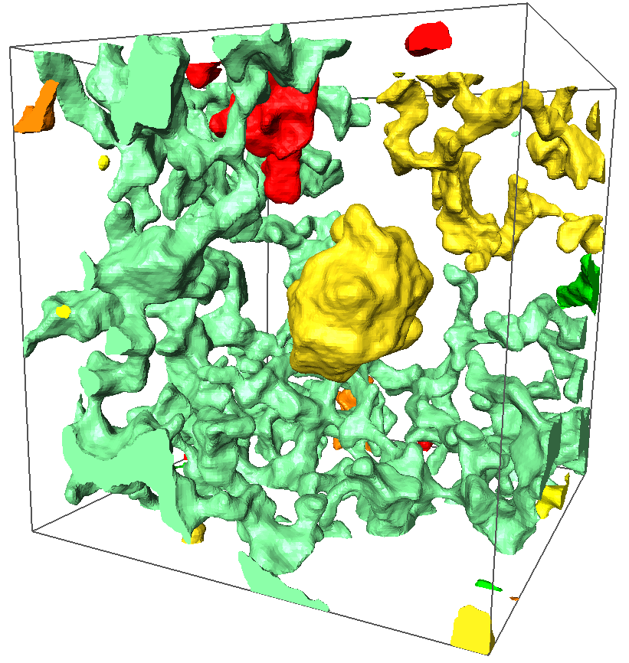
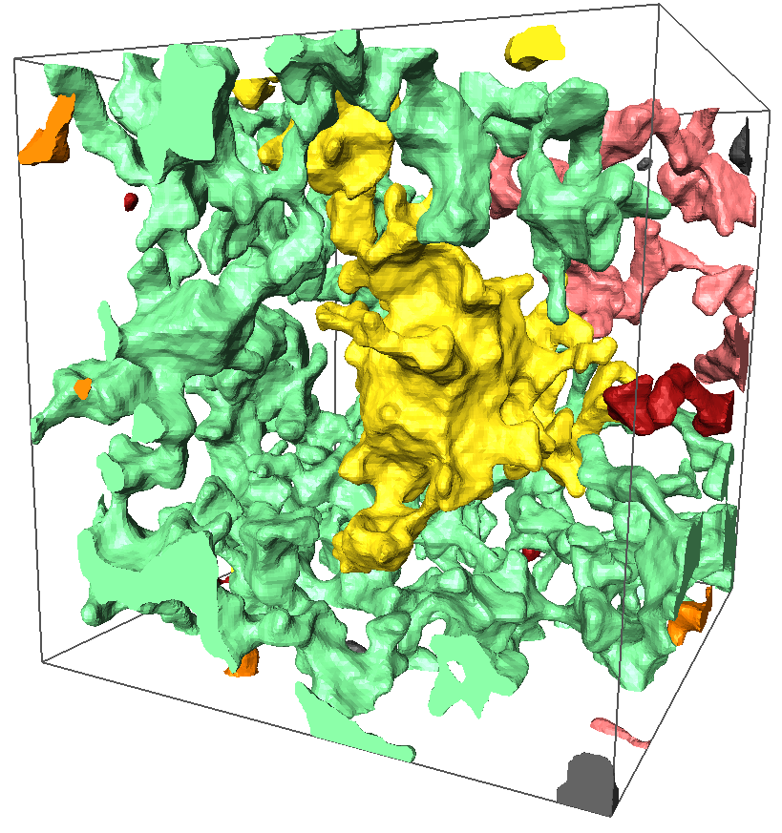
What we learned previously
Figure: Pore occupancy
Figure: 3D gas images in injection vs expansion
Drainage and S_{gi} by:
gas expansion vs gas injection
Injection
Compare the pore filling of hydrogen in gas injection vs gas expansion.
Figure: Sample schematic
Expansion
Figure: Example of Roof snap-off
P = 570 kPa
P = 350 kPa
Roof snap-off
connection
Pressure decline

Slide 6
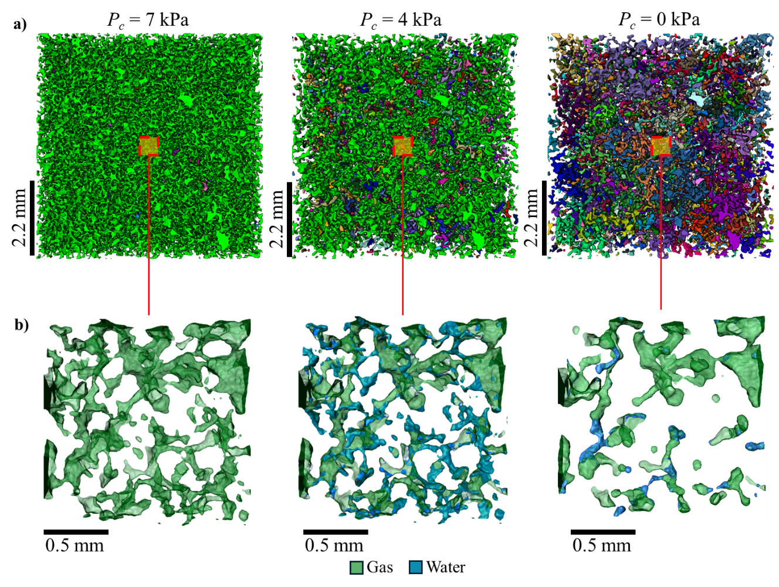
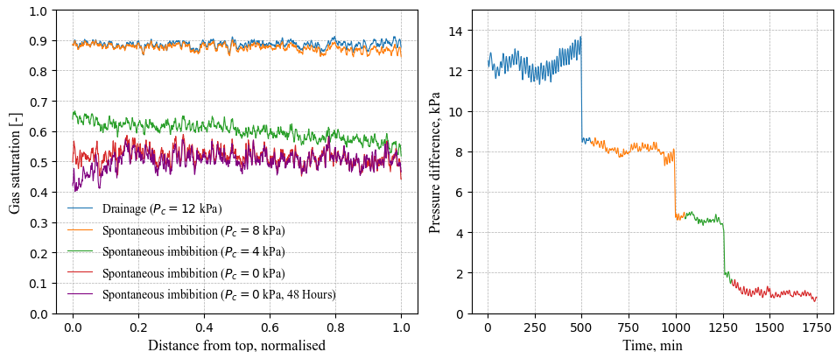
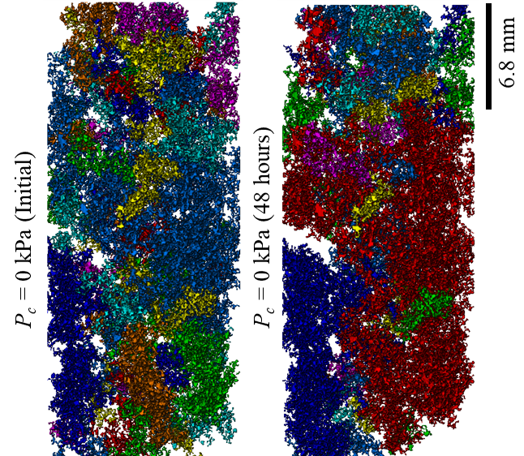
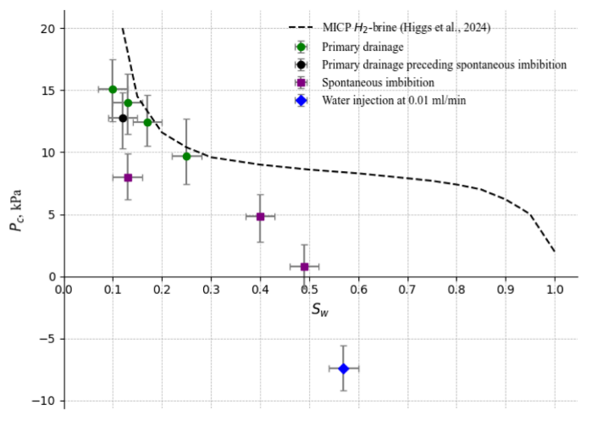
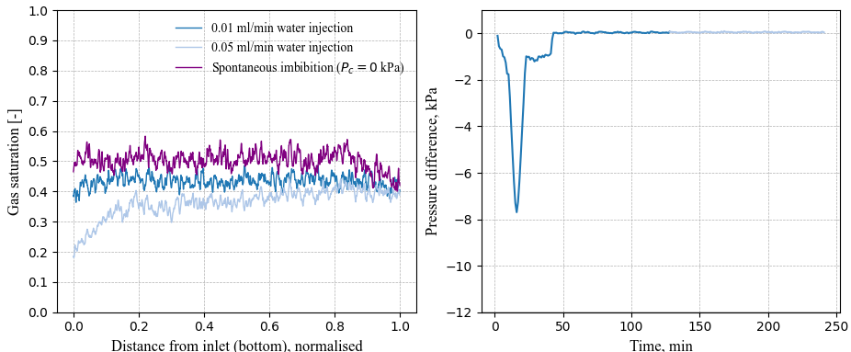
What we learned previously
Figure: Gas connectivity with dropping P_{c}
Spontaneous imbibition and S_{gr}
Porous plate as an aquifer source
Reduce P_{c} gradually
Perform water injection at P_{c} = 0
Figure: Gas saturation profiles and their corresponding pressure drop
Figure: Gas rearrangement at P_{c} = 0
Figure: P_{c}(S_{w}) diagram of drainage, SI, and brine injection

Slide 7
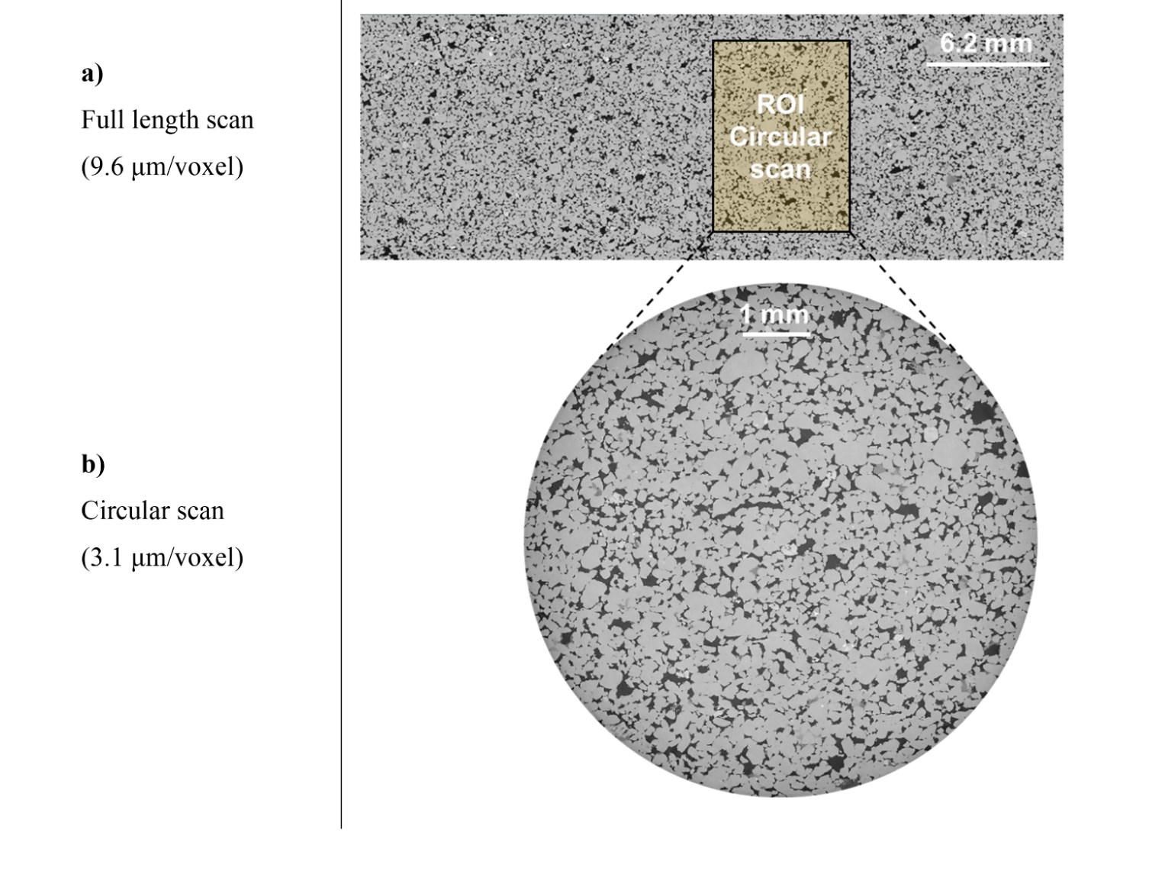
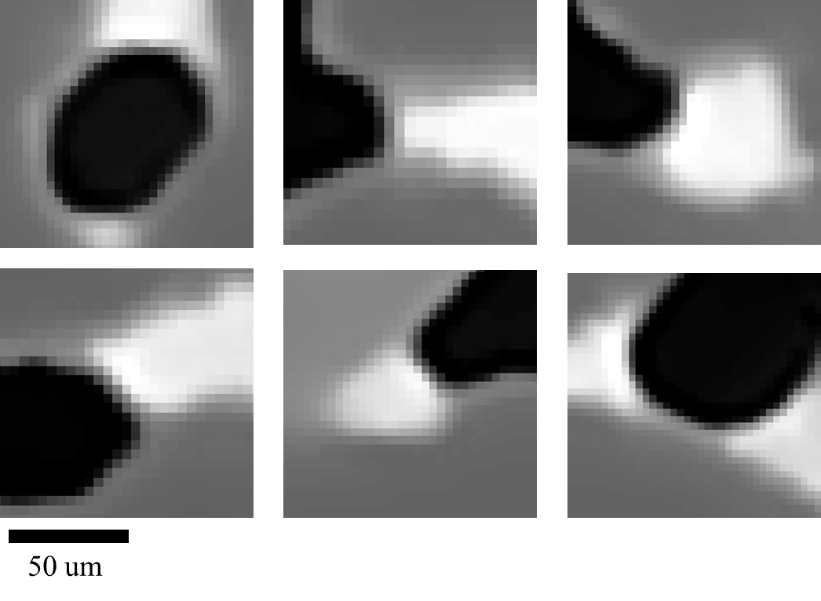
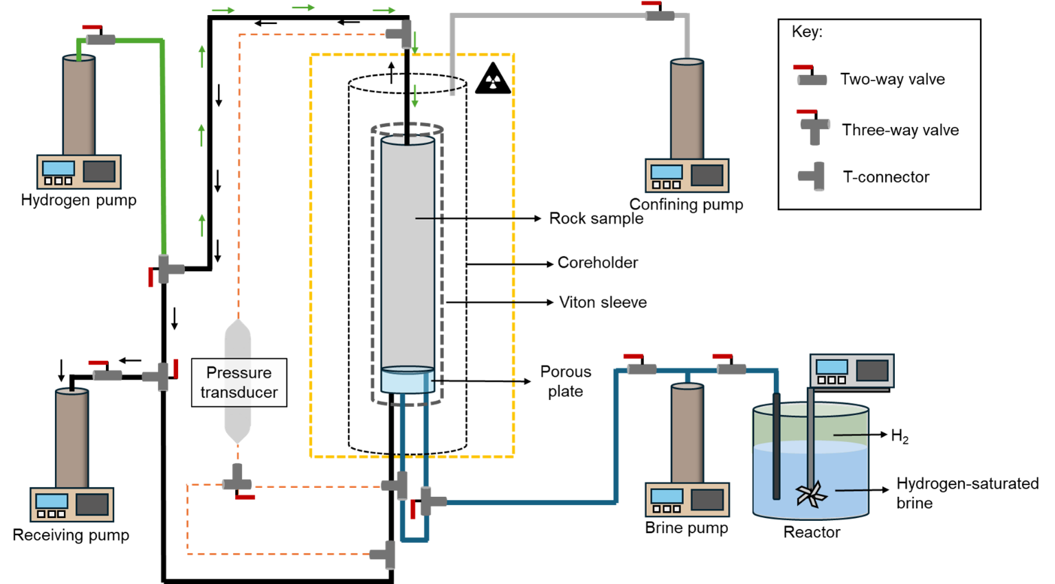
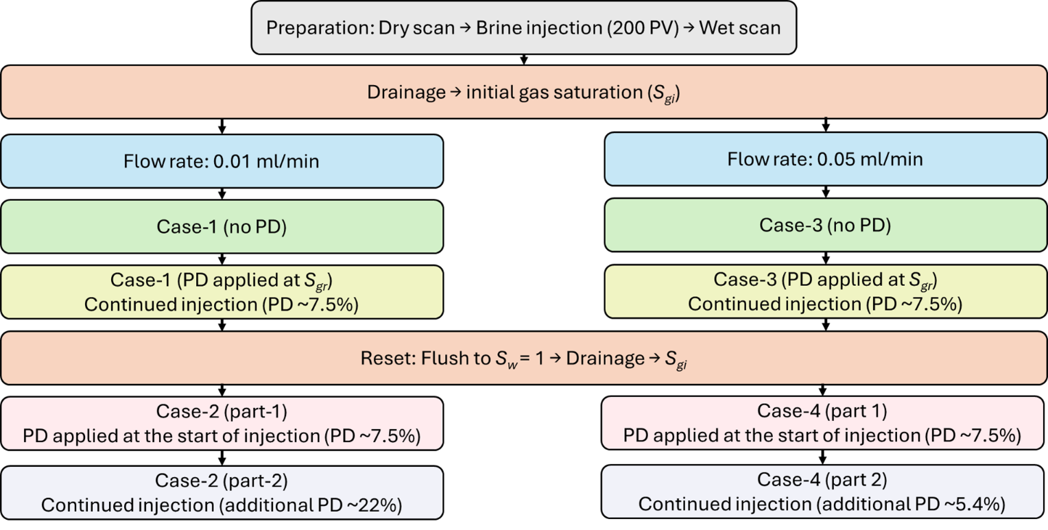
Method: Experimental apparatus
(a) Dry: Full length scan (9.6 µm/voxel)
Hydrogen-brine displacement in water-wet Bentheimer sandstone.
Impose controlled outlet pressure decline during brine injection.
Two initial conditions: High gas saturation (S_{gi}) and residual gas (S_{gr})
Vary capillary number using two brine flow rates (10⁻⁸ – 10⁻⁷).
Track gas expansion, connectivity, and saturation using micro-CT.
Black: gas
Gray: solid
White: brine
(b) Circular ROI scan (3.1 µm/voxel)
Figure: Flow loop schematic
Figure: Experimental sequence

Slide 8
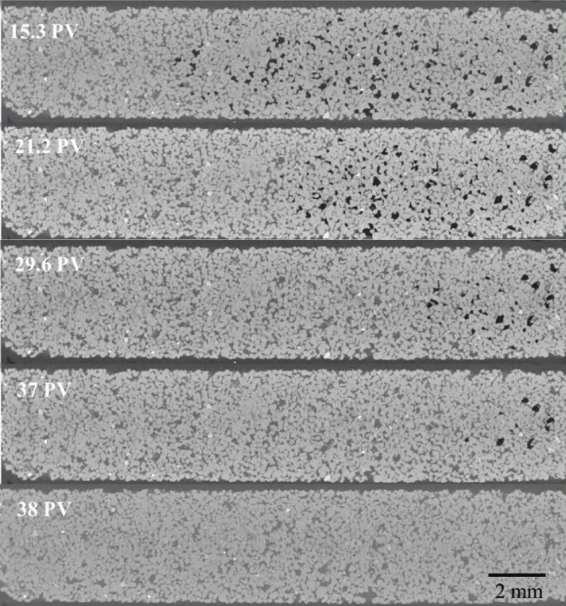

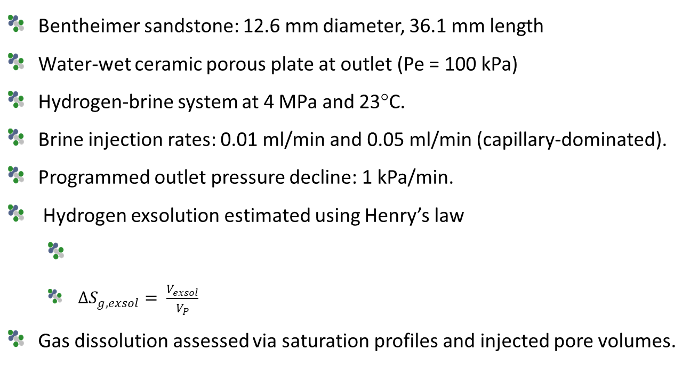
Method: Measurements
Figure: grayscale images of gas-saturated brine flooding the gas
Bentheimer sandstone: 12.6 mm diameter, 36.1 mm length
Water-wet ceramic porous plate at outlet (Pe = 100 kPa)
Hydrogen-brine system at 4 MPa and 23°C.
Brine injection rates: 0.01 ml/min and 0.05 ml/min (capillary-dominated).
Programmed outlet pressure decline: 1 kPa/min.
Hydrogen exsolution estimated using Henry’s law
$∆S_{g,exsol}= \frac{V_{exsol}}{V_{P}}$
Gas dissolution assessed via saturation profiles and injected pore volumes.
$$∆n_{exsolved}= k{ m}_{w}\left(P_{0}−P_{i}\right)$$
Gao et al. (2023)
Gas dissolution (transient)
No gas dissolution (uniform)
S_{g}
S_{g}
L
L

Slide 9
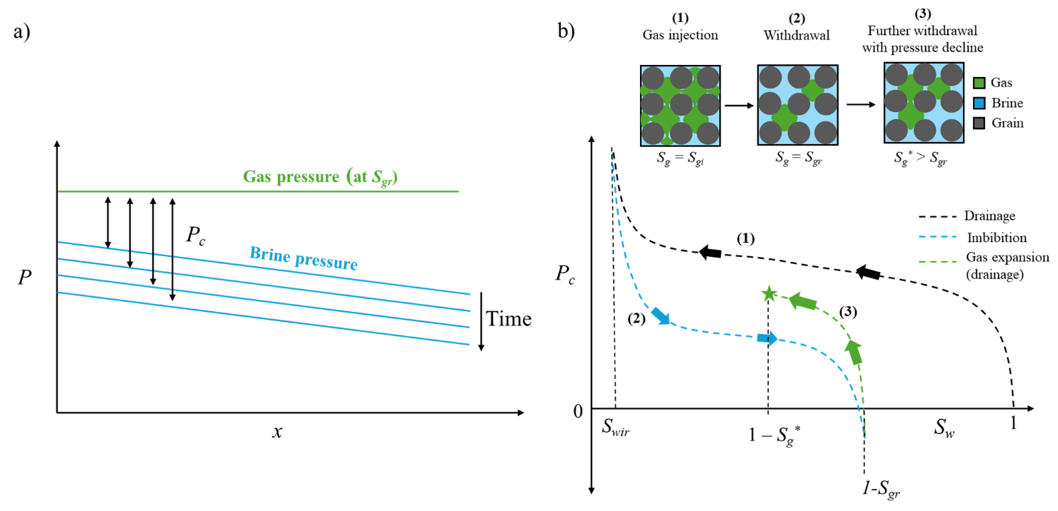

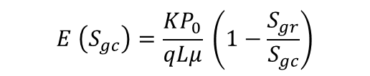

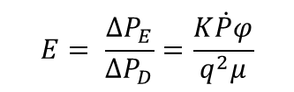
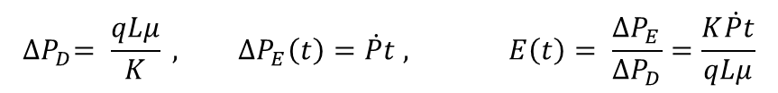

Theory
$${∆P}_{D}= \frac{qLμ}{K} , ∆P_{E}\left(t\right)=\dot{P}t , E\left(t\right)= \frac{∆P_{E}}{∆P_{D}}=\frac{K\dot{P}t}{qLμ}$$
Pressure decline causes gas expansion even without advective gas flow.
For trapped gas: pressure drop increases local capillary pressure.
Gas saturation increases approximately proportional to the fractional pressure decline.
Expansion number compares expansion-driven flow to brine-driven displacement.
Equate t to be the necessary time for displacement $Lφ/q$
$$E= \frac{∆P_{E}}{∆P_{D}}=\frac{K\dot{P}φ}{q^{2}μ}$$
E = 70
at 0.05 ml/min Q_{w}
1
$$n= \frac{PV_{g}}{ZRT}=\frac{PS_{g}V_{p}}{ZRT}$$
Ideal gas law
Figure: Schematic of phase pressure
Figure: P_{c}(S_{w}) diagram
$$PS_{g}≈P\left(t\right) S_{g}\left(t\right)≈constant$$
$$t=\frac{P_{0}}{\dot{P}} \left(1−\frac{S_{gr}}{S_{gc}}\right)$$
2
To evaluate E at the time when S_{gr} reaches S_{gc} using eq. 2
$$E \left(S_{gc}\right)=\frac{{KP}_{0}}{qLμ} \left(1−\frac{S_{gr}}{S_{gc}}\right)$$
E(S_{gc}) = 2×10⁴
at S_{gr} =0.4 and
S_{gc} = 0.65
3

Slide 10
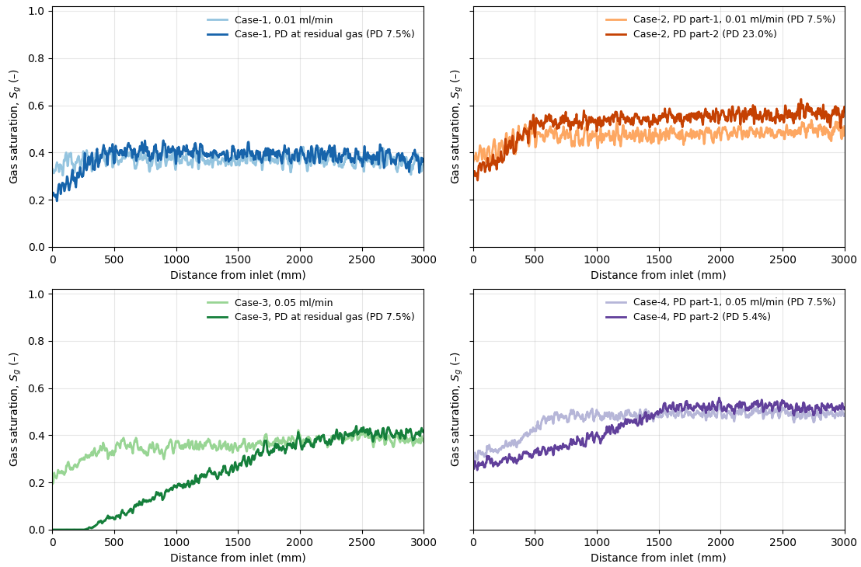
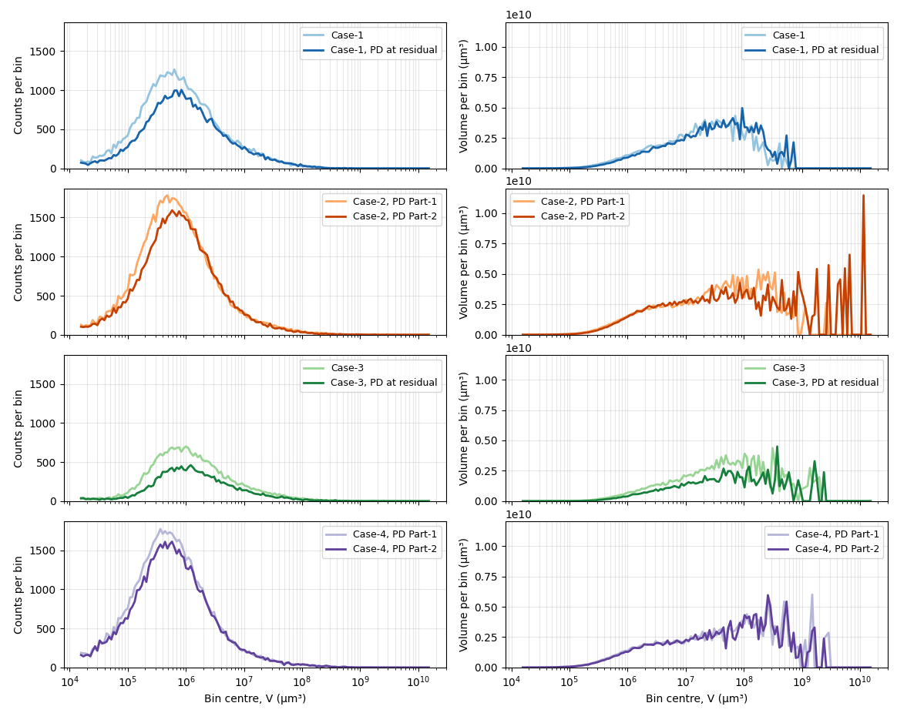
Results: Tracking saturation and volume changes
Pressure decline increases gas saturation despite continuous brine injection
Gas saturation increase scales approximately with fractional pressure drop
Similar expansion behaviour observed at both brine flow rates
Pressure decline starting at Sgi yields higher remaining gas saturation
Most of the gas was produced by expansion rather than normal displacement.
Figure: Gas saturation profiles for every case
Figure: Ganglia counts (left) and volume (right) distributions

Slide 11
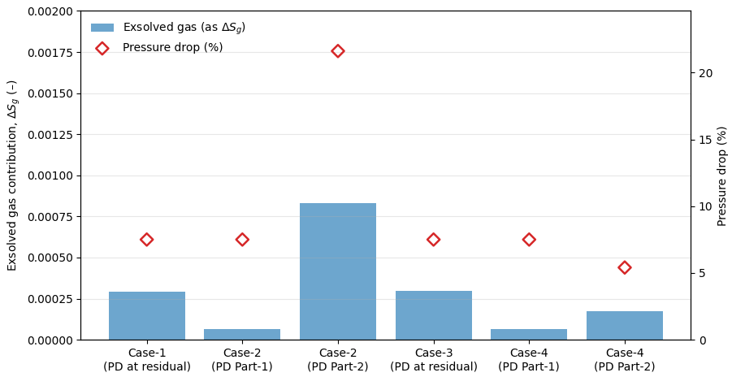
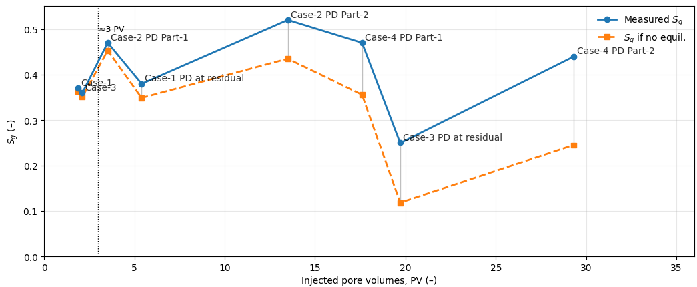
Results: Exsolved gas and gas dissolution
Exsolved gas contribution in orders of magnitude smaller than expansion-driven saturation change
Exsolution increases slightly at lower gas saturation due to the higher brine volume.
Minimal gas dissolution observed at low injected pore volume (< 3 PV).
Inlet-side dissolution more pronounced due to pressure equilibration offset.
Figure: Comparing gas dissolution assuming no pre-equilibration (orange) vs observed gas saturation (blue)
Figure: Exsolved gas contribution to the saturation

Slide 12
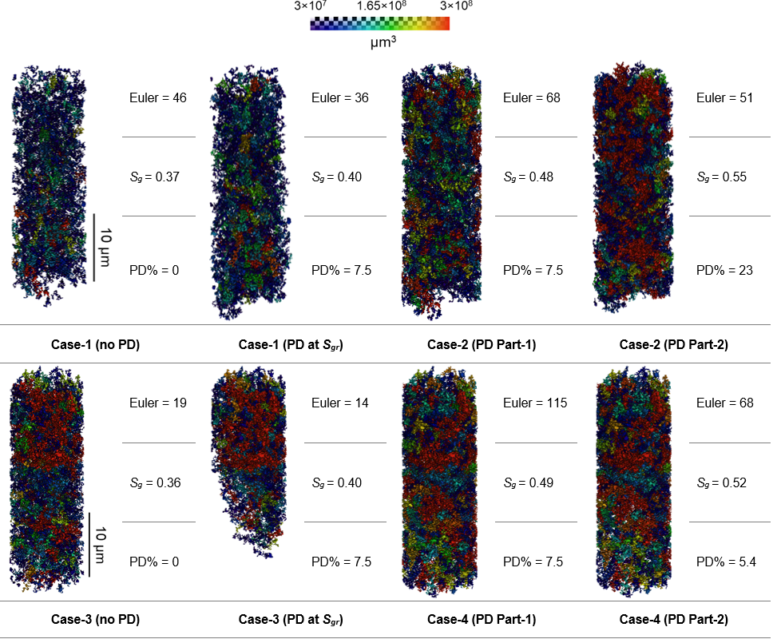

Results: 3D images of ganglia volumes

Slide 13
Conclusions
Pressure decline shows drainage-dominated displacement at the pore-scale, even during continuous brine injection.
Gas saturation increases approximately proportional to the fractional pressure decline.
Better gas connectivity is observed when the initial condition is S_{gi}.
Hydrogen exsolution is negligible; gas expansion is the dominant mechanism.
The critical gas saturation was estimated to be larger than 0.55 at these conditions.
Future work
Measure gas relative permeability during pressure decline under steady-state conditions.
Evaluate the solution-gas drive by injecting H₂-saturated brine and drop the pressure (gas nucleation).
Investigate the effects of wettability and heterogeneity.

Slide 14
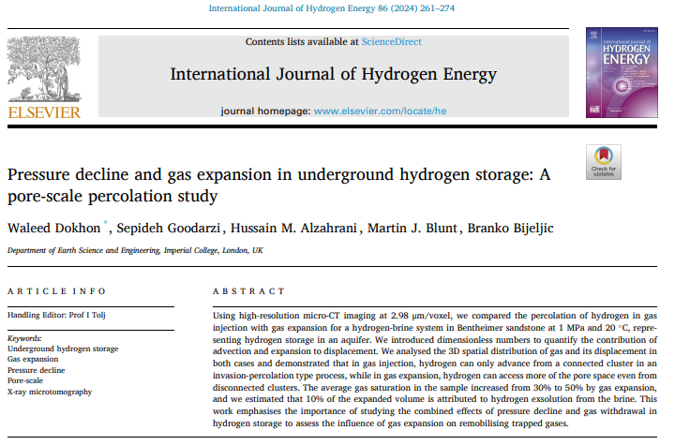
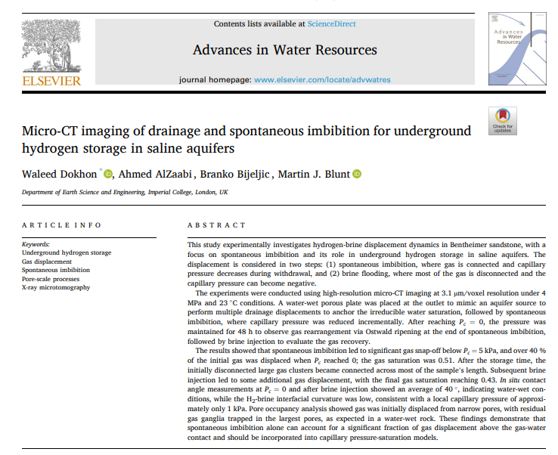
Published work

Slide 15

Thank you Happy to discuss and answer questions!
Email - waleed.dokhon21@imperial.ac.uk
LinkedIn profile

