Slide 1


CO₂ Reactive Transport in Carbon Storage: Multimineral Carbonate & Well Cement-CO₂ Interactions
25th Annual Imperial College Pore-Scale Imaging and Consortium
26th Annual Meeting of the Imperial College Consortium on Pore-Scale Imaging and Modelling
Olatunbosun A. Adedipe, Martin J. Blunt and Branko Bijeljic
14 Jan 2026

Slide 2
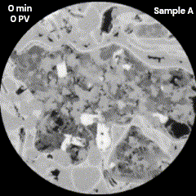
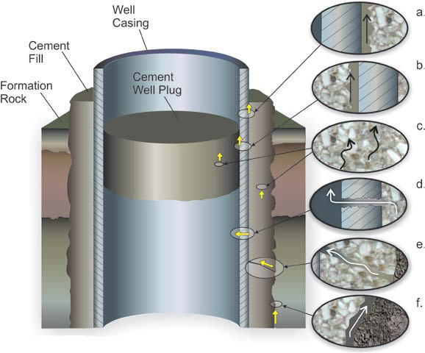
Importance of CO₂-Water Interaction in Aquifers During CO₂ Storage
Supercritical CO₂ dissolves in water to form carbonic acid (pH ≈3.1-3.5).
Within the Aquifer:
Carbonic acid reacts with carbonate minerals altering CO₂ transport and storage properties of the storage site.
In the Wellbore:
CO₂ reacts with hydrated cement products in a process called carbonation.
Cement pH ≈12 thus reaction by carbonic acid degrades the cement sheath creating CO₂ leakage pathways and wellbore integrity issues.
1 mm
Mineral dissolution by carbonic acid from Adedipe et al. 2025
OBJECTIVE 1: Multimineral carbonate dissolution
imaging and analysis
+
Water
OBJECTIVE 2: Cement dissolution and precipitation
Experiment design, imaging and analysis
CO₂ leakage pathways from Glazewski et al. 2014
26th Annual Imperial College Pore-Scale Imaging and Modelling Consortium
Notes:
In my presentation, I will cover two objectives.
1.) Imaging and analysis of multimineral carbonate dissolution.
2.) Cement dissolution and precipitation, experiment design and imaging and analysis.
Sc CO₂ dissolves in water to form carbonic acid which reacts with carbonate minerals within the aquifer altering transport and storage properties.
Carbonic acid also react with well cement, degrading the cement sheath which could lead to CO2 leakage.

Slide 3

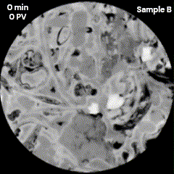
Impact of Mineral Spatial Distribution on CO₂ Dissolution Rates in Multimineral Carbonate Rocks
Olatunbosun A. Adedipe, Yousef Al-Khulaifi, Sajjad Foroughi, Qingyang Lin, Martin J. Blunt, Branko Bijeljic
Aims and Objectives
Read
Paper
Pre-Print:
Investigate reactive dissolution of carbonate rocks under CO₂-acidified brine injection.
Analyse two samples with differing calcite-to-dolomite ratios (1:3 and 1:2) and spatial mineral distributions.
Use high-resolution micro-CT + pore-scale simulations to track porosity, permeability, flow fields, and mineral reaction rates.
Quantify how flow heterogeneity impacts dissolution patterns.
Link mineral-specific reactions to fast/slow flow regions.
Provide insights to optimize CO₂ storage in heterogeneous carbonate reservoirs.
1 mm
1 mm
Carbonic acid dissolving carbonates in this work
CO₂ Reactive transport in Carbonates
Imperial College Pore-Scale Imaging and Modelling Group
Notes:
Supercritical CO₂ dissolves in water, forming carbonic acid (pH ≈ 3.1–3.5).
Screening for Pore‐scale Imaging and Modeling (SPIM) method¹
Carbonic acid reacts with carbonate minerals, triggering:
Mineral dissolution (e.g., calcite, anhydrite, dolomite)
Potential re-precipitation of new minerals
Alters porosity and permeability of the reservoir.

Slide 4
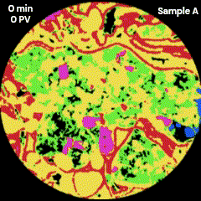
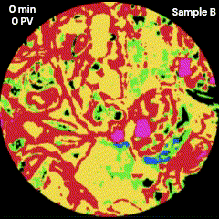
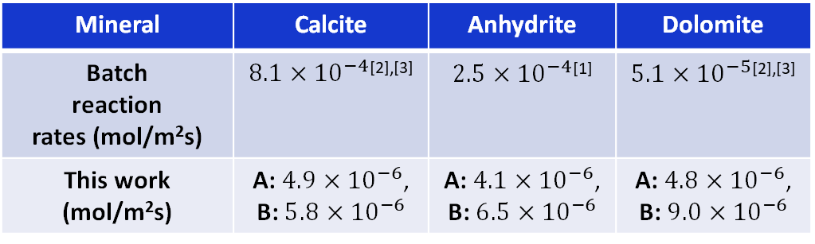
Key Points
The coupling of transport with reaction is quantified by evolving velocity distributions and mineral proximity to fast flow channels from the micro-CT images.
Minerals near fast channels dissolve faster altering reaction rate hierarchy, either forming dominant channels or widening existing channels.
Mineral reaction rates are orders of magnitude lower than the batch rates and the single-mineral system rates due to additional mass transfer limitations.
Mineral | Calcite | Anhydrite | Dolomite
Batch reaction rates (mol/m²s) | $8.1×{10}^{−4}$^{[2],[3]} | $2.5×{10}^{−4}$^{[1]} | $5.1×{10}^{−5}$^{[2],[3]}
This work (mol/m²s) | A: $4.9×{10}^{−6}$, B: $5.8×{10}^{−6}$ | A: $4.1×{10}^{−6}$, B: $6.5×{10}^{−6}$ | A: $4.8×{10}^{−6}$, B: $9.0×{10}^{−6}$
CO₂ Reactive transport in Carbonates
Imperial College Pore-Scale Imaging and Modelling Group

Slide 5
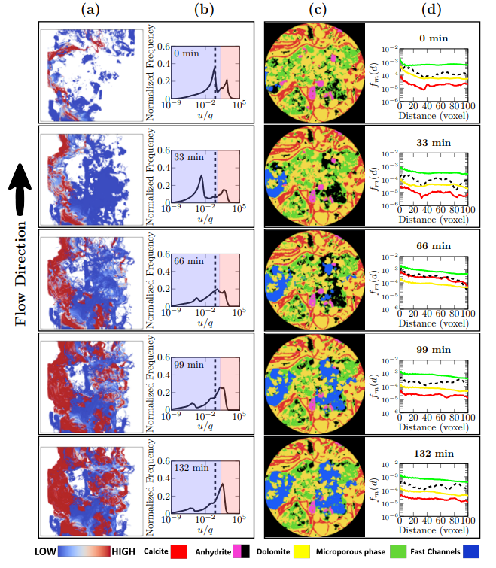
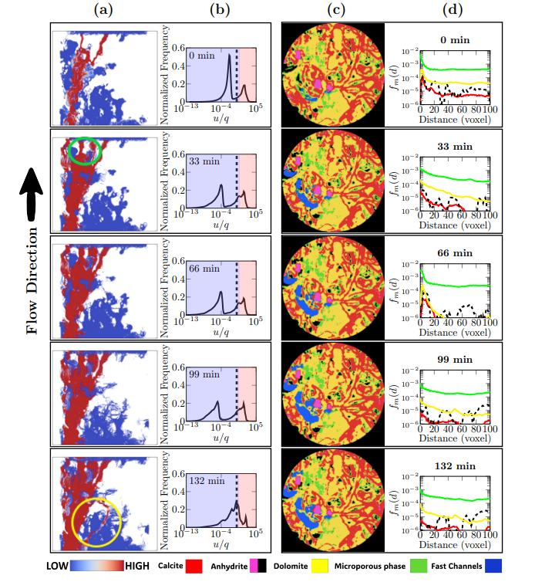
CO₂ Reactive transport in Carbonates
Imperial College Pore-Scale Imaging and Modelling Group

Slide 6
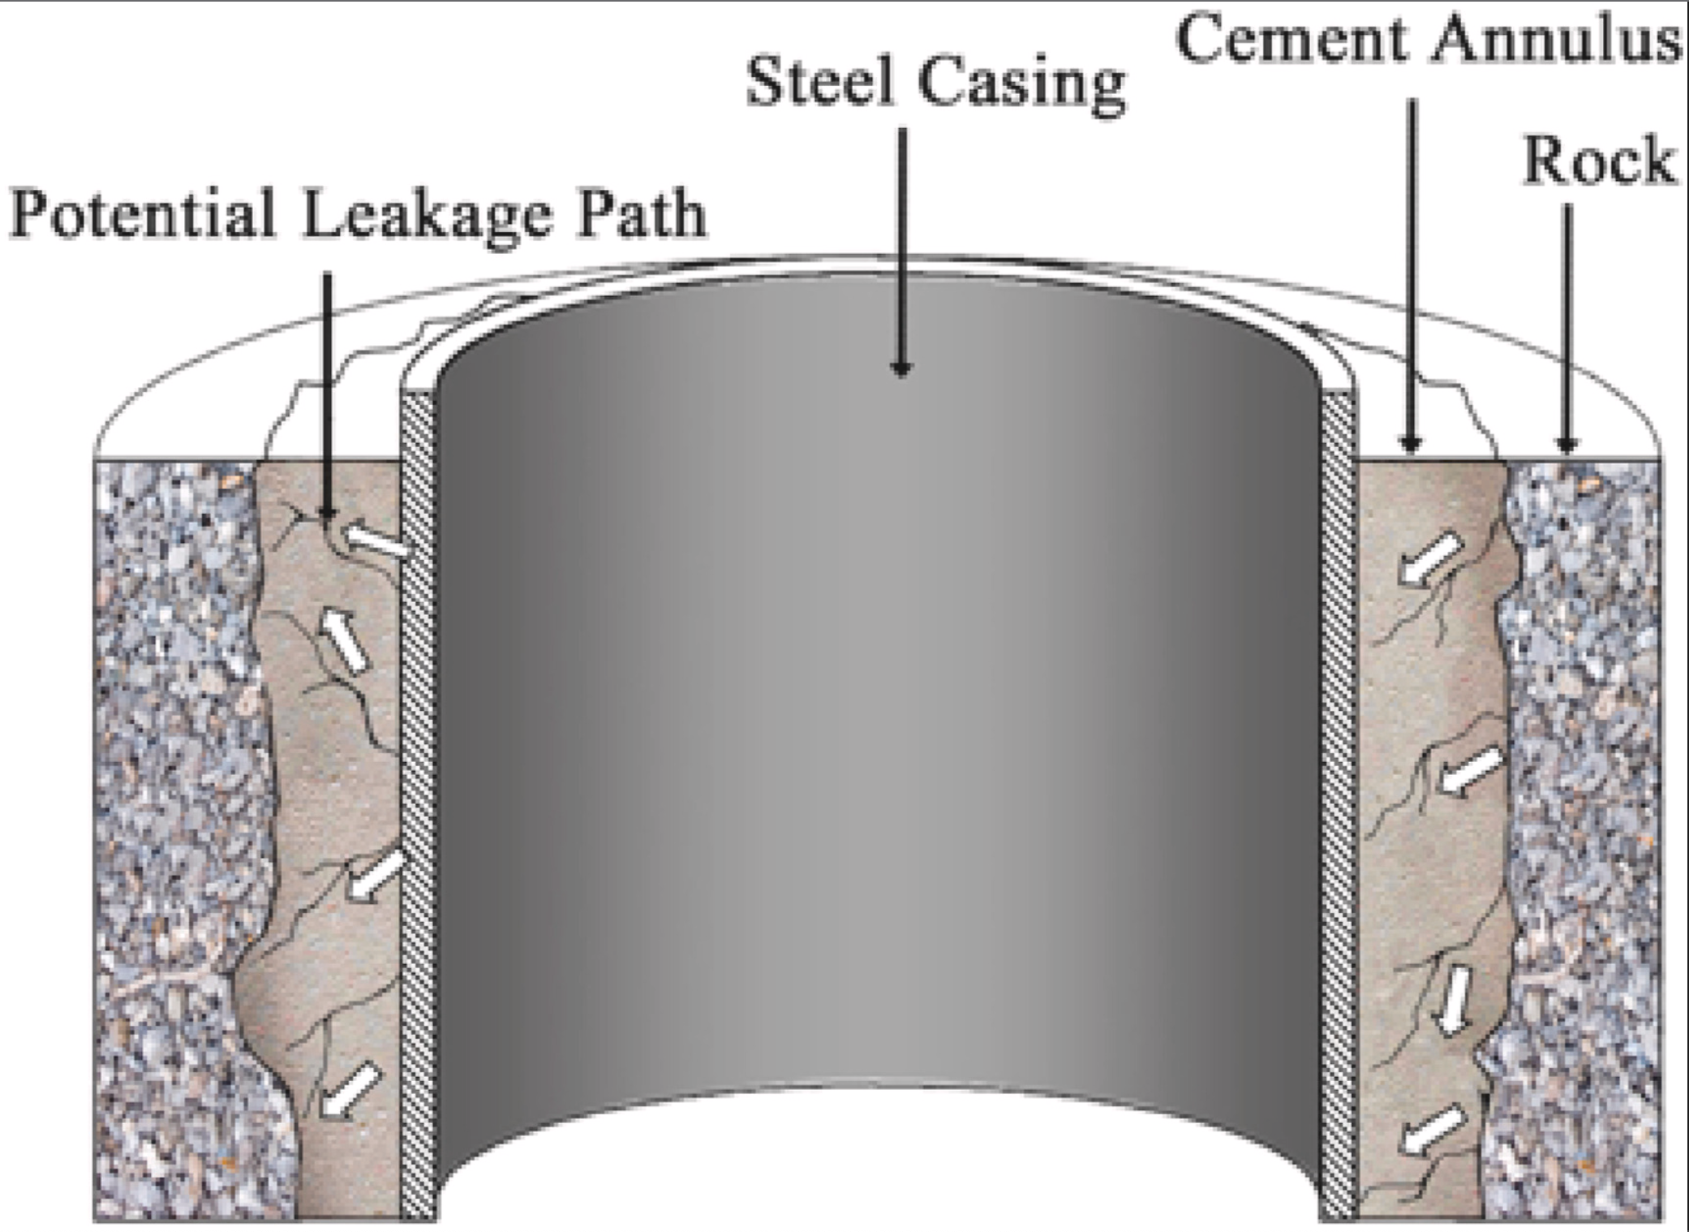
Part 2: CO₂ – Cement reaction
Research Objectives
To Investigate the effect of dissolution and precipitation on cement permeability during exposure to wet supercritical CO₂.
To design a cement formulation which enhances the reduction of well cement transport properties before and after CO₂ exposure.
Possible leakage paths for gas;
Left side: leak starting from the interface between the steel casing and cement annulus.
Right side: leak starting from the interface between cement annulus and surrounding rock.
From Li et al., 2021.
Part 2: CO₂ – Cement reaction
Imperial College Pore-Scale Imaging and Modelling Group

Slide 7
Experimental Plan
Aim: To investigate the impact of nano- and micron- sized glassflake additives on well cement transport properties in CO₂ rich environments.
Experimental conditions (batch reactor): 40ºC and 8 MPa
Procedural overview:
Prepare samples (mixing, curing, coring and drying).
Prolonged exposure to wet supercritical CO₂ in reactor vessel
95 days (4th Feb 2025 to 9th May 2025)
Micro-CT scans
173 days (5 months and 19 days) after CO₂ exposure
Tests before and after CO₂ exposure: nitrogen permeability measurement, micro-CT scans, SEM , XRD, carbonation depth test
Part 2: CO₂ – Cement reaction
Imperial College Pore-Scale Imaging and Modelling Group
Notes:
Co2 exposure; 95 days (3 months 5 days)
Micro-CT scan: 173 days (5 months and 19 days) after exposure

Slide 8
Sample Compositions
Product | Product type | Nominal Flake Thickness | Particle Diameter | Referenced as
GF350nmM | Nano Glassflake | 350 nm | Avg. 120 µm | Small nano
GF750nmM | Nano Glassflake | 750 nm | Avg. 120 µm | Large nano
GF100M | ECR Glassflake | 1.0 - 1.3 µm | Avg. 120 µm | Small micron
GF500M | ECR Glassflake | 3.5 - 5.5 µm | Avg. 120 µm | Large micron
Water-cement ratio for all samples = 0.44
13 samples in total:
1 control (no glassflake),
3 with each glassflake additive (0.25%, 0.5% & 0.75% cement replacement)
ECR = Extra Chemical Resistant, NGF = Nano Glassflake
Part 2: CO₂ – Cement reaction
Imperial College Pore-Scale Imaging and Modelling Group

Slide 9
Cement Sample Compositions
Water-cement ratio = 0.44
Sample | Glassflake (GF) Admixture | GF Amount (wt.%) | Weight of GF (g) | Weight of Cement (g) | Weight of Water (g)
1 | Neat cement (No GF) | 0 | 0 | 200 | 88
2 | Small nano | 0.25% | 0.5 | 199.5 | 88
3 |  | 0.50% | 1 | 199 | 88
4 |  | 0.75% | 1.5 | 198.5 | 88
5 | Large nano | 0.25% | 0.5 | 199.5 | 88
6 |  | 0.50% | 1 | 199 | 88
7 |  | 0.75% | 1.5 | 198.5 | 88
8 | Small micron | 0.25% | 0.5 | 199.5 | 88
9 |  | 0.50% | 1 | 199 | 88
10 |  | 0.75% | 1.5 | 198.5 | 88
11 | Large micron | 0.25% | 0.5 | 199.5 | 88
12 |  | 0.50% | 1 | 199 | 88
13 |  | 0.75% | 1.5 | 198.5 | 88
Part 2: CO₂ – Cement reaction
Imperial College Pore-Scale Imaging and Modelling Group

Slide 10


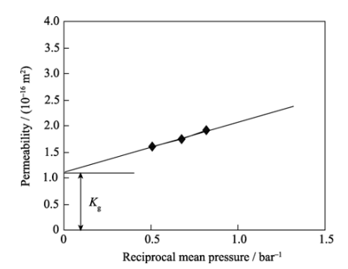
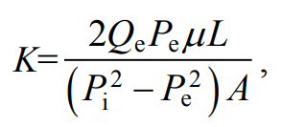
Nitrogen Permeability
Permeability measurement:
Outflow rate measured at 3 pressure drops (900kpa, 400kpa & 250kpa).
Outflow rate was measured 6 times at each pressure drop.
The gas permeability was calculated at each pressure drop.
To correct for gas slippage (Klinkenberg effect):
The gas permeabilities were plotted versus the reciprocal of mean pressure.
The intrinsic permeability is obtained from the intercept.
Wong et al, 2012
μ or η = dynamic fluid viscosity (Pa.s)
Q = outflow rate (m³/s)
L = length (m)
A = area (m²)
P₁ = Inlet pressure, Pa
P₂ = Outlet pressure, Pa
K_{g}= gas permeability (m²)
P_{m} (bar) is the mean pressure ((P₁ + P₂)/2)
β is the Klinkenberg constant.
Sinsiri et al, 2010
Part 2: CO₂ – Cement reaction
Imperial College Pore-Scale Imaging and Modelling Group

Slide 11
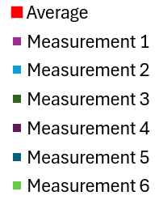
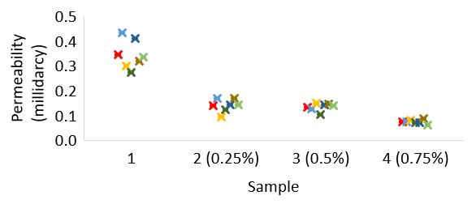
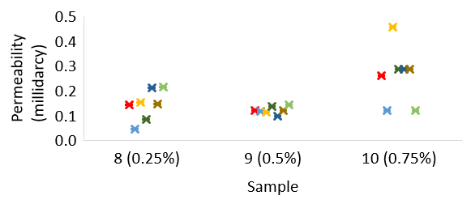
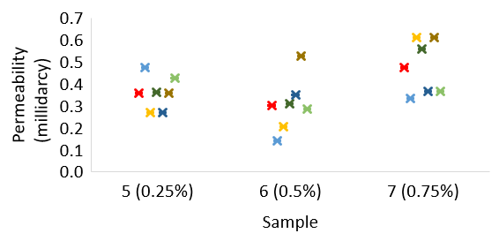
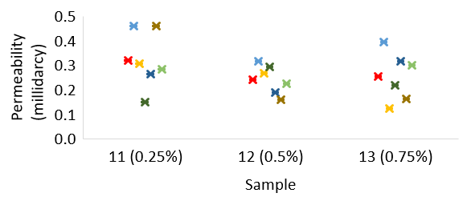
Pre-CO₂ Exposure
Small nano
Large nano
Small micron
Large micron

Slide 12
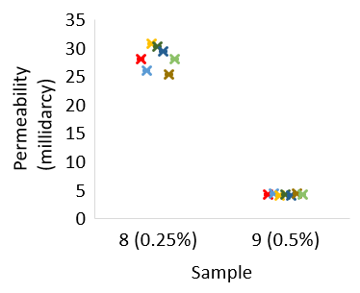
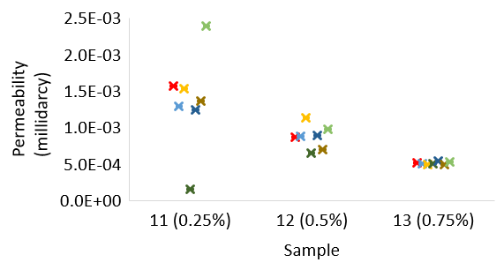
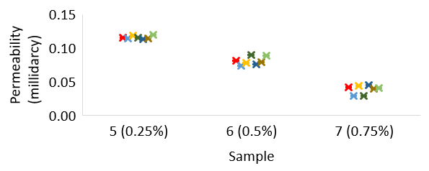
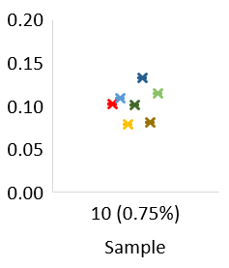
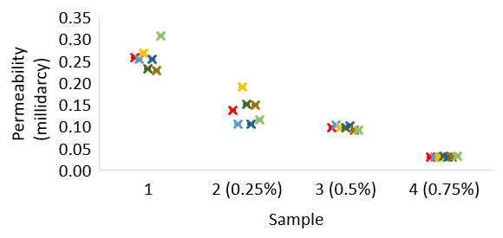
Post-CO₂ Exposure
Small nano
Large nano
Small micron
Large micron

Slide 13
Permeability Difference
Small nano
Large nano
Small micron
Large micron

Slide 14
Nitrogen Permeability: Summary
Additive | Sample | Pre-CO2 (millidarcy) | Post-CO2 (millidarcy) | Difference (millidarcy) | Difference (%) | Note
Control | 1 | 0.35 | 0.26 | 0.09 | 26% | Decrease
Small nano | 2 (0.25%) | 0.14 | 0.14 | 3.8E-03 | 3% | Decrease
Small nano | 3 (0.5%) | 0.13 | 0.10 | 0.03 | 25% | Decrease
Small nano | 4 (0.75%) | 0.07 | 0.03 | 0.04 | 56% | Decrease
Large nano | 5 (0.25%) | 0.36 | 0.12 | 0.24 | 68% | Decrease
Large nano | 6 (0.5%) | 0.30 | 0.08 | 0.22 | 73% | Decrease
Large nano | 7 (0.75%) | 0.47 | 0.04 | 0.43 | 91% | Decrease
Small micron | 8 (0.25%) | 0.14 | 28 | -28 | -20000% | Increase
Small micron | 9 (0.5%) | 0.12 | 4.2 | -4.1 | -3400% | Increase
Small micron | 10 (0.75%) | 0.26 | 0.10 | 0.16 | 61% | Decrease
Large micron | 11 (0.25%) | 0.32 | 1.6E-03 | 0.32 | 99.5% | Decrease
Large micron | 12 (0.5%) | 0.24 | 8.7E-04 | 0.24 | 99.6% | Decrease
Large micron | 13 (0.75%) | 0.25 | 5.1E-04 | 0.25 | 99.8% | Decrease
Part 2: CO₂ – Cement reaction
Imperial College Pore-Scale Imaging and Modelling Group

Slide 15
Nitrogen Permeability: Key Points
Pre-CO₂ Exposure:
Small nano admixture caused a progressive permeability reduction.
Large nano, small micron, and large micron admixtures showed an initial permeability decrease, followed by an increase beyond a threshold concentration.
Interpretation:
At low–moderate amounts, admixtures fill pore space, reducing permeability.
Beyond a critical amount, particles begin to prop open flow pathways, offsetting pore blocking and increasing permeability.
Post-CO₂ Exposure:
Overall trend: Increasing admixture content led to reduced permeability in most samples.
Likely mechanism: CaCO₃ precipitation blocking pore throats and fractures.
Key results:
Control sample: 26% permeability reduction.
Large micron (highest dosage): 99.8% reduction — greatest loss observed.
Exception: Small micron samples (8 & 9) showed large permeability increases
+20,000% and +3,400%, respectively.
Attributed to fracture formation during cement dissolution in CO₂-rich conditions.
Next step:
SEM analysis to confirm microstructural changes pre- and post-CO₂ exposure.
Part 2: CO₂ – Cement reaction
Imperial College Pore-Scale Imaging and Modelling Group

Slide 16
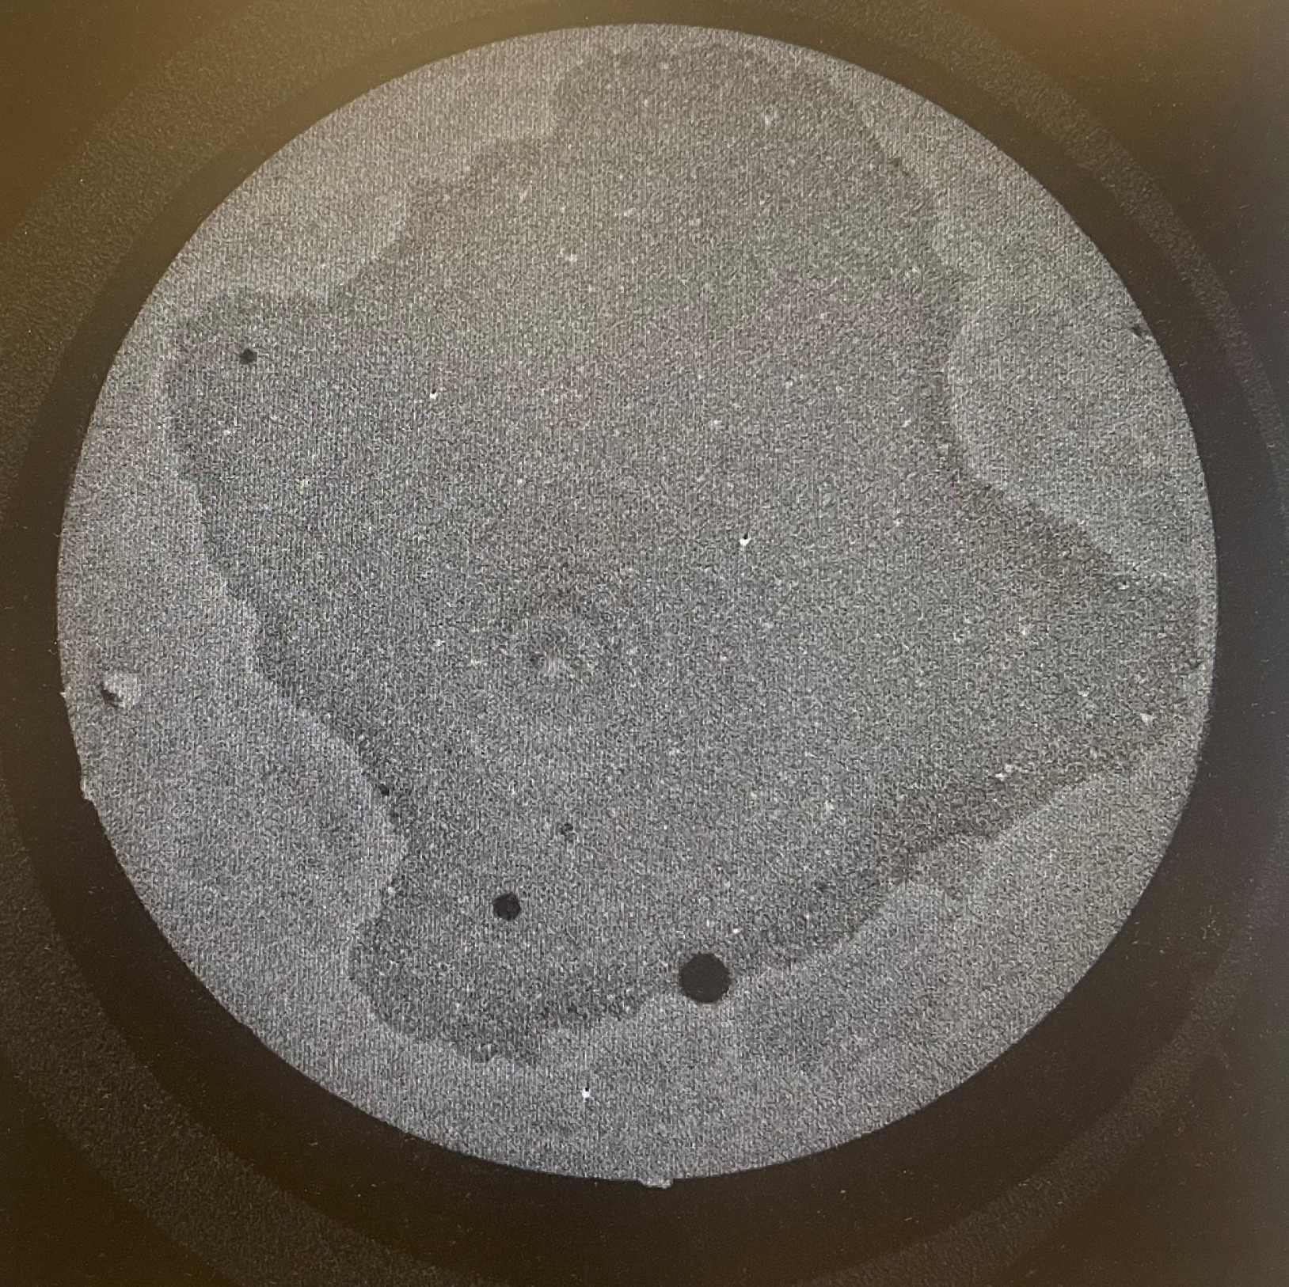
Micro-CT Scans: Post-CO₂ Exposure
Unreacted region
Reacted region
Void space (pore)
CaCO₃ precipitation
in void space
1 mm
Part 2: CO₂ – Cement reaction
Imperial College Pore-Scale Imaging and Modelling Group

Slide 17
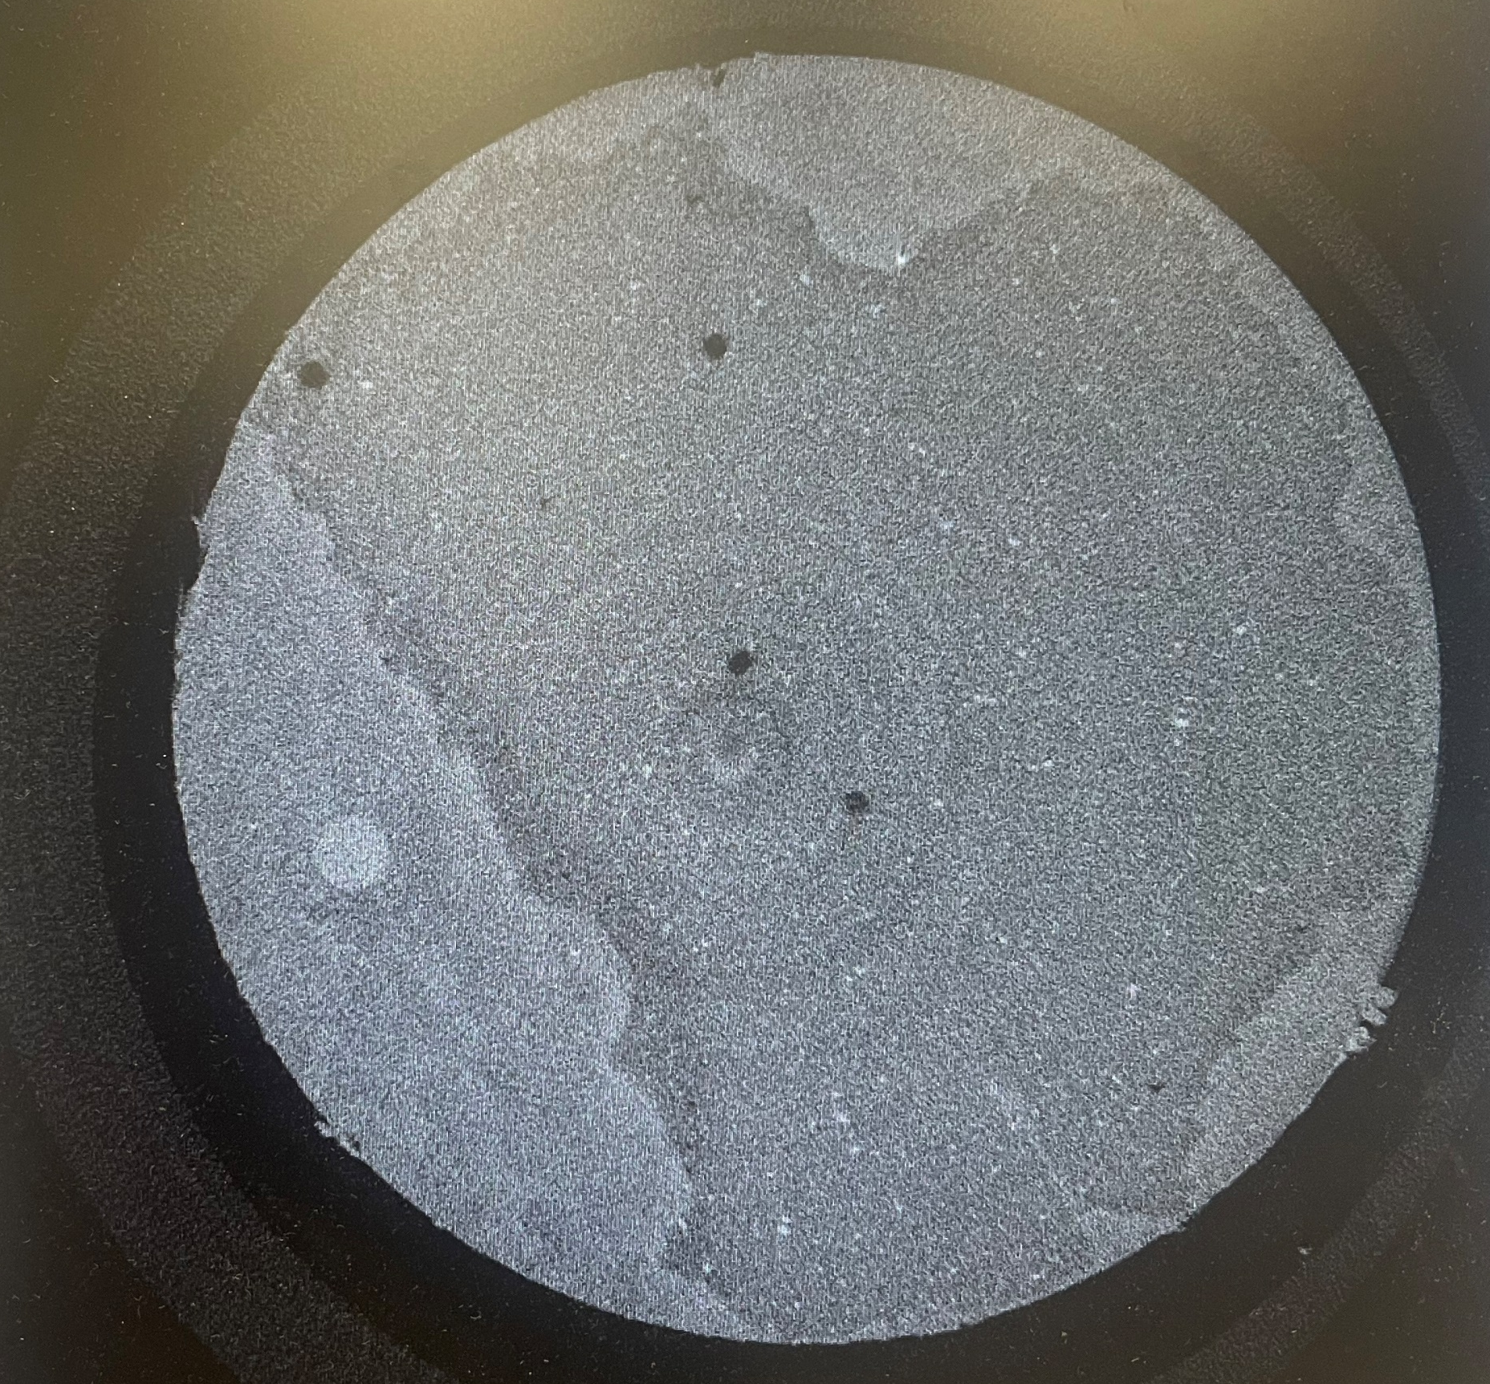
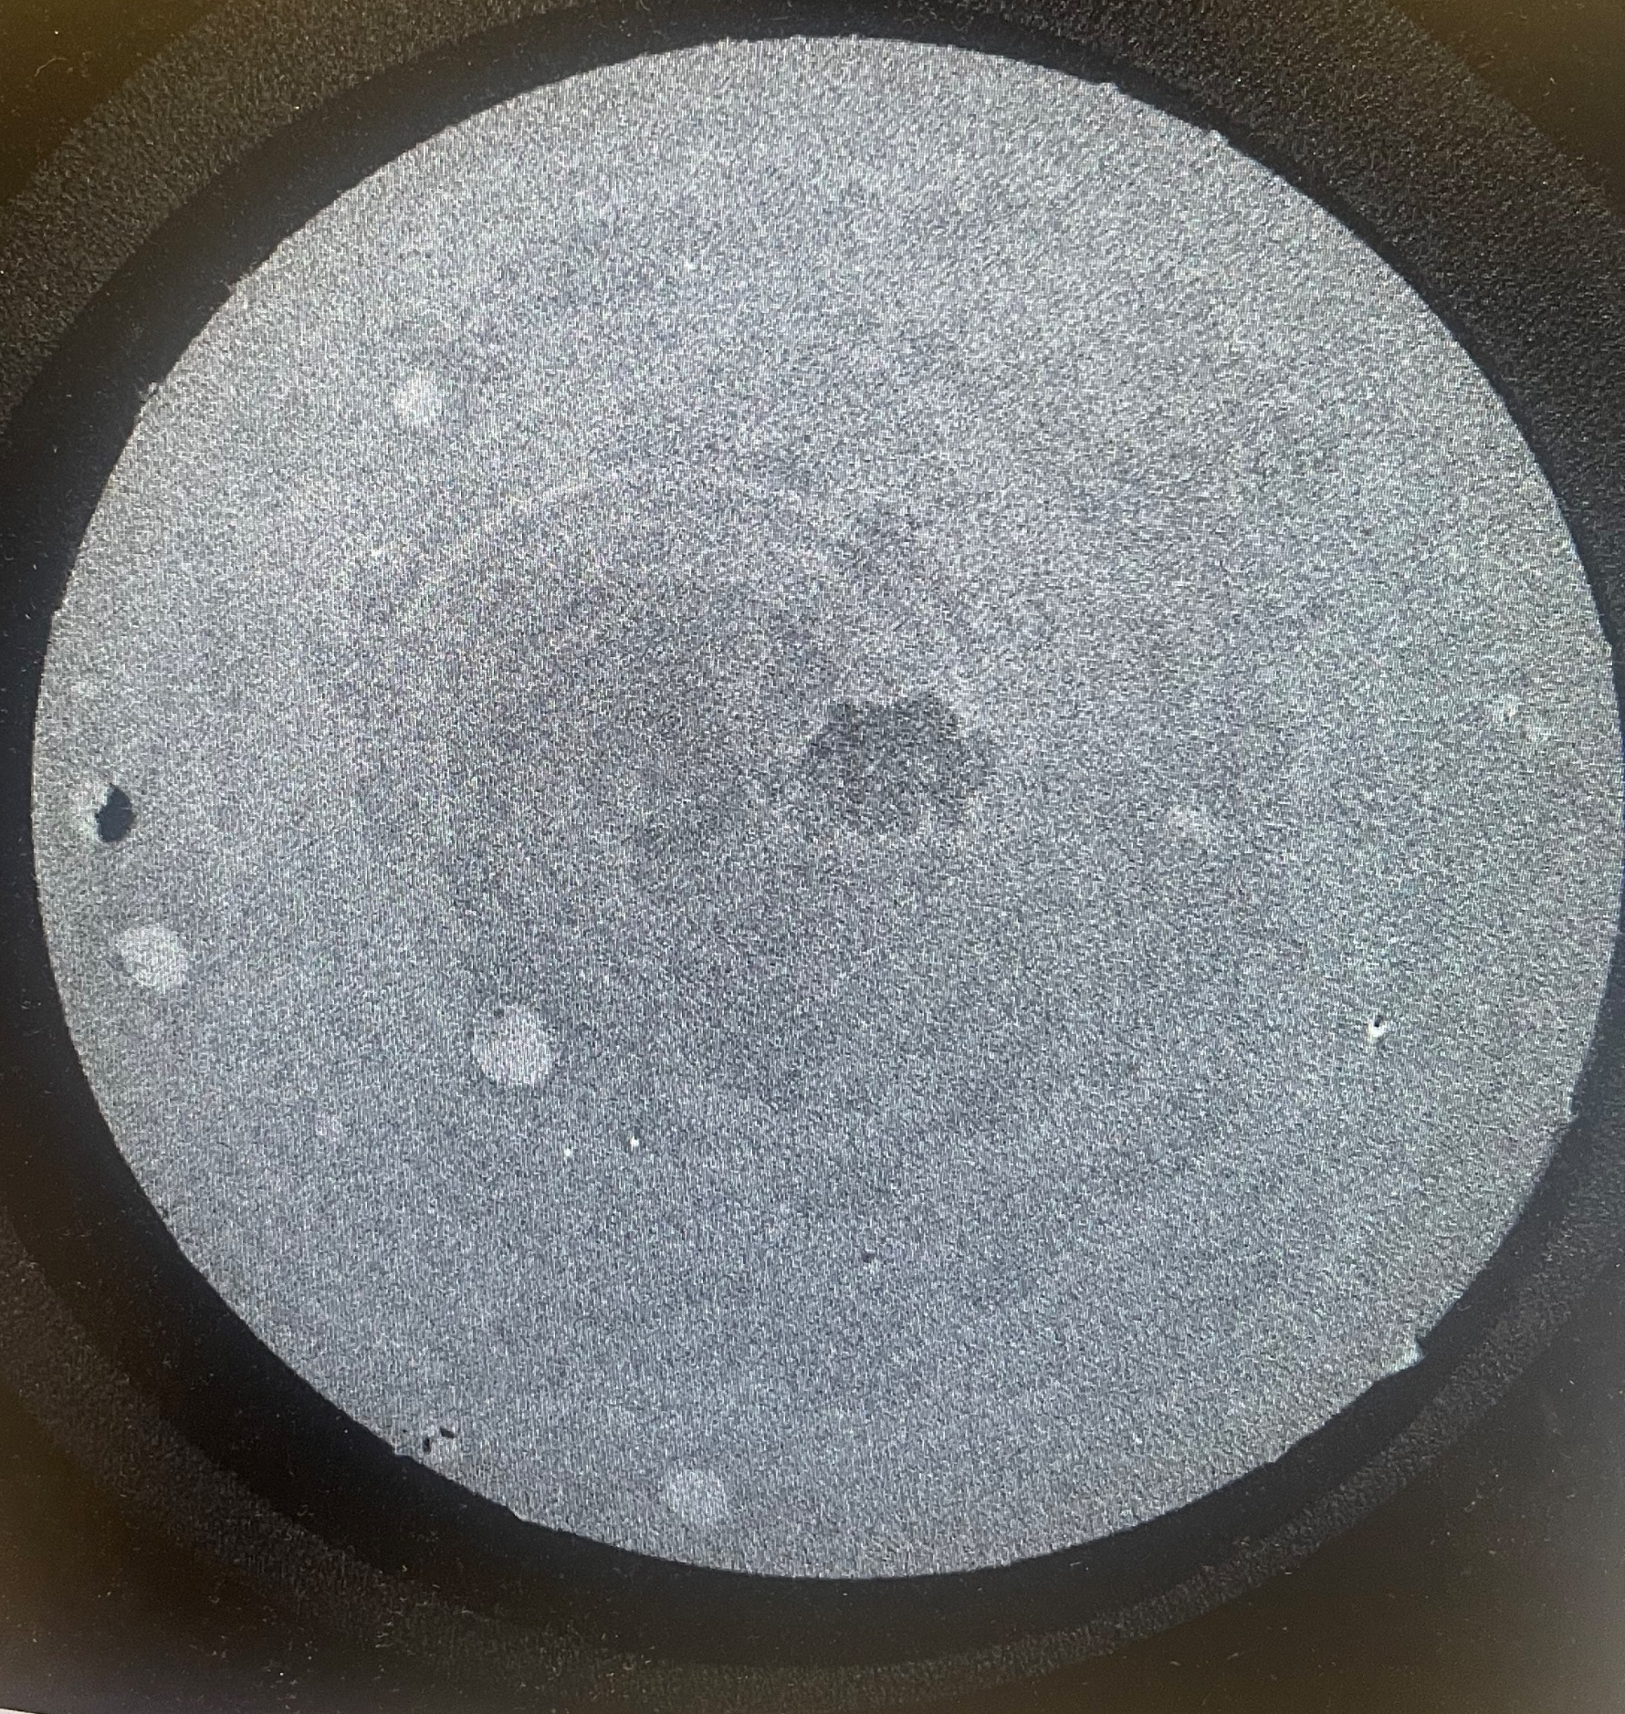
Micro-CT Scans: Post-CO₂ Exposure
1 mm
1 mm
Part 2: CO₂ – Cement reaction
Imperial College Pore-Scale Imaging and Modelling Group

Slide 18
Sample Cutting: SEM and Carbonation Depth Test
A
Uncut Sample Dimensions:
Height = 30 mm
Diameter = 12.5 mm
5 mm
Cut Sample Sections:
A = Top (5 mm x 12.5 mm)
B = Bottom (5 mm x 12.5 mm)
C = Half-cylinder (20 mm x 6.25 mm)
D = Half-cylinder (20 mm x 6.25 mm)
6.25 mm
Cut lines
A
B
20 mm
Sample
C
D
C
D
B
12.5 mm
Part 2: CO₂ – Cement reaction
Imperial College Pore-Scale Imaging and Modelling Group
Notes:
Uncut Sample Dimentions:
Height = 30 mm
Diameter = 12.5 mm
Cut Sample Sections:
A = Top (5 mm x 12.5 mm)
B = Bottom (5 mm x 12.5 mm)
C = Half-cylinder (20 mm x 6.25 mm)
D = Half-cylinder (20 mm x 6.25 mm)

Slide 19
Future Work
Micro-CT Scans: Acquire high-resolution micro-CT scans of cement cores to analyze structural changes.
CO₂ Exposure Testing: Conduct CO₂ exposure experiments in a reactor to assess chemical and physical alterations.
Nitrogen Permeability: Measure nitrogen permeability to evaluate changes in flow properties post-CO₂ exposure.
Scanning Electron Microscopy (SEM): Perform SEM analysis to investigate microstructural changes at the surface and subsurface levels.
X-ray Diffraction (XRD): Use XRD to identify mineralogical transformations induced by CO₂ exposure.
Rheological Analysis: Study the rheological behavior of cement slurries, focusing on properties like plastic viscosity and flow behavior.
Part 2: CO₂ – Cement reaction
Imperial College Pore-Scale Imaging and Modelling Group

Slide 20
References
(1) Bildstein O, Worden RH, Brosse E. Assessment of anhydrite dissolution as the rate-limiting step during thermochemical sulfate reduction. Chem Geol. 2001 Jul 1;176(1):173–89.
(2) Peng C, U. Anabaraonye B, P. Crawshaw J, C. Maitland G, Martin Trusler JP. Kinetics of carbonate mineral dissolution in CO 2 -acidified brines at storage reservoir conditions. Faraday Discuss. 2016;192(0):545–60.
(3) Peng C, Crawshaw JP, Maitland GC, Trusler JPM. Kinetics of calcite dissolution in CO2-saturated water at temperatures between (323 and 373)K and pressures up to 13.8MPa. Chem Geol. 2015 May 18;403:74–85.
(4) Wong, H. S., Zimmerman, R. W., & Buenfeld, N. R. (2012). Estimating the permeability of cement pastes and mortars using image analysis and effective medium theory. Cement and Concrete Research, 42(2), 476-483.
(5) Sinsiri, T., Chindaprasirt, P., & Jaturapitakkul, C. (2010). Influence of fly ash fineness and shape on the porosity and permeability of blended cement pastes. International Journal of Minerals, Metallurgy, and Materials, 17(6), 683-690.
Part 2: CO₂ – Cement reaction
Imperial College Pore-Scale Imaging and Modelling Group

Slide 21
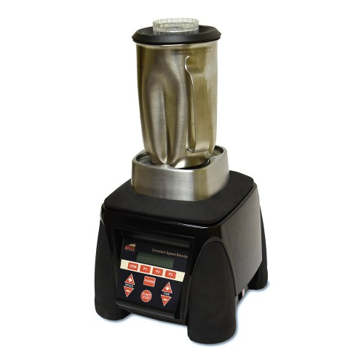
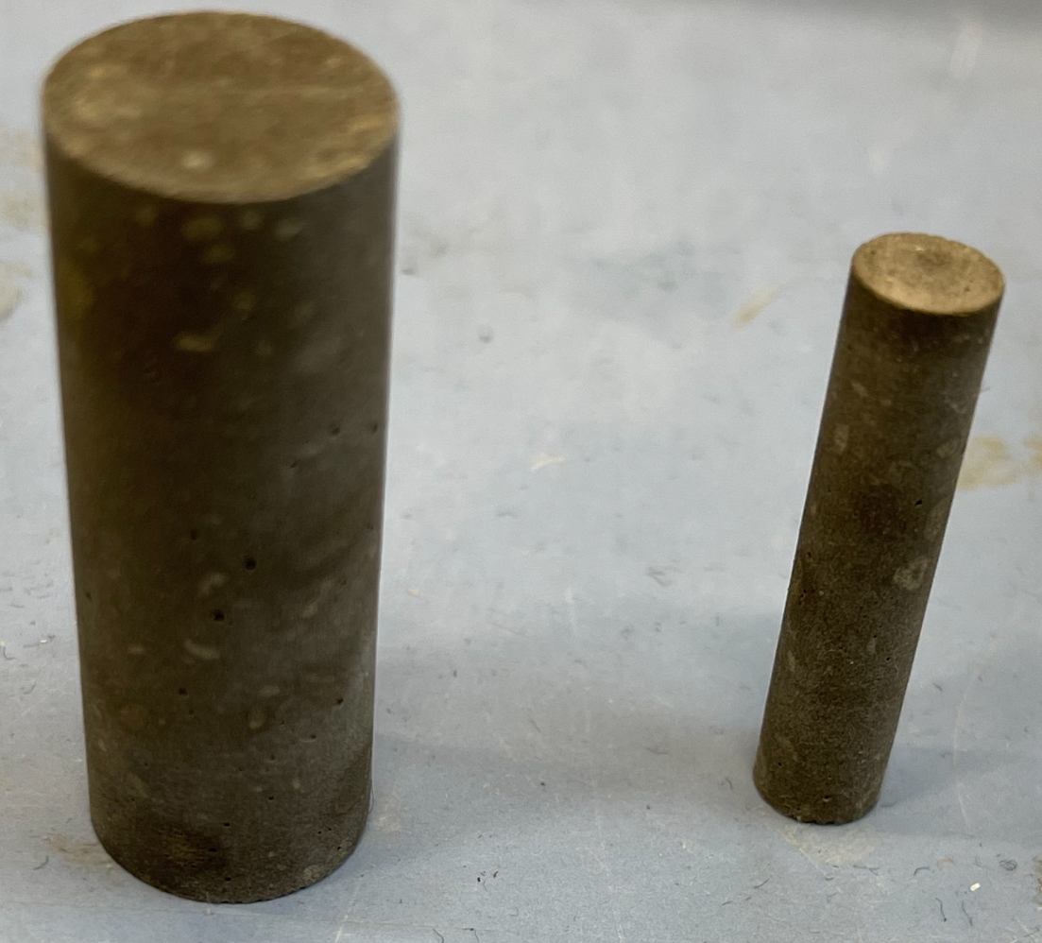
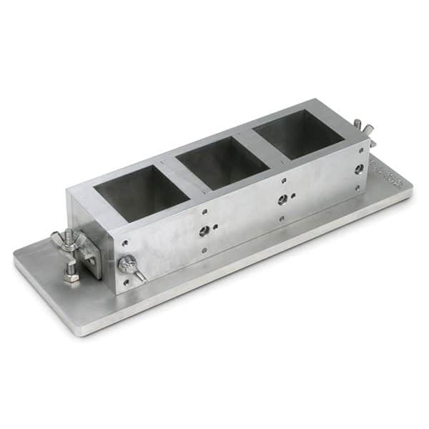
Cement Sample Method and Design
Mix cement and water:
Class G Portland cement + Deionized water
Water-cement ratio of 0.44
Mixing speeds and times:
4000 rpm for 15 seconds
12,000 rpm for 35 seconds
12.5 mm
(API RP 10B-2, 2013)
Cement mixer.
6 mm
Mixed according to American Petroleum Institute (API) Recommended Practice 10B-2
50x50x50mm cement cube mold.
30 mm
25 mm
Slurry is poured into a 50x50x50mm cube mold.
Mold is placed in curing room for 24 hours to harden before demolding.
Hardened cubes are placed in a water bath to cure for 7 days at atmospheric pressure and room temperature.
Cylindrical cores are made for micro-Ct scans.
Cylindrical cement cores.

Slide 22
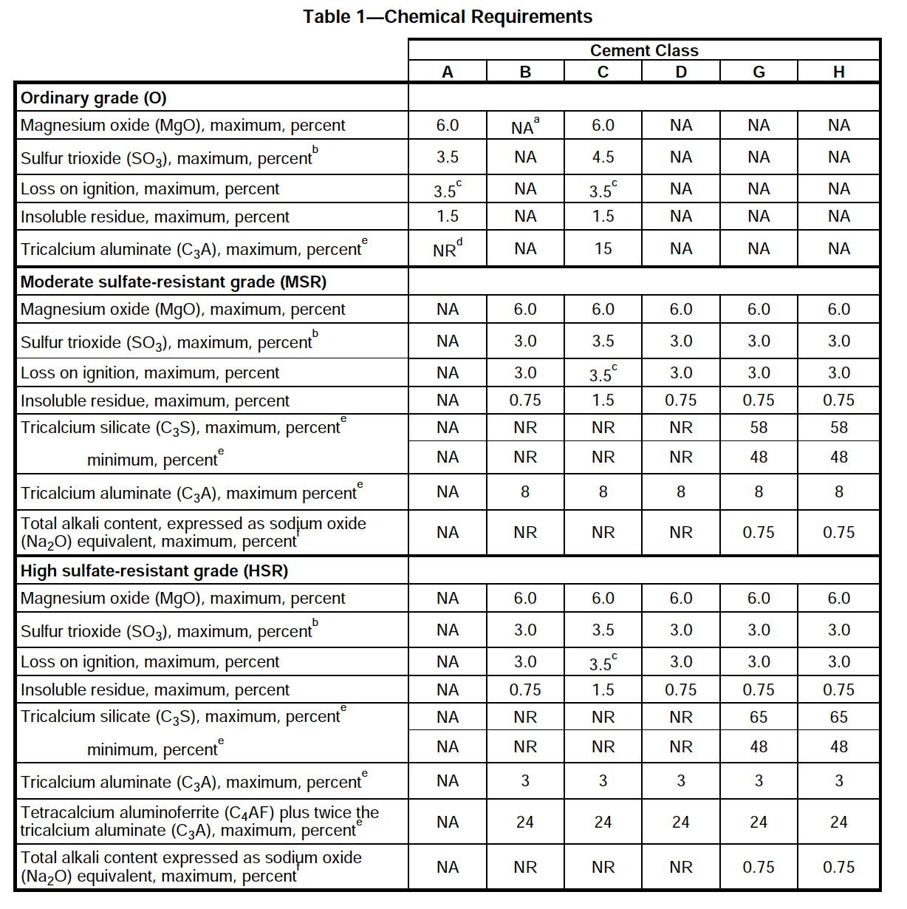
Cement Selection
American Petroleum Institute (API) Specification 10A classifies class G and H Portland cements as basic well cements.
Class G and H Portland cements are manufactured to resist sulfate attack in the subsurface.
Class G Portland cement is the most widely used well cement.
Thus, a High sulfate-resistance grade of class G Portland cement is chosen for this experimental study.
The Class G Portland cement used was provided by SLB (Schlumberger).
API Specification 10A (American Petroleum Institute (API), 2019)
Part 2: CO₂ – Cement reaction
Imperial College Pore-Scale Imaging and Modelling Group
Notes:
The select the right cement for this study, API SPEC 10A was used.
Schlumberger provided the Class G Portland cement used in this experimental study.

Slide 23
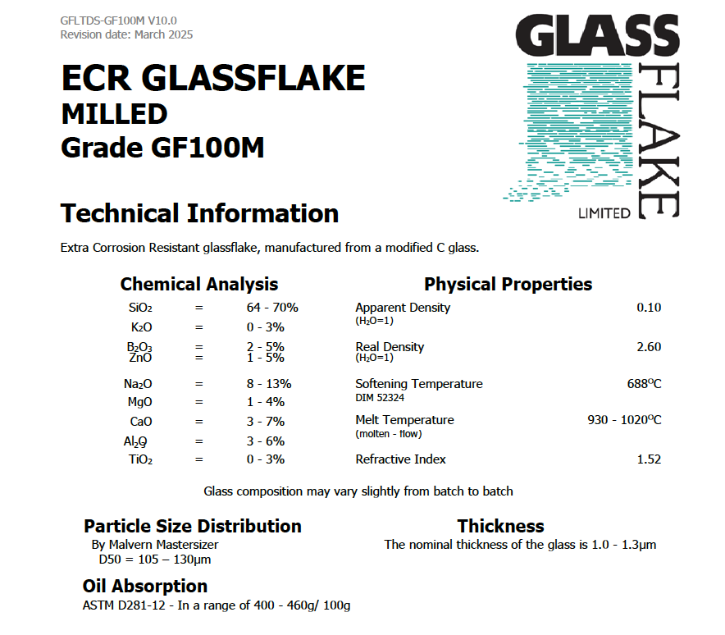

Slide 24
Sample Cube Coring
Differences in Core Permeabilities from the Same Sample
Variations in core permeabilities within a single sample can be attributed to several factors:
• Uneven Additive Distribution: The distribution of additives across the sample may not be uniform.
• Inherent Heterogeneity: Certain regions of the sample may naturally exhibit higher permeability than others.
• Subvolume Representation: Each core only reflects the properties of a specific subvolume of the larger sample cube.
To ensure a more consistent and conservative analysis, cores with the lowest permeabilities are selected for further investigation.
A
B
C
50 mm³
12.5 mm x 30 mm
(Diameter x Length)
Part 2: CO₂ – Cement reaction
Imperial College Pore-Scale Imaging and Modelling Group

Slide 25
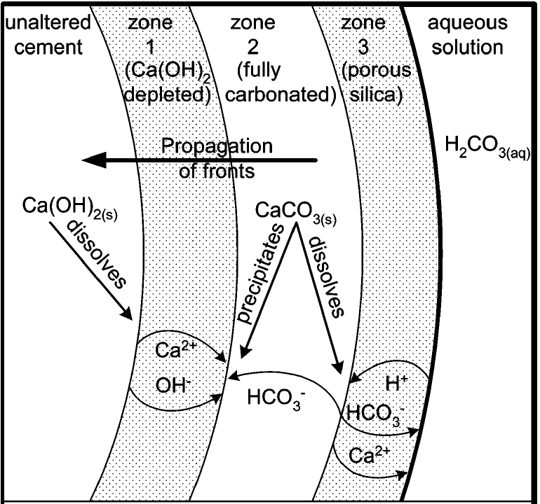
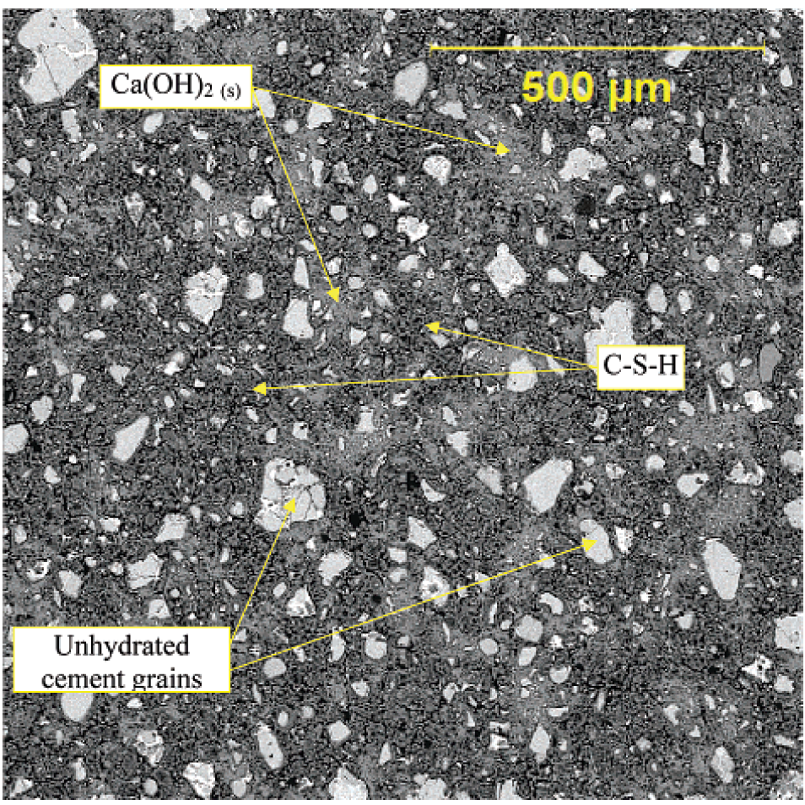
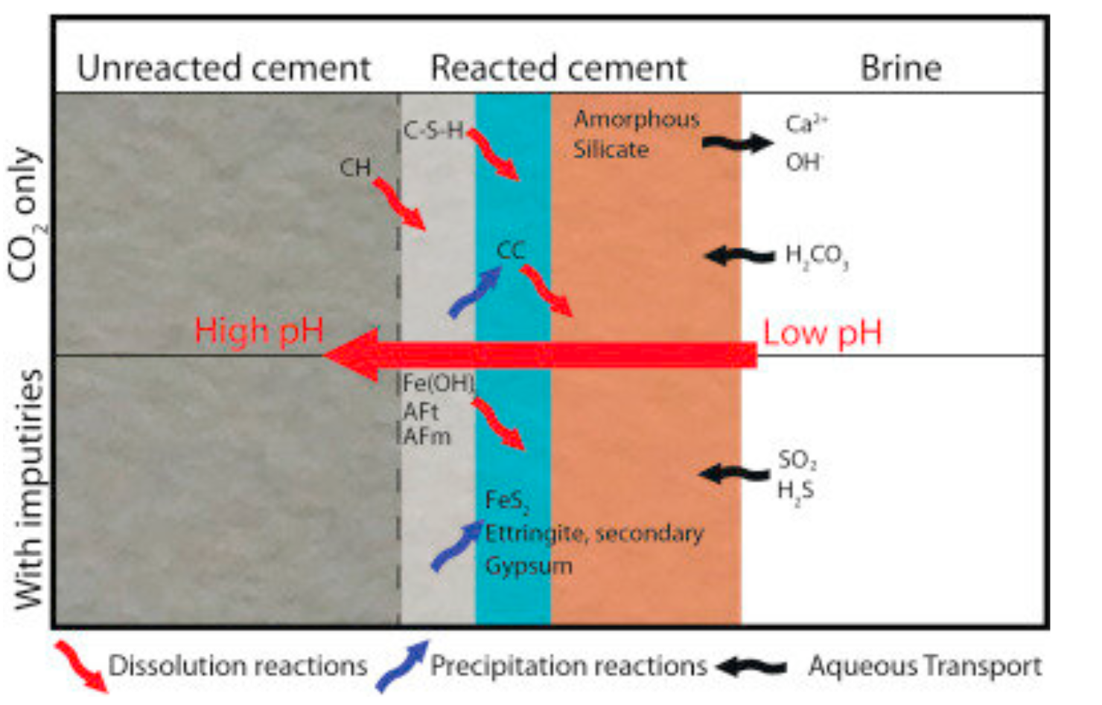
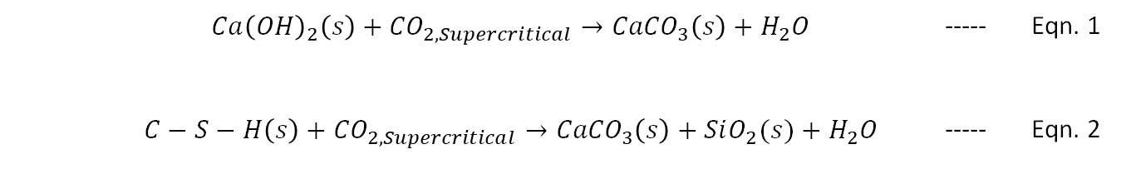
Cement Alteration
Calcium Hydroxide
Calcium Carbonate
 |  | $${Ca\left(OH\right)}_{2}\left(s\right)+{CO}_{2, Supercritical}→{CaCO}_{3}\left(s\right)+H_{2}O$$ | ----- | Eqn. 1
 |  | $$C−S−H\left(s\right)+{CO}_{2, Supercritical}→{CaCO}_{3}\left(s\right)+SiO_{2}(s)+H_{2}O$$ | ----- | Eqn. 2
Main hydration products of cement
Wang et al., 2021
CO₂ reaction with hydrated cement products shown in Eqn. 1 & 2.
Calcium Silicate Hydrate
Amorphous silica
SEM-BSE image of cured cement.
Brightest phases are unhydrated cement grains, light gray patches consist of Ca(OH)₂(s), and dark gray matrix is composed of the Calcium Silicate Hydrate (C-S-H) phase. From Kutchko et al, 2007.
Schematic showing the dissolution and calcium migration and formation of distinct zones in the cement. From Kutchko et al, 2007.
From Carroll et al., 2016.
Notes:
When dry cement is mixed with water, calcium hydroxide and calcium silicate hydrate are formed as the main hydration products. CO2 reacts with these cement hydration product in a process called carbonation.
These carbonation reactions produce water and precipitate calcium carbonate and amorphous silica.

Slide 26
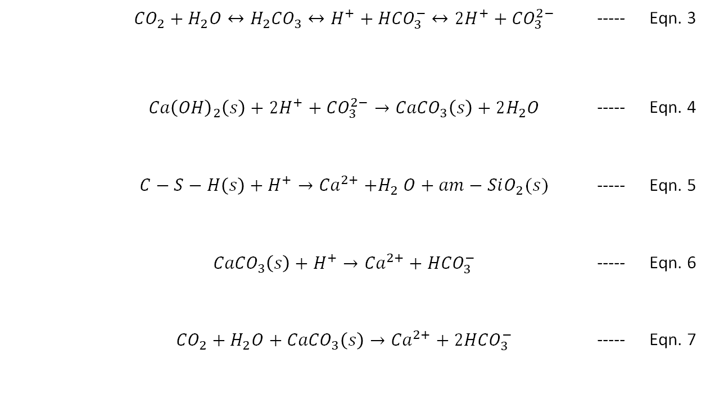
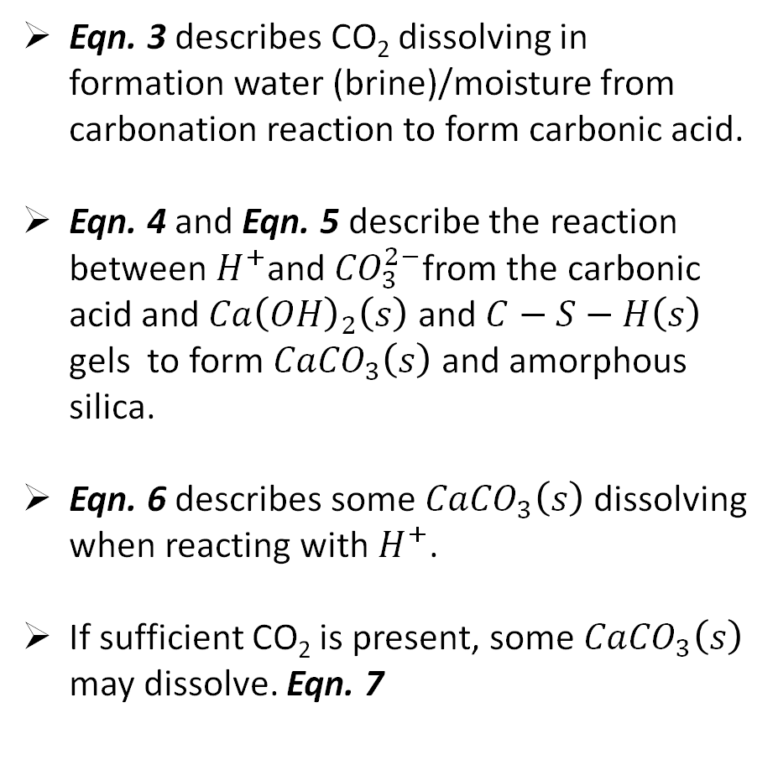
Dissolution and Precipitation Reactions
Eqn. 3 describes CO₂ dissolving in formation water (brine)/moisture from carbonation reaction to form carbonic acid.
Eqn. 4 and Eqn. 5 describe the reaction between $H^{+}$and ${CO}_{3}^{2−}$from the carbonic acid and ${Ca\left(OH\right)}_{2}\left(s\right)$ and $C−S−H\left(s\right)$ gels to form ${CaCO}_{3}\left(s\right)$ and amorphous silica.
Eqn. 6 describes some ${CaCO}_{3}\left(s\right)$ dissolving when reacting with $H^{+}$.
If sufficient CO₂ is present, some ${CaCO}_{3}\left(s\right)$ may dissolve. Eqn. 7
 |  | $${CO}_{2}+H_{2}O↔{H_{2}CO}_{3}↔H^{+}+{HCO}_{3}^{−}↔{2H}^{+}+{CO}_{3}^{2−}$$ | ----- | Eqn. 3
 |  | $${Ca\left(OH\right)}_{2}\left(s\right)+{2H}^{+}+{CO}_{3}^{2−}→{CaCO}_{3}\left(s\right)+2H_{2}O$$ | ----- | Eqn. 4
 |  | $$C−S−H\left(s\right)+H^{+}→{Ca}^{2+}{+H}_{2}O+am−SiO_{2}(s)$$ | ----- | Eqn. 5
 |  | $${CaCO}_{3}\left(s\right)+H^{+}→{Ca}^{2+}+{HCO}_{3}^{−}$$ | ----- | Eqn. 6
 |  | $${CO}_{2}+H_{2}O+{CaCO}_{3}\left(s\right)→{Ca}^{2+}+{2HCO}_{3}^{−}$$ | ----- | Eqn. 7
Gan et al., 2022
Notes:
Here the reactions between carbonic acid and cement are presented.
Thus, the risk of CO₂ leakage through wellbore cement Is determined by alteration of the porosity and micro-structure of wellbore cement following carbonation (Gan et al., 2022).

