Slide 1
2026 Annual Meeting of the Imperial College Consortium on Pore-Scale Modelling and Imaging
14th January 2026
Martin Blunt and Branko Bijeljic
Department of Earth Science and Engineering
Imperial College London

Slide 2
Personnel and projects
Martin Blunt, Professor of Flow in Porous Media – multiphase flow in porous media
Branko Bijeljic, Principal Research Fellow – multiphase flow and reactive transport
Rukuan Chai, Post-doctoral researcher – imaging and analysis of carbon dioxide storage
Linqi Zhu, Post-doctoral researcher – machine learning and time-resolved images
Hussein Alzahrani, completed PhD student – surfactant flooding
Ademola Adebimpe, 4th year PhD student – pore-scale modelling of Ostwald ripening
Jack Ma, 4th year PhD student – application of machine learning to pore-scale modelling
Waleed Dokhon, 3rd year PhD student – experimental studies of hydrogen storage
Ahmed Alzaabi, 3rd year PhD student – comparison of nitrogen, carbon dioxide and hydrogen storage
Anfal Al Zarafi, 3rd year PhD student – carbon dioxide storage in reservoir carbonates
Olatunbosun Adedipe, 3rd year PhD student – reactive transport and cement dissolution
Ibrahim Alobaidan, 3rd year PhD student – modelling and design of hydrogen storage
Qianqian Ma, 3rd year PhD student – experimental studies of reactive transport
Yuxi Liang, 3rd year PhD student – pore-scale modelling of salt precipitation
Sasha Karabasova, 2nd year PhD student – pore-scale modelling of rate effects
Mohammed Bello, 2nd year PhD student – wettability effects in gas storage
Oranan Ariyarit, 2nd year PhD student – carbon dioxide storage in depleted oilfields
Zhi Zheng, 1st year PhD student – three-phase flow in porous media
Yuxin Cheng, 1st year PhD student – reactive transport in multiphase flow
Rui Zhang, visiting PhD student – applications of machine learning
Jinlei Wang, visiting PhD student – simulations of reactive transport
Qingyang (Lewis) Lin, Professor, Zhejiang University, China – multiphase flow
Mingliang Qu, 3rd year PhD student Zhejiang University, China – multiphysics modelling

Slide 3
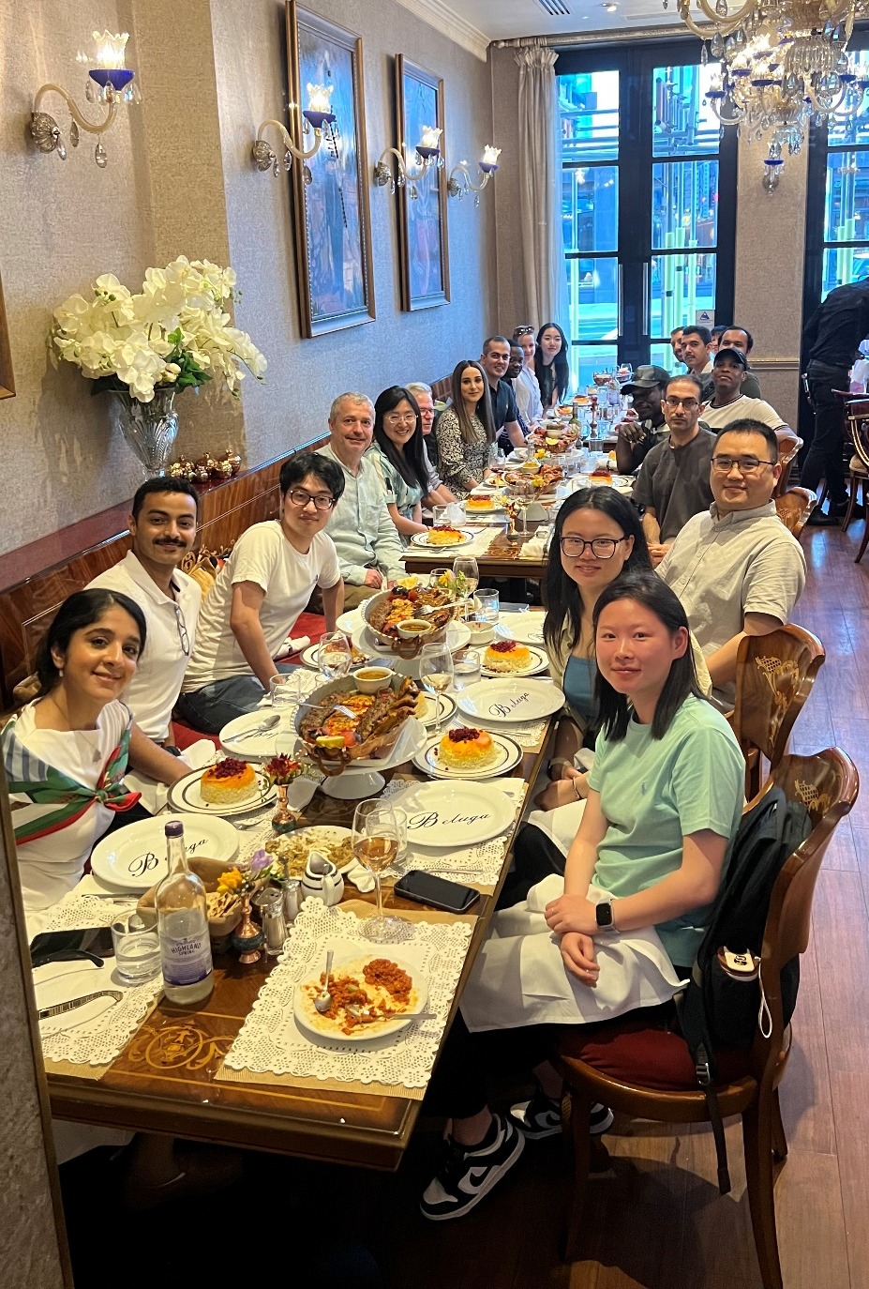
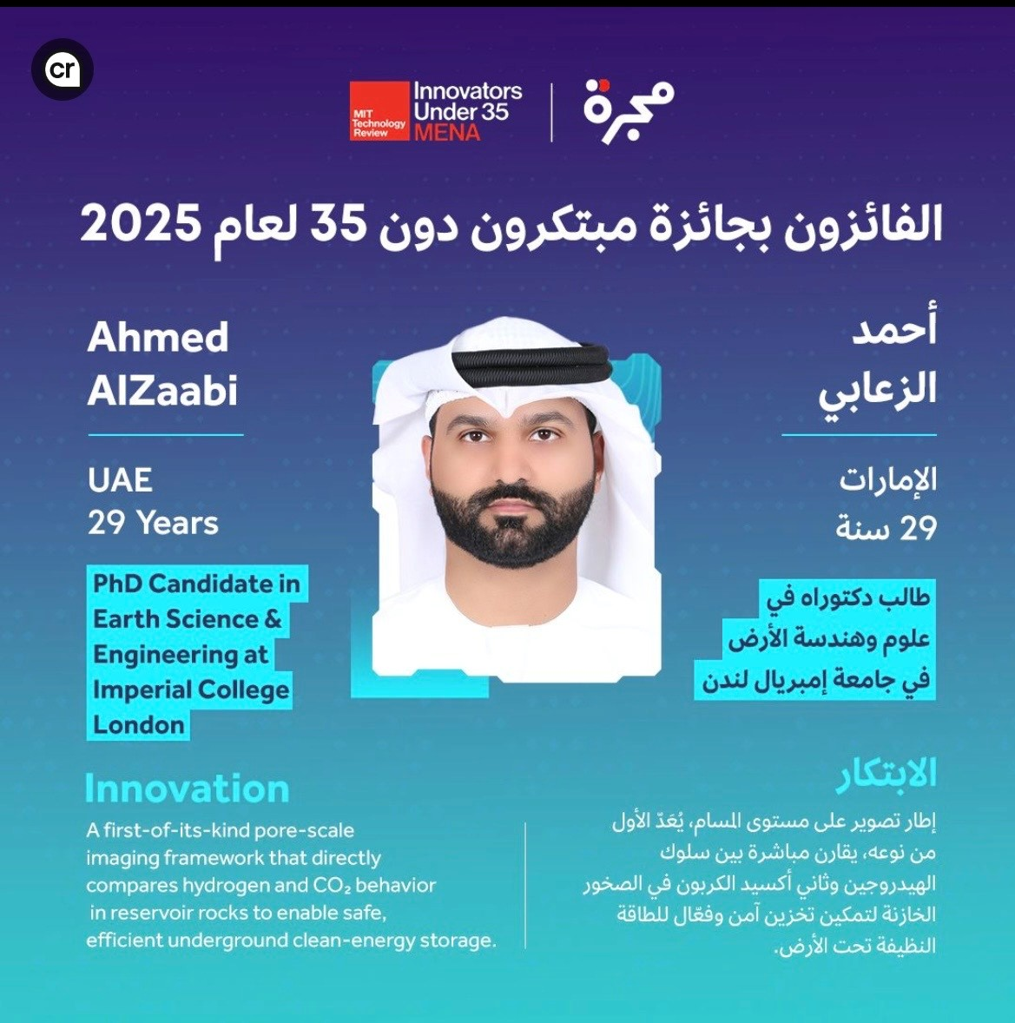
Personnel and projects

Slide 4
Agenda: 26th Pore-Scale Imaging and Modelling Meeting
9:00am Welcome coffee and Introduction (Martin Blunt)
Session 1: Hydrogen and carbon dioxide storage: from pore-scale experiments to field-scale modelling
9:20am Waleed Dokhon – The combined effects of displacement, exsolution and pressure decline in hydrogen storage
9:50am Ahmed Alzaabi: Pore-scale displacement and trapping: a comparative study of nitrogen, carbon dioxide and hydrogen
10:20am Ibrahim Alobaidan – Field-scale analysis of hydrogen storage incorporating pore-scale hysteresis models
10:50am: Coffee break
11:20am Rukuan Chai – Pore-scale dynamics and relative permeability in carbon dioxide storage
11:50am Anfal Al Zarafi – Measurement and interpretation of low carbon dioxide-brine relative permeability
12:10pm Oranan Ariyarit – How relative permeability affects the design of carbon dioxide storage in oilfields
12:30pm: Lunch
Session 2: Reactive transport experiments and modelling
1:30pm Branko Bijeljic – Introduction
1:40pm Qianqian Ma – Pore-scale mechanisms of reactive transport and carbon dioxide injection in the presence of oil
2:10pm Olatunbosun Adedipe – Flow fields in reactive transport and carbon-dioxide-cement interactions
Session 3: Pore-scale simulation and machine learning
2:40pm Sasha Karabasova: Direct pore-scale simulation of the origins of intermittency in multiphase flow
3:10 pm: Coffee break
3:40pm Ademola Adebimpe – Pore-scale modelling of Ostwald ripening: equilibrium and rate-dependence
4:10pm Yuxi Liang – Pore-scale modelling of salt precipitation in carbon dioxide storage
4:30pm Jack Ma – AI-powered four-dimensional image segmentation
5:00pm: Discussion and close
6:30pm Dinner – Ognisko (Polish Club), Exhibition Road

Slide 5
Data, codes and AI
Open access papers, talks and data (it’s been a record year for us in terms of publications)
https://www.imperial.ac.uk/earth-science/research/research-groups/pore-scale-modelling/
See also the Digital Porous Media Portal, BGS etc.
Codes available on Github
https://github.com/ImperialCollegeLondon/porescale
Machine learning and image analysis: we have the image data and a vision to create foundational AI models for 3D/4D image segmentation, analysis and modelling.

Slide 6
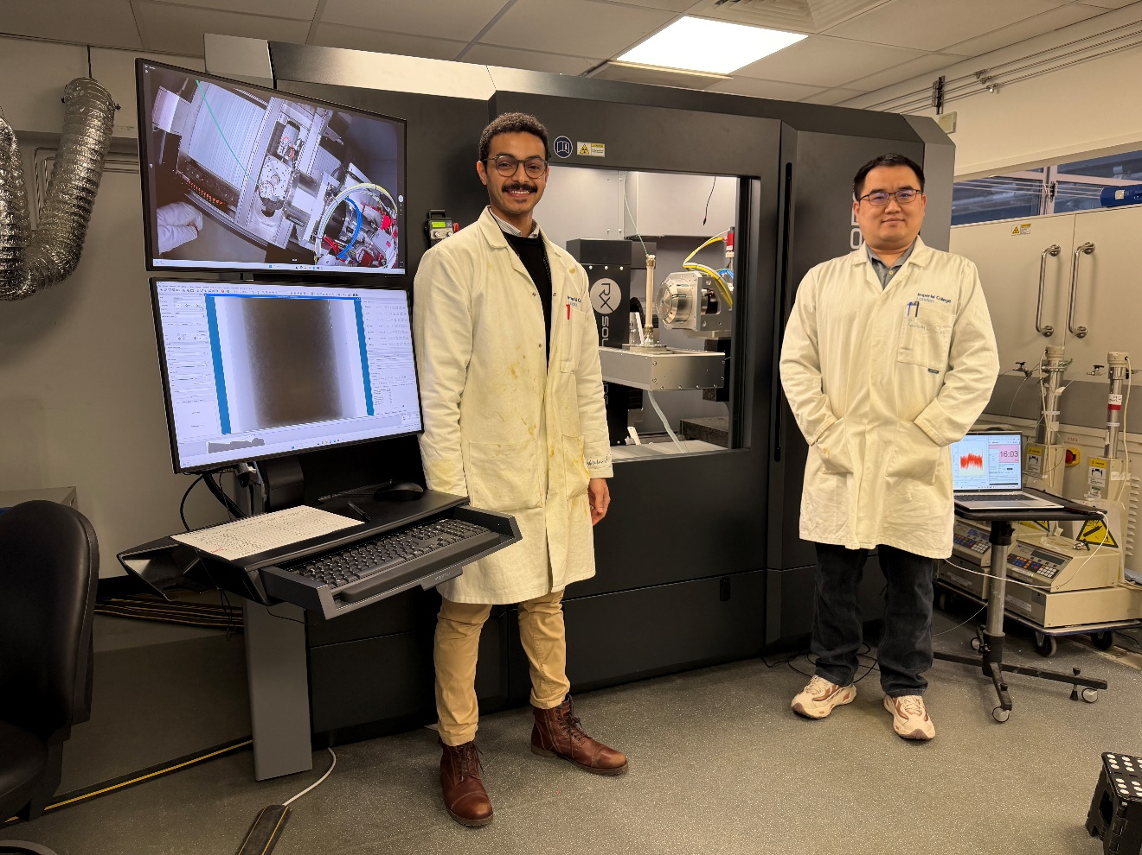
We have a new micro-CT scanner
EasyTom from RX Solutions (France): simpler internal design, easier to perform flow experiments with the same image quality but a third the price (and a tenth the maintenance costs) of our previous instruments. Funded by Imperial in recognition of the importance of our research.

Slide 7
Our vision for the future
Digital rocks – the combination of imaging, modelling, analysis and prediction – is now well established in the oil industry with growing application for carbon dioxide storage.
What’s next:
Making the link from pore-scale physics to field-scale design. Opportunities here in hydrogen storage and CCS/EOR involving three-phase flow.
Digital porous materials: using imaging, experiment and modelling to design optimal structure and wettability for manufactured materials, from electrolysers to catalysts and packed bed reactors.
Foundational machine learning models for segmentation, analysis and prediction leveraging our image repository.

Slide 8
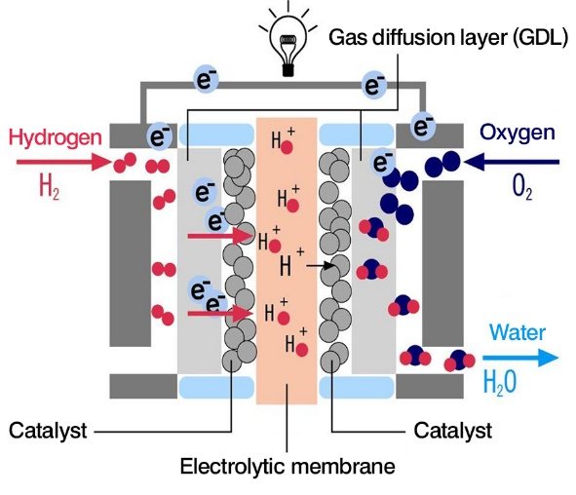

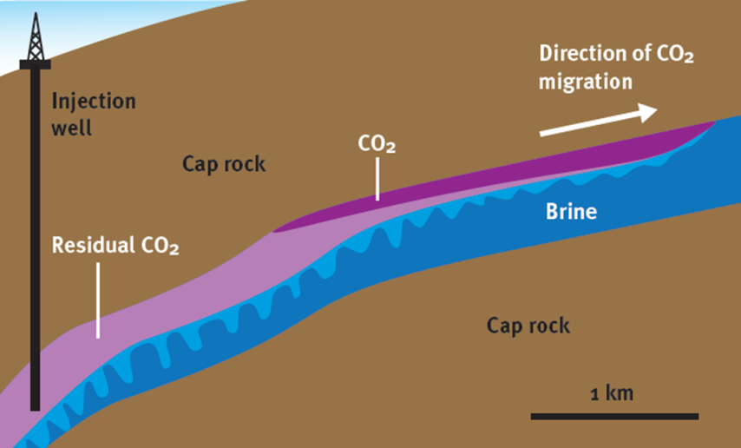
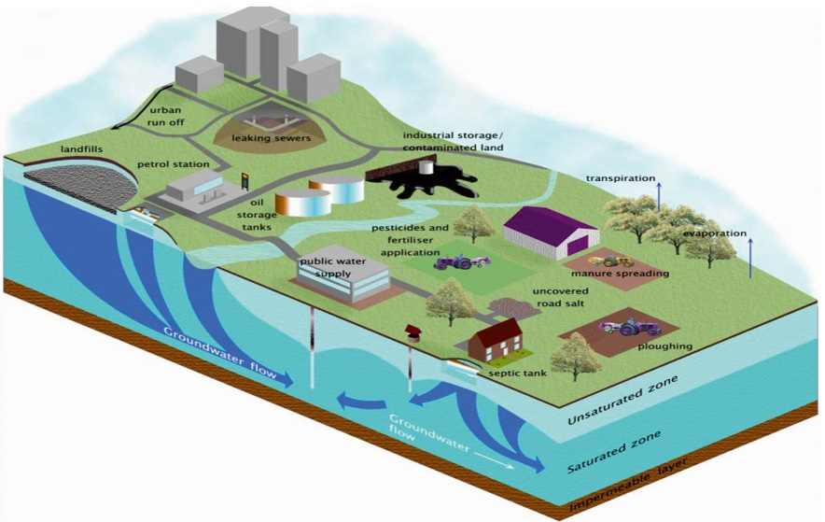
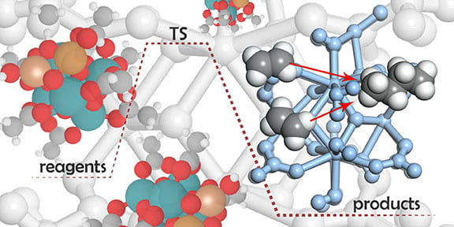
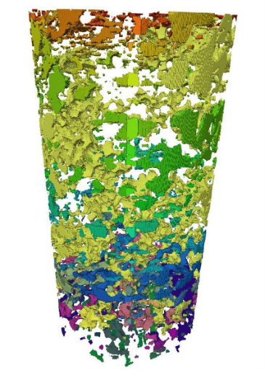
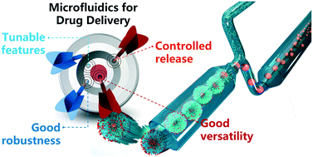
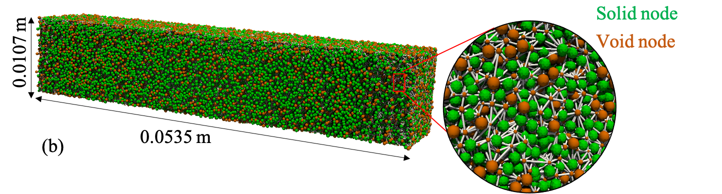
Does it matter?
Electrochemical devices
Carbon dioxide and Hydrogen Storage
http://www.euwfd.com/html/groundwater.html
Contaminant
Transport
http://energy.gov/
Heat and Mass Transport
Notes:
Industrial waste remedy
Biodegradation of landfills
Tracer studies
Miscible displacement
Capillary trapping – multi-phase flow
Development of miscibility - transport
Fluid-solid interaction - reaction

Slide 9















Many thanks

