Slide 1

Field-scale Analysis of Hydrogen Storage Incorporating Pore-scale Hysteresis Models
Ibrahim Alobaidan – PhD Student
Supervisors: Prof Martin Blunt and Dr Branko Bijeljic
14/01/2026

Slide 2
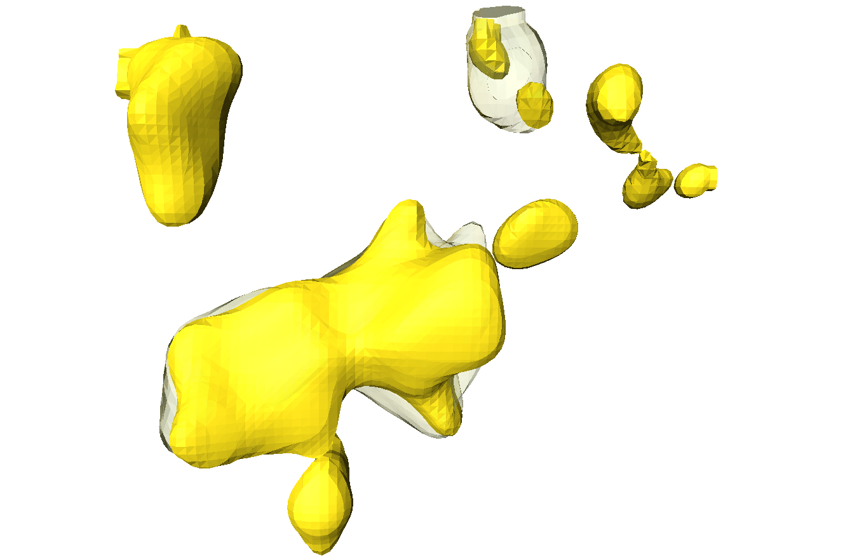
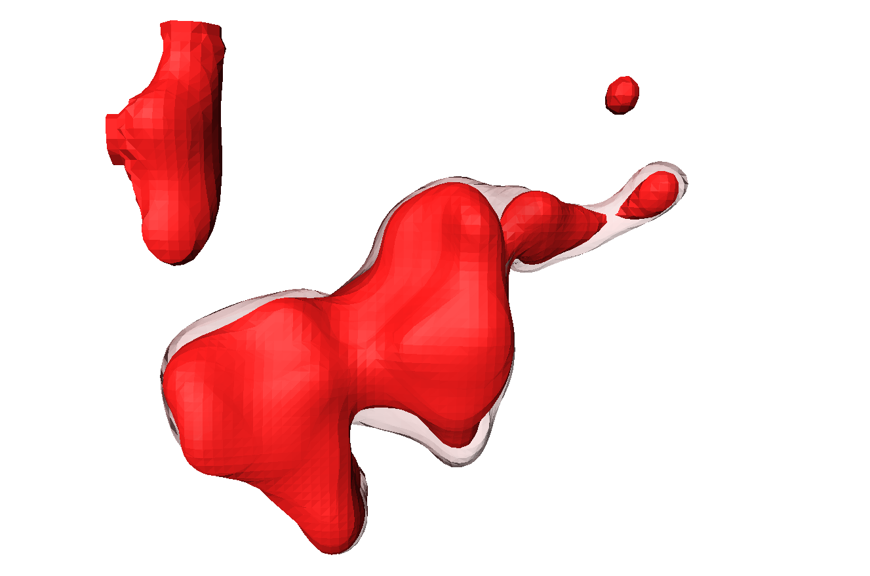
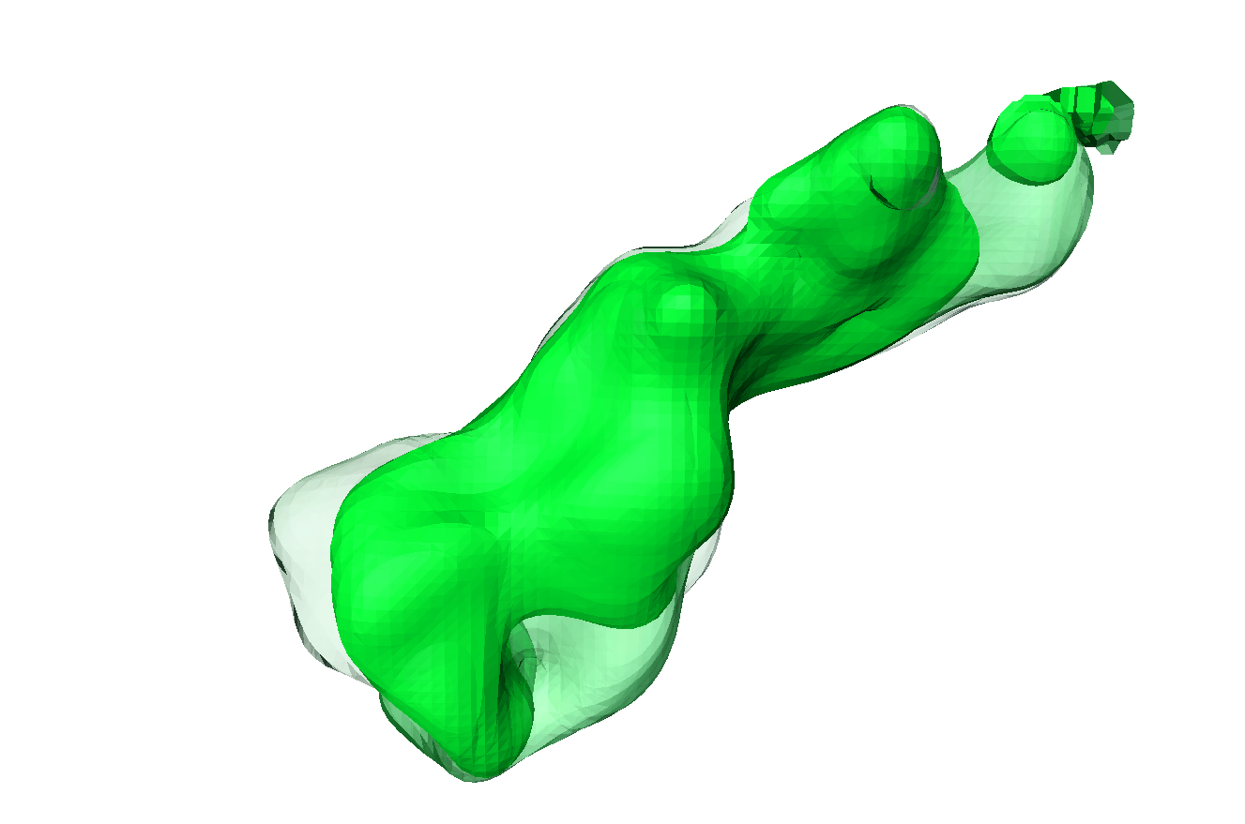
Key Insights from Pore-Scale Studies
Ostwald Ripening in different gases (AlZaabi et al., 2025)
Over time, gas redistributes within the pore space without changing overall volume, a process known as Ostwald ripening. (Goodarzi et al., 2024)
This redistribution improves connectivity and enables hydrogen withdrawal through continuous pathways. (Goodarzi et al., 2024)
Repeated drainage and imbibition cycles lower residual saturations. (Goodarzi et al., 2024)
Pressure decline, gas expansion, and exsolution can remobilize trapped hydrogen ganglia (Dokhon et al., 2024).
Ignoring gas remobilisation effects leads to an overestimation of trapping by 20–25% (Adebimpe et al., 2024).
Traditional trapping and hysteresis models do not capture the trends observed in pore-scale measurements. (Goodarzi et al., 2024)
 | N₂
 | N₂ after 24 h
 | CO₂
 | CO₂ after 24 h
 | H₂
 | H₂ after 24 h
 | H₂ after 48 h
100 µm
N₂
Euler Number
100 µm
Image | Normalized (1/mm³)
N₂ | 201
N₂ after 24 h | 89
CO₂ | 12
CO₂ after 24 h | 4
H₂ | 4
H₂ after 24 h | 3
H₂ after 48 h | 0
CO₂
100 µm
H₂
* Low Euler number implies better connected phases

Slide 3
Research Objective
Incorporating pore-scale data from in-house experiments and modelling outputs into field-scale simulations to:
Investigate recovery mechanisms in underground hydrogen storage (UHS) under various simulation scenarios.
Evaluate the applicability of traditional relative permeability trapping and hysteresis models for UHS.
Implement a flexible hysteresis module into research reservoir simulators (OPM Flow and QASR) to account for pore-scale processes associated with UHS.
Study the effects of gas remobilisation due to pressure-driven hydrogen expansion and Ostwald ripening on recovery.

Slide 4
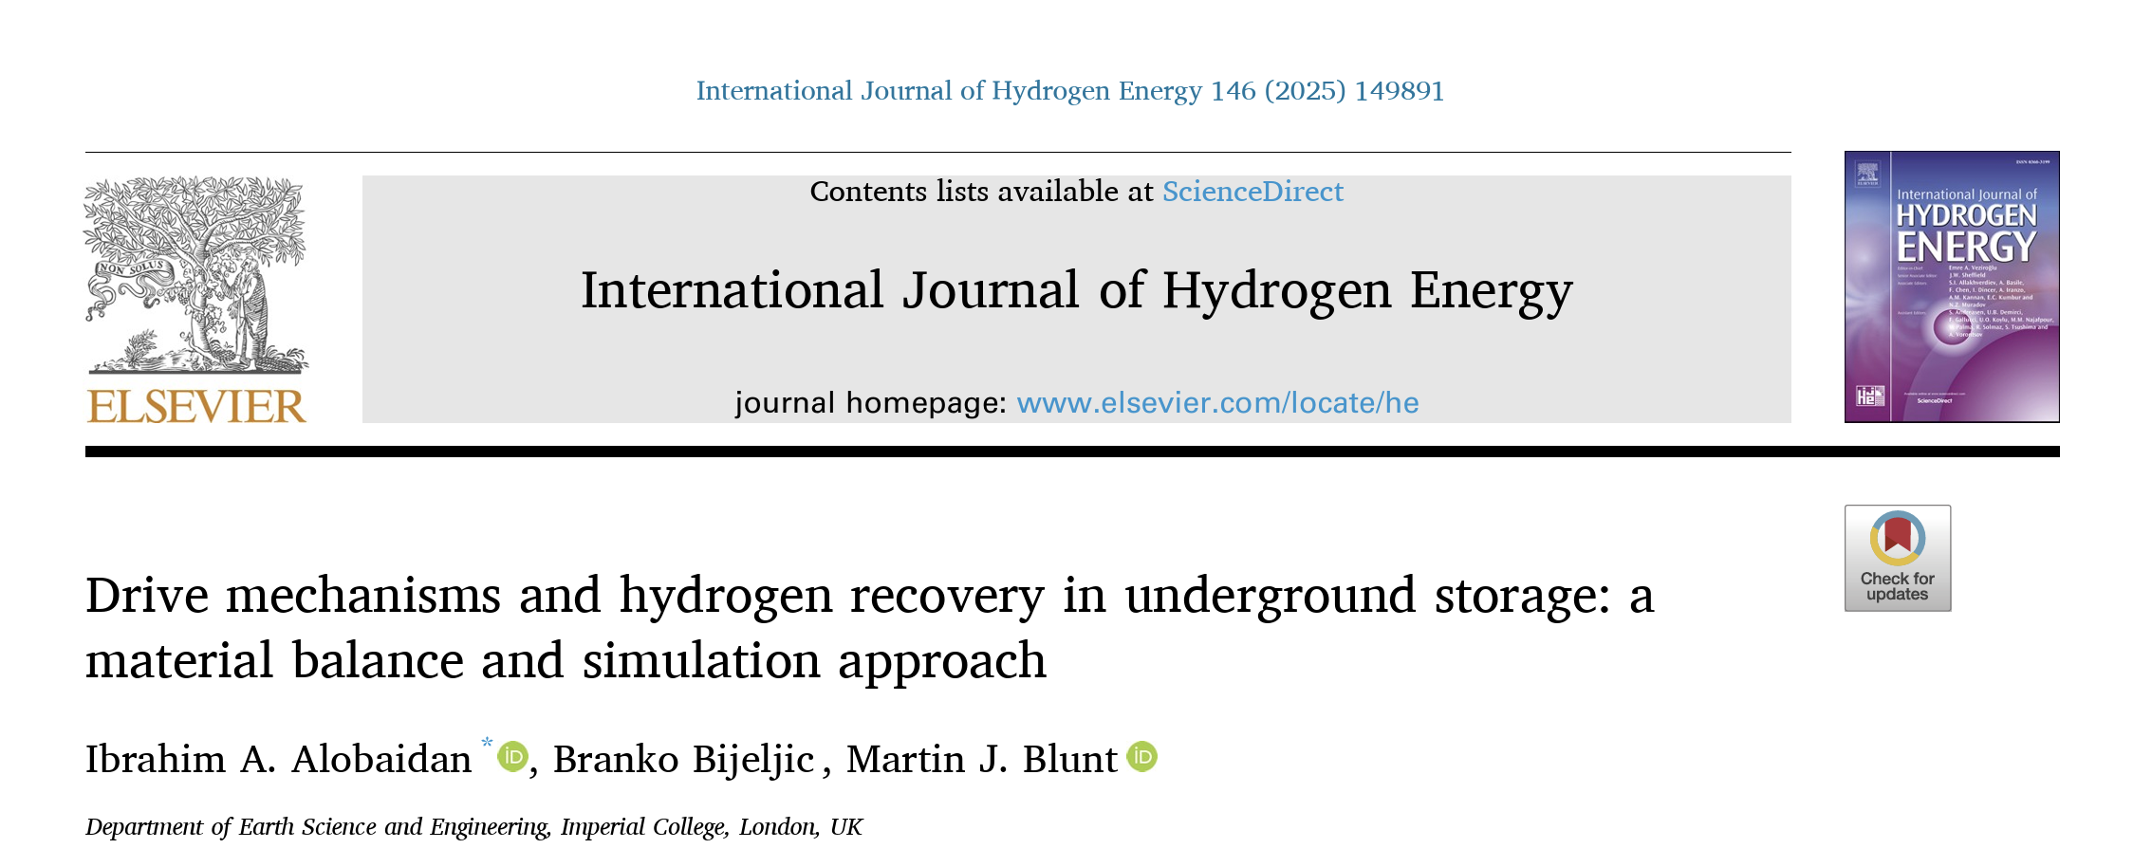

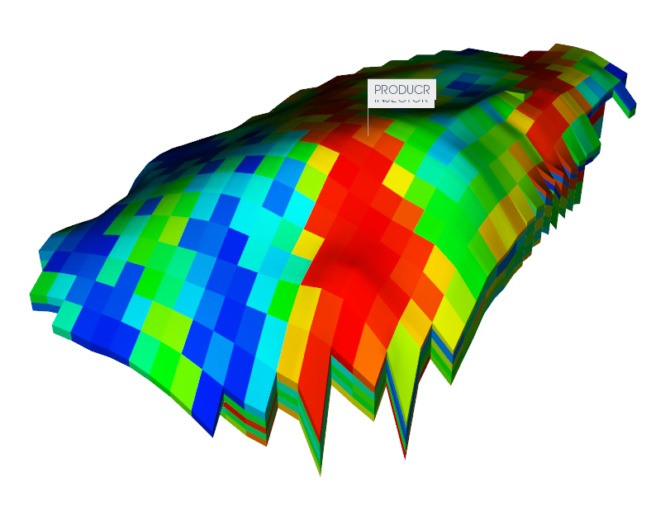
Pore-to-field Scale Research Workflow
PART 1
Scan to view full paper
Input data
- 3D geological structure
- Porosity, ϕ
- Permeability, k
- Phase behavior data
- Relative permeability, k_{r}
- Capillary pressure, P_{c}
- Gas saturation, S_{g}
Reservoir Simulator
(CMG)
Sensitivity Analysis
Traditional modelling approach
Validation
PART 2
Field-scale
analysis
Benchmarking
Research Simulators
(OPM Flow & QASR)
Implementing the Spiteri model
Flexible hysteresis module
Wettability
Effects
(OPM Hysteresis library)
PART 3
Pore-Scale Imaging and Measurements
Pore-scale modelling
Include gas remobilization
Hydrogen expansion
Ostwald Ripening
Calibration of Spiteri parameters
𝛼, 𝛽, 𝛾
^ OPM Flow is an open-source reservoir simulator, developed under the Open Porous Media project (OPM)
^ QASR is a reservoir simulator developed by Dr Ahmad Abushaikha – former PhD student in our research group, now at Hamad Bin Khalifa University, Qatar

Slide 5
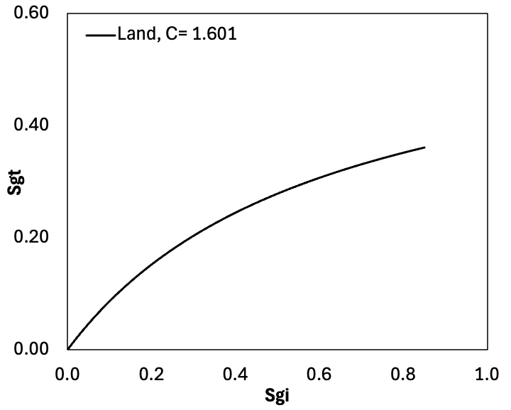
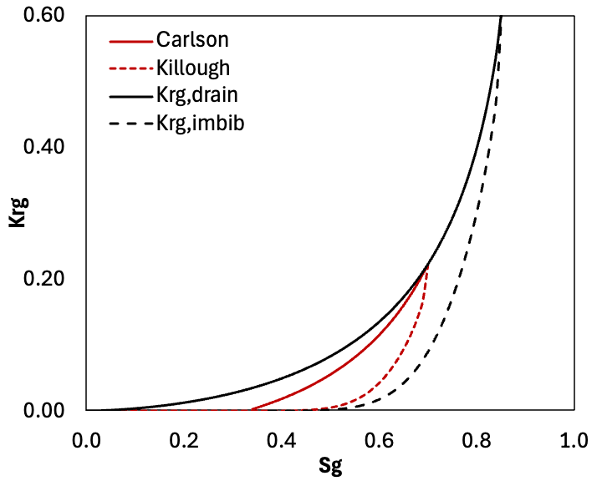
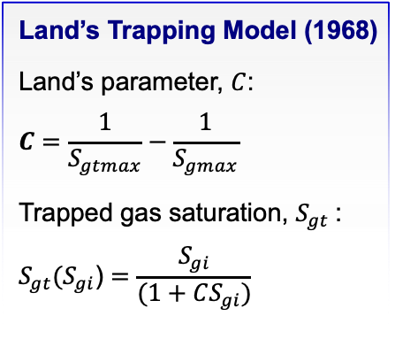




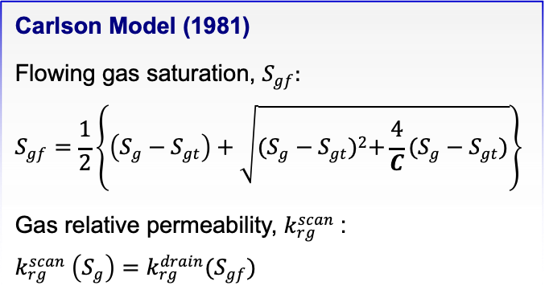


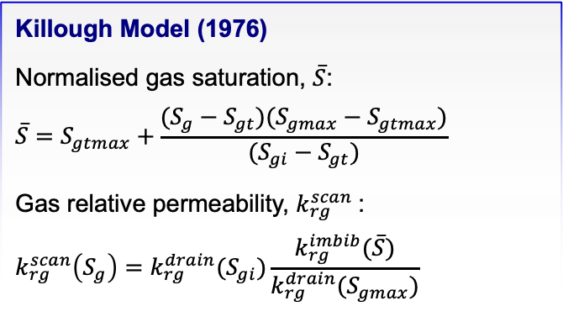

Traditional Trapping & Hysteresis Models
Land’s Trapping Model (1968)
Land’s parameter, $C$:
$$C=\frac{1}{S_{gtmax}}−\frac{1}{S_{gmax}}$$
Trapped gas saturation, $S_{gt}$:
$$S_{gt}(S_{gi}\text{)}=\frac{S_{gi}}{(1+CS_{gi})}$$
Killough Model (1976)
Normalised gas saturation, $\overline{S}$:
$$\overline{S}=S_{gtmax}+\frac{(S_{g}−S_{gt})(S_{gmax}−S_{gtmax})}{(S_{gi}−S_{gt})}$$
Gas relative permeability, $k_{rg}^{scan}$:
$$k_{rg}^{scan}\left(S_{g}\right)=k_{rg}^{drain}(S_{gi})\frac{k_{rg}^{imbib}(\overline{S})}{k_{rg}^{drain}(S_{gmax})}$$
Carlson Model (1981)
Flowing gas saturation, $S_{gf}:$
$$S_{gf}=\frac{1}{2}\left\{\left(S_{g}−S_{gt}\right)+\sqrt{{(S_{g}−S_{gt})}^{2}+\frac{4}{C}(S_{g}−S_{gt})}\right\}$$
Gas relative permeability, $k_{rg}^{scan}$:
$$k_{rg}^{scan} \left(S_{g}\right)=k_{rg}^{drain}(S_{gf})$$
$$S_{gmax}$$
+
Advantages
Standard in most reservoir simulators
Require minimal pore-scale input data
Historically validated and widely used
Limitations
Reliable mainly for strongly water-wet rocks
Cannot capture wettability variation or key pore-scale trapping mechanisms
$$k_{rg}^{drain}$$
$$k_{rg}^{imbib}$$
$$S_{gi}$$
-
$$k_{rg}^{scan}$$
$S_{gt}(S_{gi}$)
$$S_{gtmax}$$

Slide 6
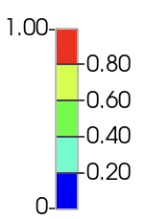

Reservoir Cross-Sectional Comparison of Gas Saturation
No hysteresis
Sg
Carlson hysteresis
Killough hysteresis

Slide 7
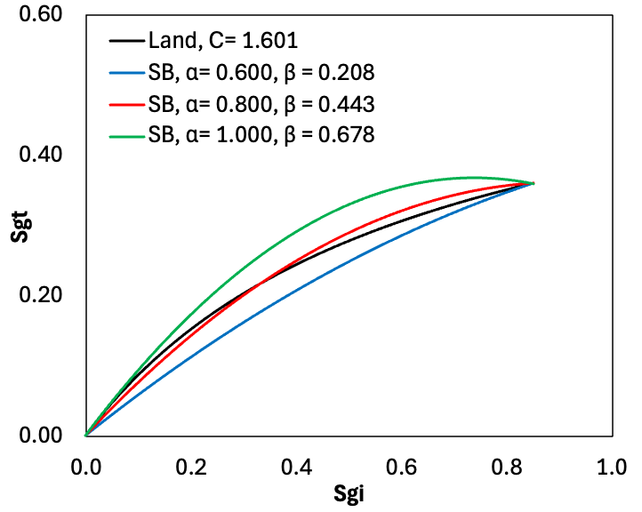
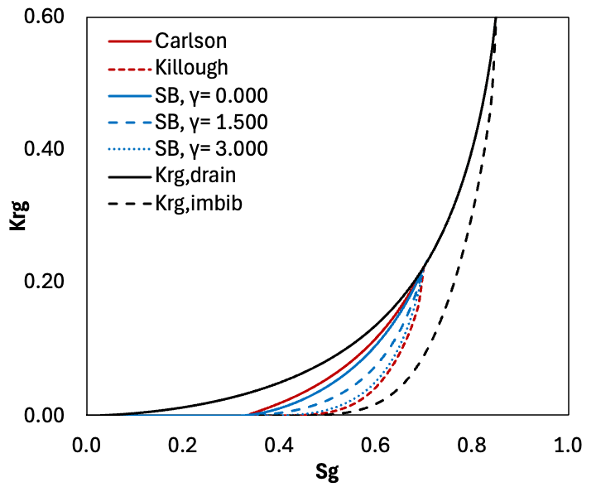


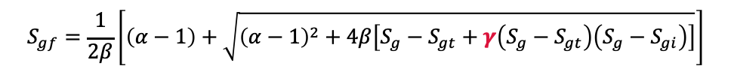
Flexible Trapping & Hysteresis Models
Spiteri et al. Model (2005)
Trapped gas saturation, $S_{gt}$:
$$S_{gt}=αS_{gi}−βS_{gi}^{2}$$
$$0≤α≤1, β≥0$$
$α$ : slope of the initial residual curve
$β$ : curvature of the initial residual curve
$γ$ : flow parameter, dependent on rock type and wettability
Flowing gas saturation, $S_{gf}:$
Gas relative permeability, $k_{rg}^{scan}$:
$$k_{rg}^{scan}\left(S_{gf}\right)=k_{rg}^{drain}\left(S_{gf}\right)$$
$$S_{gf}=\frac{1}{2β}\left[\left(α−1\right)+\sqrt{{\left(α−1\right)}^{2}+4β\left[S_{g}−S_{gt}+γ\left(S_{g}−S_{gt}\right)\left(S_{g}−S_{gi}\right)\right]}\right]$$
+
Advantages
Captures wettability variation
Flexible to incorporate other pore-scale trapping mechanisms
Limitations
Requires extensive calibration data
Never implemented in reservoir simulators
Highly non-linear and computationally demanding
-

Slide 8
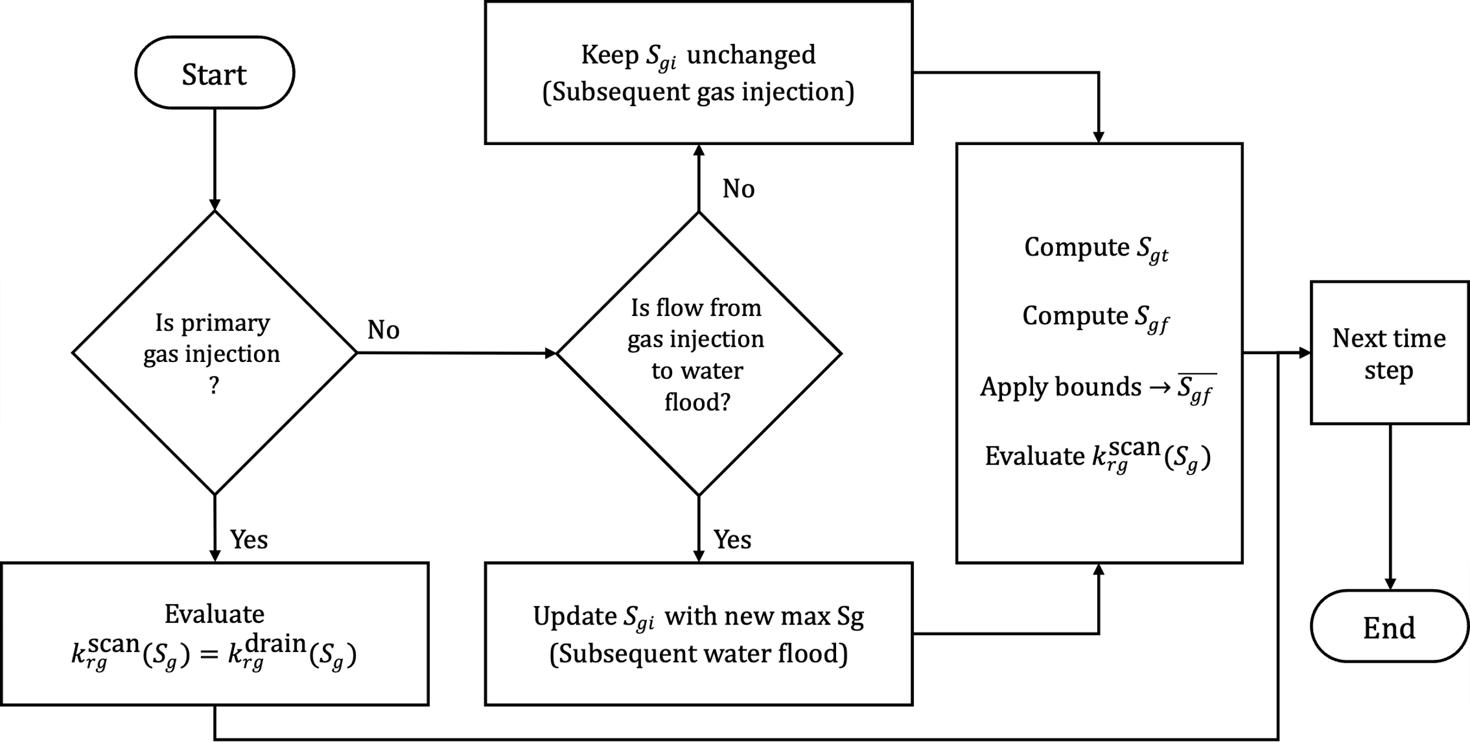
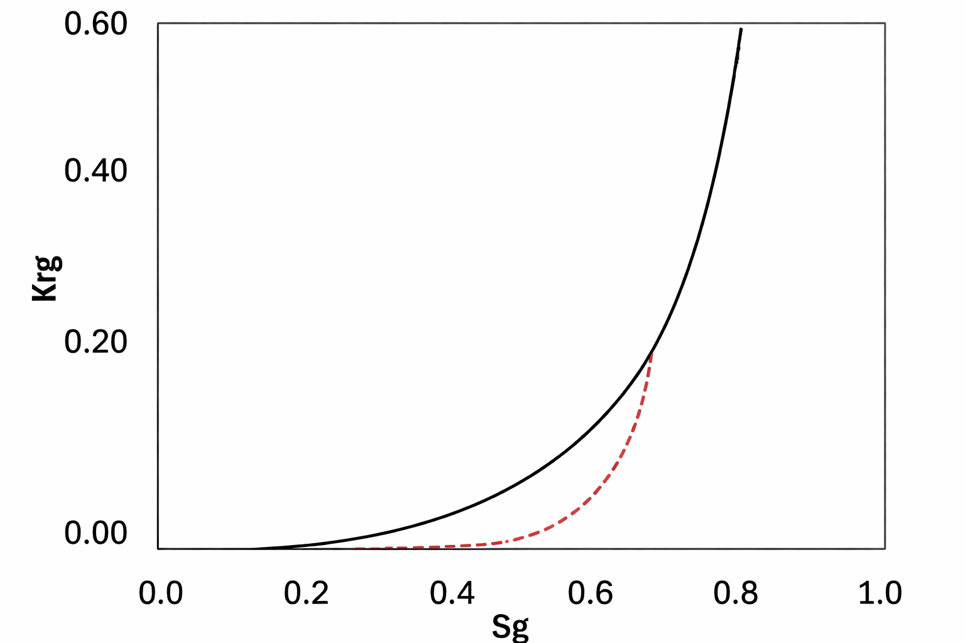
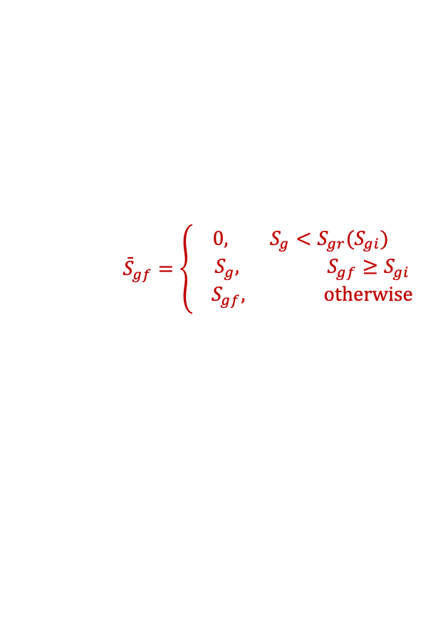
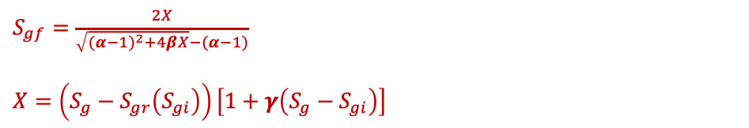

Implementing the Spiteri Model into OPM Flow Reservoir Simulator
Spiteri et al. Model (2005)
Trapped gas saturation, $S_{gt}$:
$$S_{gt}=αS_{gi}−βS_{gi}^{2}$$
$$0≤α≤1, β≥0$$
$α$ : slope of the initial residual curve
$β$ : curvature of the initial residual curve
$γ$ : flow parameter, dependent on rock type and wettability
Flowing gas saturation, $S_{gf}:$ (numerically stable form for simulators)
Gas relative permeability, $k_{rg}^{scan}$:
$$k_{rg}^{scan}\left(S_{gf}\right)=k_{rg}^{drain}\left({\overset{ˉ}{S}}_{gf}\right)$$
$S_{gf}=\frac{2X}{\sqrt{(α−1)^{2}+4βX}−(α−1)}$
$$X=\left(S_{g}−S_{gr}\left(S_{gi}\right)\right)\left[1+γ\left(S_{g}−S_{gi}\right)\right]$$
$${\overset{ˉ}{S}}_{gf}=\left\{\begin{aligned}0, S_{g}<S_{gr}(S_{gi}) \\ { S}_{g}, S_{gf}≥S_{gi} \\ S_{gf}, \text{otherwise}\end{aligned}\right.$$
3
2
1
2
1
3

Slide 9
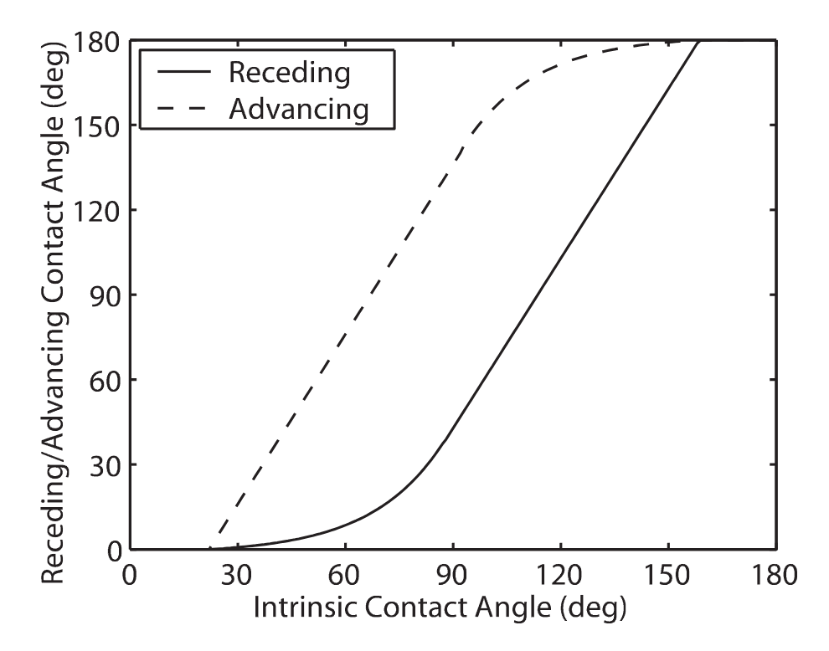
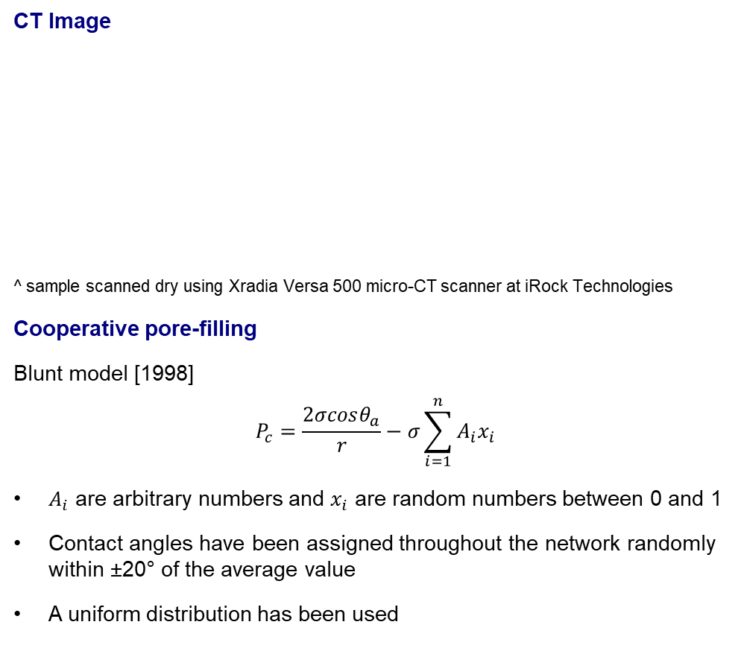
Pore-Scale Modelling for Trapping and Relative Permeability
CT Image
^ sample scanned dry using Xradia Versa 500 micro-CT scanner at iRock Technologies
Cooperative pore-filling
Blunt model [1998]
$$P_{c}=\frac{2σcosθ_{a}}{r}−σ\sum_{i=1}^{n}{A_{i}x_{i}}$$
$A_{i}$ are arbitrary numbers and $x_{i}$ are random numbers between 0 and 1
Contact angles have been assigned throughout the network randomly within ±20° of the average value
A uniform distribution has been used
Rock type | Berea Sandstone
Voxel Dimensions | 1024 × 1024 × 1024
Voxel Size | 2.7745 μm
Physical Size | ~2.84 mm × 2.84 mm × 2.84 mm
Voxel Count | 1,073,741,824 (1.07B)
Porosity | 20.18%
Permeability | 985.17 mD
Relationship between receding and advancing contact angles on a rough surface, as a function of intrinsic contact angle measured at rest on a smooth surface (Morrow 1975).

Slide 10
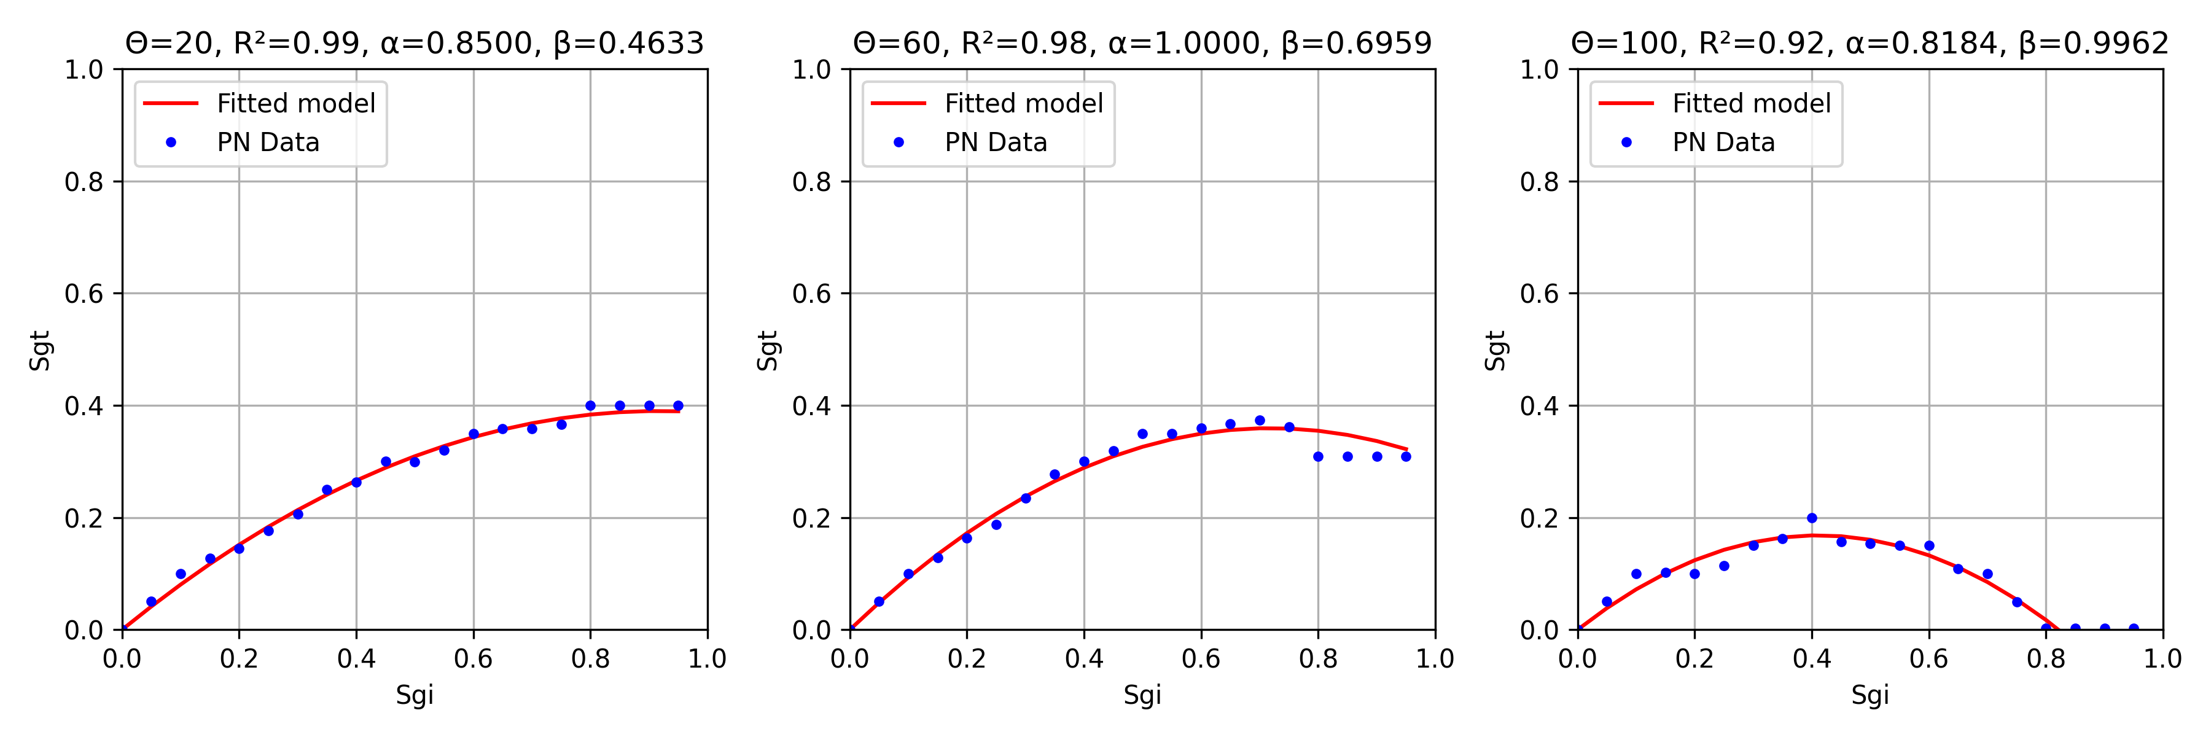
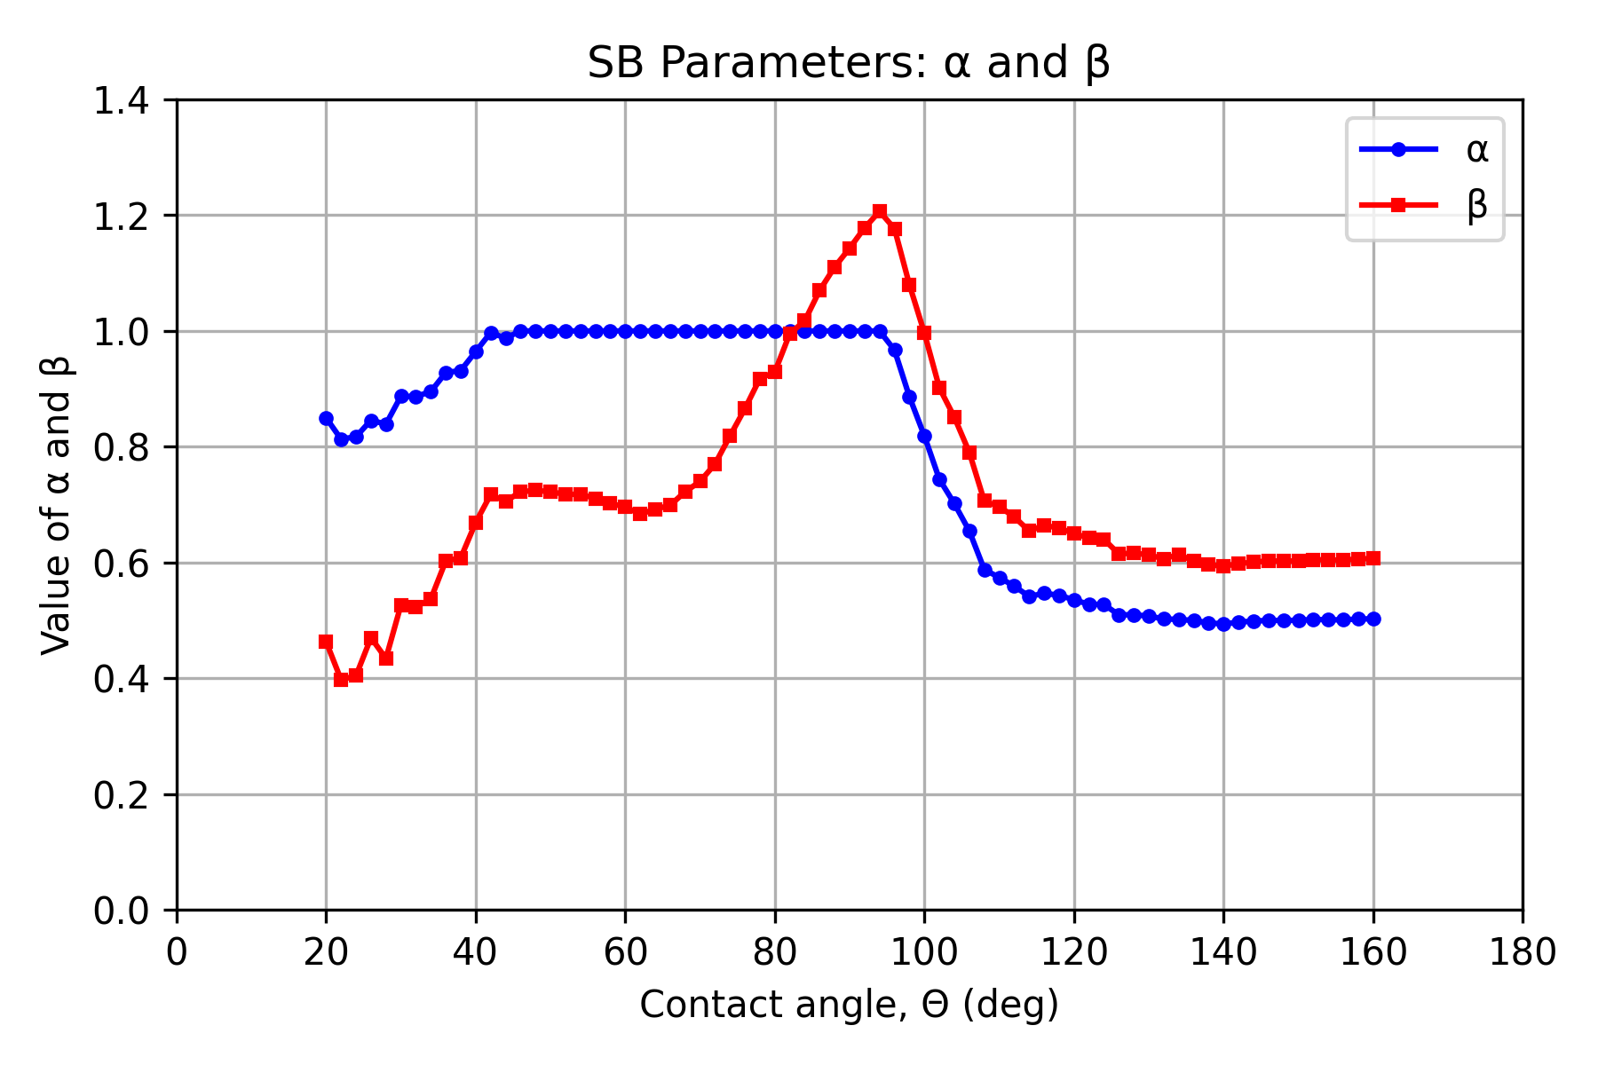
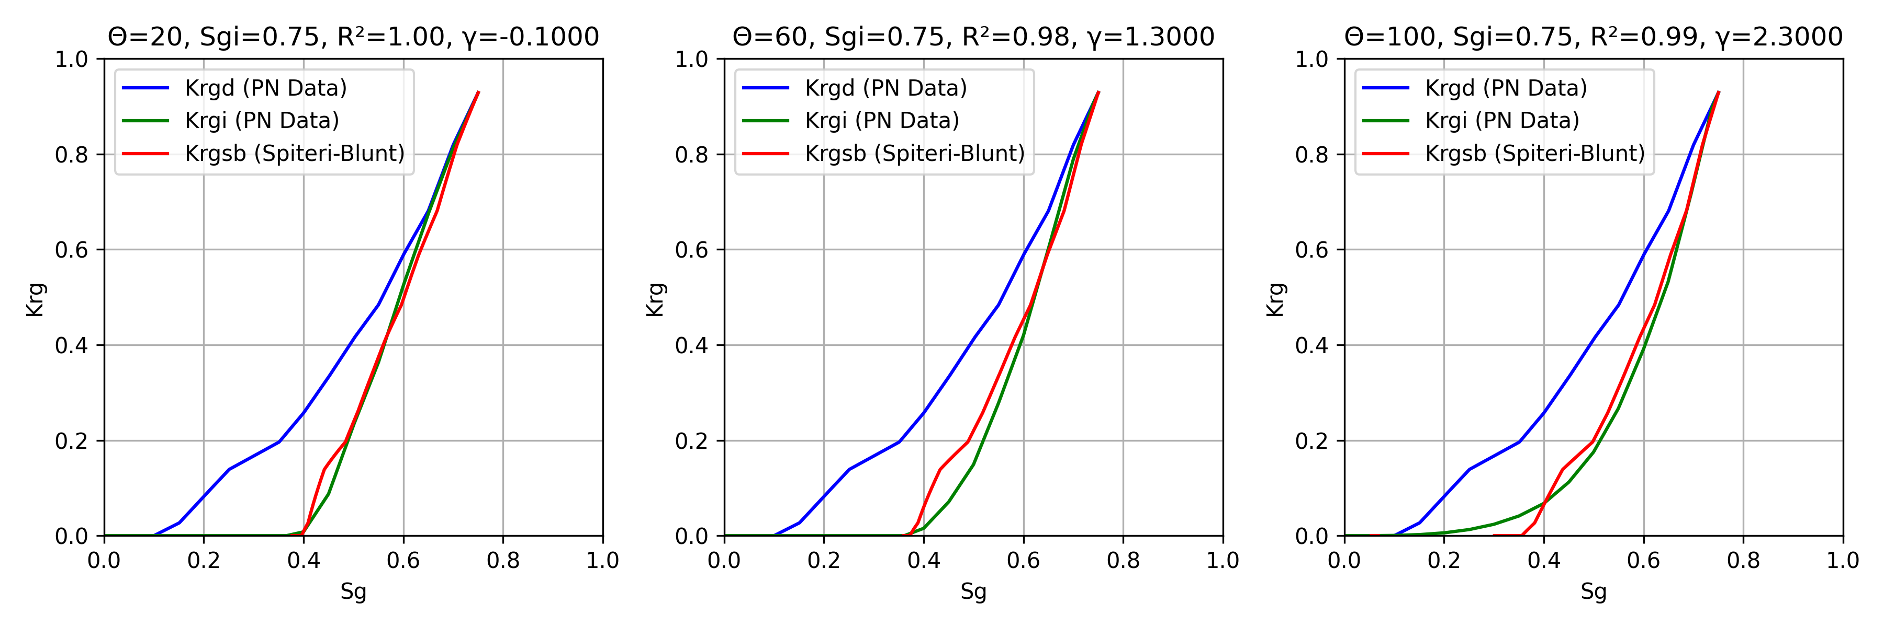
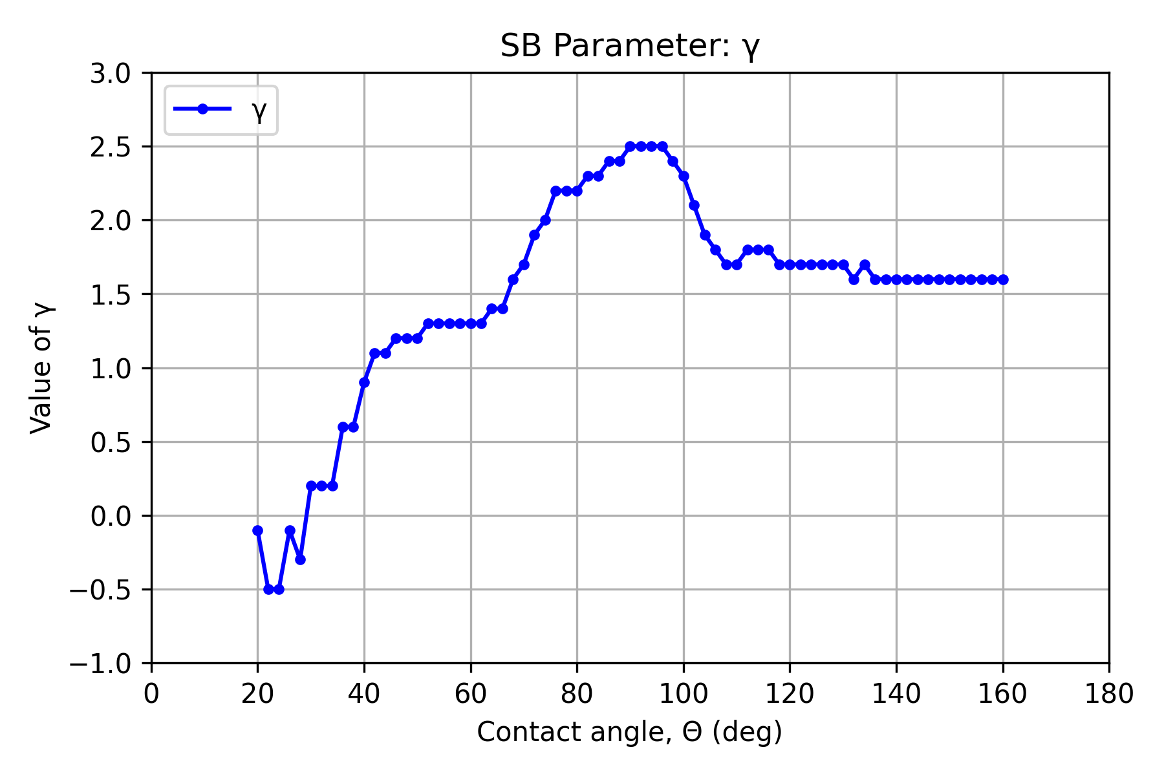

Calibration of Spiteri Parameters: 𝛼, 𝛽 & 𝛾
$$S_{gt}=αS_{gi}−βS_{gi}^{2}$$
Strongly Water-Wet
Mixed-Wet

Slide 11
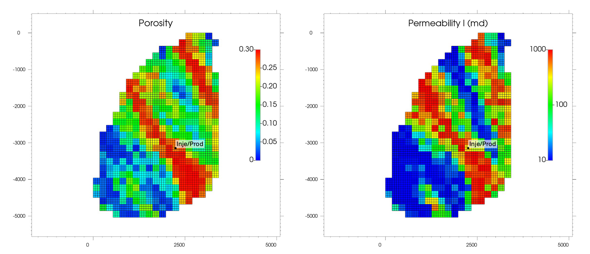
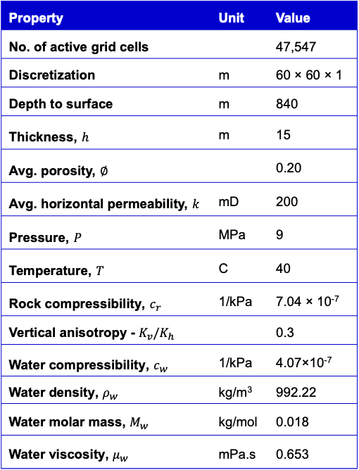
Numerical Simulation
2D porosity and permeability maps of the aquifer model
Simulation settings
Simulator | ​OPM Flow
Flow model | ​Black-oil
Flow regime | ​Gas-water
Hysteresis | Modified OPM hysteresis library​
Aquifer model parameters
Property​ | Unit​ | Value
No. of active grid cells​ | ​ | 47,547
Discretization​ | m​ | 60 × 60 × 1 ​
Depth to surface​ | m​ | 840​
Thickness​, $h$ | m​ | 15​
Avg. porosity, $∅$ |  | 0.20
Avg. horizontal permeability, $k$ | mD | 200
Pressure​, $P$ | MPa​ | 9​
Temperature​, $T$ | C​ | 40​
Rock compressibility​, $c_{r}$ | 1/kPa​ | 7.04 × 10⁻⁷​
Vertical anisotropy - $K_{v}/K_{h} ​$ | ​ | 0.3​
Water compressibility​, $c_{w}$ | 1/kPa​ | 4.07×10⁻⁷ ​
Water density​, $ρ_{w}$ | kg/m³​ | 992.22​
Water molar mass, $M_{w}$ | kg/mol | 0.018
Water viscosity​, $μ_{w}$ | mPa.s | 0.653​
Operational parameters
Summary of simulation scenarios
Parameter | Unit​ | Value
Working gas (WG)​ | ​ | H_{2​}
Injection & Production rate​ | sm³/day​ | 200,000​
Production well diameter​ | m​ | 0.1524​
Min bottom-hole pressure​ | MPa​ | 5​
Max bottom-hole pressure​ | MPa​ | 16
Inje/prod period per cycle​ | Months​ | 6 ​
 | No Hysteresis | Killough |  | Carlson |  | Spiteri
Case ID | A | B1 | B2 | C1 | C2 | D1 | D2
Wettability (°) | — | 20 | 100 | 20 | 100 | 20 | 100
C | — | 1.4016 | 18.6763 | 1.4016 | 18.6763 | — | —
α | — | — | — | — | — | 0.8500 | 0.8184
β | — | — | — | — | — | 0.4633 | 0.9962
λ | — | — | — | — | — | -0.1000 | 2.30

Slide 12
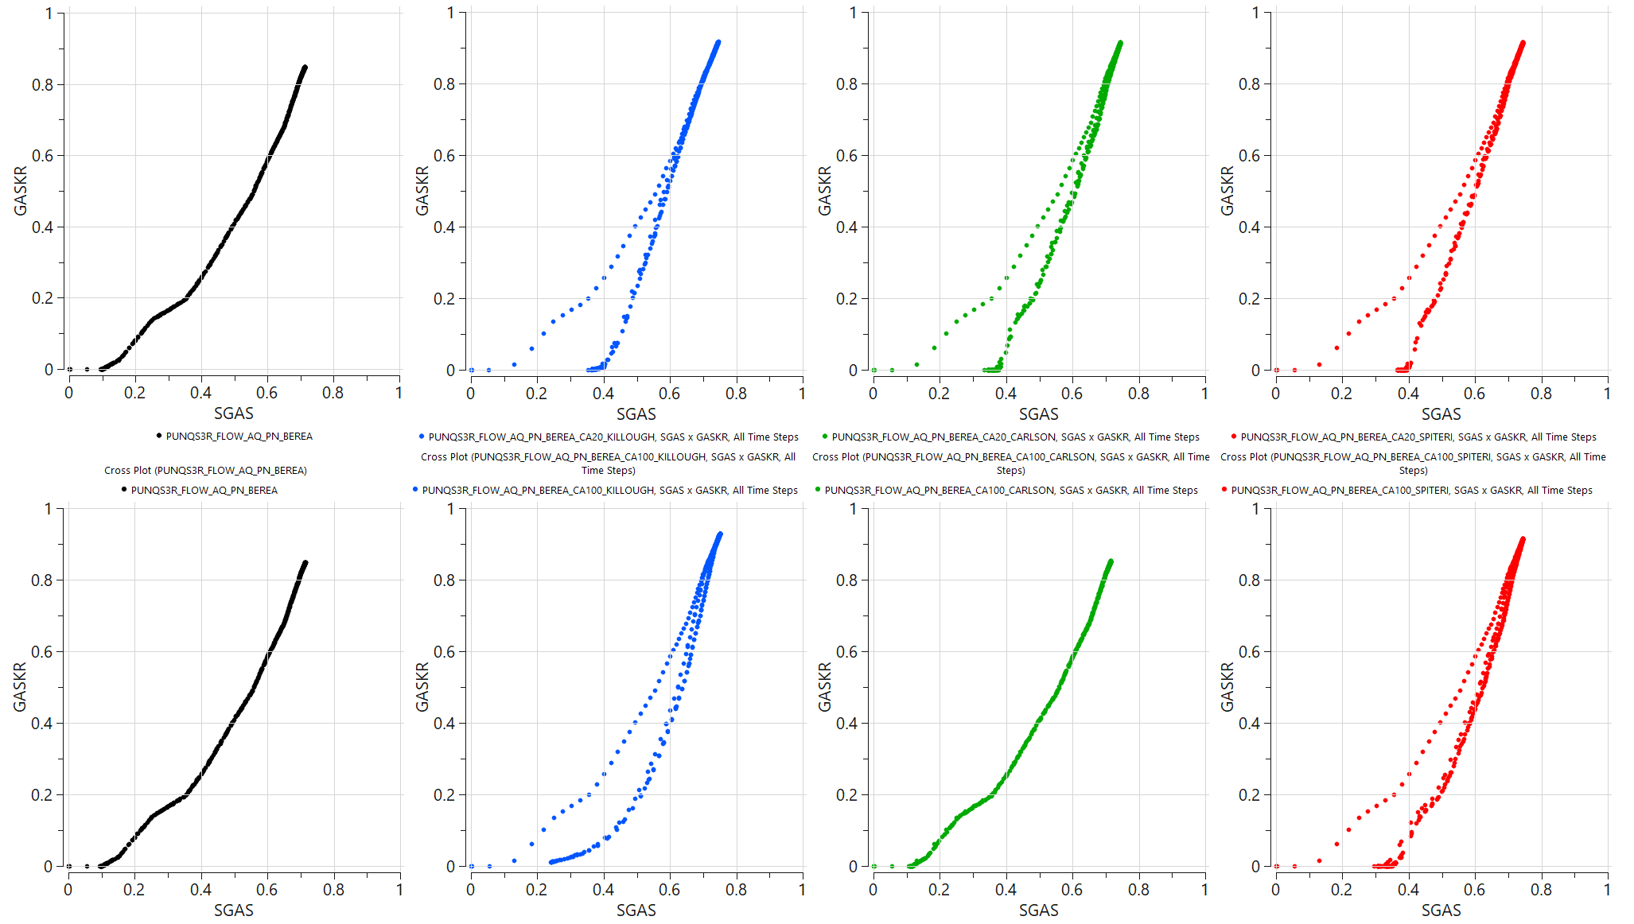
Krg vs Sg: Location 1 - Cell (32, 53, 1)
● NO HYSTERESIS | ● KILLOUGH | ● CARLSON | ● SPITERI
Water
wet
Mixed
wet

Slide 13
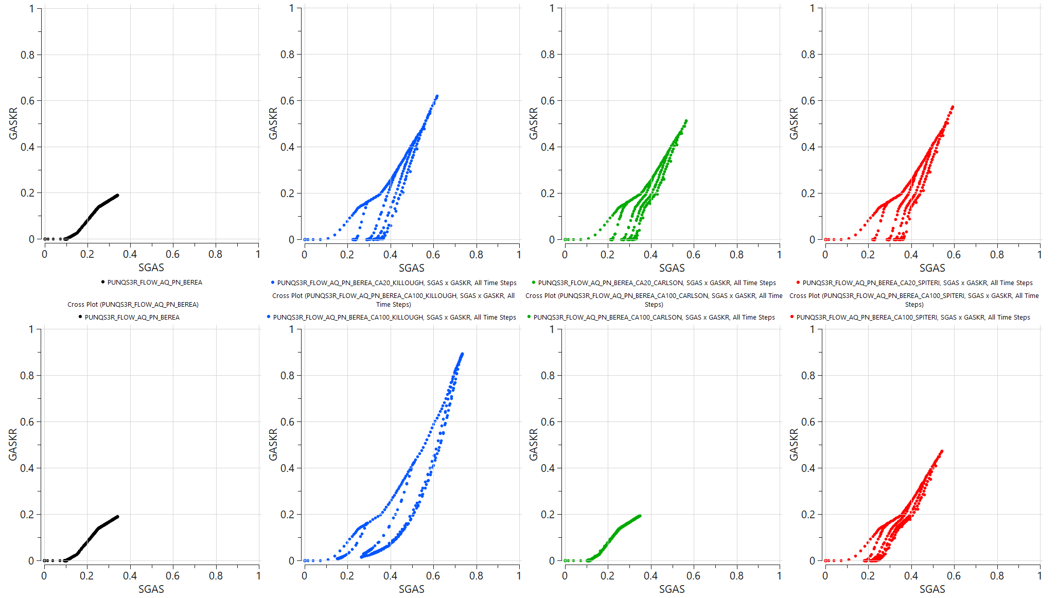
Krg vs Sg: Location 2 - Cell (45, 65, 1)
● NO HYSTERESIS | ● KILLOUGH | ● CARLSON | ● SPITERI
Water
wet
Mixed
wet

Slide 14
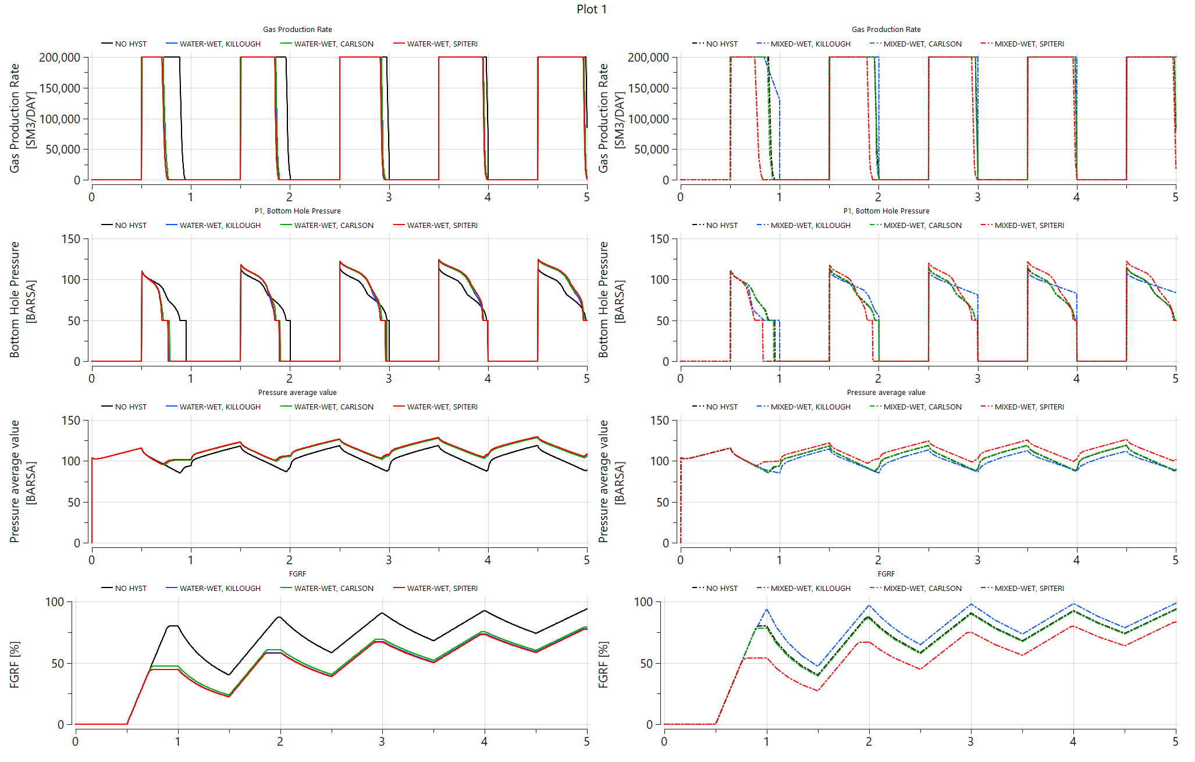
Effect of Hysteresis and Wettability on Rate, Pressure & H₂ Recovery
Water
wet
Mixed
wet

Slide 15
Conclusion and Future Work
Under strongly water-wet conditions, all hysteresis models produced comparable recovery and pressure responses.
Under mixed-wet conditions, Carlson and Killough models systematically overestimated gas recovery.
Adjusting Land’s trapping parameter is insufficient to capture non-monotonic pore-scale trapping.
Apply the proposed pore-to-field scale modelling approach to in-house sandstone and carbonate samples
Validate the approach against multiphase flow characteristics measured under displacement and during both pressure increase and decline.
Apply the new proposed approach to address conditions beyond traditional oilfield flow measurements, explicitly accounting for gas remobilisation driven by hydrogen expansion and Ostwald ripening

Slide 16
References
Alobaidan, I. A., Bijeljic, B., & Blunt, M. J. (2025). Drive mechanisms and hydrogen recovery in underground storage. Int. J. Hydrogen Energy, 146, 149891. https://doi.org/10.1016/j.ijhydene.2025.06.081
Goodarzi, S., Zhang, Y., Foroughi, S., Bijeljic, B., & Blunt, M. J. (2024). Trapping, hysteresis and Ostwald ripening in hydrogen storage. Int. J. Hydrogen Energy, 56(2), 1139–1151. https://doi.org/10.1016/j.ijhydene.2023.12.029
Dokhon, W., Goodarzi, S., Alzahrani, H. M., Blunt, M. J., & Bijeljic, B. (2024). Pressure decline and gas expansion in underground H₂ storage. Int. J. Hydrogen Energy, 86, 261–274. https://doi.org/10.1016/j.ijhydene.2024.08.139
AlZaabi, A., Alzahrani, H. M., Alhosani, A., Bijeljic, B., & Blunt, M. J. (2025). Wettability, pore occupancy and Ostwald ripening in N₂, CO₂ and H₂. Int. J. Hydrogen Energy, 135(1), 596–608. https://doi.org/10.1016/j.ijhydene.2025.04.399
Adebimpe, A. I., Foroughi, S., Bijeljic, B., & Blunt, M. J. (2024). Percolation without trapping: Ostwald ripening in porous media. Phys. Rev. E, 110(3), 035105. https://doi.org/10.1103/PhysRevE.110.035105

Slide 17
Acknowledgements
Supervisors
Prof Martin Blunt
Dr Branko Bijeljic
External Collaborator
Dr Ahmad Abushaikha
Funding
Saudi Aramco
Pore-scale Imaging and Modelling
Dr Sajjad Foroughi
Dr Sepideh Goodarzi
Abdulaziz Alsaleh
Ademola Adebimpe
Ahmad AlZaabi
Waleed Dokhon

Slide 18
Thank you

