Slide 1

Comparative Study of Carbon Dioxide and Hydrogen Relative Permeability, Pore Occupancy, Connectivity and Ostwald Ripening in Carbonate Rocks
Presenter: Ahmed AlZaabi
Supervisors: Prof. Martin J. Blunt & Dr. Branko Bijeljic
14/01/2026

Slide 2
Agenda
Previous Study
Research Objectives
Research method
Results and Discussion
Relative Permeability
Pore Occupancy
Connectivity
Ostwald Ripening
Conclusions
Future work

Slide 3
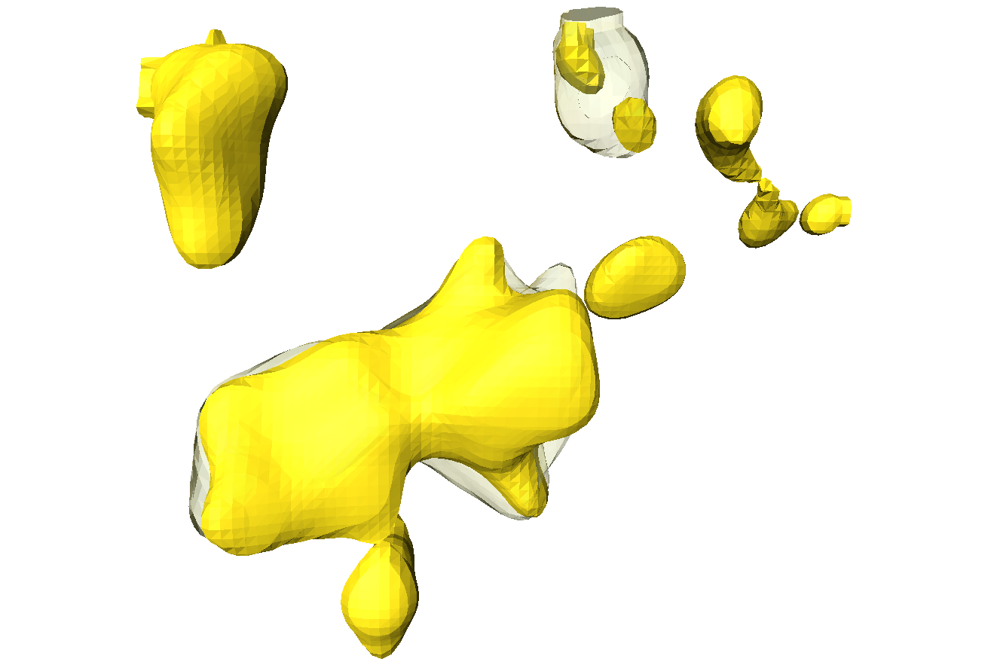
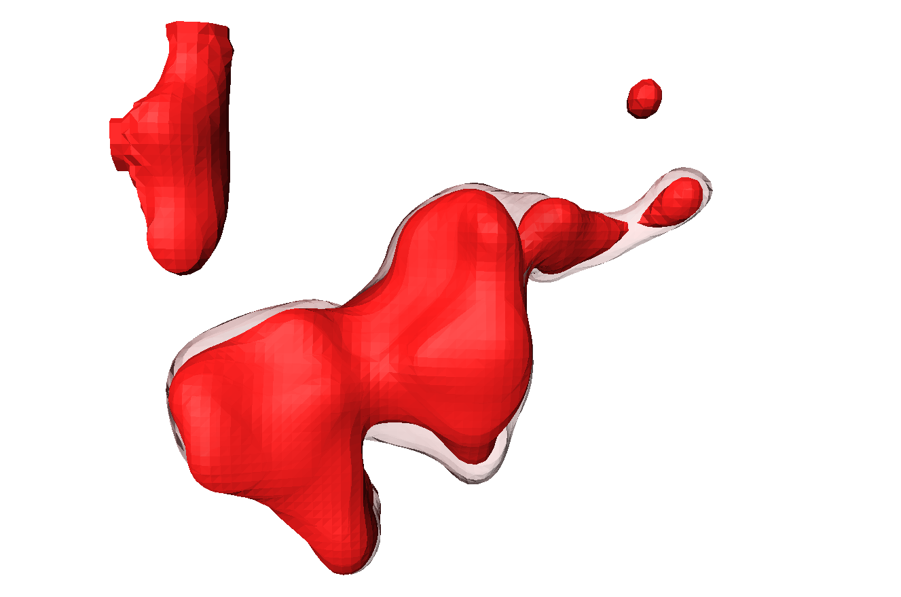
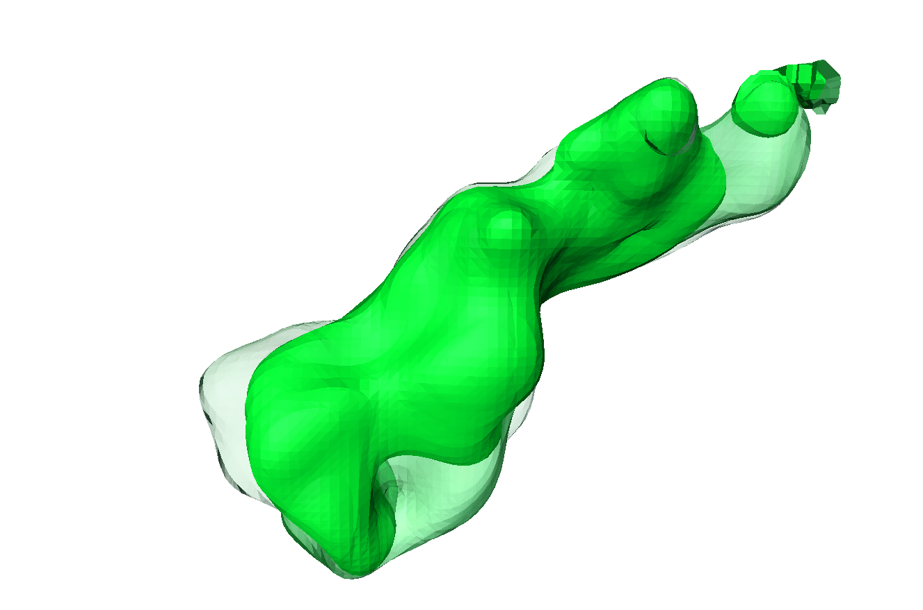

Previous Study
Ostwald Ripening differences between gases
Gas ganglia increase in size with time.
The gas ganglia are more connected with time.
 | N₂
 | N₂ after 24 h
 | CO₂
 | CO₂ after 24 h
 | H₂
 | H₂ after 24 h
 | H₂ after 48 h
100 µm
100 µm
100 µm
N₂
CO₂
H₂
AlZaabi, A., Alzahrani, H. M., Alhosani, A., Bijeljic, B., & Blunt, M. J. (2025). Wettability, pore occupancy, connectivity and Ostwald ripening of nitrogen, carbon dioxide, and hydrogen in carbonate rocks: A comparative study. International Journal of Hydrogen Energy, 135, 596-608.

Slide 4
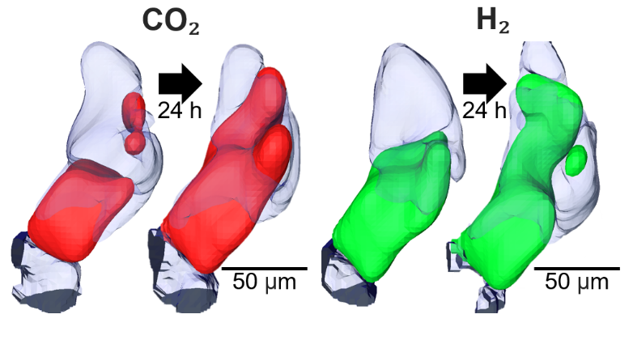
Research Objectives
The configuration of hydrogen within the pore space has not been extensively investigated for storage applications.
Carbon dioxide in a super-critical state, have been more studied: this work provides a direct comparison of its behavior with hydrogen.
The rock sample is a reservoir carbonate, as opposed to the sandstones and/or quarry samples used in previous work.

Slide 5
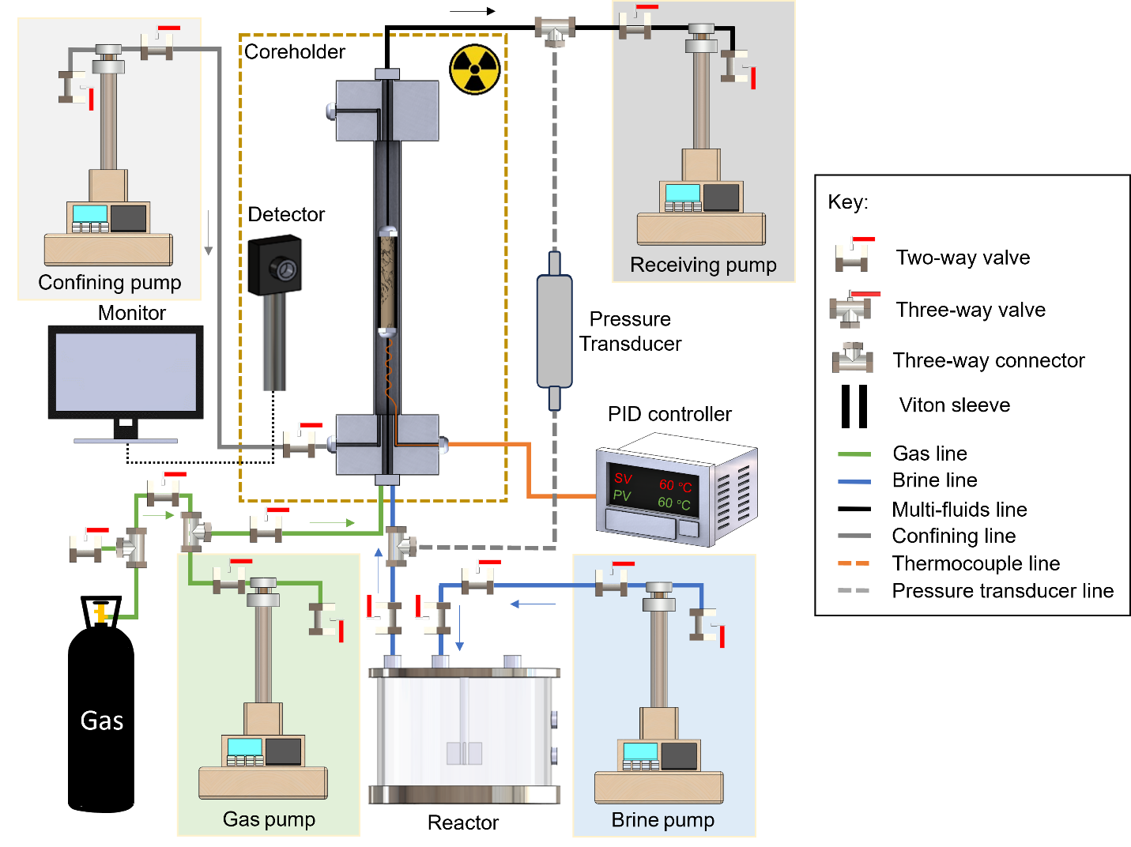
Research method
Experimental Apparatus
Xradia Versa μ-CT X-ray microscopy is used for image acquisition.
Experimental Conditions:
Pressure = 8 MPa
Temperature = 50 ◦C
Injection rate = 0.5 mL/min

Slide 6
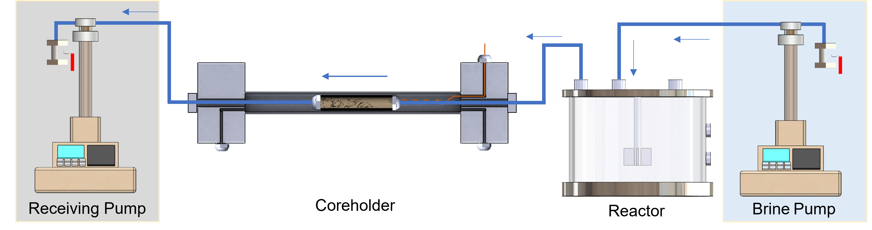
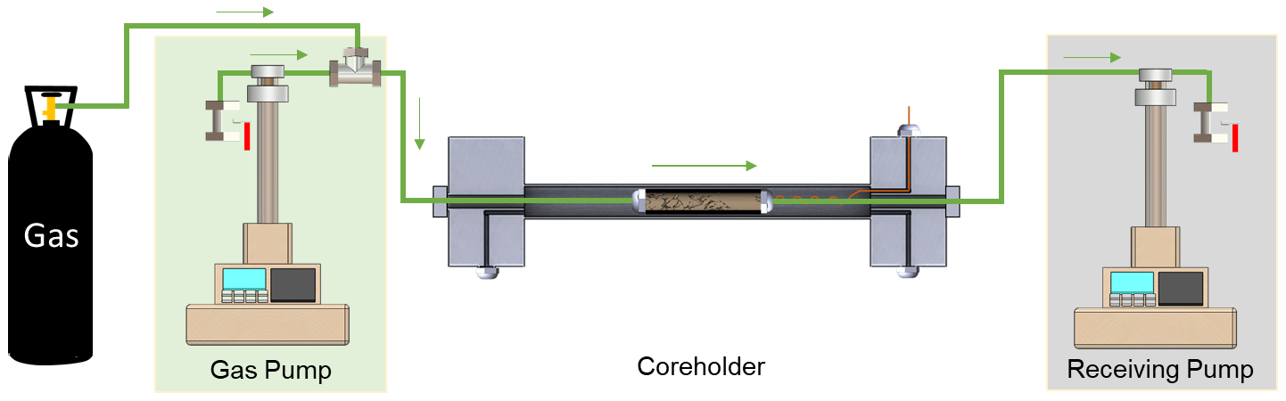
Research method
Fluid Injection path
Brine injection path
Brine and gas are injected from below the sample.
Fractional flow table:
Flooding# | f_{w} | f_{g}
1 | 1 | 0
2 | 0.8 | 0.2
3 | 0.5 | 0.5
4 | 0.1 | 0.9
5 | 0.05 | 0.95
6 | 0 | 1
Gas injection path

Slide 7
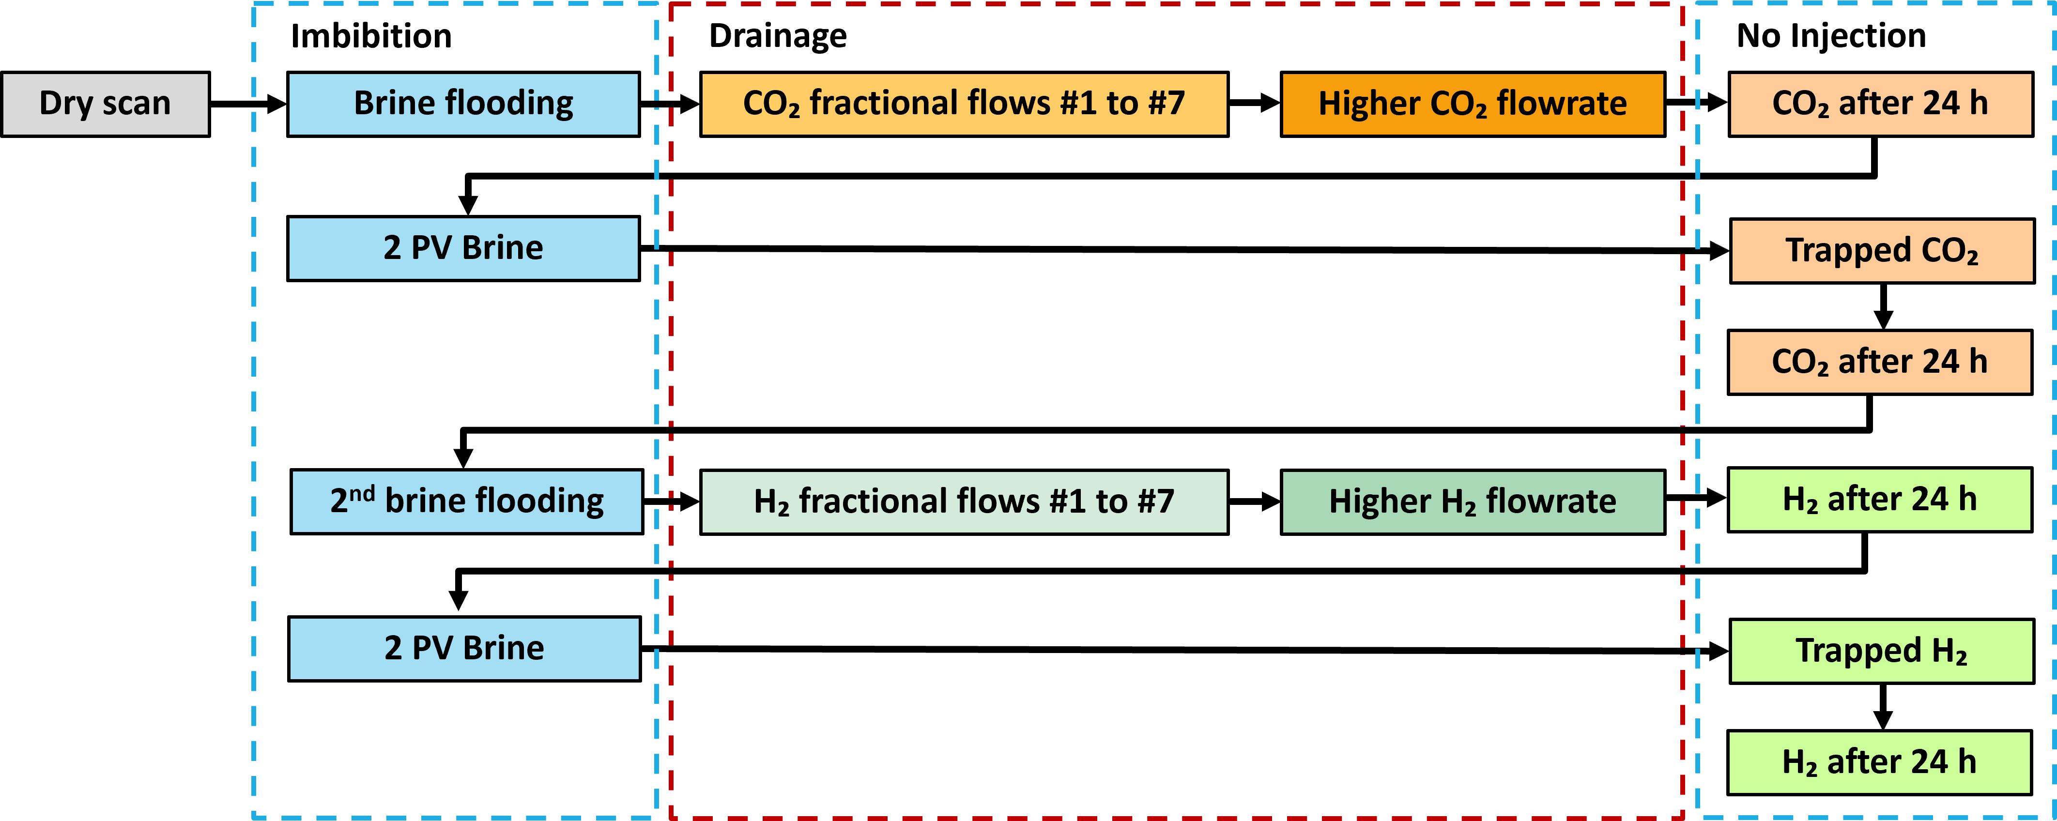
Research method
Experimental Procedure

Slide 8
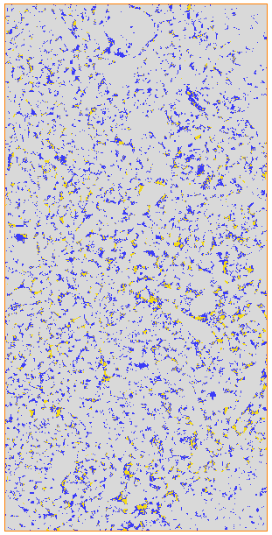
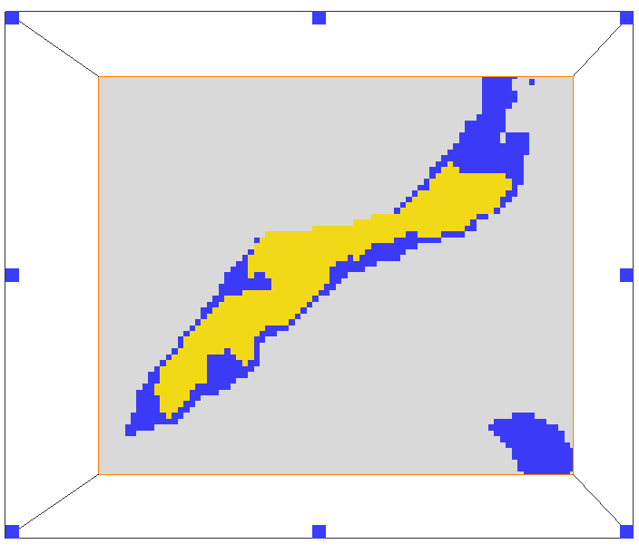
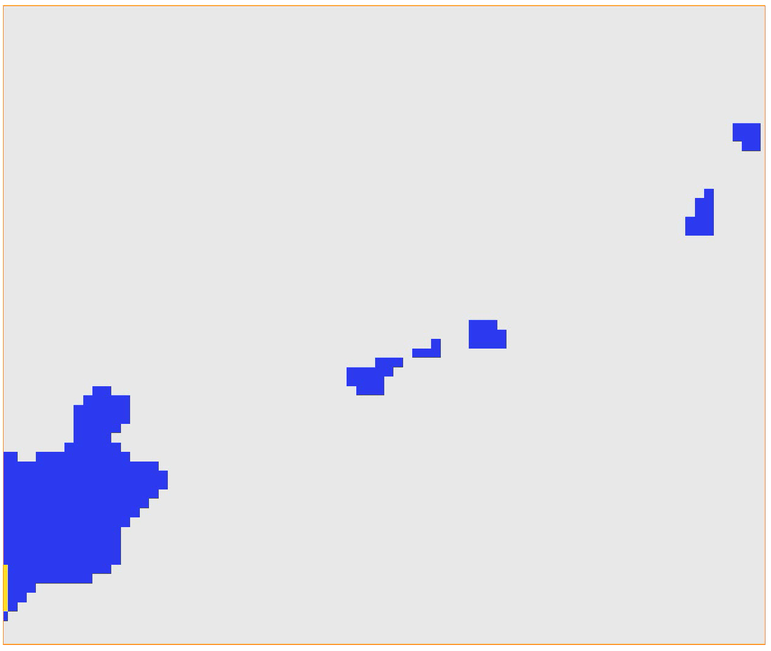
Research method
1
2
Image Analysis
The saturation and ganglia analysis is determined across the whole sample.
The pore occupancy, curvature analysis and wettability is measured on a sub volume.
8 μm
Sub volume
3
Generated Surface
1 mm
Whole Sample

Slide 9
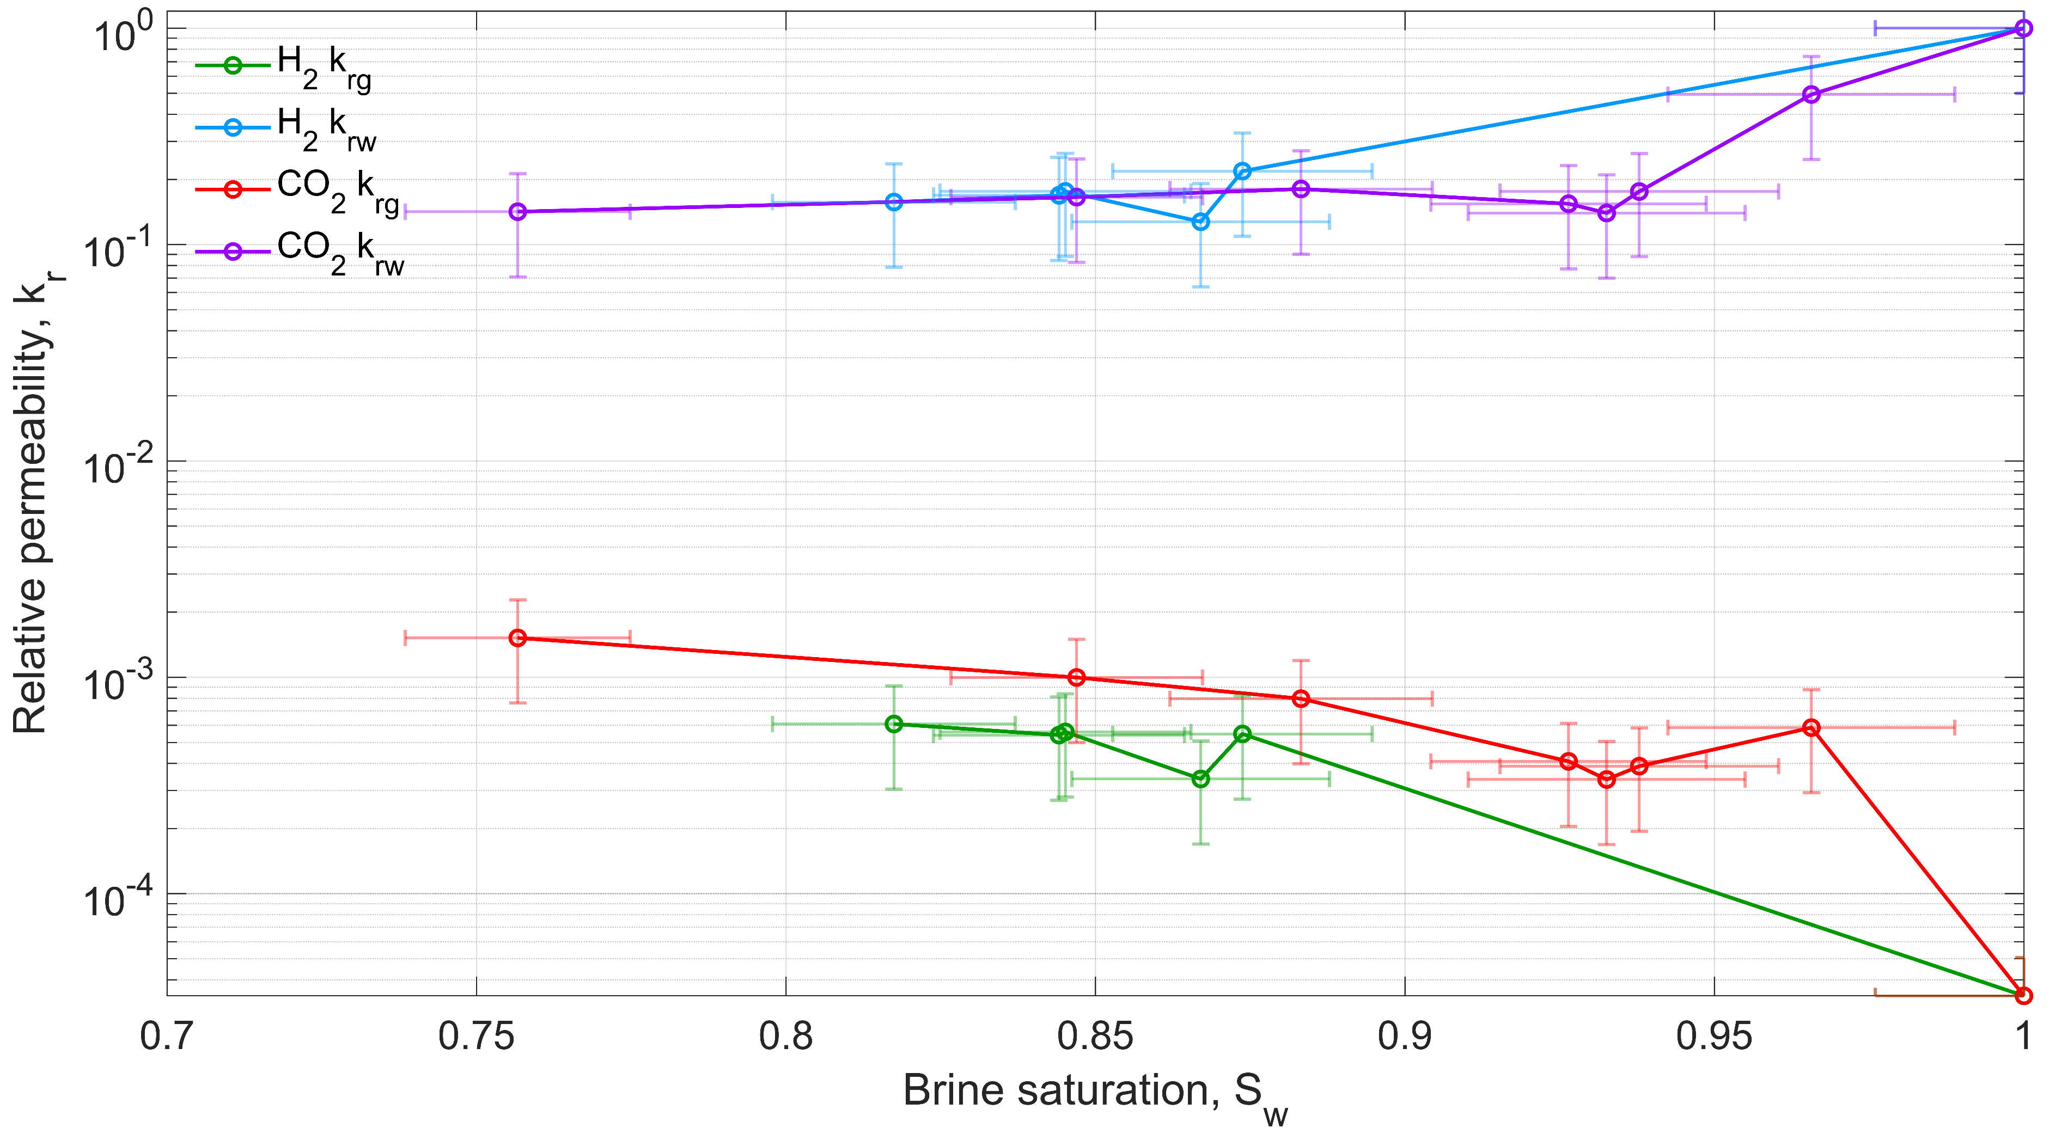
Results and Discussion
Relative Permeability

Slide 10
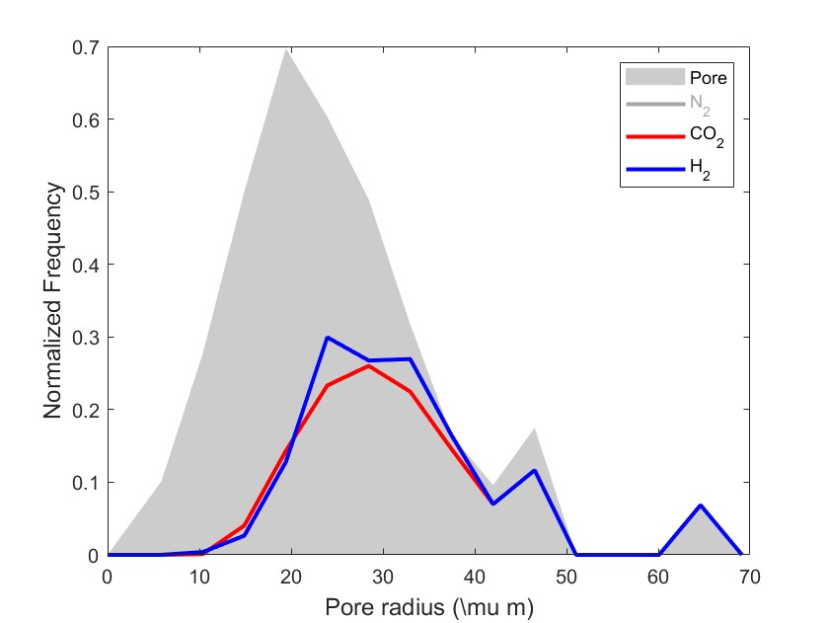
Results and Discussion
Pore Occupancy
To analyse the pore occupancy, several sub volumes of 400×400×400 voxels (135.14×135.14×135.14 μm3) were considered.
As expected for a water-wet system, the gas phase, being non-wetting, tends to reside in the larger pores and throats.
H₂ occupies larger pores relative to CO₂.

Slide 11
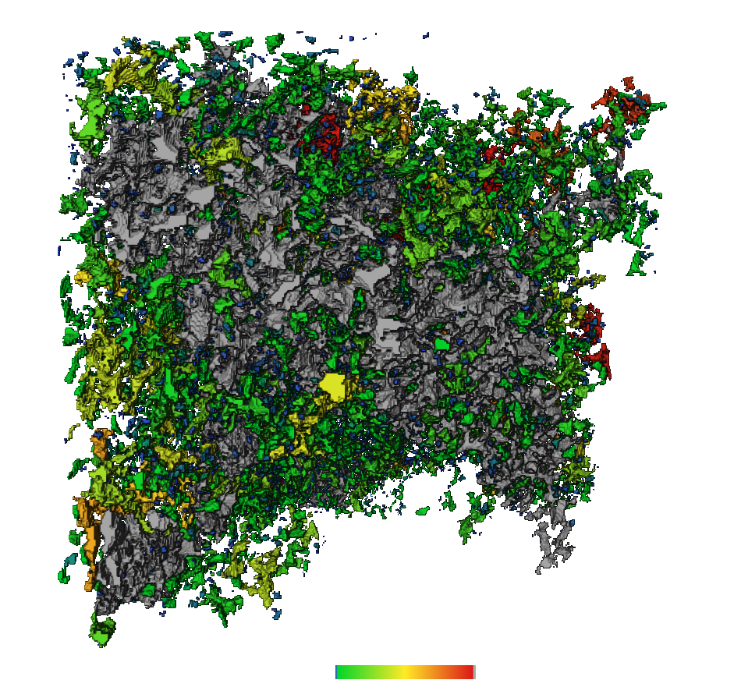
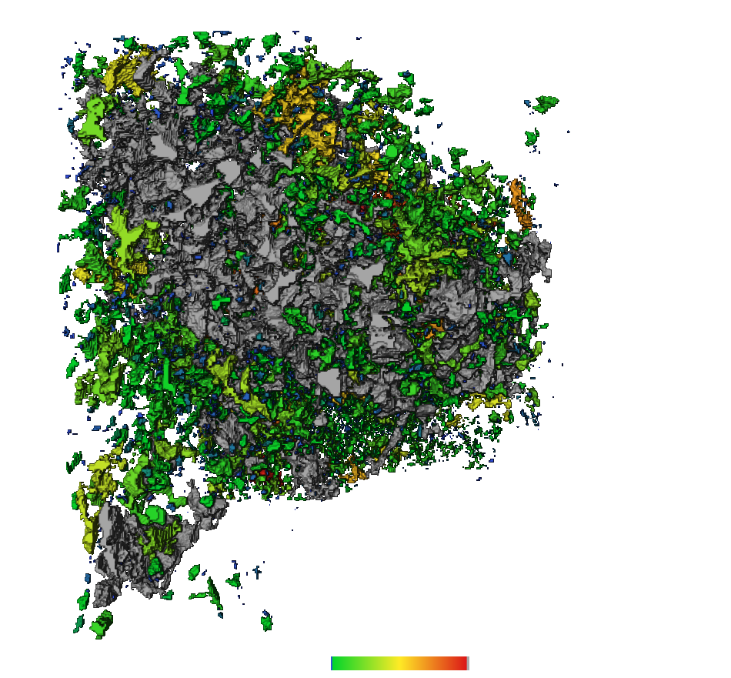
Results and Discussion
Connectivity
CO₂
H₂
Carbon dioxide is less connected than hydrogen.
Connectivity is quantified using Euler number.
Low Euler number implies better connected phases.
Image | Normalized (1/mmᶟ)
CO₂ | 12
H₂ | 4
1 mm
1 mm
0 10⁷
µmᶟ

Slide 12
Conclusions
To compare CO₂ and H₂ injection in a reservoir carbonate rock, three-dimensional µ-CT imaging was used.
Relative permeability: H₂ has lower relative permeability than CO₂.
Pore occupancy: H₂ bubbles occupy the larger pores as opposed to CO₂.
Gas connectivity and Ostwald ripening: All the gases show better connectivity with time: good for retrieval, bad for sequestration.
Implications: These results provides insight for underground H₂ storage (UHS) for clean energy storage and carbon capture and storage (CCS) projects to reduce greenhouse effect.

Slide 13
Future analysis
Continue the analysis and investigate: wettability, ganglia analysis, capillary pressure and saturation profiles.
Analyse images that were taken almost every day up to 7 days without injection to study the effect of Ostwald ripening effect.
Analyse the results from the experiment after altering the wettability.

Slide 14
Thank you
Comparative Study of Carbon Dioxide and Hydrogen Relative Permeability, Pore Occupancy, Connectivity and Ostwald Ripening in Carbonate Rocks
14/01/2026

Slide 15
References
Alhammadi, A. M., AlRatrout, A., Singh, K., Bijeljic, B., & Blunt, M. J. (2017). In situ characterization of mixed-wettability in a reservoir rock at subsurface conditions. Scientific Reports, 7(1), 10753.
Alhosani, A., Bijeljic, B., & Blunt, M. J. (2021a). Pore-scale imaging and analysis of wettability order, trapping and displacement in three-phase flow in porous media with various wettabilities. Transport in Porous Media, 140(1), 59-84.
Alhosani, A., Lin, Q., Scanziani, A., Andrews, E., Zhang, K., Bijeljic, B., & Blunt, M. J. (2021b). Pore-scale characterization of carbon dioxide storage at immiscible and near-miscible conditions in altered-wettability reservoir rocks. International Journal of Greenhouse Gas Control, 105, 103232.
Alhosani, A., Scanziani, A., Lin, Q., Foroughi, S., Alhammadi, A. M., Blunt, M. J., & Bijeljic, B. (2020). Dynamics of water injection in an oil-wet reservoir rock at subsurface conditions: Invasion patterns and pore-filling events. Physical Review E, 102(2), 023110.
Blunt, M. J. (2022). Ostwald ripening and gravitational equilibrium: Implications for long-term subsurface gas storage. Physical Review E, 106(4), 045103.
de Chalendar, J. A., Garing, C., & Benson, S. M. (2018). Pore-scale modelling of Ostwald ripening. Journal of Fluid Mechanics, 835, 363-392.
Foroughi, S., Bijeljic, B., & Blunt, M. J. (2021). Pore-by-pore modelling, validation and prediction of waterflooding in oil-wet rocks using dynamic synchrotron data. Transport in Porous Media, 138(2), 285-308.
Foroughi, S., Bijeljic, B., Lin, Q., Raeini, A. Q., & Blunt, M. J. (2020). Pore-by-pore modeling, analysis, and prediction of two-phase flow in mixed-wet rocks. Physical Review E, 102(2), 023302.
Goodarzi, S., Zhang, Y., Foroughi, S., Bijeljic, B., & Blunt, M. J. (2024). Trapping, hysteresis and Ostwald ripening in hydrogen storage: A pore-scale imaging study. International Journal of Hydrogen Energy, 56, 1139-1151.
Hematpur, H., Abdollahi, R., Rostami, S., Haghighi, M., & Blunt, M. J. (2023). Review of underground hydrogen storage: Concepts and challenges. Advances in Geo-Energy Research, 7(2), 111-131.
Iglauer, S., Ali, M., & Keshavarz, A. (2021). Hydrogen wettability of sandstone reservoirs: implications for hydrogen geo‐storage. Geophysical Research Letters, 48(3), e2020GL090814.

Slide 16
Acknowledgment
Supervisors
Prof. Martin J Blunt
Dr. Branko Bijeljic
Dr. Shehadeh Masalmeh
Experiment and analysis
Dr. Rukuan Chai
Qianqian Ma
Dr. Hussain Alzahrani
Waleed Dokhon
Anfal Al Zarafi
Dr. Vinchenzo Cunsolo
Funding
Abu Dhabi National Oil Company (ADNOC)

