Slide 1
AI-driven image segmentation for accurate characterization of wettability
Pore-Scale Modelling and Imaging
Yang Gao
Co author: Sajjad Foroughi, Jack Ma
Supervisor: Martin Blunt, Branko Bijeljic

Slide 2
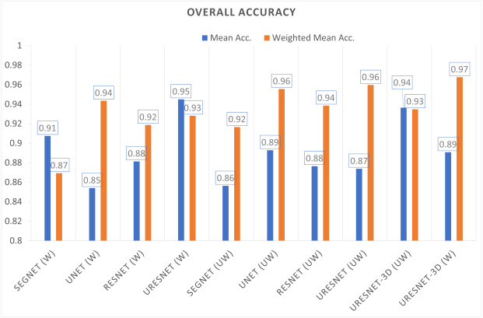
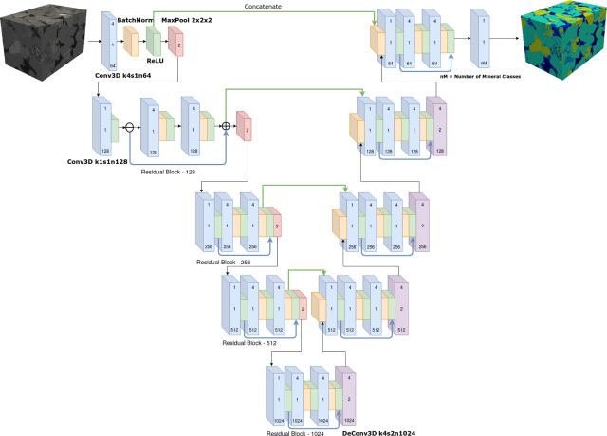
Now it's 2024! Volumetric neural networks?
Computationally demanding
We spend many times the computational resources than normal methods. It does not result in significant gains in accuracy
Many parameters and difficult to train
The number of network parameters is huge and requires a lot of data for training. But so far these have not appeared to be better generalizable (trained with one sample, applied on other samples).
5 times computational resources for 1% improvement
Ying Da Wang, Mehdi Shabaninejad, Ryan T. Armstrong, Peyman Mostaghimi. Deep neural networks for improving physical accuracy of 2D and 3D multi-mineral segmentation of rock micro-CT images, 2021. Applied Soft Computing,Volume 104,2021,107185, ISSN 1568-4946

Slide 3
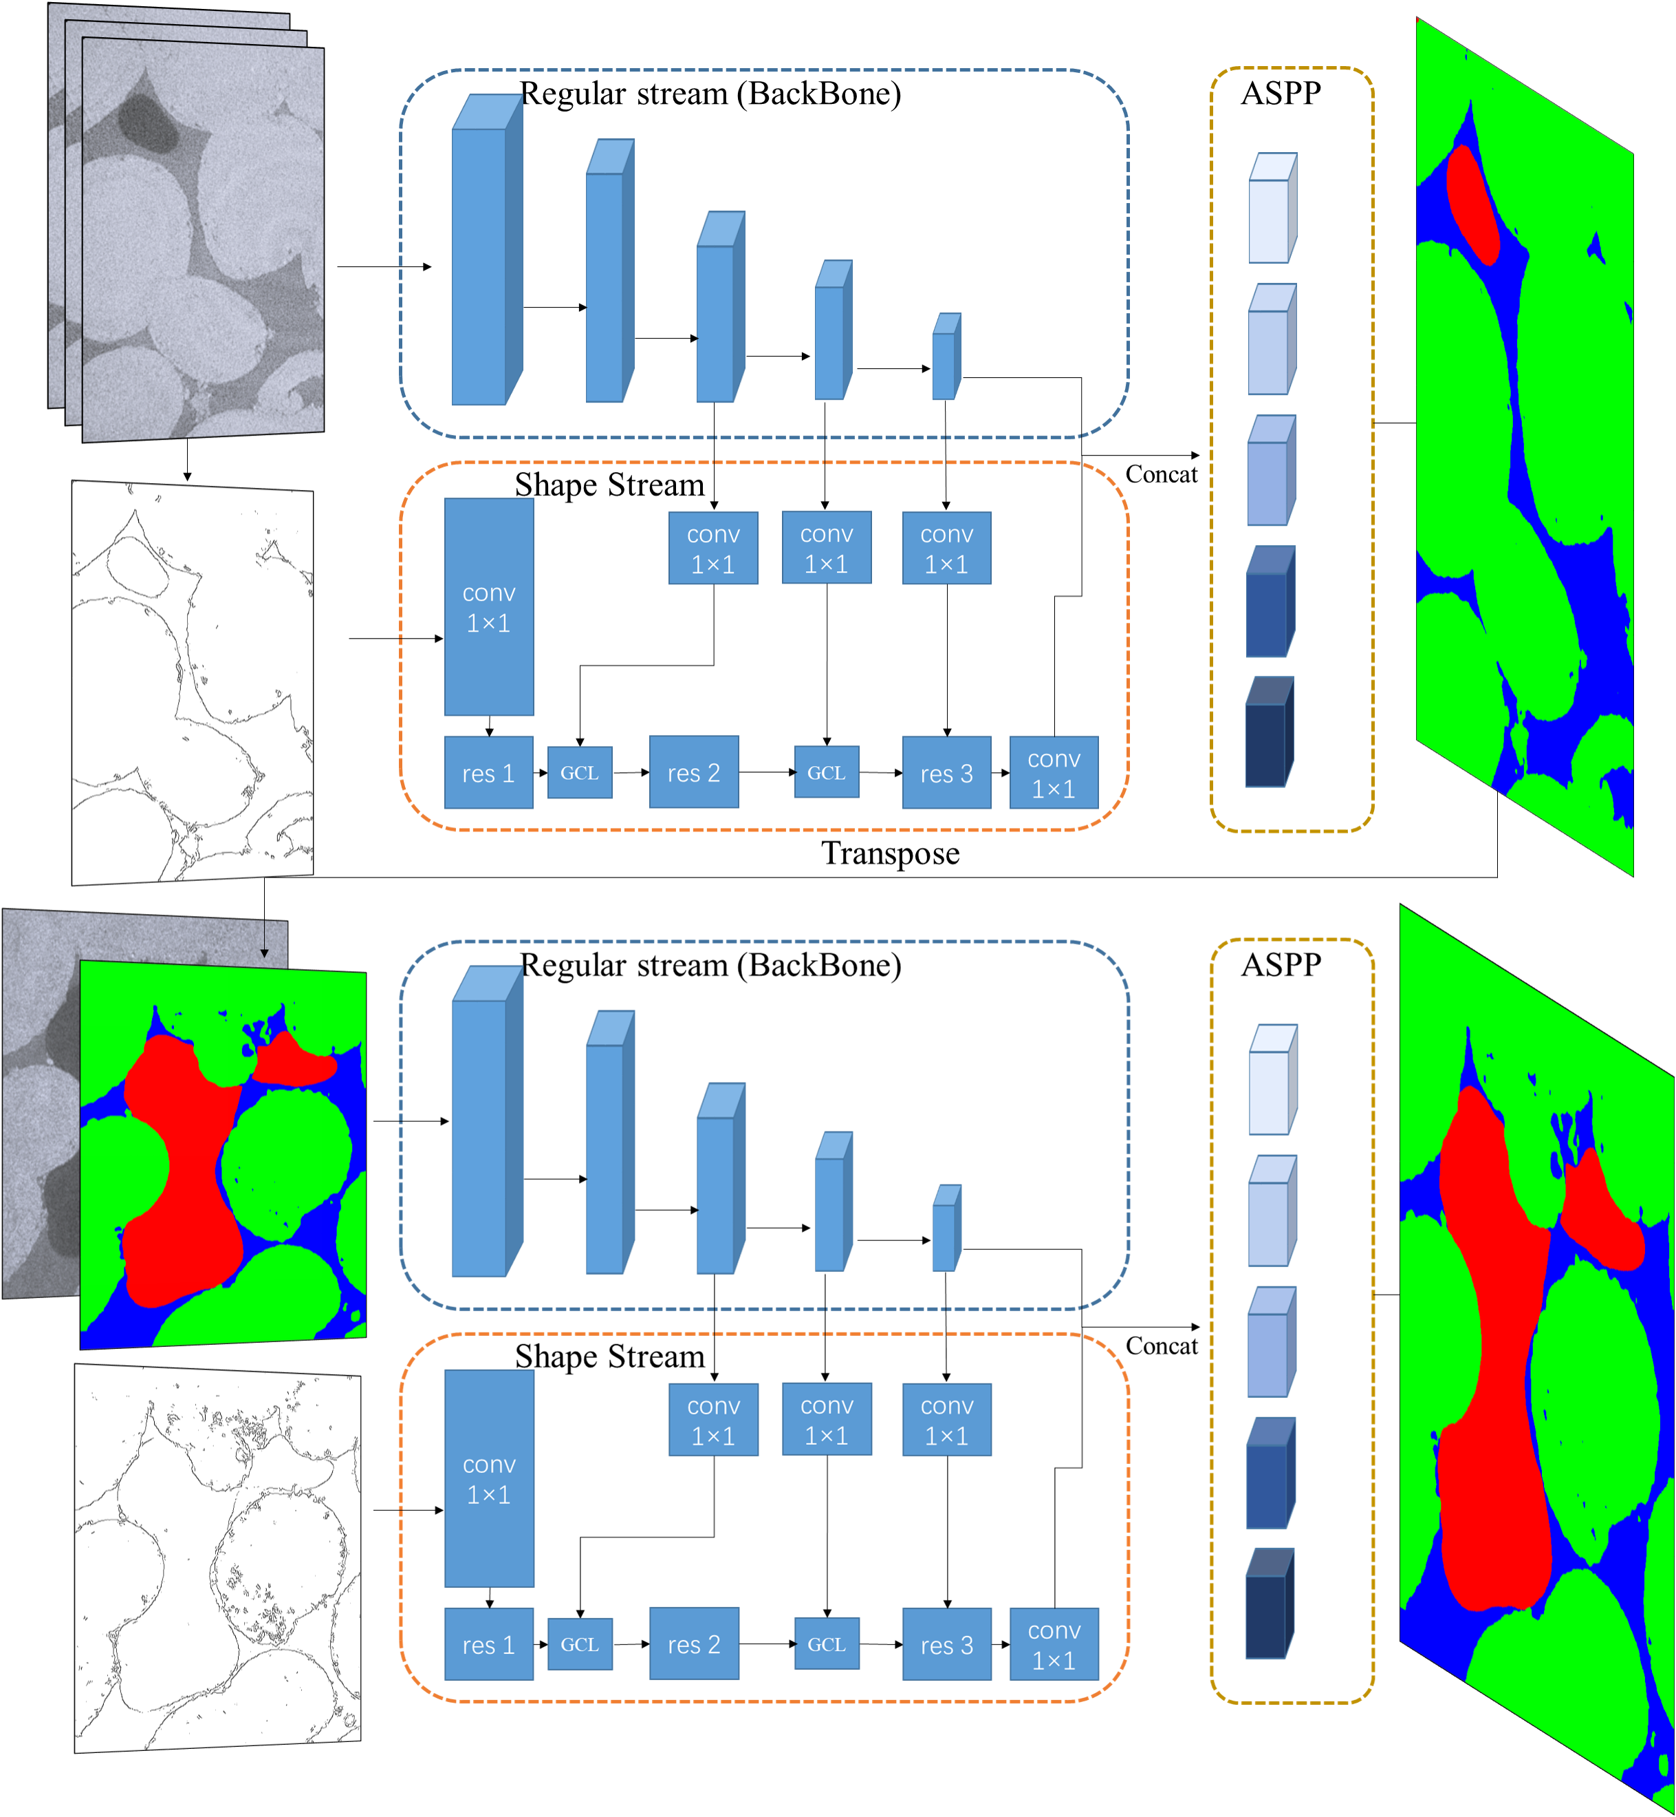
GGIECN
Grey-scale gradient information enhanced convolutional network
Automatic correction for manual bias
Generalizability for various wettability
Generalizability for various lithology
Low computational requirements
High-precision interface segmentation

Slide 4
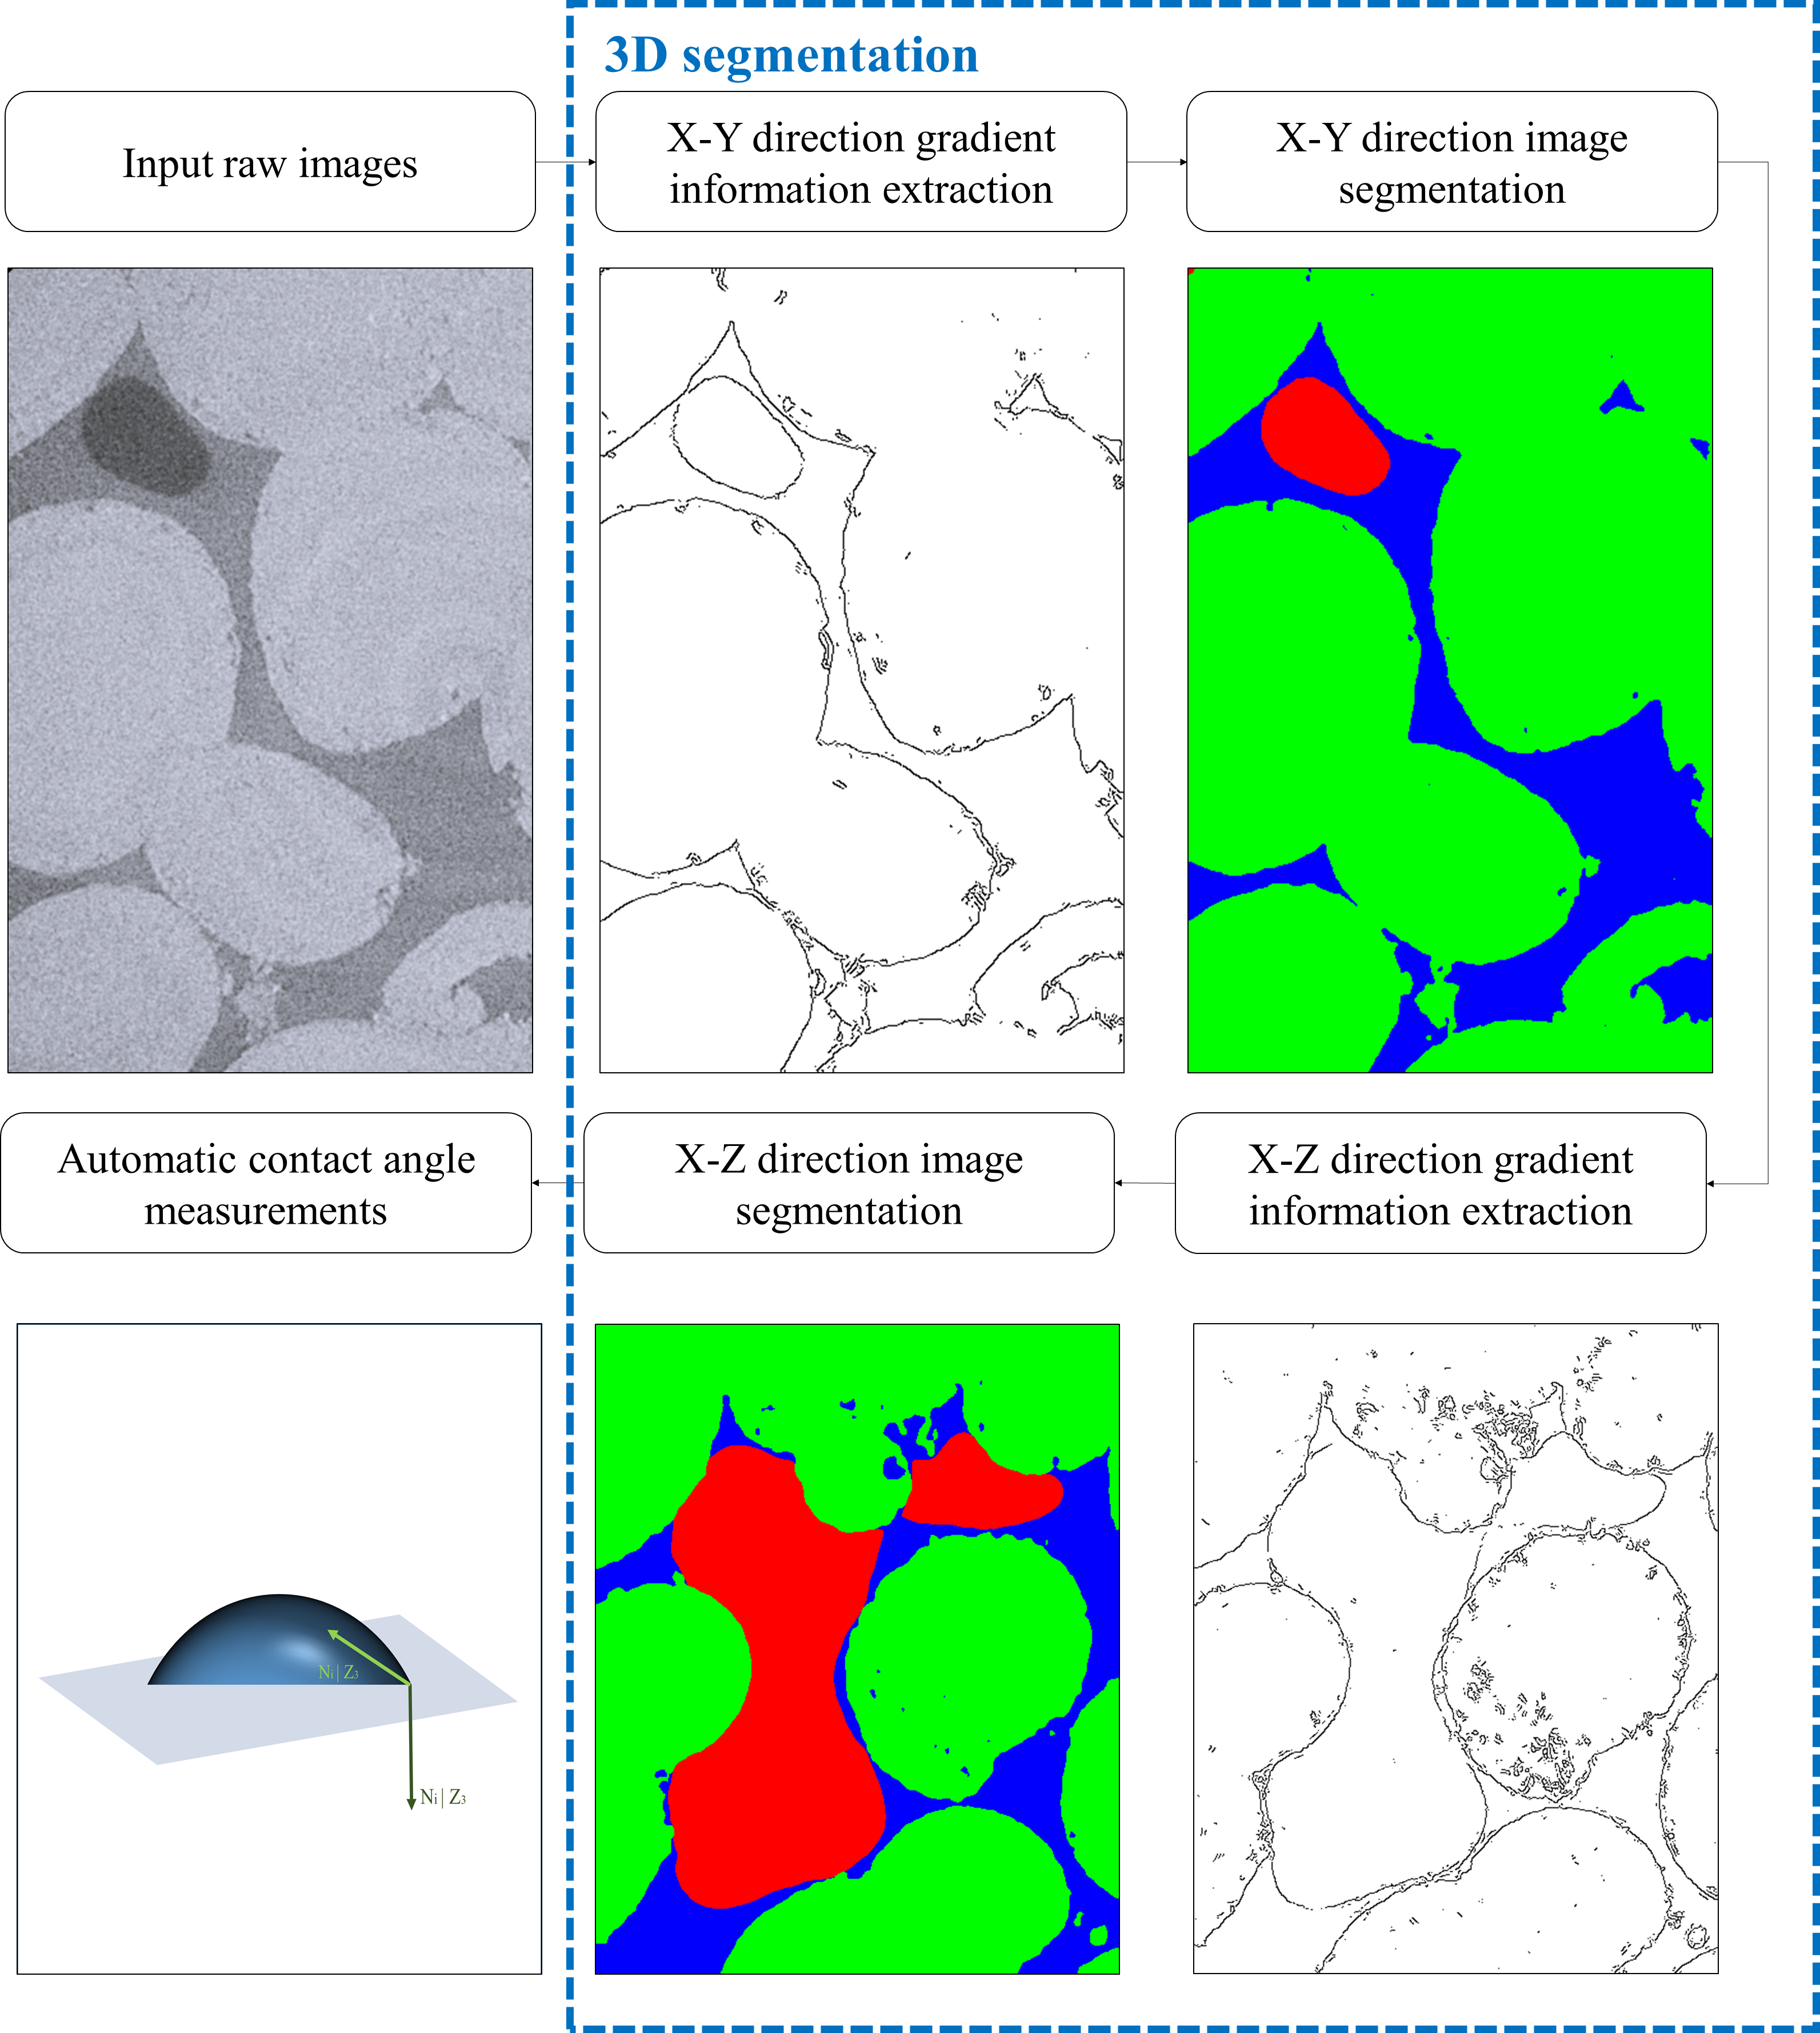
GGIECN & Automatic CA Measurement Workflow
Convey 3D structural information and segment effectively with limited graphics memory by processing images in XY and XZ directions separately
Only 40% of the data was used as training data, plus automatically extracted gradient information. We obtained wettability evaluation results that are more consistent with the physical mechanism than the training dataset.

Slide 5
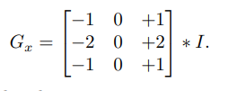
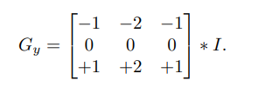


Canny – An objective method to identify boundaries based on grey-scale gradients
X direction gradient information Gx is calculated as:
Y direction gradient information Gy is calculated as:
The gradient magnitude G is calculated as:
The azimuthal angle θ is calculated as:
Gradient boundaries are identified perpendicular to θ.

Slide 6
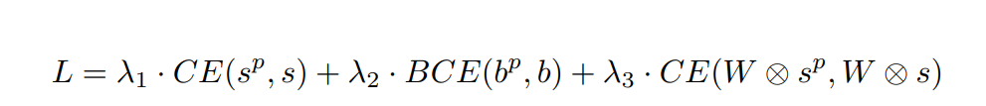
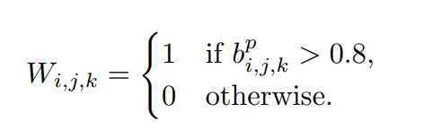

Comprehensive loss function
Basic image segmentation loss
Gradient boundary and training dataset boundary loss
Additional phase segmentation penalty for the disputed voxels on the predicted boundary

Slide 7
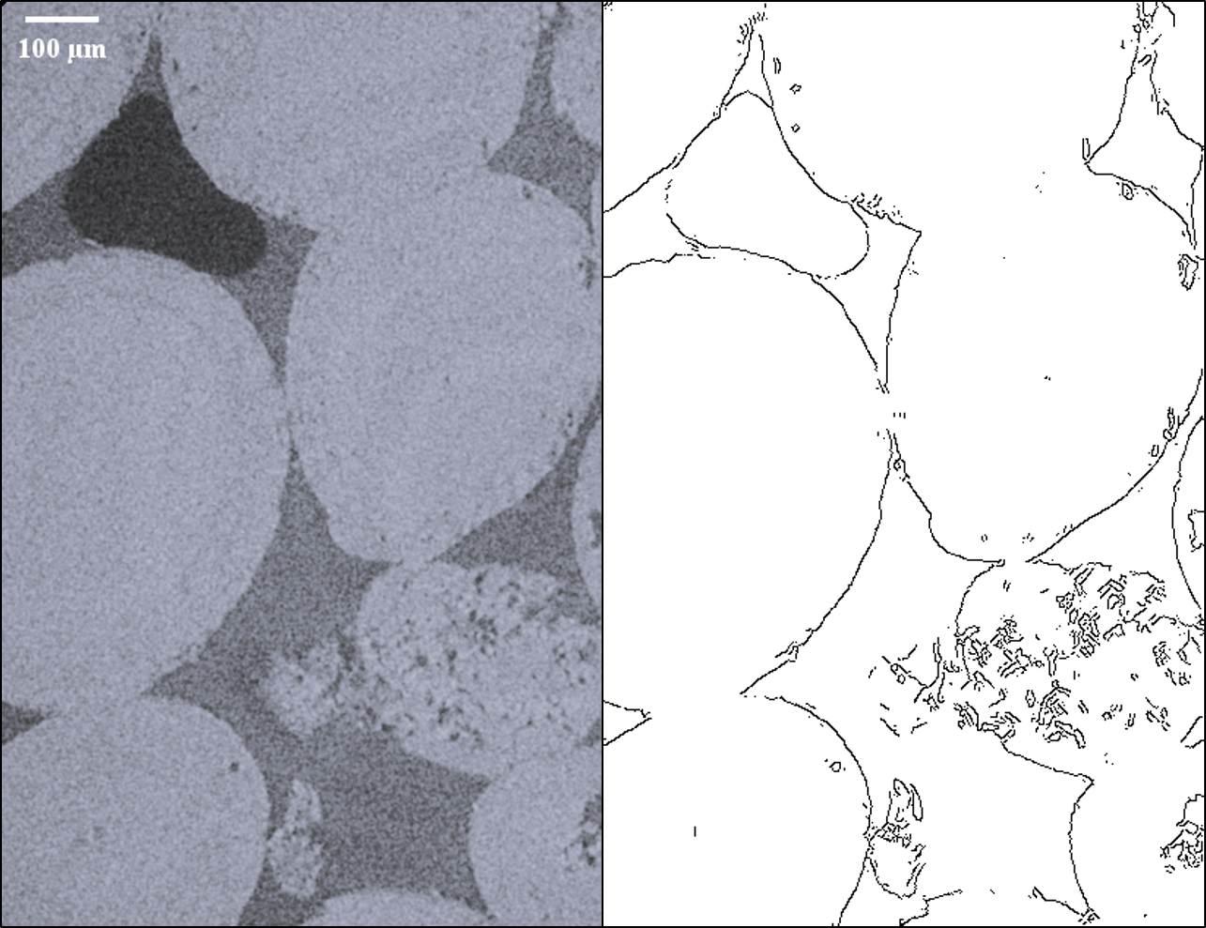
Gradient boundaries – Ketton Limestone

Slide 8
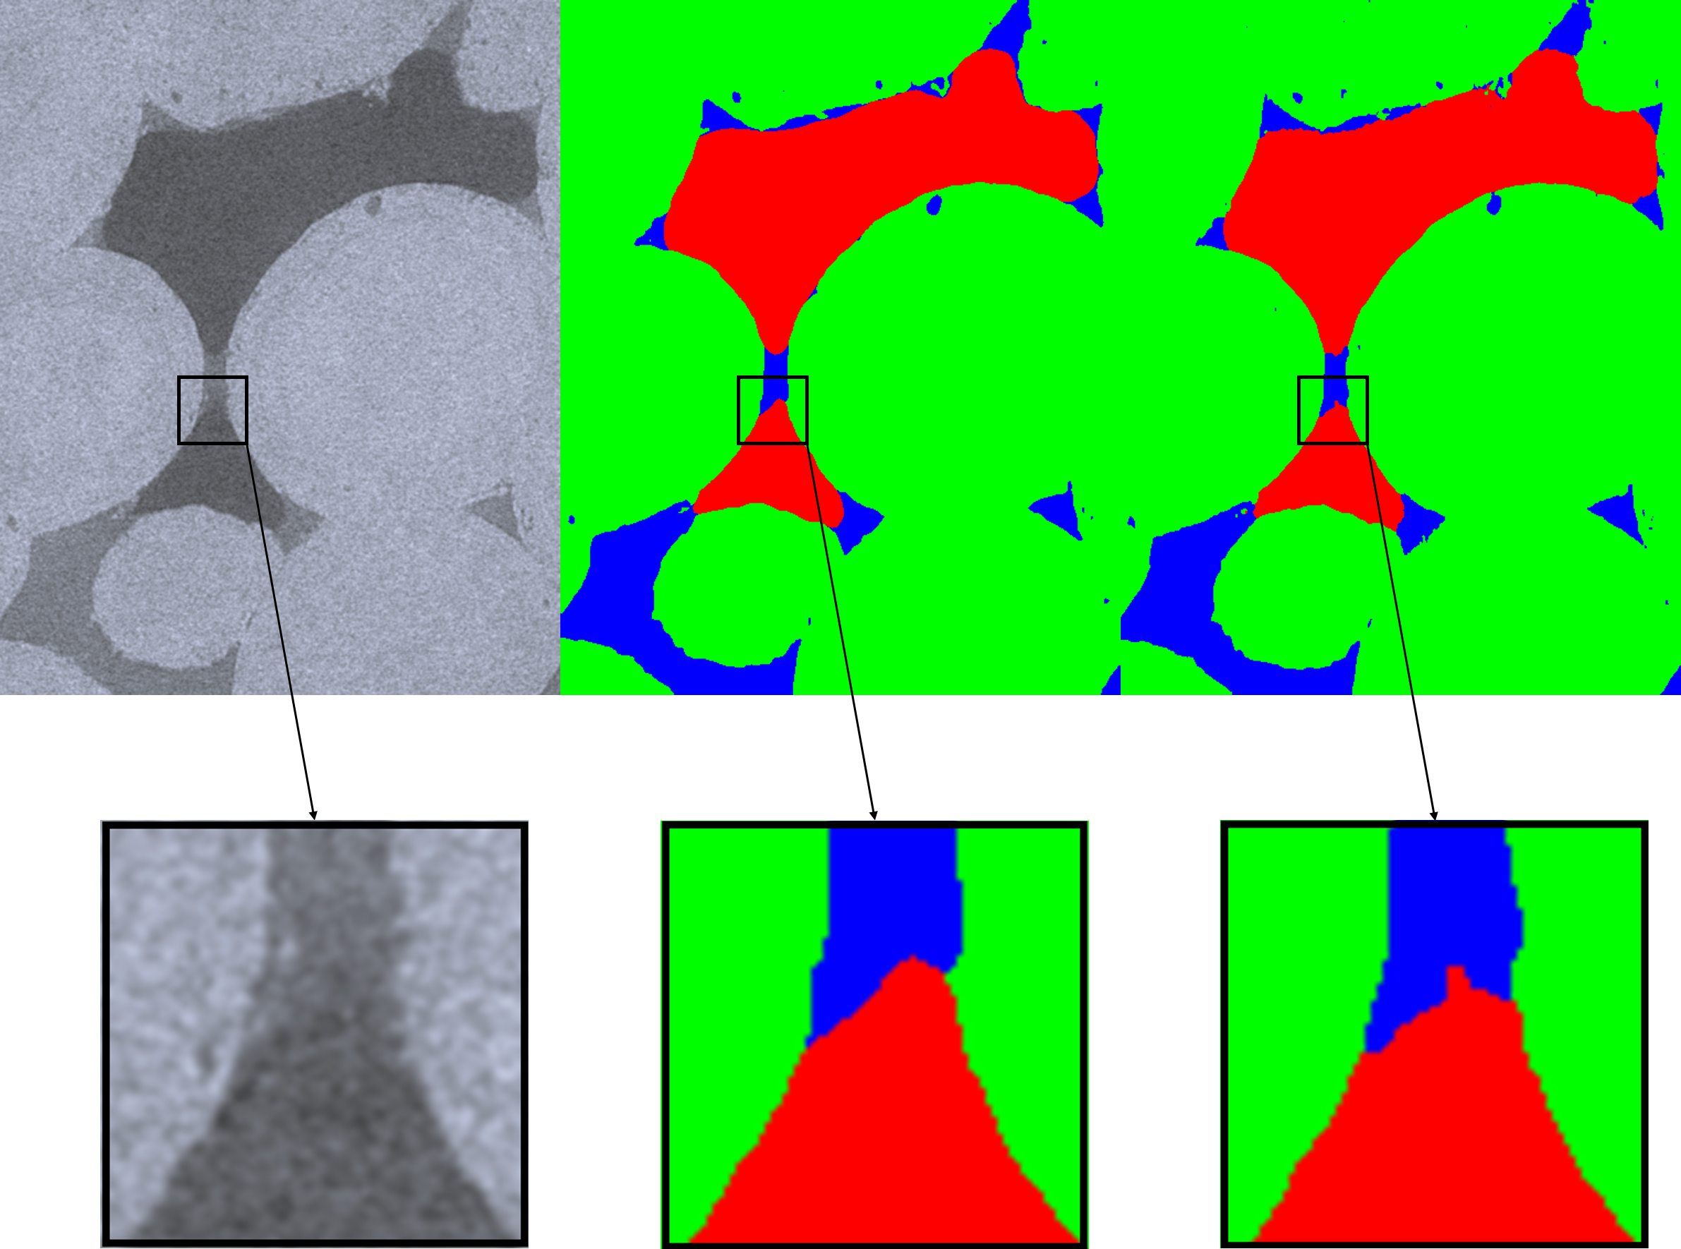
Water-wet Ketton limestone
40% of the result from watershed was used as the training dataset.
The voxel accuracy of the validation set is around 98%.
Fluid surfaces are more reasonable.
This helps to improve contact angle measurement.
Image
GGIECN
Watershed

Slide 9
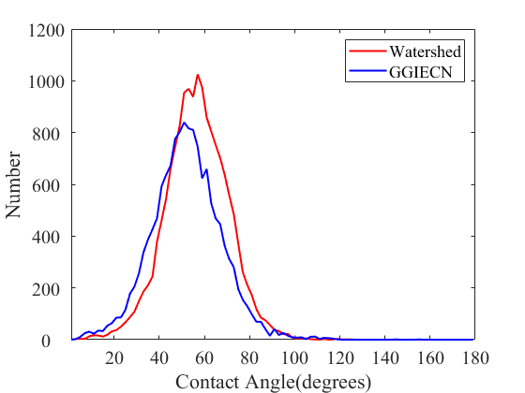
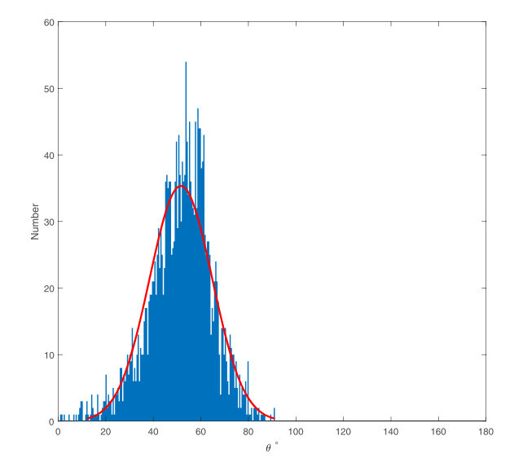
Water-wet Ketton limestone
Both the segmentation method and the contact angle measurement method are different with Jianhui Yang, While the measured results are basically the same.
Yang, J., & Zhou, Y. (2020). An automatic in situ contact angle determaination based on level set method. Water Resources Research, 56 (7),479

Slide 10
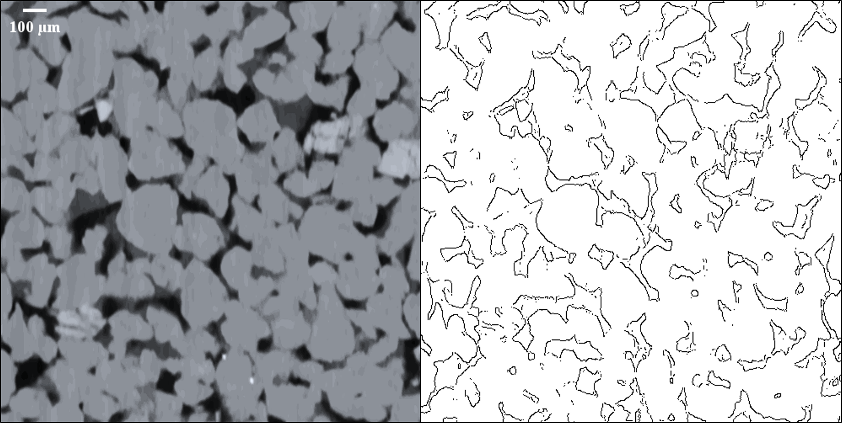
Gradient boundaries - Bentheimer sandstone

Slide 11
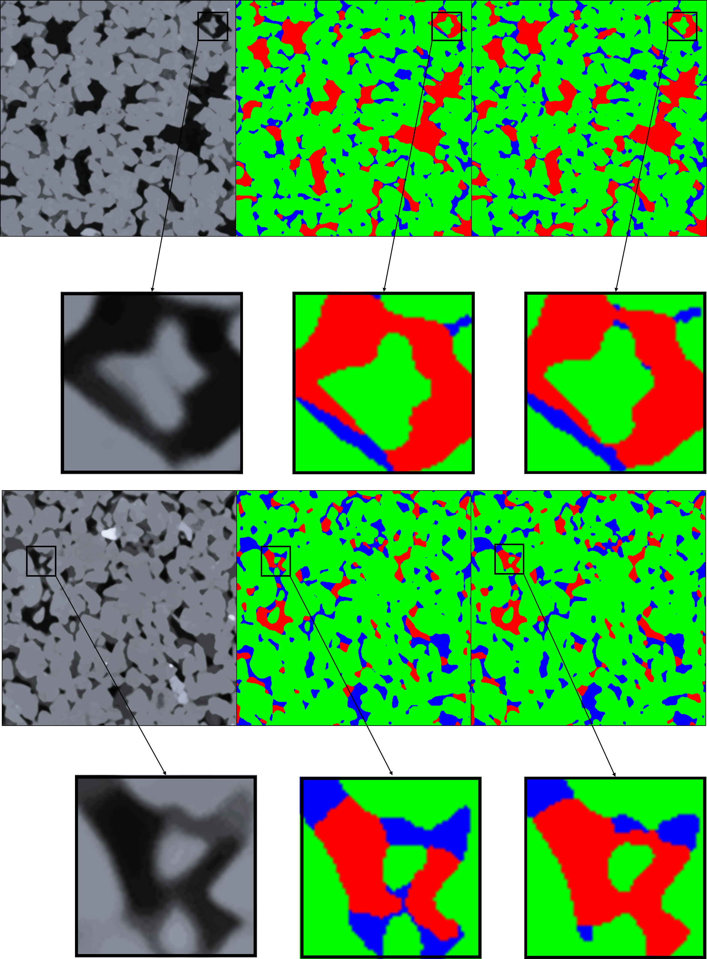
Water-wet Bentheimer sandstone
40% of the result from watershed was used as the training dataset.
The voxel accuracy of the validation set is around 96%.
Eliminates meaningless three-phase contact points due to low resolution
Image
GGIECN
Watershed

Slide 12
Mixed-wet Bentheimer sandstone
40% of the result from watershed was used as the training dataset.
The voxel accuracy of the validation set is around 96%.
Effectively filters out the abnormal segmentation contained in training dataset.
Image
GGIECN
Watershed

Slide 13
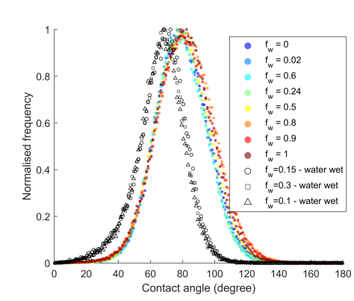
Water-wet & Mixed-wet Bentheimer sandstone
There are fewer contact points in GGIECN as it effectively filters out the abnormal points with the help of gradient information.
Lin, Q., Bijeljic, B., Berg, S., Pini, R., Blunt, M. J., & Krevor, S. (2019, Jun). Minimal surfaces in porous media: Pore-scale imaging of multiphase flow in an altered-wettability bentheimer sandstone. Phys. Rev. E, 99 , 063105.

Slide 14
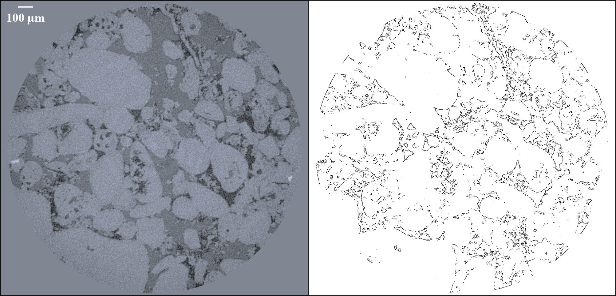
Gradient boundaries - reservoir carbonate

Slide 15
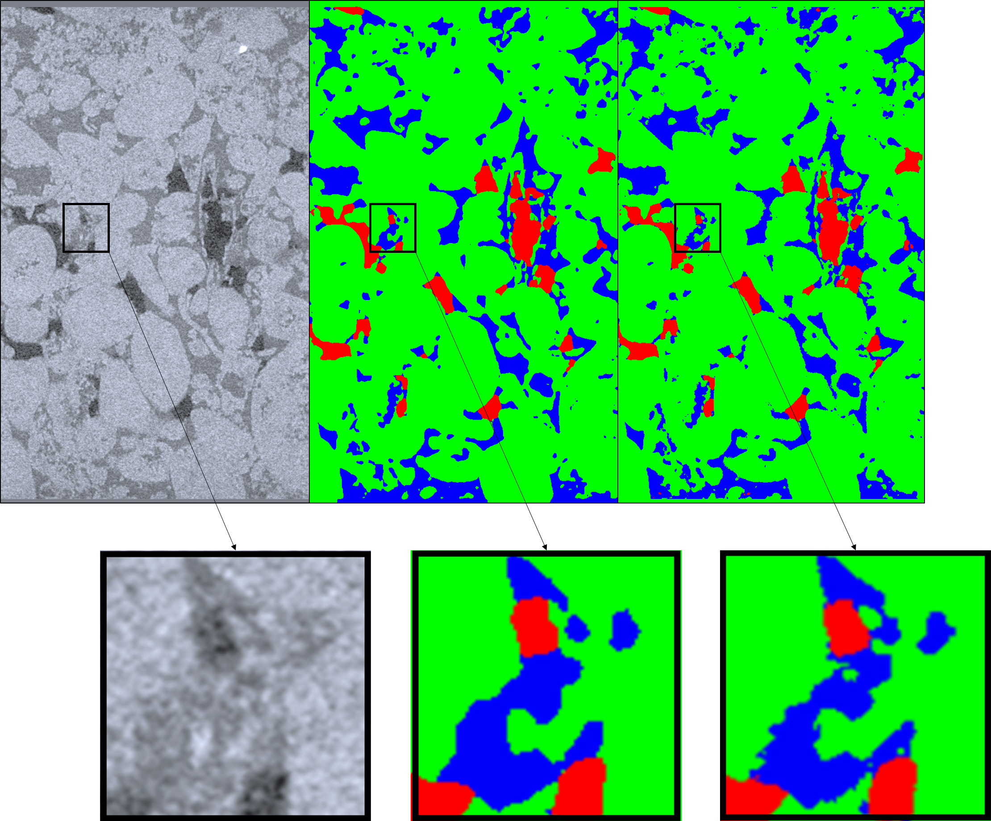
Water-wet reservoir carbonate
Verify the applicability of the workflow under complex structural conditions
40% of the result from WEKA was used as the training dataset.
The voxel accuracy of the validation set is around 96%.
Three-phase contact points for the water-wet carbonate appear more realistic using GGIECN
Image
GGIECN
WEKA

Slide 16
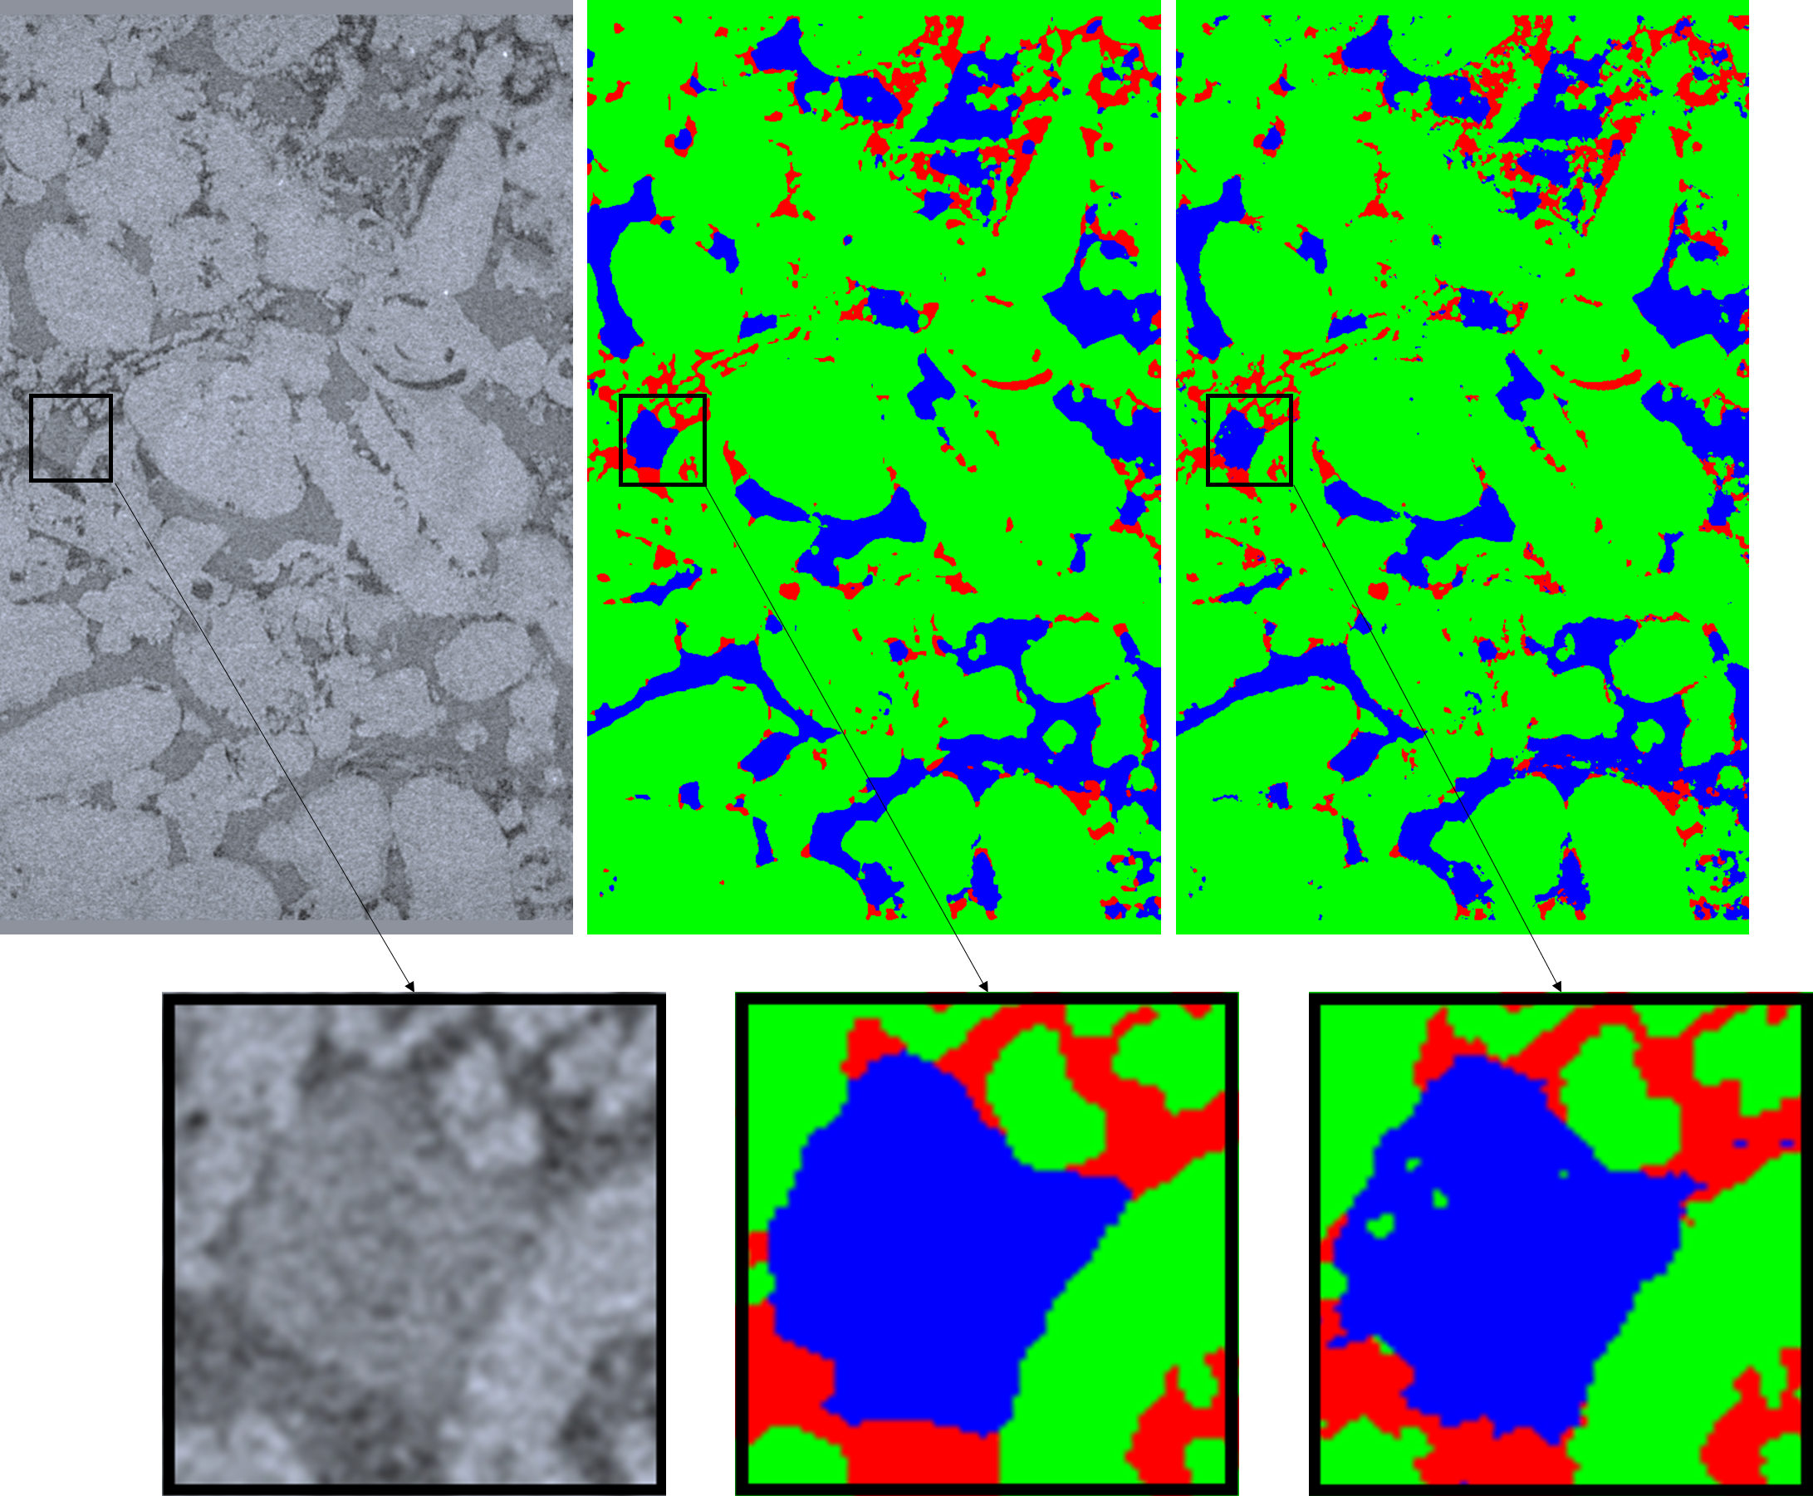
Water-wet reservoir carbonate
Verify the applicability of the workflow under complex structural conditions
40% of the result from WEKA was used as the training dataset.
The voxel accuracy of the validation set is around 96%.
GGIECN filtered out fluctuations due to the low resolution of the data
Image
GGIECN
WEKA

Slide 17
Water-wet & mixed wet reservoir carbonate
Even though only 40% of the data was used for training, the distribution of contact angles for the workflow is generally consistent with Alhammadi (2017)
Alhammadi, A. M., AlRatrout, A., Singh, K., Bijeljic, B., & Blunt, M. J. (2017). In situ characterization of mixed-wettability in a reservoir rock at subsurface conditions. Scientific Reports, 7 (1), 10753.

Slide 18
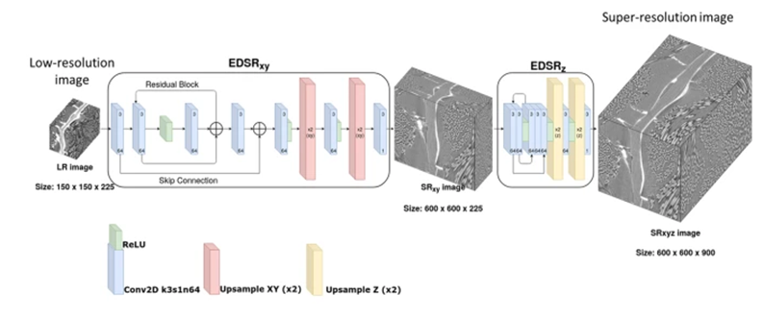
Future work
Combine GGIECN with Jack's super-resolution approach.
Optimisation of computational methods to capture Minkowski functionals.

Slide 19
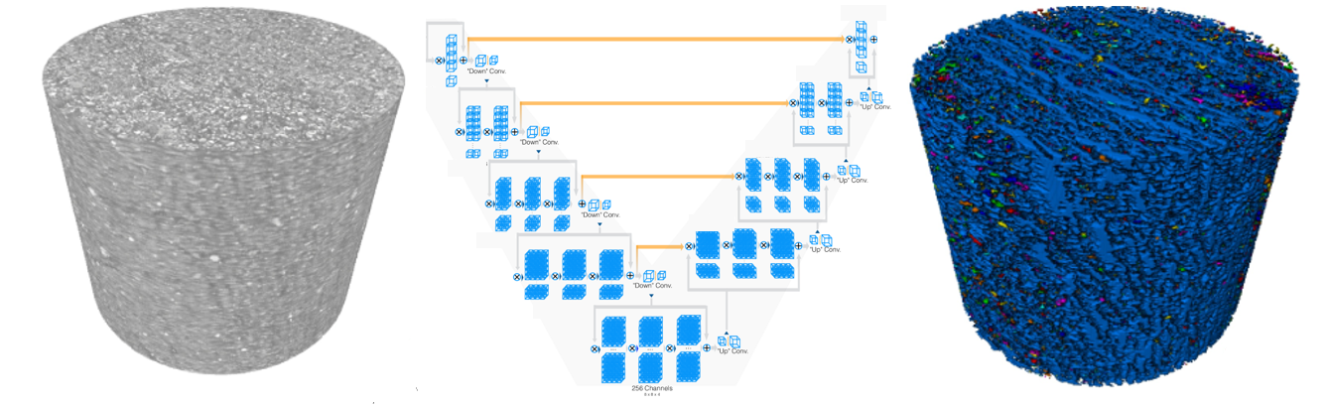
Future work
Porous media 3D-SAM (Segment Anything)
Generalised mega-model trained on large amounts of data

