Slide 1




The Combined Effects of Pressure Decline and Displacement in Underground Hydrogen Storage: a Pore-Scale Laboratory Study
Waleed Dokhon
Martin Blunt
Branko Bijeljic
1/16/2024
Notes:
Good morning esteemed colleagues. I’m Waleed Dokhon a PhD student researching the pore-scale physics in the context of Underground Hydrogen Storage. Martin has introduced to you some of the main phenomenon and physics we’re studying, and Sepideh showcased her work on Ostwald Ripening and capillary pressure hysteresis. In my work, I will talk about how pressure decline can affect displacement during withdrawal in UHS. But first, Why UHS? Why is it a hot topic right now?

Slide 2





Why Underground Hydrogen Storage?
Renewable energy output is variable
Excess energy can be converted into hydrogen for deferred use during peak demand
The substantial scale of energy demand necessitates equally large-scale storage solutions
Surface storage is challenged by limited capacity, land use impact, and cycle frequency
Subsurface alternatives include depleted gas fields, aquifers, and sedimentary rocks including sandstone and carbonates
Electrolyser
BlueH₂
GreyH₂
Renewable energy
Fuel, industry use…etc.
Green H₂
Storage
Fuel cell
Electric consumption
Source: EuroStat
Assume France’s annual electricity consumption is around 460 TWh
That equates to approximately 7 billion electric vehicle worth of batteries
2
Notes:
We know that the need for transitioning to more sustainable energy is inevitable. We also know that Renewable Energy is inherently intermittent, which poses a challenge for consistent supply – It won’t always be a sunny or windy day. Simple, a storage system should fix this issue. But the tremendous scale of the energy demand today and tomorrow will necessitate expensive and vast storage solution. If we decide to rely on batteries alone, we’d need around 7 billion electric vehicle worth of batteries to cover France’s annual electricity consumption. Our solution? Convert excess energy into hydrogen, storing it underground to withdraw in times surging demand. Hence, we turn our gaze beneath the Earth’s surface, exploring the depleted gas reservoirs, aquifers, and rock formations like sandstone and carbonates. Let’s explore some of the research areas in this field:

Slide 3
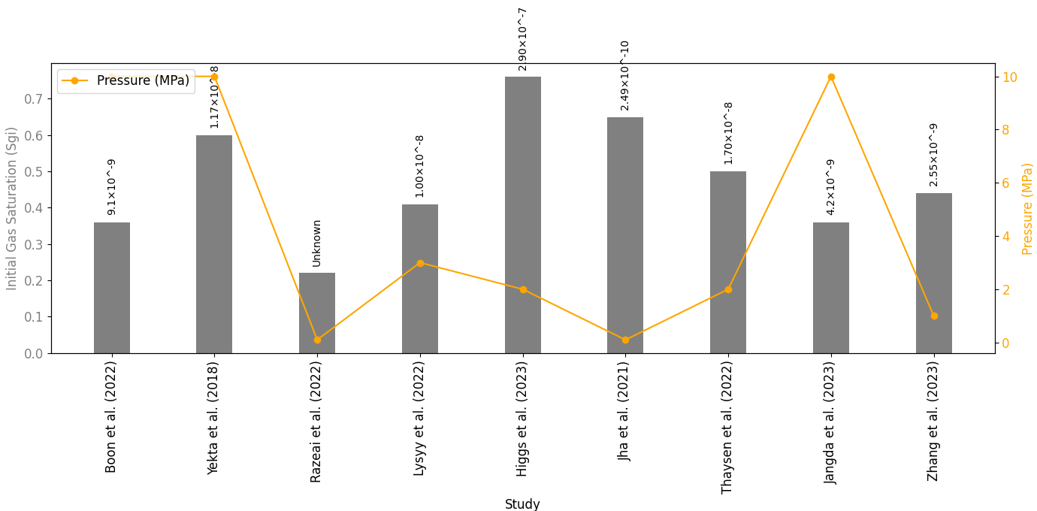
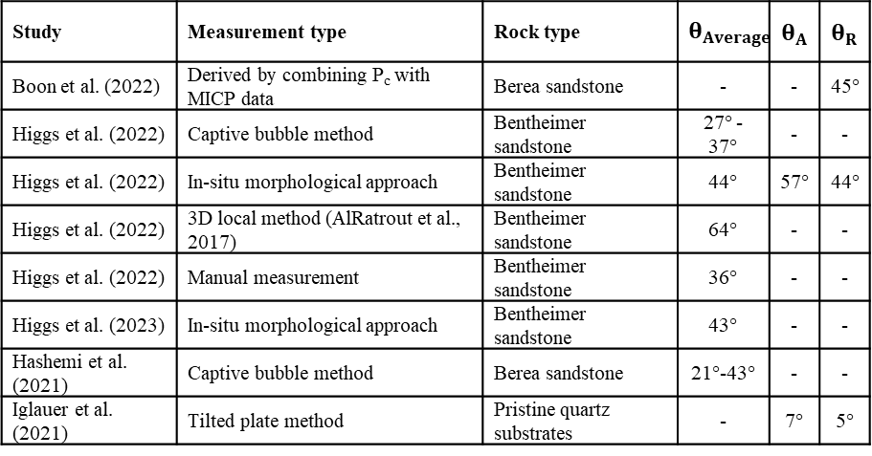
UHS Research Areas
Figure: Drainage capillary pressure experiment and MICP-derived
Capillary pressure hysteresis and initial/residual gas saturation levels
Wettability impacts and contact angle measurements
Gas trapping phenomena and effects
Ostwald ripening in dissolved gas transport
Geochemical interactions and reactive transport processes
Relative permeability assessments
Development of reservoir management and simulation models
MICP
MICP
MICP
Figure: initial gas saturation and pressure/aquifer depth with capillary number
Table: H₂-brine-rock contact angles
Study | Measurement type | Rock type | $$θ_{Average}$$ | $$θ_{A}$$ | $$θ_{R}$$
Boon et al. (2022) | Derived by combining P_{c} with MICP data | Berea sandstone | - | - | 45°
Higgs et al. (2022) | Captive bubble method | Bentheimer sandstone | 27° - 37° | - | -
Higgs et al. (2022) | In-situ morphological approach | Bentheimer sandstone | 44° | 57° | 44°
Higgs et al. (2022) | 3D local method (AlRatrout et al., 2017) | Bentheimer sandstone | 64° | - | -
Higgs et al. (2022) | Manual measurement | Bentheimer sandstone | 36° | - | -
Higgs et al. (2023) | In-situ morphological approach | Bentheimer sandstone | 43° | - | -
Hashemi et al. (2021) | Captive bubble method | Berea sandstone | 21°-43° | - | -
Iglauer et al. (2021) | Tilted plate method | Pristine quartz substrates | - | 7° | 5°
3
Notes:
The main goal is to de-risk this project by conducting laboratory flow experiments and acquire results to improve our models for larger scale pilot projects and implementations. For example, multiple studies conducted primary drainage at different initial pressure conditions and showed a trend of higher saturation at lower pressure or shallower aquifer depth. Several studies explored the contact angle of H2-brine and rock and found hydrogen to be a highly non-wetting phase. Lastly, the reservoir management strategies and modelling provide a blueprint for operational excellence. Each of these areas offers a piece of the puzzle in optimizing UHS for efficiency and reliability. Some research areas only recently became more interesting to study and look at because of the transition from oil and gas to hydrogen or CO2 such as Ostwald ripening. And now, we believe pressure variation will play an important role in UHS.

Slide 4
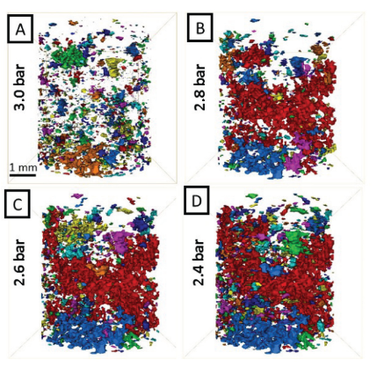
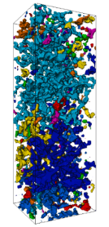
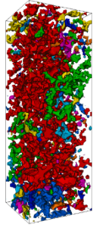
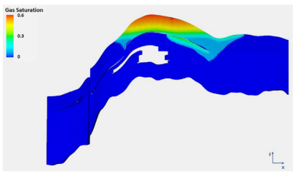
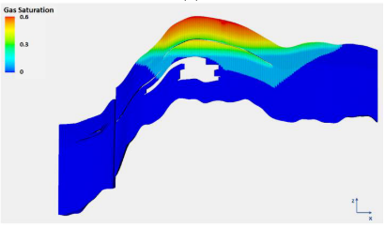
Pressure Decline, Gas Expansion and Remobilisation in Porous Media
Figure: Gas release from liquid-gas system during pressure drawdown (Berg et al., 2020)
The critical gas saturation (S_{gc}): Threshold for gas mobility within the medium
Gas can expand in events of:
Rapid withdrawal without pressure maintenance
Leakage
Pressure propagation near the wellbore
Brine production (Jung, S., 2023)
Trapped gas can remobilise due to pressure decline (Moghadasi et al., 2023)
Ostwald ripening: Transportation of dissolved gas in the aqueous phase (Blunt, 2022 and Zhang et al., 2023)
Figure: CO₂ in the pore space under pressure depletion
Moghadasi et al. (2023)
Figure: CO₂ saturation without brine production (left) and with brine production (right)
Jung, S. (2023)
P_{abs} = 10 MPa
P_{abs} = 6 MPa
4
Notes:
Let’s look here at some studies on pressure variations. in the above study as part of the effort to assess the critical gas saturation in scenarios of pressurisation (compressing) and drawdown, gas is released from solution during drawdown and dissolved in liquid during pressurisation. This was also looked at in the context of CO2 in the bottom right figure for events leakage and pressure depletion. This simulation study on the left compared the injection of CO2 with and without a brine produced well below the gas-water contact and observed larger sequestered CO2 mass and plume with a brine producer. But in the context of UHS, how is pressure variation playing a part:

Slide 5

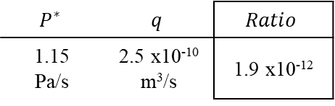



The Role of Pressure Depletion and Gas Expansion
UHS operates on a cyclical basis: Injection during periods of low demand and withdrawal when demand peaks
Significant pressure decline is expected during withdrawal
Rates of pressure decline can differ
Differentiating between invasion percolation and ordinary percolation in UHS (Lenormand et al., 1984)
UHS – Aquifer model
grain
H₂ production
gas
Ordinary
percolation
Pressure gradient
(invasion percolation)
$$∆P= \frac{qLμ}{K}$$
………. (1)
Pressure gradient for displacement
S_{w2}
P₂ < P₁
$$P_{\left(abs\right)}={(P}^{∗}) t={(P}^{∗ })\frac{Lφ}{q}$$
Pore scale
Gas-water contact
………. (2)
Decline in absolute pressure
S_{w1}
P₁
$$Percolation ratio=\frac{q^{2}μ}{K(P^{∗})φ}≪1$$
………. (3)
$$P^{∗}$$ | $$q$$ | $$Ratio$$
1.15 Pa/s | 2.5 x10⁻¹⁰ m³/s | 1.9 x10⁻¹²
Oil & Gas
CO₂ Sequestration
UHS
Injection during excess energy
Pressure increases
Withdrawal during high demand (typically for 90 days)
Pressure declines, likely at a high rate
Assuming 10 MPa decline over 90 days
Continuous production/injection
Pressure is mostly maintained to avoid bubble point or dew point
Mostly injection only
Pressure increases
5
Notes:
Let's talk about the dynamics of pressure in UHS systems compared to oil and gas reservoirs. Unlike oil and gas, where pressure maintenance is crucial to avoid the bubble point or dew point, UHS involves a cycle of withdrawal and injection in response to demand. Therefore, flow experiments under constant pressure may not necessarily be representative of the real case. H2 is injected during excess energy and pressure increases, and withdrawal during high demand and pressure declines likely at a high rate. If we imagine [this] is an aquifer model where hydrogen is stored, during production, the water-gas contact will rise, and this is an imbibition process driven by pressure gradient or invasion percolation. What also happens is that pressure is depleting, and the gas expands in the pore scale as ordinary percolation. So, we have two opposing mechanisms, gas is being displaced through invasion percolation, and gas trying to expand in ordinary percolation process. The pressure gradient displacement follows Darcy’s law, which is considered low compared to the decline in absolute pressure. The ratio of invasion percolation to the drop in pressure is expected to be very small, meaning ordinary percolation is the dominant process. If we assume a 10 MPa absolute pressure drop in a span of 90 days, then the pressure decline rate is around 1 Pa/s. The question to present here is: How would gas expansion look like in these typical pressure decline rates? And how different is it compared to pressure gradient-type displacement.

Slide 6
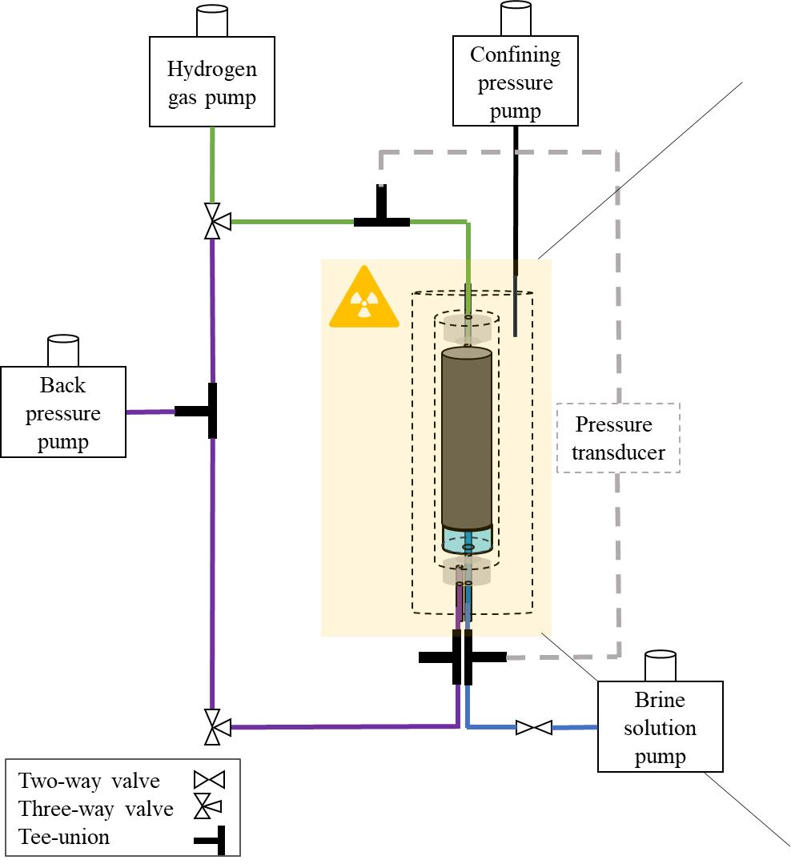
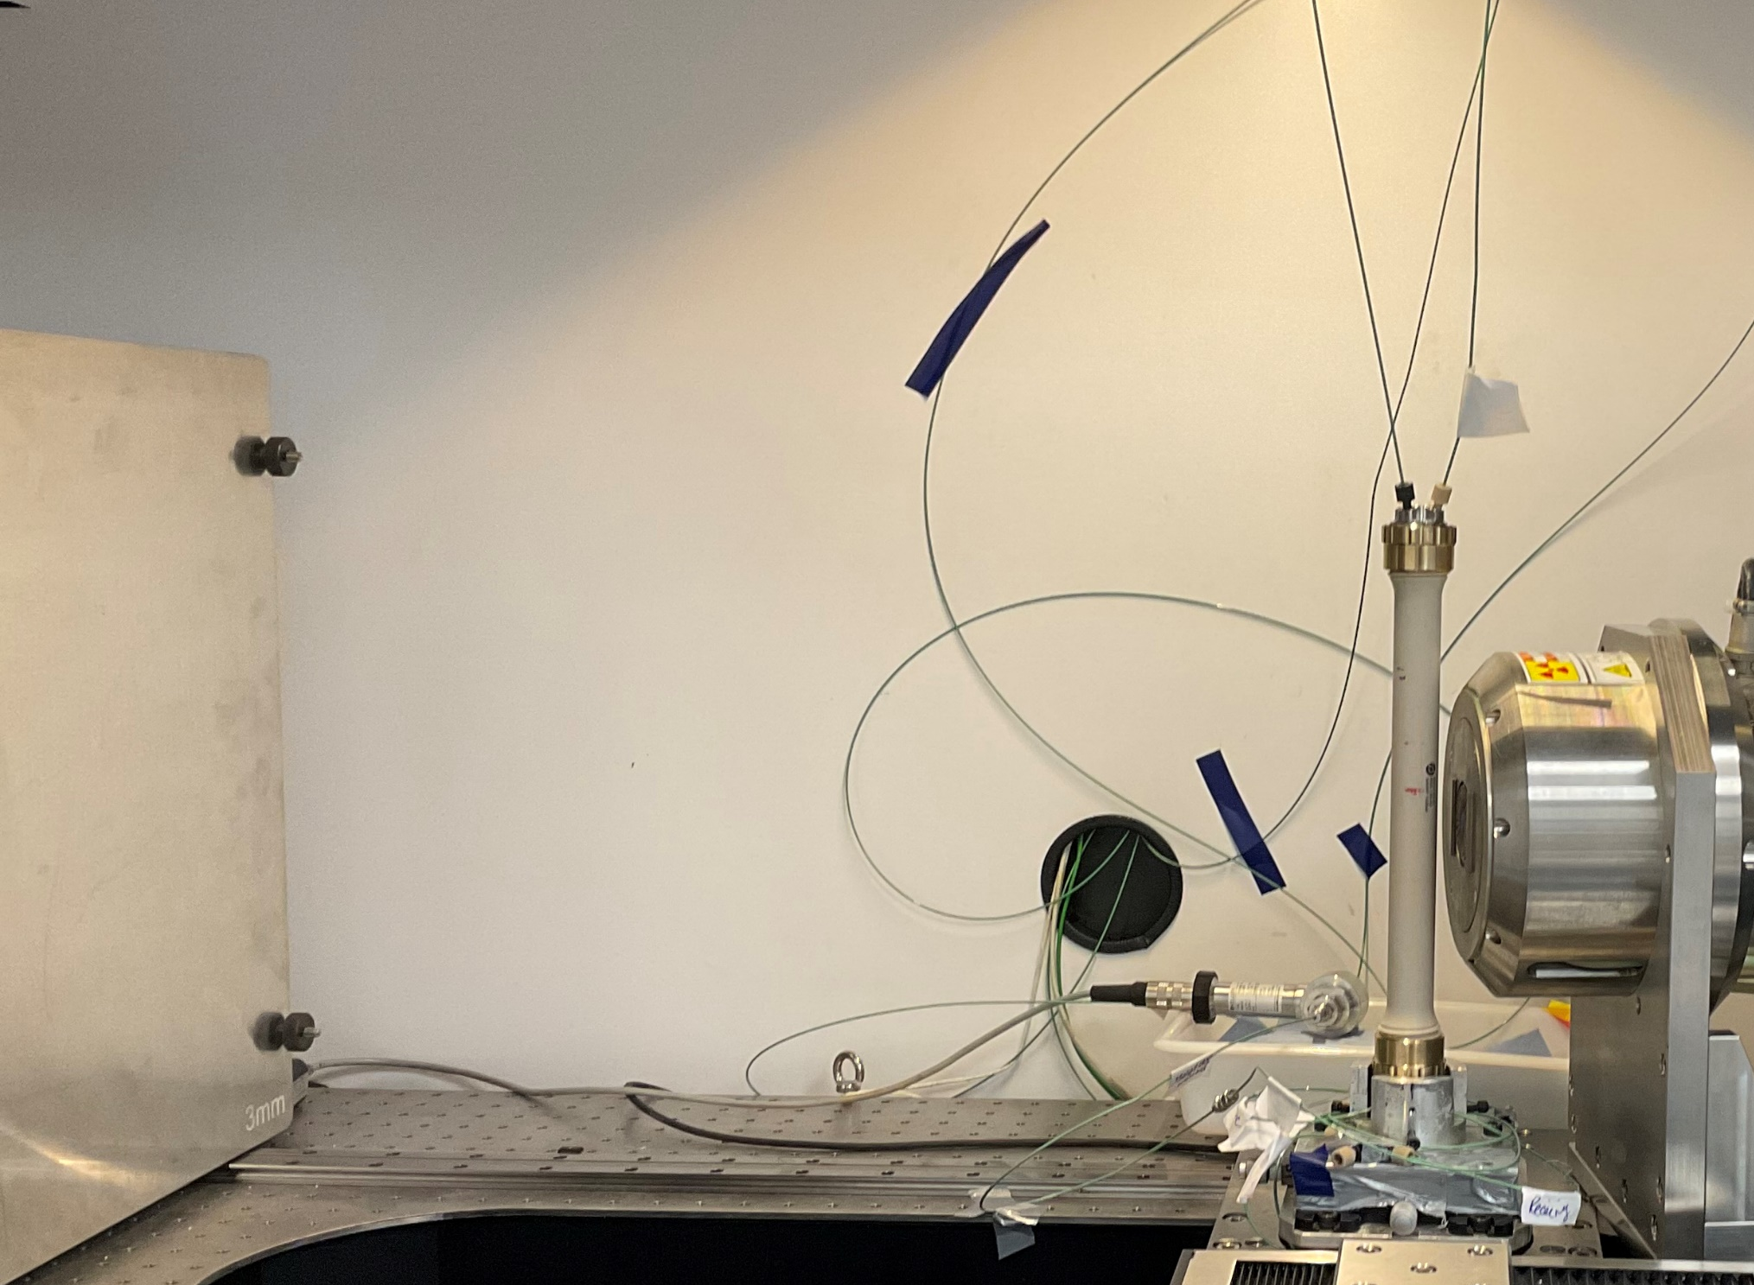
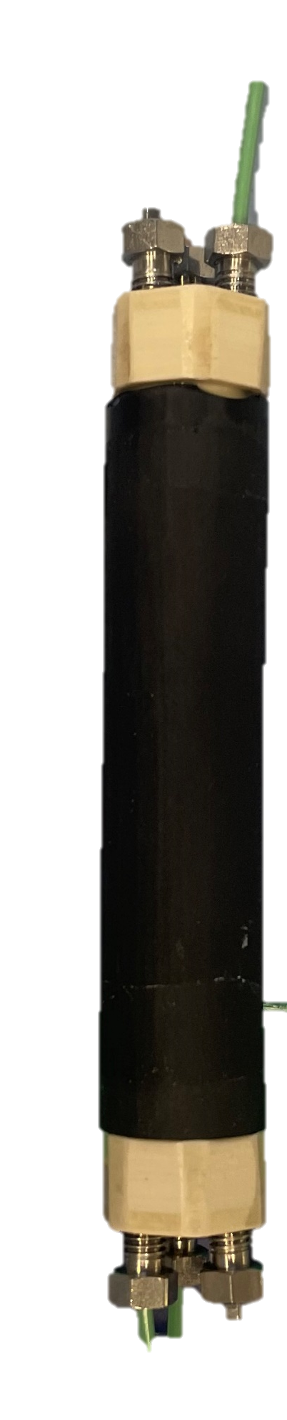
Experimental Design and Methodology
Table: Performed displacements
Bentheimer sandstone (12.4 mm diameter and 31 mm length)
P_{(abs)} = 1 MPa, T = 23 degC
Attach a hydrophilic porous plate at the outlet (P_{e} = 100 KPa)
Fully saturate the rock with brine solution (30 wt.% KI for high contrast)
Inject H₂ using a constant pressure mode at P_{c} = 11 KPa
For gas expansion, drainage displacement is performed for 1 day then stopped to begin the pressure decline sequence
Exp # | Objective | Porous plate | Followed by
1 | Uniform S_{g} | ON | -
2 | Uniform S_{g} | OFF | -
3 | Non-uniform S_{w} | ON | Pressure decline
Table: Pressure decline steps
Type | Pressure decline steps
After 1 day of drainage displacement | 990 KPa , 750 KPa , 570 KPa , 450 KPa , 350 KPa
Hydrogen tube
Injection piece
Core holder
vessel
Nitrile rubber
sleeve
Ceramic porous plate
Brine tube
bypassing the porous plate
Coreholder
Flat panel
Source
6
Notes:
For this, we conduct a flow experiment using a micro-CT scanner. We used a Bentheimer sandstone in meso-scale dimensions. We attached a hydrophilic porous plate at the outlet to limit the capillary end effect and achieve a uniform saturation during capillary pressure drainage process, which we injected using a constant pressure mode at Pc= 11 KPa. We drilled a hole in the porous plate to bypass a receiving tube. This way, we can perform the drainage displacement with and without the porous plate’s influence. To summarise, the first flow experiment is drainage displacement with the porous plate, then repeat for without the porous plate, and repeat but inject for one day and stop to begin the pressure decline sequence and gas expansion.

Slide 7
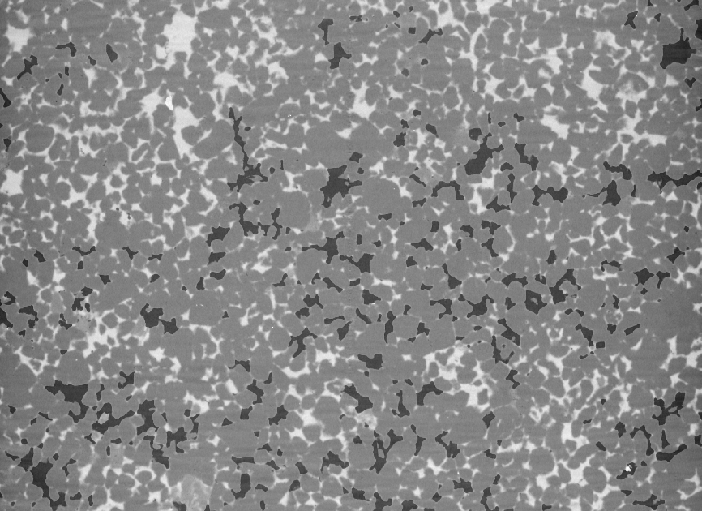

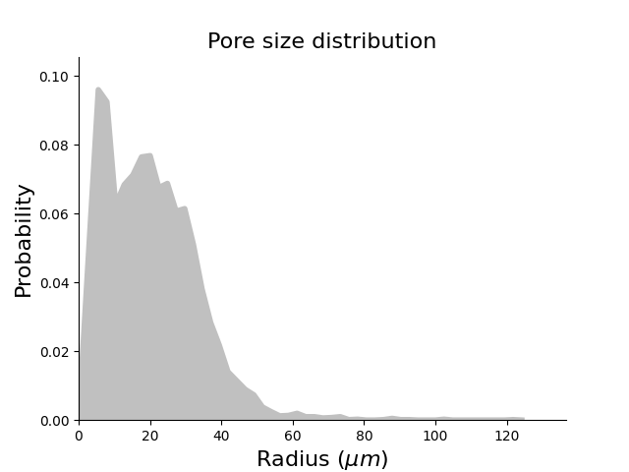
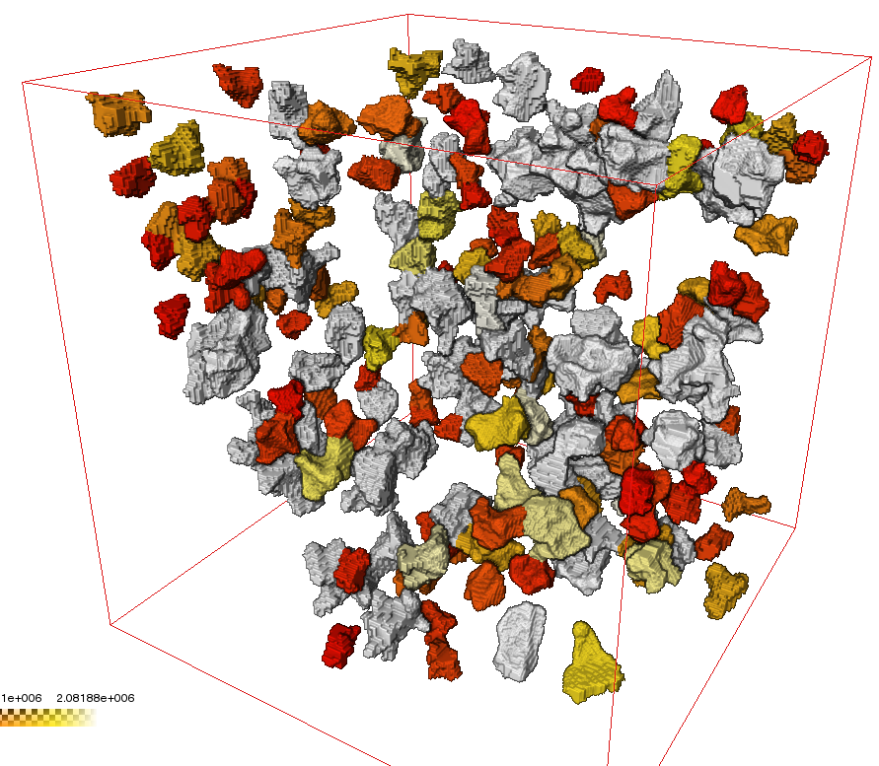
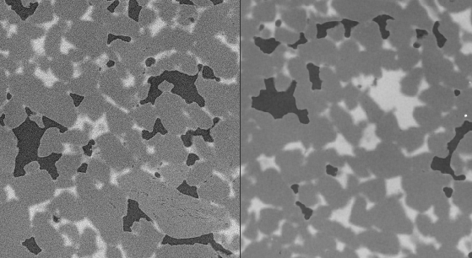
Micro-CT Scanning and Image Processing Procedure
Heliscan micro-CT scanner
Two scanning methods:
Helical scan for quick saturation estimation
Region-of-Interest (ROI) scan for in-depth analysis
Phase segmentation: Watershed algorithm for boundary detection
Sub-volume analysis
Quantify ganglia sizes and its distribution
Measure H₂-brine interfacial curvature
Evaluate the pore occupancy as a function of radius
Heliscan of dry sample
~9.8 µm/voxel
ROI scan of H₂ (dark) and brine (bright) ~2.9 µm /voxel
ROI
Figure: Pore sizes frequency in the Bentheimer sample
500³ voxels sub-volume
~9.4 mm
Non-local means filter for noise reduction
Before (left) and after (right)
~11 mm
Parameter | Heliscan | ROI scan
Exposure time, s | 0.2 | 0.62
Scan duration, h:min | 1:24 | 8:58
7
Notes:
We used a helical-type micro-CT scanner and deployed two scanning methods: a helical scan at a resolution of 10 micro-meter per voxel for quick saturation estimation, and a region-of-interest scan at 2.9 micro-meter per voxel for in depth analysis such as quantifying ganglia sizes, interfacial curvature and for pore-network model extraction. This is a cross section example with hydrogen in black, brine in white and below is an example of noise reduction in the raw images.

Slide 8
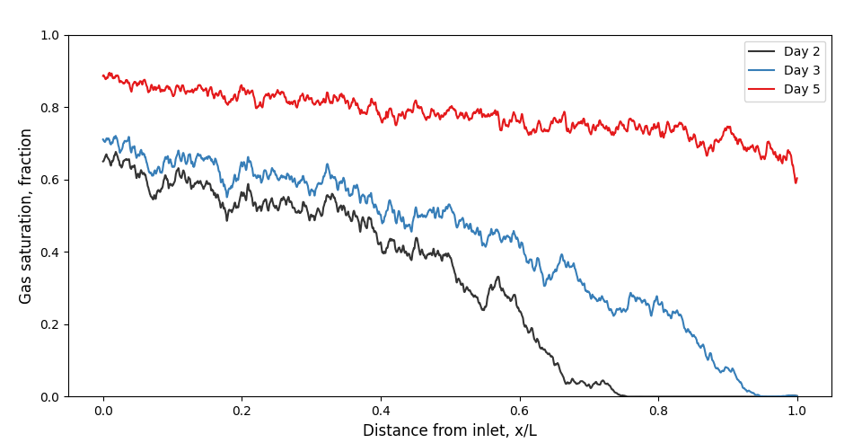
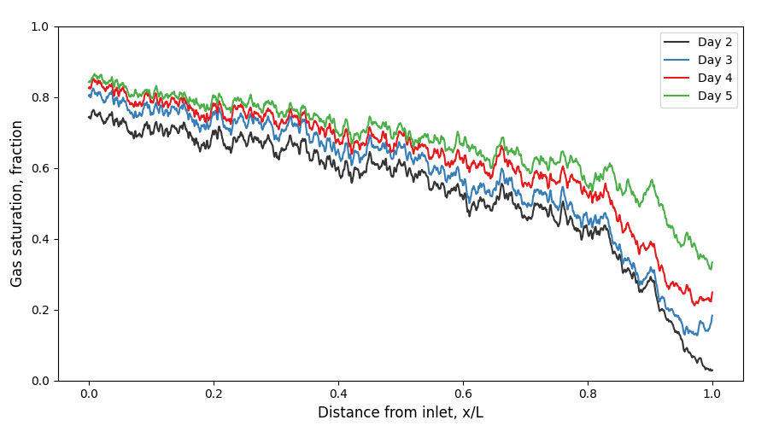
Results: Drainage Displacement with and without the Porous Plate
Figure: Drainage at P_{c} = 11 KPa with active porous plate
Capillary end effect is reduced when the porous plate is used
S_{w(avg)} = 20% at P_{c} = 11 KPa
Uniform initial gas saturation (S_{gi}) is imposed using the porous plate
Faster gas breakthrough at the outlet without the porous plate, though saturation increases slowly with the ongoing hydrogen production
When near the porous plate, hydrogen saturation rises significantly and evenly
Figure: Primary drainage capillary pressure of the Bentheimer rock
Figure: Drainage at P_{c} = 11 KPa without the porous plate
8
Notes:
Now for the interesting part. Here are the results of the drainage displacement experiments with and without the porous plate. Our findings indicate that the capillary end effect, a critical factor in fluid movement, is significantly reduced when using a porous plate. Also, we notice that hydrogen reached the outlet faster without the porous plate (comparing the black trendline in both plots). The uniform average saturation is about 80%, which agrees with the MICP-driven drainage capillary pressure published by Higgs and others in 2023. We want to compare how this invasion percolation process differs from gas expansion due to pressure decline:

Slide 9
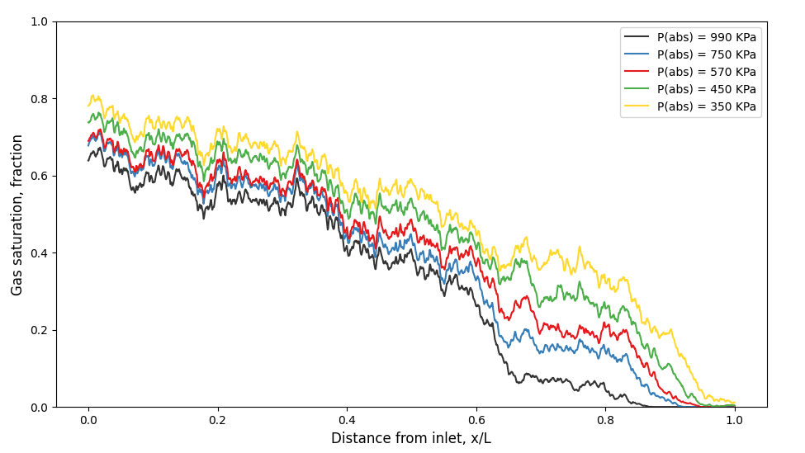
Invasion Percolation vs Ordinary Percolation: Saturation Profiles
Figure: Gas saturation profile in invasion percolation
Ordinary percolation exhibits preferential expansion, particularly from 0.6 to 0.9 x/L
Expansion patterns differ from pressure gradient drainage by laterally extending rather than moving frontally
Approximately 10% of the total added volume is attributed to dissolved hydrogen release from brine due to pressure reduction
Some expanded hydrogen is thought to be produced at the inlet (pump-intake)
Table: Release of dissolved hydrogen volume during pressure decline
Figure: Gas saturation profile in pressure decline – ordinary percolation
P(abs), KPa | H₂ volume, cm³ | Moles of H₂ in water | H₂ released from water, cm³ | Fraction of the released H₂ to the expanded H₂
990 | 0.32 | 5.2 x10⁻⁶ | - | -
750 | 0.37 | 3.7 x10⁻⁶ | 5.1 x10⁻³ | 0.11
570 | 0.40 | 2.7 x10⁻⁶ | 4.4 x10⁻³ | 0.15
450 | 0.45 | 1.9 x10⁻⁶ | 4.1 x10⁻³ | 0.08
350 | 0.50 | 1.4 x10⁻⁶ | 4.0 x10⁻³ | 0.08
porosity
9
Notes:
The top plot is the pressure gradient displacement or invasion percolation at different days, and the bottom plot is the gas saturations at different pressure steps. We notice differences in how the gas is percolating in these two scenarios: in gas expansion there is slower frontal advancement and preferential expansion between 60 and 90% of the sample’s length in the region of higher porosity. We then estimated how much dissolved hydrogen is released at each of the pressure declining steps and found it to be slightly less than 10% of the total added gas volume, which is low as expected due to the low solubility of hydrogen in brine.

Slide 10
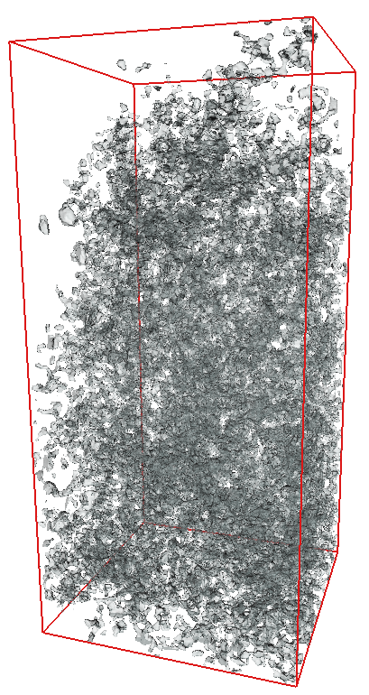
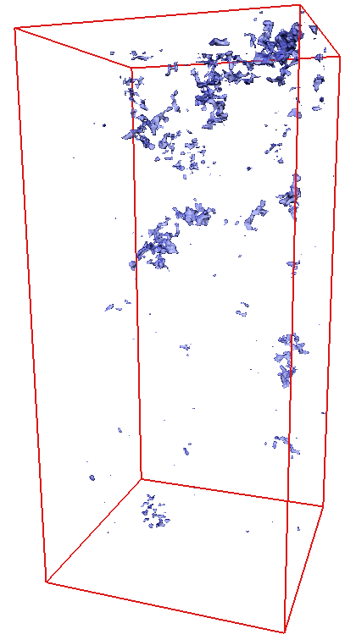
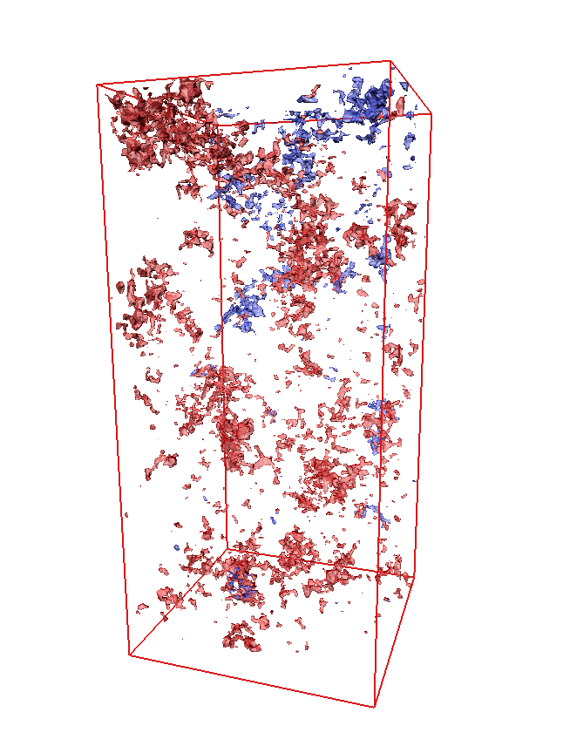
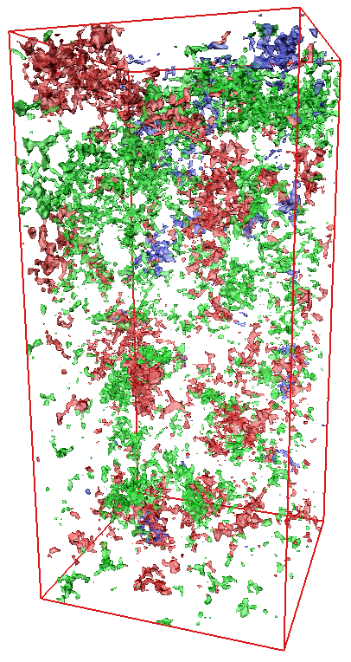
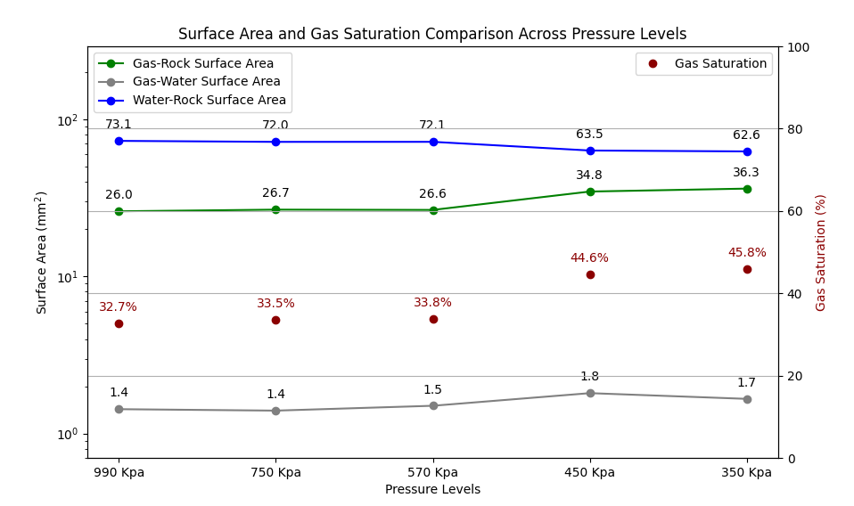
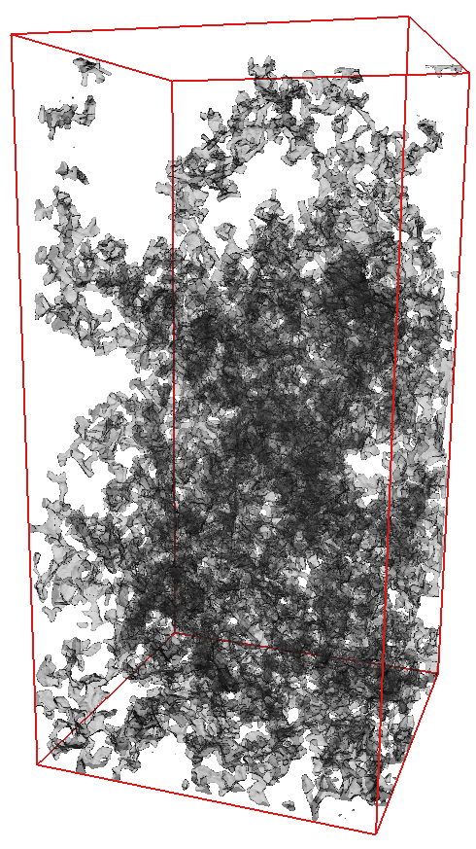
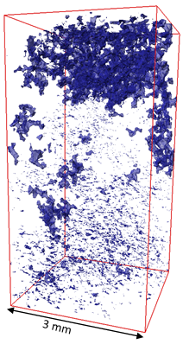
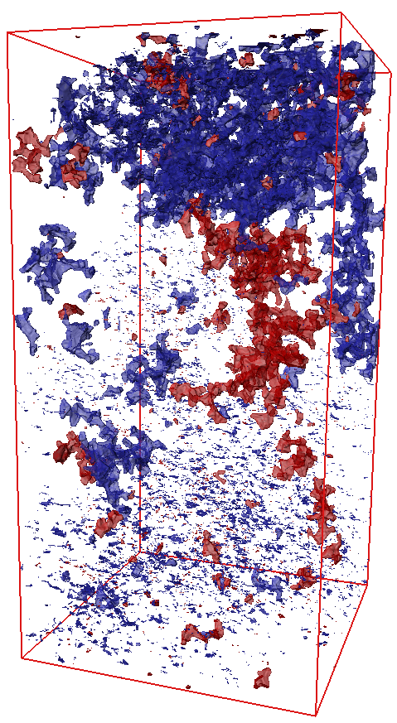
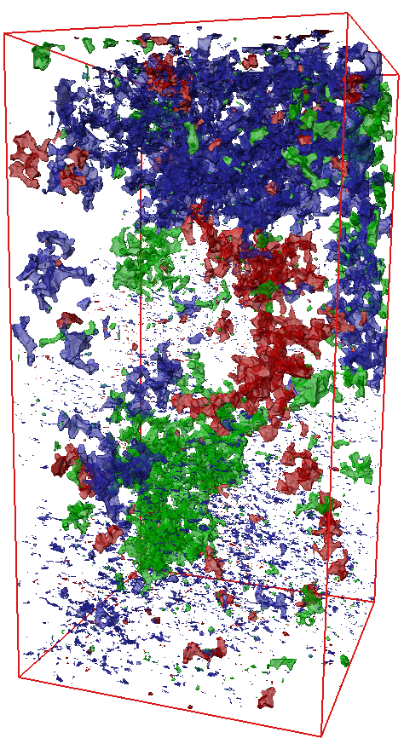
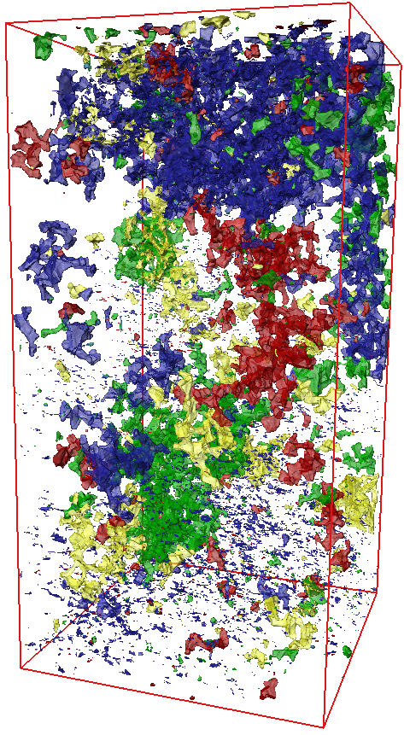
Visualisation: Expanded Gas Volume in Invasion vs Ordinary Percolations
In invasion percolation, the added gas invades in a more scattered or dispersed fashion
Ordinary percolation shows a more unified gas percolation path
During ordinary percolation, gas preferentially fills less gas saturated regions
After the first pressure decline, gas swelled against the pores’ surface in the lower region of the sample
Gas-rock surface area increased in the lower region
Figure: Regions of injected gas volume at different days in invasion percolation
Flow direction
3 mm
Figure: Surface area of the 3 phases and gas saturation in pressure decline
Day 2 (initial)
Day 3
Day 4
Day 5
Figure: Regions of expanded (added) gas volume at different pressures in ordinary percolation
P = 990 KPa
(initial)
10
P = 750 KPa
P = 570 KPa
P = 450 KPa
P = 350 KPa
Notes:
Our visual analysis, backed by micro-CT imaging, illustrates the stark contrasts between invasion and ordinary percolations. Please note that the top is invasion percolation and bottom is gas expansion or ordinary percolation and each color shows the (additional) gas volume from either injection or expansion and the black is the initial. What follows are the additions in each subsequent day or pressure by color. In invasion percolation (the top row of 3D visuals), gas invasion appears scattered, while in ordinary percolation (the bottom row) the expanded gas follows a more coherent path and better connectivity and larger ganglia. Please note also the gas rapidly occupied the least gas saturated region in ordinary percolation more than in invasion percolation. We also noticed after the initial pressure drop additions (in blue) on the bottom region which hasn’t appeared again in either red, green or yellow. This indicates initial swelling of the gas ganglia due to expansion and if [click] we look at the surface area, we notice an increase in the gas-rock surface area from 26 to 26.7 while the saturation mainly stayed the same in that time and in that swollen region. Let’s now look at how gas ganglia distribution look like:

Slide 11
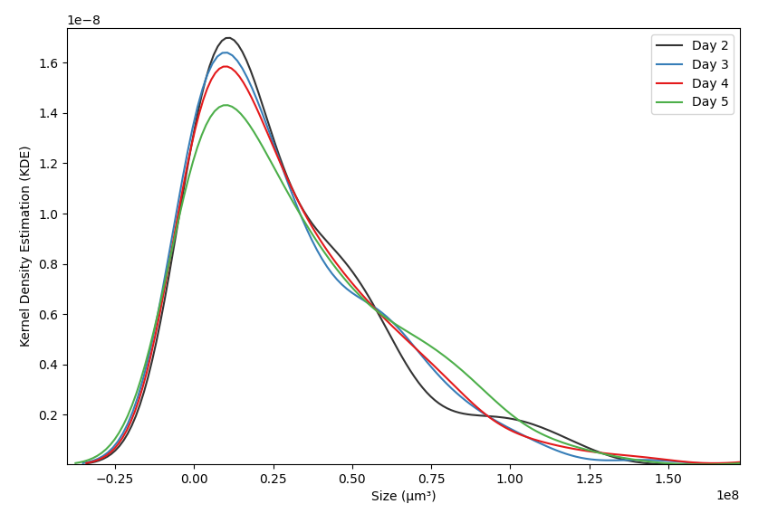
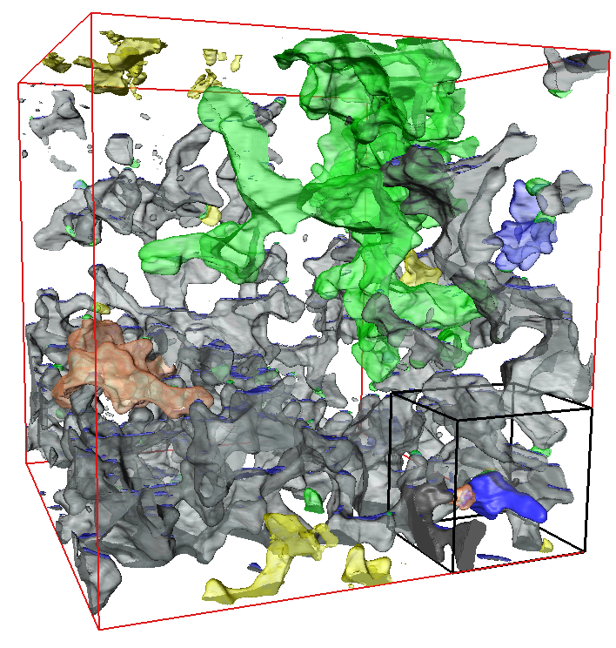
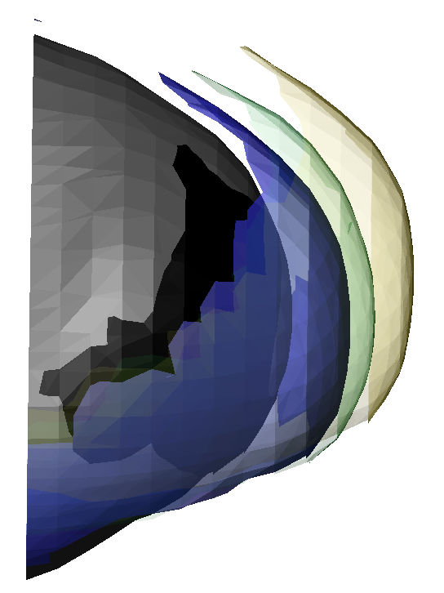
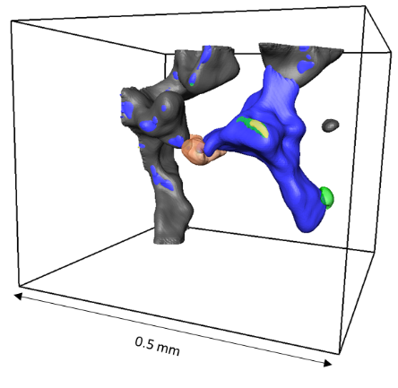
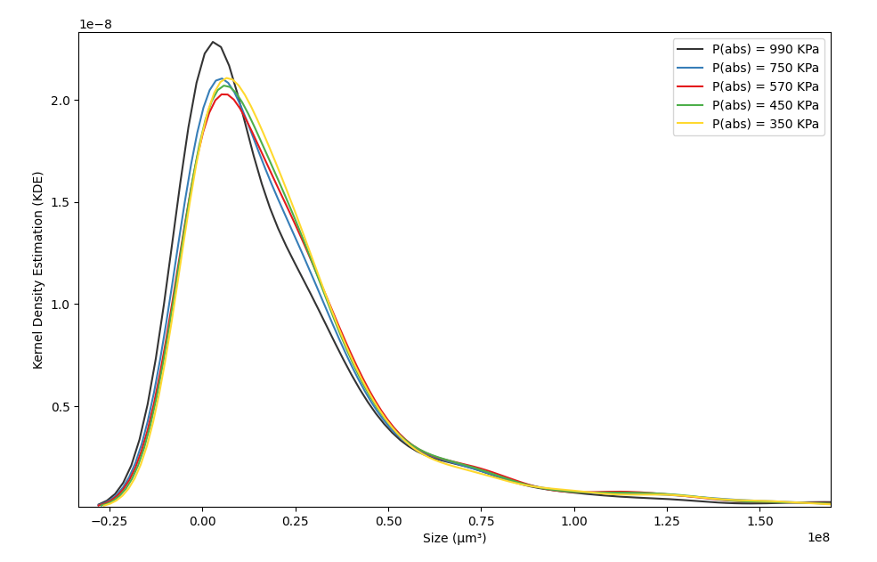
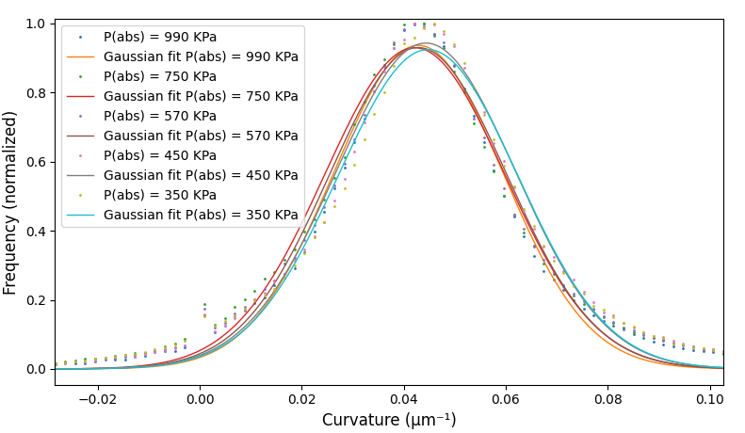
H₂-Brine Interfacial Curvature and Quantification of Gas Ganglia Sizes
Figure: Ganglia sizes in invasion percolation process
In invasion percolation: consistent mode of gas ganglia sizes, while slightly skewed to smaller pores
During gas expansion:
See larger gas ganglia, suggesting ganglia growth
The most significant size shift occurs following the initial pressure decline
Mean H₂-brine curvature increases
H₂ –brine local capillary pressure in pressure decline
P_{c}= 2030 Pa
P_{c}= 2062 Pa
P_{c}= 2160 Pa
Figure: Ganglia sizes in ordinary percolation process
1.5 mm
~40 µm
Figure: Curvature-based capillary pressure at subsequent pressure drops
11
Notes:
Let me take your attention to the plots on the right to examine the sizes of gas ganglia. Same as before, the top is for invasion percolation and bottom is for gas expansion. In invasion percolation, we noticed a consistent size mode while slightly skewed to smaller sizes, and in gas expansion, we observed a trend towards larger gas ganglia, particularly after the first pressure drop. This proves that in ordinary percolation, more larger pores are invaded. This growth indicated an evolving interfacial curvature, if we look at the graphs on the left, the mean interfacial curvature is in an increasing trend. This is an example showing the evolution of the interfacial curvature under gas expansion.

Slide 12
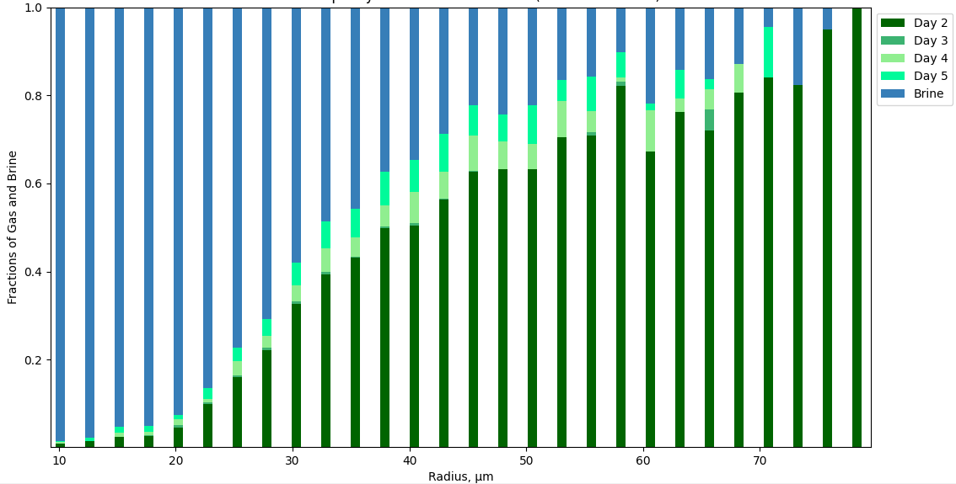
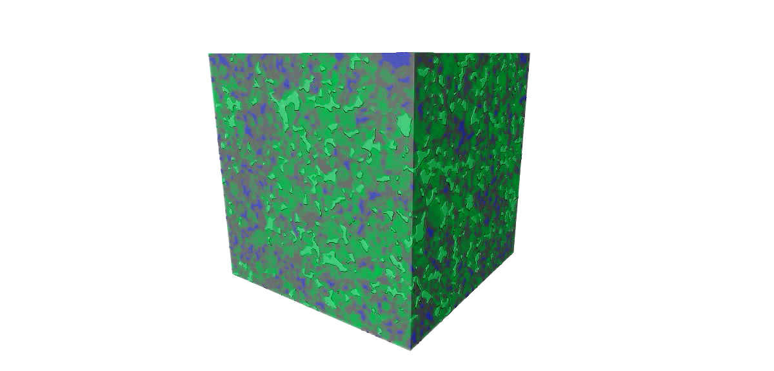
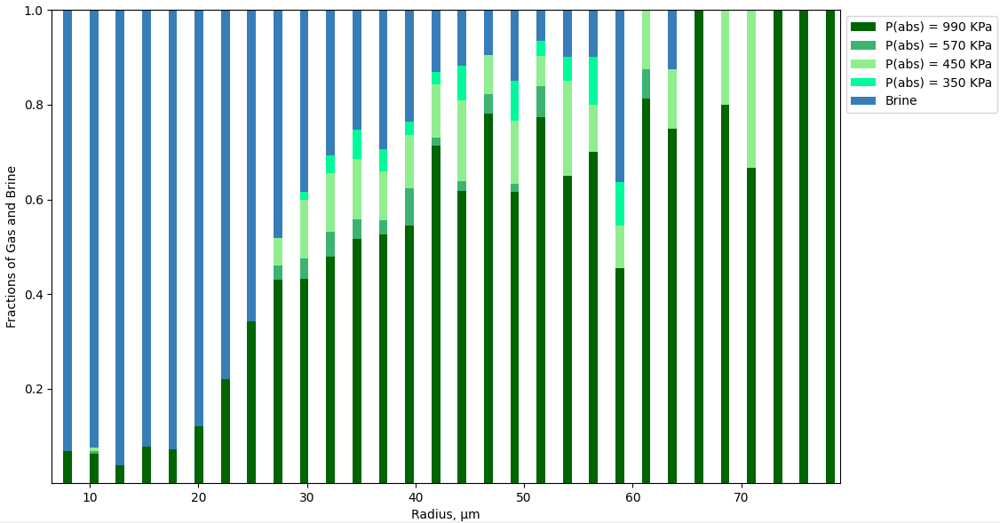
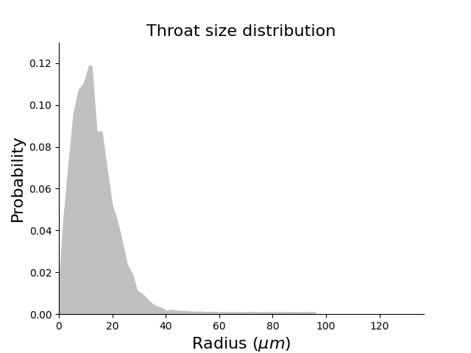
PNM: Pore Occupancy in Invasion vs Ordinary Percolations
Figure: Pore occupancy of gas in invasion percolation
Extracted a 1000³ voxels pore network model to quantify pore occupancy as a function of radius
Average pore radius is around 25 µm, with pores as large as 80 and as small as 10 µm
Invasion percolation demonstrates widespread pore filling across various sizes
Ordinary percolation predominantly occupies the larger pore spaces
grain
gas
Brine
Figure: Pore occupancy of gas in ordinary percolation
Figure: Extracted pore network model pore and throat radii distribution
12
Notes:
We extracted a 1000³ voxels and ran a pore network model to quantify the pore occupancy across a spectrum of radii, witnessing a fascinating trend. While invasion percolation fills most pores, gas expansion selectively occupies larger pores. This is because in ordinary percolation, everywhere in the porous medium is available and therefore pores with lower entry pressure are first filled. Because of the nature of pressure-gradient displacement, smaller pores can be filled in the process.

Slide 13
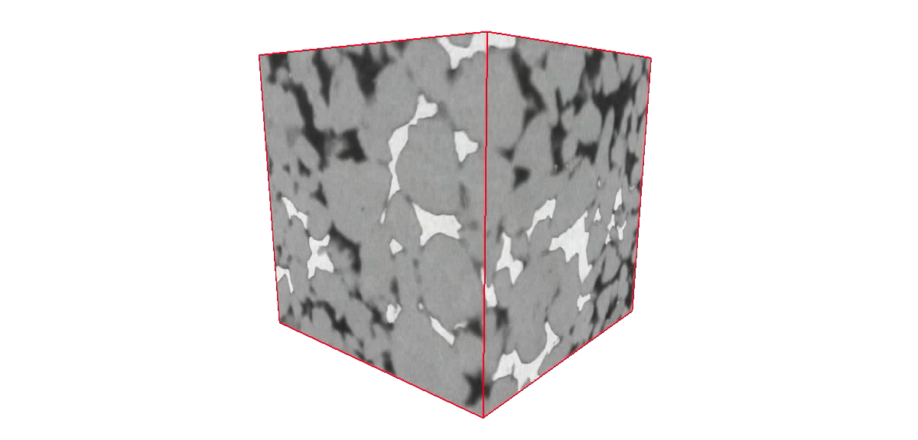
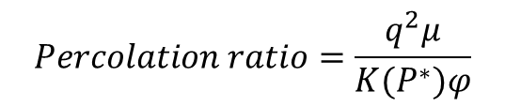
Lessons Learned
Gas expansion behaves as an ordinary percolation process.
Pressure depletion and gas expansion enhances gas connectivity upon withdrawal.
Gas expansion's ordinary percolation exhibits different pore occupancy patterns compared to pressure gradient displacement.
Laboratory-scale pressure gradient displacement will invade smaller pores before achieving steady-state conditions.
Future Work
Investigate the combined impact of pressure decline and gas displacement in UHS.
Assess capillary pressure hysteresis and residual gas saturation (S_{gr}) during pressure decline and imbibition displacement.
Explore the effects of pressure decline on gas relative permeability in porous media.
Conduct sensitivity analysis on percolation ratios, focusing on varying pressure decline rates.
$$Percolation ratio=\frac{q^{2}μ}{K(P^{∗})φ}$$
13
Notes:
To conclude, our research into UHS has yielded several key lessons. We've learned that gas expansion follows an ordinary percolation process, and that pressure depletion can actually enhance gas connectivity—essential for efficient withdrawal. Looking ahead, we aim to study the combined effects of pressure decline and imbibition displacement, re-evaluate capillary pressure hysteresis in conjunction with pressure decline, and assess the impact on gas relative permeability. Also, sensitivity tests on various percolation ratios will further our understanding of these complex systems.

Slide 14

Thank You Happy to discuss and answer questions
Email - waleed.dokhon21@imperial.ac.uk
My LinkedIn profile
Notes:
Thank you for being a great audience and I’ll be more than happy to discuss and answer questions.

