Slide 1
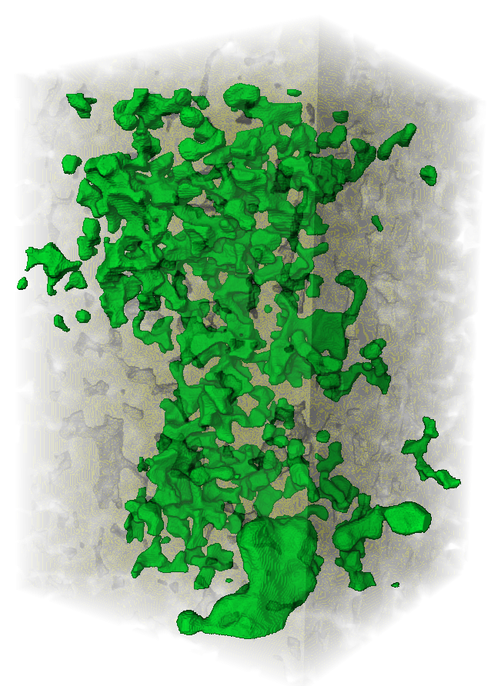


Ostwald Ripening Leads to Less Hysteresis during Hydrogen Injection and Withdrawal
Sepideh Goodarzi, Branko Bijeljic and Martin J. Blunt
Digital Rock Phase 2
January 2024

Slide 2
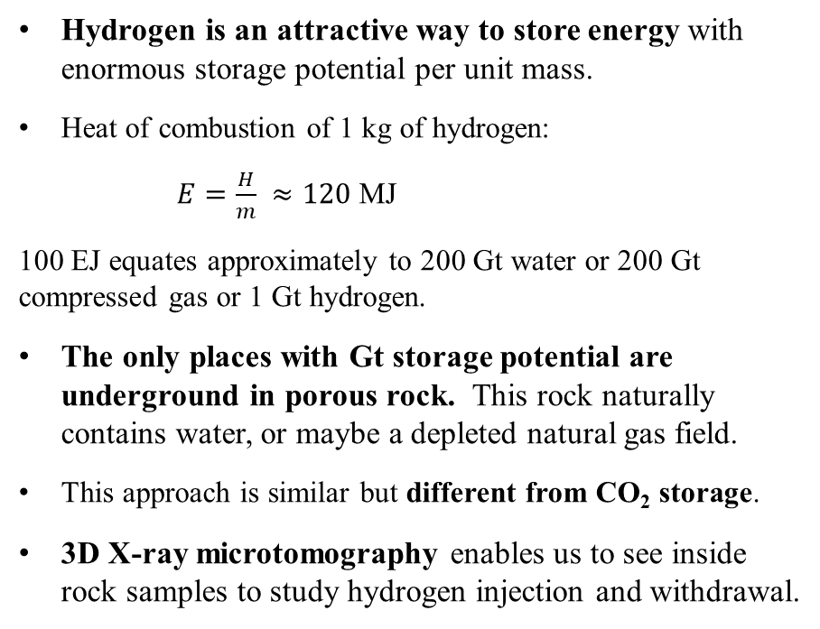
Underground hydrogen storage in porous reservoirs
Hydrogen is an attractive way to store energy with enormous storage potential per unit mass.
Heat of combustion of 1 kg of hydrogen:
$E=\frac{H}{m} ≈120$ MJ
100 EJ equates approximately to 200 Gt water or 200 Gt compressed gas or 1 Gt hydrogen.
The only places with Gt storage potential are underground in porous rock. This rock naturally contains water, or maybe a depleted natural gas field.
This approach is similar but different from CO₂ storage.
3D X-ray microtomography enables us to see inside rock samples to study hydrogen injection and withdrawal.
B D
Drainage
Hysteresis loop
Capillary Pressure
Imbibition
E C A
Water Saturation
24th Anniversary of the Imperial College Consortium on Pore-Scale Modelling and Imaging

Slide 3
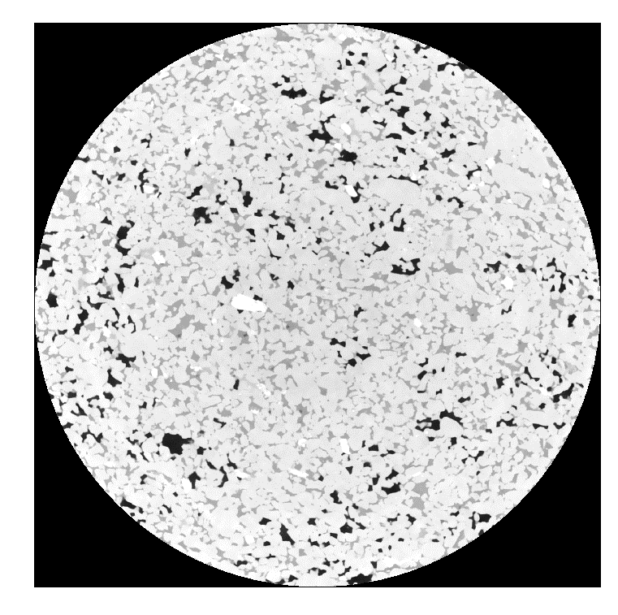
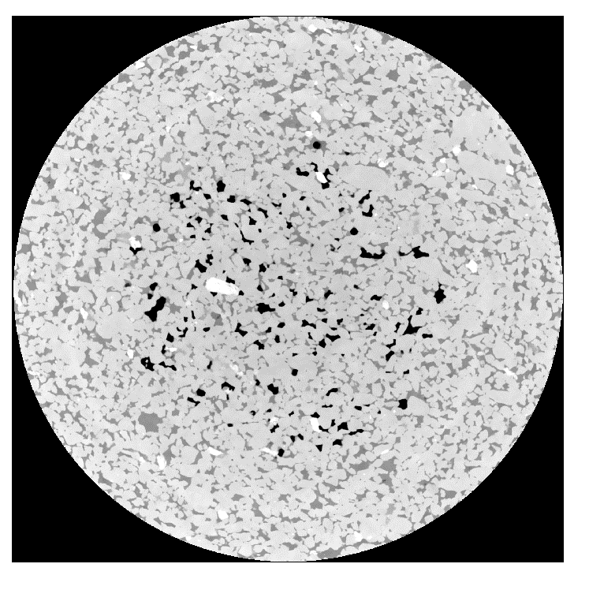
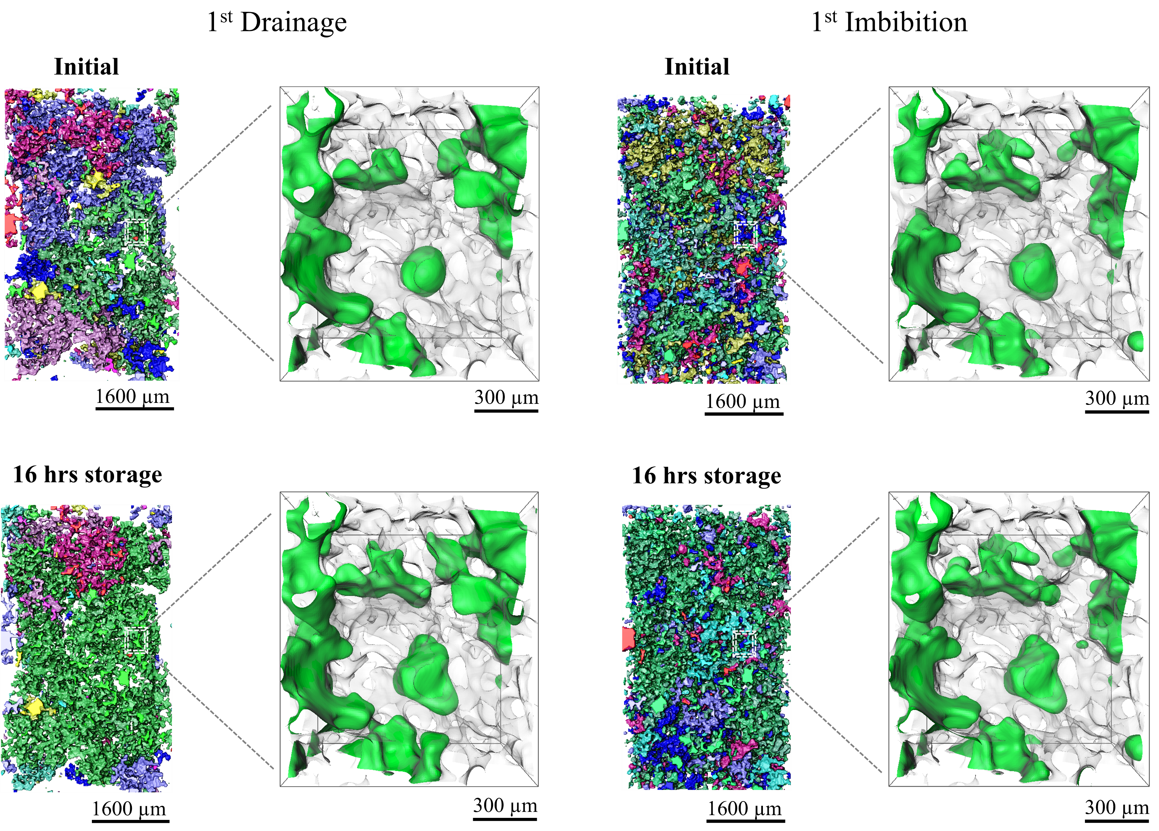
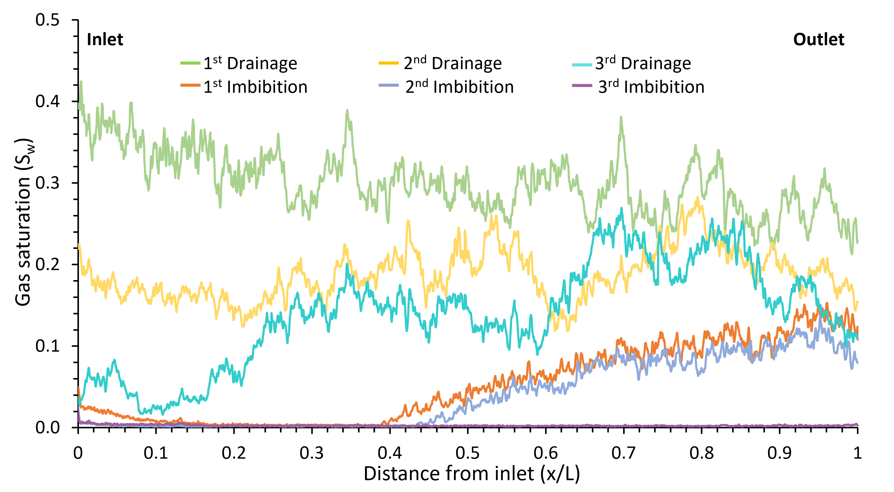
Key insights from previous work
Increased connectivity
1st Drainage
1st Imbibition
Hydrogen tends to occupy the larger regions of the pore space.
Without flow there is a significant rearrangement of the hydrogen within the pore space.
Ostwald ripening-a single large ganglion dominating the volume.
16 hrs storage
Possibility of hydrogen withdrawal through a connected pathway
Injecting H₂
Injecting H₂O
Small bubble
Big bubble
16 hrs storage
Non-uniform gas saturation profile
Low initial gas saturation
Published in International Journal of Hydrogen Energy: https://doi.org/10.1016/j.ijhydene.2023.12.029
Shrinkage of ganglia
24th Anniversary of the Imperial College Consortium on Pore-Scale Modelling and Imaging

Slide 4
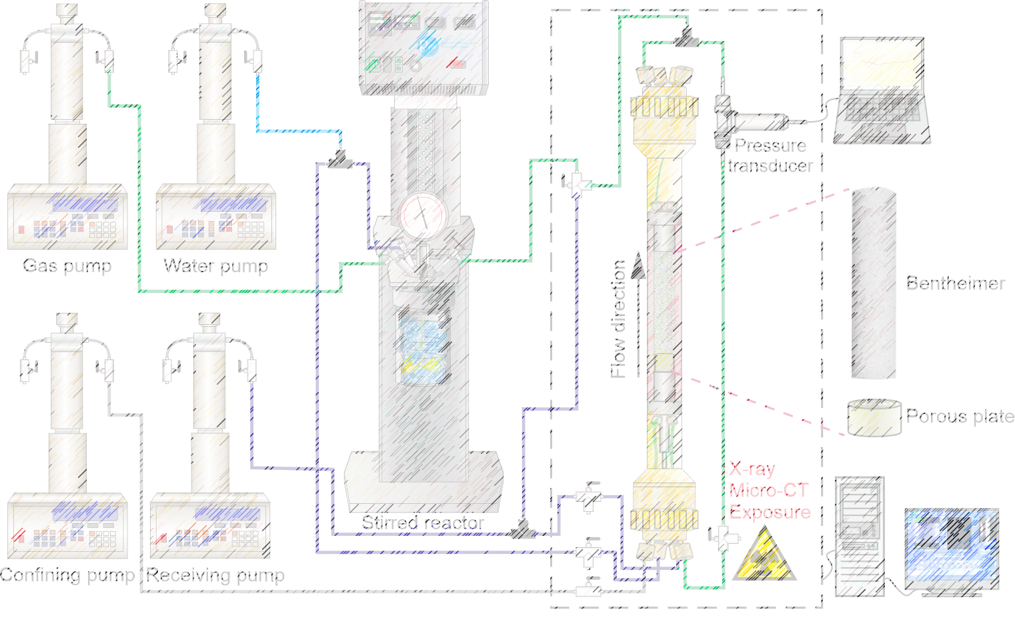
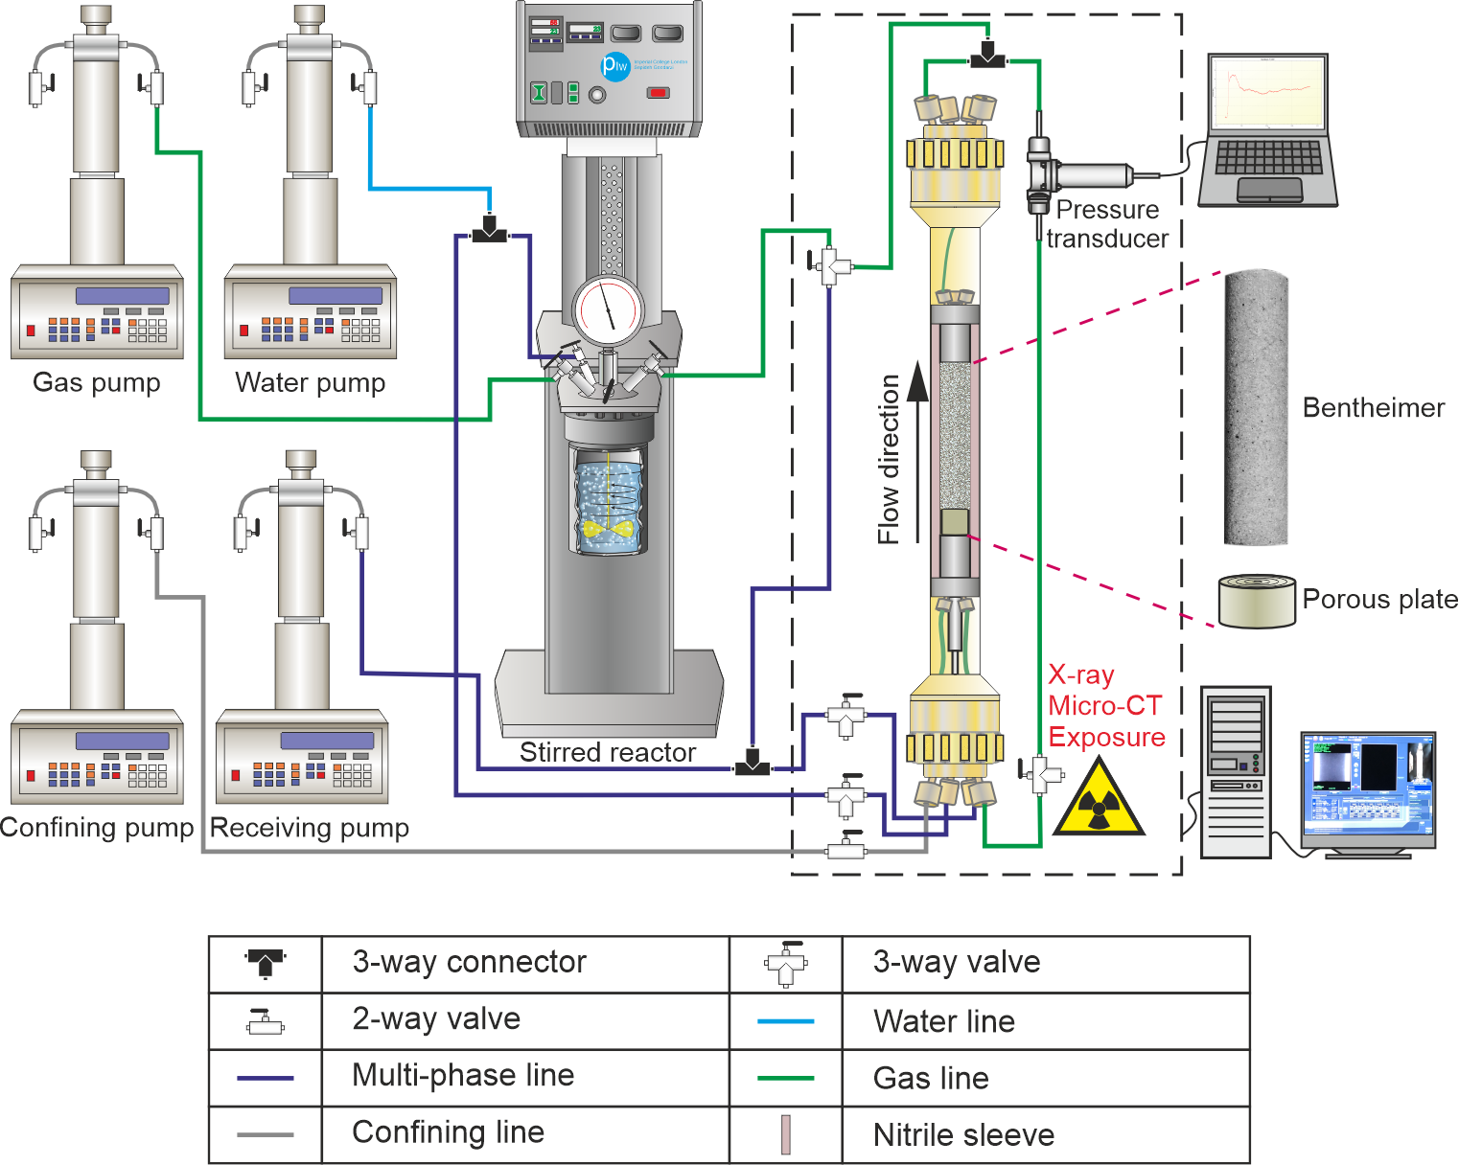
Repeated 3 flooding cycles- Hydrogen and Brine
Hydrogen
Porous plate to allow a higher initial hydrogen saturation.
Using imposed pressures to determine capillary pressure in drainage.
Pre-equilibrated brine to reduce the effect of dissolution.
Higher pressure, 8 MPa, to better represent reservoir conditions.
D=12.8 mm & L=60 mm
Brine
Injecting
H₂
From Top
Bottom-to-top scan
Injecting
brine
From bottom
Bottom-to-top scan
storage
Bottom-to-top scan
Cycle 1
16 hrs
24th Anniversary of the Imperial College Consortium on Pore-Scale Modelling and Imaging

Slide 5
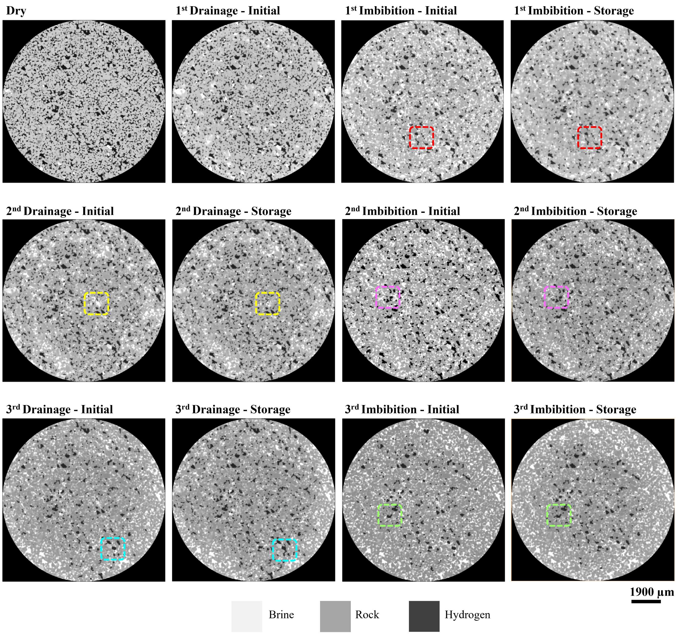
Gas rearrangement observed from grey scale images
Imaging was performed using a Zeiss Xradia 510 X-ray scanner, equipped with a flat panel detector.
The exposure duration was set at 1.2 seconds, with a total of 3001 projections.
In total, the images spanned 3023 voxels in the x-direction, 3064 voxels in the y-direction, and 11586 voxels in the z-direction.
The detector delivered three-dimensional images featuring a voxel size of 5.4 μm.
Initial
16 h storage
200 µm
24th Anniversary of the Imperial College Consortium on Pore-Scale Modelling and Imaging

Slide 6
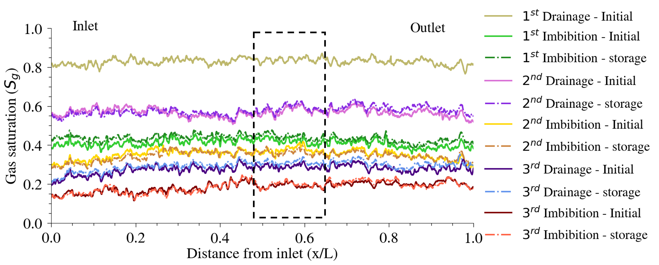
Uniform gas saturation profile after gas and water injection
High initial gas saturation after hydrogen injection.
Uniform gas saturation after injection and withdrawal.
Average initial gas saturation: 84%
Average residual gas saturation: 42%
24th Anniversary of the Imperial College Consortium on Pore-Scale Modelling and Imaging

Slide 7
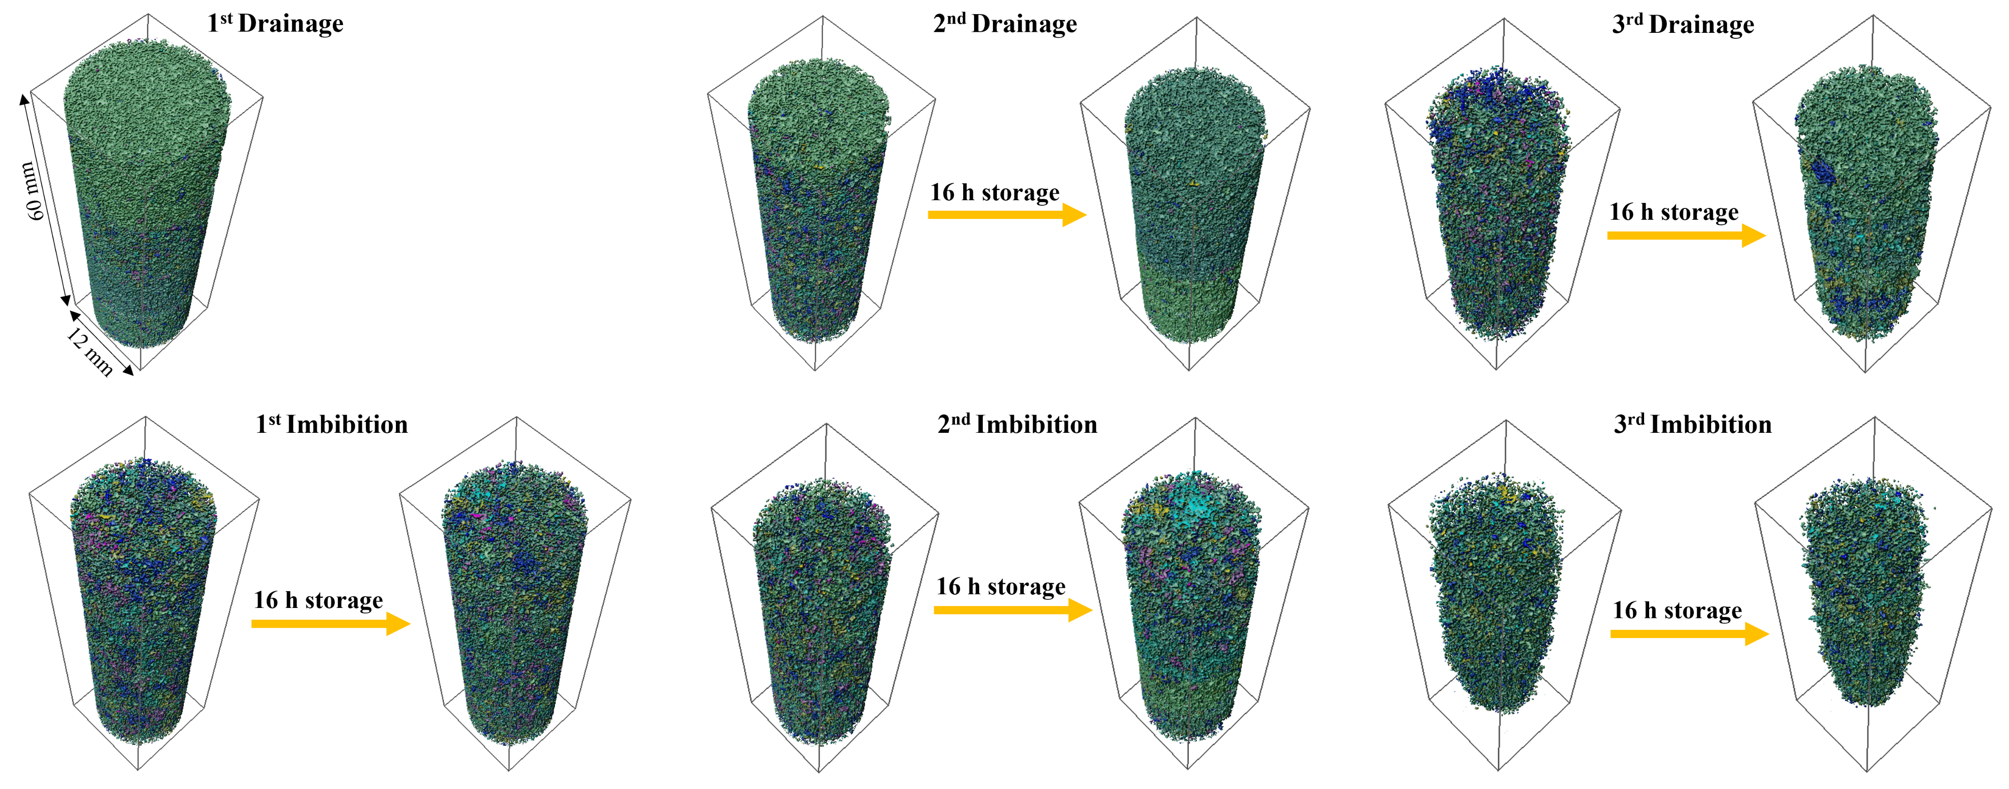
Formation of a single, large connected ganglion
24th Anniversary of the Imperial College Consortium on Pore-Scale Modelling and Imaging

Slide 8
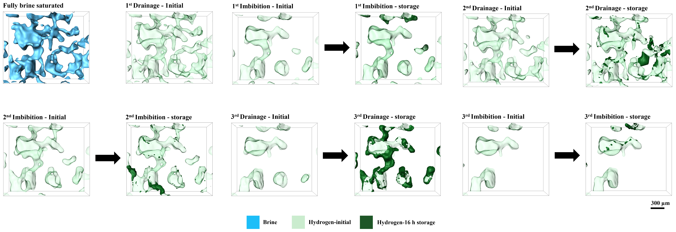
Zoomed-in images of hydrogen
24th Anniversary of the Imperial College Consortium on Pore-Scale Modelling and Imaging

Slide 9
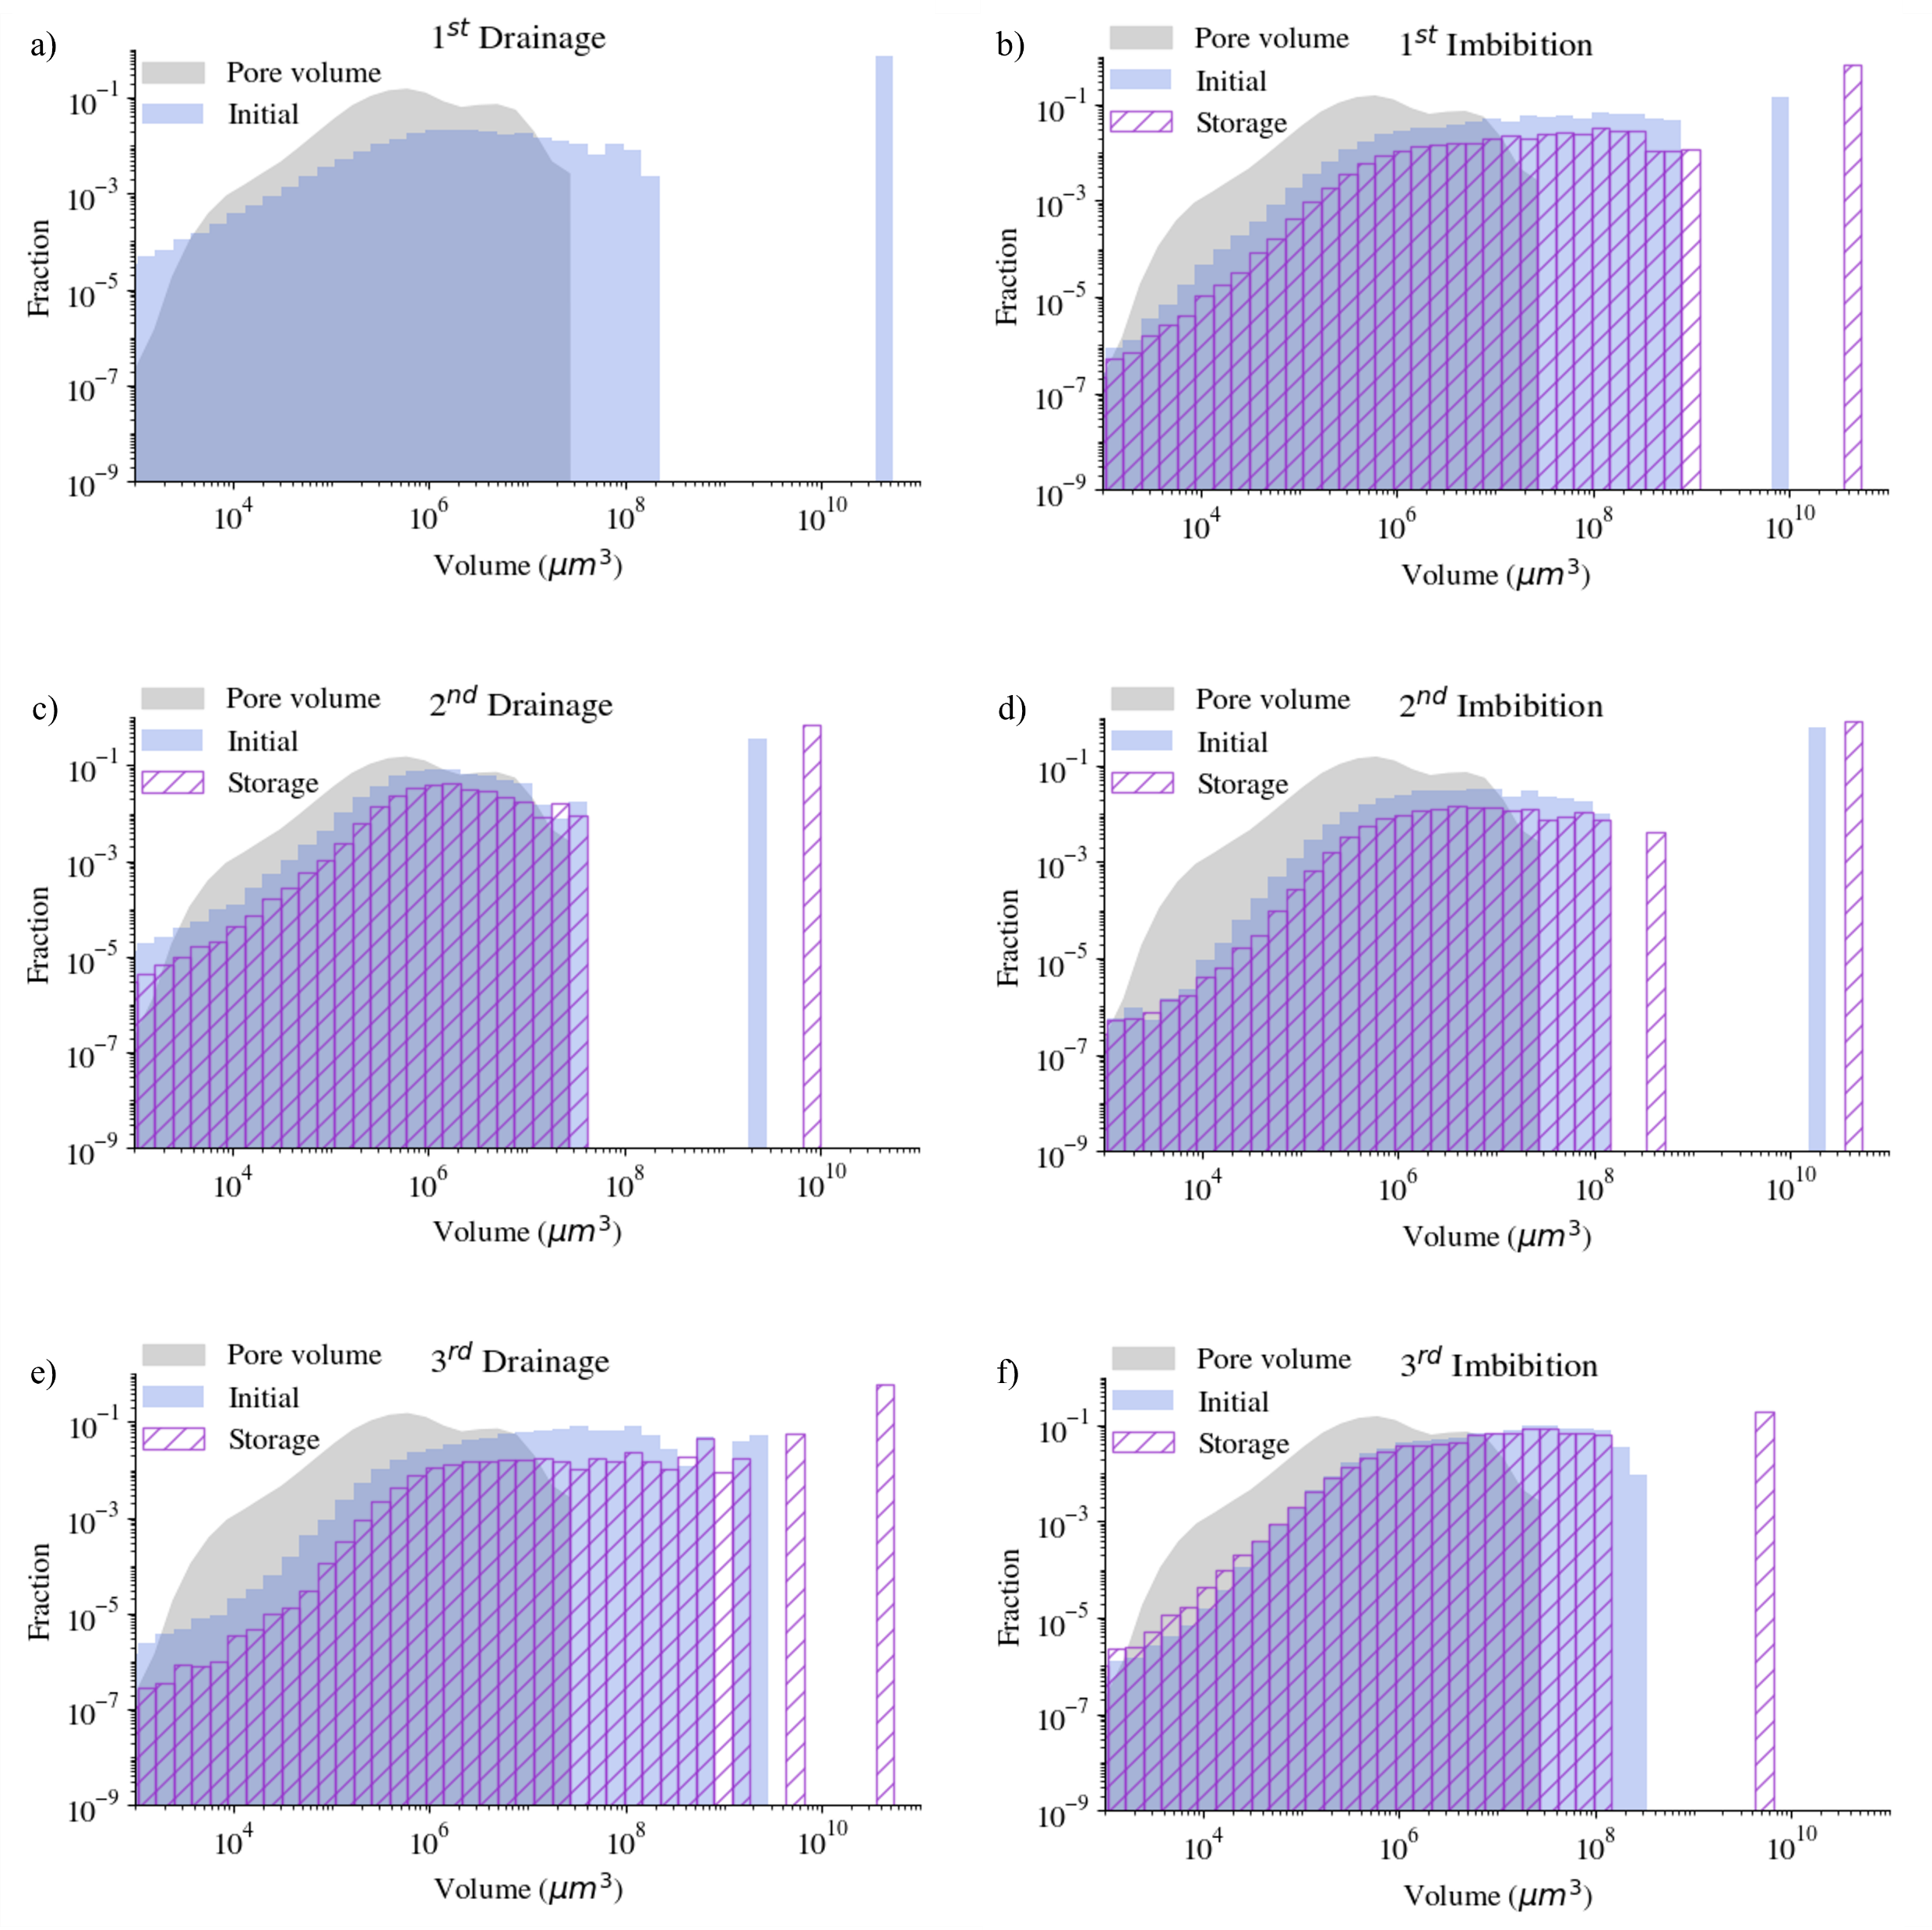
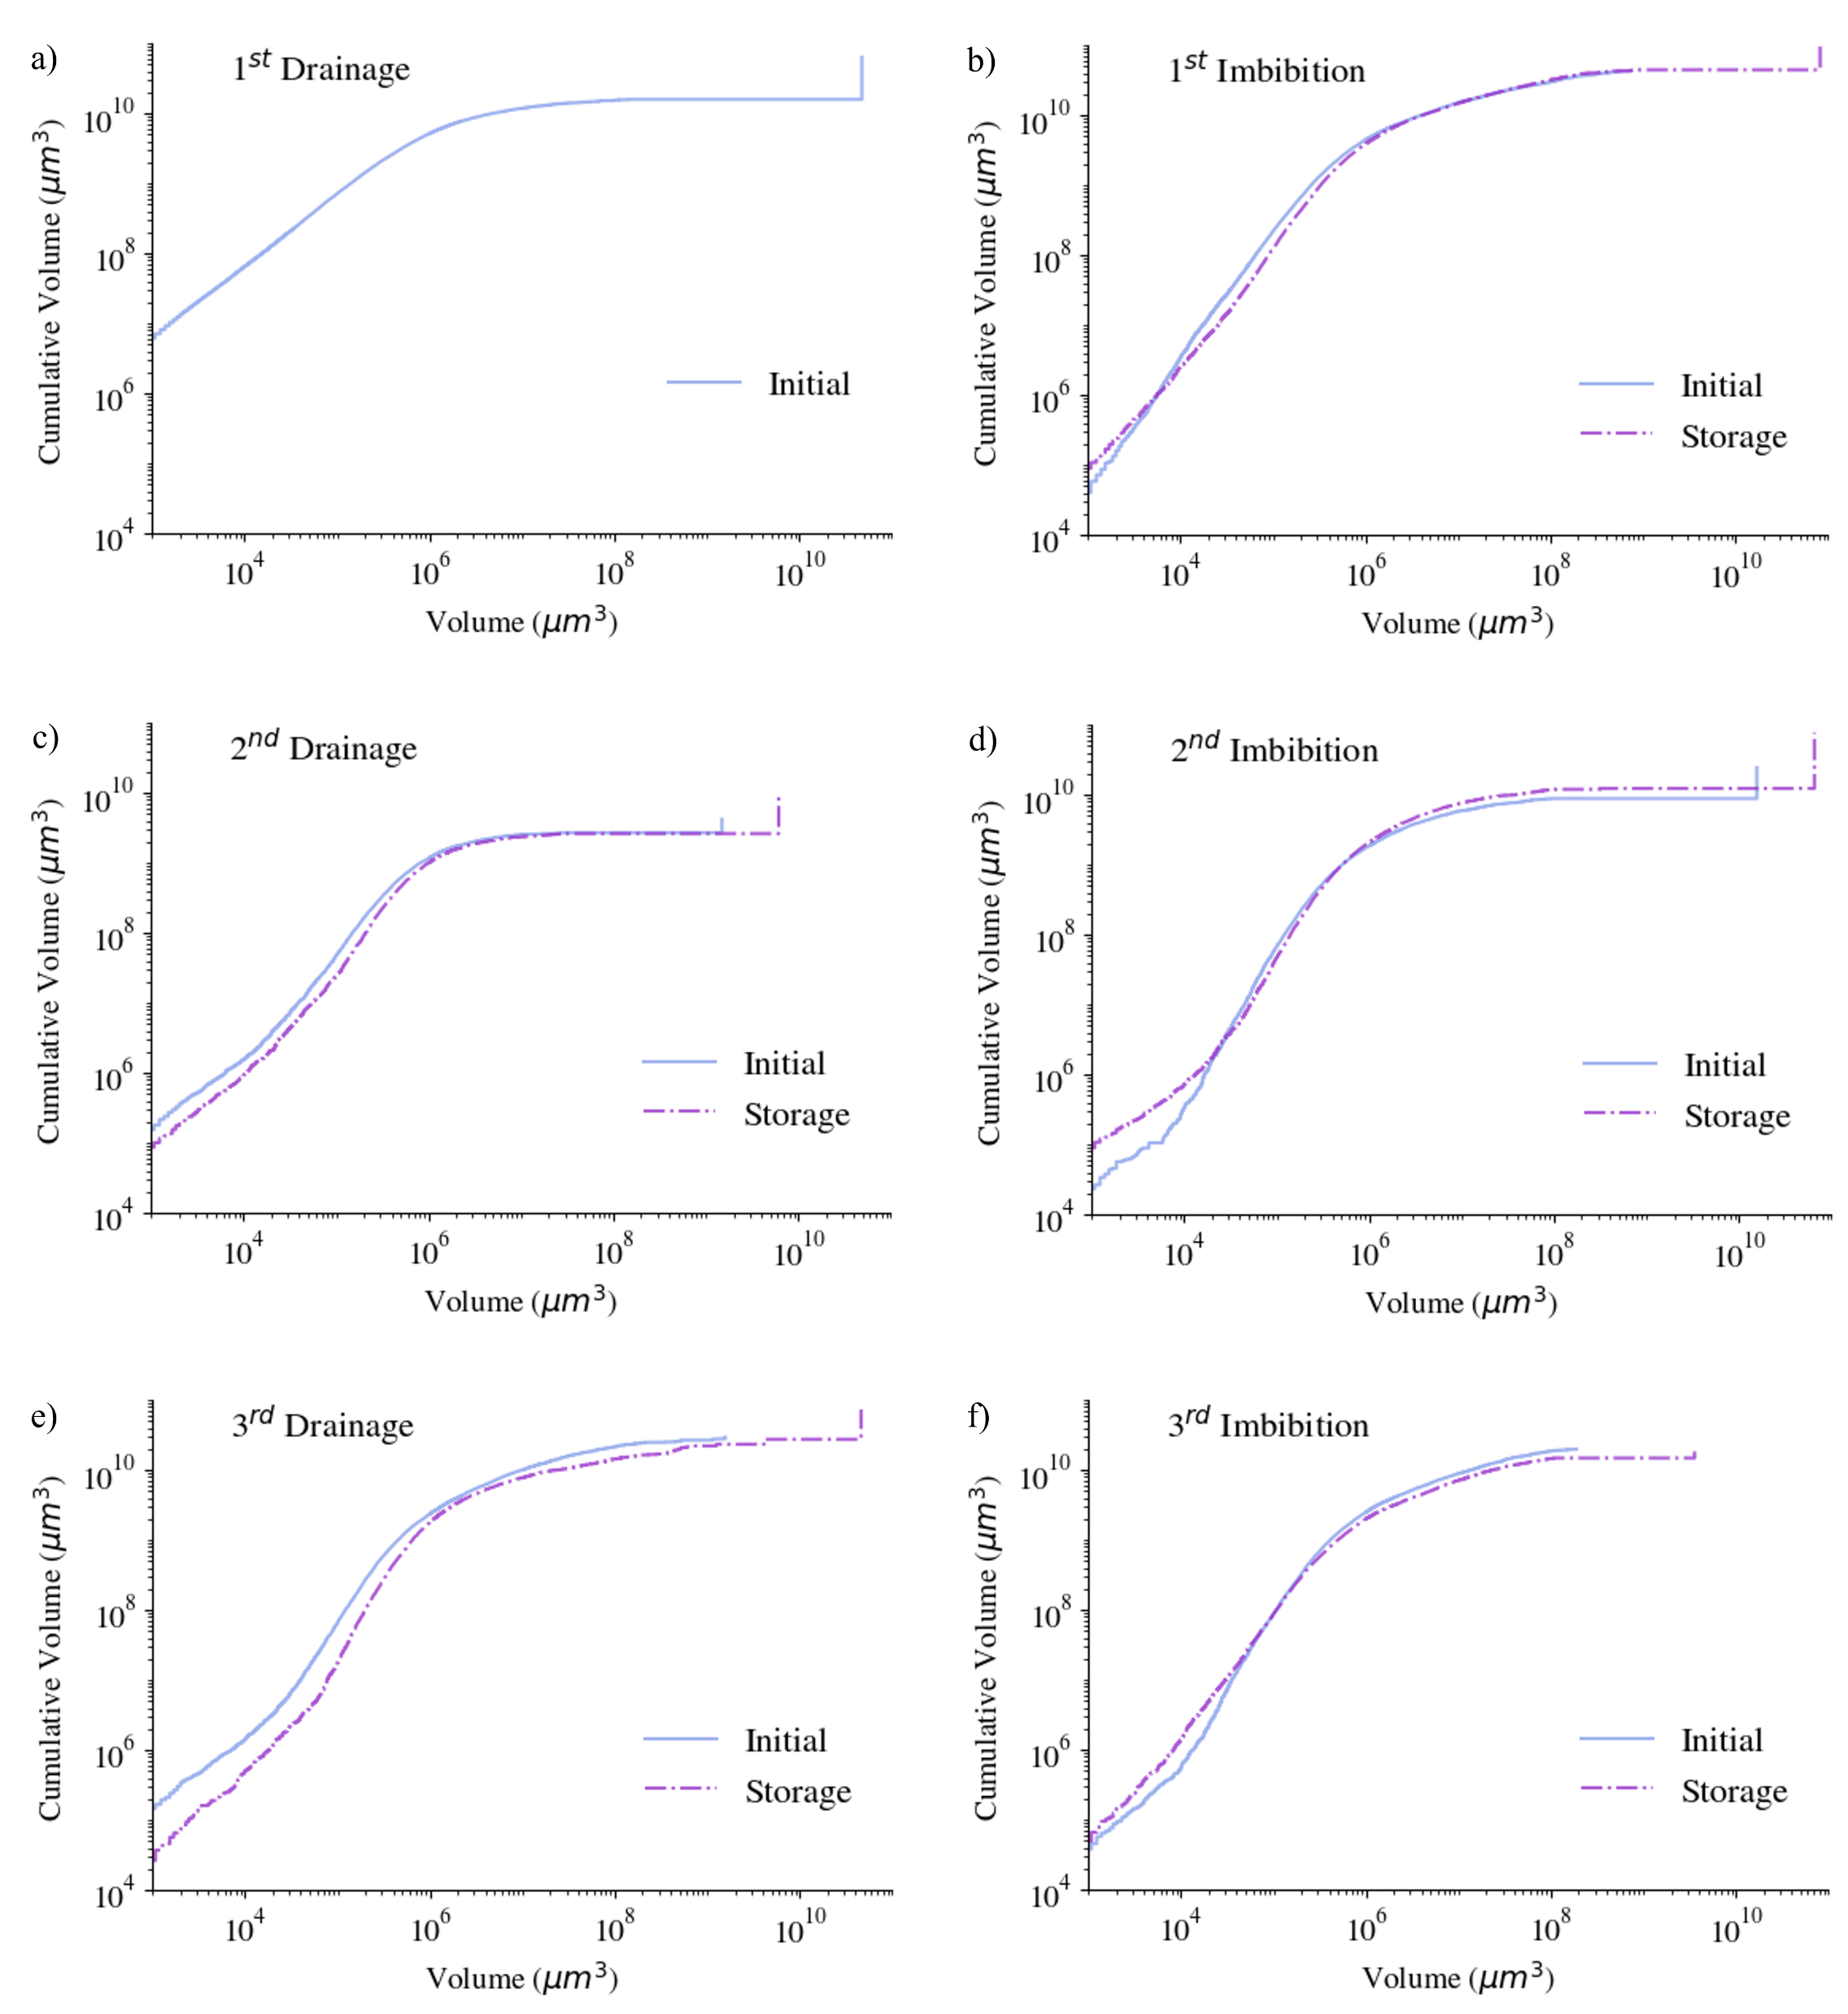
Smaller bubbles aggregating into larger ones
Normalised Euler Characteristic (mm⁻³)
 | Initial | 16hrs storage
1st Drainage | -57 | -
1st Imbibition | 21 | 20
2nd Drainage | -18 | -21
2nd Imbibition | 7 | 3
3rd Drainage | -4 | -12
3rd Imbibition | 14 | 11
Negative-well connected
Positive-trapped
After imbibition one big ganglion begins to dominate the volume (vertical portion), which makes the withdrawal of hydrogen through a connected pathway possible.
Ostwald ripening impacts the distribution of fluids in porous media.
24th Anniversary of the Imperial College Consortium on Pore-Scale Modelling and Imaging

Slide 10
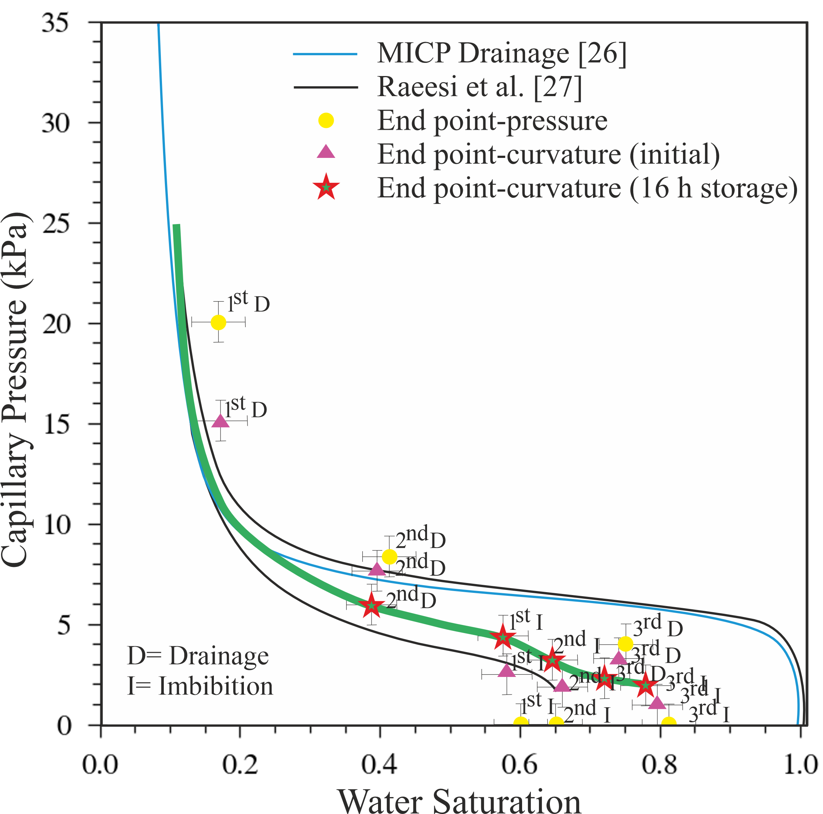
Challenging hysteresis models
1
2
Imposing pressure in 3 cycles: 20,9,3 kPa.
The residual saturation decreases from the first to second imbibition cycle and is further reduced after the third cycle.
Less gas trapping during the third imbibition.
There is a tendency for the capillary pressure to increase on waiting after imbibition and to decrease after drainage-leads to less hysteresis between drainage and imbibition.
[1] Q. Lin, et al., “Imaging and measurement of pore-scale interfacial curvature to determine capillary pressure simultaneously with relative permeability,” Water Resources Research, 2018. [2] B. Raeesi, et al.,“Capillary pressure hysteresis behaviour of three sandstones measured with a multistep outflow–inflow apparatus,” Vadose Zone Journal, 2014.
24th Anniversary of the Imperial College Consortium on Pore-Scale Modelling and Imaging

Slide 11
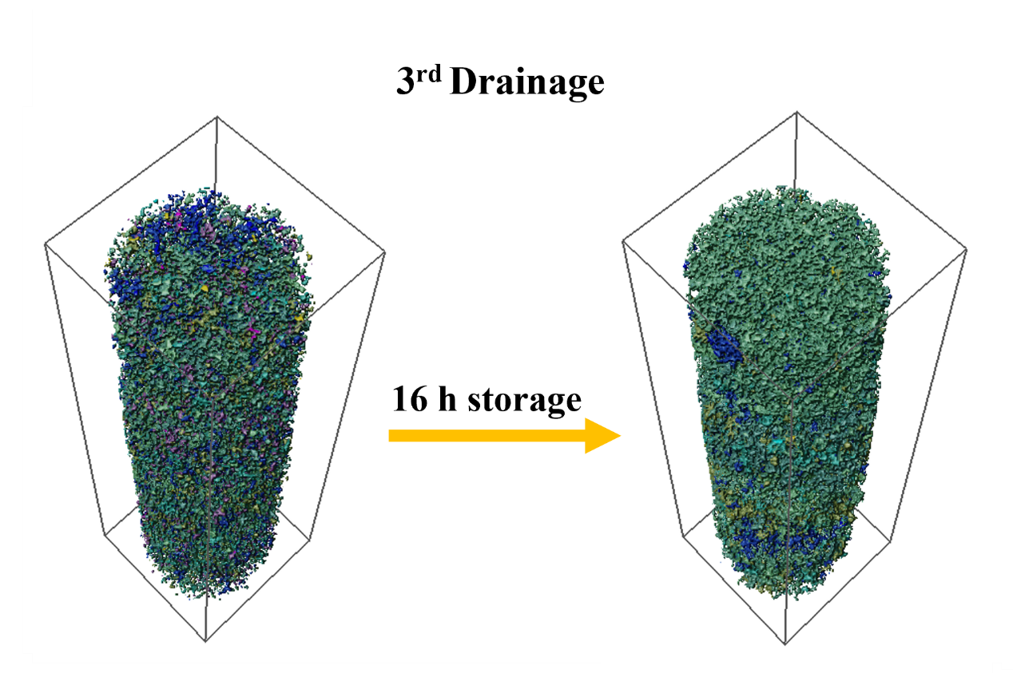
Concluding remarks
Achieved uniform gas saturation - improved the gas saturation profile to a uniform state, enhancing the efficiency and reliability of underground hydrogen storage.
Ostwald Ripening Dominates - Ostwald ripening leads to the aggregation of hydrogen, forming a single dominant large ganglion that occupies most of the volume.
This leads to less trapping in the second cycle which contradicts traditional hysteresis models (the capillary pressure functions cannot cross).
Enhanced Gas Connectivity - Gas phase connectivity increases after 16 hours, as quantified by the Euler characteristic.
well-connected
Future directions:
Measurements of capillary pressure at intermediate points, and not just at the end of injection, combined with the use of differential pressure to determine capillary pressure.
Study of a wider range of rock types to get a better understanding of the impact of Ostwald ripening on hysteresis.
THANK YOU
24th Anniversary of the Imperial College Consortium on Pore-Scale Modelling and Imaging

