Slide 1


CO₂ Reactive Transport: Multimineral Carbonate Systems, Well Cement-CO₂ Interactions
Pore-Scale Consortium
16 Jan 2024
Olatunbosun A. Adedipe, Martin Blunt and Branko Bijeljic

Slide 2
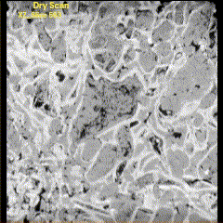
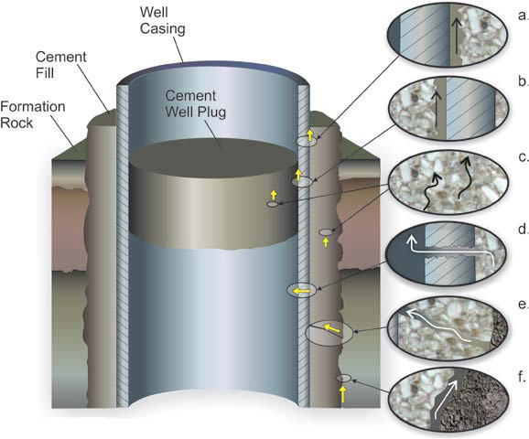
Importance of CO₂-Water Interaction in Aquifers During CO₂ Storage
Sc CO₂ dissolves in water to form carbonic acid (pH ≈3.1-3.5).
Within the Aquifer:
Carbonic acid reacts with carbonate minerals altering CO₂ transport and storage properties of the storage site.
In the Wellbore:
CO₂ reacts with hydrated cement products in a process called carbonation.
Cement pH ≈12 thus reaction by carbonic acid degrades the cement sheath creating CO₂ leakage pathways and wellbore integrity issues.
Mineral dissolution by carbonic acid.
OBJECTIVE 1: Multimineral carbonate dissolution
imaging and analysis
+
Water
OBJECTIVE 2: Cement dissolution and precipitation
Experiment design, Imaging and analysis
CO₂ leakage pathways from Glazewski et al. 2014
Notes:
In my presentation, I will cover two objectives.
1.) Imaging and analysis of multimineral carbonate dissolution.
2.) Cement dissolution and precipitation, experiment design and imaging and analysis.
Sc CO₂ dissolves in water to form carbonic acid which reacts with carbonate minerals within the aquafer and with well cement, degrading the cement sheath which could lead to CO2 leakage.

Slide 3
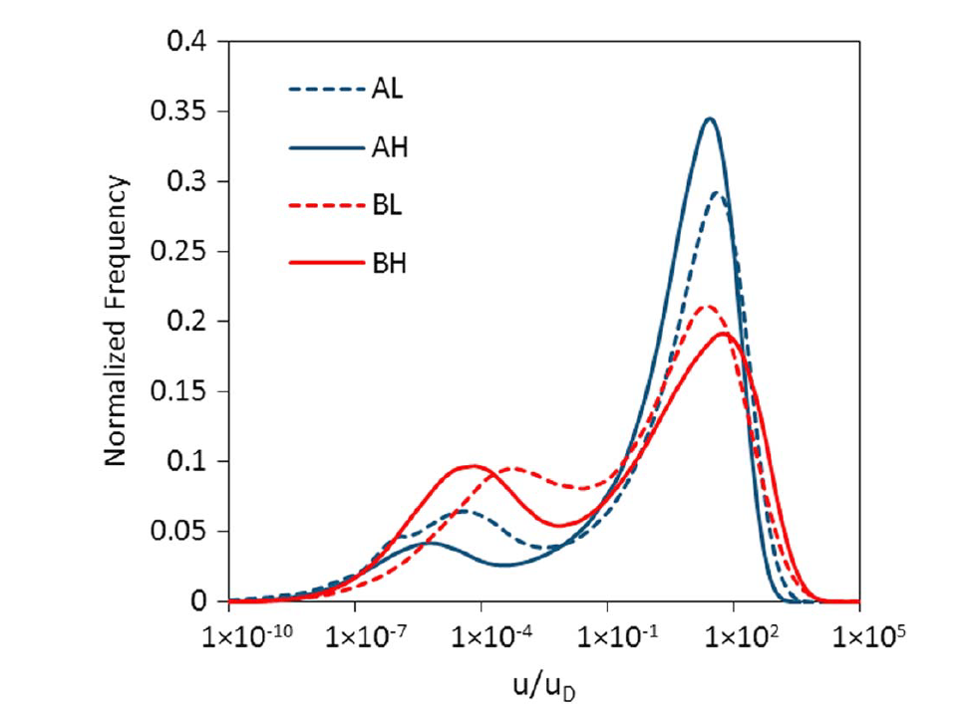
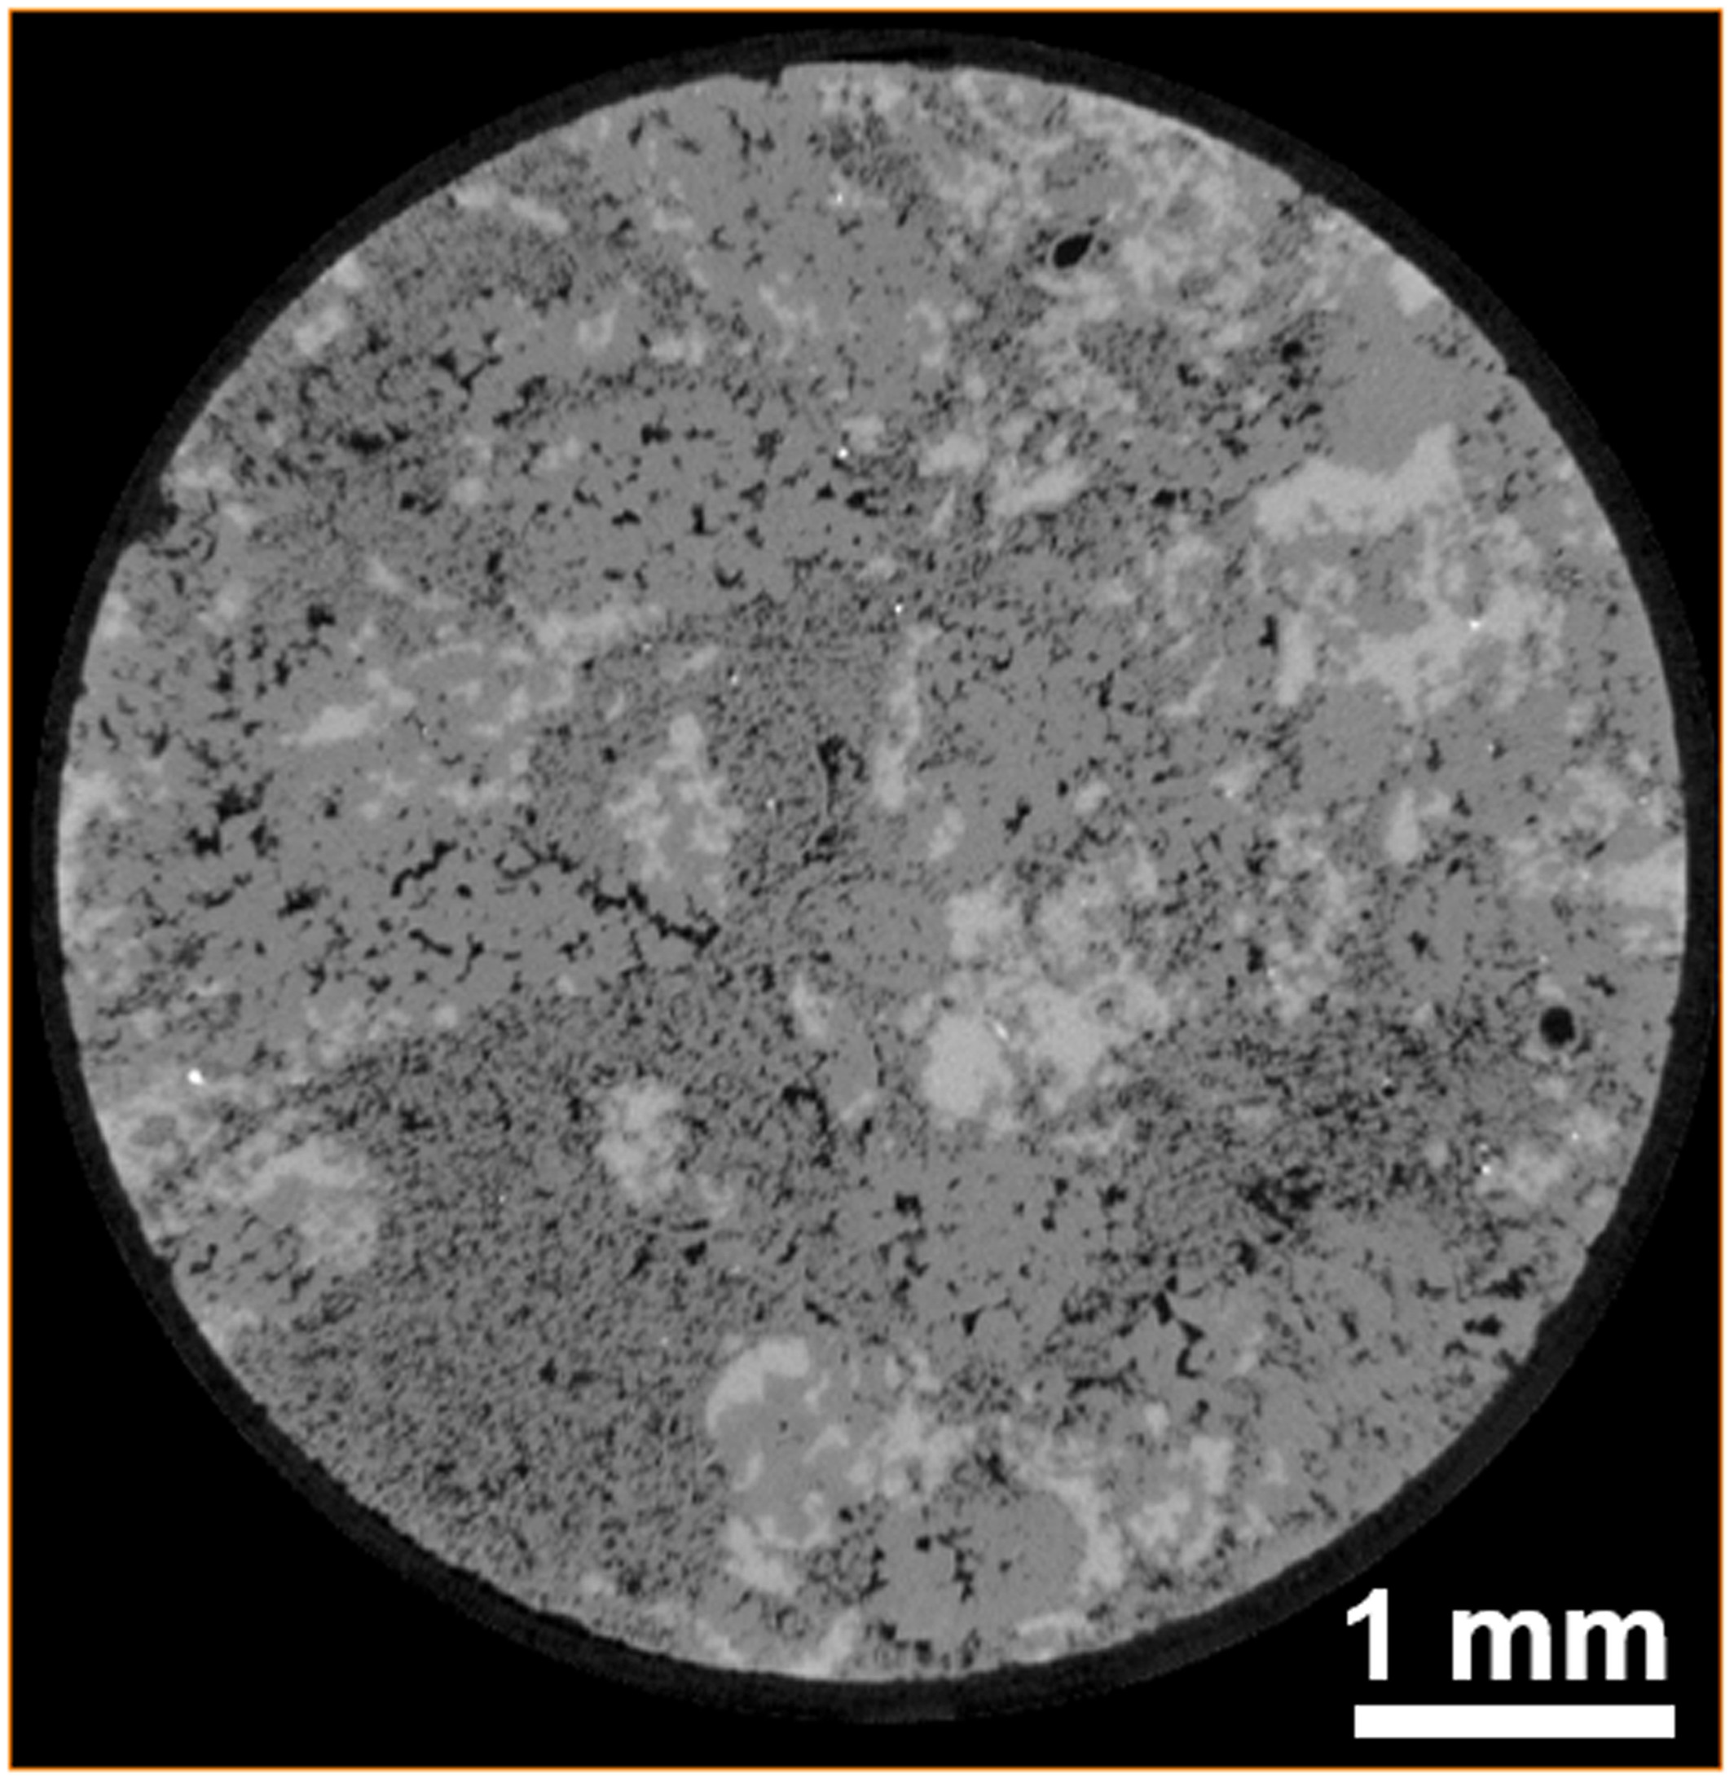
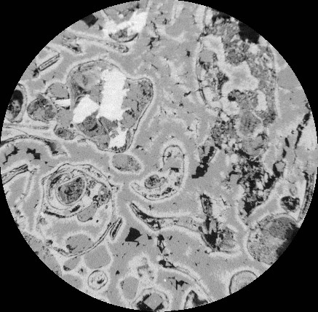
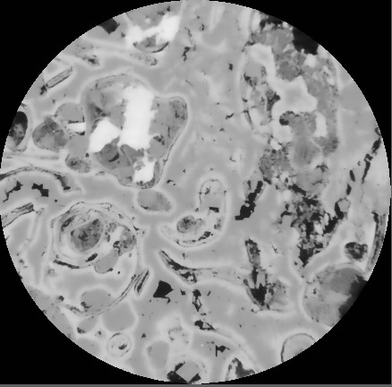
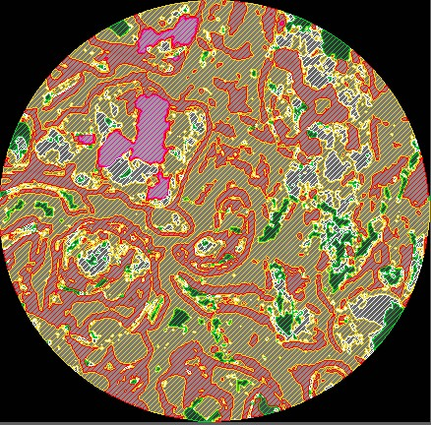
PART 1: CO₂ Reactive transport in Carbonate Aquifers
Transport Heterogeneity
Mineral Heterogeneity
Al‐Khulaifi et al. 2019 investigated impact of transport and mineral spatial distribution heterogeneity on the effective reaction rates for:
Two mineral system with ratio 8:1 (Dolomite: Calcite).
4 samples, 2 sets of pairs (i.e., AH, AL,BH & BL).
Velocity distribution in rock samples.
Dry scan of two mineral system.
In my analysis I will investigate impact of multimineral spatial distribution on the effective reaction rates :
2 samples, 1 more homogeneous and 1 more heterogeneous in terms of transport.
Multimineral system that is more heterogeneous with ratio 9:25:15:1 (Microporous-dolomite: Dolomite: Calcite: Anhydrite)
Image processing of multimineral system
Notes:
A = homogenous, B = heterogeneous, H = 0.5 ml/min, L = 0.1 ml/min

Slide 4
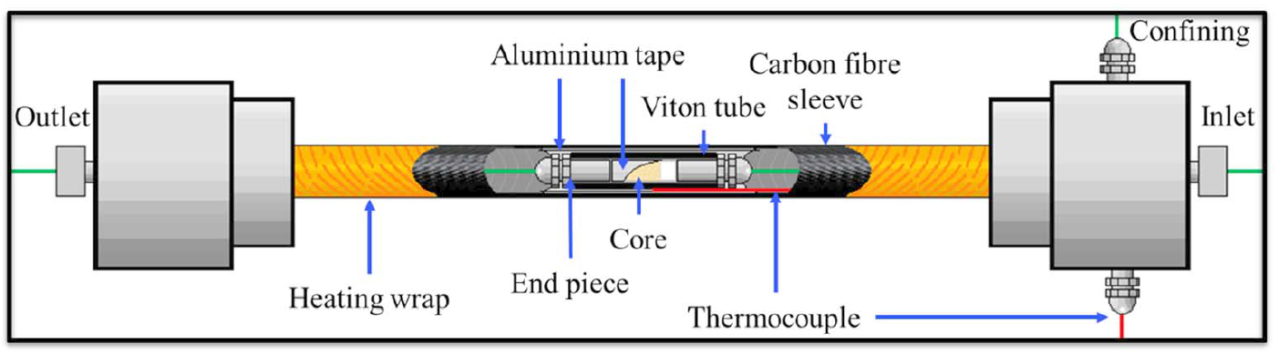
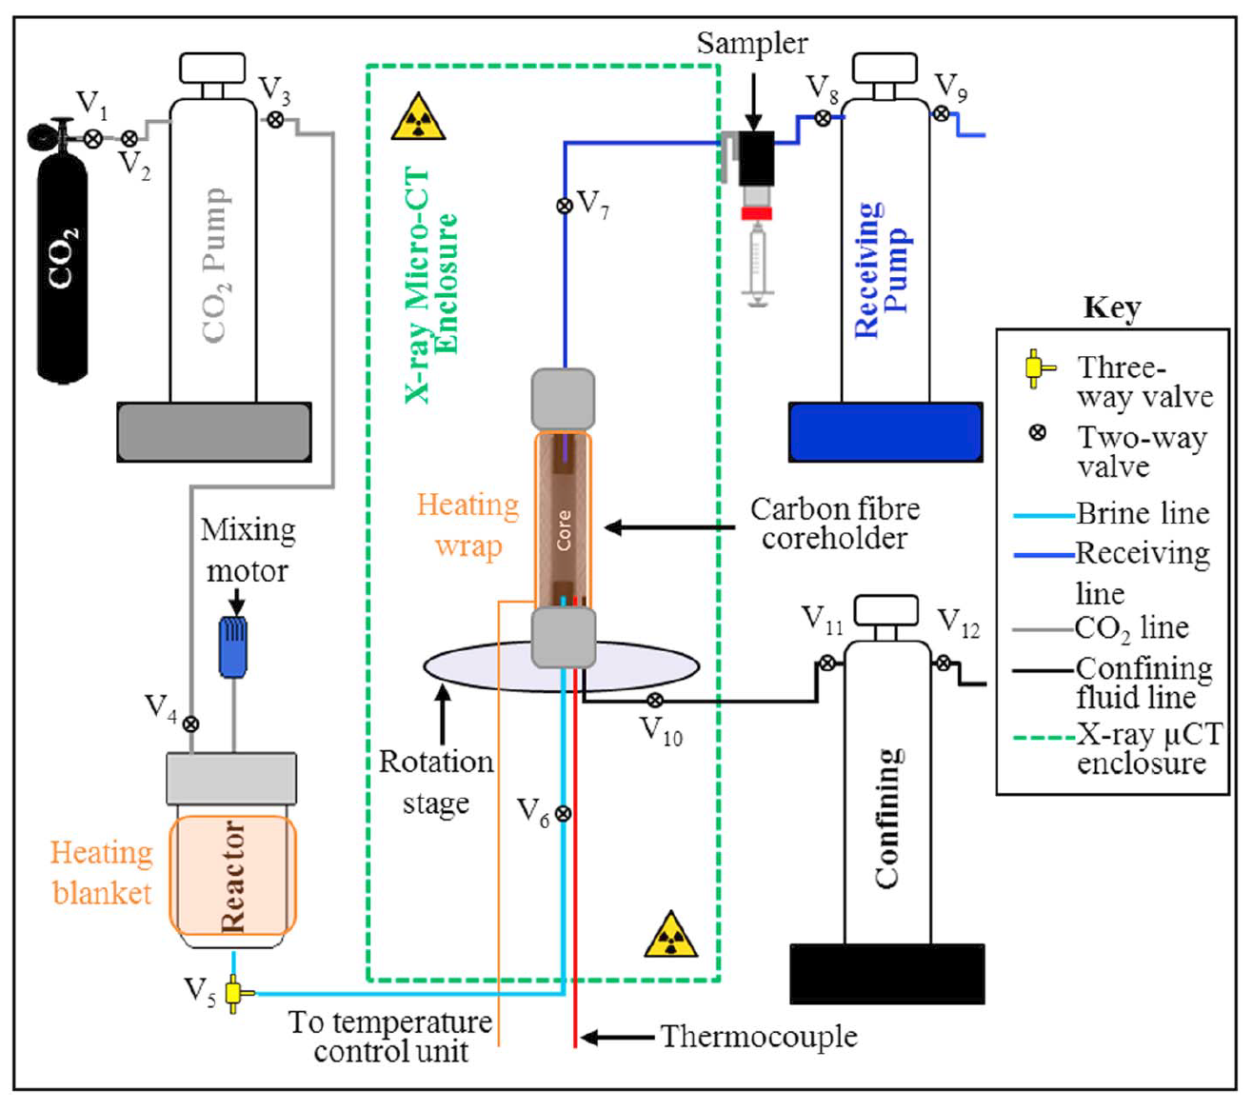
CO₂ Flooding Apparatus
Core holder assembly. Source: [AL‐KHULAIFI ET AL. 2019]
Experimental conditions:
P = 10MPa
T = 50 ºC
Brine Composition:
1% KCl, 5% NaCl
CO2 saturated at: 10MPa, 50 ºC
Experimental setup. [AL‐Khulaifi et al.. 2019]
Notes:
Reactive transport
Fluids flowing through rocks in the subsurface often react chemically with the rocks and can change properties such as their strength and permeability to fluids. Despite this, little is known about how best to predict these reactions and the impact that they will have on the properties of the rocks. We use imaging, flow experiments and chemical analysis techniques to analyse how the chemical reactions take place within the pore space and how they impact the subsequent flow of fluids. (KrevorLab) With this knowledge we can design simulators which are better for prediction and decision making.
EDIT!!!!!

Slide 5
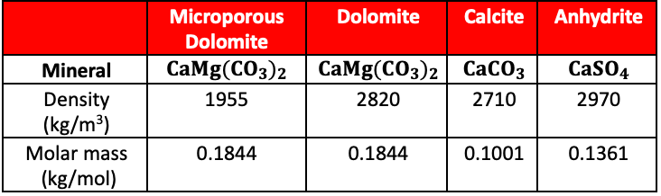
Image Processing
Microporous dolomite properties obtained by thresholding mineralogical properties based on grayscale values.
Anhydrite
Calcite
Dolomite
Pore
Microporous Dolomite
A: Raw Image
5.2 µm voxel size
B: Filtered Image
Non-local Means Filter
C: Segmented Image
Watershed segmentation

Slide 6




Determination of Microporous-dolomite Properties
$$G_{m}=24672$$
$$G_{s}=30583$$
Dolomite
Microporous Dolomite
$$G_{p}=11308$$
Pore
$$∅_{MPD}=\frac{G_{s}∗G_{m}}{G_{s}∗G_{p}}=\frac{30583−24672}{30583−11308}=0.3067$$
$ρ_{MPD}=ρ_{s}\left(1−∅_{MPD}\right)=2820\left(1−0.3067\right)=1955.1\frac{kg}{m^{3 }}$

Slide 7
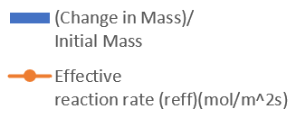
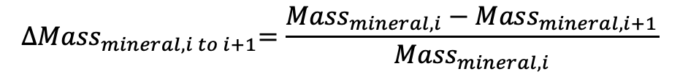
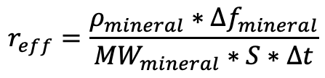
Effective Reaction Rate &
Mineral Mass Change Plots
$$r_{eff}=\frac{ρ_{mineral}∗{∆f}_{mineral}}{{MW}_{mineral}∗S∗∆t}$$
$${∆Mass}_{mineral,i to i+1}=\frac{{Mass}_{mineral,i}−{Mass}_{mineral,i+1}}{{Mass}_{mineral,i}}$$

Slide 8
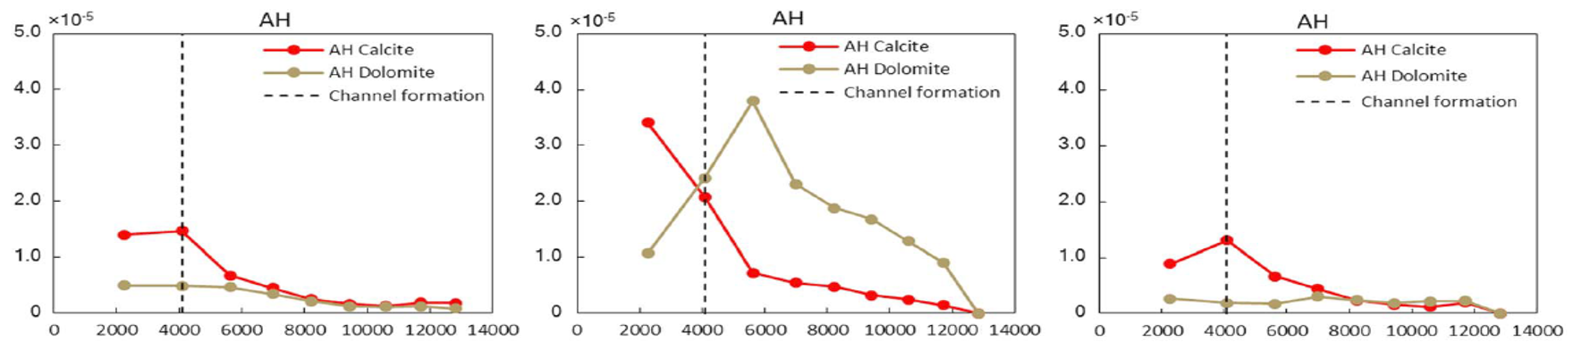


Work In Progress
Effective reaction rates for dolomite and calcite from Al‐Khulaifi et al. 2019.
Anhydrite and calcite start reacting fast but then rection depends on the availability of fresh reactant.
Dolomite and microporous dolomite start reacting slower but then react more as they are more abundant and exposed to reactant in formed channels.
Channel formation

Slide 9
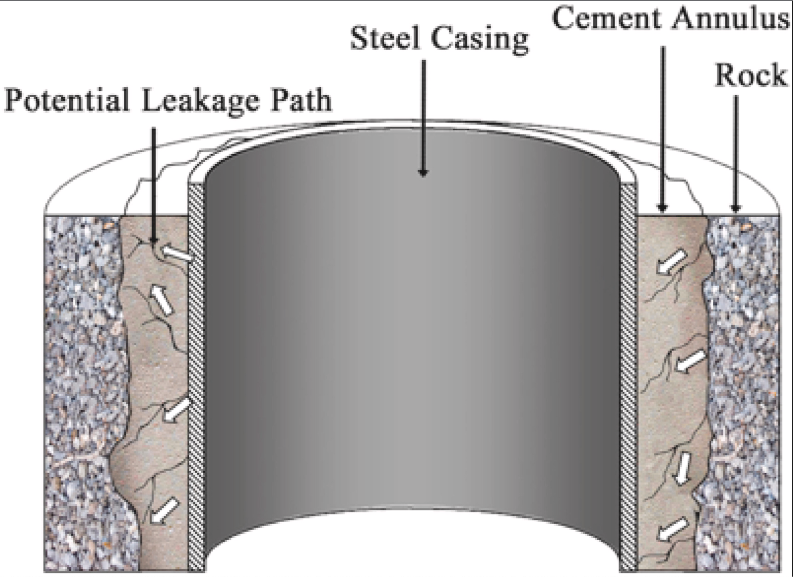
Part 2: CO₂ – Cement reaction
Research Objectives
To Investigate the effect of dissolution and precipitation on cement permeability during exposure to CO₂ and carbonic acid.
To design a cement formulation which mitigates deterioration of cement sheath integrity during and after CO₂ exposure.
Possible leakage paths for gas;
Left side: leak starting from the interface between the steel casing and cement annulus.
Right side: leak starting from the interface between cement annulus and surrounding rock.
From Li et al., 2021.

Slide 10
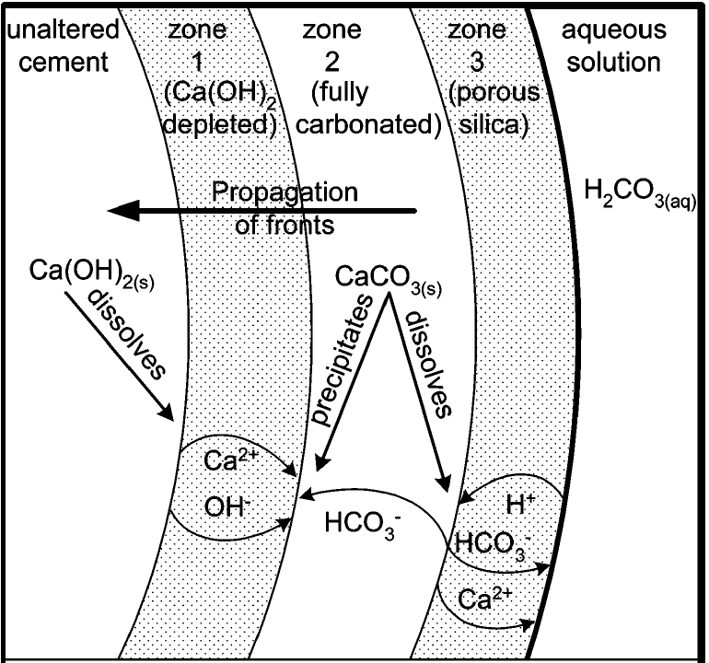
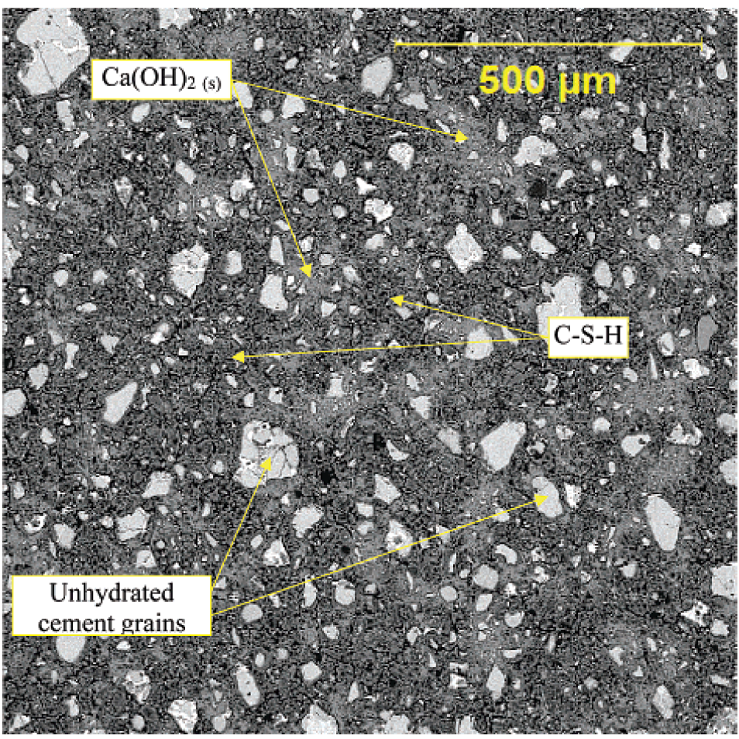
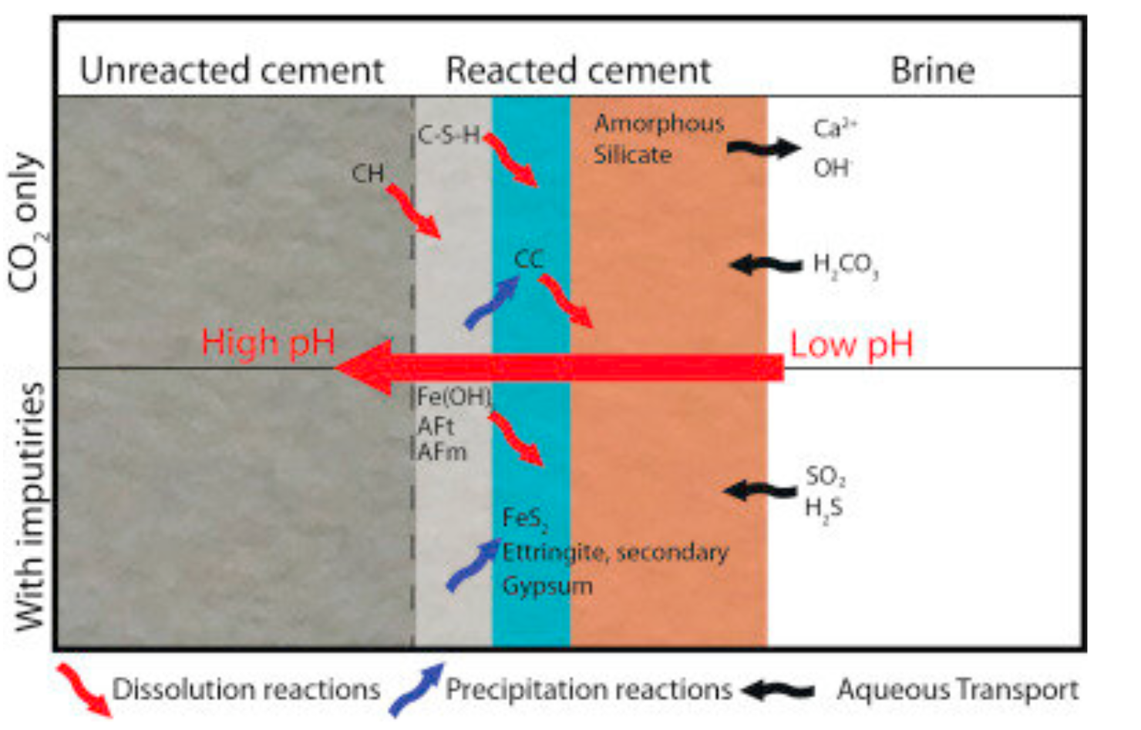
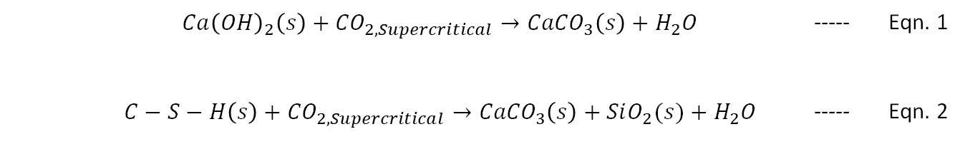
Cement Alteration
Calcium Hydroxide
Calcium Carbonate
 |  | $${Ca\left(OH\right)}_{2}\left(s\right)+{CO}_{2, Supercritical}→{CaCO}_{3}\left(s\right)+H_{2}O$$ | ----- | Eqn. 1
 |  | $$C−S−H\left(s\right)+{CO}_{2, Supercritical}→{CaCO}_{3}\left(s\right)+SiO_{2}(s)+H_{2}O$$ | ----- | Eqn. 2
Main hydration products of cement
Wang et al., 2021
CO₂ reaction with hydrated cement products shown in Eqn. 1 & 2.
Calcium Silicate Hydrate
Amorphous silica
SEM-BSE image of cured cement.
Brightest phases are unhydrated cement grains, light gray patches consist of Ca(OH)₂(s), and dark gray matrix is composed of the Calcium Silicate Hydrate (C-S-H) phase. From Kutchko et al, 2007.
Schematic showing the dissolution and calcium migration and formation of distinct zones in the cement. From Kutchko et al, 2007.
From Carroll et al., 2016.
Notes:
When dry cement is mixed with water, calcium hydroxide and calcium silicate hydrate are formed as the main hydration products. CO2 reacts with these cement hydration product in a process called carbonation.
These carbonation reactions produce water and precipitate calcium carbonate and amorphous silica.

Slide 11
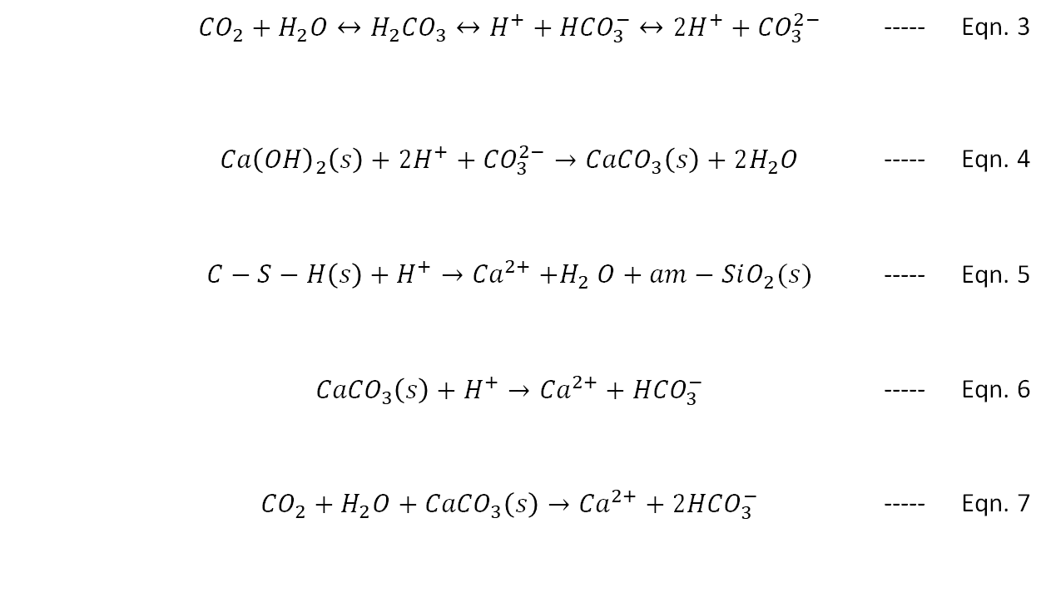
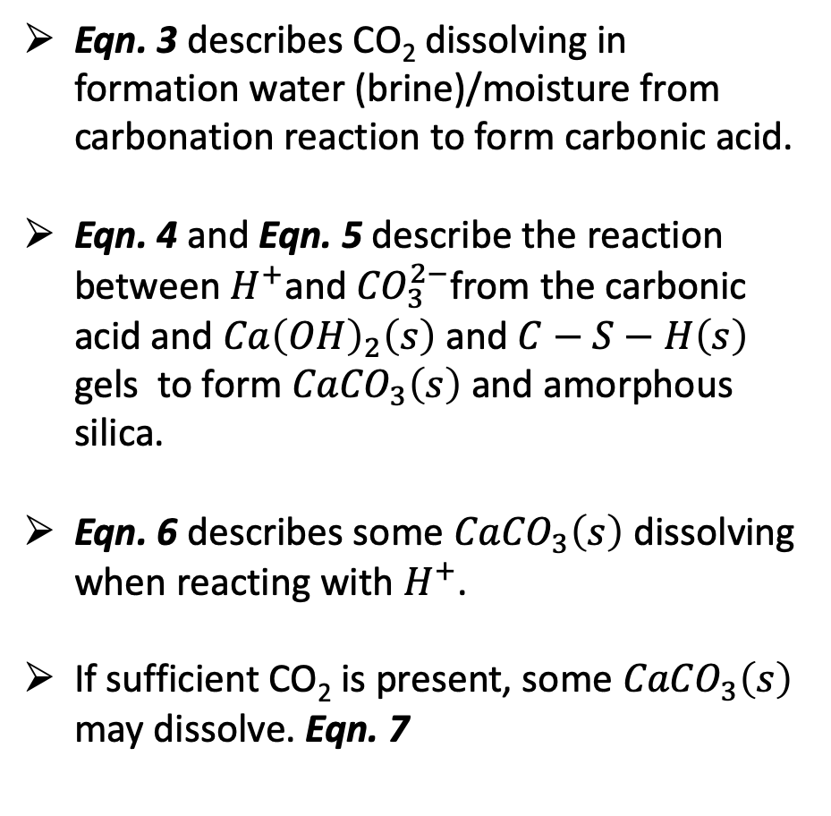
Dissolution and Precipitation Reactions
Eqn. 3 describes CO₂ dissolving in formation water (brine)/moisture from carbonation reaction to form carbonic acid.
Eqn. 4 and Eqn. 5 describe the reaction between $H^{+}$and ${CO}_{3}^{2−}$from the carbonic acid and ${Ca\left(OH\right)}_{2}\left(s\right)$ and $C−S−H\left(s\right)$ gels to form ${CaCO}_{3}\left(s\right)$ and amorphous silica.
Eqn. 6 describes some ${CaCO}_{3}\left(s\right)$ dissolving when reacting with $H^{+}$.
If sufficient CO₂ is present, some ${CaCO}_{3}\left(s\right)$ may dissolve. Eqn. 7
 |  | $${CO}_{2}+H_{2}O↔{H_{2}CO}_{3}↔H^{+}+{HCO}_{3}^{−}↔{2H}^{+}+{CO}_{3}^{2−}$$ | ----- | Eqn. 3
 |  | $${Ca\left(OH\right)}_{2}\left(s\right)+{2H}^{+}+{CO}_{3}^{2−}→{CaCO}_{3}\left(s\right)+2H_{2}O$$ | ----- | Eqn. 4
 |  | $$C−S−H\left(s\right)+H^{+}→{Ca}^{2+}{+H}_{2}O+am−SiO_{2}(s)$$ | ----- | Eqn. 5
 |  | $${CaCO}_{3}\left(s\right)+H^{+}→{Ca}^{2+}+{HCO}_{3}^{−}$$ | ----- | Eqn. 6
 |  | $${CO}_{2}+H_{2}O+{CaCO}_{3}\left(s\right)→{Ca}^{2+}+{2HCO}_{3}^{−}$$ | ----- | Eqn. 7
Gan et al., 2022
Notes:
Thus, the risk of leakage of CO₂ through the wellbore cement Is determined by alteration of the porosity and micro-structure of the wellbore cement following carbonation (Gan et al., 2022).

Slide 12
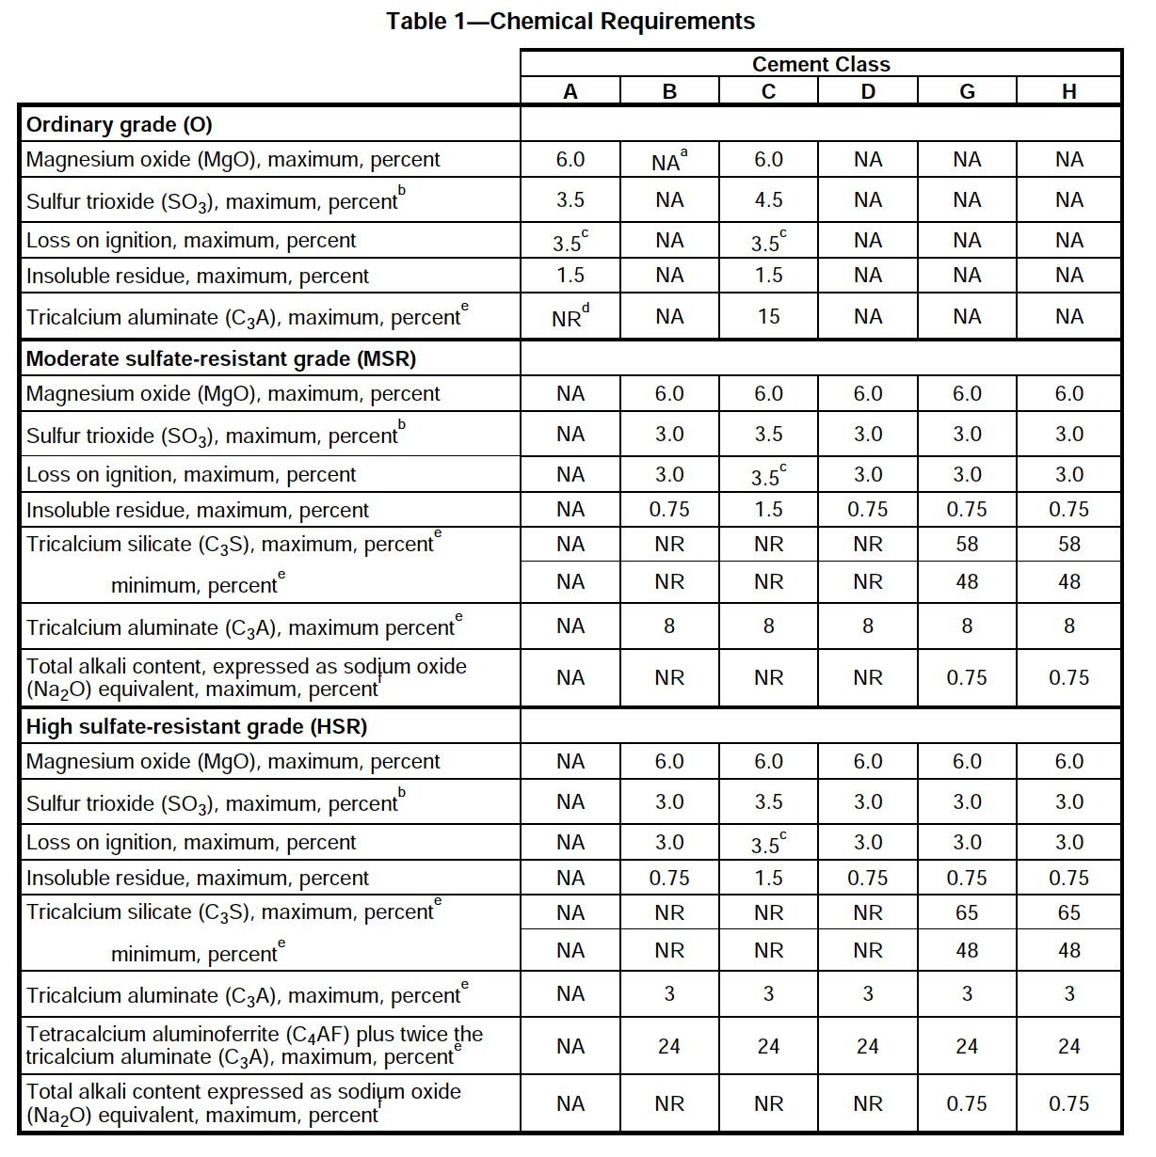
Cement Selection
American Petroleum Institute (API) Specification 10A classifies class G and H Portland cements as basic well cements.
Class G and H Portland cements are manufactured to resist sulfate attack in the subsurface.
Class G Portland cement is the most widely used well cement.
Thus, a High sulfate-resistance grade of class G Portland cement is chosen for this experimental study.
The Class G Portland cement used was provided by SLB (Schlumberger).
API Specification 10A (American Petroleum Institute (API), 2019)

Slide 13
Experimental Work
Evaluate performance of Class G well cement in the experiments:
Dry supercritical CO₂ injection only
Wet supercritical CO₂ (CO₂ equilibrated brine) injection
Saline brine injection only
This study will be carried out using:
X-ray microcomputed Tomography (micro-CT) using differential imaging
Scanning Electron Microscopy (SEM)

Slide 14
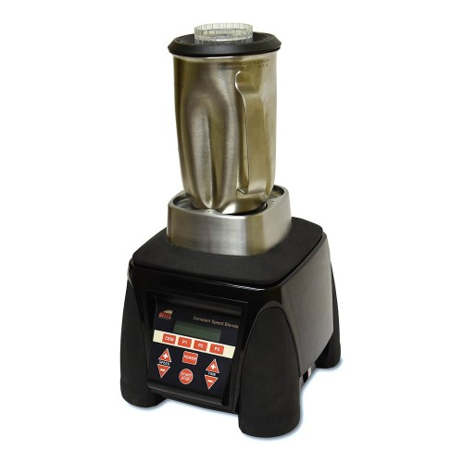
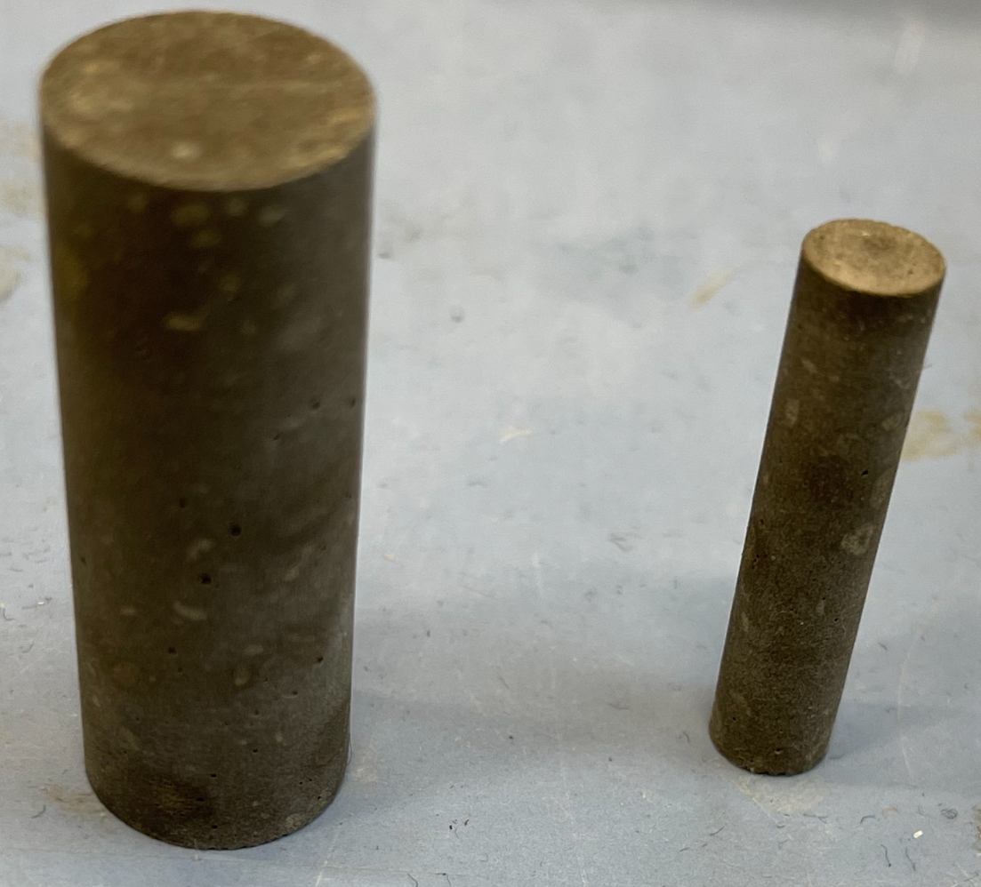
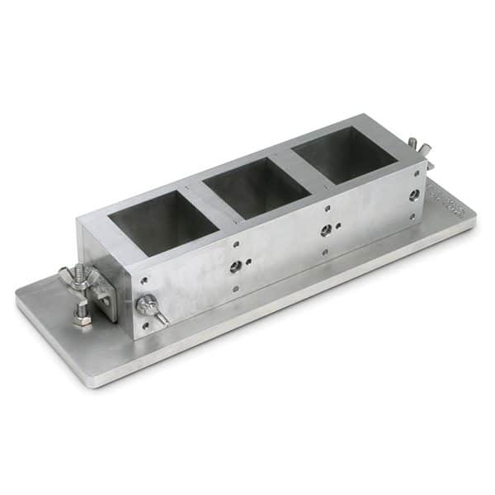
Cement Sample Method and Design
Mix cement and water:
Class G Portland cement + Deionized water
Water-cement ratio of 0.44
Mixing speeds and times:
4000 rpm for 15 seconds
12,000 rpm for 35 seconds
12.5 mm
(API RP 10B-2, 2013)
Cement mixer.
6 mm
Mixed according to American Petroleum Institute (API) Recommended Practice 10B-2
50x50x50mm cement cube mold.
30 mm
25 mm
Slurry is poured into a 50x50x50mm cube mold.
Mold is placed in curing room for 24 hours to harden before demolding.
Hardened cubes are placed in a water bath to cure for 7 days at atmospheric pressure and room temperature.
Cylindrical cores are made for micro-Ct scans.
Cylindrical cement cores.

Slide 15
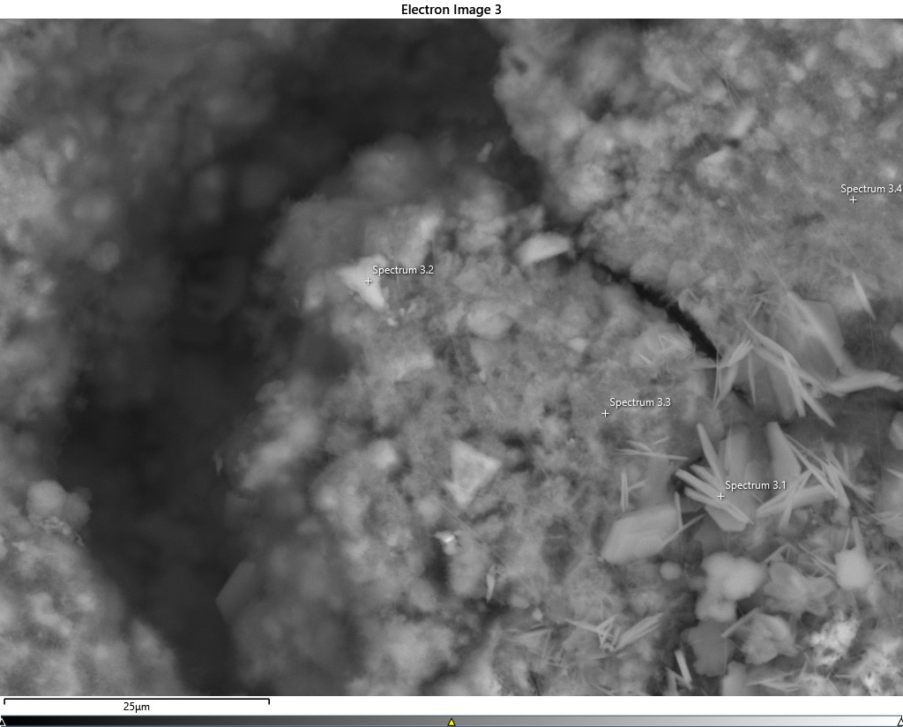
Scanning Electron Microscopy (SEM)
Unhydrated Cement
Void
Calcium Silicate Hydrate
Calcium Hydroxide
25 µm
SEM image of cement paste sample

Slide 16
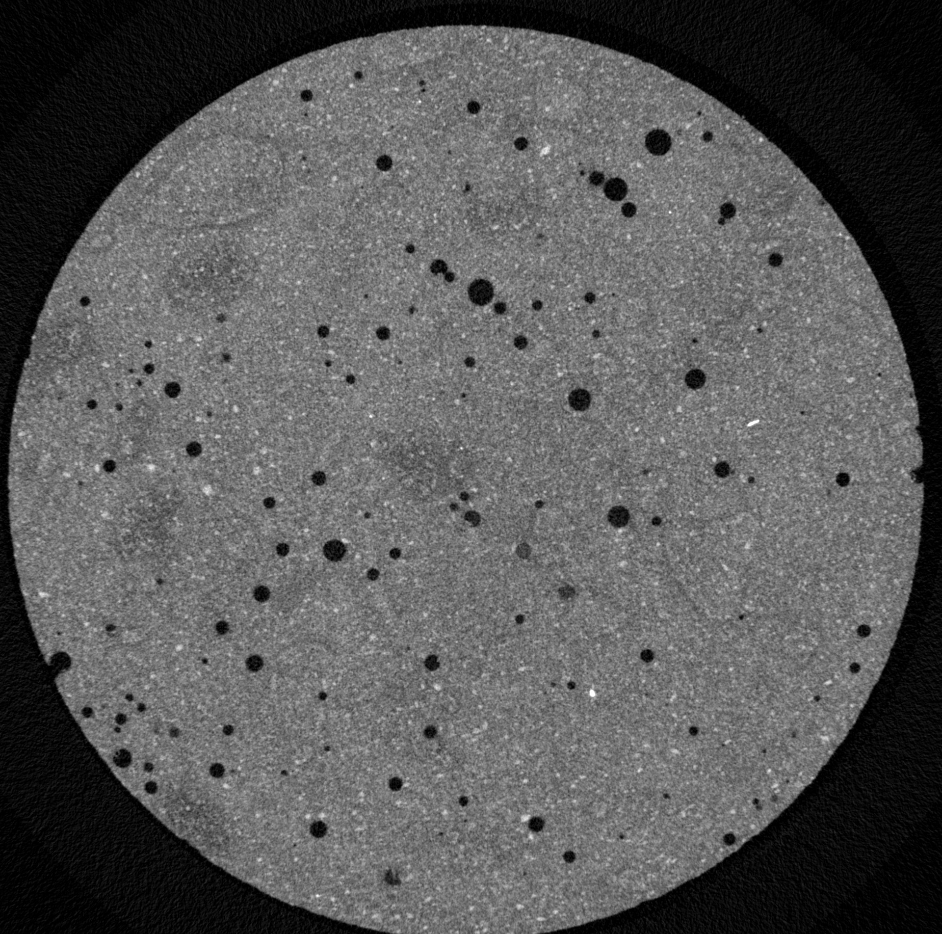
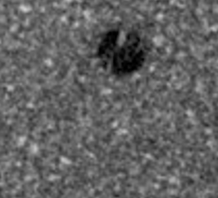
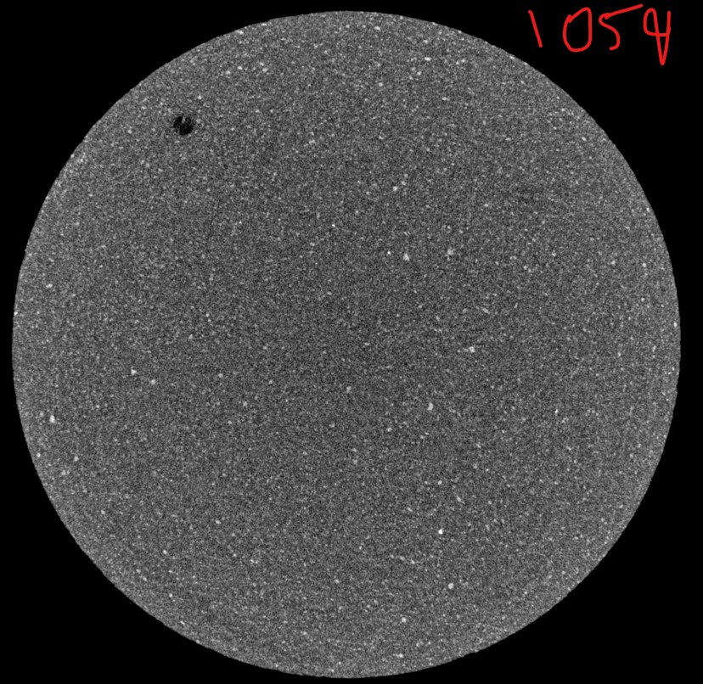
Sample Preparation
Observed from Micro-CT dry scan:
Presence of air bubbles in hardened cement sample.
Void
Calcium Hydroxide
Calcium Silicate Hydrate
Cement sample dry scan with air bubbles.
Unhydrated cement
Solution:
Use vibration table for ∼15 mins to remove air bubbles.
Resulted in more homogeneous sample with less air bubbles.
Cement sample dry scan after using vibration table

Slide 17
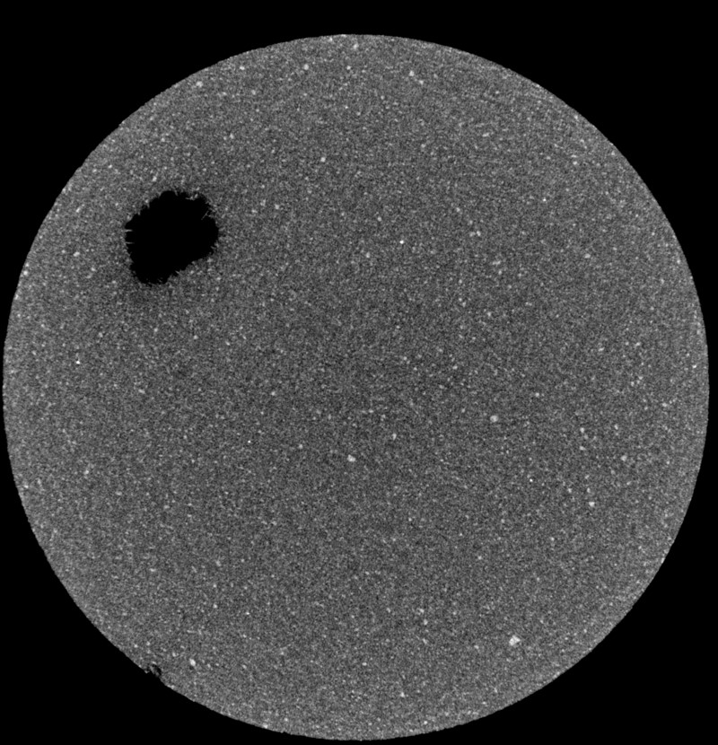
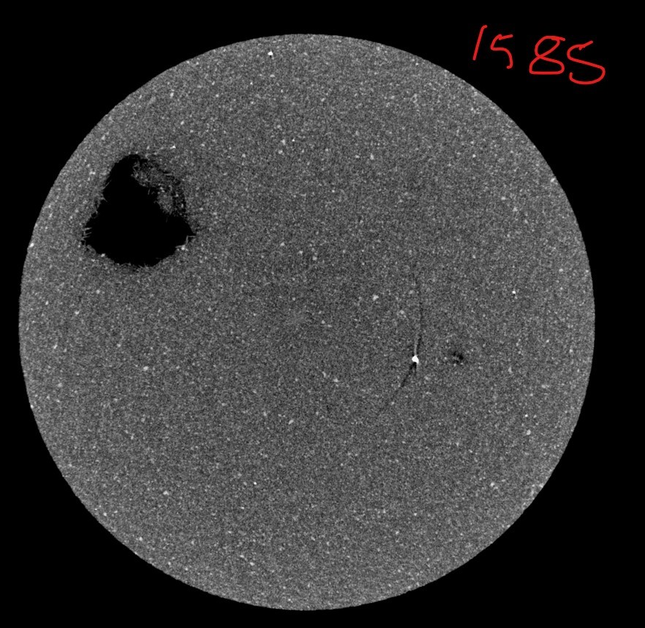
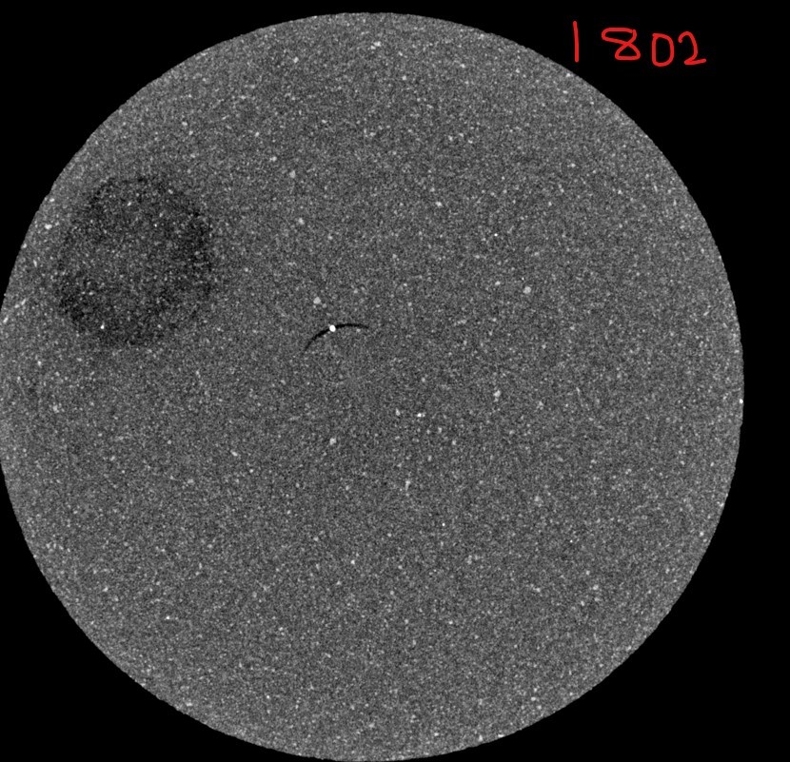

Sample Preparation
Observed from Micro-CT dry scan after air bubble reduction by vibration:
Presence of less air bubbles and a large void through a section of the hardened cement sample.
Note: The large void may be attributed to combination of small air bubbles during vibration of the sample.
Cement sample dry scan showing formation of large void.

Slide 18
Future Work
Cement Samples:
Cement paste samples prepared are representative of cement used during well cementation.
Presence of cement hydration product and homogeneous mixture confirmed from SEM and micro-CT images.
Preparation of cement paste samples with incorporated cracks and channels.
Preparation of cement mortars with varying levels of aggregate.
Preparation of cement paste samples with admixtures.

Slide 19
Works Cited
American Petroleum Institute (API), 2019. API SPEC 10A : Cements and Materials for Well Cementing [WWW Document]. URL https://global.ihs.com/doc_detail.cfm?document_name=API%20SPEC%2010A&item_s_key=00128165.
American Petroleum Institute (API), 2013. API RP 10B-2 : Recommended Practice for Testing Well Cements [WWW Document]. URL https://global.ihs.com/doc_detail.cfm?&document_name=API%20RP%2010B%2D2&item_s_key=00464011&item_key_date=800831&.
Bachu S. 2 - Screening and selection criteria, and characterisation techniques for the geological sequestration of carbon dioxide (CO2). In: Maroto-Valer MM, editor. Developments and Innovation in Carbon Dioxide (CO2) Capture and Storage Technology [Internet]. Woodhead Publishing; 2010 [cited 2023 May 16]. p. 27–56. (Woodhead Publishing Series in Energy; vol. 2). Available from: https://www.sciencedirect.com/science/article/pii/B9781845697976500023
Carroll, S., Carey, J. W., Dzombak, D., Huerta, N. J., Li, L., Richard, T., ... & Zhang, L. (2016). Role of chemistry, mechanics, and transport on well integrity in CO2 storage environments. International Journal of Greenhouse Gas Control, 49, 149-160.
Kutchko, B. G., Strazisar, B. R., Dzombak, D. A., Lowry, G. V., & Thaulow, N. (2007). Degradation of well cement by CO2 under geologic sequestration conditions. Environmental science & technology, 41(13), 4787-4792.
Li, L., Zhang, Y., Hubler, M. H., & Xi, Y. (2021). Experimental study on nanoparticle injection technology for remediating leaks in the cement from wellbore systems. Journal of Petroleum Science and Engineering, 203, 108829.
Wang Y, Liu S, Zhang L, Gan M, Miao X, Wei N, et al. Evidence of self-sealing in wellbore cement under geologic CO2 storage conditions by micro-computed tomography (CT), scanning electron microscopy (SEM) and Raman observations. Appl Geochem. 2021 May 1;128:104937.
Gan M, Zhang L, Wang Y, Mei K, Fu X, Cheng X, et al. 3D micro-structural changes of an artificial flow channel in wellbore cement under geologic CO2 storage conditions: Combined effect of effective stress and flow. Constr Build Mater. 2022;325:126761.
Glazewski K, Hamling J, Peck W, Doll T, Laumb J, Gorecki C, et al. Wellbore Evaluation of the Basal Cambrian System. Energy Procedia. 2014 Dec 31;63:5715–23.
Notes:
Add api and other references

Slide 20

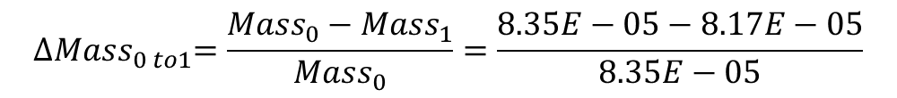
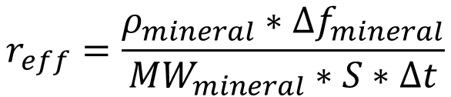
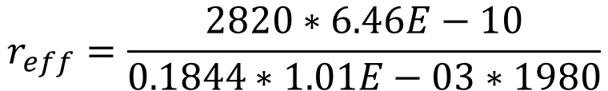
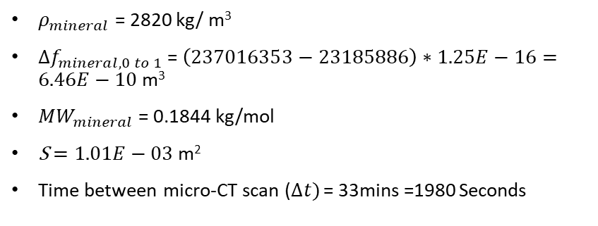
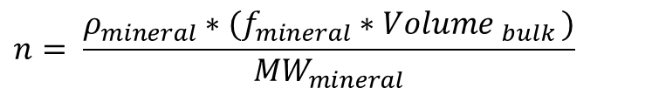
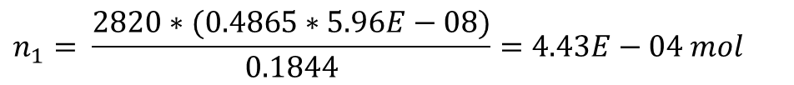
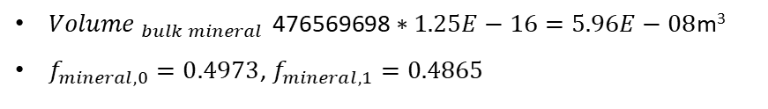
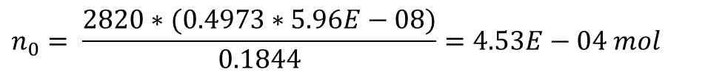
Example: Dolomite
From Image: scan 0 to scan 1
$$r_{eff}=\frac{ρ_{mineral}∗{∆f}_{mineral}}{{MW}_{mineral}∗S∗∆t}$$
$${Mass}_{mineral}=number of moles(n) ∗{MW}_{mineral}$$
$$n= \frac{ρ_{mineral}∗(f_{mineral}∗{Volume }_{bulk })}{{MW}_{mineral}}$$
$ρ_{mineral}$ = 2820 kg/ m³
${∆f}_{mineral, 0 to 1}$ = $\left(237016353−23185886\right)∗1.25E−16=6.46E−10 \text{m}\text{3}$
${MW}_{mineral}$ = 0.1844 kg/mol
S $=1.01E−03$m²
Time between micro-CT scan ($∆t)$ = 33mins =1980 Seconds
${Volume }_{bulk mineral }\text{476569698}∗1.25E−16=5.96E−08$m³
$f_{mineral, 0}=0.4973$, $f_{mineral, 1}=0.4865$
Scan 0:
$$n_{0}= \frac{2820∗(0.4973∗5.96E−08)}{0.1844}=4.53E−04 mol$$
$${Mass}_{0}=4.53E−04 ∗0.1844=8.35E−05kg$$
Scan 1:
$$r_{eff}=\frac{2820∗6.46E−10}{0.1844∗1.01E−03∗1980}$$
$$n_{1}= \frac{2820∗(0.4865∗5.96E−08)}{0.1844}=4.43E−04 mol$$
$${Mass}_{1}=4.43E−04 ∗0.1844=8.17E−05 kg$$
$$r_{eff}=4.93E−06 \text{mol}\text{/}\text{m}\text{2}\text{s}$$
Change in Mass, 0 to 1:
$${∆Mass}_{0 to1}=\frac{{Mass}_{0}−{Mass}_{1}}{{Mass}_{0}}=\frac{8.35E−05−8.17E−05}{8.35E−05}$$
$${∆Mass}_{0 to1}=0.02178$$

Slide 21
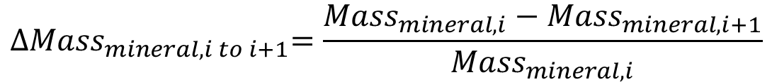
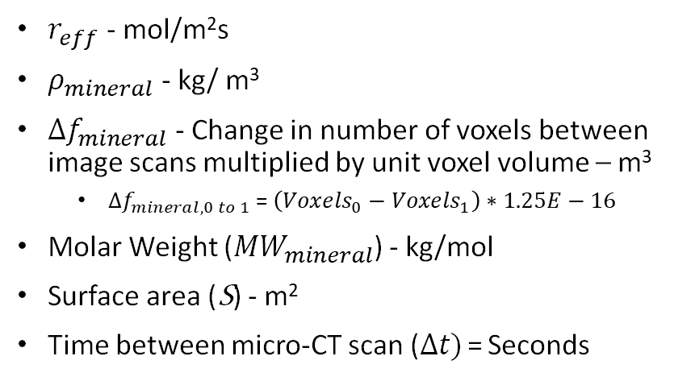
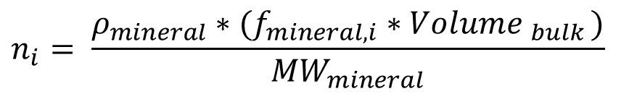
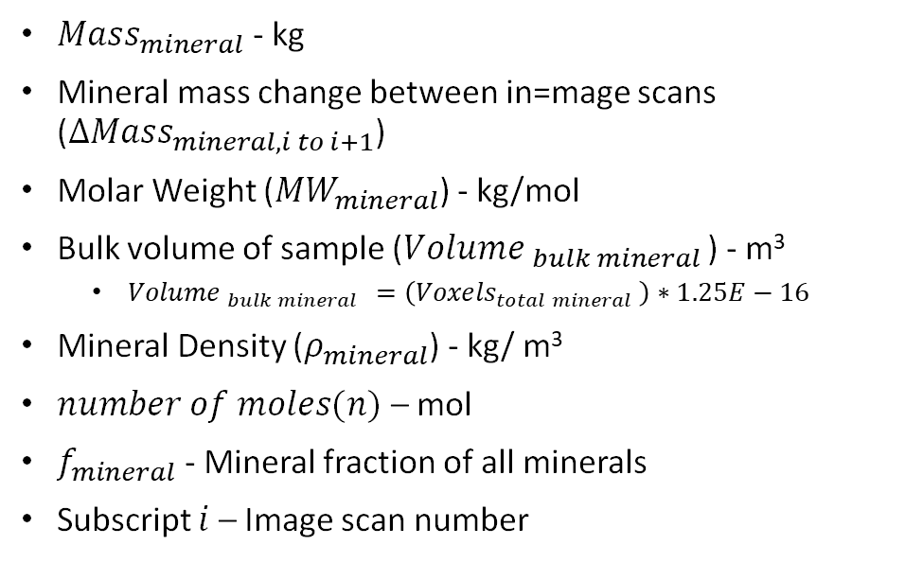
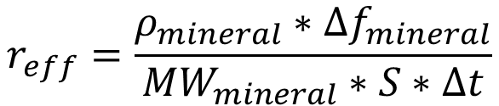
Effective Reaction Rate
Mineral Mass Change
$${∆Mass}_{mineral,i to i+1}=\frac{{Mass}_{mineral,i}−{Mass}_{mineral,i+1}}{{Mass}_{mineral,i}}$$
$$r_{eff}=\frac{ρ_{mineral}∗{∆f}_{mineral}}{{MW}_{mineral}∗S∗∆t}$$
$${Mass}_{mineral,i}=n_{i} ∗{MW}_{mineral}$$
$$n_{i}= \frac{ρ_{mineral}∗(f_{mineral, i}∗{Volume }_{bulk })}{{MW}_{mineral}}$$
$r_{eff}$ - mol/m²s
$ρ_{mineral}$ - kg/ m³
${∆f}_{mineral}$ - Change in number of voxels between image scans multiplied by unit voxel volume – m³
${∆f}_{mineral, 0 to 1}$ = $\left({Voxels}_{0}−{Voxels}_{1}\right)∗1.25E−16$
Molar Weight (${MW}_{mineral}$) - kg/mol
Surface area (S) - m²
Time between micro-CT scan ($∆t)$ = Seconds
${Mass}_{mineral}$ - kg
Mineral mass change between in=mage scans (${∆Mass}_{mineral,i to i+1}$)
Molar Weight (${MW}_{mineral}$) - kg/mol
Bulk volume of sample (${Volume }_{bulk mineral }$) - m³
${Volume }_{bulk mineral }=\left({Voxels}_{total mineral} \right)∗1.25E−16$
Mineral Density ($ρ_{mineral}$) - kg/ m³
$number of moles(n)$ – mol
$f_{mineral}$ - Mineral fraction of all minerals
Subscript $i$ – Image scan number

Slide 22
CO₂ Leakage Pathways
A) Interface between casing and cement (micro-annulus, channel).
B) Interface between casing and cement (micro-annulus)(wax, oil, dirt, etc.).
C) Bulk permeability (connected pore, cracks, channels).
D) Leak in casing (connection)(corrosion, deformation).
E) Annulus cement (connected pores, cracks).
F) Interface rock and cement (micro-annulus, channel)(mud cake, cuttings, oil, etc.)
+
Water
Bachu, 2010
CO₂ leakage pathways from Glazewski et al. 2014

Slide 23
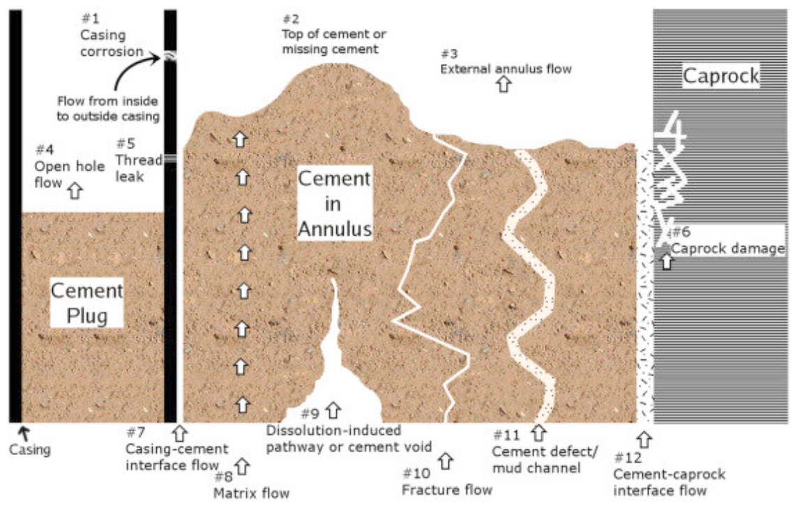
Wellbore Cement
Schematic diagram of an abandoned well showing principal leakage pathways. From Carroll et al., 2016.

