Slide 1




Pore-scale digital twin for coupled heat and mass transport: applications to thermal energy storage and reactors
Mingliang Qu, Martin. J. Blunt, Xiaolei Fan, Qingyang Lin
Imperial College Consortium on
Pore-Scale Modelling and Imaging Annual Meeting

Slide 2
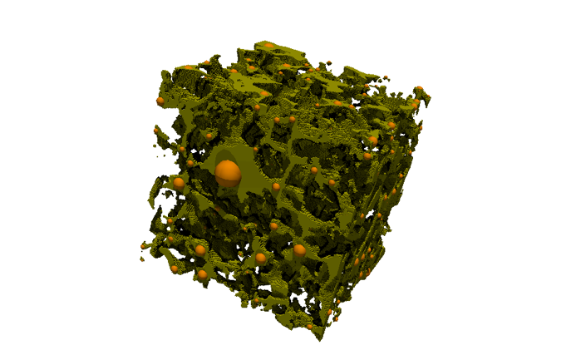
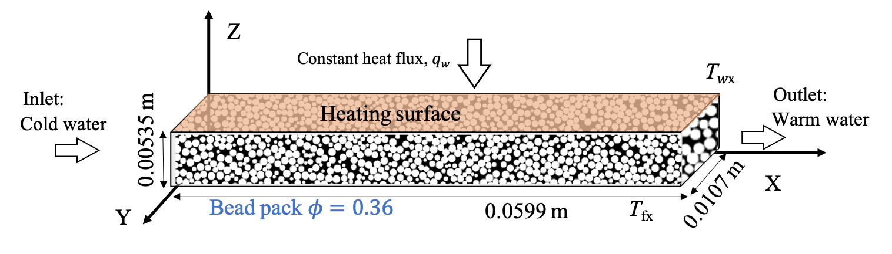
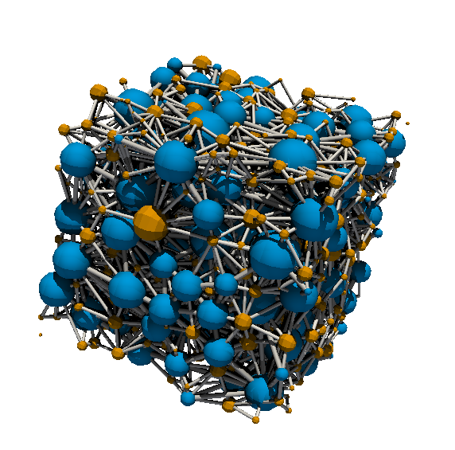
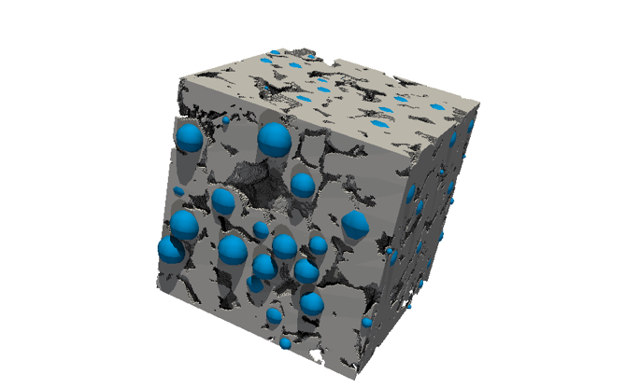
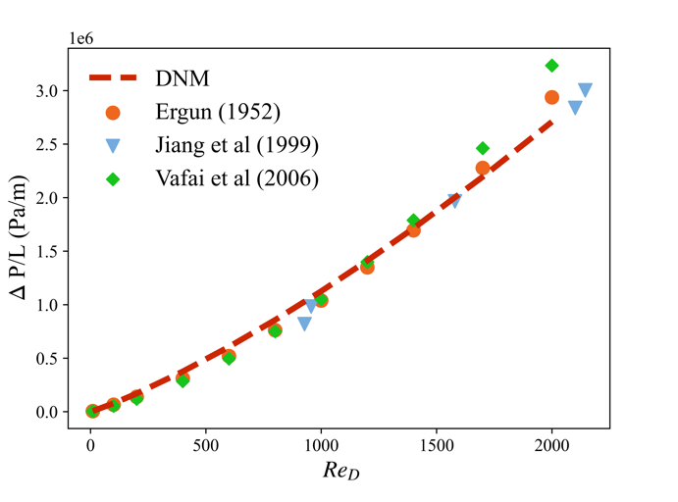
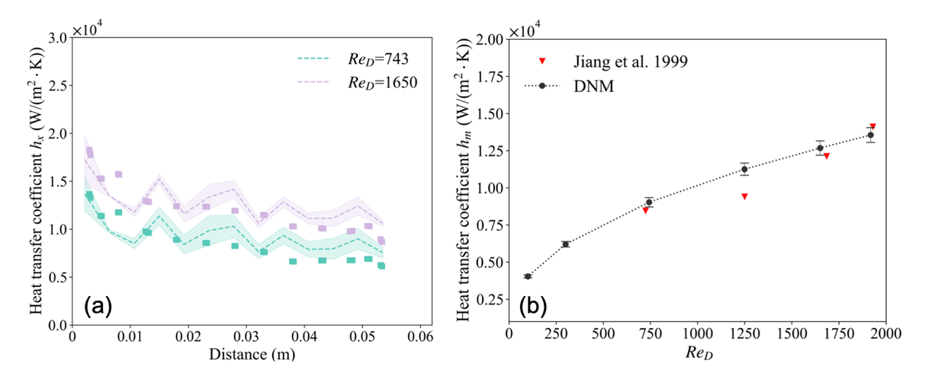
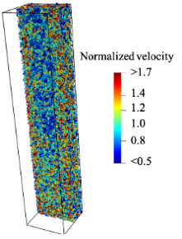
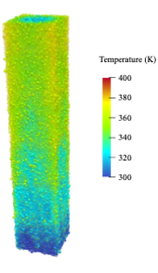
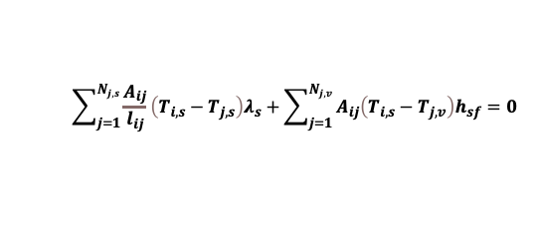
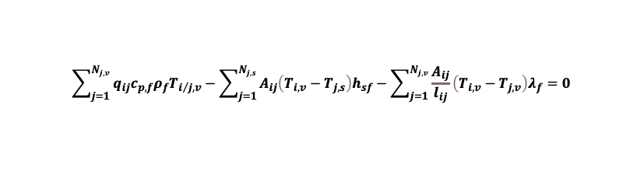

Background – Dual-Network Model (DNM)
Dual-network model building
Validation
Segmentation
Extraction
Fabrication
An example of a packed bed structure
Work domain: 10.7×5.35×59.9 mm³ ;
Nodes: 85,000 (beads&pores)
Time: <0.01 core hours
Pore space
Solid phase
Governing Equations
a) Pressure drop curve
b) Local heat transfer coefficient
c) System heat transfer coefficient
Flow
$$P_{i}−P_{j}={\left(\frac{1}{g_{ij}}+E_{ij}+C_{ij}\right)q}_{ij}$$
Heat
$$\sum_{j=1}^{N_{j,v}}{q_{ij}c_{p,f}ρ_{f}T_{i/j,v}}−\sum_{j=1}^{N_{j, s}}{A_{ij}\left(T_{i,v}−T_{j,s}\right)h_{sf}}−\sum_{j=1}^{N_{j, v}}{\frac{A_{ij}}{l_{ij}}\left(T_{i,v}−T_{j,v}\right)λ_{f}}=0$$
$$\sum_{j=1}^{N_{j, s}}{\frac{A_{ij}}{l_{ij}}\left(T_{i,s}−T_{j,s}\right)λ_{s}}+\sum_{j=1}^{N_{j, v}}{A_{ij}\left(T_{i,s}−T_{j,v}\right)h_{sf}}=0$$
Deviation of model compared with experiment is <10%
Qu M-L, et al. Pore-to-mesoscale network modeling of heat transfer and fluid flow in packed beds with application to process design. AIChE J. 2023;e18213

Slide 3
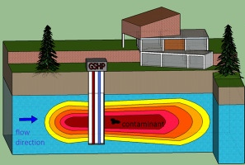
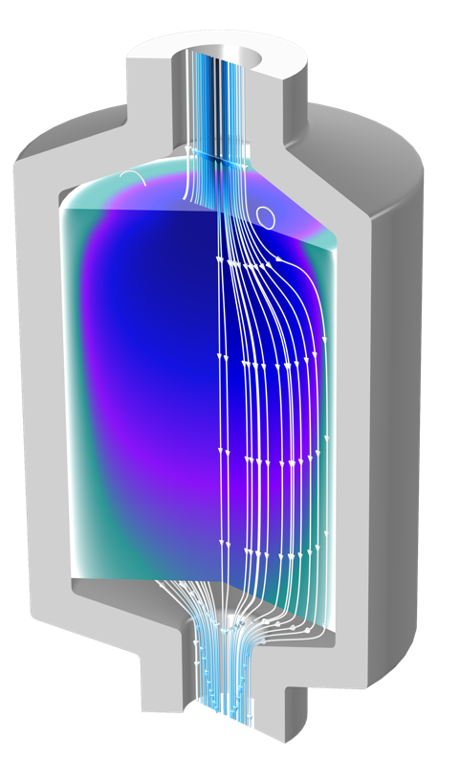
Background – Case study
The dual-network model (DNM) provides the advantage of offering a pore-scale perspective for complex pore systems while using limited computational resources.
Case 1
Challenges to other approaches
Large length and time scales
Meter-scale system
Hour-level duration
Homogeneous & Heterogeneous structure
Estaillades
Bentheimer
Non-Fourier transport
Temperature field
(a) Natural porous media:
- Aquifer Thermal Energy Storage (ATES)
Reactor scale pore structure
Including ~10,000 beads
A gap in time resolution between reaction and transport
Nano second for kinetic model
Second for transport
Particle-by-particle system design
Case 2
(b) Engineered porous media:
- Sorption Thermal Energy Storage (STES)

Slide 4
Contents
Development of MpNM
Case 1
Natural porous media: Aquifer thermal energy storage
Case 2
Engineered porous media: Sorption thermal energy storage (ongoing)

Slide 5
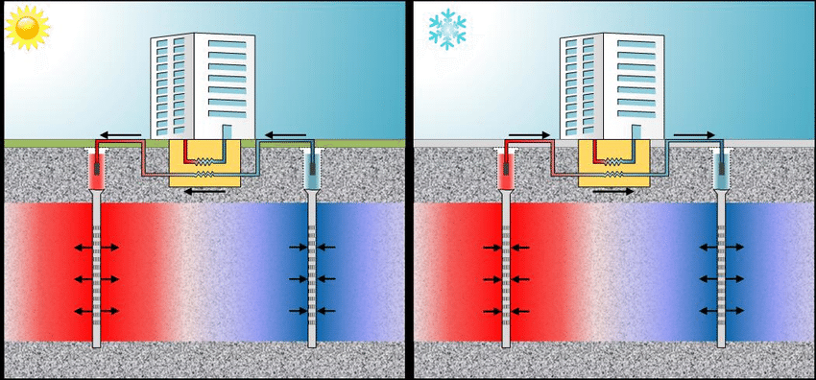

Case 1: Aquifer thermal energy storage
Aquifer thermal energy storage
Efficient energy storage
Sustainable energy utilization
Seasonal thermal energy storage
Environmentally friendly
Long-term stability
Cost-effective
Continuum assumptions:
Homogeneous system
Local thermal equilibrium
Constant fluid parameters
Fourier transport
Reality:
Heterogeneous system
Local thermal nonequilibrium
Varying fluid parameters
Anomalous transport
Correct
DNM was used to explore how pore-scale fluctuations affect average properties.
Notes:
we can see a lot of models have following assumptions

Slide 6
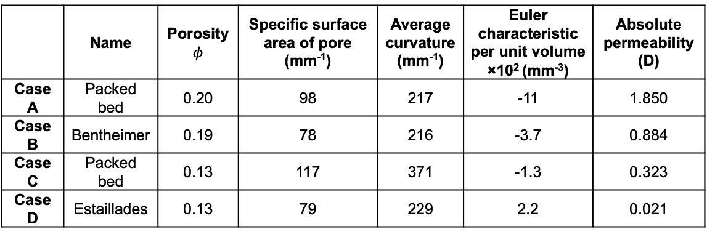
Case 1: Materials
Four types of porous media were studied in this work.
Cross-sections of three-dimensional images (1.79×1.79 mm) :
A random close packing of equally-sized spheres (a packed bed) where the spheres are then dilated to reach a porosity of 0.20;
Bentheimer sandstone (porosity of 0.19);
A packed bed (here the porosity is 0.13);
Estaillades limestone (also with a resolved porosity of 0.13).
All parameters were calculated on 1.79×1.79×1.79 mm³.
 | Name | Porosity $$φ$$ | Specific surface area of pore (mm⁻¹) | Average curvature (mm⁻¹) | Euler characteristic per unit volume ×10² (mm⁻³) | Absolute permeability (D)
Case A | Packed bed | 0.20 | 98 | 217 | -11 | 1.850
Case B | Bentheimer | 0.19 | 78 | 216 | -3.7 | 0.884
Case C | Packed bed | 0.13 | 117 | 371 | -1.3 | 0.323
Case D | Estaillades | 0.13 | 79 | 229 | 2.2 | 0.021

Slide 7
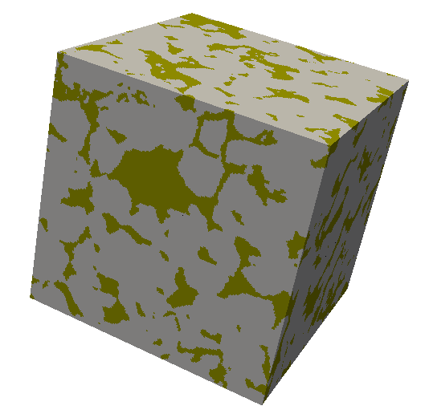
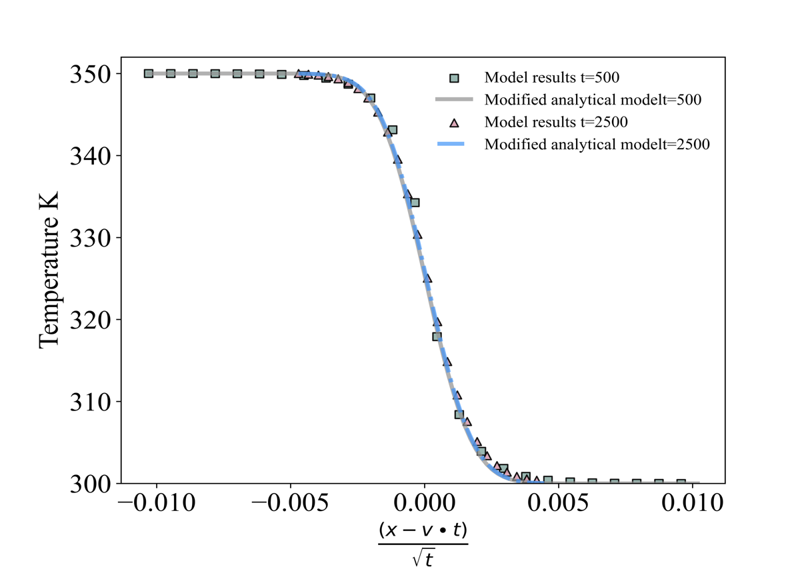
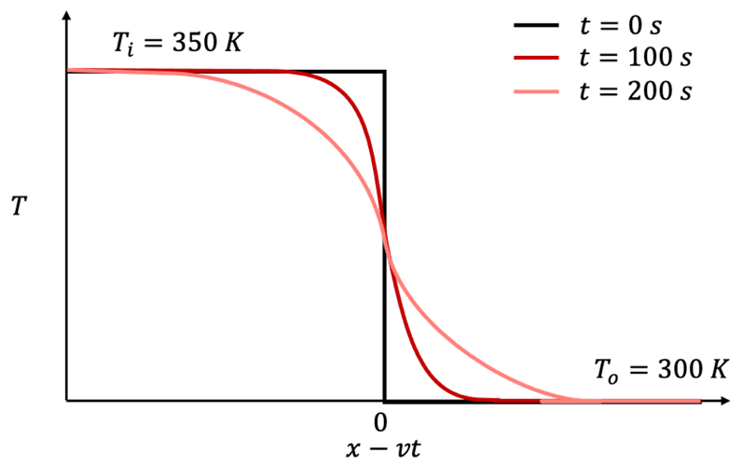



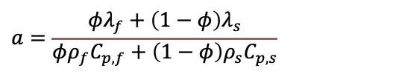
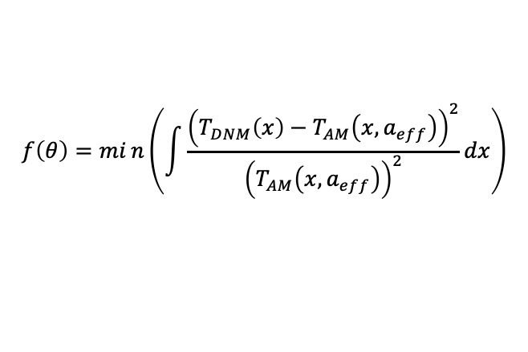
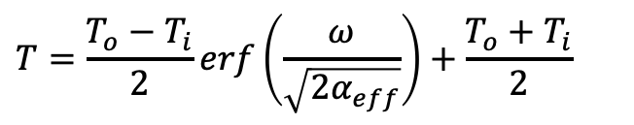
Case 1: Workflow
Analytical model
Dual-network model
$$T=\frac{T_{o}−T_{i}}{2}erf\left(\frac{ω}{\sqrt{2α_{eff}}}\right)+\frac{T_{o}+T_{i}}{2}$$
Porosity
Operation
Meter scale
Transient
Heat & mass
Viscosity changeable
……
$$ω=\frac{x−vt}{\sqrt{t}}$$
Abs. Perm.
$$α_{eff}=βa+γv$$
$$v=\frac{qρ_{f}C_{p,f}}{φρ_{f}C_{p,f}+\left(1−φ\right)ρ_{s}C_{p,s}}$$
Therm. Para.
$$a=\frac{φλ_{f}+\left(1−φ\right)λ_{s}}{φρ_{f}C_{p,f}+\left(1−φ\right)ρ_{s}C_{p,s}}$$
$$f\left(θ\right)=min\left(\int{\frac{{\left(T_{DNM}\left(x\right)−T_{AM}\left(x,a_{eff}\right)\right)}^{2}}{{\left(T_{AM}\left(x,a_{eff}\right)\right)}^{2}}dx}\right)$$
We use the SKO package in PYTHON which applies a genetic algorithm to find the best-match parameters in our analysis.

Slide 8
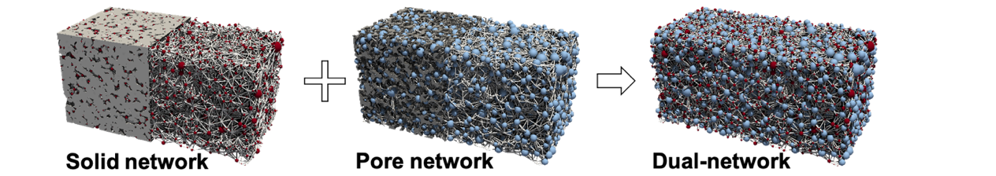
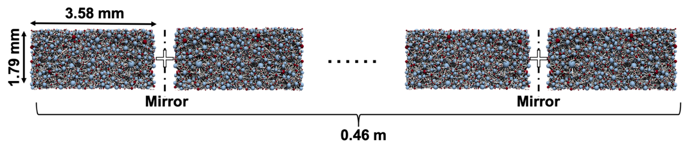
Case 1: Network fabrication method
The maximum-ball method was utilized to precisely extract the network from the solid phase and pore space.
A length of 0.46 m in the flow direction meets the assumption of boundary at infinity for the early state.
This approach involved creating a mirrored copy of the network and removing duplicate nodes from the connected surfaces of both networks.
Network size parameter
Boundary conditions
 | Physical size (m³) | No. Solid nodes (×10⁶) | No. Void nodes (×10⁶) | Total No. Nodes (×10⁶) | Total No. Links (×10⁷)
Case A | 0.458×0.00179×0.00179 | 0.7248 | 1.0072 | 1.7321 | 1.2278
Case B | 0.458×0.00179×0.00179 | 0.2754 | 0.6328 | 0.9081 | 0.5757
Case C | 0.458×0.00179×0.00179 | 0.6876 | 1.1988 | 1,8864 | 1.2484
Case D | 0.458×0.00179×0.00179 | 0.1323 | 0.6080 | 0.7403 | 0.3310
 |  | Boundary condition |  | values | Initial condition
Heat transfer | Solid | Dirichlet | Left | 350K | First half 350 K Second half 300 K
 |  | Dirichlet | Right | 300K
 |  | Neumann | others | ∇T_{s} ⋅ 𝐧 =0
Heat transfer | Fluid | Dirichlet | Left | 350K | First half 350 K Second half 300 K
 |  | Dirichlet | Right | 300K
 |  | Neumann | others | ∇T_{f} ⋅ 𝐧 =0
Flow | / | Neumann | Left | V=variable | 0
 |  | Outflow | Right | ∇T_{f} ⋅ 𝐧 =0

Slide 9
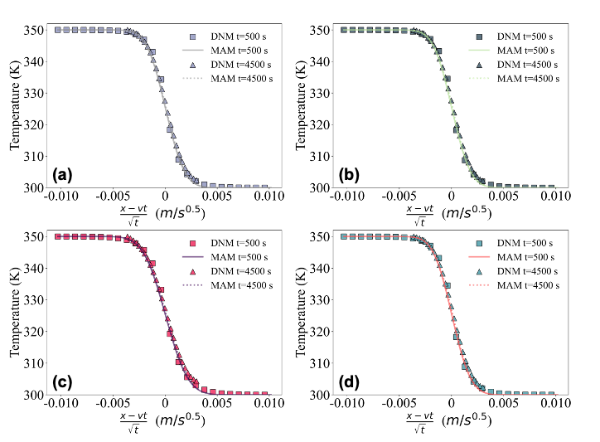
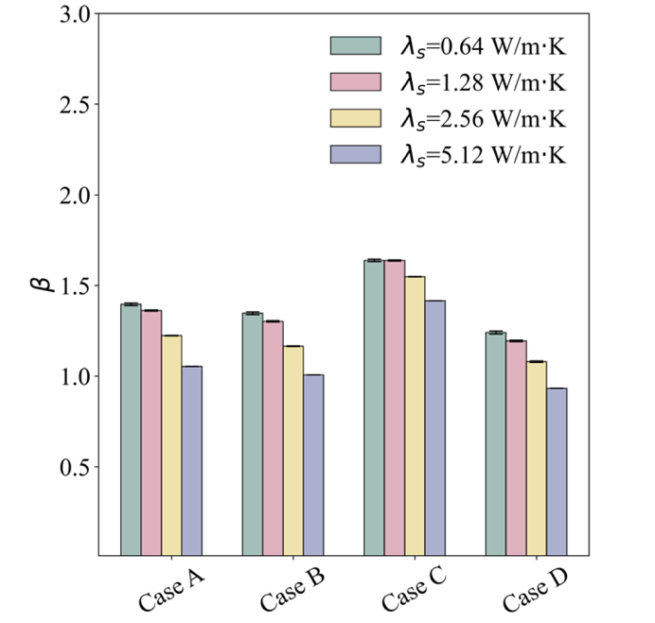
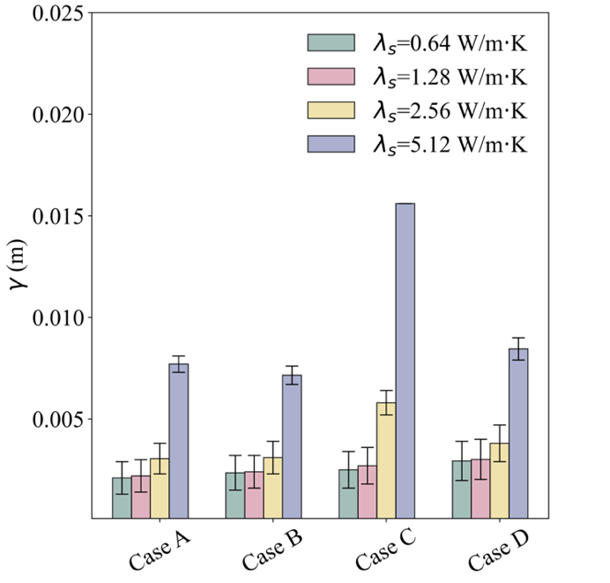
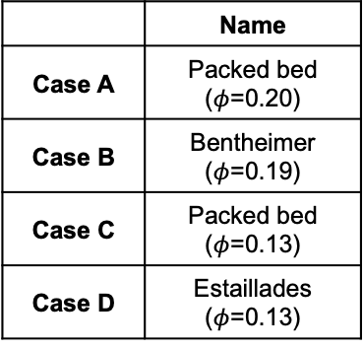
Case 1: Results and discussion
Effective Thermal diffusivity in analytical model : $α_{eff}=βa+γv$
(e)
(f)
 | Name
Case A | Packed bed ($φ$=0.20)
Case B | Bentheimer ($φ$=0.19)
Case C | Packed bed ($φ$=0.13)
Case D | Estaillades ($φ$=0.13)
We set 4 different thermal conductivities (0.64-5.12) for solid phase and 4 various entrance velocity (Reynolds numbers are less than 0.01) in this work.
In Fig(a-d), the analytical model aligns with the DNM results when the effective thermal diffusivity is appropriately set.
A couple of β and 𝛾 can be solved by two effective thermal diffusivities with different velocities, as there are two variables.

Slide 10
Case 1: Results and discussion
Effective Thermal diffusivity in analytical model : $α_{eff}=βa+γv$
(e)
(f)
 | Name
Case A | Packed bed ($φ$=0.20)
Case B | Bentheimer ($φ$=0.19)
Case C | Packed bed ($φ$=0.13)
Case D | Estaillades ($φ$=0.13)
In Fig(e), the initial trend indicates that the correction factor β is highest for the lowest solid thermal conductivity.
In more homogeneous porous media, such as packed beds and Bentheimer, β is higher compared to the heterogeneous case as shown as Fig(e).
Fig(f) illustrates the dispersivity 𝛾 is sensitive to the thermal conductivity and increases as the thermal conductivity of the solid phase rises. Additionally, 𝛾 rises with a decrease in porosity.

Slide 11
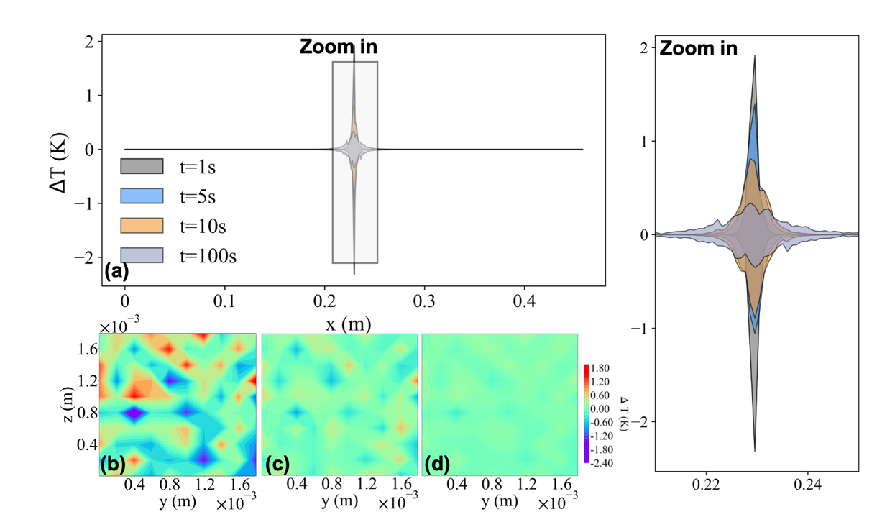
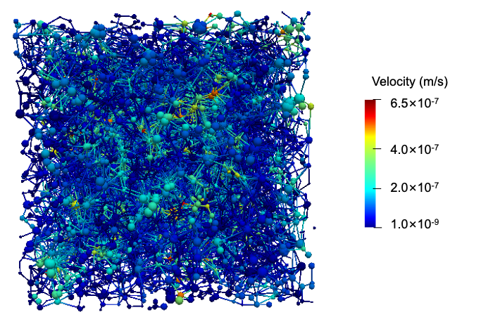
Case 1: Results and discussion
Case C
(e)
Fig (a) The distribution of temperature difference across a slice perpendicular to the flow direction at middle when (b) t = 1s; (c) t = 10 s; and (d) t = 100s.
Fig (f) Velocity slice for Case D at 0.229 m.
In Fig(a), the temperature difference in a slice vertical to the flow direction for the packed bed with porosity 0.13 as an example.
At 1 s as Fig(b), the maximum temperature difference in the middle region is around 2.1 K. After 10 s, the maximum temperature difference decreases to 0.72 K. At later times, the temperature differences vanish, aligning with a one-dimensional analytical solution.
The early temperature variation leads to a lasting change in thermal plume dispersion.
Moreover, fluctuations in velocity persist – see Fig(f).

Slide 12
Case 1: Conclusions
We used a dual-network model to study the deviation between continuum assumptions and accounting for pore-scale fluctuations for systems of size 0.46 m.
Comparing the results with an analytical model, we introduced correction factor β for thermal conductivity and dispersivity γ to adjust thermal diffusivity in the analytical model.
Our findings indicate that the thermal conductivity of the solid phase affects the correction factors, highlighting the need to select appropriate correction factors based on local geological conditions, which can vary by 50% or more.
In summary, our model provides a framework to predict effective heat transport coefficients for various pore structures and thermal properties and capture pore-scale behavior to tune porosity-weighted parameters. Neglecting local temperature fluctuations in a continuum model maybe impact the assessment of thermal transport.

Slide 13
Contents
Development of MpNM
Case 1
Natural porous media: Aquifer thermal energy storage
Case 2
Engineered porous media: Sorption thermal energy storage (ongoing)
Notes:
The first part is the how to build this model

Slide 14
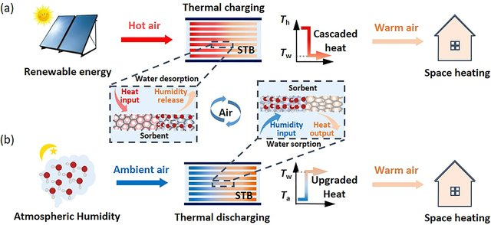
Case 2: Sorption thermal energy storage (ongoing)
Sorption Thermal Energy Storage
Flexibility,
Efficient energy storage,
High thermal storage density,
Low environmental impact,
ACS Energy Letters, 2021, 6(5): 1795-1802.
Digital twin is important approach to guide reactor optimization and design. However, there are some challenges:
Reactor scale pore structure: Including ~10,000 beads
A gap of time resolution between reaction and transport
Nano second for kinetic model
Second for transport
Non-Fickian transport
……
DNM could be used to make a pore-scale digital twin to guide design for reactor.

Slide 15
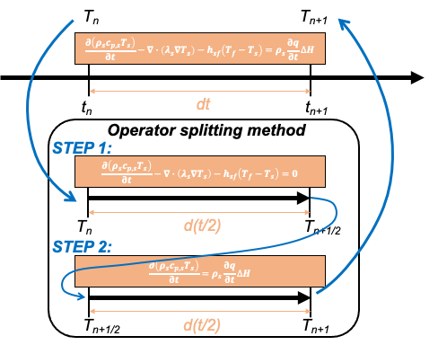
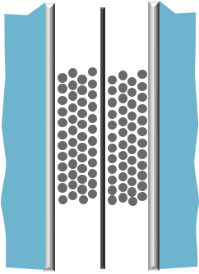
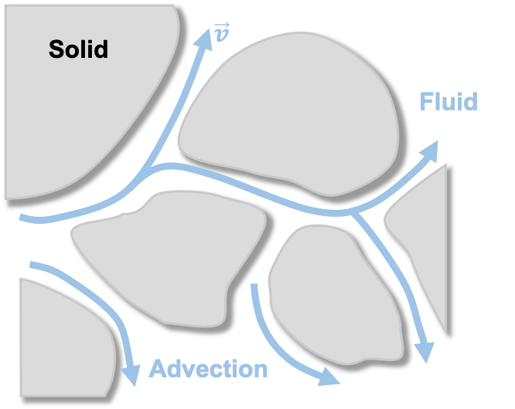


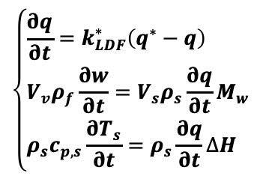
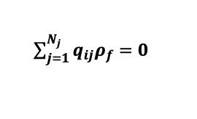

Case 2: A multi-scale problem
m
Reactor level
cm
Upscaling ?
Transport model
$\sum_{j=1}^{N_{j}}{q_{ij}ρ_{f}}=0$
mm
$$\frac{∂\left(w_{w}V_{v}\right)}{∂t}+∇\left(vw_{w}\right)−∇∙\left(D∇w_{w}\right)=ρ_{s}\frac{∂q}{∂t}M_{w}$$
Spatial scale
$$\frac{∂\left(ρ_{s}c_{p,s}T_{s}\right)}{∂t}−∇∙\left(λ_{s}∇T_{s}\right)−h_{sf}\left(T_{f}−T_{s}\right)=ρ_{s}\frac{∂q}{∂t}∆H$$
Reaction level
$$\frac{∂\left(ρ_{f}c_{p,f}T_{f}\right)}{∂t}+∇\left(ρ_{f}c_{p,f}T_{f}v\right)−∇∙\left(λ_{f}∇T_{f}\right)−h_{sf}\left(T_{s}−T_{f}\right)=0$$
μm
$$\left\{\begin{aligned}&\frac{∂q}{∂t}=k_{LDF}^{∗}\left(q^{∗}−q\right) \\ &V_{v}ρ_{f}\frac{∂w}{∂t}=V_{s}ρ_{s}\frac{∂q}{∂t}M_{w} \\ &ρ_{s}c_{p,s}\frac{∂T_{s}}{∂t}=ρ_{s}\frac{∂q}{∂t}∆H\end{aligned}\right.$$
Mean-field
Kinetic model
Dual Network Model can be a potential tool to address this challenge.
nm
ns
μs
ms
s
hour
Temporal scale

Slide 16
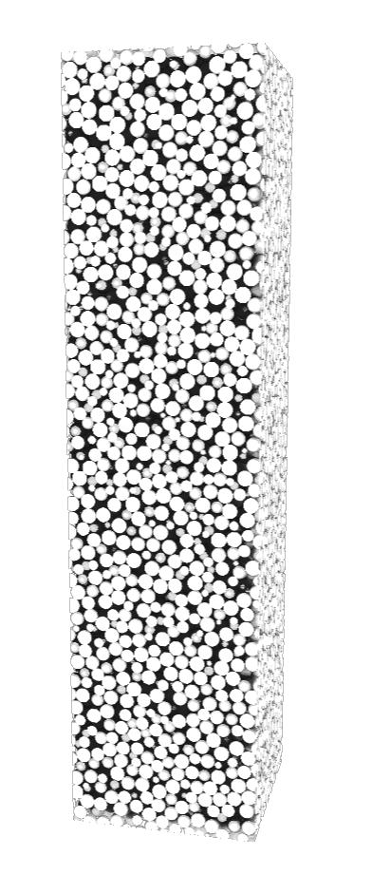
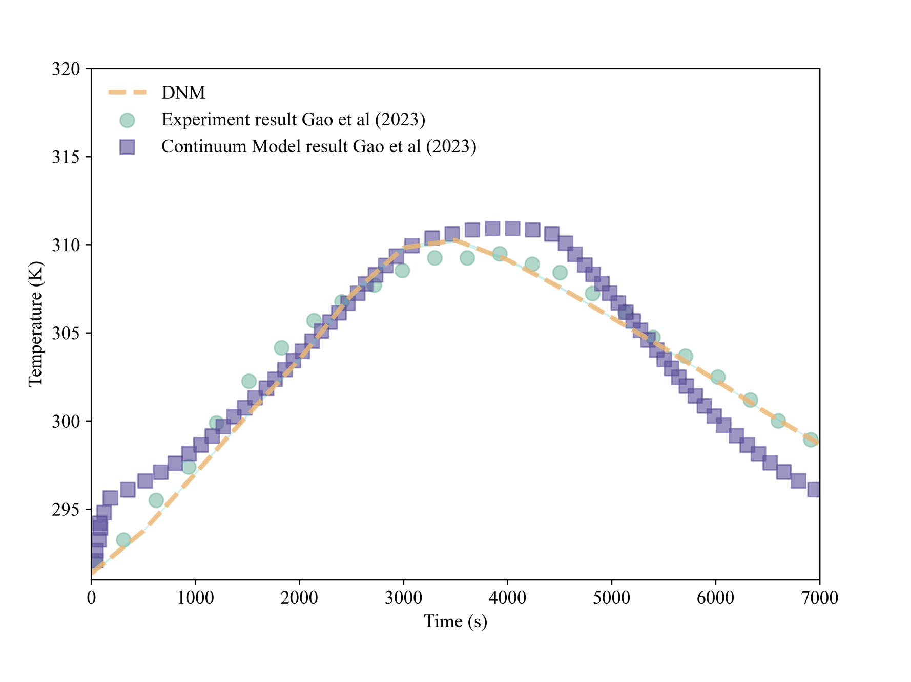
Case 2: Model validation
A bead pack structure has been fabricated which is similar to the experiment from Gao et al 2023. The local temperature has been studied in this case (We consider pore structure formed by packing).
Work domain:
Physical size: 0.1 × 0.025 × 0.025 m³
Image size: 2000 × 500 × 500 Voxels
Resolution: 50 μm
Porosity: 33.1%
Network: 21,326 nodes & 154,246 links
Case description:
13X Zeolite bead diameter: 2 mm
Entrance velocity: 0.21 m/s
Entrance temperature: 293.15 K
Initial temperature: 291.35 K
Processes: one-step reaction & heat and mass transfer
The prediction using our model has better match with the experimental data than continuum model.

Slide 17
Case 2: Design of reactor
Uniform (random) distribution:
– load of active sorbent 30%, 50%, 70%, 90% :
Sorbent bead
bead
Flow direction
0.025 m
Packed bed
0.1 m
In chemical engineering, optimizing the spatial distribution or load of sorbent enables efficient reactor operation.
In this work, we can use model to set a part of particles are sorbent, it can simulate different load with active sorbent in packed bed.
We are exploring the correlation between load of active particles and heat and mass transport.
Comparing a continuum model, we can provide a pore-scale perspective in this system.

Slide 18
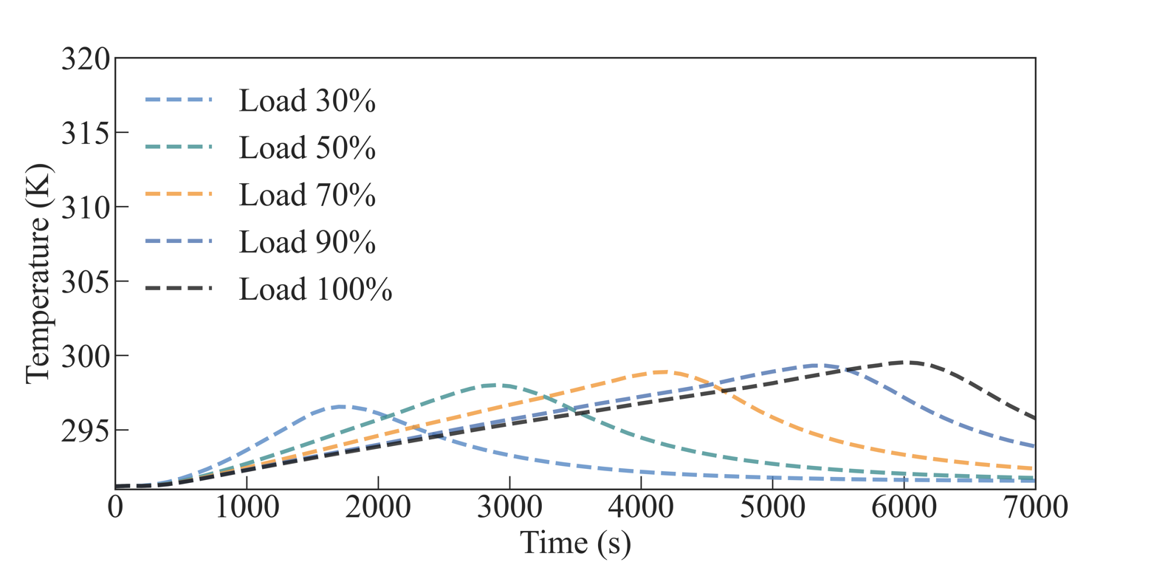
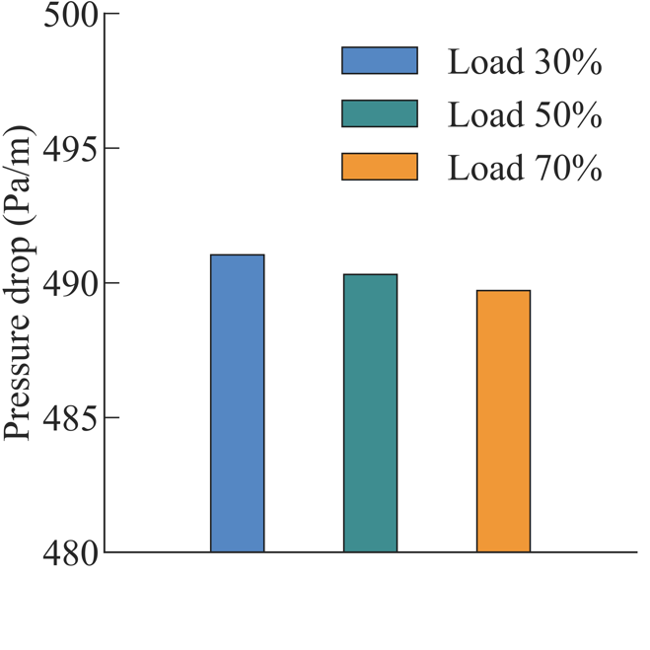
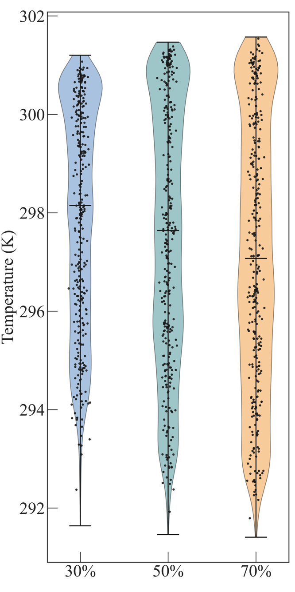
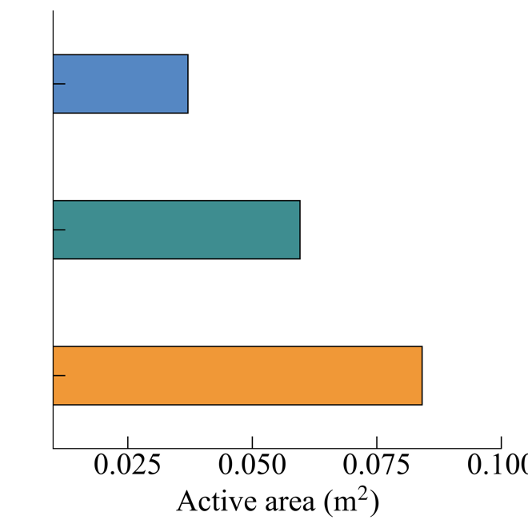
Case 2: Results and discussion
Uniform (random) distribution:
– load of active sorbent 30%, 50%, 70%, 90% :
Sorbent bead
bead
Flow direction
0.025 m
(a)
Packed bed
0.1 m
Fig (a) shows the reactor outlet temperature, indicating different peak times for various curves.
The peak for the low load case occurs earlier and has a lower value than the others.
The temperature rising rate for the low load case is higher than that of the others.
In Fig (b-c), we observe that the pressure drop decreases with the load increase, and the active area of sorbent increases as the load rises.
In Fig (d), the high load case exhibits a wider temperature range, as high load releases more energy at t = 1,500 s.
(b)
(c)
(d)

Slide 19
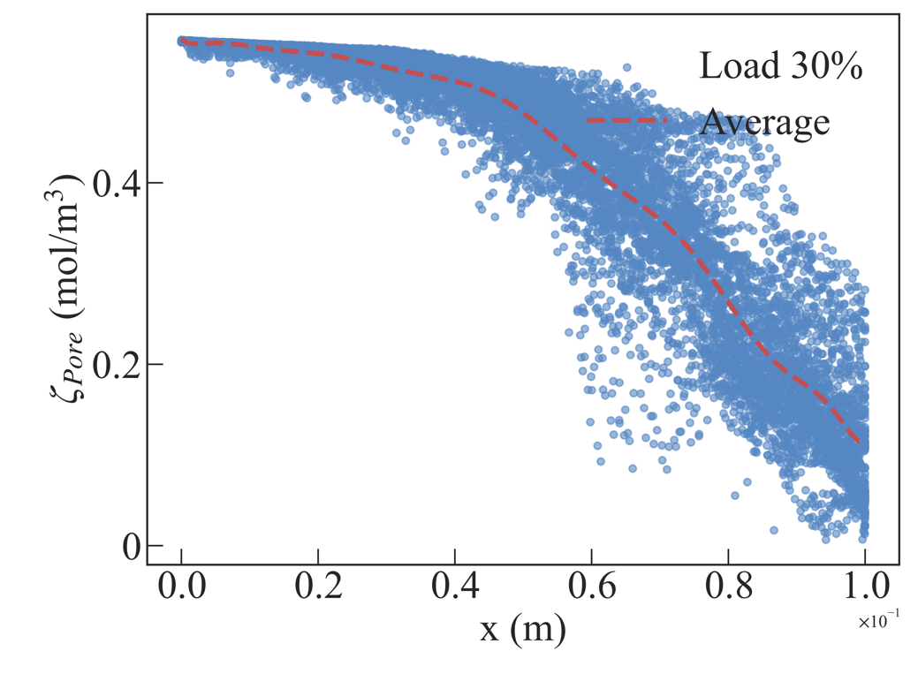
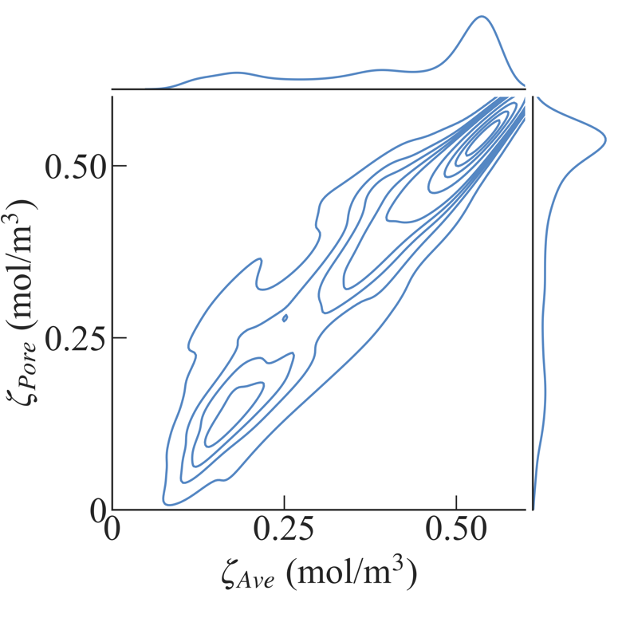
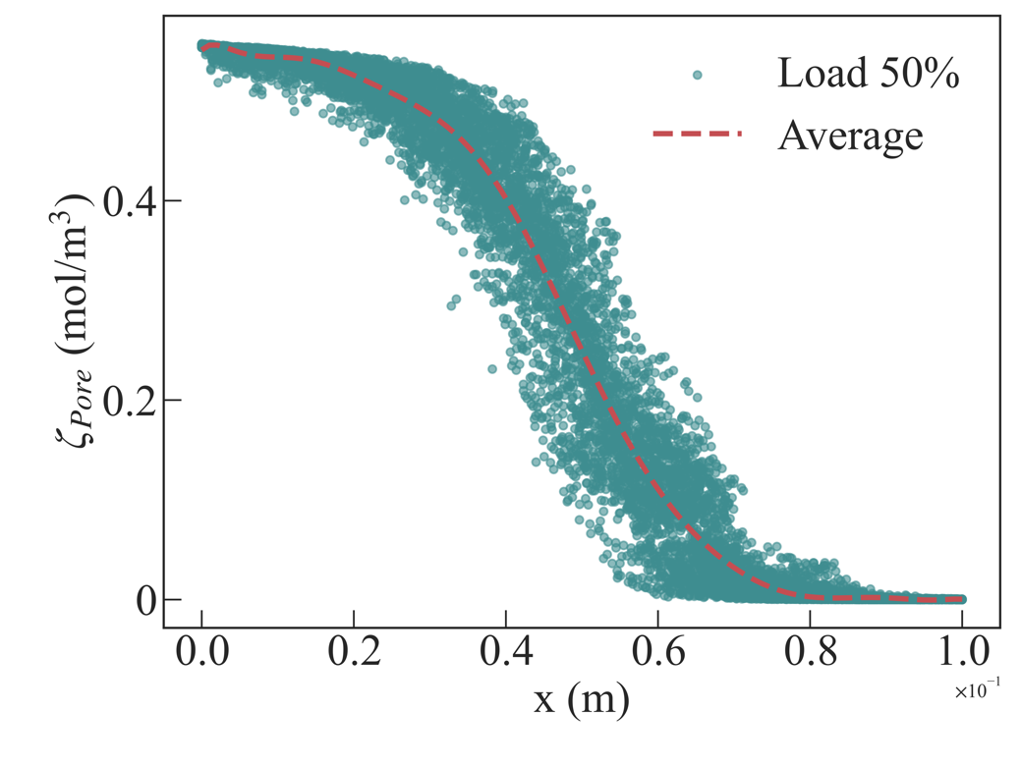
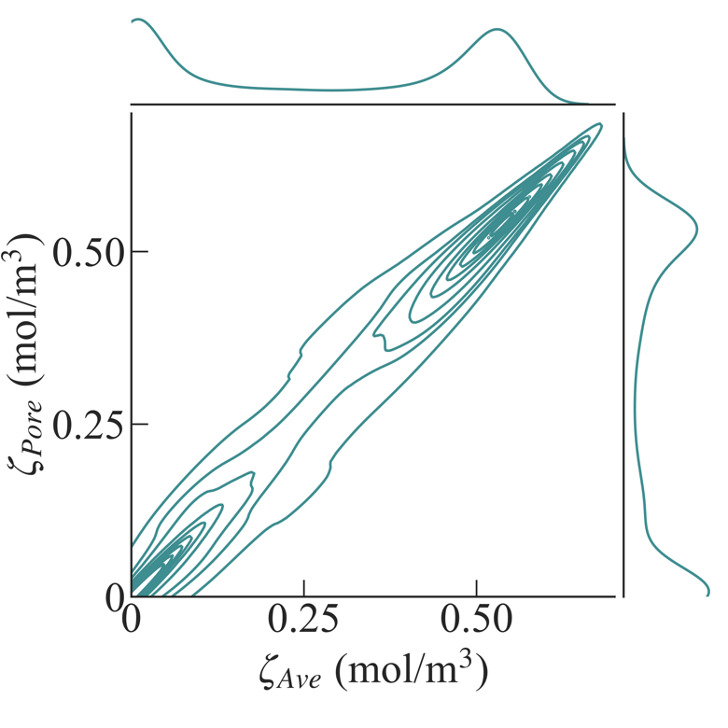
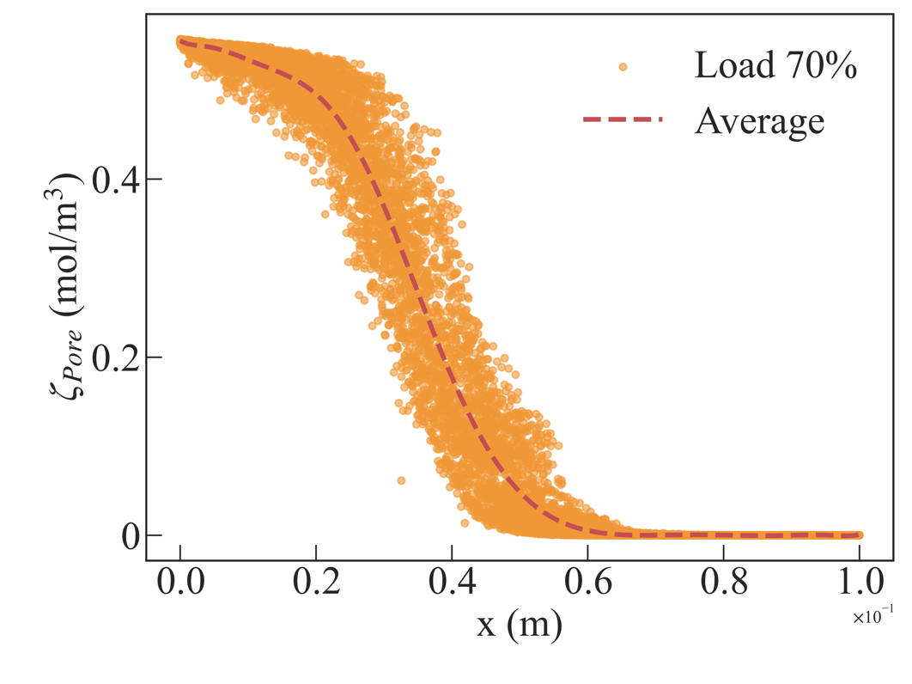
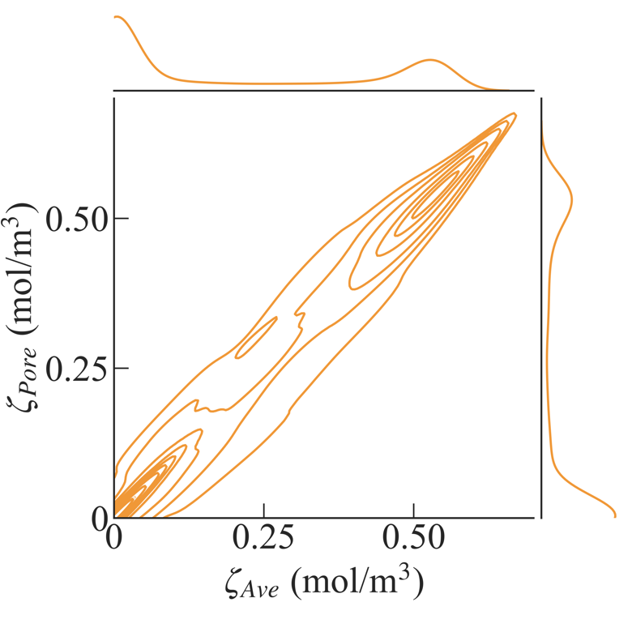
Case 2: Results and Discussion
Uniform (random) distribution:
– load of active sorbent 30%, 50%, 70%, 90% :
Sorbent bead
bead
Flow direction
0.025 m
(a)
(d)
Packed bed
0.1 m
In Fig(a-c), we plot the vapor concentration (t = 1,500s) in the pore as a function of distance along the flow direction, and obtain the average value curve (red curves).
The local concentration has a wide range, deviating from the average value.
The 2D kernel density estimate (KDE) of Fig(d-f), were used to clearly demonstrate the deviation between the pore concentration and the average value. It means that the local concentration is uneven
(b)
(e)
(c)
(f)

Slide 20
Case 2: Conclusions and outlook
We coupled a one-step reaction with the heat and mass transfer model to analyze a sorption thermal energy storage process.
We observed that various loads affect the concentration and temperature profiles in the reactor.
In the case of a packed bed, typically considered a homogeneous material, the concentration profiles are non-uniform, with the high-load case exhibiting a more uniform profile than the low-load case.
Our model offers advantages in terms of simulation speed and provides a potential approach for considering large-scale porous media, including millions of pores.
In the next step, we will explore the the mechanism of transport in a multi-layer packed bed.
Moreover, we aim to incorporate complex reaction processes, such as CO₂ hydrogenation (CO2+4H2→CH4+2H2O) into our model to simulate sorption enhanced reaction.
Subsequently, we intend to utilize this model to optimize the spatial distribution of active catalysts and sorbent in packed beds to enhance efficiency.
Outlook

Slide 21
Thank you for listening!
Questions and comments
E-mail: m.qu@imperial.ac.uk / mingliangqu@zju.edu.cn

