Slide 1
Super-resolution imaging of multiphase fluid distributions in porous media using deep learning
Jack Ma
Supervisors: Prof. Martin Blunt, Prof. Yanghua Wang, Dr. Branko Bijeljic
15/01/2024
Notes:
Hello, everyone.
Thank you all for being here today.
I am delighted to present you a topic about the applications of super-resolution on pore-scale imaging.

Slide 2
Outline
Background and motivation
Methodology
Current results
Future work
Notes:
Here is the outline.

Slide 3
Background and motivation
Notes:
So, Let’s dive into the first part: the background.

Slide 4
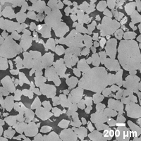
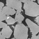
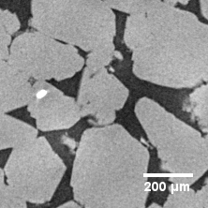
Resolution and field of view
To obtain more accurate flow simulation results, we expect images with higher resolution and larger field of view (FOV).
However, due to inherent limitations of tomography, there is a trade-off between high resolution and field of view, which has been a limitation for simulation.
Low resolution with large FOV
Zoomed in low-resolution image
High resolution with small FOV
Notes:
However, there also exist limitations.
In pore-scale imaging, there is often a trade-off between field of view and high resolution. Field of view refers to the area of the sample being imaged that can be captured in a single image, while high resolution refers to the level of detail and clarity in the image.
What is the trade-off? It’s very easy to understand. As, you can see from the 3 figures. To achieve a high-resolution image of a small portion of the sample, the field of view needs to be reduced, meaning that only a small area of the sample can be imaged at once. Conversely, to capture a larger field of view, the resolution needs to be reduced, which can result in lower quality or less detailed images.
Therefore, what we hope is to obtain images with high-resolution and large FOV.
Pore-scale imaging is an important tool for the study of flow in porous media. However, as I just mentioned, the resolution is limited by the capabilities of the imaging technology, which may not be sufficient for certain applications.
Super resolution (SR) is an area of research in image processing that focuses on enhancing the resolution of an image. It aims to generate a high-resolution (HR) version of an image given a low-resolution (LR) input, often referred to as "upscaling". This problem is intrinsically ill-posed, as multiple HR images can correspond to the same LR image.
In recent years, deep learning has proven to be highly effective for super-resolution tasks. For example, Convolutional Neural Networks (CNNs) are often used due to their ability to learn hierarchical features and patterns in images. The process typically involves training a network on pairs of LR and corresponding HR images, allowing it to learn an end-to-end mapping from the LR to HR space.

Slide 5
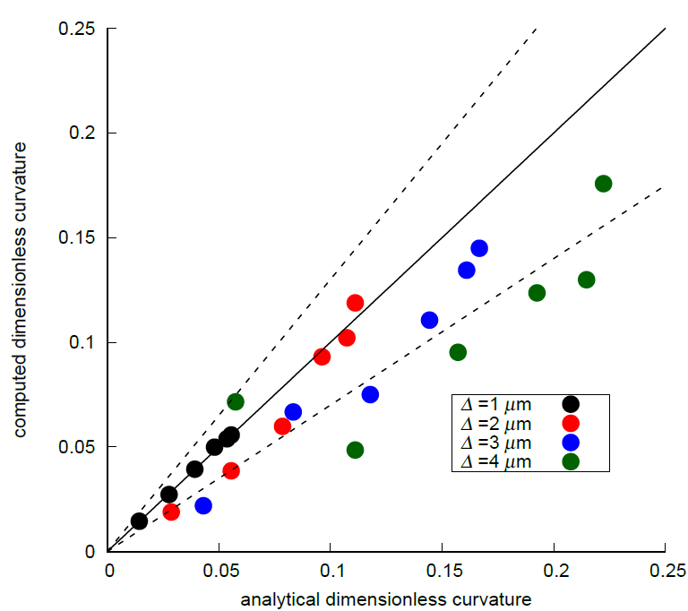
Resolution and calculation of local capillary pressures
Besides, resolution of images matters in multiphase flow.
Akai et al. (2019) quantified likely errors of local capillary pressures according to the relationship between the average radius of curvature and the image resolution.
Generally, images with high resolution can reduce the likely calculation errors.
Lower resolution higher likely errors (Akai et al. 2019)
Notes:
However, there also exist limitations.
In pore-scale imaging, there is often a trade-off between field of view and high resolution. Field of view refers to the area of the sample being imaged that can be captured in a single image, while high resolution refers to the level of detail and clarity in the image.
What is the trade-off? It’s very easy to understand. As, you can see from the 3 figures. To achieve a high-resolution image of a small portion of the sample, the field of view needs to be reduced, meaning that only a small area of the sample can be imaged at once. Conversely, to capture a larger field of view, the resolution needs to be reduced, which can result in lower quality or less detailed images.
Therefore, what we hope is to obtain images with high-resolution and large FOV.
Pore-scale imaging is an important tool for the study of flow in porous media. However, as I just mentioned, the resolution is limited by the capabilities of the imaging technology, which may not be sufficient for certain applications.
Super resolution (SR) is an area of research in image processing that focuses on enhancing the resolution of an image. It aims to generate a high-resolution (HR) version of an image given a low-resolution (LR) input, often referred to as "upscaling". This problem is intrinsically ill-posed, as multiple HR images can correspond to the same LR image.
In recent years, deep learning has proven to be highly effective for super-resolution tasks. For example, Convolutional Neural Networks (CNNs) are often used due to their ability to learn hierarchical features and patterns in images. The process typically involves training a network on pairs of LR and corresponding HR images, allowing it to learn an end-to-end mapping from the LR to HR space.

Slide 6
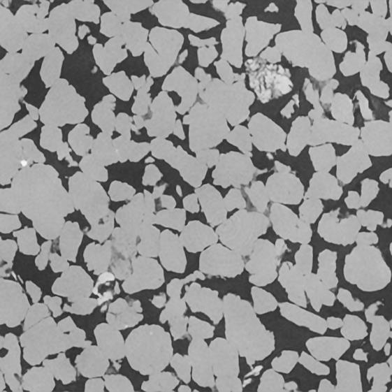
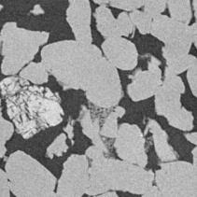
Image super resolution
The objective of Image Super-Resolution (SR) is to enhance the resolution of Low-Resolution (LR) images to match High-Resolution (HR).
Coarse structure
Fine details
SR image (high resolution with large FOV)
Integration
Notes:
However, there also exist limitations.
In pore-scale imaging, there is often a trade-off between field of view and high resolution. Field of view refers to the area of the sample being imaged that can be captured in a single image, while high resolution refers to the level of detail and clarity in the image.
What is the trade-off? It’s very easy to understand. As, you can see from the 3 figures. To achieve a high-resolution image of a small portion of the sample, the field of view needs to be reduced, meaning that only a small area of the sample can be imaged at once. Conversely, to capture a larger field of view, the resolution needs to be reduced, which can result in lower quality or less detailed images.
Therefore, what we hope is to obtain images with high-resolution and large FOV.
Pore-scale imaging is an important tool for the study of flow in porous media. However, as I just mentioned, the resolution is limited by the capabilities of the imaging technology, which may not be sufficient for certain applications.
Super resolution (SR) is an area of research in image processing that focuses on enhancing the resolution of an image. It aims to generate a high-resolution (HR) version of an image given a low-resolution (LR) input, often referred to as "upscaling". This problem is intrinsically ill-posed, as multiple HR images can correspond to the same LR image.
In recent years, deep learning has proven to be highly effective for super-resolution tasks. For example, Convolutional Neural Networks (CNNs) are often used due to their ability to learn hierarchical features and patterns in images. The process typically involves training a network on pairs of LR and corresponding HR images, allowing it to learn an end-to-end mapping from the LR to HR space.

Slide 7
Research objectives
The application of super-resolution to multiphase flow to capture the saturation, fluid-fluid interfaces and contact angles with greater accuracy.
The main research objectives are as follows:
Apply 3D super resolution to multiphase flow images and implement geometrical and physical evaluation
According to domain and physical knowledge, develop a 3D physics-informed super-resolution method that can recover interfaces with constant curvature
Notes:
However, there also exist limitations.
In pore-scale imaging, there is often a trade-off between field of view and high resolution. Field of view refers to the area of the sample being imaged that can be captured in a single image, while high resolution refers to the level of detail and clarity in the image.
What is the trade-off? It’s very easy to understand. As, you can see from the 3 figures. To achieve a high-resolution image of a small portion of the sample, the field of view needs to be reduced, meaning that only a small area of the sample can be imaged at once. Conversely, to capture a larger field of view, the resolution needs to be reduced, which can result in lower quality or less detailed images.
Therefore, what we hope is to obtain images with high-resolution and large FOV.
Pore-scale imaging is an important tool for the study of flow in porous media. However, as I just mentioned, the resolution is limited by the capabilities of the imaging technology, which may not be sufficient for certain applications.
Super resolution (SR) is an area of research in image processing that focuses on enhancing the resolution of an image. It aims to generate a high-resolution (HR) version of an image given a low-resolution (LR) input, often referred to as "upscaling". This problem is intrinsically ill-posed, as multiple HR images can correspond to the same LR image.
In recent years, deep learning has proven to be highly effective for super-resolution tasks. For example, Convolutional Neural Networks (CNNs) are often used due to their ability to learn hierarchical features and patterns in images. The process typically involves training a network on pairs of LR and corresponding HR images, allowing it to learn an end-to-end mapping from the LR to HR space.

Slide 8
Methodology
Notes:
Next, let me introduce the 2D super resolution and show some interesting results.

Slide 9
3D super-resolution
Notes:
Next, 3D super resolution.

Slide 10
Dataset
Chose Bentheimer sandstone and Estaillades carbonate to train and test 3D super resolution models
Training dataset:
  Dimension: 400 x 400 x 400 (HR), 100 x 100 x 100 (LR generated by Bicubic interpolation)
  Voxel size: 3.8 microns
Test dataset:
  Dimension: 400 x 400 x 400 (HR), 100 x 100 x 100 (LR generated by Bicubic interpolation)
  Voxel size: 3.8 microns
Bentheimer sandstone rocks (Wang et al., 2019)

Slide 11
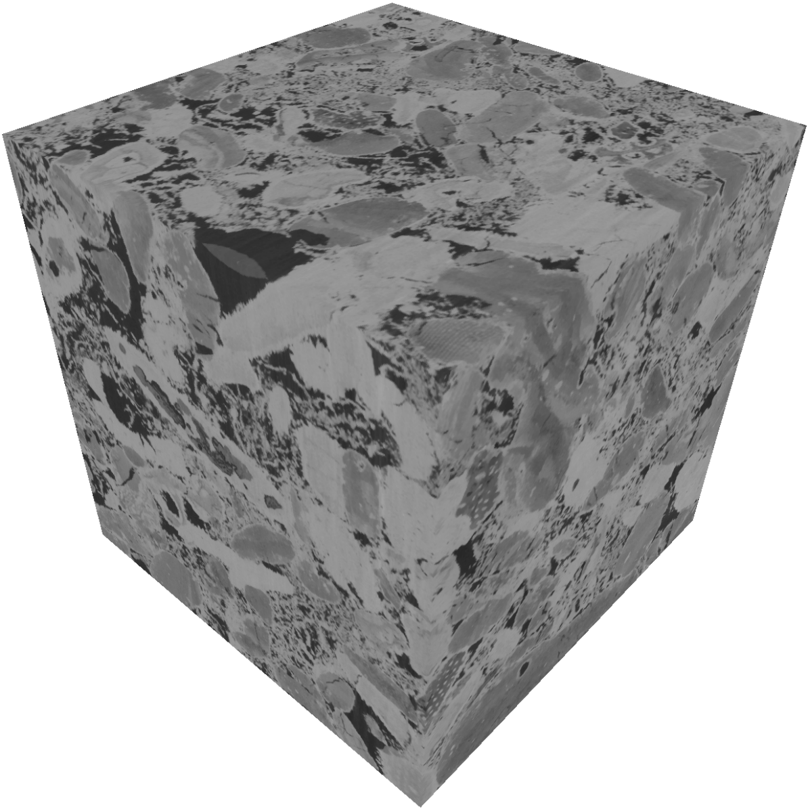
Dataset
Chose Bentheimer sandstone and Estaillades carbonate to train and test 3D super resolution models
Training dataset:
  Dimension: 1120 x 1120 x 1120 (HR), 280 x 280 x 280 (LR generated by Bicubic interpolation)
  Voxel size: 3.58 microns
Test dataset:
  Dimension: 1120 x 1120 x 1120 (HR), 280 x 280 x 280 (LR generated by Bicubic interpolation)
  Voxel size: 3.58 microns
Estaillades Carbonate rocks (Gao et al., 2023)

Slide 12
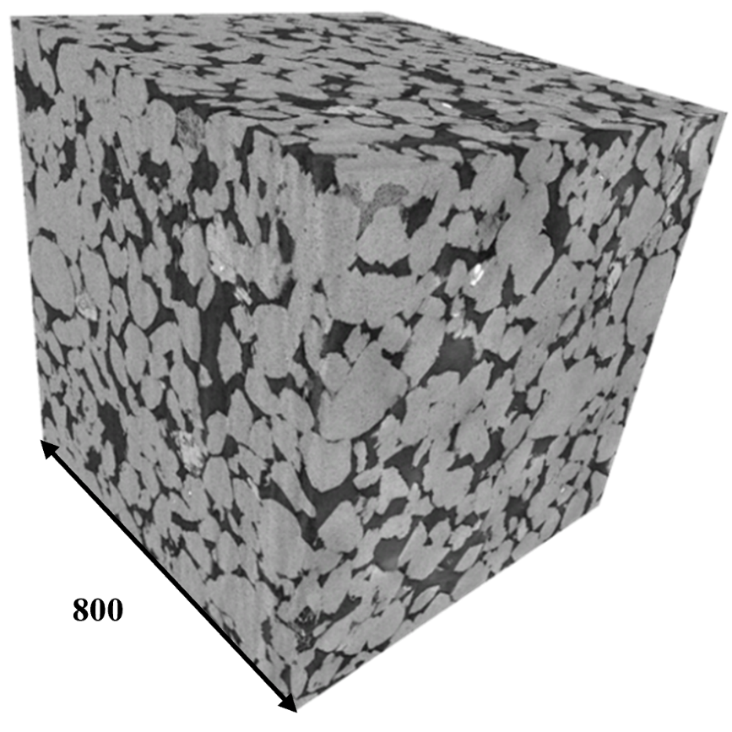
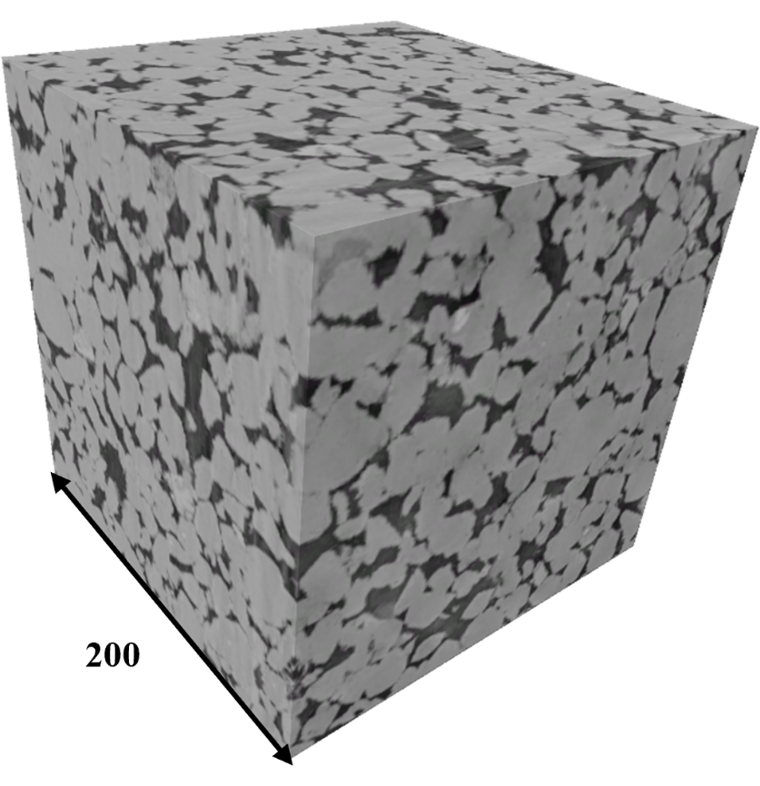
High-resolution image
800 x 800 x 800
Low-resolution image
200 x 200 x 200

Slide 13
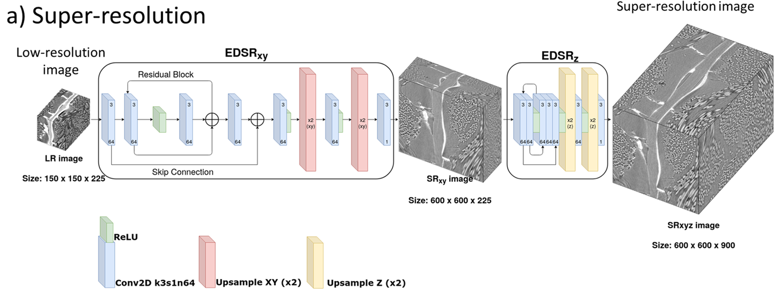



3D super-resolution model and architecture
Dual-Enhanced Deep Super-Resolution (Dual-EDSR) (Wang et al., 2023)
Notes:
Because directly dealing with 3D images is extremely GPU-memory consuming. After literature survey, I chose to Dual-EDSR model.
It is designed to tackle the 3D super-resolution problem by considering it as a two-step process: first performing super-resolution in the XY plane, and then in the Z direction. This model consists of two components: the XY super-resolver (SRxy) and the Z super-resolver (SRz). These two super-resolvers work together to generate a 3D super-resolved image from a low-resolution input.
Let me the architecture in detail.
The network architecture of Dual-EDSR consists of two super-resolvers, specifically an XY super-resolver (SRxy) and a Z super-resolver (SRz).
The XY super-resolver operates on 2D slices of the input 3D image, viewing these slices as a batch. It applies a super-resolution transformation to the XY planes of the image, expanding them by a specified scale factor, in my study, it’s 4.
The output of the XY super-resolver, a batch of super-resolved 2D images, is then passed to the Z super-resolver. The Z super-resolver takes this batch and treats it as a 3D image, then applies super-resolution transformation along the Z-axis.
In a nutshell, this two-step approach allows the network to effectively handle the 3D super-resolution task by breaking it down into two 2D super-resolution tasks.

Slide 14
3D super-resolution model and architecture
Dual-Enhanced Deep Super-Resolution (Dual-EDSR) (Wang et al., 2023)
Notes:
Because directly dealing with 3D images is extremely GPU-memory consuming. After literature survey, I chose to Dual-EDSR model.
It is designed to tackle the 3D super-resolution problem by considering it as a two-step process: first performing super-resolution in the XY plane, and then in the Z direction. This model consists of two components: the XY super-resolver (SRxy) and the Z super-resolver (SRz). These two super-resolvers work together to generate a 3D super-resolved image from a low-resolution input.
Let me the architecture in detail.
The network architecture of Dual-EDSR consists of two super-resolvers, specifically an XY super-resolver (SRxy) and a Z super-resolver (SRz).
The XY super-resolver operates on 2D slices of the input 3D image, viewing these slices as a batch. It applies a super-resolution transformation to the XY planes of the image, expanding them by a specified scale factor, in my study, it’s 4.
The output of the XY super-resolver, a batch of super-resolved 2D images, is then passed to the Z super-resolver. The Z super-resolver takes this batch and treats it as a 3D image, then applies super-resolution transformation along the Z-axis.
In a nutshell, this two-step approach allows the network to effectively handle the 3D super-resolution task by breaking it down into two 2D super-resolution tasks.

Slide 15
3D super-resolution model and architecture
Dual-Enhanced Deep Super-Resolution (Dual-EDSR) (Wang et al., 2023)
Notes:
Because directly dealing with 3D images is extremely GPU-memory consuming. After literature survey, I chose to Dual-EDSR model.
It is designed to tackle the 3D super-resolution problem by considering it as a two-step process: first performing super-resolution in the XY plane, and then in the Z direction. This model consists of two components: the XY super-resolver (SRxy) and the Z super-resolver (SRz). These two super-resolvers work together to generate a 3D super-resolved image from a low-resolution input.
Let me the architecture in detail.
The network architecture of Dual-EDSR consists of two super-resolvers, specifically an XY super-resolver (SRxy) and a Z super-resolver (SRz).
The XY super-resolver operates on 2D slices of the input 3D image, viewing these slices as a batch. It applies a super-resolution transformation to the XY planes of the image, expanding them by a specified scale factor, in my study, it’s 4.
The output of the XY super-resolver, a batch of super-resolved 2D images, is then passed to the Z super-resolver. The Z super-resolver takes this batch and treats it as a 3D image, then applies super-resolution transformation along the Z-axis.
In a nutshell, this two-step approach allows the network to effectively handle the 3D super-resolution task by breaking it down into two 2D super-resolution tasks.

Slide 16
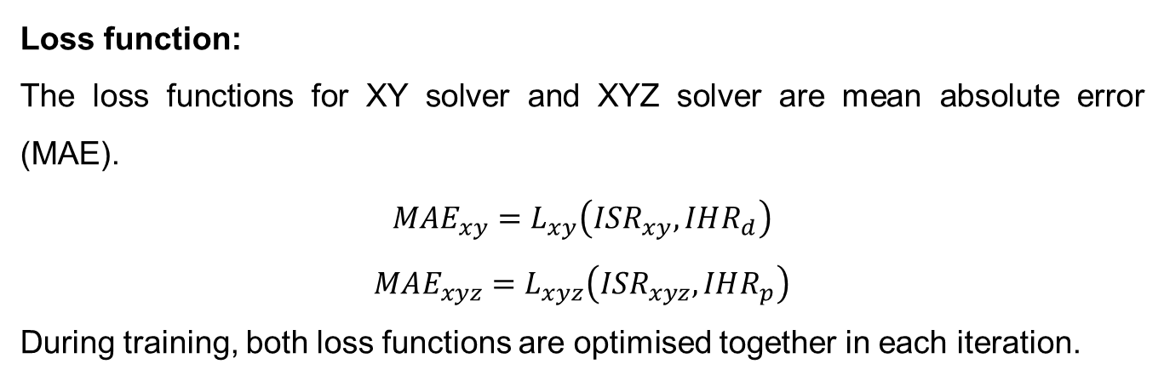
Training strategy and details
Loss function:
The loss functions for XY solver and XYZ solver are mean absolute error (MAE).
$$MAE_{xy}=L_{xy}\left(ISR_{xy},IHR_{d}\right)$$
$$MAE_{xyz}=L_{xyz}\left(ISR_{xyz},IHR_{p}\right)$$
During training, both loss functions are optimised together in each iteration.
Notes:
The model leverages mean absolute error (MAE) loss for both steps of the super-resolution process.

Slide 17
Current results
Single-phase (pore-grain)
Notes:
Next, 3D super resolution.

Slide 18
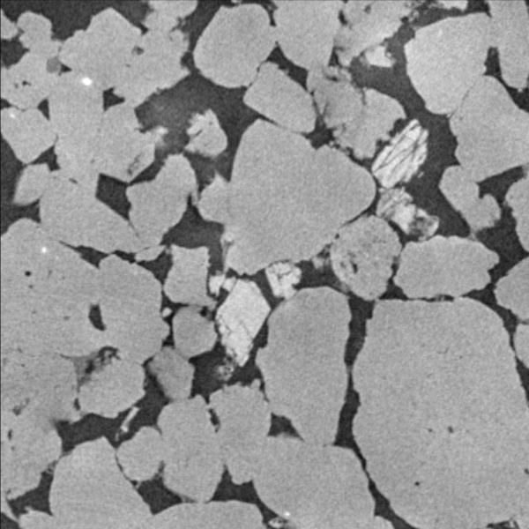

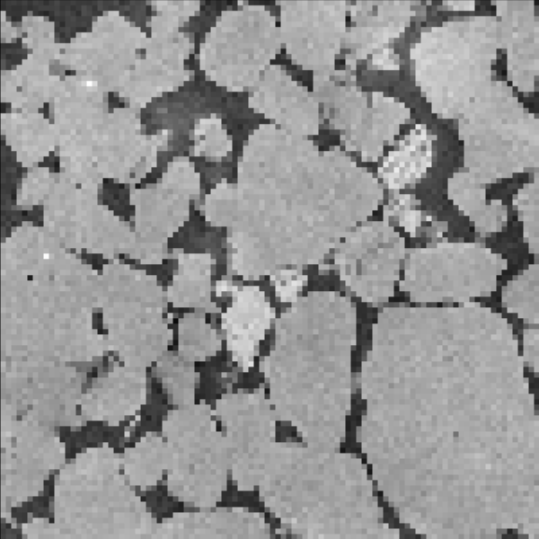
Current results
Bentheimer sandstone (2D slices of 3D images)
400
400
400
HR
SR
LR

Slide 19
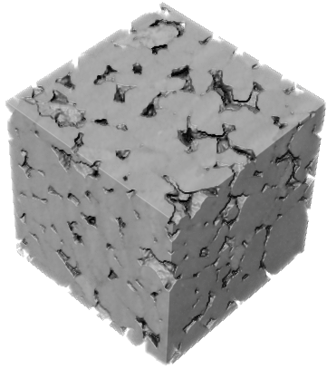
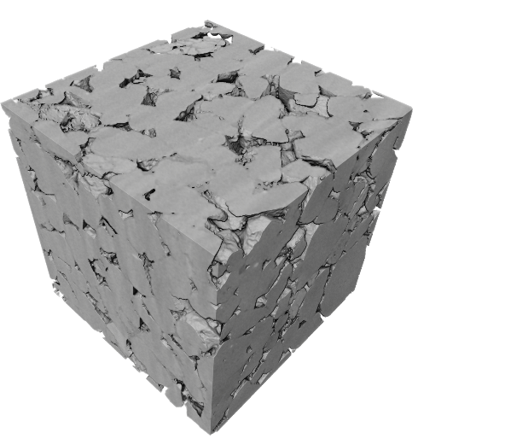
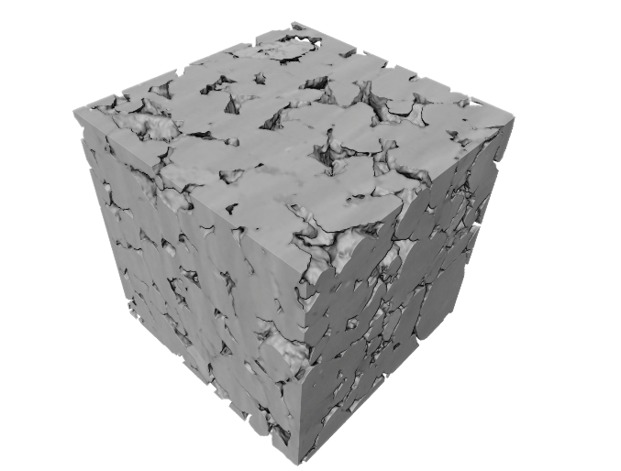
Current results
Bentheimer sandstone
400
400
100
HR
SR
LR

Slide 20
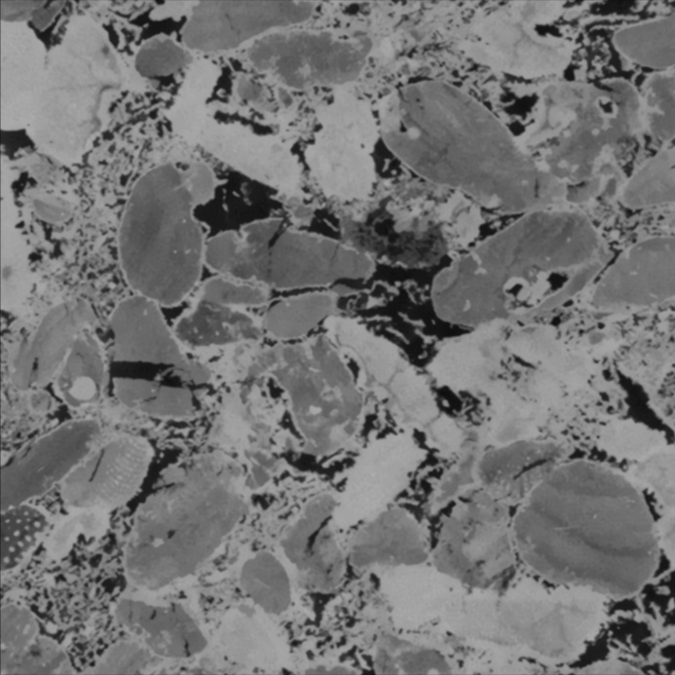
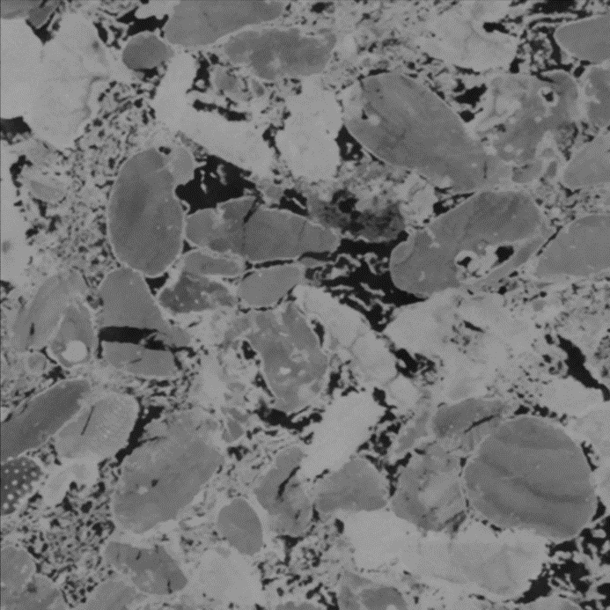

Current results
Estaillades carbonate (2D slices of 3D images)
1120
1120
280
HR
SR
LR

Slide 21
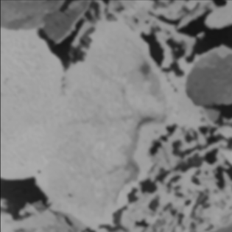


Current results
Estaillades carbonate (2D slices of 3D images)
280
280
70
HR
SR
LR

Slide 22
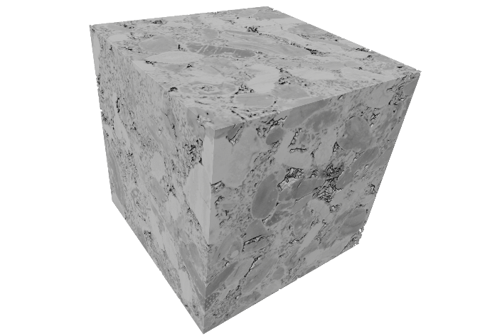
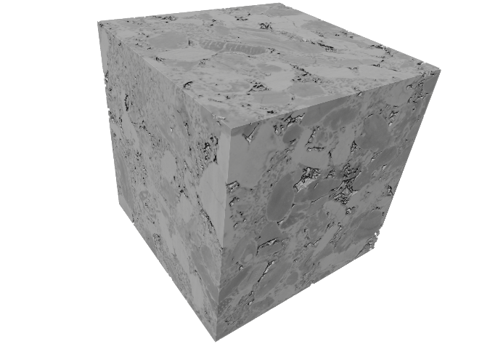

Current results
Estaillades carbonate
1120
1120
1120
HR
SR
LR

Slide 23
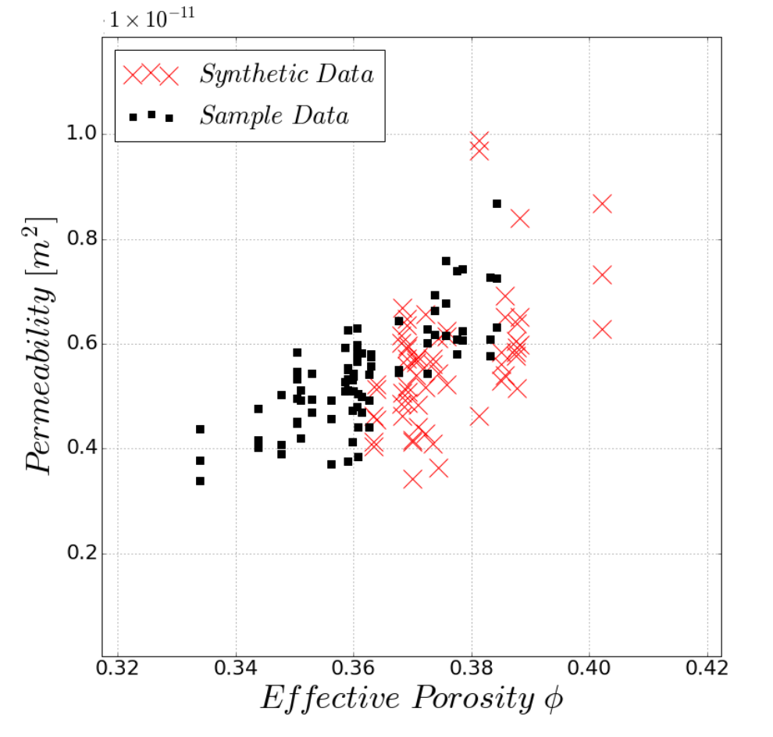
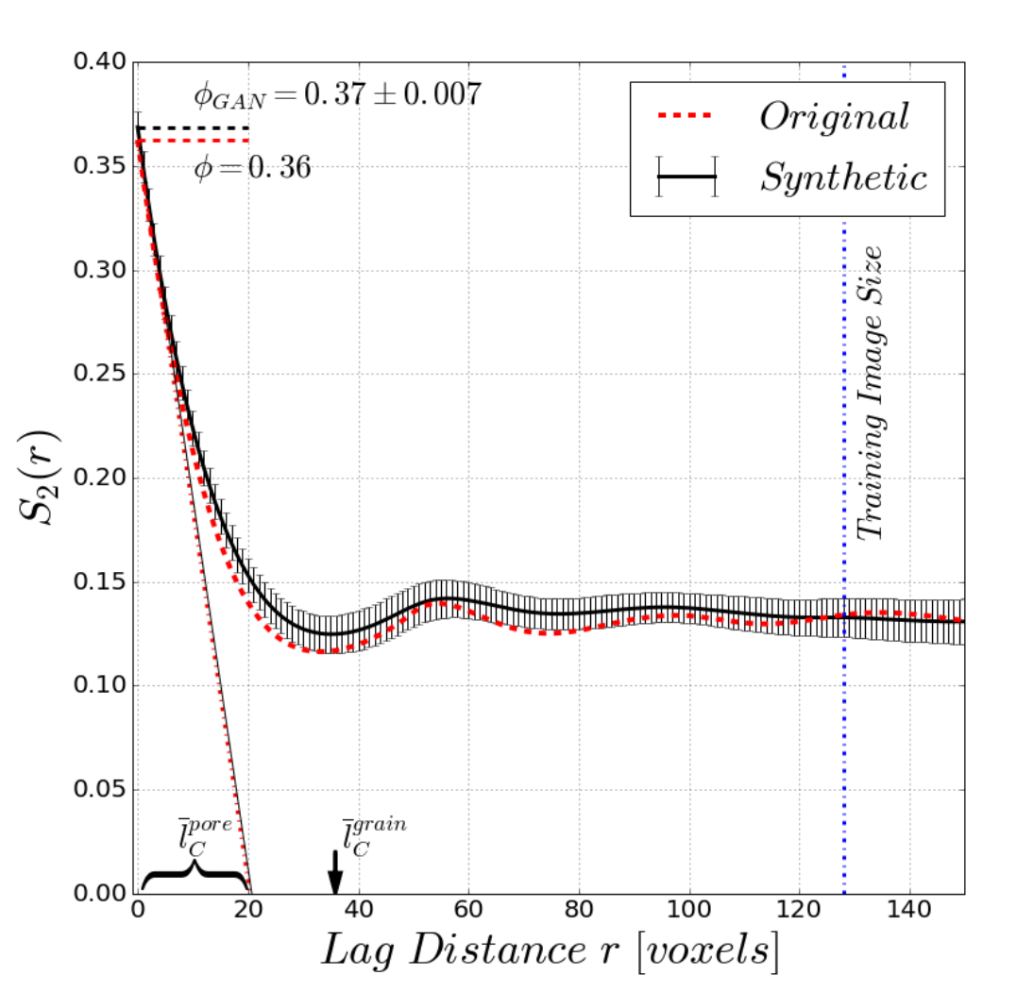
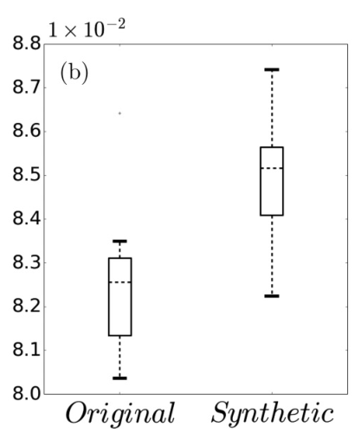
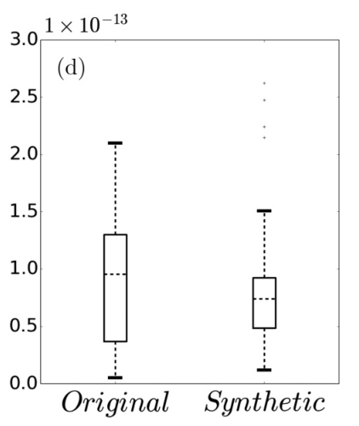
Evaluation
After the process of image segmentation, it becomes possible for us to calculate the parameters related to flow simulation and modelling. These parameters can be compared with those derived from super-resolution results as well as directly observed experimental data. Evaluation criteria used are as follows:
  Two-point statistics
  Gray-Level Co-Occurrence Matrix
  Morphological measures:
    Porosity
    Specific surface area
    Curvature
    Euler characteristic
  Singe-phase/Multi-phase permeability
Porosity-permeability relationships
Two-point statistics
Specific surface area
Euler characteristic
Evaluation criteria (Mosser et al., 2017)

Slide 24
Future work
Notes:
Now, Let’s dive into the final part: the background.

Slide 25

Possible approaches
1. Directly apply DualEDSR on multiphase flow dataset
Notes:
Super-resolution methods can enhance the resolution and quality of images, making finer structures and details more visible.
In multiphase flows, the interface between fluids is crucial for determining flow properties. Super-resolution can aid in more accurately detecting and analyzing these interfaces.

Slide 26



Young Laplace equation and constant curvature
Constant curvature of the interface between fluids
$$P_{c}={P_{fluid1}−P}_{fluid2}$$
$$P_{c}=κ=σ\left(\frac{1}{r_{1}}+\frac{1}{r_{2}}\right)$$
$$P_{c}=\frac{2σ}{R_{c}}$$
A schematic view of two fluids in a cylindrical tube and the contact angle θ (AlRatrout et al. 2017)
Notes:
Super-resolution methods can enhance the resolution and quality of images, making finer structures and details more visible.
In multiphase flows, the interface between fluids is crucial for determining flow properties. Super-resolution can aid in more accurately detecting and analyzing these interfaces.

Slide 27
Young Laplace equation and constant curvature
Constant curvature of the interface between fluids
Fluid 1
Fluid 2
We have to avoid recovering the interface which doesn’t have constant curvature.
A schematic view of two fluids in a cylindrical tube and the contact angle θ (AlRatrout et al. 2017)
Notes:
Super-resolution methods can enhance the resolution and quality of images, making finer structures and details more visible.
In multiphase flows, the interface between fluids is crucial for determining flow properties. Super-resolution can aid in more accurately detecting and analyzing these interfaces.

Slide 28


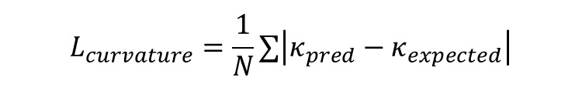

Possible approaches
2. Physics-informed super resolution
Accuracy in Super-Resolution:
  This requires standard image loss functions to ensure the super-resolved image is close to the high-resolution target.
Physical Accuracy:
  Incorporating the constant curvature principle from the Young-Laplace equation to ensure physical plausibility at fluid interfaces.
Edge Preservation:
  Since interfaces between fluids are critical, edge preservation is important.
$$L_{MSE}=\frac{1}{N}∑{\left(SR−HR\right)}^{2}$$
$$L_{curvature}=\frac{1}{N}∑\left|κ_{pred}−κ_{expected}\right|$$
$$L_{edge}=\frac{1}{N}∑\left|E_{pred}−E_{true}\right|$$
$$L_{total}={αL}_{MSE}+{βL}_{curvature}+{γL}_{edge}$$
Notes:
Super-resolution methods can enhance the resolution and quality of images, making finer structures and details more visible.
In multiphase flows, the interface between fluids is crucial for determining flow properties. Super-resolution can aid in more accurately detecting and analyzing these interfaces.

Slide 29
Acknowledgments
We are grateful to the sponsors, Resource Geophysics Academy, Imperial College London, for supporting this research
Notes:
29

