Slide 1


Pore-scale imaging and analysis of surfactant flooding (secondary recovery experiment)
Hussain M. AlZahrani, Martin J Blunt & Branko Bijeljic
16-01-2024
Imperial College Consortium on Pore-Scale Modelling and Imaging Annual Meeting
Notes:
It is my pleasure to talk to you today about my recent work on Pore-scale imaging and analysis of surfactant flooding (secondary recovery experiment) . This is an experimental work, most of it done in our lab in ESE and some crucial measurements were also conducted in collaboration with the Department of Chemical Engineering. I would like to extend my sincere appreciation to Proof Martin Trusler and his team for their valuable cooperation.

Slide 2
Project objectives
Understand oil recovery mechanisms at the pore scale when using cationic surfactant flooding in carbonate reservoirs.
Interpretation of fluid displacement, oil recovery, and quantification of in situ changes in wettability.
Is recovery from this surfactant due to principally lowered IFT or wettability alteration?
Three-dimensional pore-scale high-resolution X-ray imaging and analysis were applied.
An experimental approach is used to investigate the oil recovery mechanisms.
Notes:
So, the main objectives of my project are: 1) to have a better understanding of the oil recovery mechanism a the pore level when a carbonate rock is flooded with cationic surfactant .
The Interpretation of fluid displacement, oil recovery, and quantification of in situ changes in wettability.
And to answer a very important question about weather the oil recovery from this surfactant is due to principally lowered IFT or wettability alteration?
In order to achieve our objectives : Three-dimensional pore-scale high-resolution X-ray imaging and analysis were applied. Along with An experimental approach to investigate the oil recovery mechanisms

Slide 3
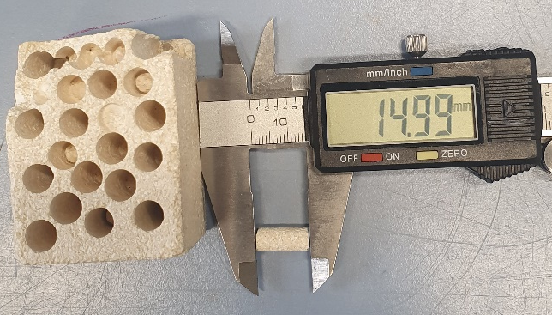
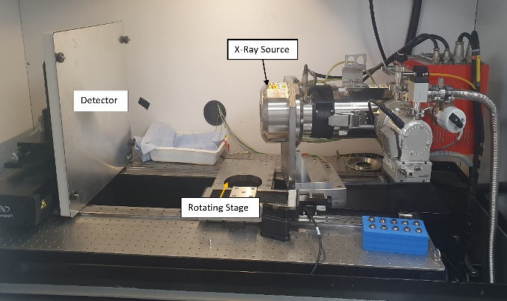
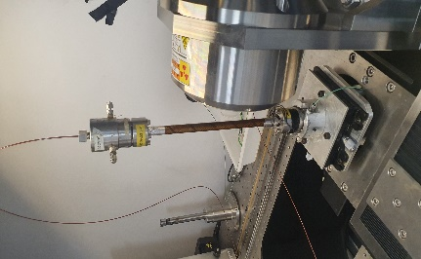
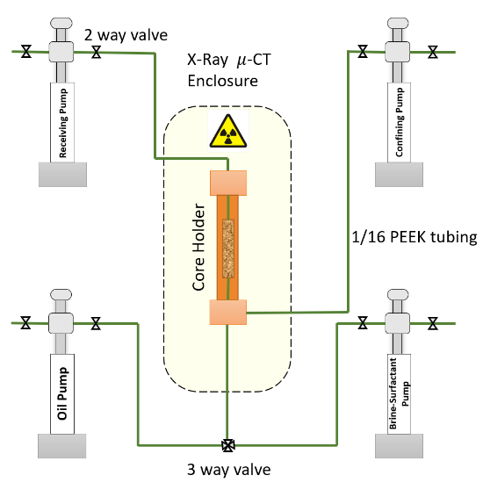
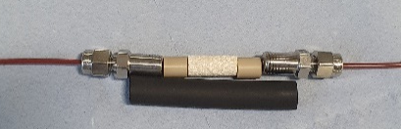
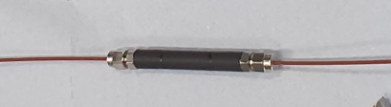
Experimental Design and Methodology
Notes:
So I will start with the Experimental Design and Methodology

Slide 4
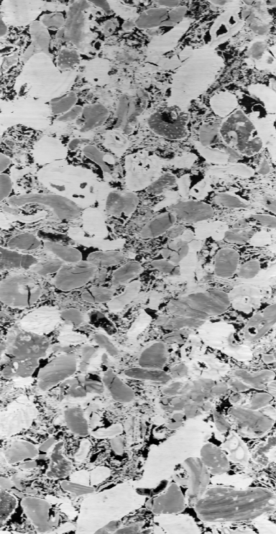
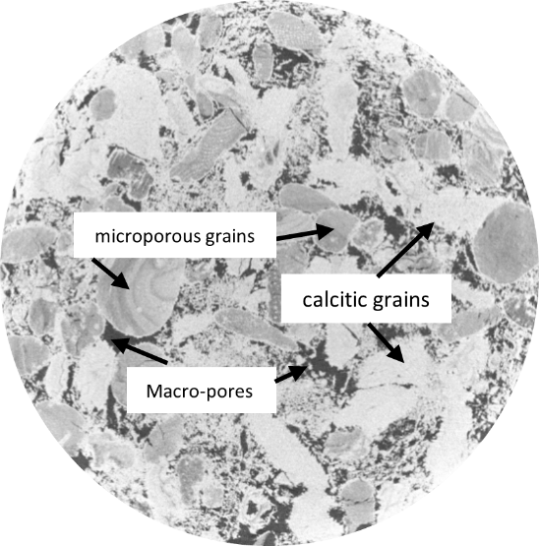
Materials
Decane and Crude oil
Brine
Surfactant
Estaillades limestone
6 mm
97 wt% calcite with traces of dolomite.
Bimodal pore structure.
Average porosity of 30%.
Average permeability of 180 mD.
Decane (purity ≥ 99.0%, Sigma-Aldarich) as the oil phase.
Brine with total salinity of 44,920 ppm.
Cationic surfactant.
IUPAC name: Dodecyl trimethyl ammonium bromide.
linear formula CH3(CH2)11N(CH3)3Br.
The trade name is (DTAB).
Concentration 10 g/l (above CMC)
12 mm
Density at 21◦C, kg/m³ | 830 ± 5
Saturates, wt% | 55.25
Aromatics, wt% | 38.07
Resins, wt% | 6.22
Asphaltenes, wt% | 0.46
Total Acid Number, mg KOH/g | 0.24
Total Base Number, ppm | 356
Salts | g/L
KCl | 0.477
CaCl₂ | 9.500
MgCl₂ | 3.642
NaCl | 31.178
NaHCO₃ | 0.124
Total | 44.920
Notes:
The rock sample selected for this study was Estaillades carbonate rock which consists of 97 wt. % of calcite with traces of dolomite having a bimodal pore structure.
Estaillades is a cretaceous limestone extracted from a region near Oppede, France.
It has an average porosity of 30% and an average permeability of 180 mD
The dimensions of the sample is 6 mm in diameter and 12 mm in length.(Click)
This table summarizes the crude oil properties so, we have the density of the crude oil , SARA analysis and the total Acid and base number. Crude oil was mainly used to alter the wettability of the rock to the original conditions of the reservoir which is oil wet system. After the wettability alteration Crude oil was replaced by Decane as the oil phase in our expermint. Decane was doped with 25 % of Iododecan to make it denser so it could be distinguished from the other phased under the X-ray. .(Click)
The brine was prepared in the lab as synthetic solutions of several pure salts in deionized water at certain ratios to obtain a total salinity of 44,920 ppm as shown in the table .(Click)
We used a cationic surfactant and here I am showing its linear formula. The trade name for this Surfactant is (DTAB). The Surfactant concentration used in this expermint was 10 g/l which is above the CMC of this Surfacatnt.

Slide 5
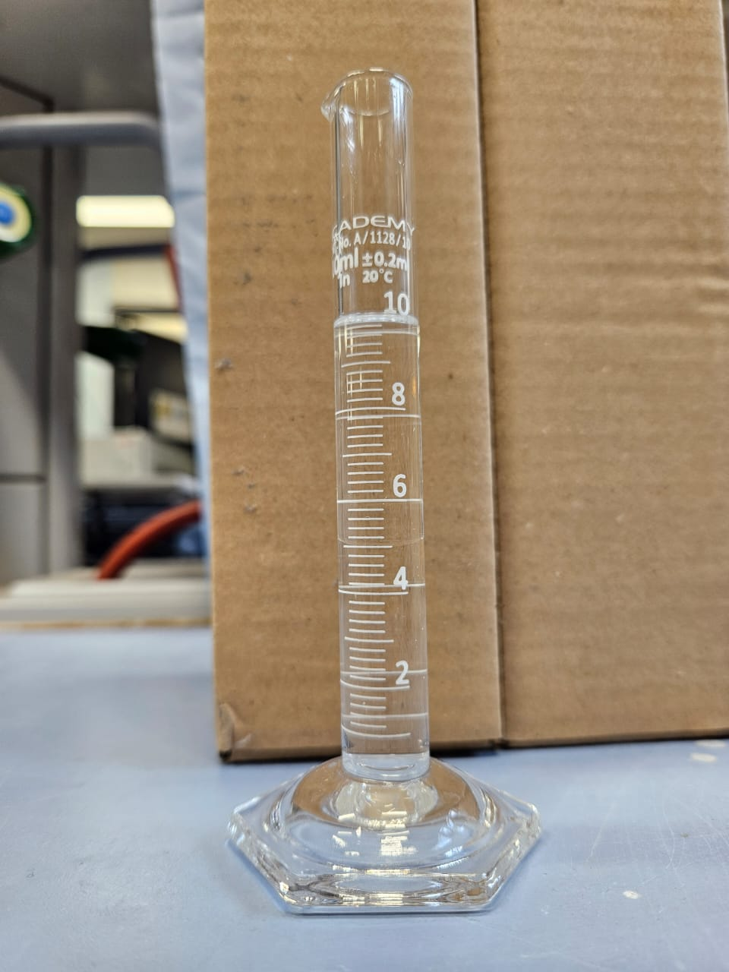
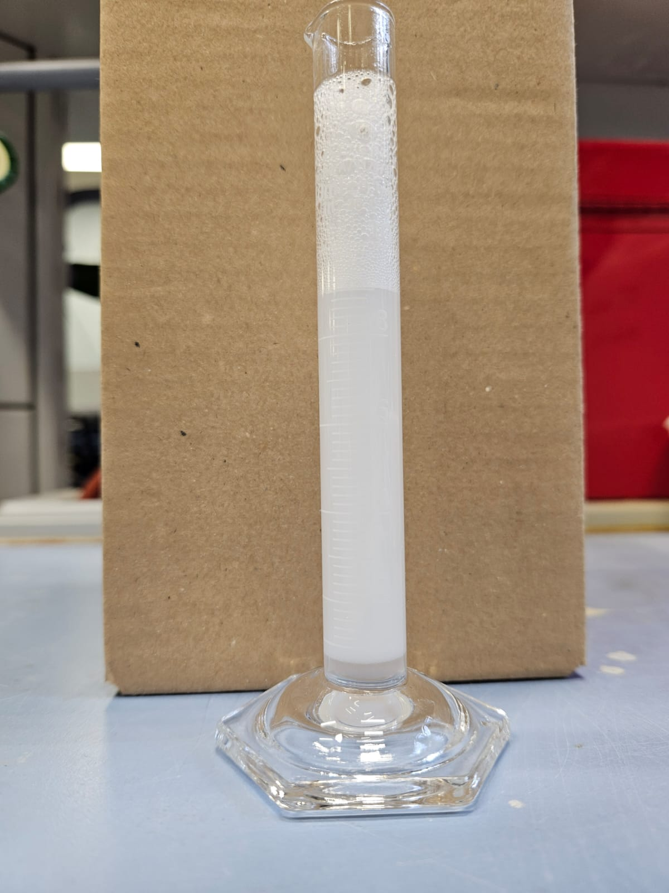
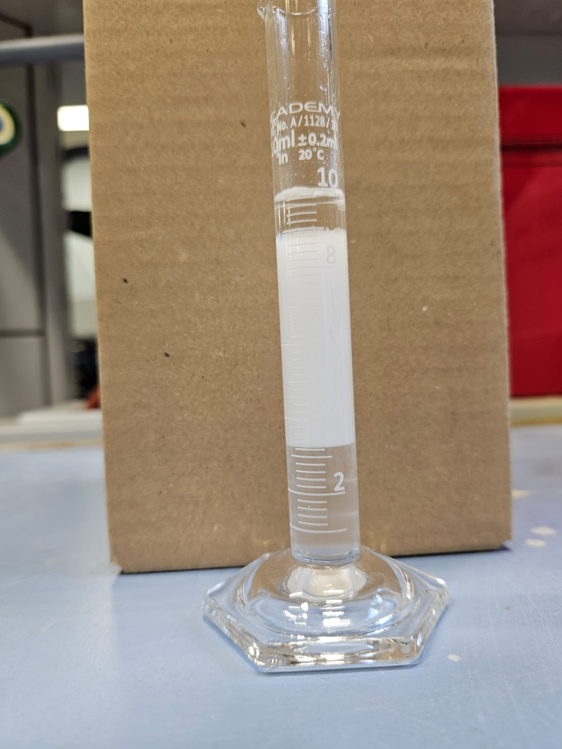
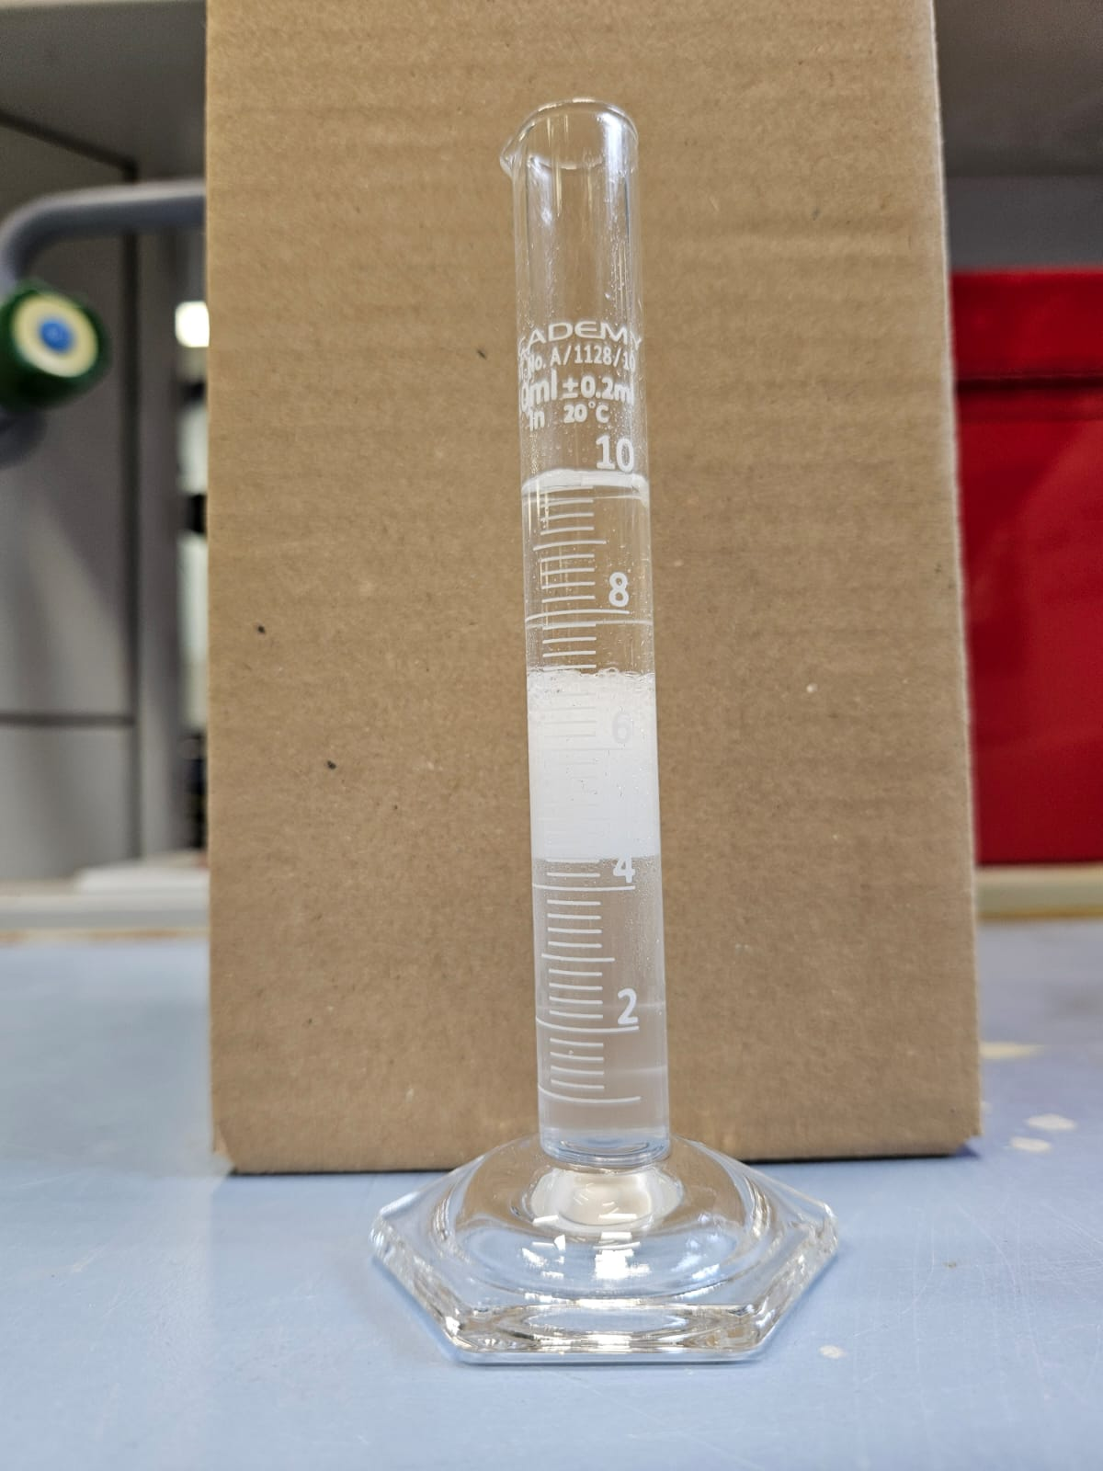
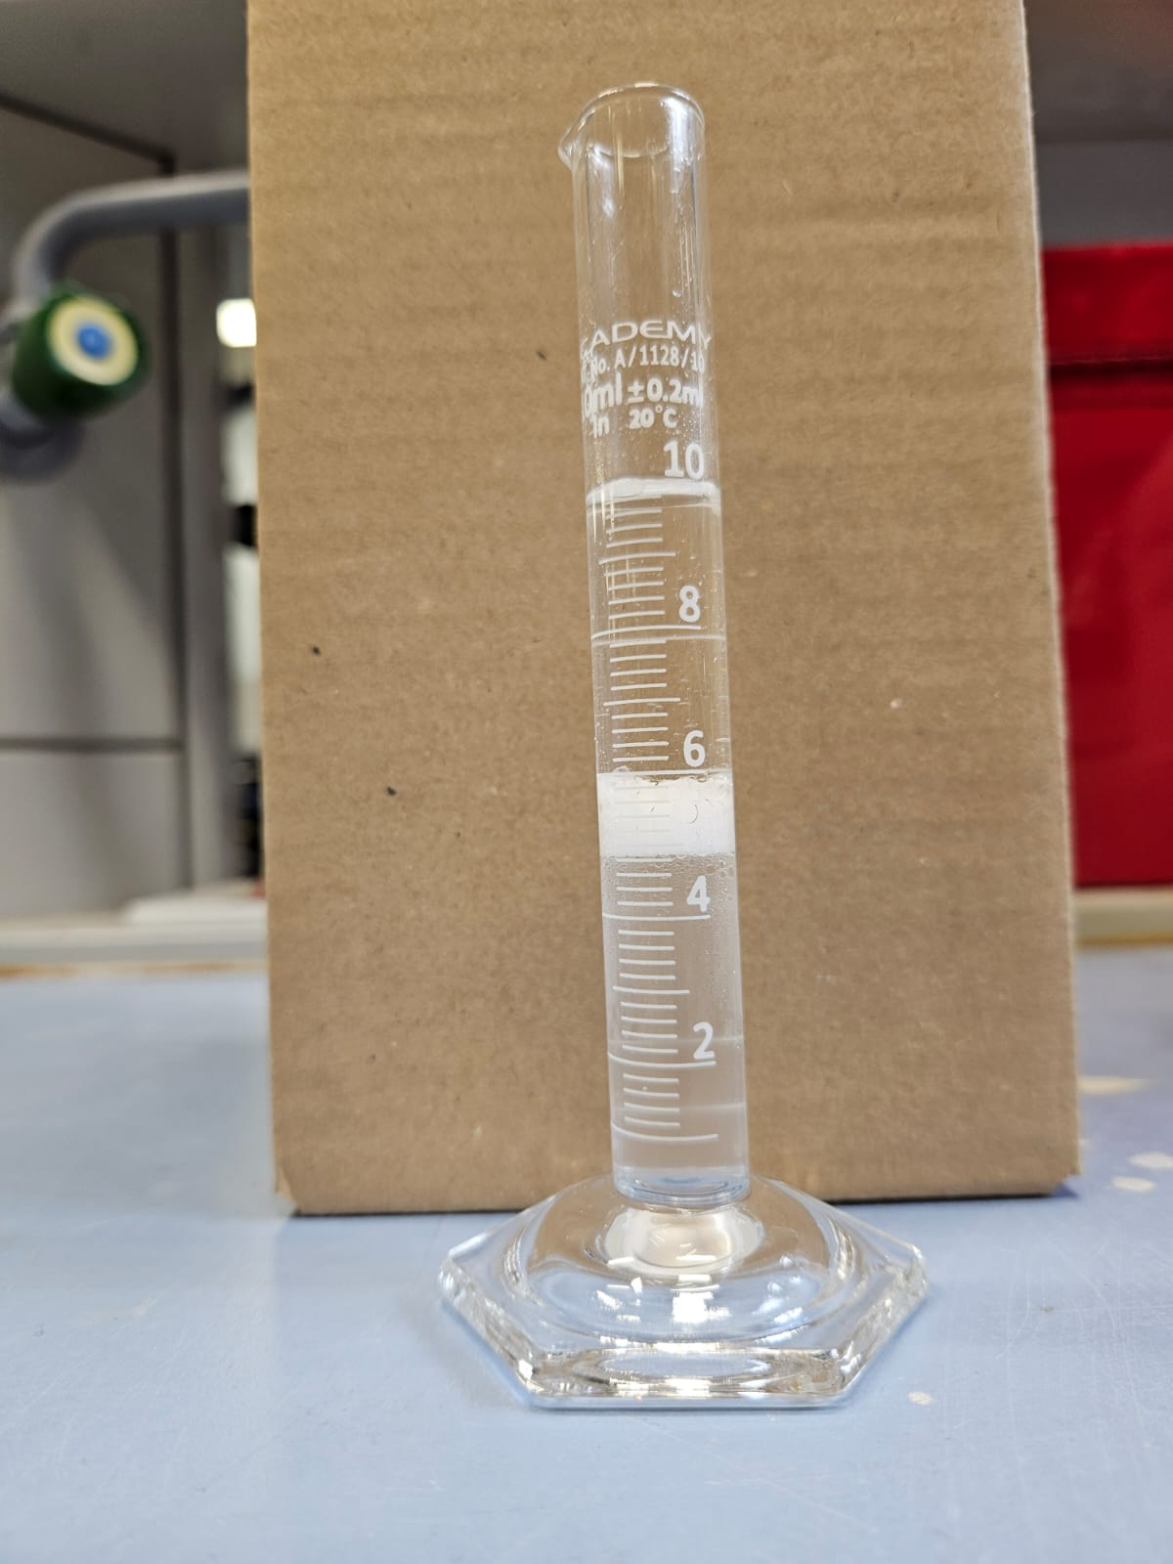
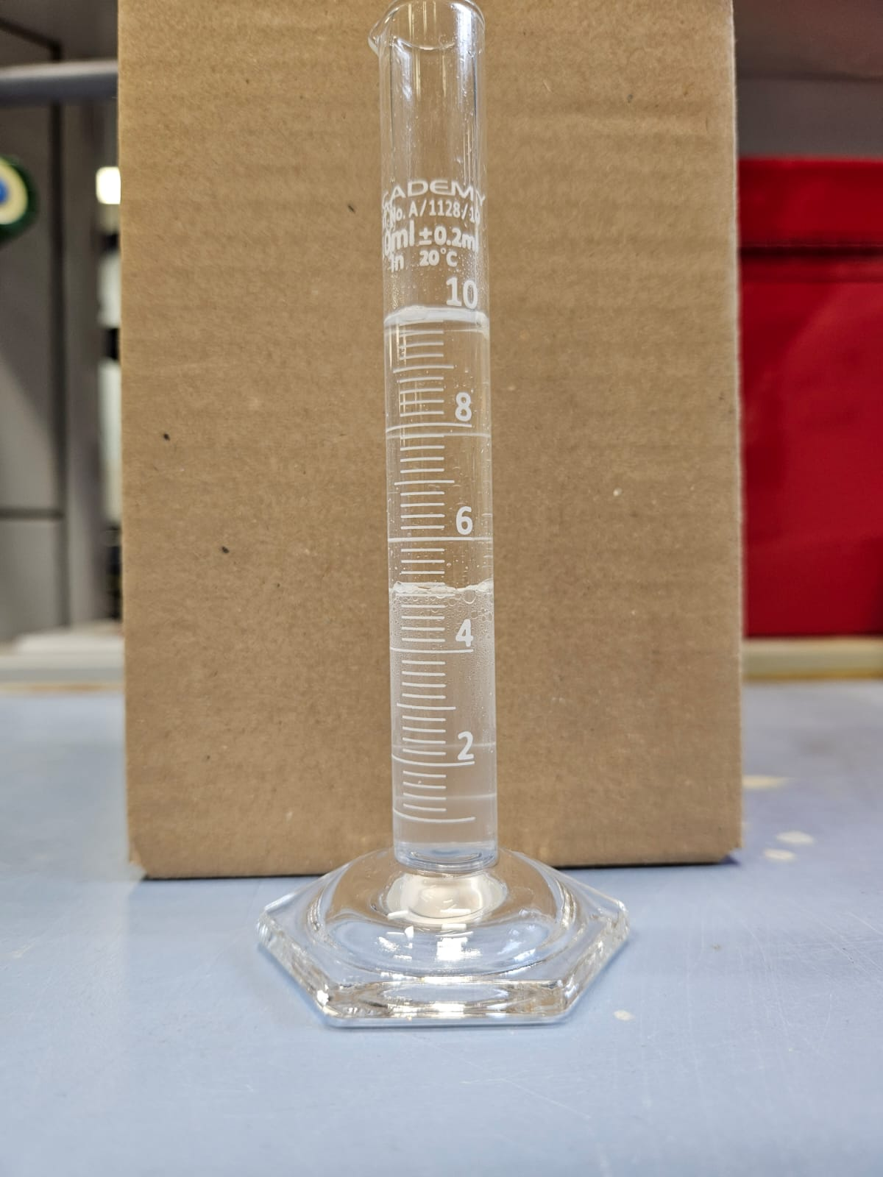
Characterization of micro-emulsion formation and IFT measurements
Fluid type | ρ (g/cm³) | µ kinematic (mm³/s) | µ dynamic (mPa.s) | σ (mN.m⁻¹)
Brine (B) | 1.0291 | 0.967 | 0.995 | σ_{BO} = 43.815
Oil (O) | 0.815 | 1.318 | 1.099
Surfactant(Brine and 10g/l Surfactant) (S) | 1.0311 | 1.107 | 1.141 | σ _{SO} =6.284
Notes:
A static phase behavior test was performed to examine the formation of a micro-emulsion. .(Click)
In a test tube, doped decane was combined with the aqueous phase consisting of brine and surfactant at a 50% ratio. The test tube was then shaken thoroughly and .(Click)
an unstable micro-emulsion was formed. .(Click)
It took about 28 minutes for the micro-emulsion to destabilize and segregate into distinct oil and brine phases. It is worth mentioning that no co-surfactant was added to stabilize the micro-emulsion as one of the objectives for this study is not to have ultra-low IFT which can be found in a stabilized micro-emulsion. .(Click)
IFT measurements were carried out in the chemical engineering lab. The IFT decreased from 44 to 6 mN.m⁻¹ , which is a reduction by a factor of 7.

Slide 6
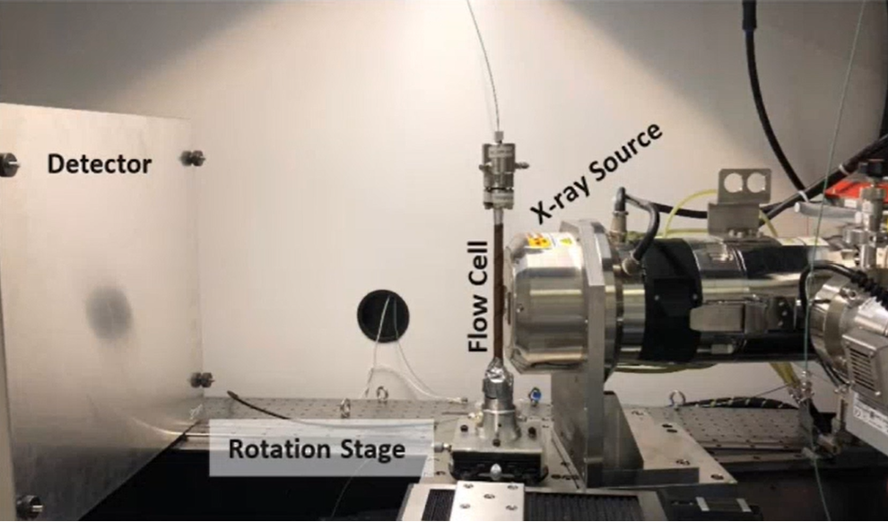
Experimental apparatus
Hassler type core holder
FEI Heliscan micro-CT scanner
Syringe pumps
Notes:
Moving to Experimental apparatus, it consist of mainly a Hassler-type core holder which is transparent to X-ray and can withstand high pressure and high temperature. Also, It serves as the housing for our rock sample. The core holder is placed in FEI Heliscan micro-CT scanner. .(Click)
This image shows the enclosure of the FEI Heliscan , where we can see the X-ray source and the detector and the rotating stage which allows for 360 degree of rotation to acquire 3D tomgram and where that core holder can be mounted. .(Click)
The core holder is connected with peek tubes and valves to 4 Syringe pumps to control the pressure and flow rate of the system. We had one pump for oil injection …

Slide 7
Experimental Procedure
Sample Preparation
Clean vacuum and dry the rock sample.
Drainage
Inject crude oil to reach Swi.
Wettability alteration
Continuously inject crude oil at a low rate and high temperature of 80 °C.
Secondary Surfactant flooding
Flood the sample with 3 PVs of surfactant as a secondary recovery mode.
Dry scan imaging.
Saturate the sample with formation brine.
Reverse the flow direction half-way through.
Notes:
In terms of the Experimental Procedure. We started with sample preparation where the sample is cleaned , vacuumed, and dried.
then a dry scan image is obtained. Once we done with scanning, we flodded the sample with formation brine. .(Click)
After that the drainage process starts by injecting crude oil to displace the formation brine to reach a very low initial water saturation. .(Click)
And that takes us to the Wettability alteration stage or what we call (dynamic aging ) where we continuously injected crude oil at a low rate (1micro Liter/min) and high temperature .and the objective of this process is to alter the wettability of the system to be more oil-wet and restore the original reservoir condition for the rock in terms of wettability. This process took approximately a month and, in the middle, we reversed the flow direction to ensure that oil contacted all the inner surfaces of the sample. This step has another setup that I will share with you in the next slide .(Click)
Once the Wettability alteration is completed the core holder was moved back to the micro-CT scanner to perform the surfactant flooding. Three pore volumes of surfactant were injected at a constant rate of 10µl/min.

Slide 8
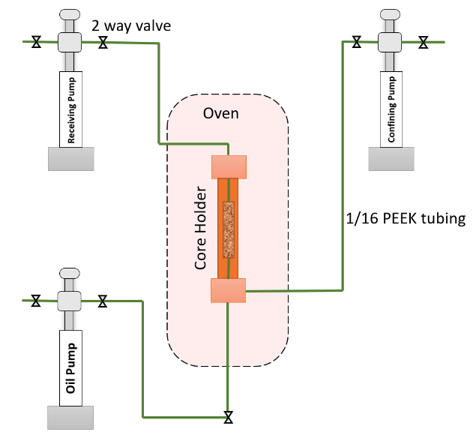
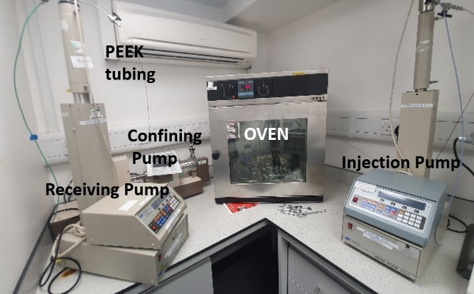
Apparatus to alter wettability
Syringe pumps
Hassler type core holder
Notes:
So, this is the set up for the wettability alteration. Here we have our sample inside the core holder and it is placed inside an oven at elevated temprture and pressure and the core holder is connect through peek tubes to 3 syringe pumps to control the flow rate and pressure

Slide 9
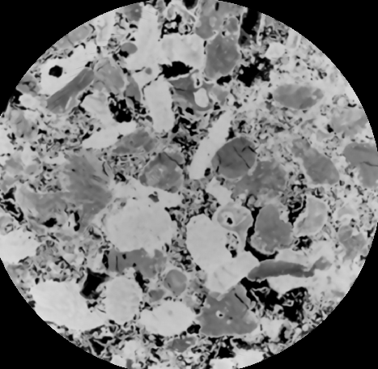
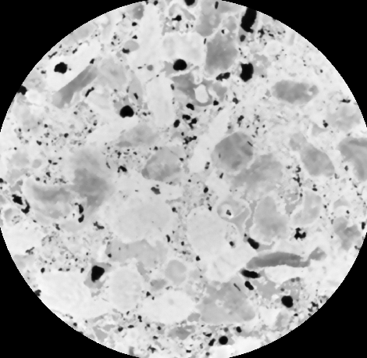
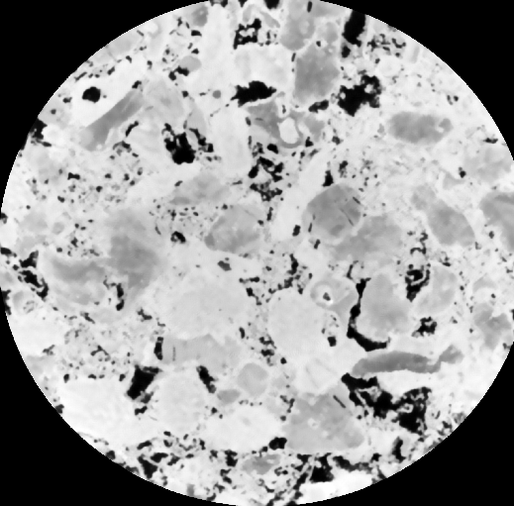
Micro-CT Imaging Process
Before injection
01
Micro-CT images (Reference images)
Wettability alteration then Decane Injection
02
Micro-CT images
Surfactant flooding
At constant rate of 0.01ml/min
Micro-CT images acquired after 1PV, 2PV and 3 PV.
03
Notes:
So we obtained a total of 5 images with high resolution of 2.9µm/voxel using the FEI Heliscan micro-CT scanner. The first image was acquired before injecting any fluids into the sample we call this image a (reference image) which can be used later to segment the pores and rock grains. .(Click)
Then another image is obtained after wettability alteration and decane injection to capture the initial oil in place and the initial water saturation. .(Click)
once that completed , the Surfactant flooding started and the micro-CT imaging was acquired to capture the distribution of fluids inside the porous media after each pore volume of Surfactant injected.

Slide 10
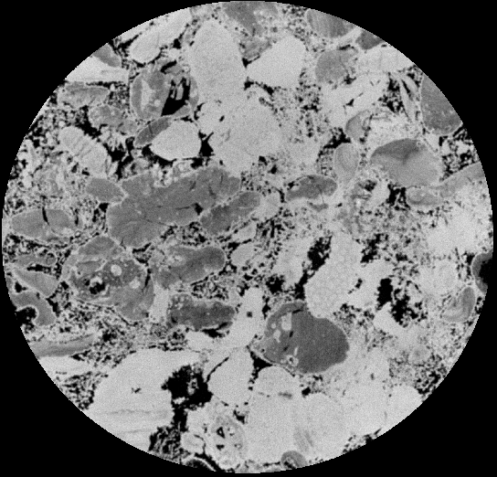
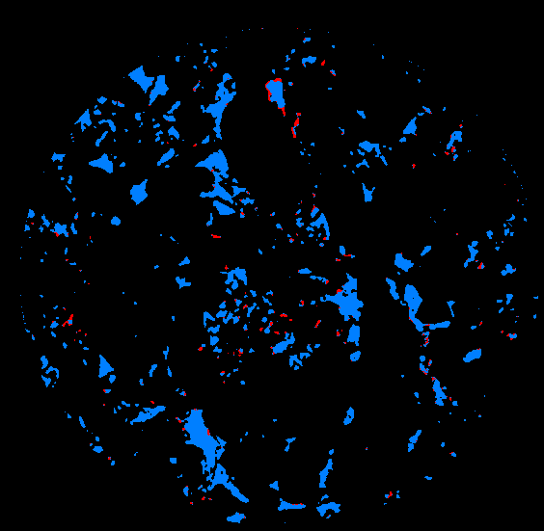
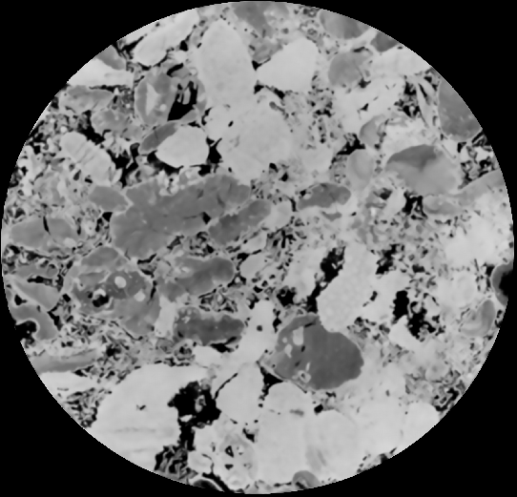
Image Processing and Analysis
Processing
Grey-scale normalization
Registration
Filtration
Segmentation
Analysis
Fluid saturation
Recovery calculation
Pore occupancy mapping
Contact angle and curvature
Notes:
So before we can analyse the images and generat results the raw obtained images needs to be processed. .(Click)
That’s include Grey-scale normalization where the gray value of all the obtained images are unified. Then the images get registered against a reference image to make sure they are all at the same position so we can compare like to like.In terms of filtration, we used a non-local mean filter to remove the noise from the images. And finally we moved to segmentation process which is essentially segmenting different phases we have , surfactant , oil , rock. .(Click)
Based on these segmented images, we can perform our analysis that’s include Fluid saturation ,Recovery calculation,Pore occupancy mapping,Contact angle and curvature. Image processing and most of the analysis were done using Avizo softwear which is a 3D visualization software. Also, some of the analyses were done using some computer coding developed by some members in our research group.

Slide 11
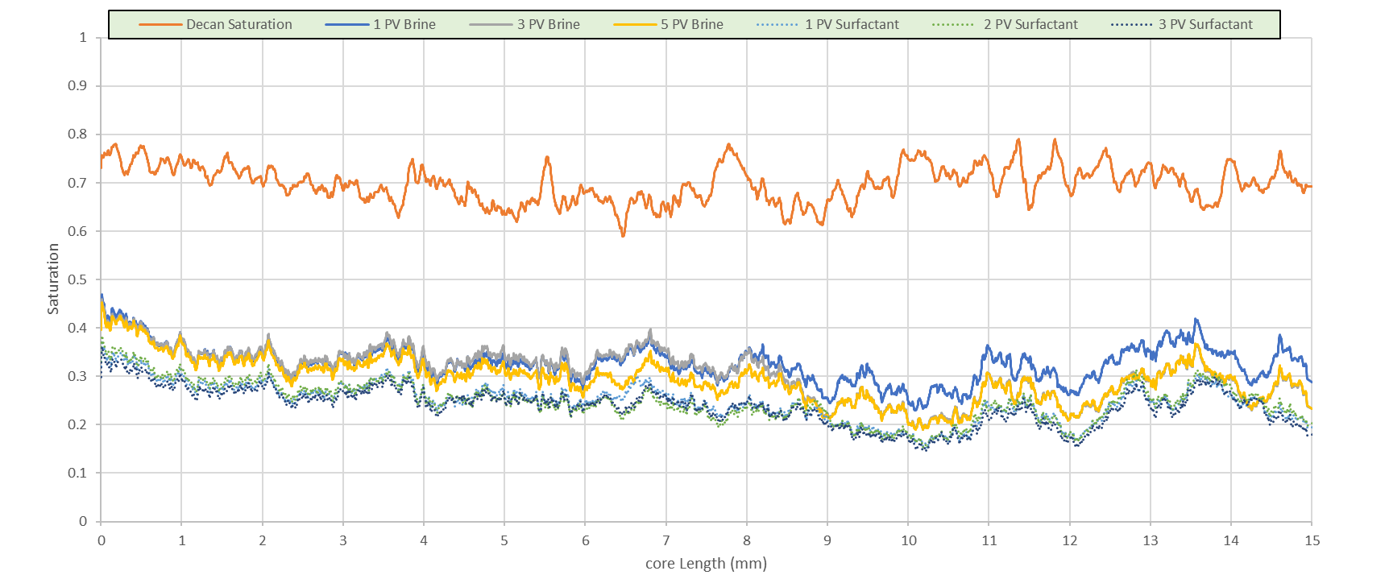
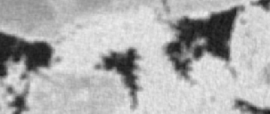
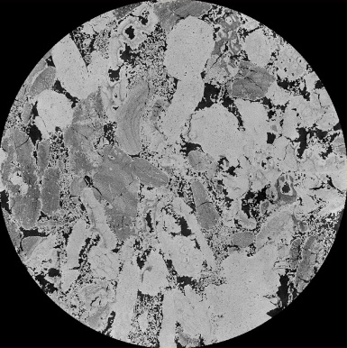
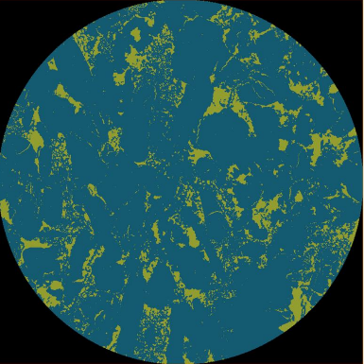
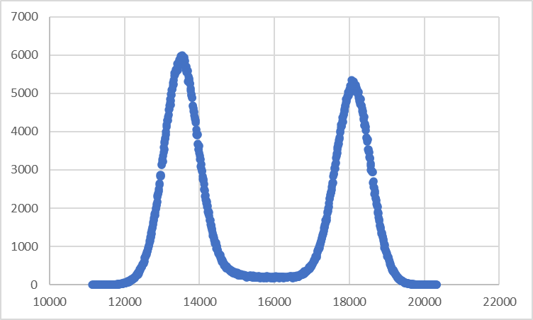
S-3PV
1.06mm
RESULTS
Notes:
This is in a nutshell our materials, setup, procedure and workflow, so now let’s talk about the results.

Slide 12
Decane Saturation: Surfactant Flooding Leads to Incremental Recovery
Flow Direction
Notes:
This is the oil saturation profile across the length of the sample. We can see we have an initially high oil saturation with very little irrducable water saturation distributed uniformly across the sample. After the injection of the 1st PV volume of surfactant we observed a very efficient displacement of oil by surfactant.
Overall, the ultimate oil recovery of the oil initially in place in macro-pores was 75%.
What is behind this very high oil recovery? So we started that investigation work looking at the fluids occupancy.

Slide 13
Pore and throat radius occupancy for oil
Notes:
And with the fluids occupancy, we extracted a pore network from the high resultion segmented images and we looked at the fluid occupancy in these pores and throats.
.(Click)
Before I show you the occupancy maps for oil and Surfactant in pores and throats. let's have a look at the normalised values of the volume fractions of pores of a certain size occupied by oil. The total area under the dark blue curve is 1 while the other lines represents the oil fraction or rather the fraction of the pores and throats occupied by oil. The diagram on the left is for the pores and the one on the right for the throats and
Majority of the pores have radii (rei dee ai) in the range of 5-40 micro-m and it is the same for the throats.
Generally we can see very efficient displacement in the big bores and throats.

Slide 14
Pore occupancy mapping: preferential displacement of larger pores
1PV S
2PV S
3 PV S
Notes:
Here I am showing Pore occupancy mapping where the green color is oil and the blue color is brine/surfactant. BSF oil occupayed all the big pores and most of the smaller on. Brine reside in mainly in small pores. This is an indication of week oil-wet.
After injecting the first pore volume of surfactant, it invaded the larger pores displacing oil but most of the smaller pores remain intact and filled with oil. Which is what we would expect for a weakly oil-wet system. Also, we had an interesting observation weher we can see the oil is displacing brine from small pores. This had some impact on contact ange measurement as I am going to show you later on
After injectign the 2nd pore volume of surfactant little amount of oil was displaced from smaller pore which might indicat very week wettability alteration.
Similler observation was noticed after the injection of the3rd pore volume of surfactant however the amount of displaced oil is very little and it is mainly from smaller pores.

Slide 15
Throat occupancy mapping: similar findings as in pore occupancy mapping
BSF
1PV S
2PV S
3 PV S
Notes:
This is throat occupancy mapping, where we observed similar findings as in pore occupancy mapping.

Slide 16
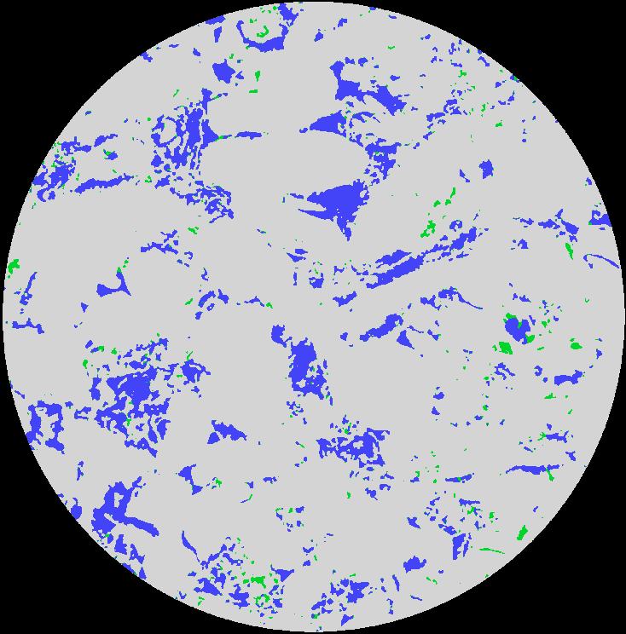
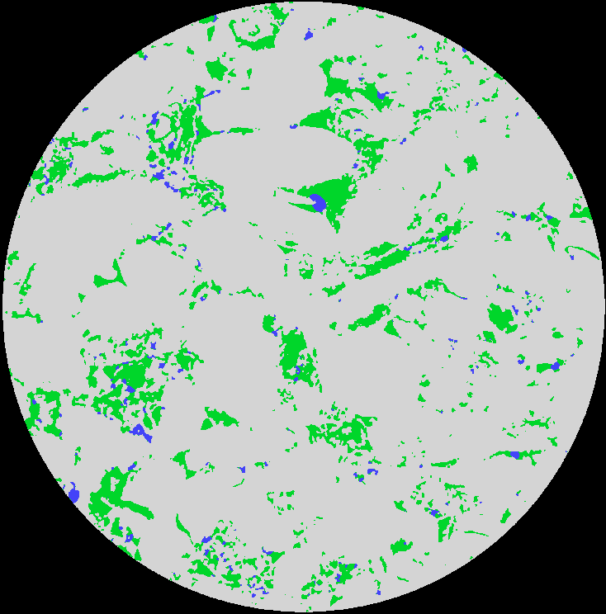
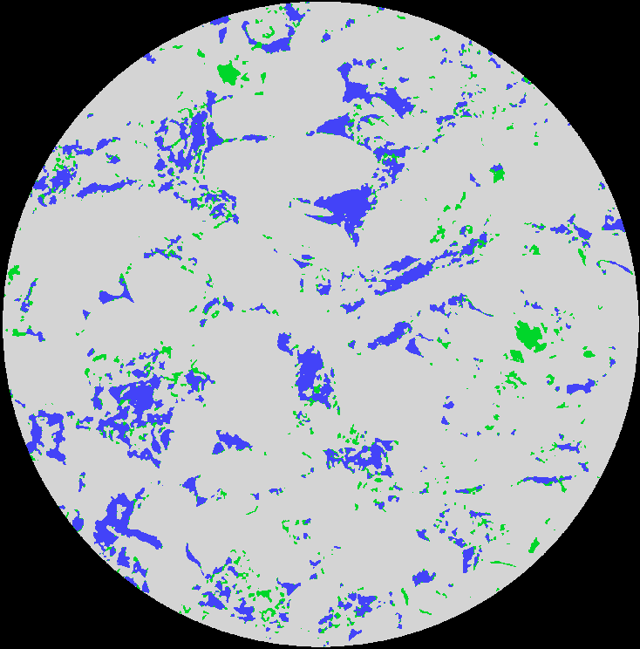

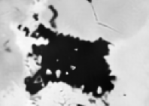
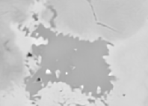
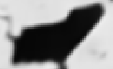

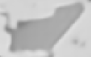
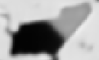
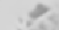
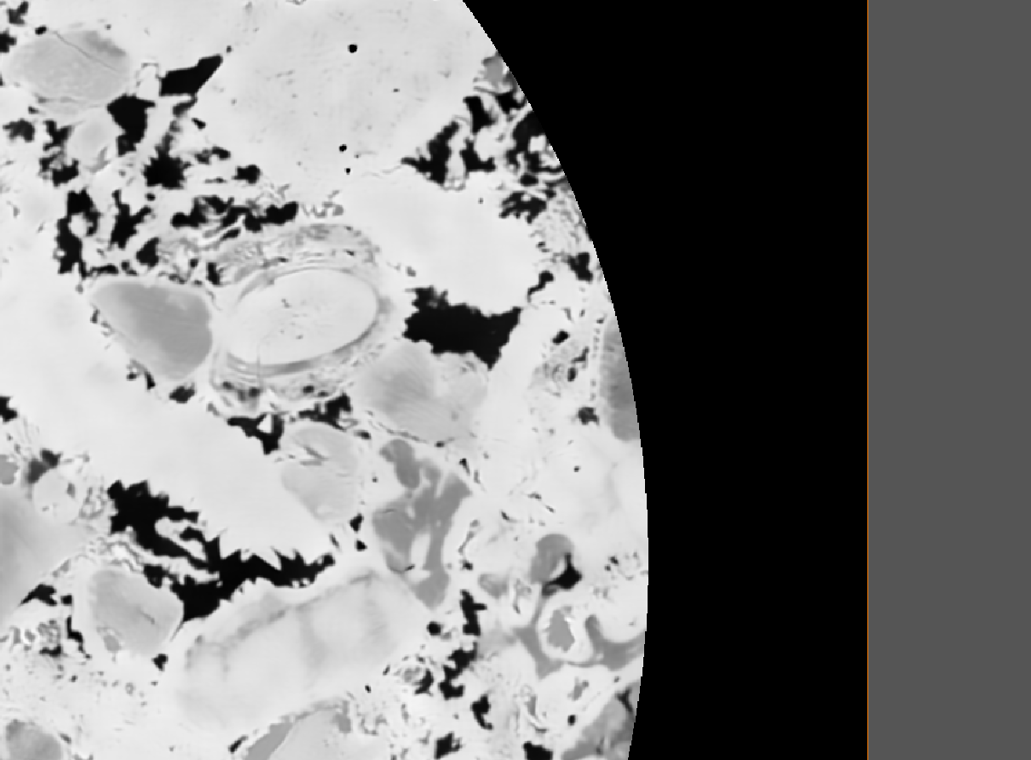
Observations of Displacement Processes: a Wettability Change?
3PV S
2PV S
BSF
Surfactant
1PV S
Oil
Big Pore
100 µm
100 µm
Medium Pore
Surfactant/Brine
50 µm
50 µm
50 µm
50 µm
Rock
oil
Small Pore
50 µm
50 µm
50 µm
50 µm
1mm
1mm
1mm
1mm
Notes:
So to visualize what we saw in the pore accupancy mapping, let’s move to the direct observation from segmented and the processed images from the micro-CT scanner. So, I will show you some example . Here we have x-y cross section of segmented image. ….
oil is located in big and small pores along with some brine which indicate a mix- wettability system.
very efficient recovery with surfactant displacing oil in the larger pores.
It took 3 3PVs to displace oil from mid size pores.
Some oil displacement took place in small pores after the 3rd PV.
So we looked at preoccupancy…… and the last thing we did in our analysis is wettability cheracterization. So we conducted contact angle measurements and curvature analysis to assess the wettability alteration

Slide 17
Contact angle distribution: A wide distribution indicating mixed-wettability
BSF
1PV S
BSF = 98º ±24.3º
1PV S = 110º ±23.3º
2PV S = 100º ±24.8º
3PV S = 96º ±23.7º
1mm
1mm
Notes:
Geometric contact angle can give us an indication of the wettability status of the system. So, here I am showing the contact angle distribution. So before injecting any surfactant when the oil is intally saturating the sample we can see a contact angle of 98 degree which indicate that we have week oil-wet system. .(Click)
after injecting the 1st pore volume of surfactant the contact angle increase which is something that we would not expect. We are expecting the contact angle to decrease indicating that the system is shifting toward more water- wet causing the oil displacement.
However , after careful examination of the processed and segmented image, we observed that the oil in big pores is displaced by the surfactant so, we do not have much of interfaces left and we can see the interfaces only in the small pores.
So if we focus on these small pores we can see that after the injection of the 1st PV of surfactant, there is a displacement of the brine by the oil in small pores and this let to an alteration of wettability to more oil-wet system.

Slide 18
Mean Curvature Analysis
Notes:
Here I am showing Mean curvature which is the mean of the two principal curvature values. It gives an indication of the system wettability.
The mean curvature values were measured on smoothed oil-Surfactant interfaces obtained from segmented images.
Here we see a slight shift in the mean curvature from a negative value (oil-wet system) to a close-to-zero value (mixed-wet).

Slide 19
Capillary pressure analysis (P_{c} = σκ): not consistent with a classical function, so must be associated with a wettability change
1PV S
3PV S
2PV S
BSF
Notes:
So using the mean curvature value, we can calculate the capillary pressure value using Young Laplace equation.
Before surfactant flooding we get negative Pc which an indication of week oil wet system. However after injecting the surfactant we saw increasing capillary pressure values corresponding to the mean curvature values, this is quite favourable for oil recovery and it might indicate slight shift in wettability.

Slide 20
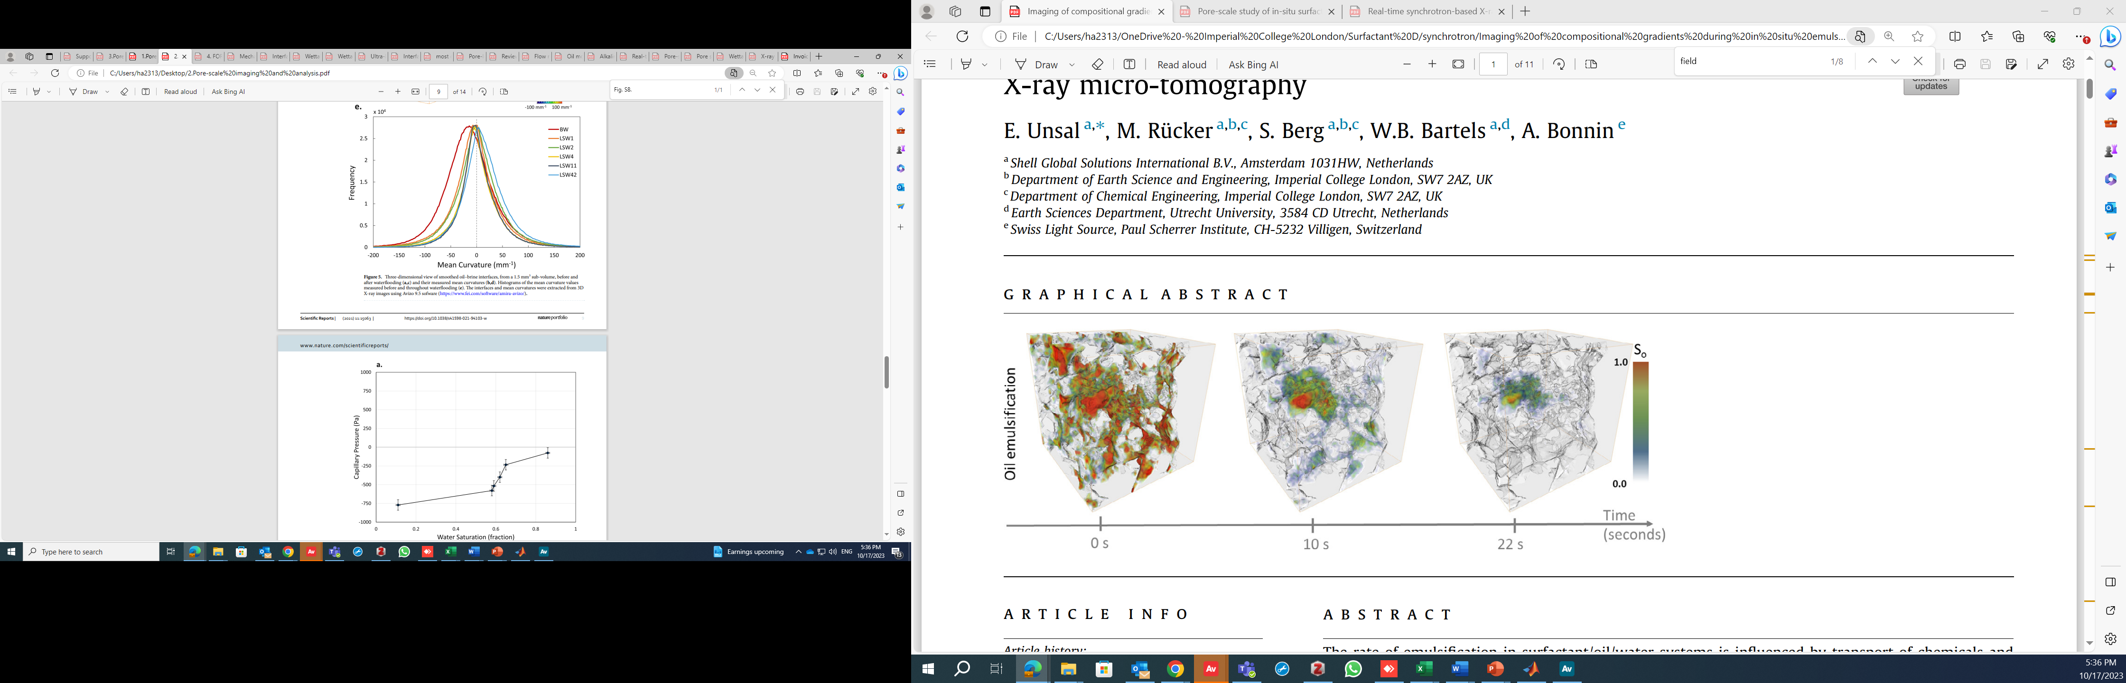
low salinity waterflooding
Selem, A.M., Agenet, N., Gao, Y. et al. Pore-scale imaging and analysis of low salinity waterflooding in a heterogeneous carbonate rock at reservoir conditions. Sci Rep 11, 15063 (2021). https://doi.org/10.1038/s41598-021-94103-w
Notes:
These results are similar to previous work on low salinity waterflooding where they concluded that the wettability alteration is the main driving mechanism for oil recovery, however, the mean curvature in their experiment was changed to almost zero indicating a wettability alteration to mix wet system. Also, they have seen an increase in capillary pressure which could be associated with wettability change.

Slide 21
Summary
The high concentration of surfactant resulted in an increase in oil recovery with very efficient displacement of oil in the big pores.
Pore occupancy maps showed that surfactant initially invaded the larger pores displacing oil but most smaller pores remained intact and filled with oil. This observation aligns with the expectations for a system exhibiting weak oil-wet characteristics.
Contact angle, curvature, and capillary pressure analyses show a slight shift in the wettability from weak oil-wet to a mixed-wet configuration in the system.
It's possible that localized rapid changes in wettability occurred, but we can not capture it with the current resolution of our instrument.
We think that the reduction in interfacial tension by a factor of 7 played a critical role in driving the efficient displacement of oil by surfactant.

Slide 22
Current Work
Tertiary recovery with the same high concentration of surfactant.
Surfactant flooding experiment near CMC concentration (Secondary).

Slide 23
Future Work
Surfactant flooding experiment near CMC concentration (Tertiary Recovery).
Time-resolved (synchrotron) imaging to see if there is a rapid wettability change locally to facilitate pore-scale displacement.

