Slide 1
Imperial College
London
24th Meeting of the Imperial College Consortium
on Pore-Scale Modelling and Imaging
16/01/2024
Machine Learning and NMR Interpretation for Porous Media
Gang Luo, Lizhi Xiao, Branko Bijeljic and Martin Blunt
Department of Earth Science and Engineering, Imperial College London
College of Artificial Intelligence, China University of Petroleum

Slide 2
Outline
Background
Methodology
A Lightweight Multiscale Neural Network (LMsNN) for
the Inversion of Relaxation Spectra
Experiment
Validation of Synthetic Data
Application of NMR Rock Core Analysis
Processing with NMR Logging Data
Discussion and Further Work

Slide 3
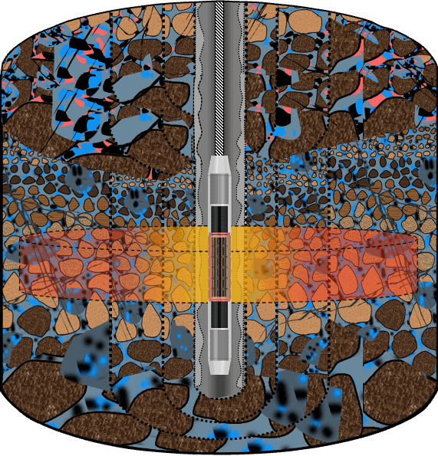
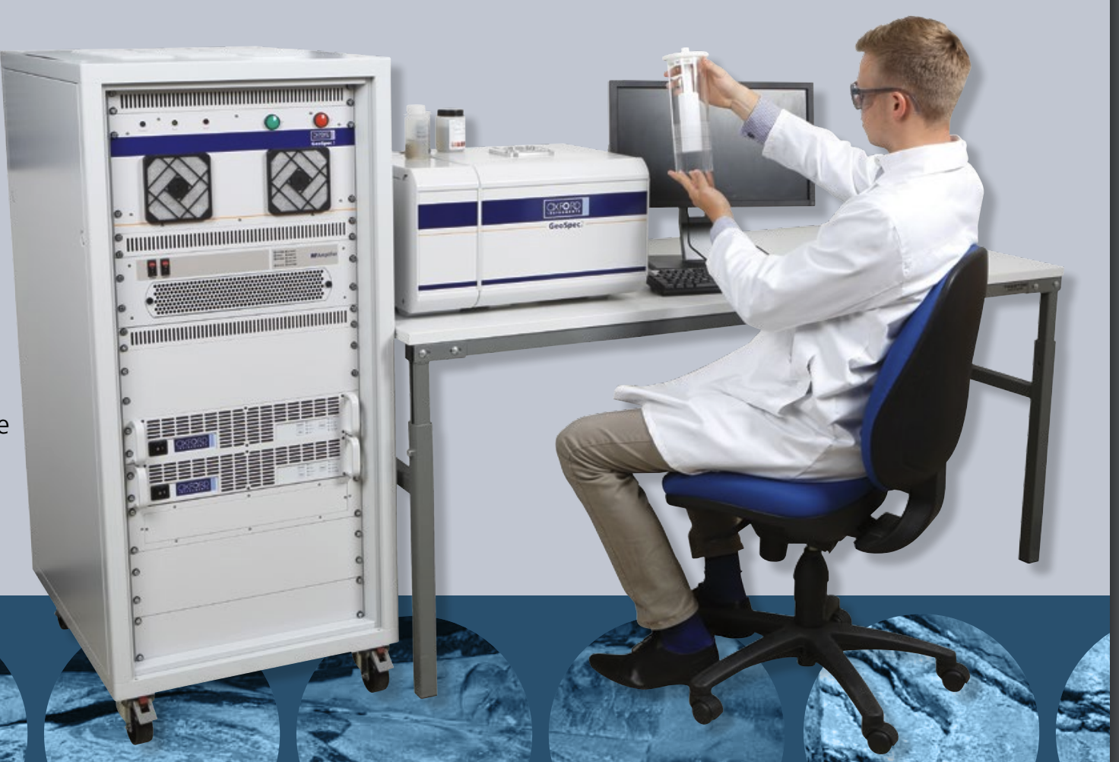
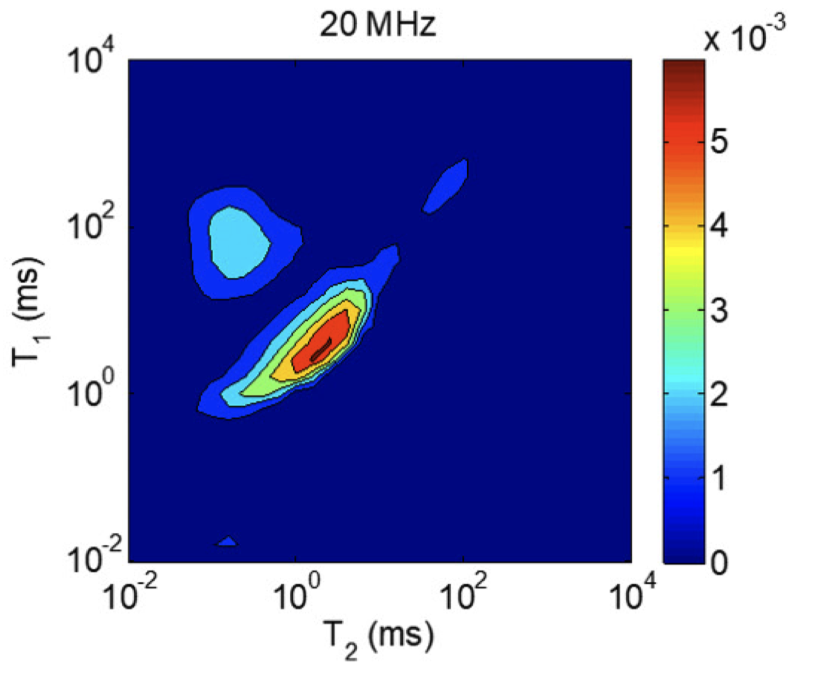


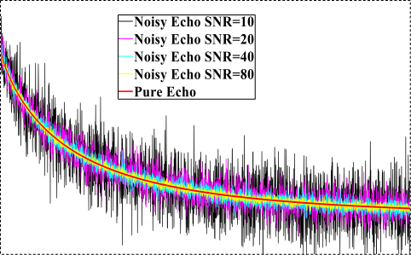
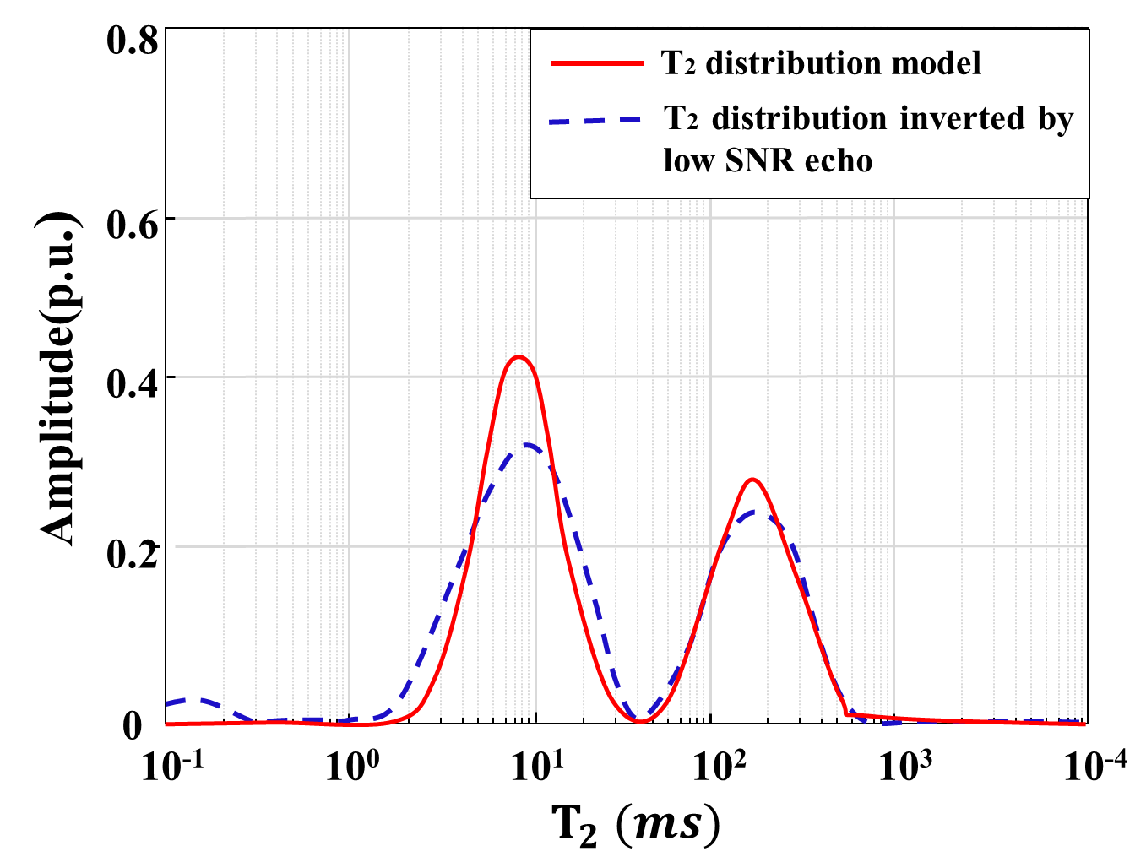
Background
NMR Measurements
Inversion of the Spectra
Further Analysis
Pore-size
Distributions
Fluid Distributions
2-D Spectrum
GeoSpec core analysers, Oxford Instruments
NMR Well Logging
Rock Core Analysis
Porosity
Wettability
Capillary Pressure
Permeability
1-D Spectrum
Echo Signals

Slide 4
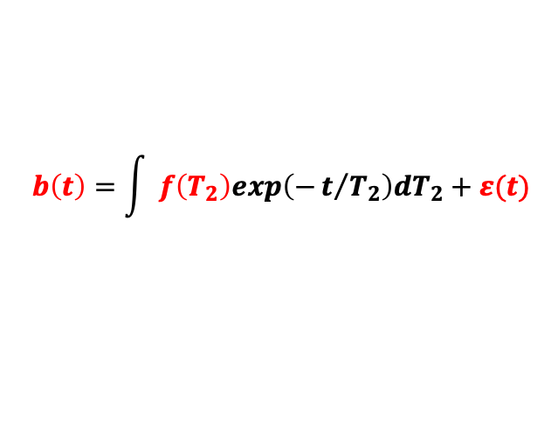
Background
Challenges
CPMG Pulse Sequence Response Equation
Inversion is an underdetermined process (Multi-solution).
$$b\left(t\right)=\int{ }f\left(T_{2}\right)exp\left(−t/{T_{2}}\right)dT_{2}+ε(t)$$
Strong Noise contained in signals.
Signals
T₂ spectra
Noise
Research Motivations
1.5
Use Machine learning to reduce the noise in the echo signals.
Amplitude(p.u.)
Improving the accuracy of the inverse spectrum.
0
Times (ms)
500

Slide 5
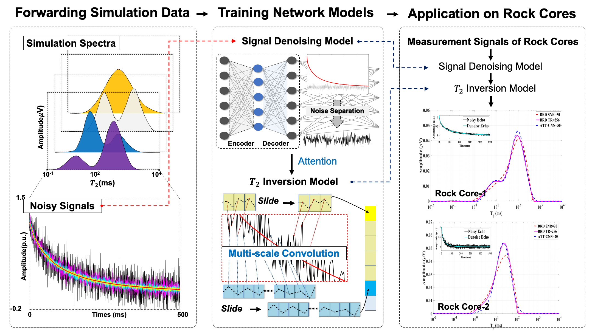
Background
My previous work: A Supervised Deep Learning Method for the Inversion of the T₂ Spectra
The spectra with Gaussian distribution is considered as a priori knowledge to construct an NMR synthetic dataset.
The network perform signal denoising and relaxation spectrum inversion simultaneously.
The approach was validated on core analysis.
Luo, Gang, Luo, Sihui, Xiao, Lizhi, Blunt, Martin J., Bijeljic, Branko, Liao, Guangzhi, and Rongbo Shao. "NMR Logging Data Processing Using Deep Learning." Paper presented at the SPWLA 64th Annual Logging Symposium, Lake Conroe, Texas, USA, June 2023. doi: https://doi.org/10.30632/SPWLA-2023-0026

Slide 6
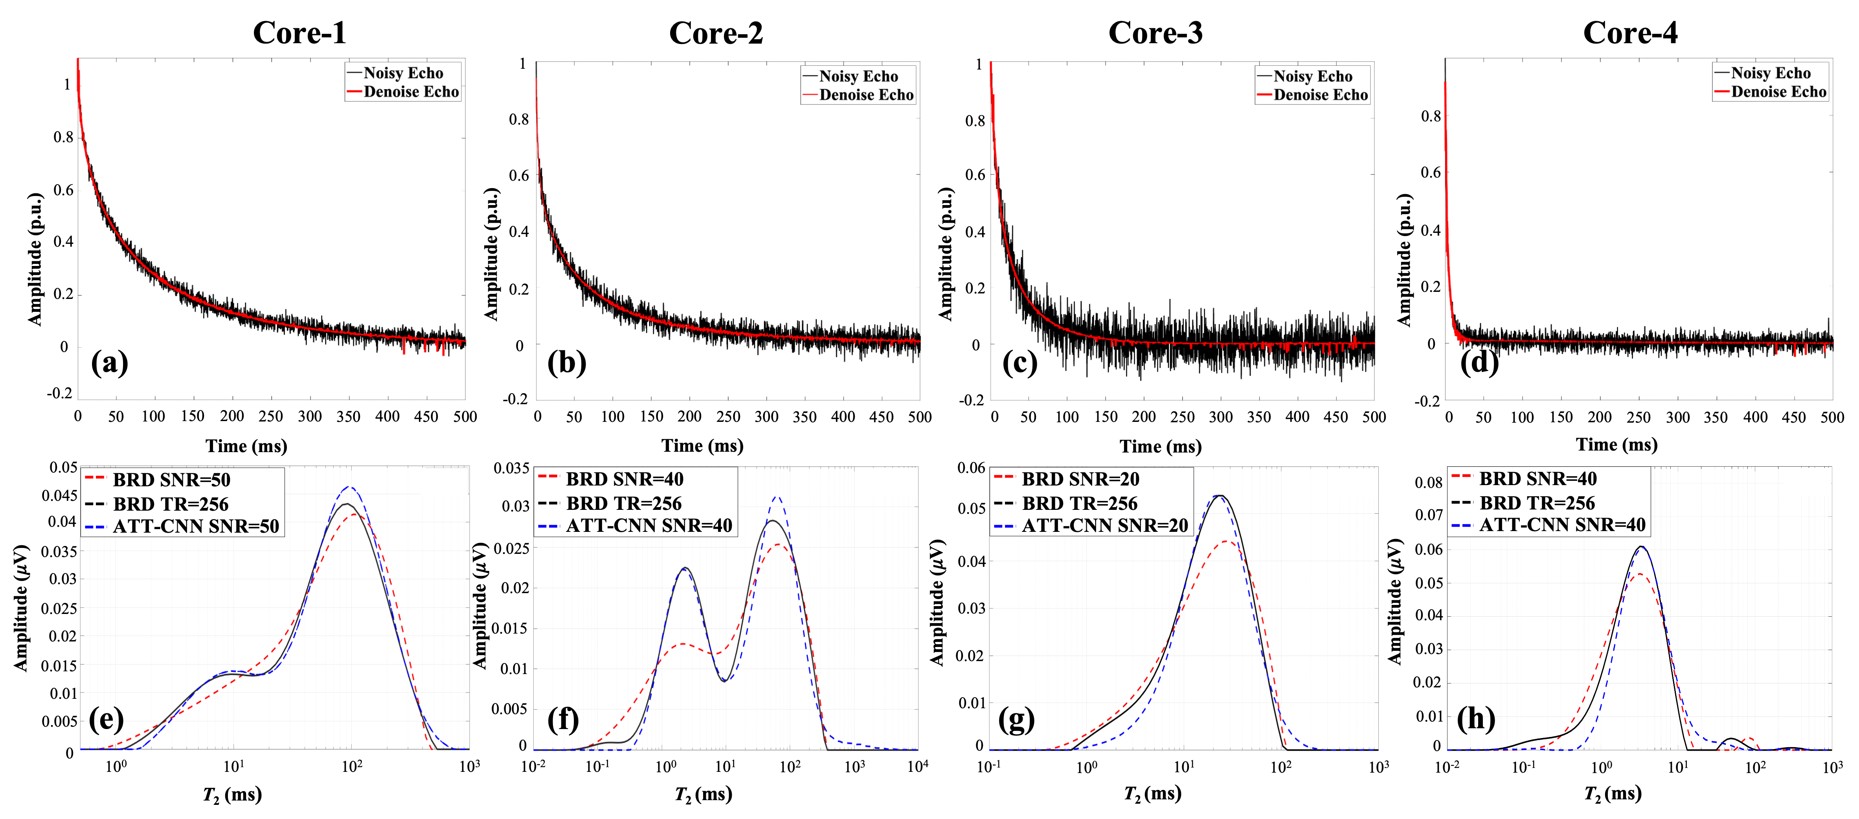
Background
A Supervised Deep Learning Method Results
Inversion results using Bulter–Reeds–Dawsons (BRD) inversion for 256-scan echoes, and inversion results of BRD and ATT-CNN models for low SNR echoes. The noisy echoes and denoised echoes are compared to illustrate the denoising performance.
Luo, Gang, Luo, Sihui, Xiao, Lizhi, Blunt, Martin J., Bijeljic, Branko, Liao, Guangzhi, and Rongbo Shao. "NMR Logging Data Processing Using Deep Learning." Paper presented at the SPWLA 64th Annual Logging Symposium, Lake Conroe, Texas, USA, June 2023. doi: https://doi.org/10.30632/SPWLA-2023-0026

Slide 7
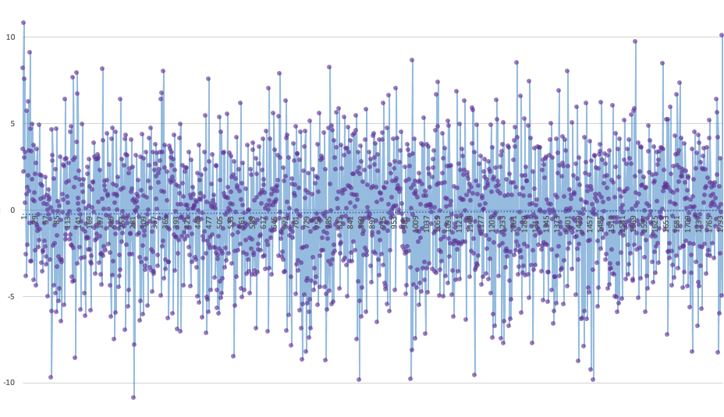
Background
What did we learn from previous work?
Some limitations:
The supervised training approach highly dependent on the synthetic dataset. Constraints and assumptions may not be suitable when the application changes.
The approach has not been further used to process NMR logging data with more complex situation .
Signal-to-noise ratio (SNR) of NMR logging is constrained by formation porosity, magnetic field strength, and instrument movement.
Need to develop more comprehensive and adaptable deep learning methods that can be used in different formations and actual logging data.
Actual NMR logging echo signal

Slide 8
Outline
Background
Methodology
A Lightweight Multiscale Neural Network (LMsNN) for
the Inversion of Relaxation Spectra
Experiment
Validation of Synthetic Data
Application of NMR Rock Core Analysis
Processing with NMR Logging Data
Discussion and Further Work

Slide 9
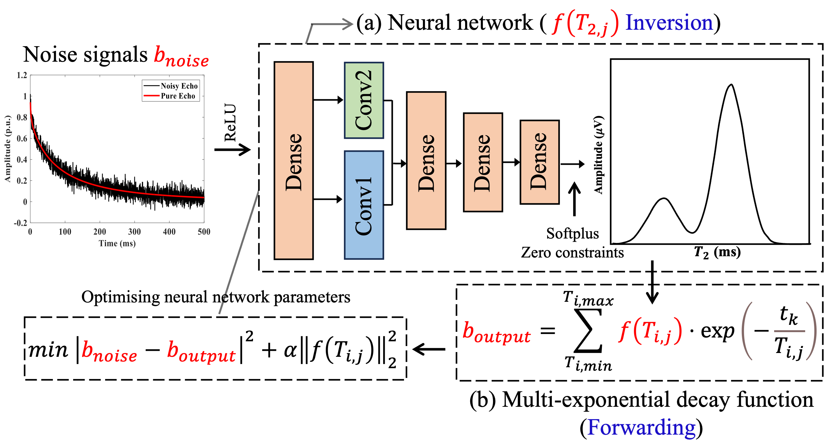
Methodology
New Method: Lightweight Multiscale Neural Network (LMsNN)
Inversion:
Non-negative constraint on the signal is achieved by the ReLU activation function.
Convolution kernel with two sizes is used to extract multiscale features of the signal.
Softplus activation function is used to add non-negative constraints to the inverted T₂ spectrum.
Adding constraints to the short relaxation components to reduce artefacts.
ReLU
Smooth constrains
A lightweight multiscale neural network for inverting relaxation spectra.

Slide 10
Methodology
New Method: Lightweight Multiscale Neural Network (LMsNN)
Forwarding
T₂ spectrum acquired from the inversion part is brought into the CPMG multi-exponential decay equation to calculate a noiseless echo signal.
ReLU
Smooth constrains
A lightweight multiscale neural network for inverting relaxation spectra.

Slide 11
Methodology
New Method: Lightweight Multiscale Neural Network (LMsNN)
Loss function
The absolute error between the input and output echo signals.
Second-paradigm number of the inversion spectrum to introduce a smoothing constraint on the relaxation spectrum.
ReLU
Smooth constrains
A lightweight multiscale neural network for inverting relaxation spectra.

Slide 12
Methodology
New Method: Lightweight Multiscale Neural Network (LMsNN)
CPMG decay equation
Secondary task
Reconstruction of the echo signal
ReLU
Constrains
Smooth, Non-negative of Signals and spectra, Artefacts
Improve smoothness and accuracy of T₂ spectrum
Smooth constrains
Deep neural networks are used as as optimisers to solve this highly non-linear and underdetermined optimisation problem.
A lightweight multiscale neural network for inverting relaxation spectra.

Slide 13
Outline
Background
Methodology
A Lightweight Multiscale Neural Network (LMsNN) for
the Inversion of Relaxation Spectra
Applications
1.Validation of Synthetic Data
2.Application of NMR Rock Core Analysis
3.Processing with NMR Logging Data
Discussion and Further Work

Slide 14
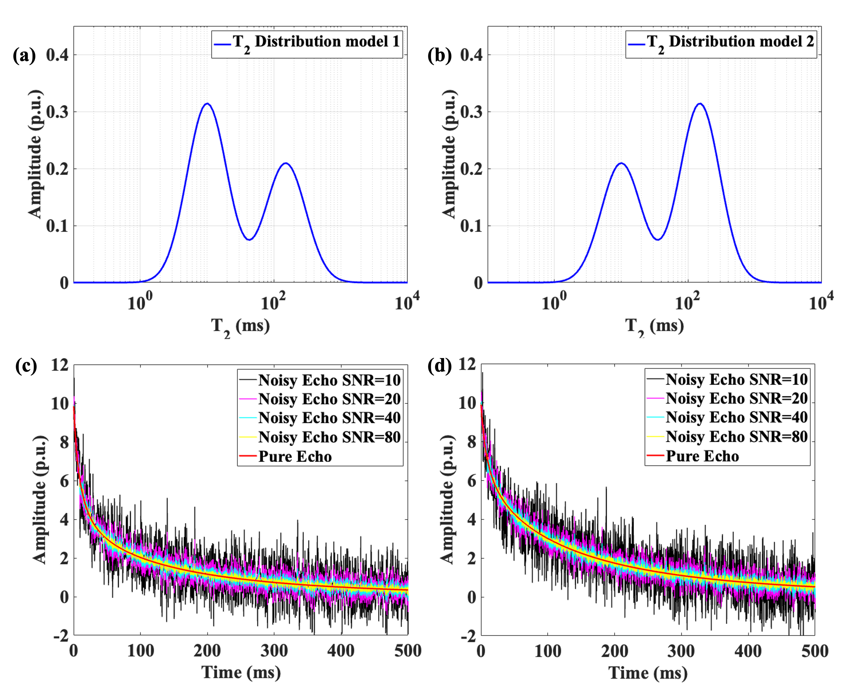
Applications
1. Validation of Synthetic Data
Modelling two T₂ distributions
Established bimodal relaxation spectra for two fluid components.
Bound water (10 ms) and movable oil (150 ms) in rock pores with proportions of 3:2 and 2:3.
Simulated pulse sequence parameters, including echo spacing, number of echoes.
Calculated noiseless echo by CPMG pulse sequence response equation.
Echo signals with different SNRs are obtained by adding different levels of Gaussian noise.
The numerical synthetic T₂ distribution models containing different ratios of BW and MO. And decay signals with different SNR corresponding to the distribution models (SNR=10, 20, 40, 80).

Slide 15
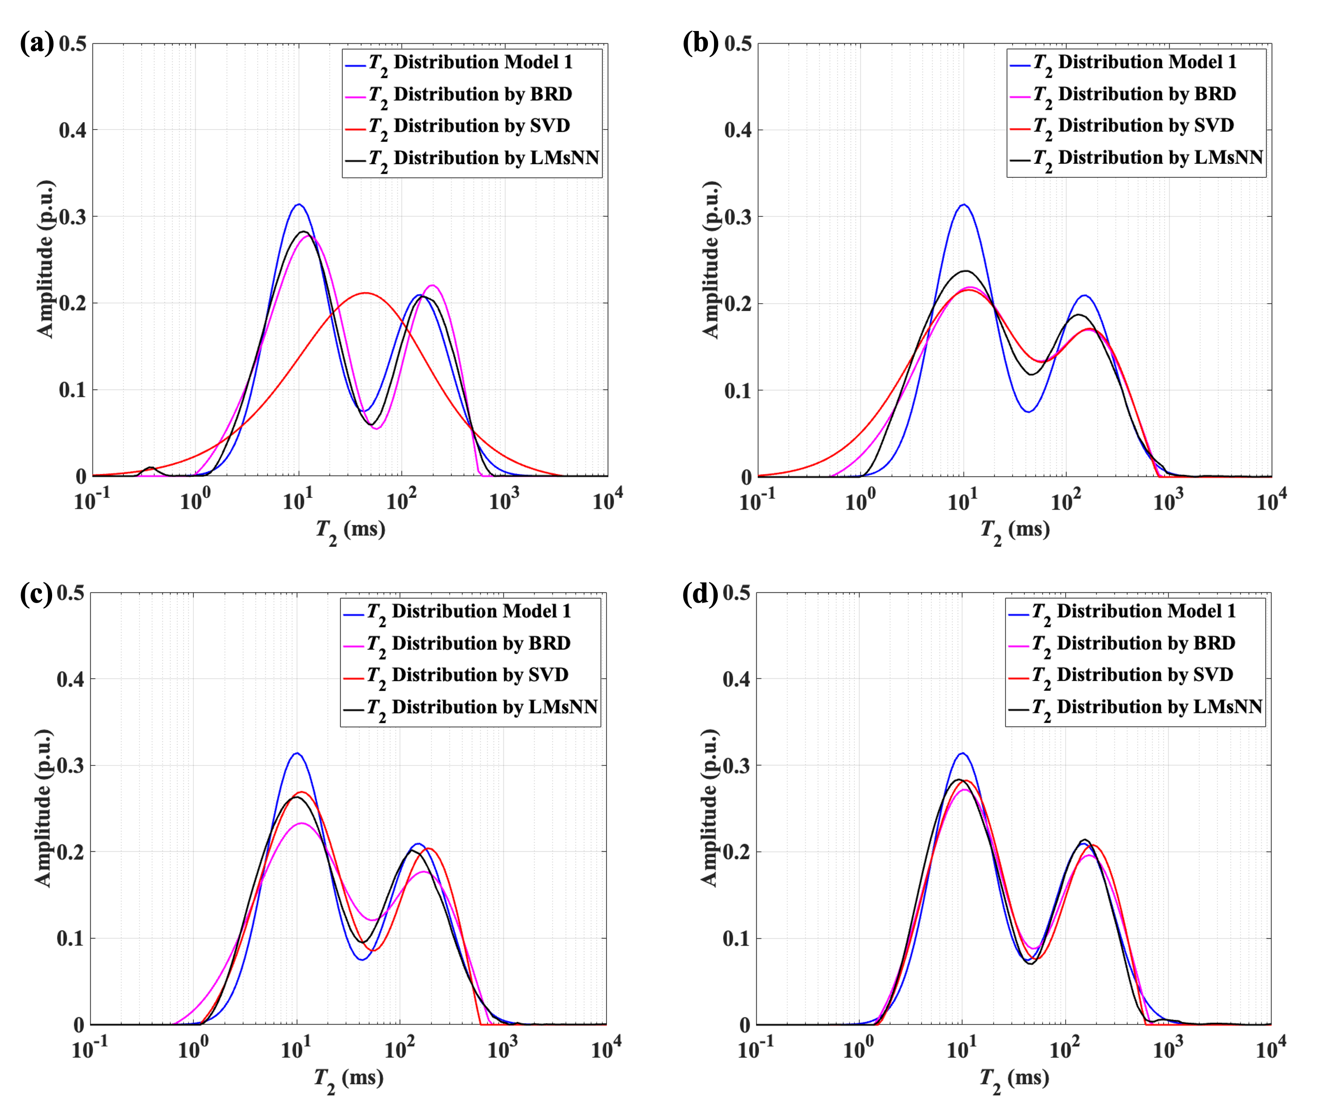
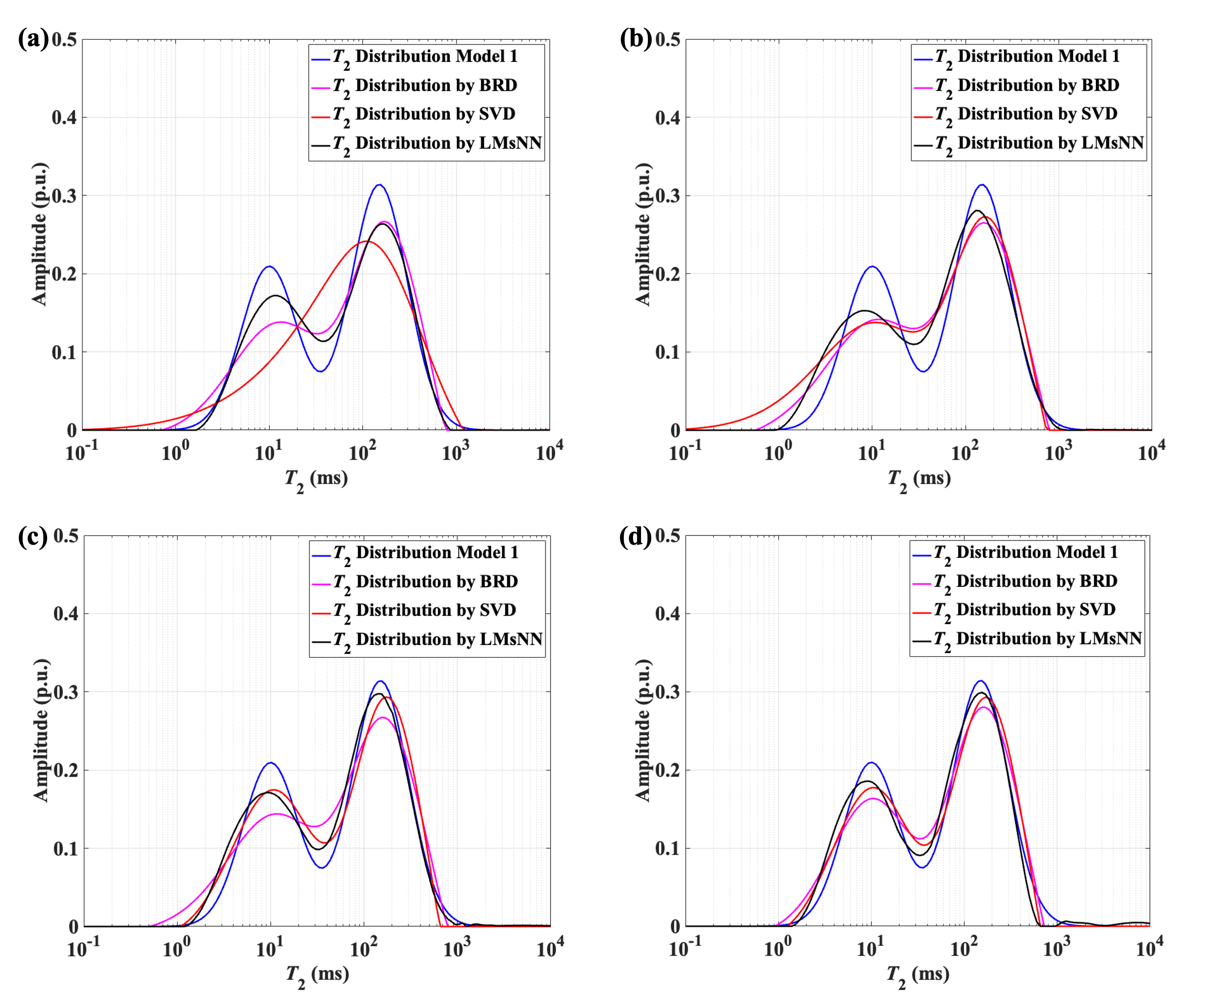
Applications
T₂ Model 1
T₂ Model 2
SNR = 10
SNR = 20
SNR = 10
SNR = 20
SNR = 40
SNR = 80
SNR = 40
SNR = 80
T₂ spectra inverted by using BRD, SVD, and LMsNN methods based on model 1 and model 2 at different SNRs. (a) SNR = 10; (b) SNR = 20; (c) SNR = 40; (d) SNR = 80.

Slide 16
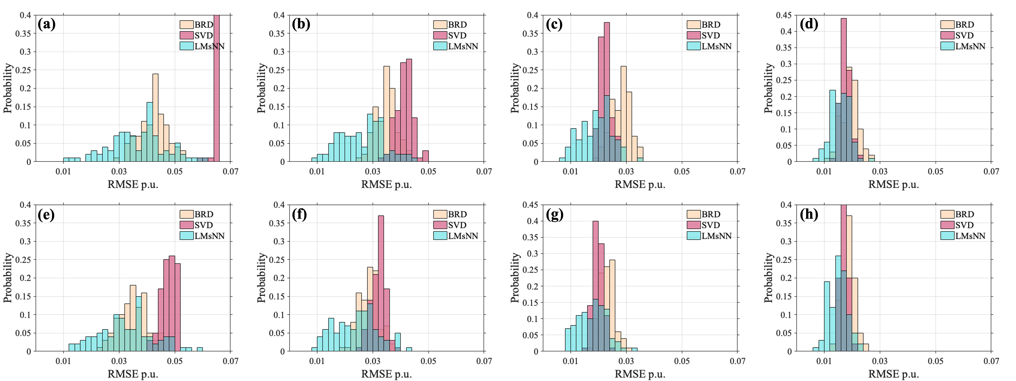
Applications
100 random simulations and inverse by BRD, SVD, and LMsNN methods at different SNRs.
T₂ Model 1
SNR = 10
SNR = 20
SNR = 40
SNR = 80
T₂ Model 2
SNR = 10
SNR = 20
SNR = 40
SNR = 80
Histogram of RMSE probability statistics for two models. (a)-(d) is the result of model 1 with SNR 10, 20, 40 and 80, (e)-(h) is the result of model 2.

Slide 17
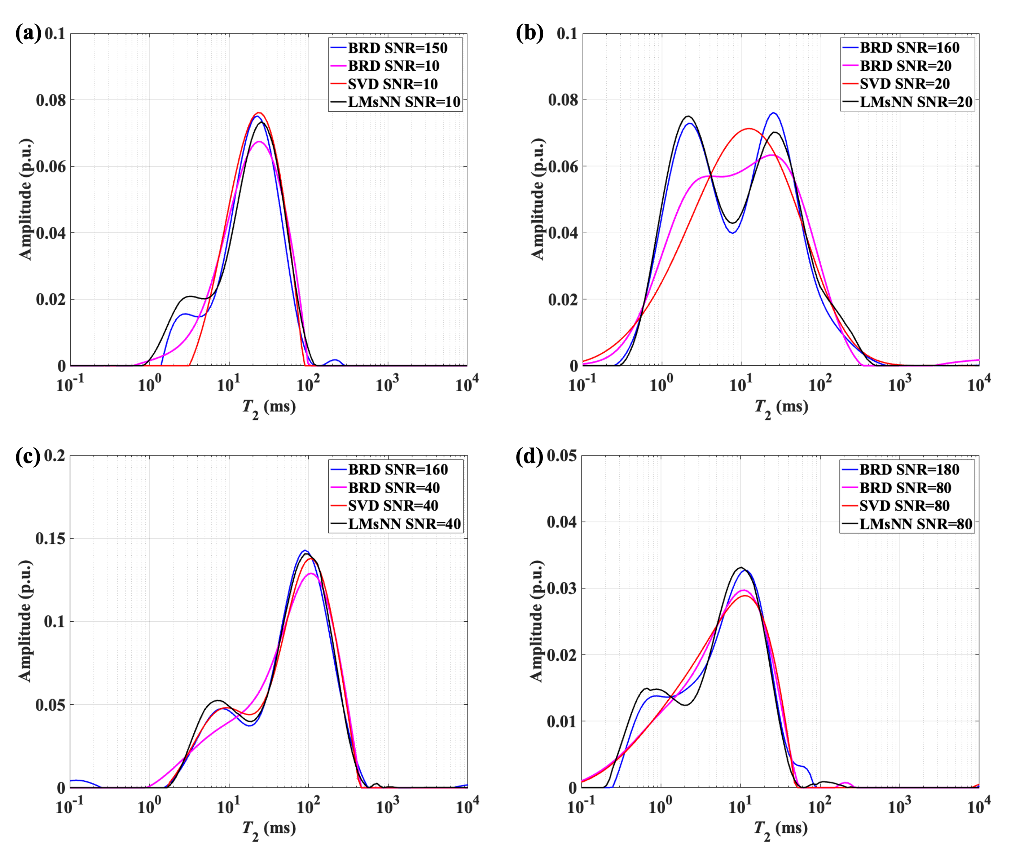
Applications
2. Application of NMR Rock Core Analysis
LMsNN, BRD and SVD methods are used for core analysis.
T₂ spectra inverted by LMsNN method shows high resolution compared to other methods.
T₂ spectra inverted by LMsNN always indicates bimodal features, and better reduction of artefacts with short relaxation times.
LMsNN improves the accuracy of spectra for pore distribution indication
Core 2
Core 1
Core 3
Core 4
Description of cores and instrumental measurement parameters
Cores |  | Scan number | SNR | Composition | Permeability
Synthetic | Core 1 | 4 | 20 | 10% chlorite with quartz sand | 1mD
 |  | 256 | 160
 | Core 2 | 4 | 10 | Epoxy resin mixed with quartz sand | 10mD
 |  | 512 | 150
 | Core 3 | 8 | 40 | 10% illite with quartz sand | 100mD
 |  | 256 | 160
Real core | Core 4 | 128 | 80 | Shale stone | --
 |  | 512 | 180
Inversion results of four rock cores by using BRD, SVD, and LMsNN methods.

Slide 18
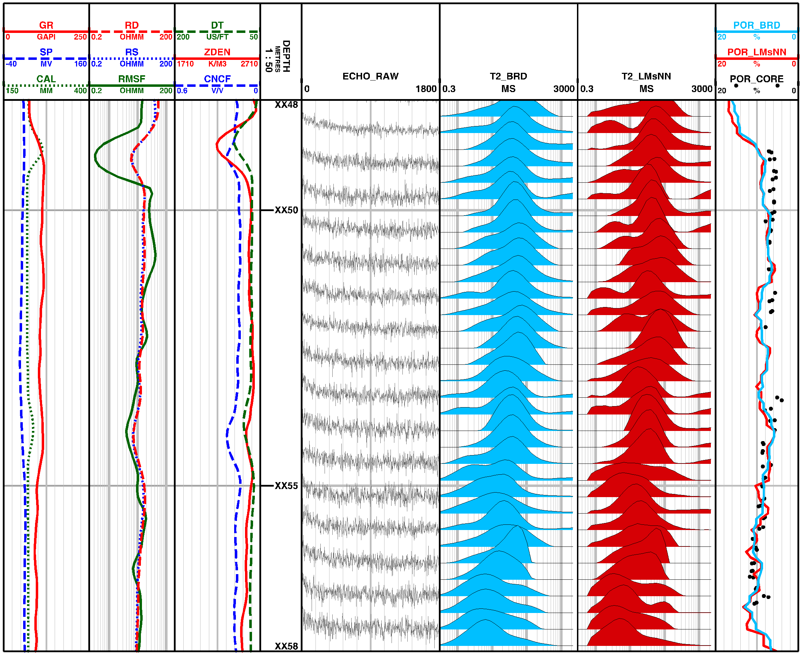
Applications
Conventional Logging Technology
NMR Logging
Data SNR 5-10
BRD
LMsNN
Porosity
3. Process NMR Logging Data
The inverted T₂ spectra by LMsNN exhibit a more remarkable bimodal than BRD method.
The calculated porosities from the inverted T₂ spectra are agree with coring porosity.
LMsNN method can improve the resolution of the relaxation spectrum which further helps to complete the comprehensive evaluation of the reservoirs.

Slide 19
Outline
Background
Methodology
A Lightweight Multiscale Neural Network (LMsNN) for
the Inversion of Relaxation Spectra
Experiment
Validation of Synthetic Data
Application of NMR Rock Core Analysis
Processing with NMR Logging Data
Conclusions and Further Work

Slide 20
Conclusions and Further Work
Conclusions
A lightweight multi-scale neural network self-supervised training is proposed by introducing physical equations as constraints.
The new method is developed for better inversion of NMR signal accuracy and tested on Synthetic Data, rock cores and well logging data.
Adaptive extraction of key features in the echo signal to invert the T₂ spectrum can be applied to formations and cores with different physical properties.
The new method provides a better indication of the pore distribution in the rock as well as helping to complete the reservoir interpretation.

Slide 21
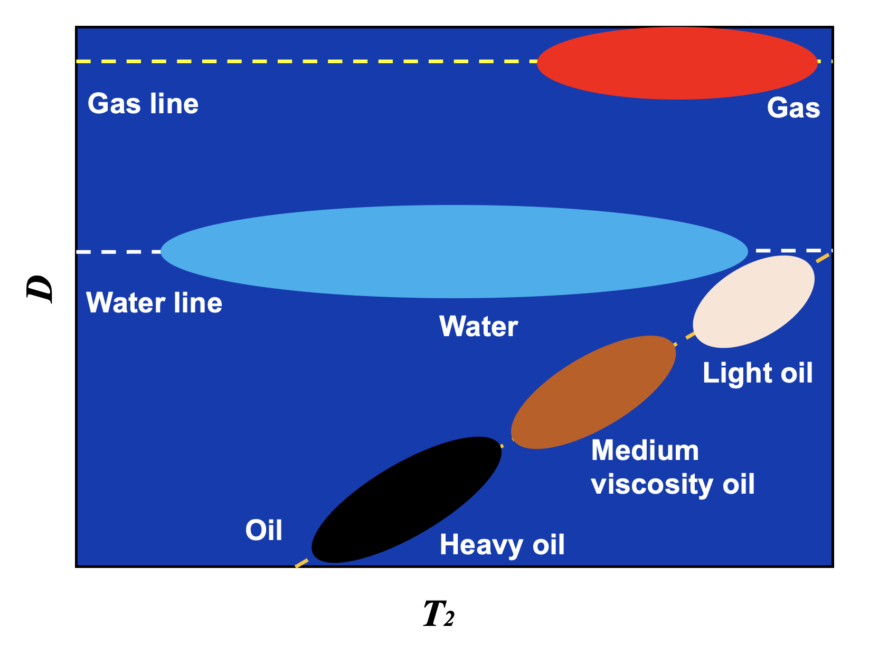
Conclusions and Further Work
Further Work
Denoising for NMR signals based on machine learning.
Intelligent interpretation of NMR relaxation spectra.
Providing quantitative evaluation of fluids.

Slide 22
Thanks for your attention
Questions and comments

