Slide 1
PhD Welcome
Academic year 2024-2025
Dr Dalal Alrajeh
Director of Postgraduate Research

Slide 2
Why are you doing a PhD?
Opportunity to
tackle a long-term problem for 3 years (a bit more for other studentships)
be creative within your field
contribute to your field
develop research and transferrable skills
A flexible and enjoyable endeavour
Interact with people from all over the world
Get access to a different kind of career path (e.g., through internships and career events)

Slide 3

Beware - the Einstein Effect!
Err...
Student thinks PhD is a really big deal
Student wants the PhD to be ‘the one’ ➙ General theory of everything.
Reality
Usually more evolutionary than revolutionary
PhD provides training/apprenticeship
Best work is often after the PhD

Slide 4
Advice from the academics
“Go bold for your research: if you don’t feel challenged by your research question, then you are not doing exciting research.”
“Avoid isolating. Their peers and fellow PhD students are equally important to their PhD supervisor.”
“A PhD is shorter than you think, make a sheet with square boxes, one for each week of the program and fill them in, to help keep things in perspective”
“Instead of trying to be smart, just try to be nice, we are all smart here”

Slide 5
Week 1
Registration (should have already been done, any problems speak to Amani El-Kholy after)
ID Cards: can be collected from Amani all of this week
Room Key: Some offices require keys please visit Ann Halford in room 440 with your ID card
Computer / Login / Email / PhD Mailing list / Dept and College Webpage: visit CSG (Geoff Bruce) room 307.
Contact you supervisor for an introductory meeting.

Slide 6
Discuss with your supervisor expectations
Please read the mutual expectation document.
Meetings:
Supervisors normally available for at least one hour every one/two weeks (on average)
Supervisor’s primary role is to advise and guide
Teaching: you may be expected to teach or supervise undergraduate and/or master’s students and help other colleagues in the lab or office
Holiday:
Discuss your leave dates in good time (start of the year).
You are entitled to a minimum of 30 days to a maximum of 40 days per year (including public holidays and university closure days). See guidance.

Slide 7
Key contact points
In the Department | In College
Supervisor | Library (DoC: Ann-Emily Brew)
PhD Student Representation | Accommodation
Postgraduate Administrator | Registry, International Office, Research Office
Computing Support Group | ICT
PhD Year Mentors | Health and Welfare Services
PhD Tutor | College Tutors
Director of Postgraduate Research | Union

Slide 8

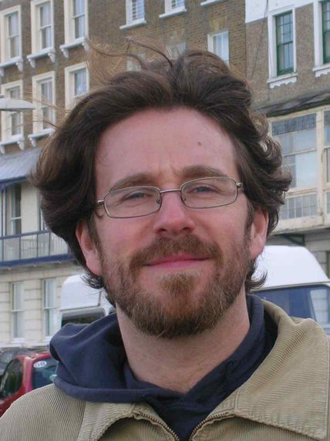
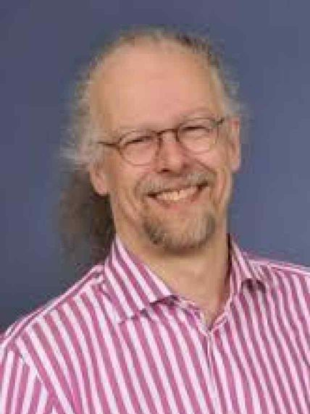
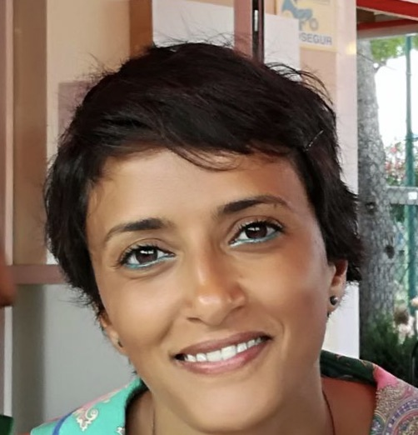
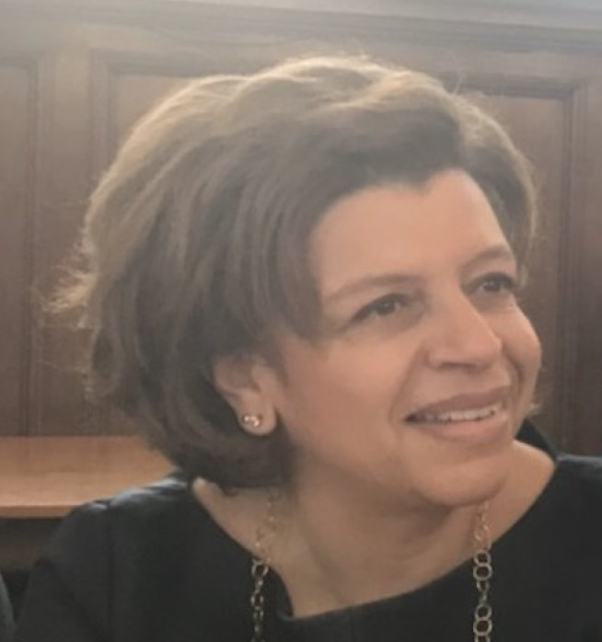
Who will be looking after you?
Your 1st (and 2nd Supervisors)
1st year Mentor
Dr Francesco Belardineli (francesco.belardinelli@imperial.ac.uk)
PhD Tutor (Pastoral, examiners, interruptions, ..)
2024/25 Prof Paul Kelly (p.kelly@imperial.ac.uk)
Director of Postgraduate Research (academic milestones, training & development)
Dr Dalal Alrajeh (dalal.alrajeh@imperial.ac.uk)
PhD Program Administrator
Dr Amani El-Kholy (a.o.el-kholy@imperial.ac.uk)
1st Year PhD Reps

Slide 9
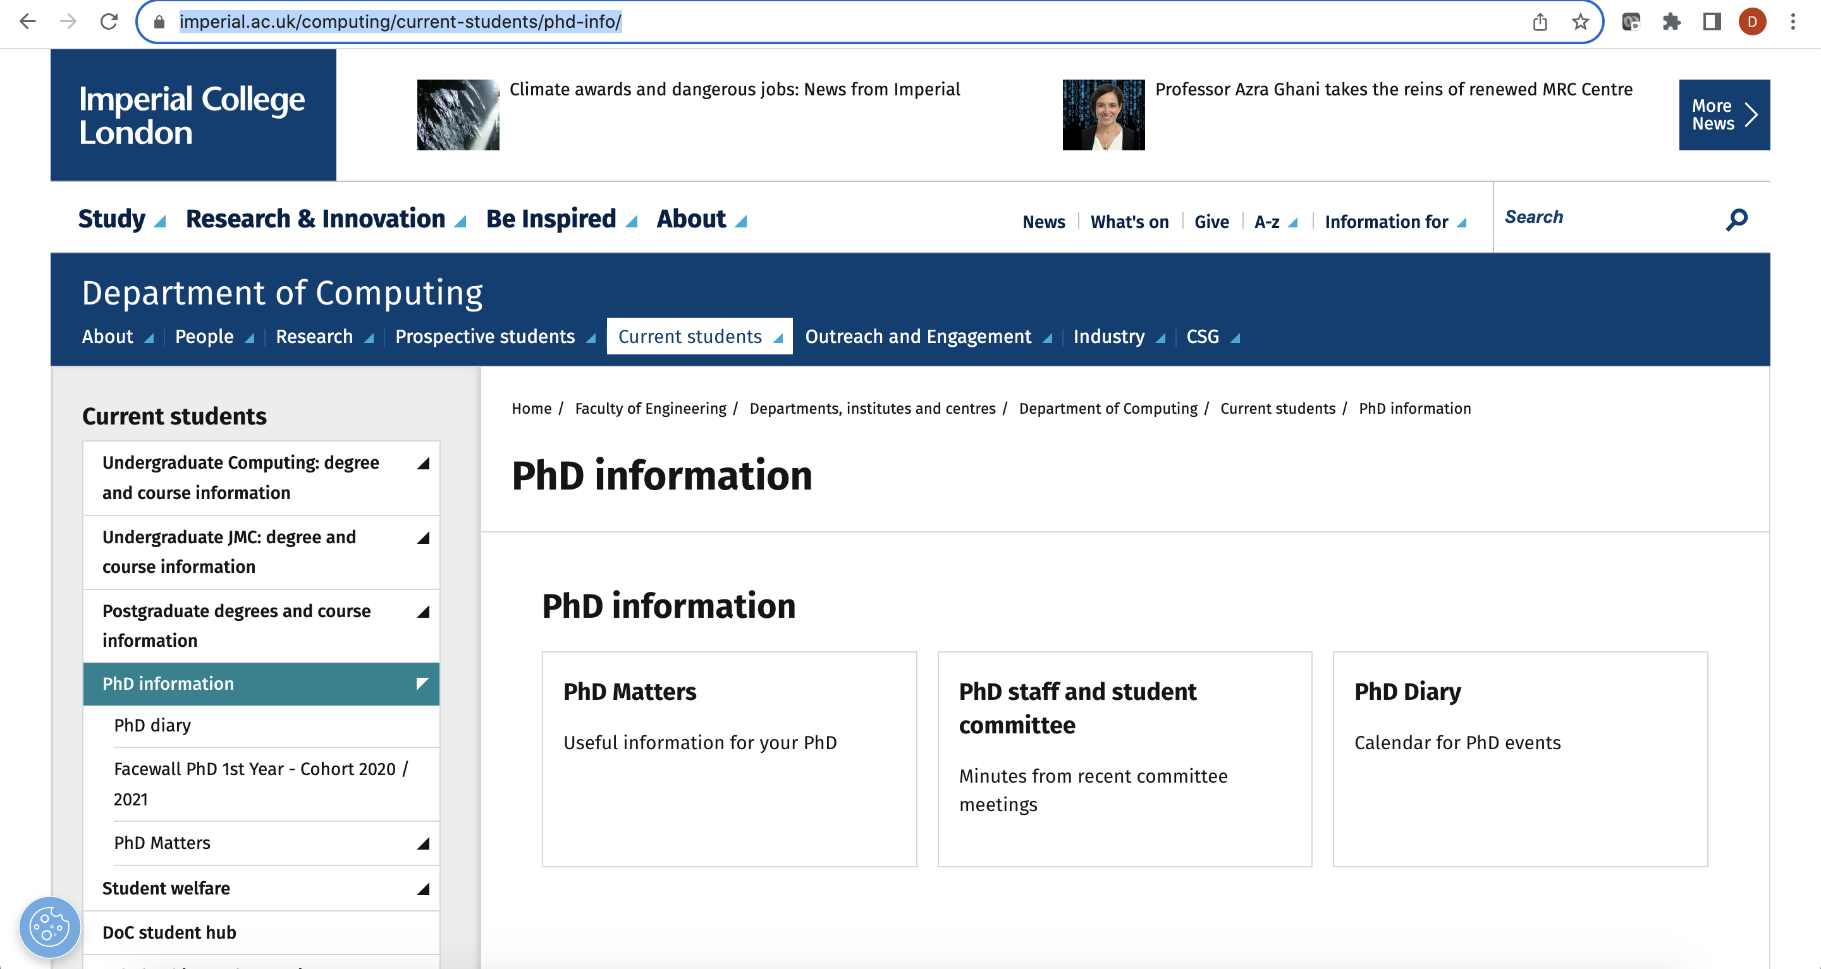

Getting started
PhD students are expected to be on campus
Visit Computing PhD webpage & handbook https://www.imperial.ac.uk/computing/current-students/phd-info/

Slide 10
Key Milestones
Research Plan Confirmation (RPC) - Month 3 (FT) Extended abstract
Early-Stage Assessment (ESA) - Month 9-12 (FT) Written report & oral examination
Late-Stage Review (LSR) - Month 24 (FT) Poster presentation & assessment
Progress Review– Month 36 (FT) timetable of remaining work to be completed to meet the expected thesis submission deadline
Write Up Period – Month 37 -38 (FT)

Slide 11
Year 1 – Milestones
Research Plan Confirmation (RPC) - Month 3
Title, short abstract, name of 1st (and 2nd supervisor)
Signature of your 1st supervisor
Signature of mutual expectation document by supervisor and student
Early-Stage Assessment (ESA) - Month 9-12 (HARD DEADLINE).
Written report and oral examination
Submit ESA through Turnitin
Mandatory plagiarism awareness training
CfAE – Center for Academic English (non-native English language students) – 1st assessment by 3 months, 2nd by month 12
Two Early Career Researcher Institute professional skills credits
All submissions will be on the scientia PhD portal

Slide 12
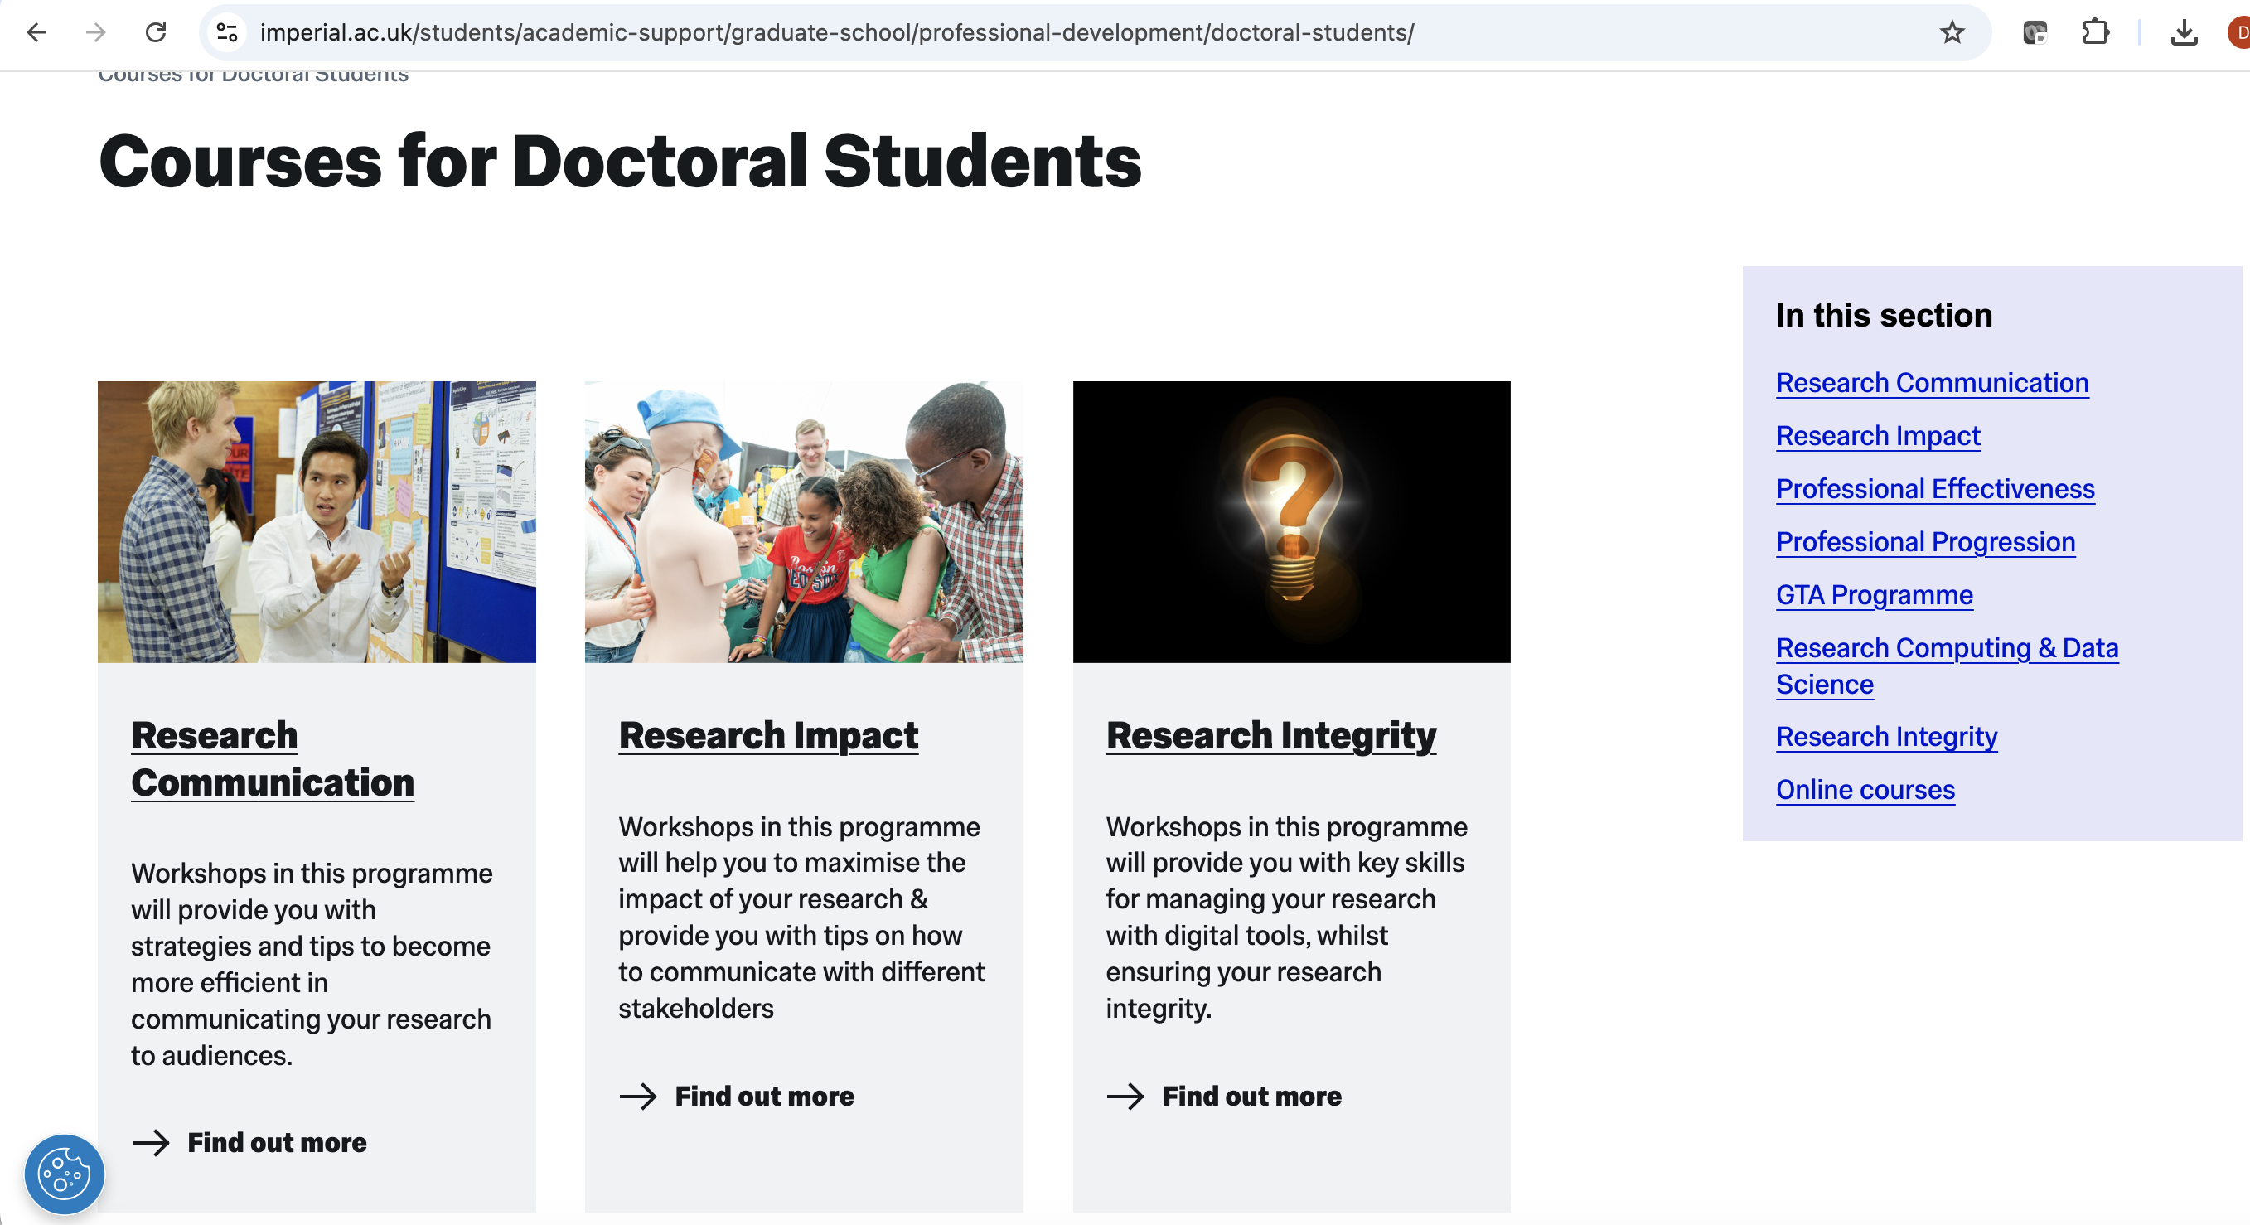
Early career Researcher Institute
Online departmental induction course for new research students is now available to view here: ECRI’s Online Induction (PGR) - Overview | Rise 360 (articulate.com)

Slide 13
Departmental Activities
Industry events: Meta (November 6th)
Library induction (October 11th, 1-2 pm, room TR1 Library space)
ICC PhD Conference: By and for PhD students (December 2024/~July 2025)
Bespoke Computing Training from CfAE (e.g., ESA preparation, LSR, Thesis writing)
Social Fridays (Usually at 5pm)
Mentor lunches once a term (Date TBC)
Women in Computing events. Visit here for details.
Seminars: Research students (e.g., ICARL), research groups (e.g., SRG, LSDS, Spike), department, college (e.g., AI network)
Reading groups (e.g., computational statistics and machine learning webpage visit here, mailing list: csml-reading-group@imperial.ac.uk)

Slide 14
College-wide Activities
Centre for Language, Culture and Communication Courses:
Art and Humanities: arts, history, philosophy, music appreciation, …
Languages: Arabic, …, Spanish,
business and enterprise strategy and many more
Student Union: Sports, clubs, societies, ..
https://www.imperial.ac.uk/centre-for-languages-culture-and-communication/
Important to have a life on the outside!

Slide 15
PhD Buddies
PhD buddies are here to answer any questions you might have about life as a PhD student, supervisor relations, time management of your research and any other issues that an existing PhD student can share with you.
https://www.imperial.ac.uk/computing/prospective-students/phd/phd-buddies/

