Slide 1
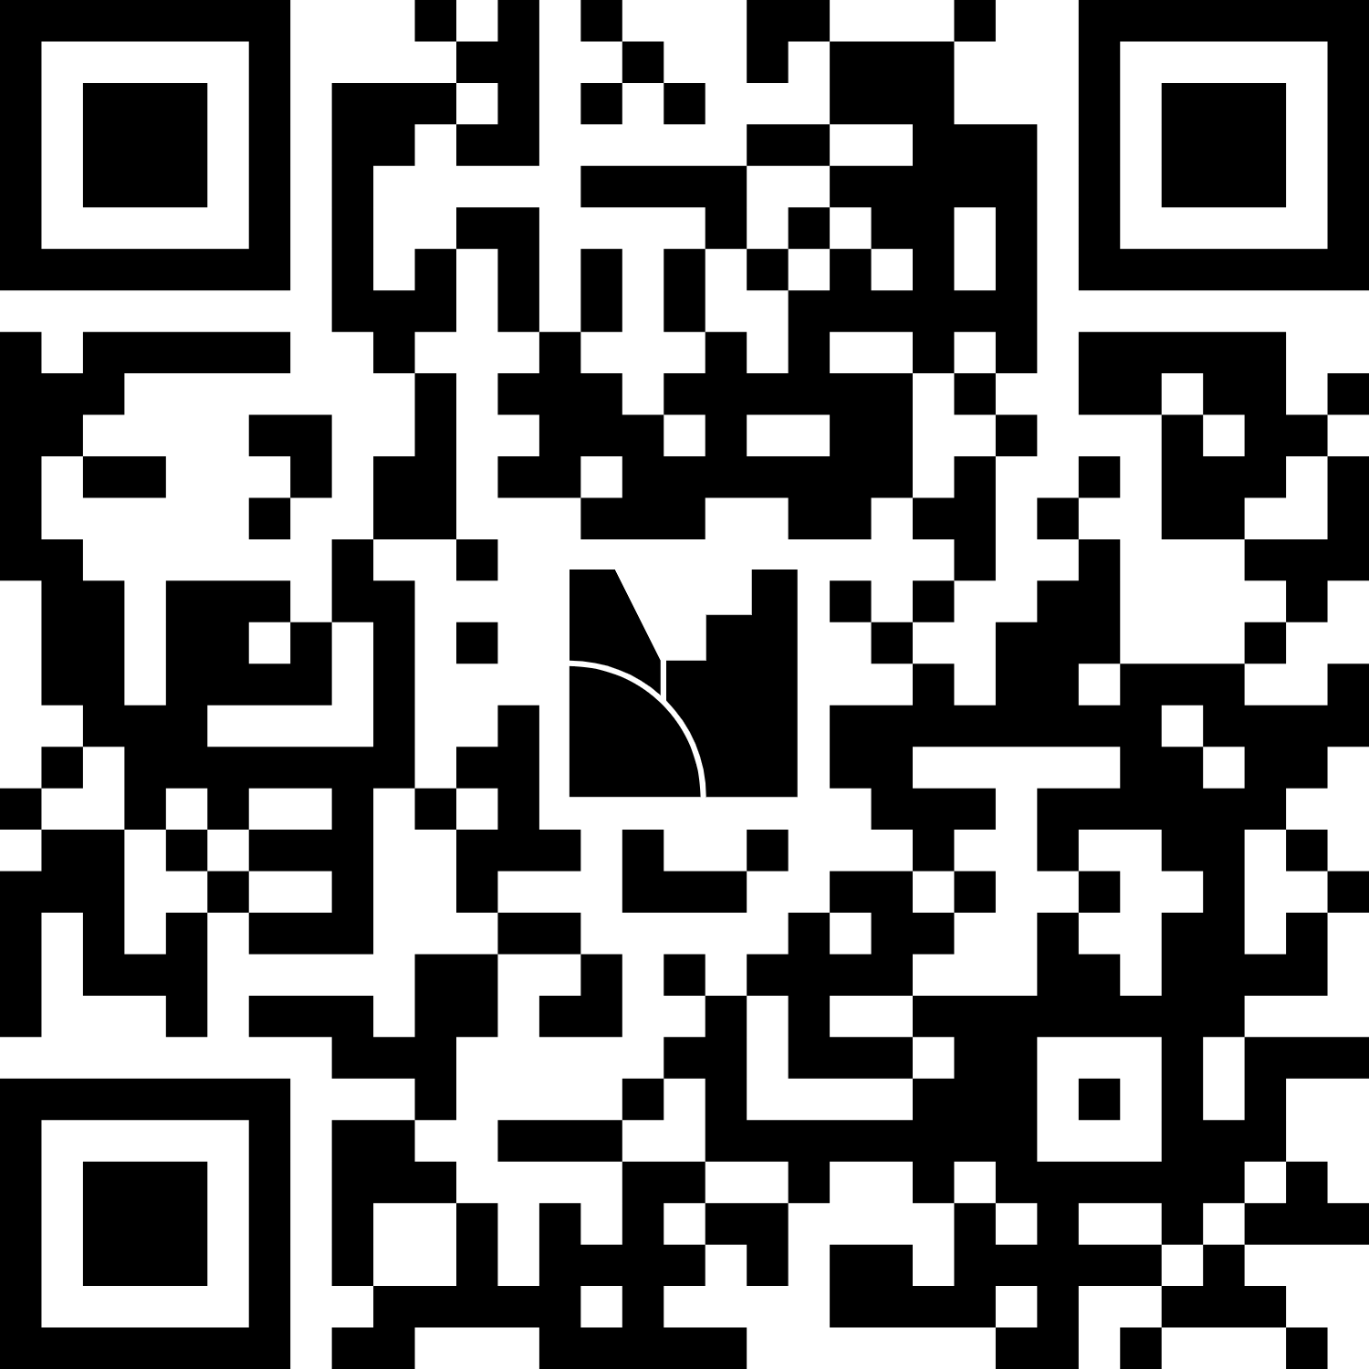

Imperial Learning Analytics
Pilot to Practice: Supporting Learning & Teaching with Imperial Learning Analytics Dashboards
Notes:
Helen

Slide 2





The Central Learning Analytics Team
Helen Walkey
Charlotte Whitaker
Rosany Antonyvincent
Mehdi Moussaoui
Oscar Cerna Loli
Learning Analytics Product Manager
Learning Analytics Project Manager
Data Analyst
Data Analyst
Data Analyst
Notes:
Helen

Slide 3

The Imperial Learning Analytics Community
Faculty Data Analysts
Students
Central LA Team
Researchers
Ed Tech Specialists
Staff partners
Notes:
Helen

Slide 4
Imperial Learning Analytics Vision
We envision a future where reliable, accurate data about our learners and their online behaviours are available to academics, educators, professional staff and students;
enabling them to improve teaching and learning experiences through evidence-based evaluation, data-driven design and insights into learner behaviours.
Notes:
Helen

Slide 5
What kinds of data?
Student identifiers
Interactions with learning resources and activities in the VLE or other learning platforms
Interactions with video resources in Panopto
Attendance records
End of year grade
Component marks (pre-exam board)
Assessment schedules
Requests for coursework extensions
Notes:
Helen

Slide 6
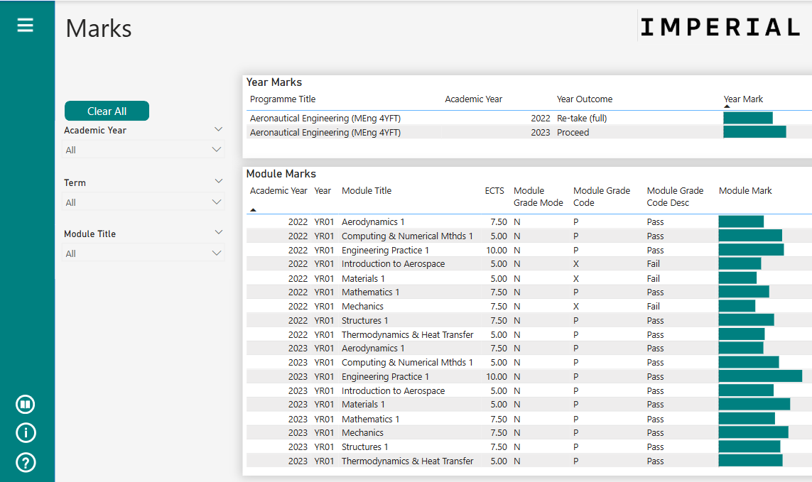
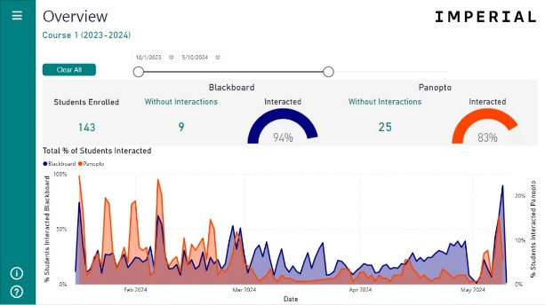
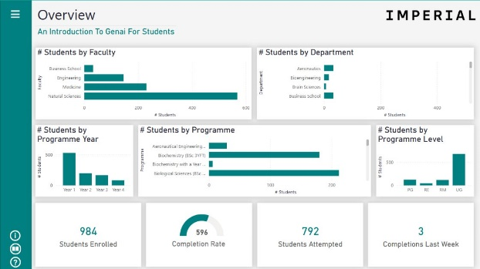
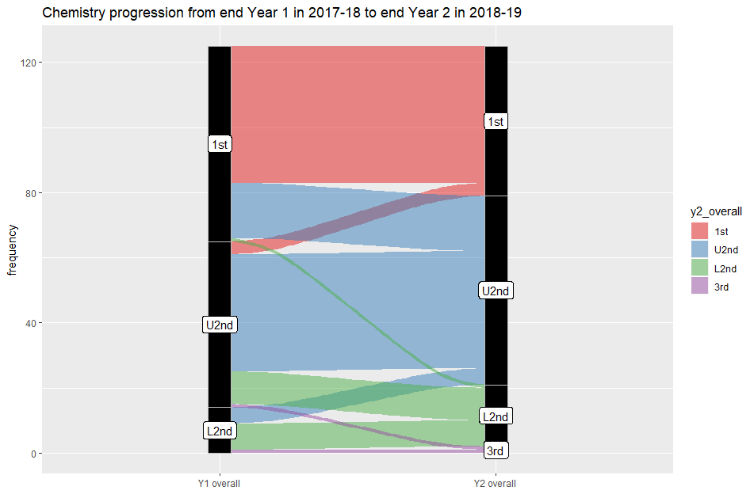
For 2025-26: dashboards and data to understand students better and what works well in learning & teaching
Student Profile →Personal Tutor
Module Teacher
Course Monitoring
Data for Evaluation
To empower tutors to know and support their students by providing a view of each tutee’s learning journey.
To show how a cohort of students interact with the online learning resources and activities for a module.
To monitor enrolment in and completion of online courses.
To provide datasets for analysis to inform learning design, interventions, and policy in learning and teaching.
Notes:
Helen

Slide 7
Course Monitoring Dashboard
Notes:
Helen

Slide 8
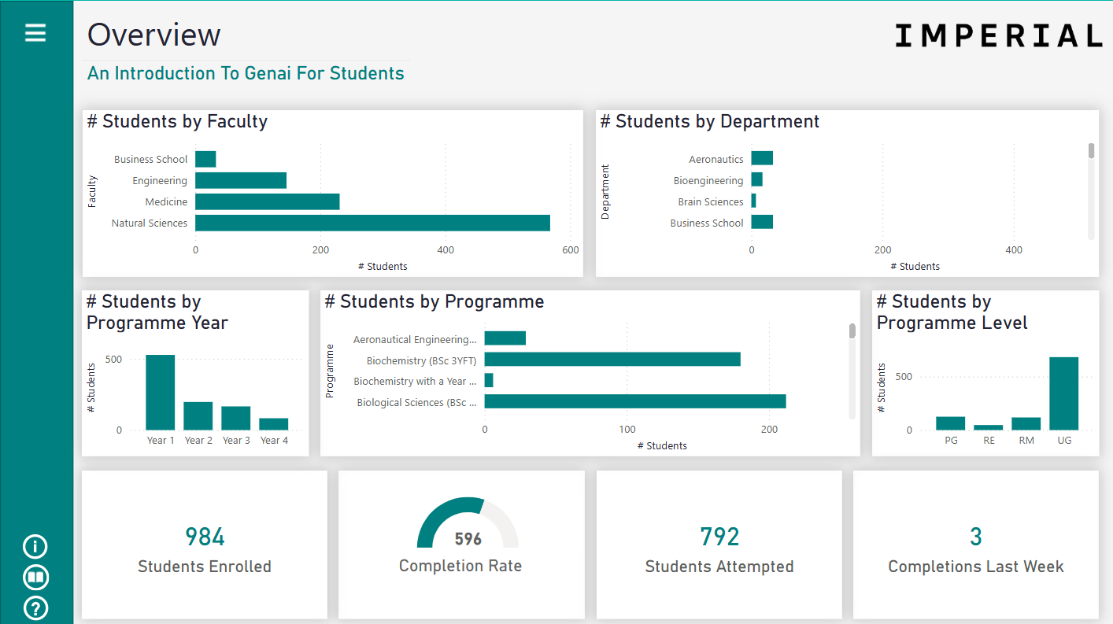
Course Monitoring Dashboard
Purpose of this Power BI dashboard:
Monitor Course Uptake and Completion: Provide insights on student enrolment and completion rates for short online courses.
Supports institutional reporting by providing insights into course uptake and completion.
Ensures stakeholders can monitor and analyse participation without using identifiable student data.
Users:
Staff who need to monitor the completion of the Intro to GenAI For Students or Plagiarism Awareness courses across Imperial and those who designed the courses, for evaluation purposes.
Notes:
Helen > Charlotte for DEMO

Slide 9
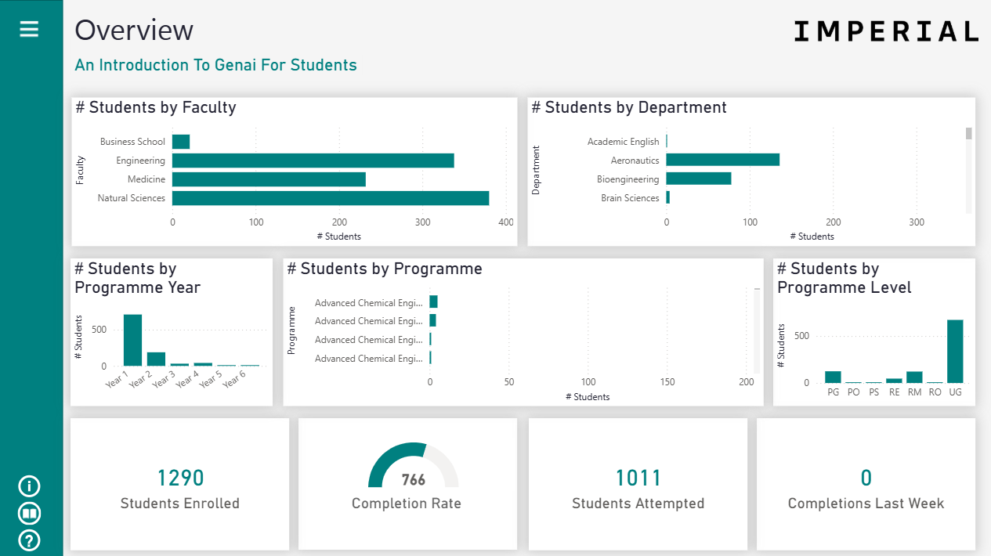
Course Monitoring Dashboard
Hands-on exploration
Imperial Learning Analytics Power BI App
Notes:
Charlotte

Slide 10
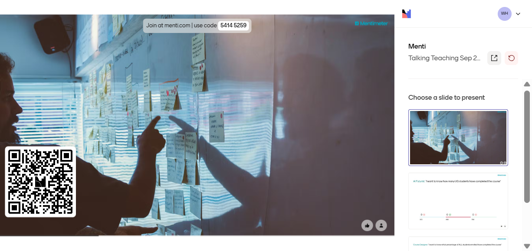
Notes:
Helen

Slide 11
AI Futurist “I want to know how many UG students have completed the course”
Notes:
Helen

Slide 12
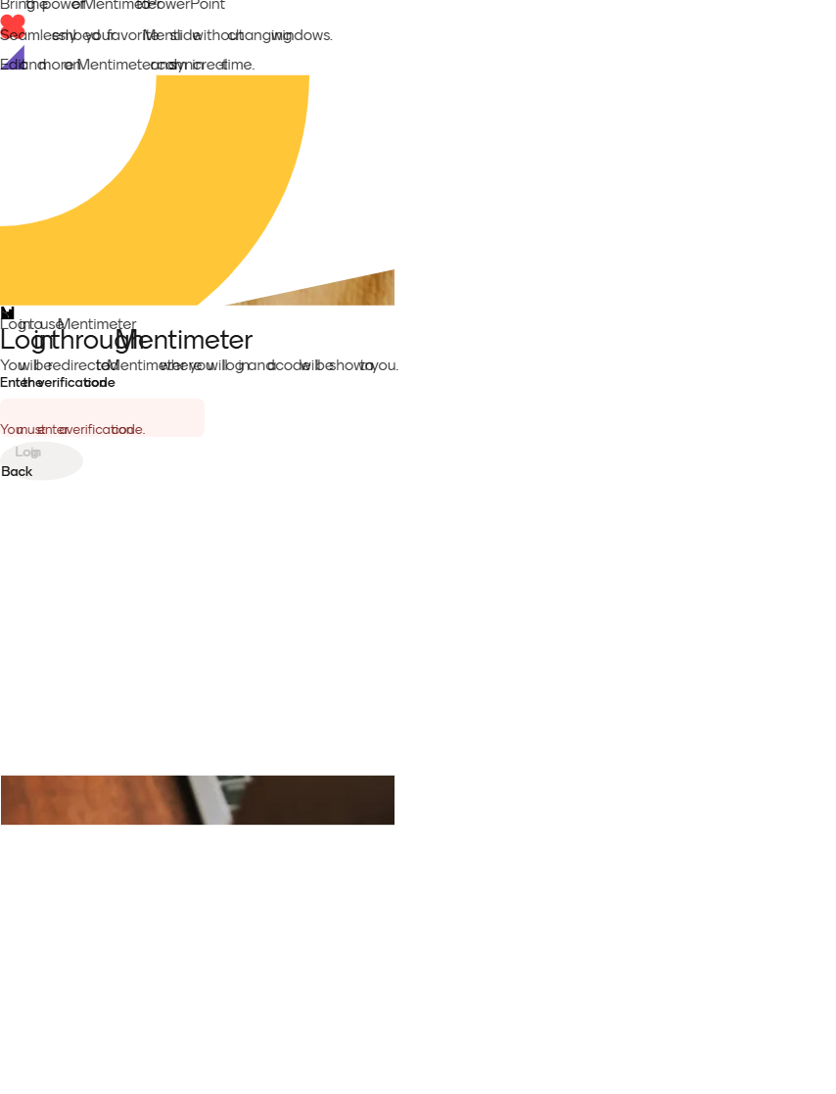
Notes:
Helen

Slide 13
Course Designer “I want to know what percentage of ALL students enrolled have completed the course”
Notes:
Helen

Slide 14
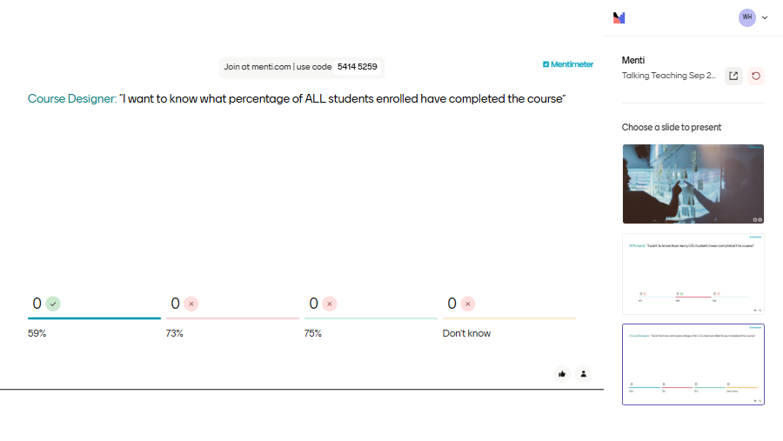

Slide 15
Life Sciences DUGS “Teaching staff allocated time at the end of the 9 am lecture on 6th Nov 2024 for students to do the course. I want to know if it was successful”

Slide 17
Education Office Manager “I want to know how many year 1 undergraduate students have not yet enrolled on the course”

Slide 18
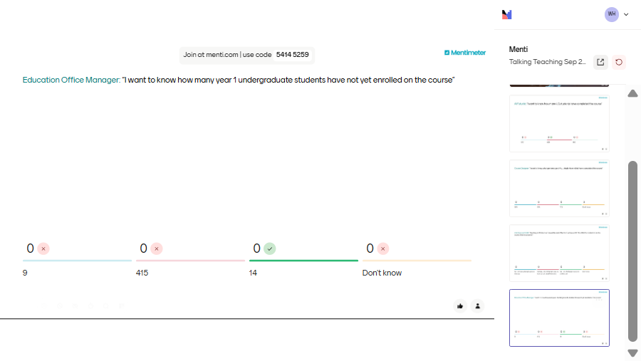

Slide 19






Our Approach to Co-creation
Co-creation isn’t a one-off event — it’s a continuous conversation
Workshops, Surveys & Interviews
Prototype & Co-Design Workshops
& Iteration
Beta Testing & Feedback with Volunteers
Fixing Issues & Quick Additions
Release
Ongoing Feedback Built In
Notes:
Charlotte
Our dashboard process isn’t a one-shot deal.
We start by deeply understanding what users need through workshops, surveys, and interviews.
Then we prototype early—and co-create through feedback sessions and design workshops.
After that, we beta-test with real users in real workflows, collect structured feedback, and refine based on what we learn.
Once it’s stable, we roll out more widely.
But even then—we keep listening.
Every dashboard has an embedded feedback button, where users can suggest features, report bugs, or ask questions anytime.
It’s about continuous improvement, not a finish line.

Slide 20
What else is coming for you to use in 2025-26
Notes:
Charlotte

Slide 21
Student Profile
Notes:
Charlotte

Slide 22
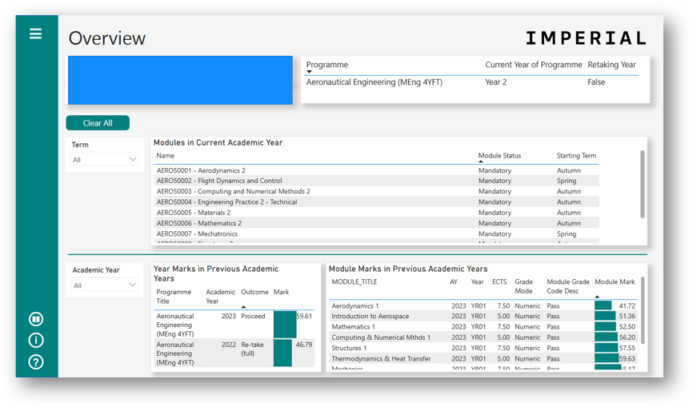
Student Profile
Purpose of this Power BI dashboard
To empower Personal Tutors and administrative staff to know and support their students by providing a view of an individual student’s:
Personal details
Programme and module registration
End of year marks (past years)
End of module marks (past years)
Users
Undergraduate Personal Tutors and Education Administrators across Imperial*
* Not for Personal Tutors of PGT students nor Supervisors of PGR students
c
Student Profile
A more comprehensive Personal Tutor Dashboard will be developed by extending the Student Profile, as data become available.
Notes:
Charlotte

Slide 23
Module Teacher Dashboard
Notes:
Charlotte

Slide 24
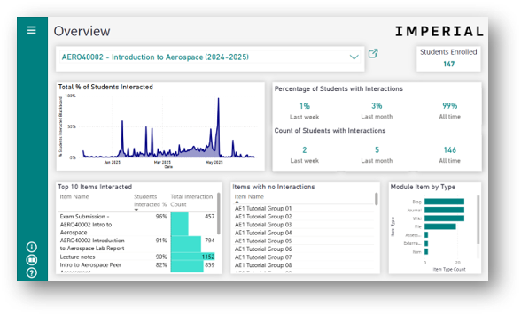
Module Teacher Dashboard
Purpose of this Power BI dashboard
To show how a cohort of students interact with the online learning resources and activities for your module, both during and after delivery of teaching. It is not designed to show behaviour individual students.
Users
Staff who teach students and those who design online resources and activities.
Notes:
Charlotte

Slide 25
Dashboard release
Student Profile
We are aiming to release the Student Profile for Personal Tutors to use from October 2025-26.
Module Teacher
The Module Teacher Dashboard is available for teaching staff to use. It is being updated to include 2025-26 from October.
These Power BI dashboards have user-access-controls so that Personal Tutors will only see data for their tutees and teaching staff will only see the modules on which they teach.
Data Protection
The data processing involved in creating and using Imperial Learning Analytics dashboard and setting up access controls, is described as registered activities in the Data Asset Registration Tool.
Students are made aware of this use of their personal data in the Privacy Notice for Students and Prospective Students and the Learning Analytics Privacy Notice.
Notes:
Charlotte

Slide 26
Getting set up & started with Student Profile & Module Teacher Dashboard
What the central learning analytics team needs
Data linking teaching staff to the modules on which they teach
We plan to use lists already shared with EdTech Labs and ask departments to verify the lists.
Communication within your department to introduce dashboard to teaching staff
We can provide text for you to use/modify for email/Teams/newsletter content.
Data linking Personal Tutors and tutees
We shall send details of the required format and how to share the data with us.

Slide 27
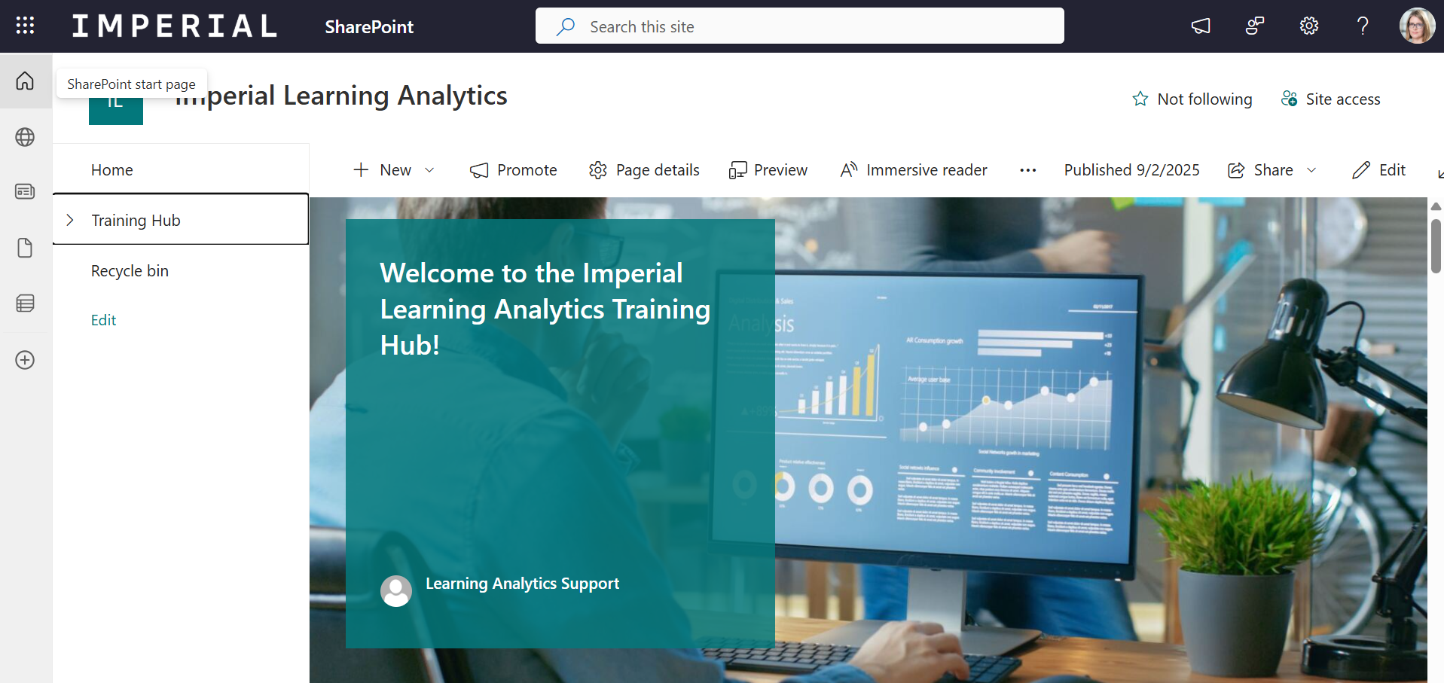
Dashboard support
Support for users
The dashboard contains a welcome page with information for users.
We have a training hub with information and videos to help users get started with the dashboard.
We shall set up drop-in sessions for users to attend if they wish to get help and ask questions.
There is a button in the dashboard linked to a form in ASK via which users can request help and report issues.

Slide 28
Measuring Impact – How Will We Know It Is Working?
We’re now moving into the evaluation stage, asking:
Usage patterns
Who’s using the dashboards, how often and how deeply
Feedback
What are users saying via interviews, surveys and feedback tools
Behavioural change
Are we seeing earlier or more effective interventions
Baselines and tracking
Measuring progress over time, not just snapshots
Notes:
When it comes to evaluating impact, it’s not one-size-fits-all
We’ll be looking at:
Usage patterns – who’s using the dashboards, how often, and how deeply.
Feedback – what are people saying in surveys and interviews? Are the tools helping or just sitting there?
Behavioural change – are we seeing earlier, more proactive support?
Tracking change over time – we’re keen to move beyond snapshots to real, measurable change.”

Slide 29
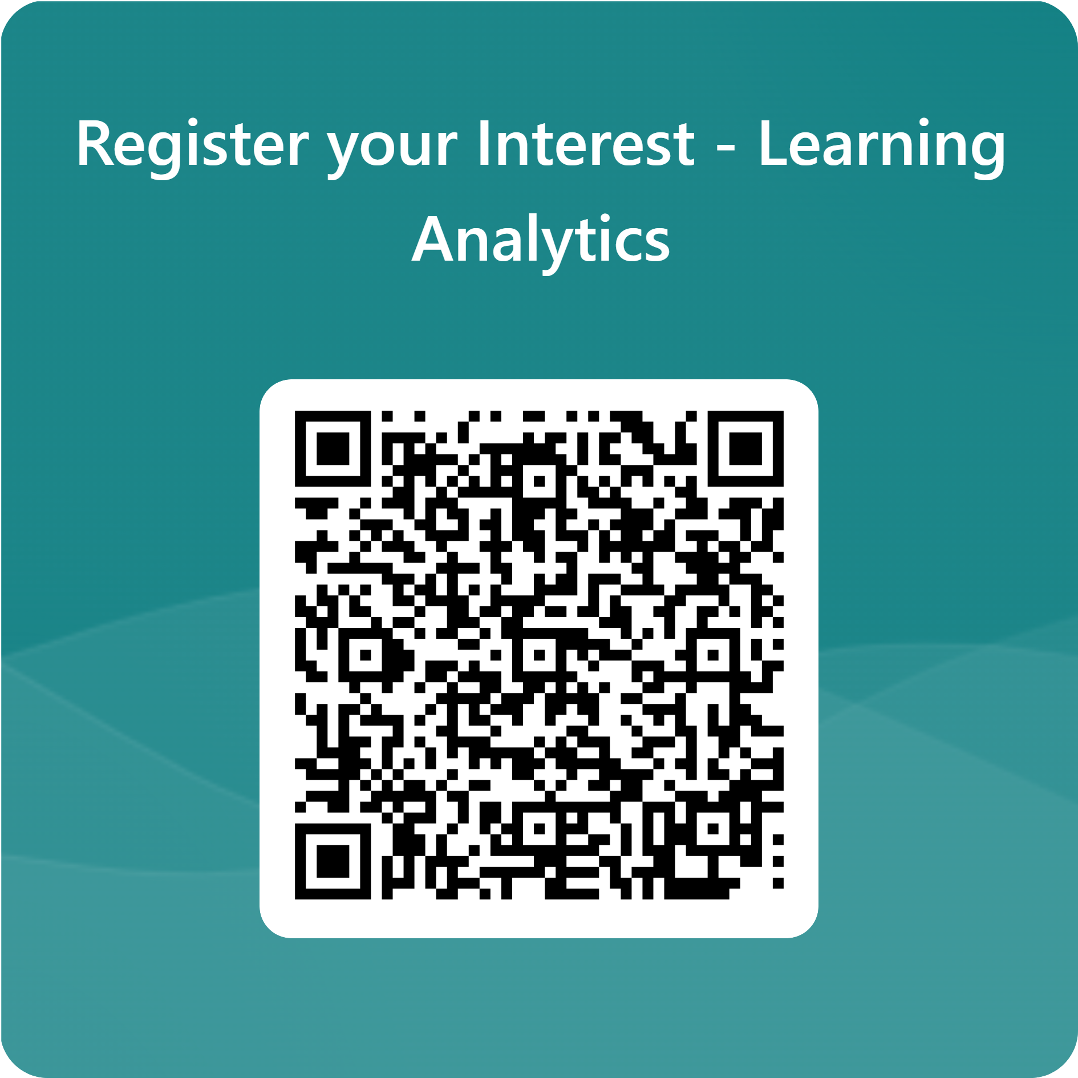
Any questions?
Notes:
Talking Teaching can ask more questions

