Slide 1
Consumer Law
Students as consumers
Legal & Regulatory Affairs
February 2025

Slide 2
Agenda:
  Introduction to consumer law
  Students as consumers
  Consumer law at Imperial:
      Information provision to prospective students
      Terms and conditions and programme changes
      Complaint handling processes and practices
  Case studies and examples
  Existing compliance protocols
  Any questions?

Slide 3

Introduction to consumer law
Why is compliance important?
Student experience and satisfaction
Ongoing conditions of registration with the OfS
Tuition fees and education contracts accounted for ~38.1% of total income 23-24 (up 4.5% from 22-23)
Respect, Collaboration, Integrity, Innovation, Excellence
  Risks of non-compliance
    Investigation by OfS (in partnership with Trading Standards) or CMA
    Student complaints to Office of the Independent Adjudicator (OIA) and/or legal claims for breach of contract (and damages)
    Ultimate sanctions – courts find there is a breach of consumer law, leading to fines, damages, requirement to change practices, and reputational damage

Slide 4
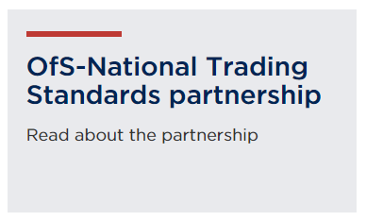


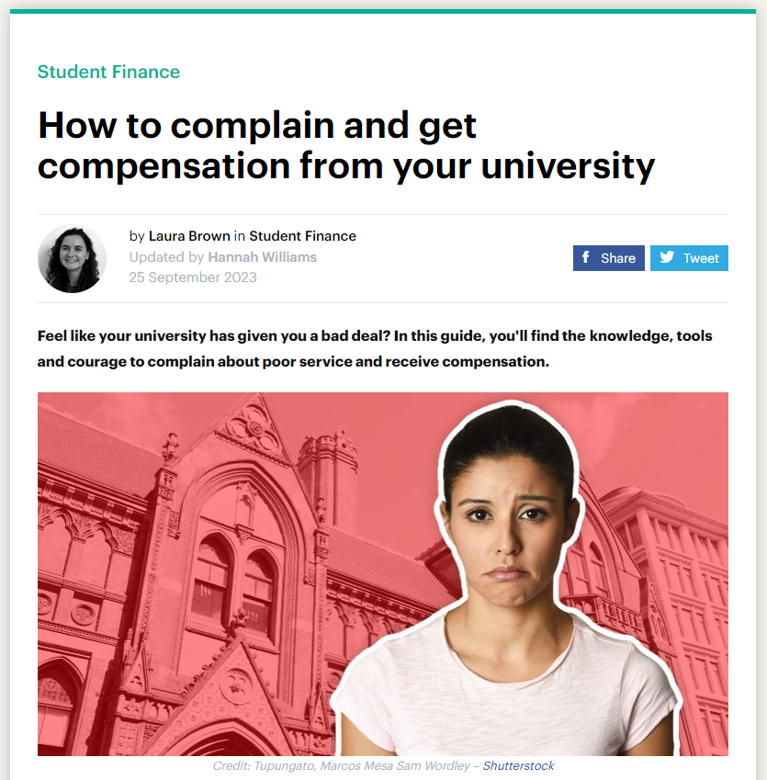
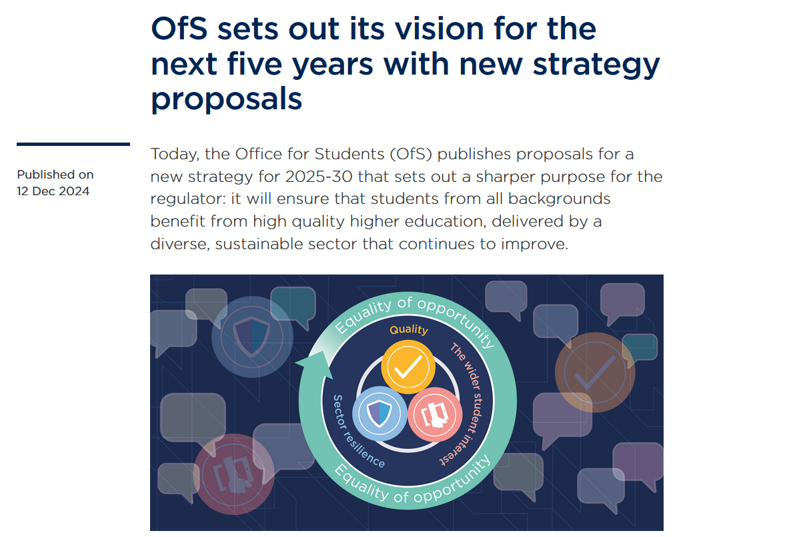
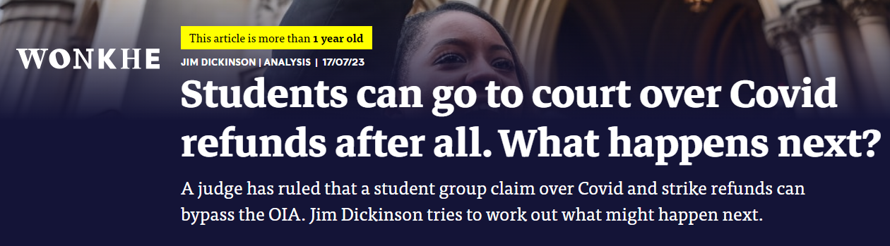
Introduction to consumer law
Growing awareness

Slide 5

Introduction to consumer law
Growing role for the OfS
    Condition C1 of the OfS Conditions of Registration: to register – and stay registered – with the OfS, universities must show that they offer high quality higher education, this includes giving ‘due regard to relevant guidance about how to comply with consumer protection law.’
    Independent Review of the OfS, July 2024: review led by Sir David Behan recommends: ‘that to support the OfS to enact a strong, student championing role, the OfS be given consumer enforcement powers.’
    OfS Strategy 2025-2030: confirms the regulator’s commitment to securing the powers it needs to further champion the student interest and intervene as appropriate. In the meantime, the OfS will continue to refer cases to National Trading Standards and the CMA where it identifies concerns about an institution’s compliance with consumer protection law.

Slide 6
Consumer law at Imperial
Information provision to prospective students
Terms and conditions and programme changes
Complaint handling processes and practices

Slide 7

Information provision to prospective students
The basic principles
Students must be given clear, intelligible, unambiguous and timely information so they know in advance what is being offered and can compare different courses and providers to make an informed choice
Under Consumer Protection from Unfair Trading Regulations (“CPRs”):
Students must be given important (“material”) information at each stage of dealings with Imperial:
      Research
      Application
      Offer
      Enrolment
Must be accessible, accurate, up to date and given before an offer of a place is accepted

Slide 8
Information provision to prospective students
What is “material” information under CPRs?
  Material programme information includes:
      Programme title
      Entry requirements
      Length and location, including work placements/study years (online hours)
      Core modules and an indication of likely optional modules
      The composition and delivery
      Assessment method and weighting
      Award and awarding body, including any accreditations & regulations
      Location of study
Material costs information includes:
  Tuition fees:
      Known/anticipated increases, calculation, and criteria
  Additional costs:
      field trips, studio hire, equipment, materials
      Indicative level of the costs or, if unknown, how they will be calculated
      Whether they are optional or mandatory

Slide 9
Information provision to prospective students
Prospective Imperial UG student decision making timeline
April
UCAS courses go live
June
Open days
September
UCAS applications open
October
Final UCAS application deadline
UK exam period and results
September
Open and Applicant Visitor Days
January
July
Arrivals and enrolment
Programme information released
Applicant interviews
Research
Application
Offer
Acceptance and Enrolment

Slide 10
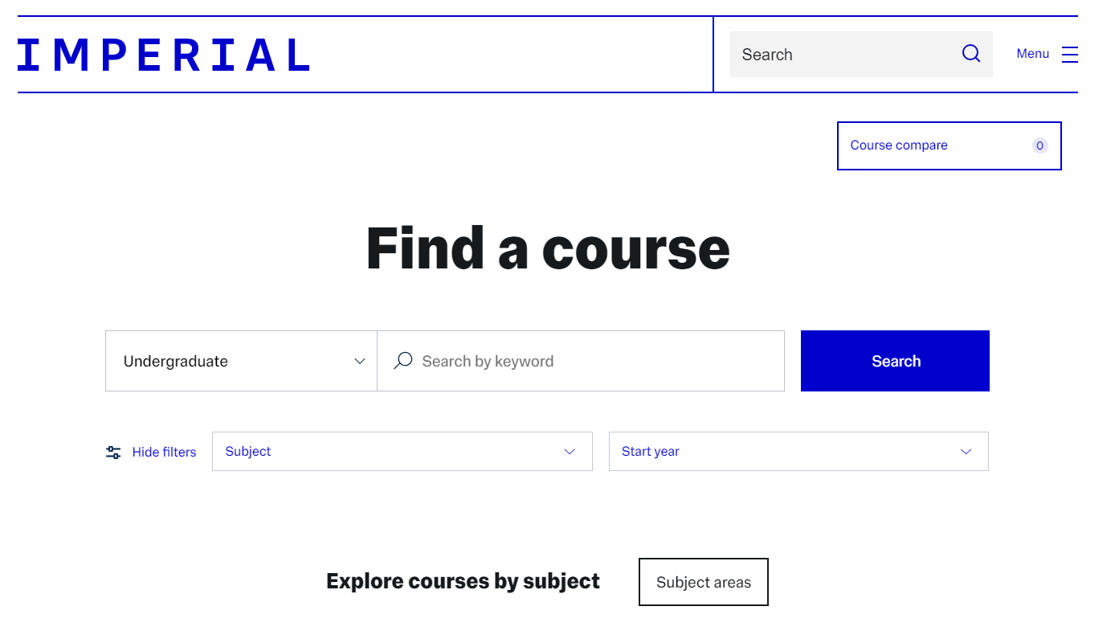
Information provision to prospective students
Sources of information that can be relied upon
Open days
Verbal representations
Prospectuses and programme information
Information on Imperial’s website
Written and oral communication between Imperial and the prospective student
Failure to provide accurate, up to date, material information, or ‘hiding’ it, or failing to provide it in a clear, intelligible and unambiguous way may be a “misleading action” or “misleading omission” under the CPRs

Slide 11
Information provision to prospective students
Highlighting any material information changes with an offer
  Once an offer is accepted there is a legally binding contract in place. The contract comprises:
      The terms of the offer letter
      The prospectus and programme information
      Imperial’s student terms and conditions
      Imperial’s Charter, Statutes, Ordinances, Regulations and the body of rules, policies, and procedures made under them (as updated from time to time)
      All the provided pre-contractual information
Any material information changes pre-enrolment must be notified, and the express agreement of the student obtained either by:
      Pre-offer: highlighting clearly proposed changes in an offer letter, so it is clear on what basis on offer is accepted; or
      Post-offer: email or other direct communication to all firms/insurances/undecided
Imperial should require offer holders to confirm their agreement to the changes and track and record responses

Slide 12
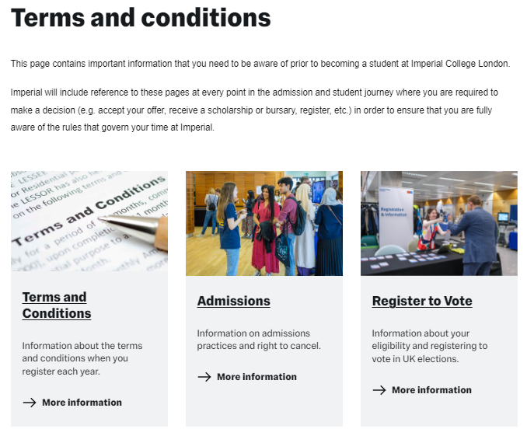
Terms and conditions
Fair, plain, and intelligible
Terms must be in plain English and accessible, with the opportunity to review before accepting an offer. They also should not create a significant imbalance or contrary to principles of good faith and “fair and open dealing”
  Examples of “unfair” terms:
      Granting a wide discretion to vary and modify the contract, including the: programme content, structure, location, amount of contact time, and fees
      Utilising broad and vague disclaimers
      Any exclusion or limitation of Imperial’s liability
      Imposing academic sanctions for non-payment of non-tuition fee debts
      Entire agreement clauses

Slide 13

Programme changes
Imperial’s ability to vary the contract for programme changes
  However, programme changes are sometimes necessary for several reasons:
      Staff changes
      Demand alters
      Timetabling
      External bodies and regulators require changes
      New insights and feedback are obtained on materials
Changes must be carefully managed depending on the stage of the student’s journey, and communicated at the earliest opportunity to avoid it becoming a “misleading omission” under the CPRs:
      Minor modifications: are not unusual and permitted under Imperial’s terms and conditions
      Major modifications: require consent and, post-offer, may require consultation, a notification of the decision/outcome, and the offer to withdraw, transfer to another programme, or refund fees
“Major” and “Minor” changes are defined under Imperial’s Programme and Module Modification Procedure, in addition to the approvals required

Slide 14
Complaint handling processes and practices
Professional diligence
  Imperial is expected to exercise “professional diligence” in managing student complaints and must respond to complaints with care and skill, to ensure:
      Students are enabled to raise concerns
      Procedures are timely and provide sufficient notice
      Requests for evidence are reasonable
      Investigations are sufficient and adequate
      Accessibility, confidentiality, and respect
The CMA advise compliance with the OIA ‘Good Practice Framework’ in handling student complaints. Accordingly, Imperial’s Regulation 19 (Student Complaints Procedure) provides an assurance that:
      “This procedure is aligned to […]the Good Practice Framework: Handling Academic Appeals and Student Complaints (Office of the Independent Adjudicator for Higher Education).”

Slide 15
Case studies and examples

Slide 16

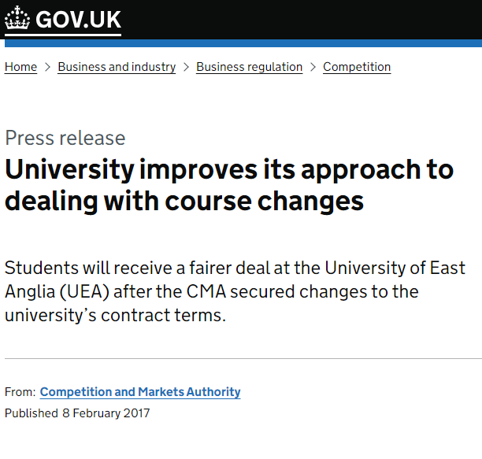
Case studies and examples
University of East Anglia (UEA)
UEA changed their American Literature programme to introduce 2 new compulsory modules in the 2nd year
UEA considered the changes to be ‘minor’ and permitted under its terms and conditions, so students were not notified
In 2017, CMA intervention resulted in UEA giving an ‘undertaking’ to the CMA to treat the addition of a compulsory module as a substantial change
The undertaking was released to the press

Slide 17



Case studies and examples
National Trading Standards Case Studies
  From 2023, the OfS have referred concerns to National Trading Standards (through their partnership) about consumer protection law for a number of providers, including:
      University of Manchester
      ICON College
      London Bridge Business Academy
  Some common themes emerged from the case studies, including concerns around:
      exclusion clauses and any limitation of liability by HEI providers
      force majeure events that could reasonably be within the HEI providers' control and therefore unlikely to be classified as a force majeure event, as well as the need to explain what reasonable steps would be taken in such circumstances
      wide discretion to increase fees
      broad discretion to cancel or withdraw offers in the event of programme oversubscription
      imposing additional programme costs because of changes made by the HEI provider
      boilerplate provisions around ‘entire agreement’ excluding any pre-contractual information or representations

Slide 18
Case studies and examples
Getting the balance right
When creating programme information, balance is needed to provide sufficient information for the student to make an informed decision, but with recognition that there may need to be variation in course content. Consider the following examples:
      “You will study the development of quantum mechanics from 1900-1930, focusing on the contributions of Niels Bohr and his work on atomic structure, as well as Albert Einstein's theories of relativity with Dr Jane Smith, the world’s preeminent academic on quantum theory.”
      “You will study pioneers of modern physics including Niels Bohr, Albert Einstein, Marie Curie, and Max Planck.”
      “You will have 3 hours of seminars each week in a contemporary air-conditioned room with small groups of 10 students, delivered by a world leading Professor who has a 4* REF rating.”
      “You will have an average of 3 hours in scheduled learning and teaching per week, delivered through a variety of methods, including lectures and seminars.”

Slide 19
Existing compliance protocols

Slide 20
Existing compliance protocols
Programme modification governance
Senate is delegated authority from Council under Imperial’s Charter and Statutes to: “be the body responsible for the academic work of the University” (though since HERA 2017, Council is required to have oversight and take a more active role)
QAEC is a sub-committee of Senate with delegated authority to, on the advice of the Programmes Committee, approve major modifications to existing programmes and short courses (including suspension and withdrawal)
The Programmes Committee has responsibilities, amongst others, to:
      consider proposals for the suspension or withdrawal of programmes and major modifications to programme title, curriculum structure, content and delivery of individual programmes in accordance with the university Programme and Module Modification Procedure
      receive and endorse reports from Faculty Education Committees on the approval of minor modifications to approved curricula
      To ensure that sufficient external and independent consultation (including student consultation) has been sought for major modifications and proposals for the suspension or withdrawal of programmes in accordance with the university Programme and Module Modification Procedure
Council
Senate
Quality Assurance and Enhancement Committee
Programmes Committee
Faculty Education Committees (x5)

Slide 21
Any questions?
Contact the Legal & Regulatory Affairs Team
with any questions at: legal@imperial.ac.uk

