Slide 1
Safeguarding Training
For team discussion
Contact: Director of Safeguarding
Louise Lindsay l.lindsay@imperial.ac.uk

Slide 2
Why this is Important?
Imperial is committed to providing a safe environment for all students, staff and visitors who access our facilities and services.
All roles, including yours, may encounter these under-18s or vulnerable adults.
This may be a regular part of your work or an occasional interaction, for example, work experience in the office, supporting a colleague, helping a young person on campus.
We have a legal duty to protect our community from harm and abuse.
This training material has been developed to signpost how you can recognise, respond and report any safeguarding concerns.

Slide 3
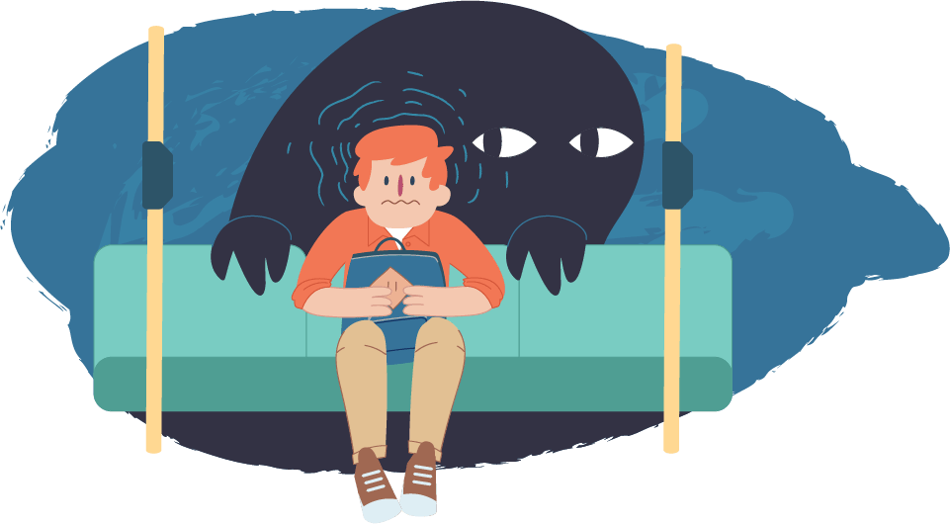
What is abuse?
The term abuse covers physical, sexual, financial and psychological harm. It also covers neglect.
Abuse includes forms of harassment or similar unwanted behaviour due to age, disability, sex, sexual orientation, gender reassignment, race, religion or belief. It also covers circumstances of modern slavery.
Abuse can be child to child
Abuse can be single or repeated acts of harm or exploitation and may follow a period of grooming and manipulation of someone vulnerable.
Abuse may be deliberate, but it can also occur through negligence, ignorance or lack of professional competence.

Slide 4

Reflection
Think about your own role with the University and the times when you might see or interact with a child (anyone under the age or 18) or a person who is vulnerable and needs support.

Slide 5

How a safeguarding concern might arise
A safeguarding concern may come to light in different ways, such as direct observation, a referral from another student or staff member, or information from a third party.
Sometimes, a concern may only come to light because the person discloses it to you directly. If this happens, it is essential that you are aware of Imperial's procedures on what to do and how to behave.
In all cases, it is important that the case is discussed with as few people as possible and is referred via the proper procedure as soon as possible.
Your reaction is very important. Disclosure may not be made at a convenient time for you; however, it is the best time for the person making the disclosure, and you must accept this.

Slide 6
If a concern is disclosed to you…
DO
Stay calm and listen carefully
Take it seriously even if the person is confused: let them know you are taking it seriously
Be empathetic
Tell the person they have done the right thing by telling you
Let the person explain their situation/concerns at their own pace
Let them know it's not their fault
Explain confidentiality, but clarify that in line with the safeguarding procedure, you have to share the information with a Lead Safeguarding Officer if it involves a child
Reassure the person that they will be supported
Make sure the person's immediate safety needs are met
Make a written record, dated and signed, of what you have been told and what you did – in their words, not yours
Explain what you will do next
Seek help for yourself if you feel you need support
DON’T
Show shock or disbelief
Promise to keep secrets
If the disclosure involves sharing of images on phones or the internet, do not view the material yourself
Investigate the situation yourself in any way
Contact the alleged perpetrator
Be dismissive
Share information with any other individual or member of staff other than on a need-to-know basis
Put your arm around the person, as this may make them feel uncomfortable, and stop talking
Use leading questions
Attempt to resolve the situation yourself or give the individual your personal contact details
Delay in reporting a disclosure to the Lead Safeguarding Officer

Slide 7

Consent and Confidentiality
Informed consent
Children: Where possible, children and young people should be given the opportunity to agree on the next steps,
but any concerns must always be shared with the local or lead safeguarding officers so one person does not hold the knowledge and decision on the next steps.
Data protection legislation, including GDPR, does not prevent the sharing of safeguarding information with the relevant professional.
Adults: The law assumes that adults have the right and capacity to make informed decisions, including the right to withhold consent.
A 'best interests' decision' can be made to protect someone if they, as an adult,' lack the capacity' to make a specific decision at a specific time.

Slide 8
Consent and Confidentiality
Breaching confidentiality
The instances where you may consider breaching an individual's confidentiality or acting without their consent include the following:
The individual is a child or vulnerable adult at risk (disclosure for a child is not a discretionary option).
Doing so is in the public interest.
A crime has been committed or is likely to be committed.
Other people are at risk.
The individual is acting under duress, and you have concerns that they are not making their own informed decision.
The allegation involves a member of staff or other professional people. Again, if this situation arises, reporting it is a 'must’.
You have directly witnessed the incident or crime.

Slide 9

Consent and Confidentiality
The decision to breach an adult's confidentiality and act without their cooperation and involvement should never be taken lightly.
When considering the best course of action, consider the benefits and risks of breaching confidentiality and weigh these carefully in relation to the individual's situation.
Disclosures of abuse made by a vulnerable adult at risk or a child should always be reported.
Other blanket approaches and routine or automatic breaches of confidentiality are never acceptable.
Benefits and Risks
Individual's situation

Slide 10
Low level concerns
A low-level concern is any concern, no matter how small, and even if no more than causing a sense of unease or a 'nagging doubt' that an adult working on or on behalf of Imperial may have acted in a way that is inconsistent with our code of conduct.
This could include inappropriate behaviour outside of work.
Examples of low-level behaviour would include, but are not limited to:
Connecting on social media with young people met in a professional context
Having favourites when working with children
Humiliating an individual
Losing one's temper – even if this is to another adult, as this is a possible indicator of conduct that could also be directed to a child or vulnerable person
If you witness or hear something involving a child or vulnerable person that makes you feel uncomfortable you should not keep that information do yourself. Concerns can be anonymised if you do not have consent from the adult and the concern does not relate to a child.

Slide 11
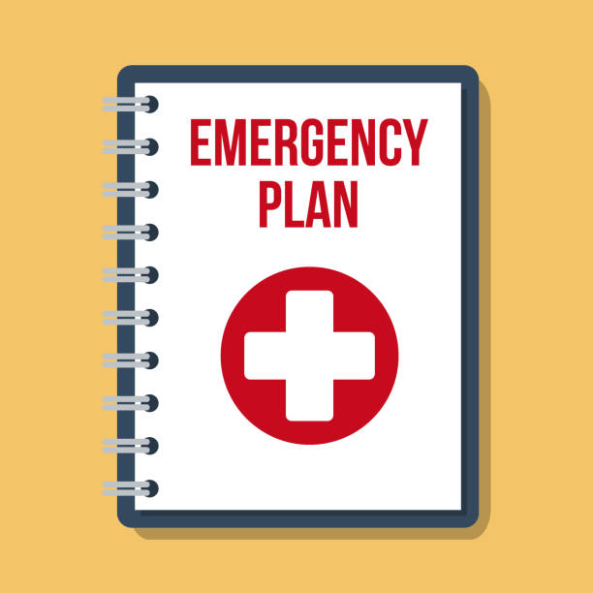
In an emergency
This requires immediate support from the police or other emergency services.
Situations where there is an immediate risk of harm to the individual
or others obviously require urgent intervention.
Emergency numbers(24hours): 4444
(Silwood: 42444)
External: 020 7589 1000
Call 999

Slide 12

Prevent
Prevent is a statutory obligation for Higher Education institutions to prevent individuals from being drawn into terrorism.
Prevent aims to safeguard and support vulnerable people to stop them from being drawn into terrorism or supporting terrorism through early intervention.
Prevent supports those whose vulnerabilities may make them easy targets and most at risk of being drawn into terrorism.
Prevent is about identifying potentially vulnerable individuals and offering support where needed. Prevent does not require Imperial to spy on students or staff, and no one is being asked to keep records of student or staff members' behaviours.

Slide 13
Prevent
Extremists are found across the political and religious spectrum. The Prevent Duty is designed to work with all types of extremism. Extremist views can, for example, include being anti-Semitic, Islamophobic, Hinduphobic, xenophobic, homophobic and anarchistic.
If you develop a concern that an Imperial member or visitor may be on a path towards radicalisation, you should first discuss this with your line manager.
You should arrange to meet with a Local Adviser in your Faculty/Division as soon as possible. They will be able to advise whether more information is needed or what to do next.
Individuals are expected to share welfare concerns that they may have regarding vulnerable individuals, as you would if you had any serious concerns regarding a fellow member of Imperial's community.

Slide 14
Logging concerns
Imperial has a legal duty to keep children and vulnerable adults at risk safe and protect them from harm. This reporting would include concerns brought to our attention where the abuse is taking place outside of our community (for example, a report of domestic violence in the staff or student's home).
Individuals may self-refer an issue of concern. The raising of low-level concerns is a professional dialogue in line with good practice and should provide opportunities for shared learning.
You do not need to have proof that abuse is taking place before reporting any concerns.
You do need to take responsibility for recognising and referring concerns, including low-level concerns, to the appropriate member of Imperial, who can then take further steps to support the individual.
Safeguarding legislation specifically requires this proactive engagement to support and protect children, but it is good practice to support our wider community and be in line with welfare and duty of care responsibilities.
You can anonymise the details of an adult of concern if you have not gained consent to share their information.

Slide 15

Who should you contact
The University has a Safeguarding Referrals Flowchart that lists the staff accountable for safeguarding referrals by area.
Please take a look at the flowchart now to identify your local contacts.
If your area is not specifically listed, then your initial contact will be Louise Lindsay, Director of Safeguarding l.lindsay@imperial.ac.uk
Report and support is also available to disclose unwelcome behaviours such as bullying, harassment, sexual violence, sexual harassment, sexual misconduct, racial discrimination and more. Report and Support tool

Slide 16

Testing Understanding
Safeguarding is not my responsibility because we have Designated Safeguarding Leads at the University…

Slide 17
Testing Understanding
Safeguarding is not my responsibility because we have Designated Safeguarding Leads at the University…
False
Safeguarding is everyone’s responsibility

Slide 18
Testing Understanding
Safeguarding is only relevant for University roles that work with children…

Slide 19
Testing Understanding
Safeguarding is only relevant for University roles that work with children…
False
Safeguarding is also relevant for roles that may occasionally interact with children or vulnerable adults. It is everyone’s responsibility

Slide 20
Testing Understanding
The safeguarding of children includes young people aged 16-17…

Slide 21
Testing Understanding
The safeguarding of children includes young people aged 16-17…
True
Young people aged 16 or 17 are still considered children

Slide 22
Testing Understanding
Abuse may cover single or repeated acts of harm or exploitation and is always perpetrated with deliberate intent…

Slide 23
Testing Understanding
Abuse may cover single or repeated acts of harm or exploitation and is always perpetrated with deliberate intent…
False
Abuse may be deliberate, but it can also occur through negligence, ignorance or lack of professional competence

Slide 24
Testing Understanding
Abuse can include physical, sexual, psychological, financial and discriminatory abuse but does not include neglect…

Slide 25
Testing Understanding
Abuse can include physical, sexual, psychological, financial and discriminatory abuse but does not include neglect…
False
Abuse can include neglect

Slide 26
Testing Understanding
If a person starts to disclose abuse, you must not agree to keep the issue a secret between you even if this means that they may discontinue the disclosure

Slide 27
Testing Understanding
If a person starts to disclose abuse, you must not agree to keep the issue a secret between you even if this means that they may discontinue the disclosure
True
You should not agree to keep disclosures of harm secret as there may be circumstances where you would need to breach this confidentiality.
You must tell someone if a child is being harmed or at risk of harm

Slide 28
Testing Understanding
Confidentiality and informed consent are important considerations in safeguarding
Which is correct?
a) You should never share information without consent
b) You can share information without consider only if there is a legitimate reason for doing so

Slide 29
Testing Understanding
You can share information without consider only if there is a legitimate reason for doing so
The instances where you may consider breaching an individual's confidentiality or acting without their consent include the following:
The individual is a child or vulnerable adult at risk (here, a child is a 'must' and not a discretionary option for consideration).
Doing so is in the public interest.
A crime has been committed or is likely to be committed.
Other people are at risk.
The individual is acting under duress, and you have concerns that they are not making their own informed decision.
The allegation involves a member of staff or other professional people. Again, if this situation arises, reporting it is a 'must’.
You have directly witnessed the incident or crime.

Slide 30
Testing Understanding
You need to have proof that abuse is taking place before reporting your suspicions

Slide 31
Testing Understanding
You need to have proof that abuse is taking place before reporting your suspicions
False
You do not need to have proof that abuse is taking place before reporting any concerns. You do need to take responsibility for recognising and referring concerns, including low-level concerns, to the appropriate member of Imperial, who can then take further steps to support the individual.

Slide 32
Testing Understanding
Someone discloses something to you that indicates there is an immediate risk to their safety. What should you do?
a) Call the emergency services
b) Speak to your manager
c) Consult with the Lead Safeguarding Officer
d) Give your phone number to the individual

Slide 33
Testing Understanding
Call the emergency services
Call the emergency services if there is an immediate risk to someone’s safety
Then notify your safeguarding contact

Slide 34
Testing Understanding
A low-level concern should be raised:
Whenever I have a concern about conduct, no matter how small the concern
Only if I witness harm to a child or adult
Only if the conduct causing concern has taken place in the work setting

Slide 35
Testing Understanding
Whenever I have a concern about conduct, no matter how small the concern

Slide 36
Testing Understanding
Low level concerns:
a) Only arise through intentional misbehaviour
b) Only arise through naivety or careless behaviour
c) May be the result of intentional or unintentional behaviour
d) Cannot be raised by the individual themselves as a self- referral

Slide 37
Testing Understanding
Low level concerns:
May be the result of intentional or unintentional behaviour
Individuals are encouraged to self-refer as this also helps develop training and practice guidance for others

Slide 38
Testing Understanding
My role in relation to Prevent is to:
a) Spy on others
b) Share welfare concerns
c) Leave it to others to raise concerns

Slide 39
Testing Understanding
My role in relation to Prevent is to:
Share welfare concerns

Slide 40
Resources
Child Protection and Safeguarding Policy
Child Protection and Safeguarding Code of Practice
Contacts for further support
Guidance on raising Low-level safeguarding concerns
Imperial’s Report and Support tool
Prevent - Referral of Concerns
Student Support Zone
Guidance Safer working practice Professional and Personnel Relationships

