Slide 1






Recruitment Workshop Positive Action
& “Know Your Pool”
Sneha Saunders
Department of Chemical Engineering, Imperial College London s.saunders@imperial.ac.uk

Slide 2

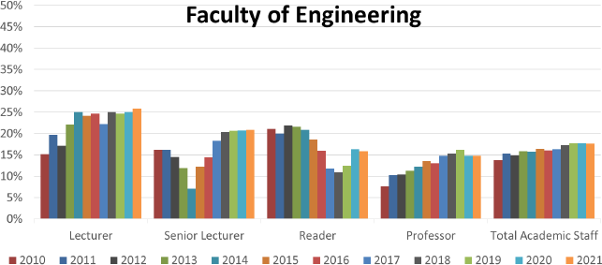
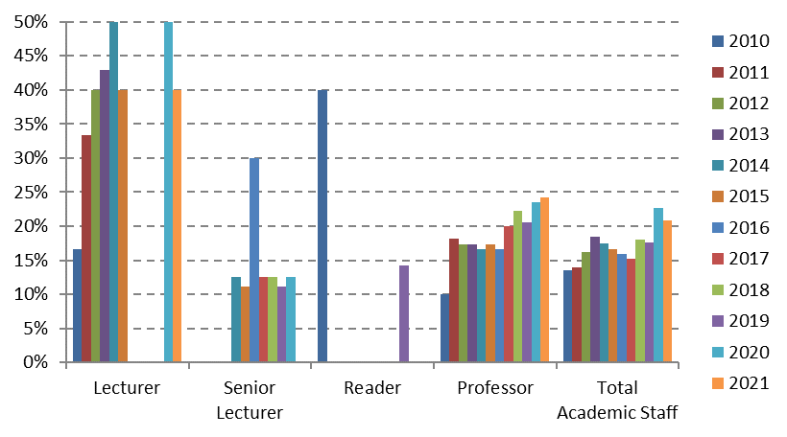
ChemEng Update
FoE-wide
Academic staff by grade
Some larger variations caused by small numbers in statistics
Strong positive trends at prof level (24%, > FoE 15%) as well as lecturer level
Female staff

Slide 3
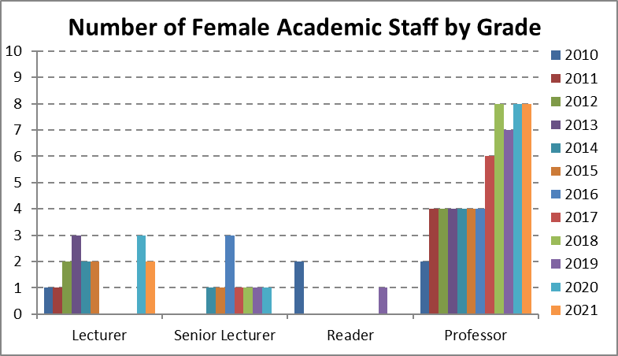
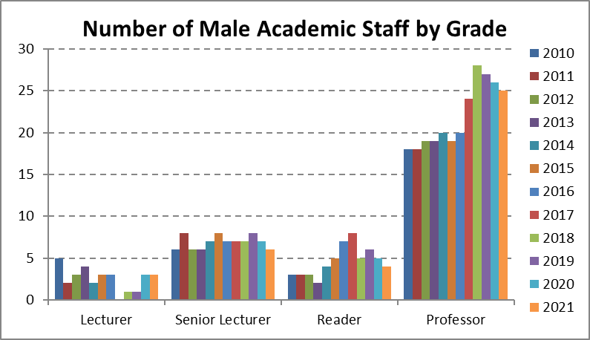
ChemEng breakdown
Academic Recruitment 2019
 | Applications | Interviewed | Successful
Male | 111 | 9 | 4
Female | 22 | 3 | 2
Total | 133 | 12 | 5
Academic Recruitment 2018
 | Applications | Interviewed | Successful
Male | 106 | 5 | 1
Female | 38 | 6 | 3
Total | 144 | 11 | 5
all adverts on BBSTEM https://bbstem.co.uk/
Black British Professionals in STEM
Founded by a ChemEng Alumna! ☺
Positive F% trends supported in absolute numbers
Large variation in professional & technical services M/F distribution; overall positive trend.

Slide 4
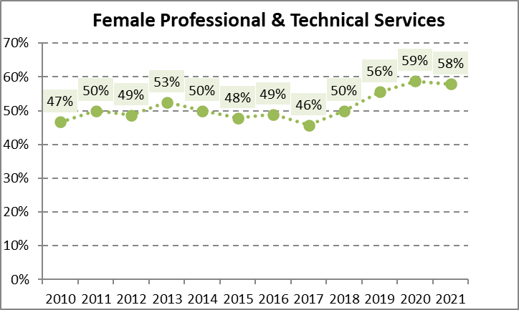
ChemEng breakdown
Positive F% trends supported in absolute numbers
Large variation in professional & technical services M/F distribution; overall positive trend.

Slide 5
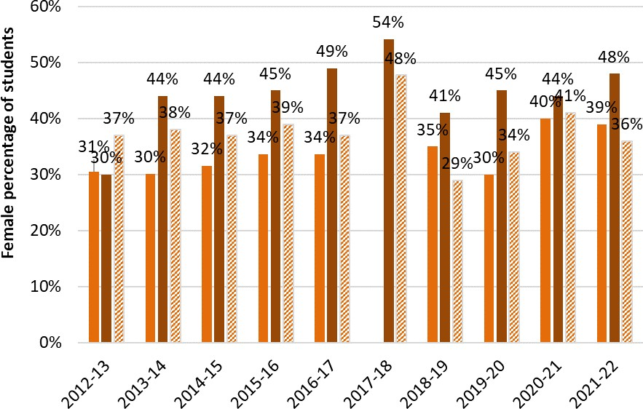
ChemEng breakdown
Student data UG – MSc – PGR distribution
F% student data consistently above national average

Slide 6
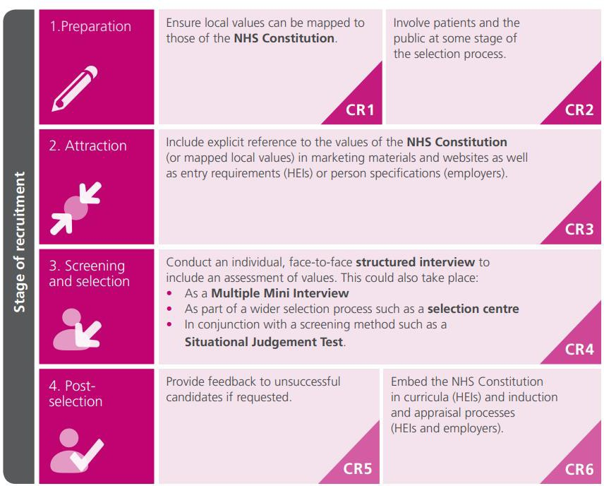
ChemEng Approach
Values based recruitment: Inspired by NHS

Slide 7
ChemEng Approach: Values based recruitment
We took a lot of care with the language in the advert, consciously trying to make it gender-neutral and
also putting it through two websites to check
We told colleagues to encourage people in their network to apply and to think about EDI when making invitations
We spent a few minutes talking about unconscious bias before shortlisting and made sure to have a
[reasonably] diverse shortlisting panel
We organised the interview day so that the activities fitted into core working hours
We changed the style of questioning from a more adversarial style to a more engaging and inquisitive
style, e.g.:
  from “why do want to work here” to “tell us about a time you…”
  moving away from time constrained questions, such as “in the past 5 years” to “since completing your PhD”)
We spent time talking about the Dept’s values and how candidates had demonstrated them in the past

Slide 8
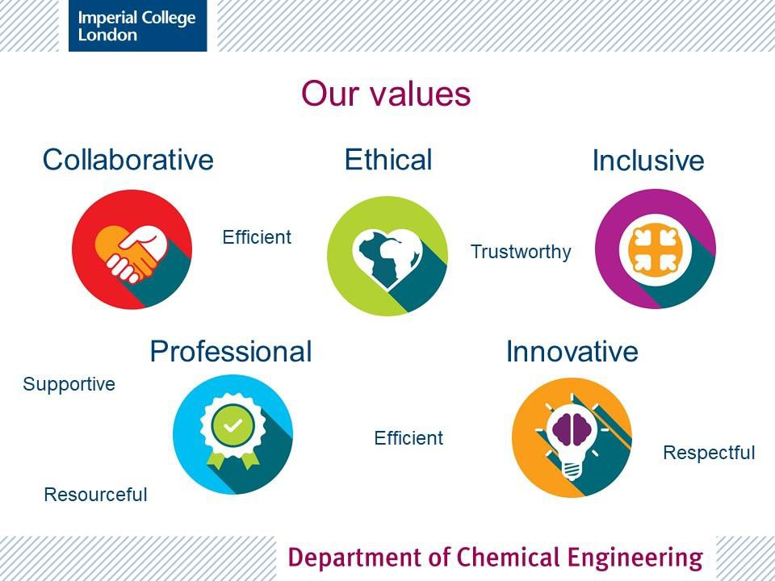
ChemEng Approach: Values based recruitment
Provided a context as to how values were generated and what they are
Explained use of values in
recruitment and progression
Asked candidates to choose two and describe how they have demonstrated them in the past

Slide 9
ChemEng Approach: Values based recruitment
Outcomes
Better balance in shortlist
Positive feedback even from unsuccessful candidates (some have become research collaborators)
Better balance in final recruitment ( over past 3 rounds of academic recruitment: 5 female, 6 male)
Positive impression of department before starting

Slide 10
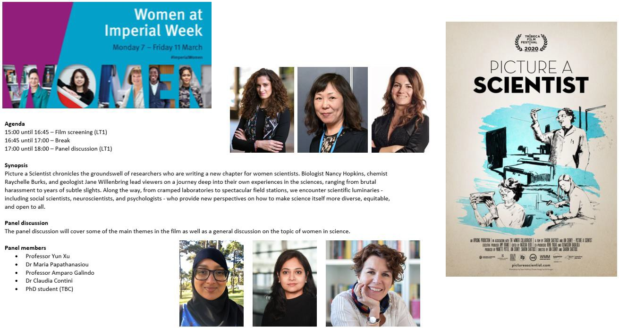
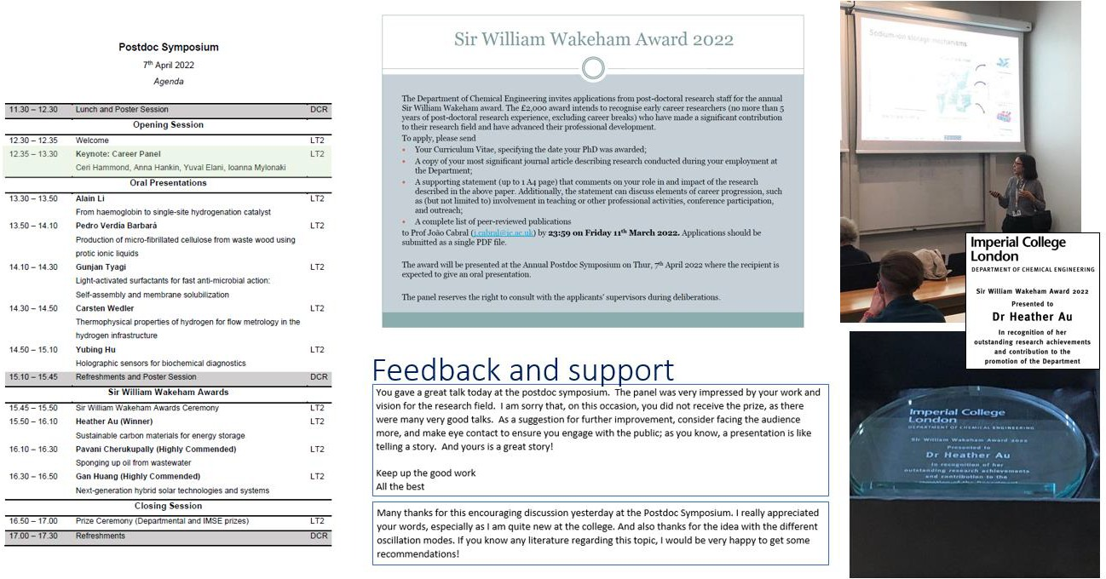
ChemEng – Ongoing work/Next steps
Ensure we are celebrating our diversity on every
channel
Ensure gender/diversity balance on ALL recruitment panels
Cultivate talent for the whole career pipeline:
  Supporting postdoctoral researchers
    Mentoring
    Workshops
    Development opportunities
  Career development meeting with HoD for all 4+
years
  ED&I training for all staff
Improve recruitment materials and job packs

